Slide 1



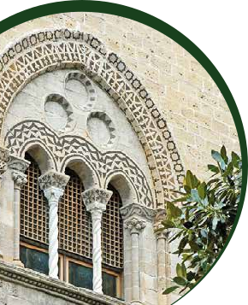




Il trapianto epatico in Sicilia:
la storia e il presente
S. Gruttadauria MD, FACS
Chairman of Department for the Treatment and Study of Abdominal
Diseases and Abdominal Transplantation, IRCCS-ISMETT-UPMCI

Slide 2
Chronic shortage of donors
*
*
*
Proiezione CNT 30/09/2022

Slide 3
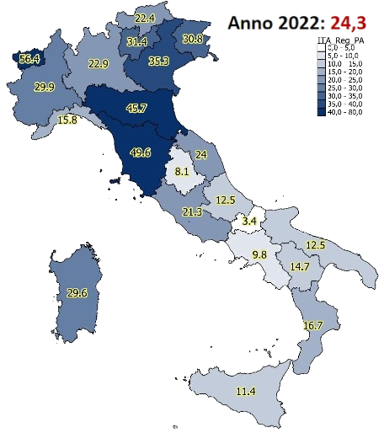
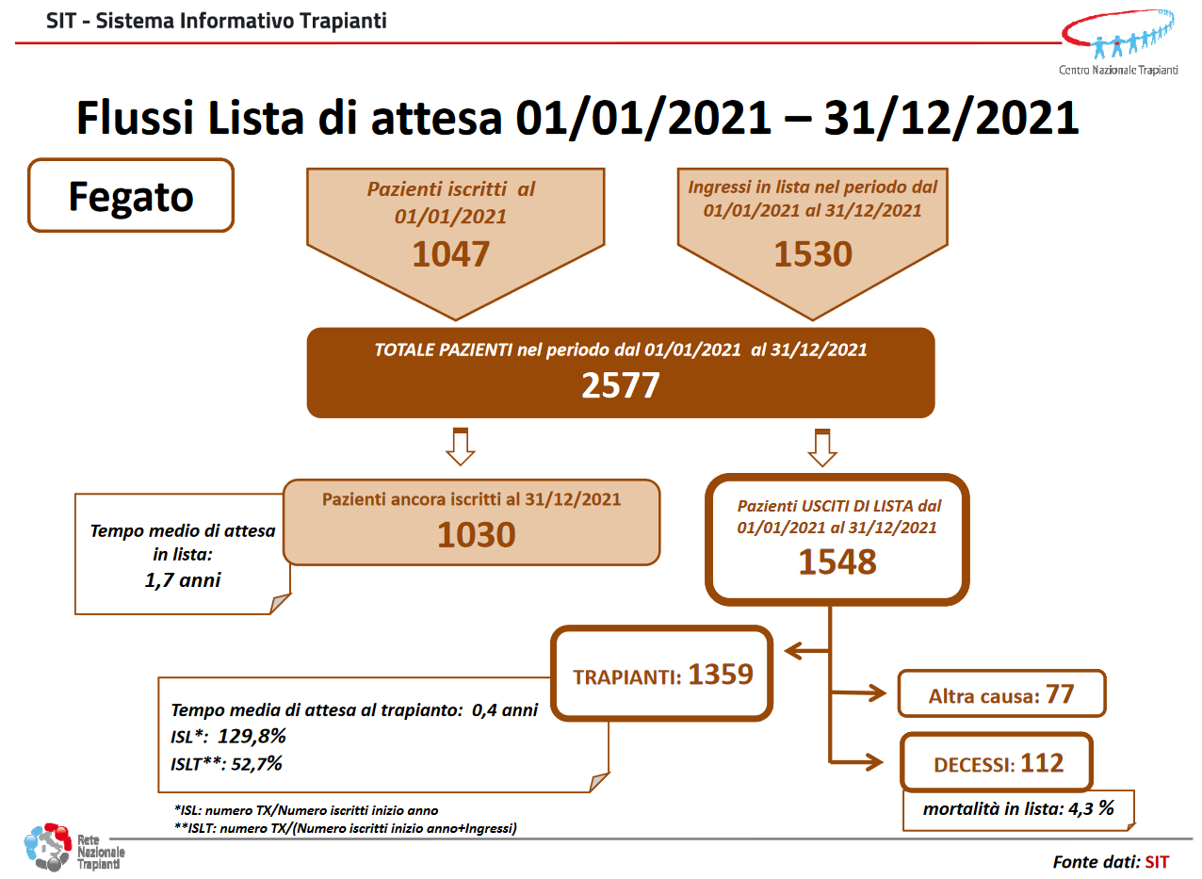

Chronic shortage of donors

Slide 4
ISMETT Experience: increasing the pool of donors

Slide 5
Liver transplantation @ ISMETT 1999-2022 (N=1564)
Donors p.m.p | N.A. | 7.9 | 7.6 | 8.0 | 11.7 | 6.9 | 9.9 | 10.5 | 12.3 | 11.1 | 9.1 | 10.3 | 12.4 | 11 | 8.2 | 8.6 | 9.8 | 17.1 | 8.7 | 8.0 | 9.0 | 14.4 | 11.4

Slide 6
ISMETT Experience: increasing the pool of donors

Slide 7
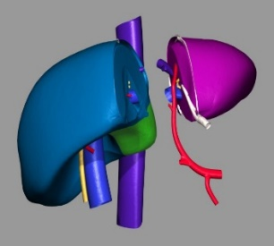
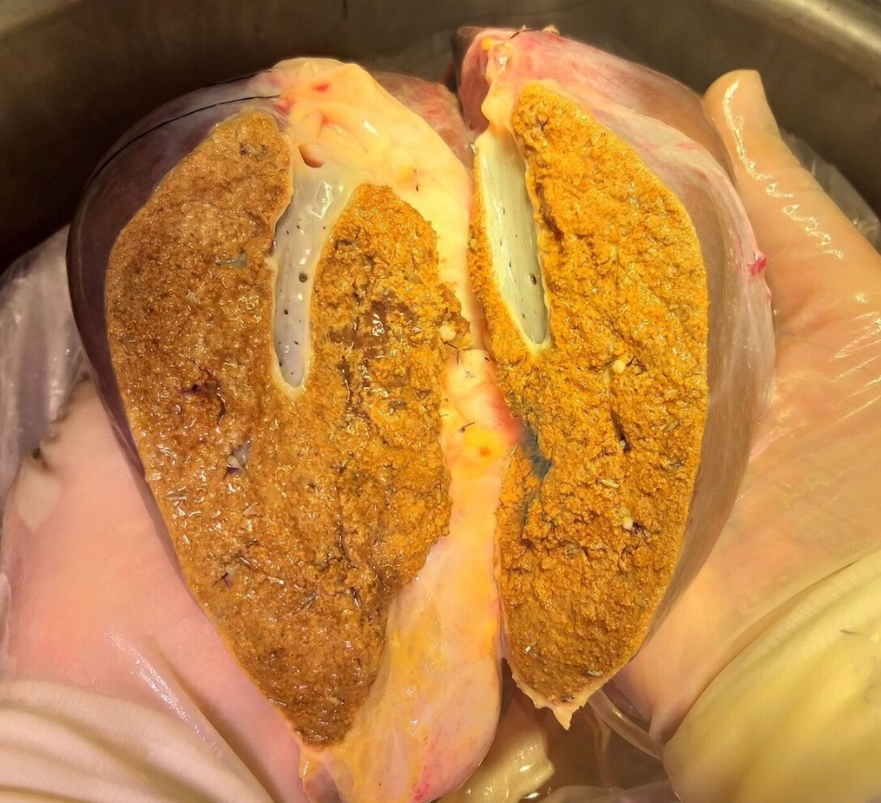
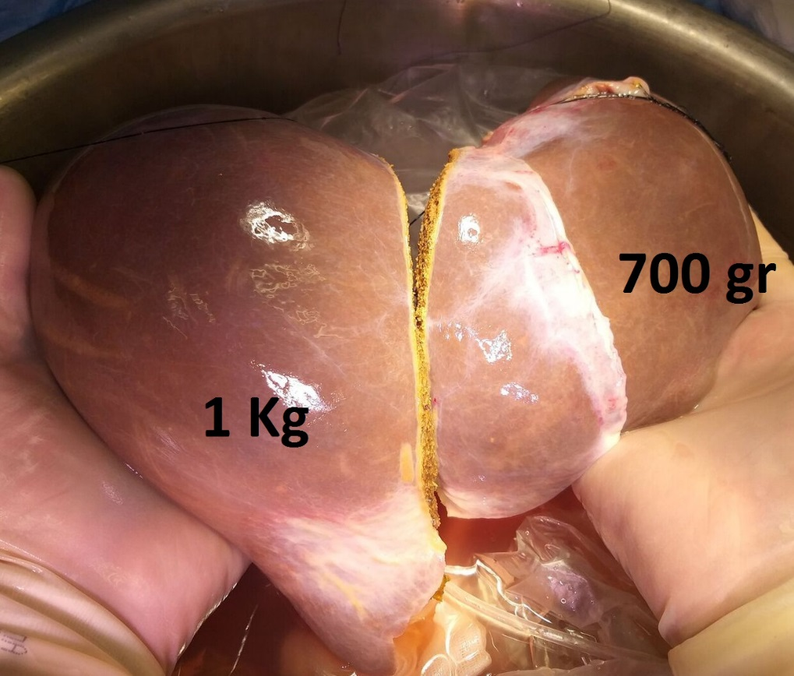
Split Liver: Modified Broering technique
  True-right / left split for 1 Adult and 1 large child
Alive and well at 3 m
Alive and well at 3 m

Slide 8

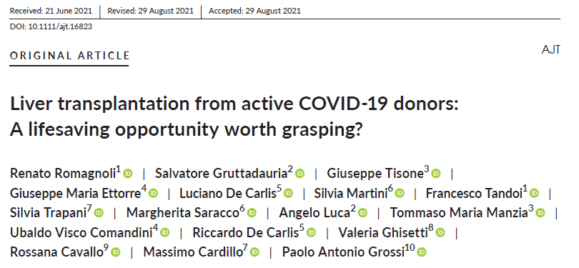
Liver Transplant during the Pandemia
    Multicentric Italian series of 10 LTRs
    Only two recipients had a positive molecular test at LT and one of them remained positive up to 21 days post-LT
    On donors’ liver biopsy at transplantation was negative in 100% (9/9), suggesting a very low risk of transmission with LT
    Might contribute to safely increase the donor pool
Overall, 4 Patients received @ Palermo program a liver from a Covid-19 positive donor
Notes:
Italian Transplant Authority granted the license to transplant donor positive livers into recipient after infection with clinical need of LT

Slide 9
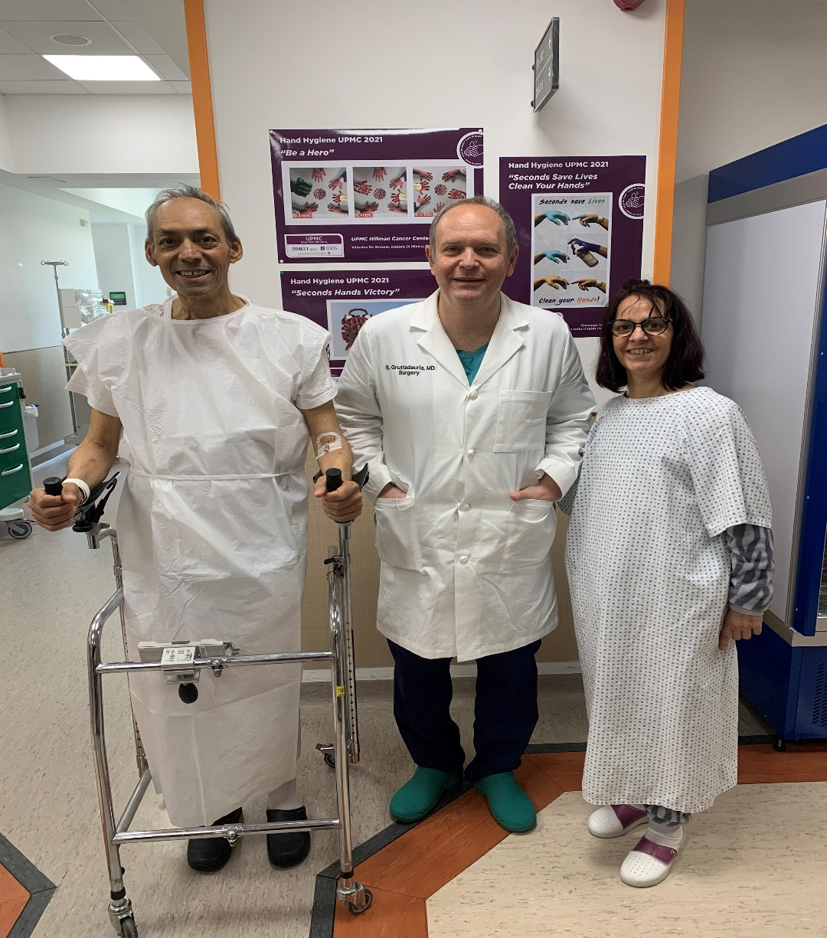
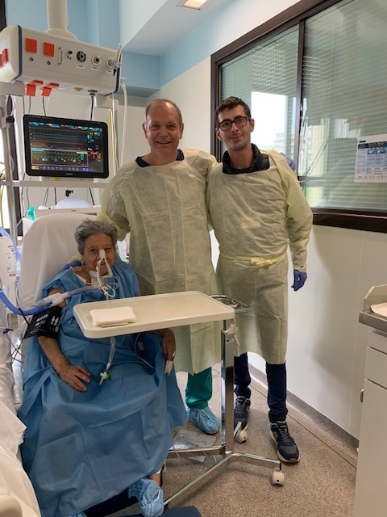
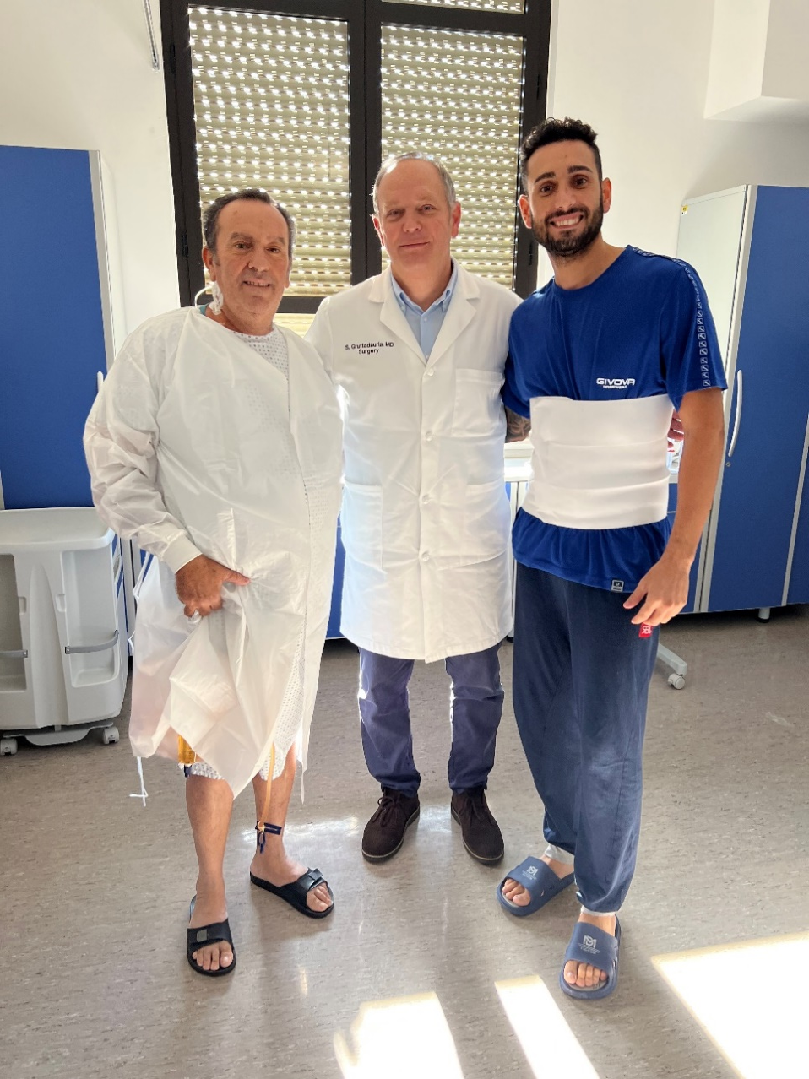
Living-donor liver transplantation

Slide 10
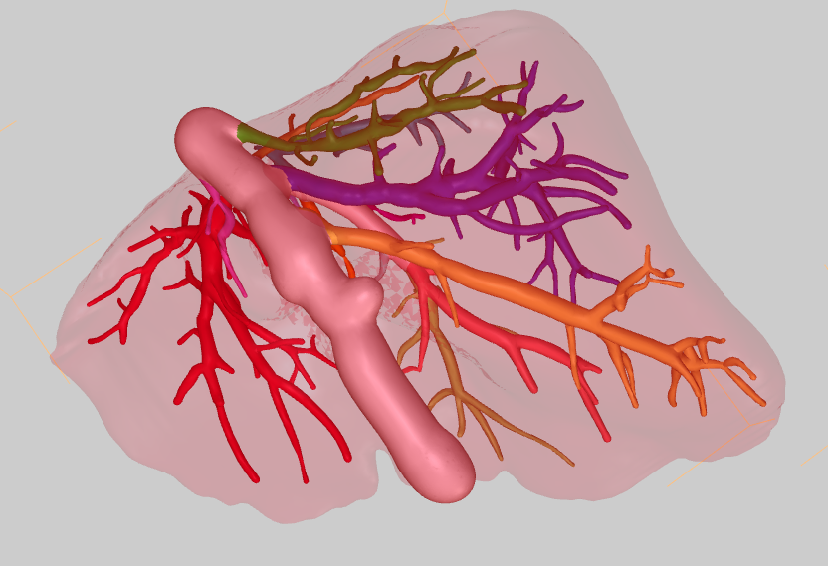
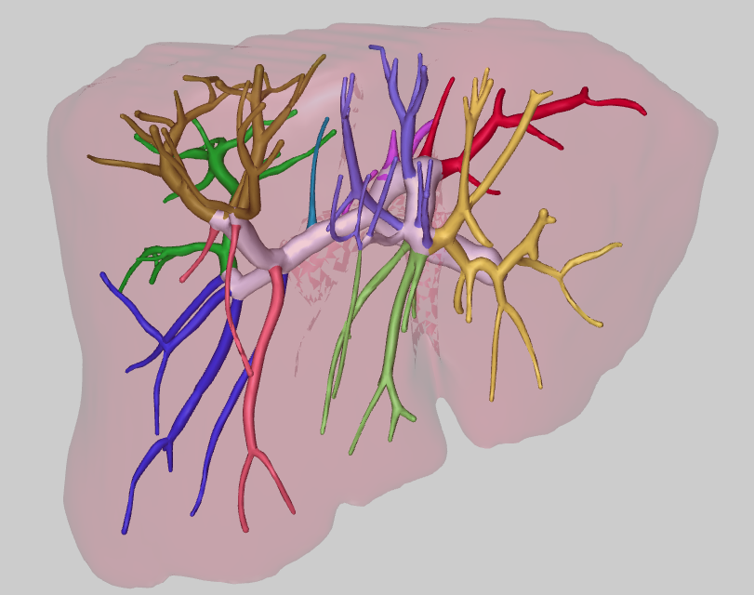
Living-donor liver transplantation

Slide 11
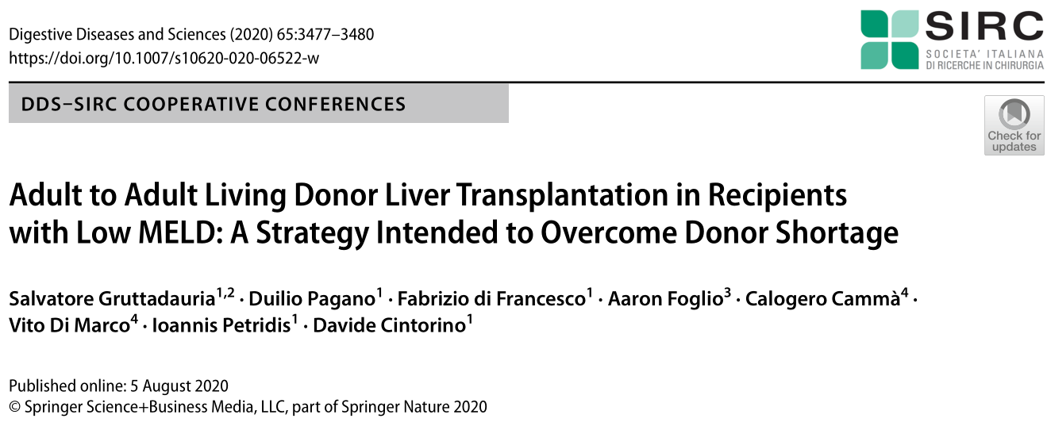
Living-donor liver transplantation

Slide 12
Transplant oncology
    Selection of donors
    The possibility of allocation of normal DCD grafts for CRLM patients is highly variable among regions /countries
    Living donation for non-established transplant indications may be possible in centers with well established LDLT programs, but ethical challenges must be addressed and careful selection of both donor and recipient is mandatory
    Expansion of the donor pool
      ECD grafts: patients with CRLM have normal liver function and no portal hypertension
      Novel surgical approaches : RAPID technique
Villard et al. HepatoBiliary Surg Nutr 2021
Notes:
Today’s donor pool could increase with the use of extended criteria donors, which is sufficient and display an acceptable risk-benefit ratio for patients with unresectable CRLM.

Slide 13
Transplant oncology (clinical studies)
COLT
MELODIC
RAPID

Slide 14
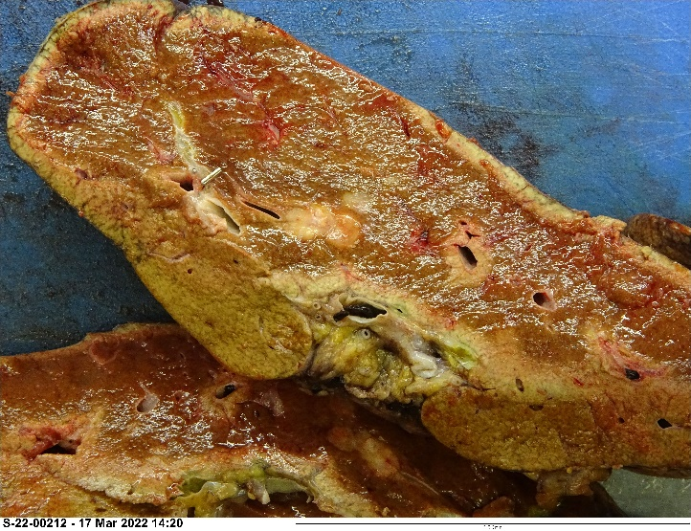
Transplant oncology
    Clinical case
    DecCM 62 y/o
    2020 → Left hemicolectomy and Atypical Liver Resections of S5/S2-S3/S4b
      Final Diagnosis: adenocarcinoma (G3); 1/24 lymph node positive. Liver nodules compatible with intestinal adenocarcinoma metastasis. IHC: CK20+ CK2+ CK7- TTF1-, PSA- (pT3pN1apM1)
    May 2021 → US guided Liver Resections of multiple lesions (S8, S5-S6, S6, S4a, S2)
      Path: Liver nodules compatible with intestinal adenocarcinoma metastasis IHC: CK20+ CK2+ CK7- TTF1-, PSA-
    Jan, 2022 → after further Abd MRI Patient was enrolled in the COLT protocol and listed for liver transplantation
    Mar, 2022 → new small lesions (TD max 11 mm) in S4 and S8 with stability of other liver lesions
    15 Mar, 2022 → Liver transplant from deceased donor
      Final Diagnosis: Multiple liver nodules in S2, S3, S5 and S8 compatible with intestinal adenocarcinoma metastasis (CDX2 +).
    Patient received immunosuppressive therapy with Everolimus and MMF

Slide 15
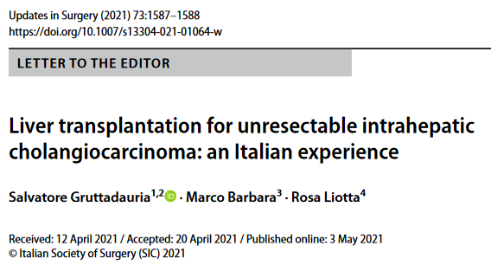
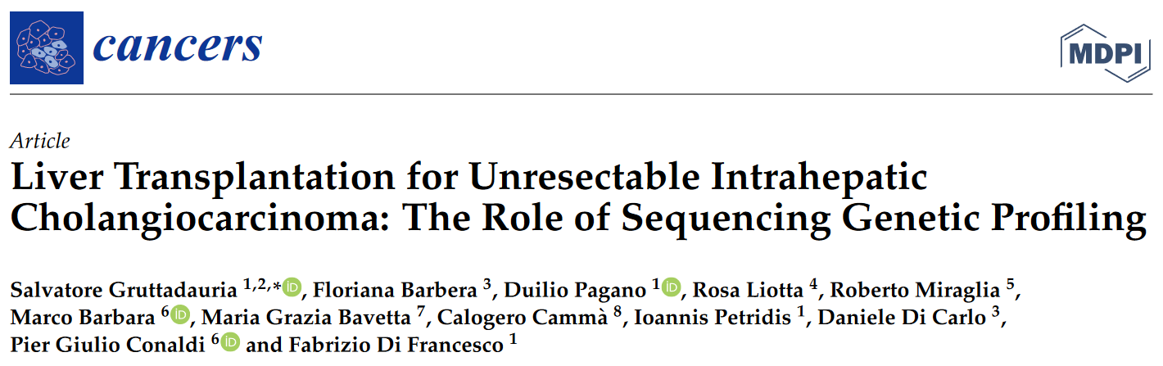
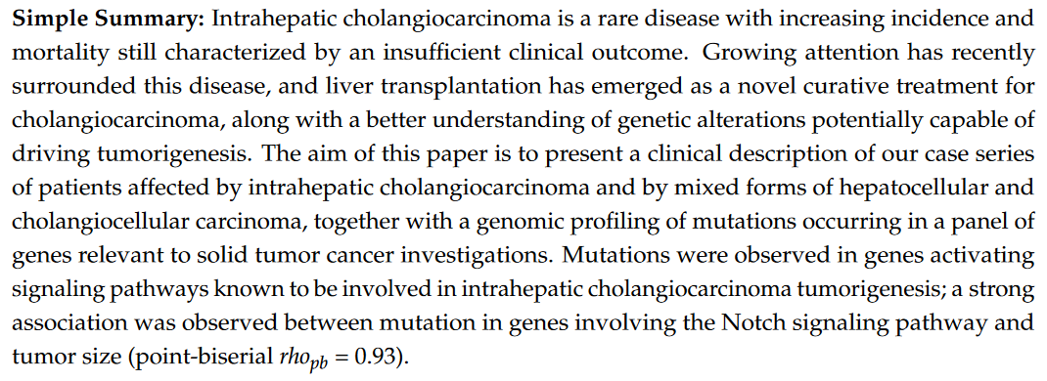
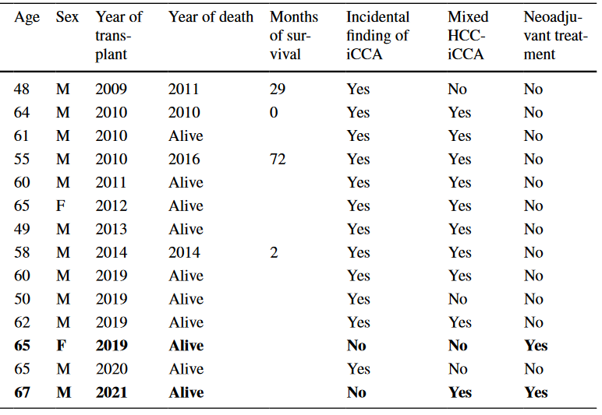
Transplant oncology

Slide 16
Transplant oncology
1999 – 2022
579 LTs for oncologic diseases
1566 OLTx
1999 – 2022
1180 Liver resections in adult oncologic patients

Slide 17
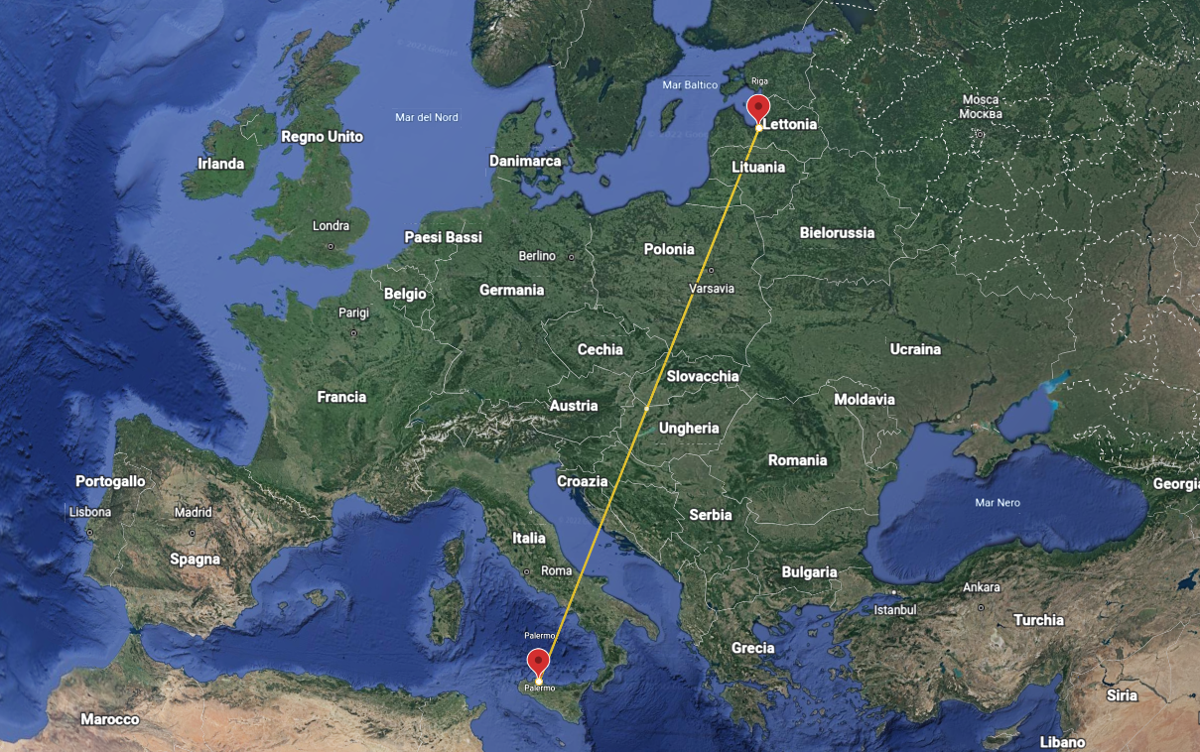

Da Riga a Palermo: Machine Perfusion

Slide 18
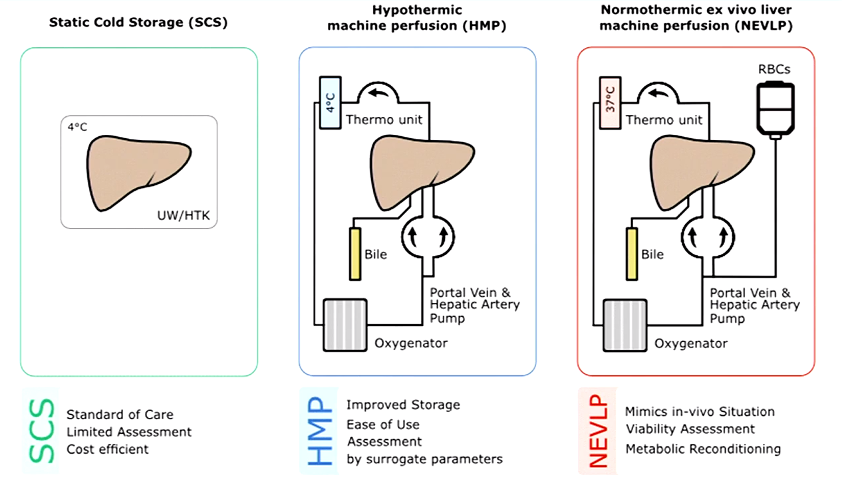
Machine perfusion
Notes:
Machine perfusion has been applied to renal transplantation, liver transplantation and lung transplantation. It is an alternative to static cold storage (SCS).
Machine perfusion has various forms and can be categorised according to the temperature of the perfusate: cold (4 °C) and warm (37 °C).
Perfusion systems are now small, can function autonomically and are increasingly used.
Tipical example is the unavoidable prolonged ischemic time before procurement in donation after cardiac death. (DCD).

Slide 19
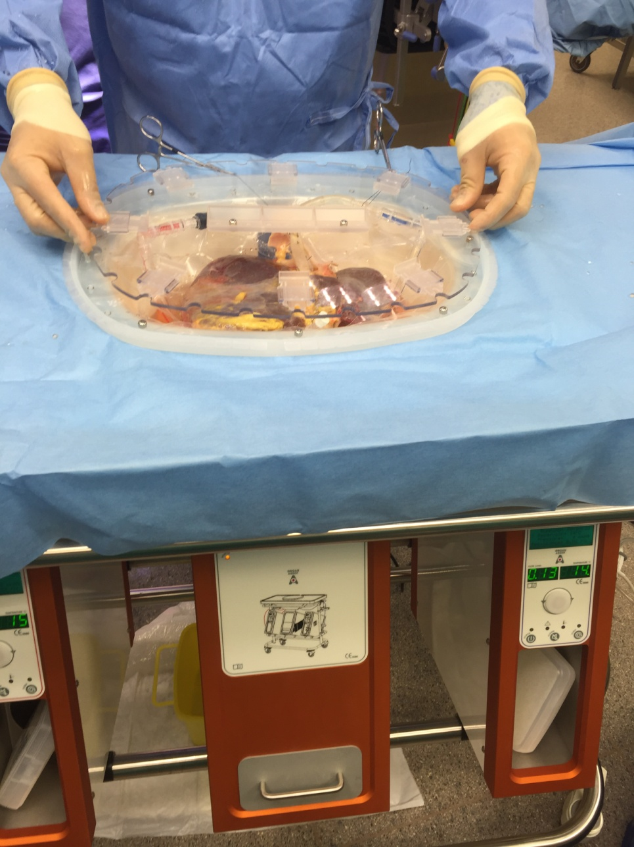
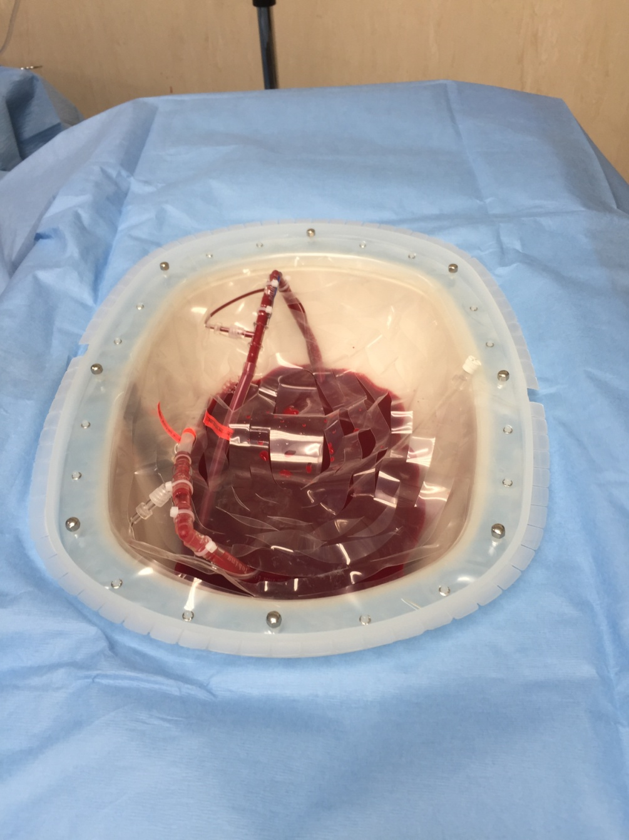
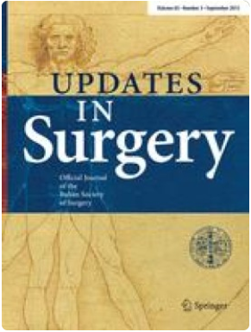
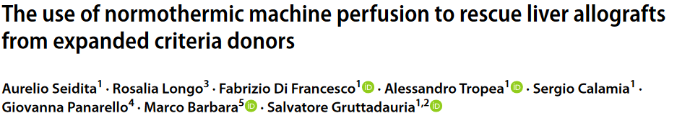
Ex-vivo Liver Perfusion: ISMETT experience 2016-2022
59 Total perfused liver grafts
7 discarded liver after MP from DBD
46 OLTx from DBD
26 whole liver graft reconditioned with combined Hypotermic Liver Assist and Sechrist 3500 Air/Oxygen Mixer
20 whole liver graft reconditioned with Normothermic Liver Assist / Organox and Sechrist 3500 Air/Oxygen Mixer
  10 of which were extraregional donors discarded by other Italian Centers
6 OLTx from DCD graft reconditioned with Normothermic Liver Assist / Organox and Sechrist 3500 Air/Oxygen Mixer
Median donor age = 60 ys
Mean MP time = 4,1 hrs
Mean CIT = 10.2 hrs
During MP arterial and portal flow, lactate level on perfusate, bile production evaluated every 30 min
Liver biopsies were obtained first and after MP

Slide 20
Machine perfusion
    Platform for concurrent graft modification
    Defatting
      Augment the protective effect of the perfusion adding «defatting cocktail»
      Reduce intracellular lipid conctent by 50% during 3 H NMP in steatotic rat liver
    Elderly
      Neutralize the impact of other risk factors that predispose to IRI
      Viability assessment to confirm the functionality and predict the effect of comorbid factor
    Possible future directions
      Antiviral medication
      Immune modulation for tolerance induction
      Novel drug delivery system (nanoparticles)

Slide 21

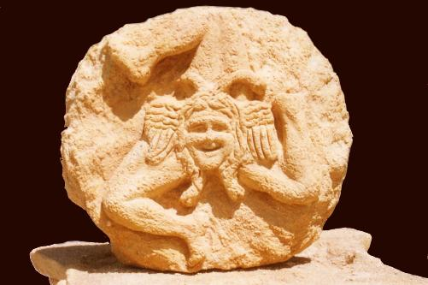
Thank you

