Slide 1
Il trapianto epatico in Sicilia: la storia e il presente
Antonio Arcadipane
ISMETT, Palermo

Slide 2
Milestones at ISMETT
DCD program
EX Vivo
Lung Liver and Kidney program
2018
2015
Comb. Lung-Liver
transplant
2009
2012
Long Term
VAD
L.Donor Liver
Transplant
Heart
Rete RESPIRA
2004
2005
2002
Lung
Ped.Liver
Transplant
Liver
1999
Pancreas
Kidney
Cadaver and Living

Slide 3
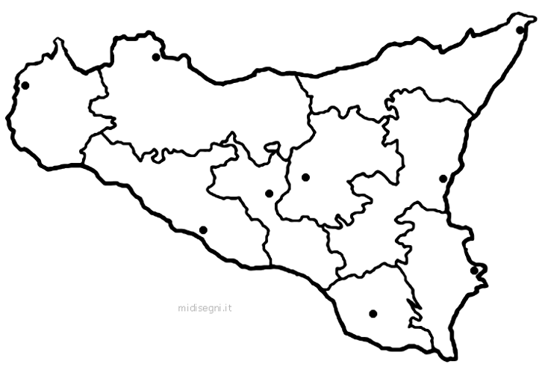
ISMETT ECMO Team DCD Mission
Senior CCM / Transplant surgeon
Perfusionist / Scrub Nurse
Anesth. Fellow ( 20% )
6 DCD missions
1 ambulance
5 helicopter
Distance 5-250 km
Mission Time 480 - 1320 min

Slide 4
NORMOTERMIC REGIONAL PERFUSION (nRP)
Cannulazione femoro-femorale VA
Cannula arteriosa da 19-21F
Cannula venosa 21-23F
Baloon aortico sopraceliaco
Monitoraggio arterioso radiale e femorale

Slide 5
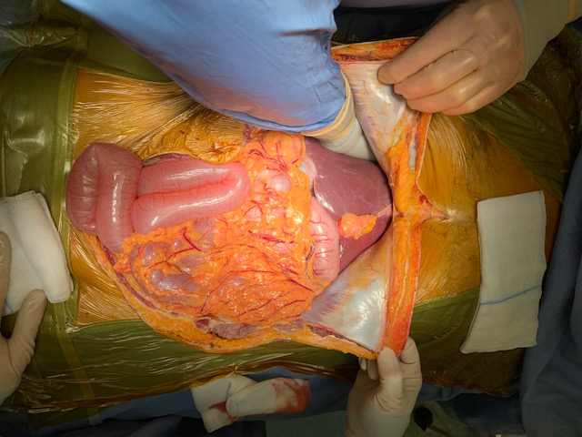

Slide 6
Despite low donation rate in Sicily, thanks to alternative strategies likes
Living donors program
Extended criteria donors
Ex vivo perfusion
DCD’s
in the past 5 years the numbers of transplants have steadily increased
Donation rate in Sicily is to LOW!

Slide 7
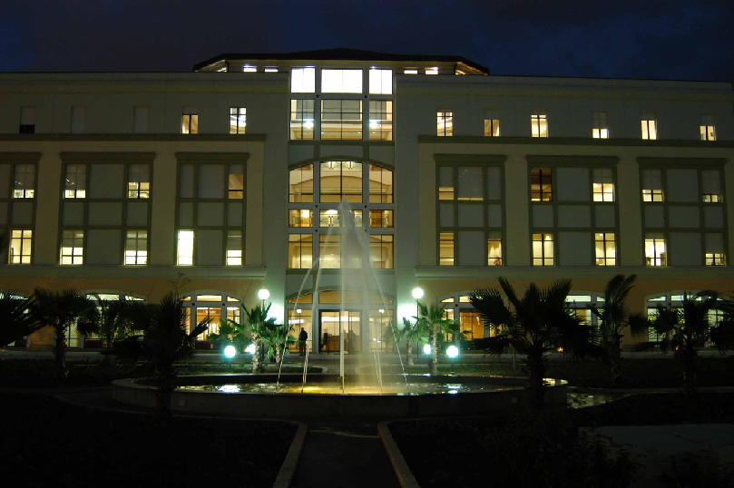
Thanks

