Slide 1

2-3 Dicembre 2022
Autoimmune hepatitis and Covid-19
Five questions
G Mazzola , MD

Slide 2
COVID e AIH : Question 1.
It possible that SARS-CoV-2-Induces Autoimmunity ?
A list of numerous autoantibodies has been detected in patients with SARS-CoV-2 infection
Interestingly, ANA, LAC, and ANCAs have been tested in 33 consecutive patients with COVID-19, 94% of whom had interstitial pneumonia
Anti-ds DNA positivity was reported in 38-60% of patients with AIH/PBC overlap syndrome with Covid - 19
Dotan, A. SARS-CoV-2 as an Instrumental Trigger of Autoimmunity. Autoimmun. Rev. 2021

Slide 3
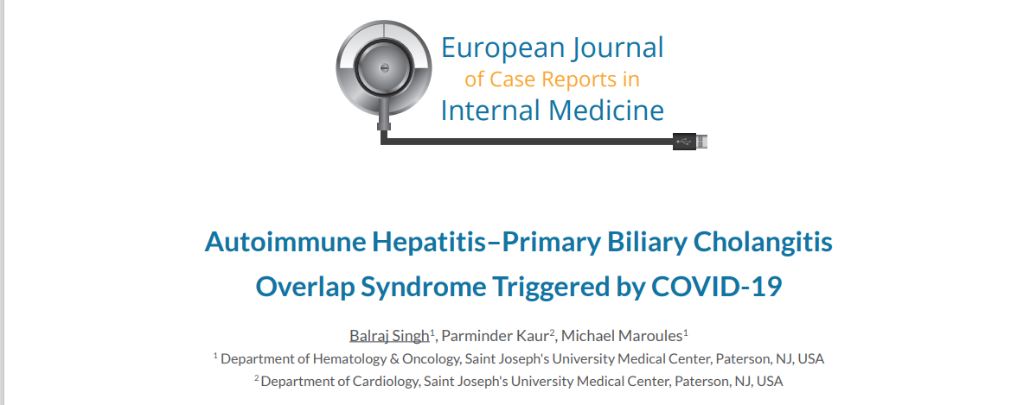

Slide 4
COVID e AIH : Question 2.
Is the Risk of SARS-CoV-2 severe illness Increased in Autoimmune Liver Disease Patients?
No differences in rates of major outcomes between patients with liver diseases (AIH and non AIH).
Factors associated with death within the AIH cohort included age and advanced liver disease (Child B and C) but not immunosuppression
Marjot, T et al. SARS-CoV-2 Infection in Patients with Autoimmune Hepatitis. J. Hepatol. 2021

Slide 5
COVID e AIH : Question 3.
What is The Impact of Immunosuppressive Therapy on Viral Infection ?
The impact of AIH medications, including glucocorticoids, thiopurines, mycophenolate and tacrolimus on the risk of worse COVID-19 severity has been evaluated in a large international retrospective study
Baseline treatment with systemic glucocorticoids or thiopurines prior to the onset of COVID-19 was significantly associated with COVID- 19 severity
Efe, C. et al. Effects of Immunosuppressive Drugs on COVID-19 Severity
in Patients with Autoimmune Hepatitis. Liver Int. 2022

Slide 6
COVID e AIH : Question 4.
Can the Vaccination against SARS-CoV-2 Trigger Autoimmunity?
The mechanism of induction of autoimmunity by vaccine is unknown, but probably several factors may play a role, including genetic susceptibility
Lodato, F. An Unusual Case of Acute Cholestatic Hepatitis after M-RNASARS-CoV-2 Vaccine:
Coincidence, Autoimmunity or Drug-Related Liver Injury. J. Hepatol. 2021

Slide 7
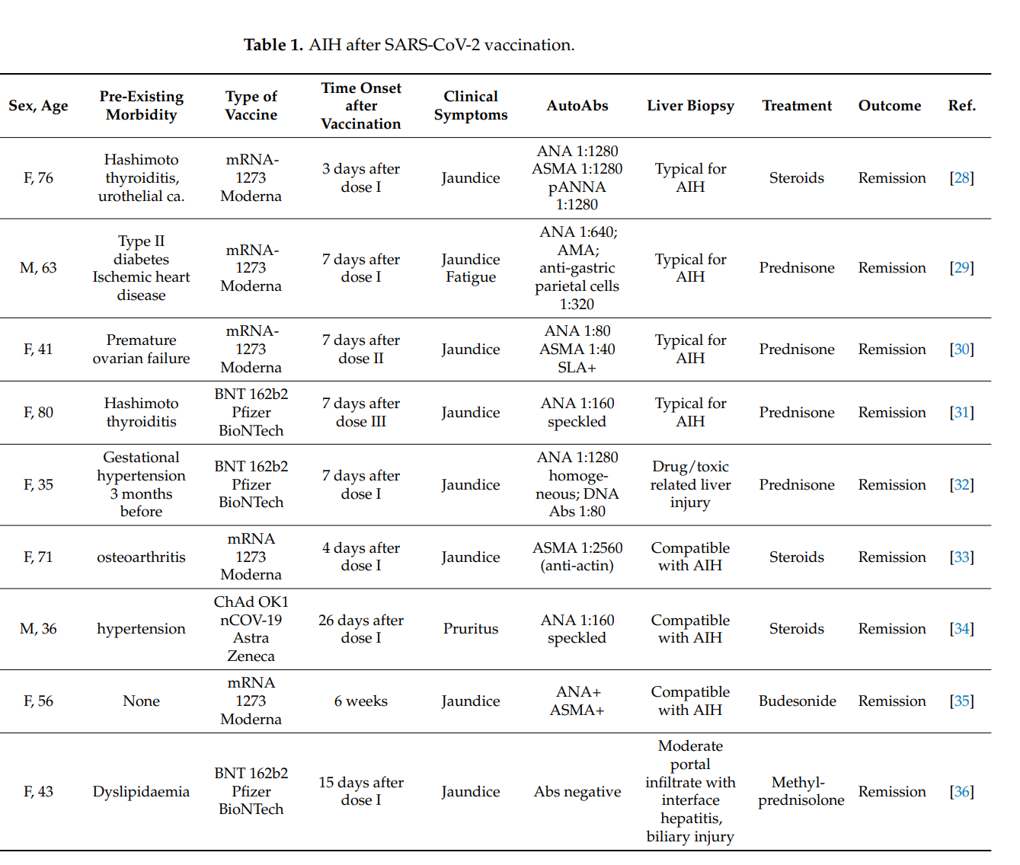

Slide 8
COVID e AIH : Question 5.
What is SARS-CoV-2 Vaccination Response in Patients with Autoimmune Liver Disease ?
A prospective observational study comparing the humoral and T- cellular immune response to SARS-CoV-2 vaccination in patients with autoimmune liver disease has been recently published
In the autoimmune assay of 20 AIH patients, a spike-specific T-cell response was undetectable in 45% despite a positive serology, while 85% of the PBC/PSC patients demonstrated a spike-specific T-cell response.
Duengelhoef, P. SARS-CoV-2 Vaccination Response in Patients with
Autoimmune Hepatitis and Autoimmune Cholestatic Liver Disease UEG 2022

Slide 9
Conclusions
There is a rationale supporting the link between SARS-CoV-2 infection and AILDs
The risk of infection is similar in all chronic liver diseases
The use of immunosuppressants (steroids and thiopurines) has been correlated to an increase of disease severity
A limited number of cases of AIH has been reported after vaccination against SARS-CoV-2.
Further mechanistic studies are needed to describe in detail the role of an incorrect autoimmune response in COVID-19 patients

