Slide 1
Antonio Cascio Università di Palermo

Slide 2
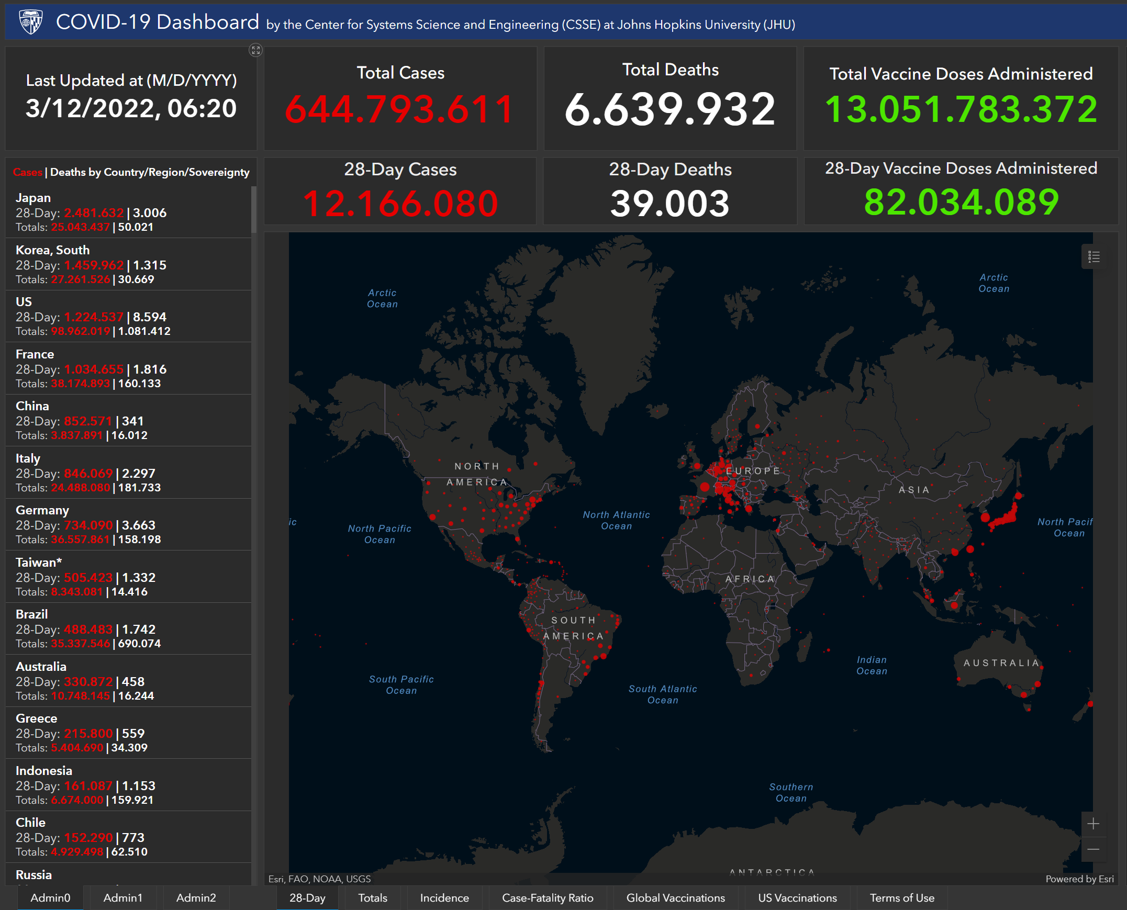

Slide 3
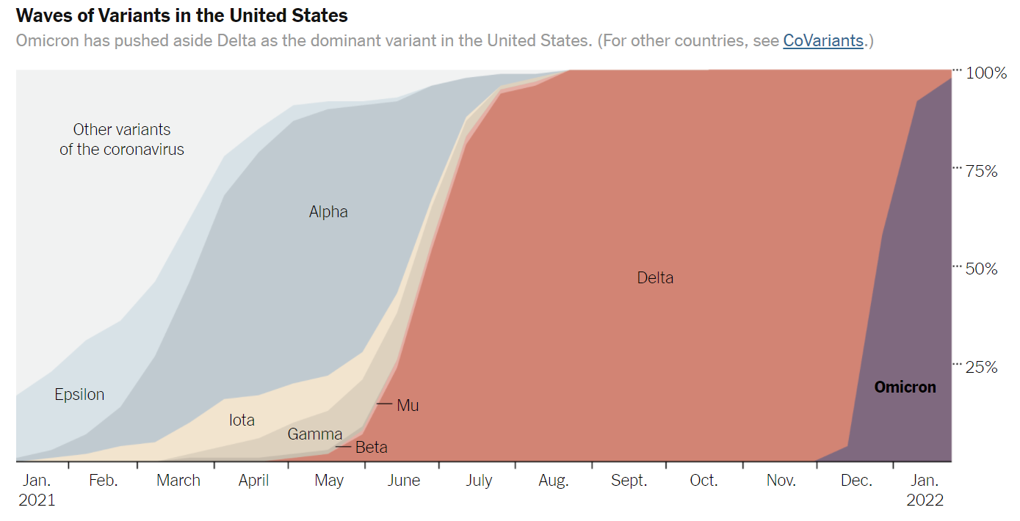

Slide 4
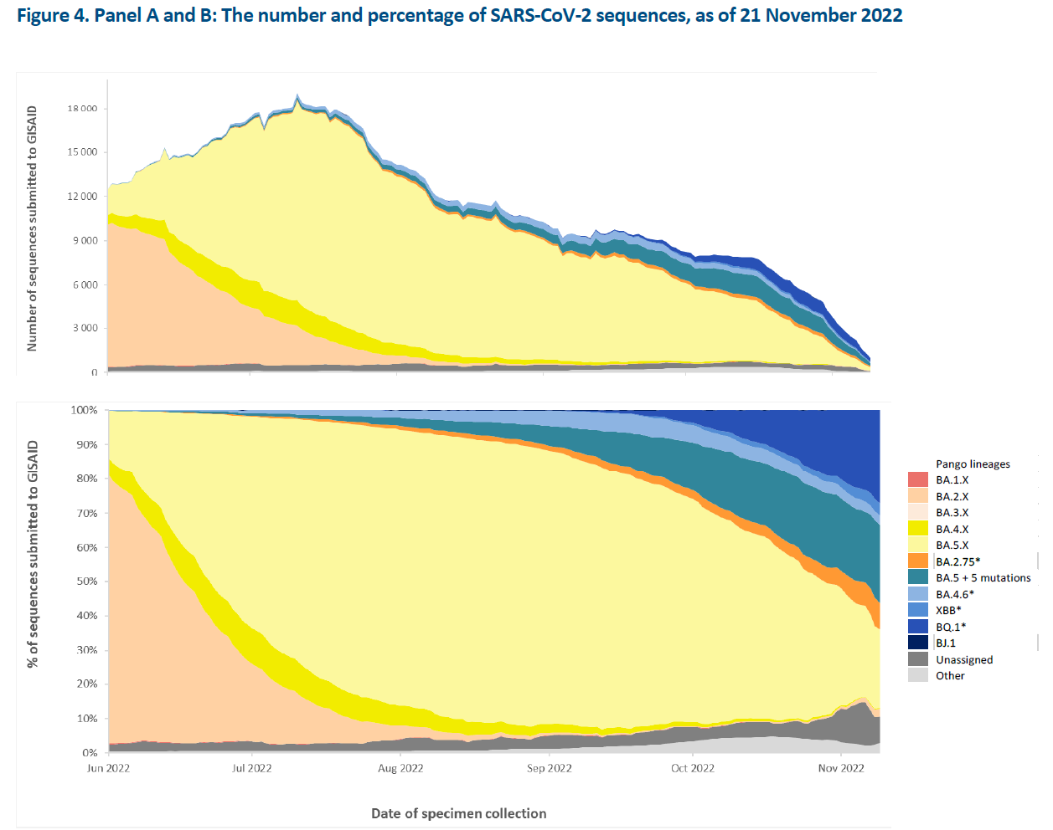

Slide 5
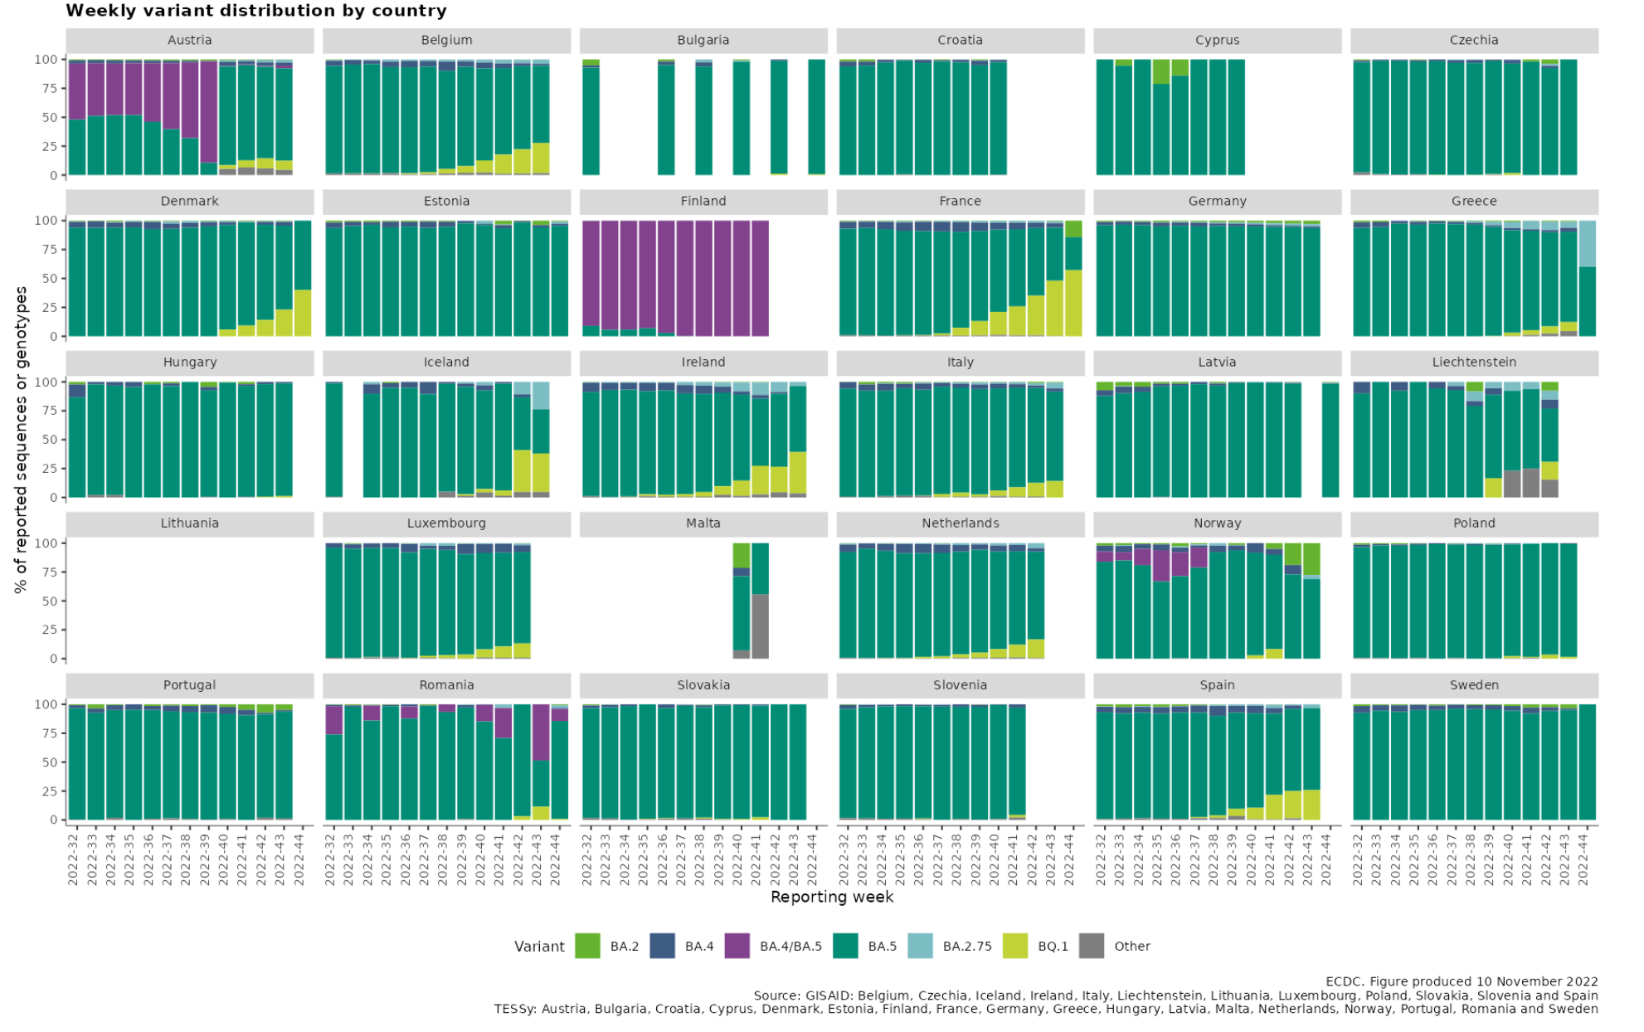

Slide 6
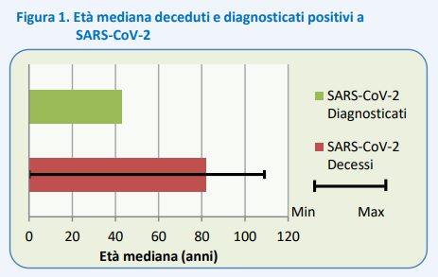

Slide 7
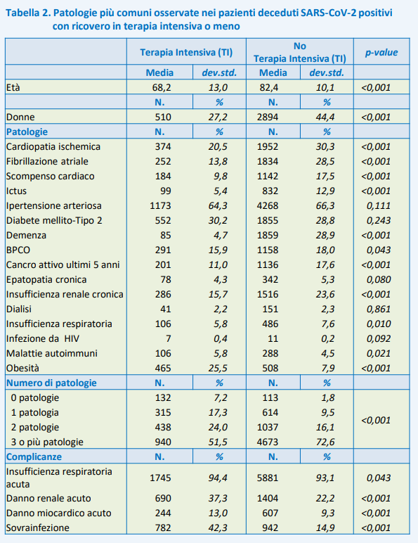
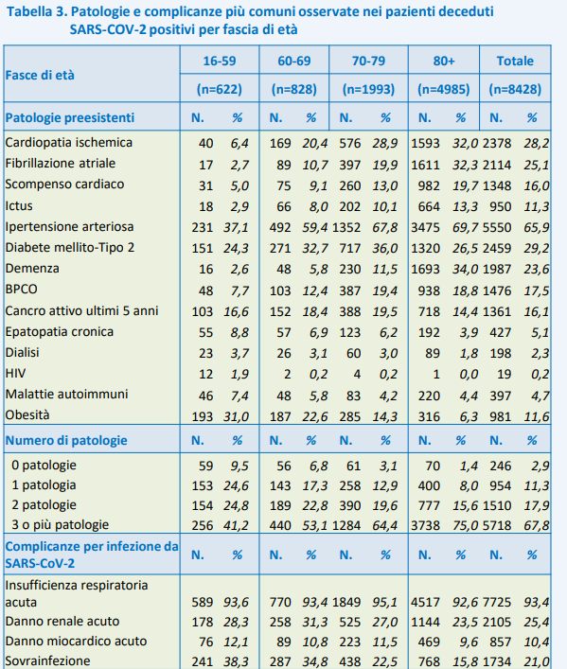

Slide 8
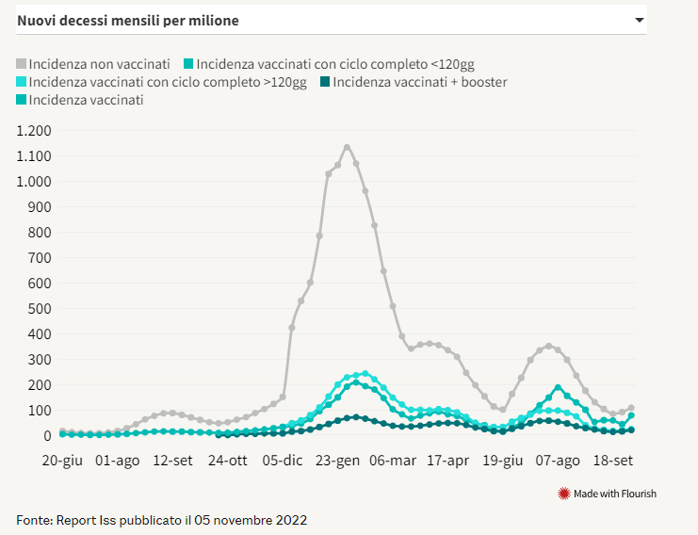

Slide 9
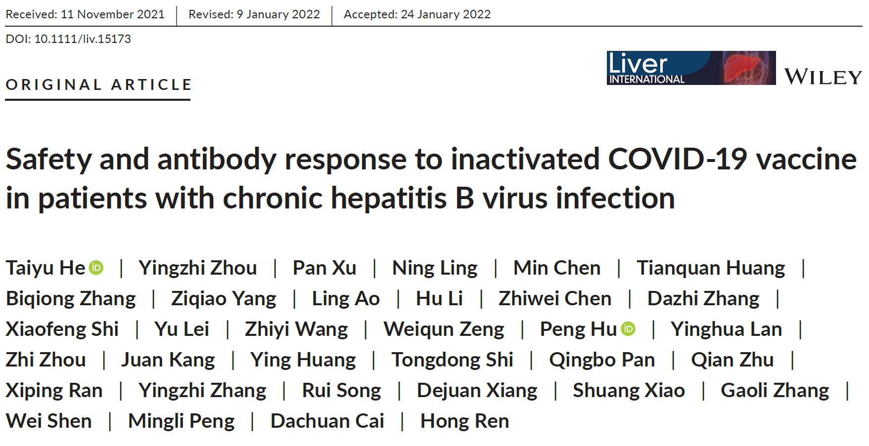
362 adult CHB patients and 87 healthy controls at an interval of at least 21 days after a full-course vaccination (21–105 days) were enrolled. Adverse events (AEs) were collected by questionnaire. The antibody profiles at 1, 2 and 3 months were elucidated by determination of anti-spike IgG, anti-receptor-binding domain (RBD) IgG, and RBD-angiotensin-converting enzyme 2 blocking antibody. SARS-CoV-2 specific B cells were also analysed.
Results
All AEs were mild and self-limiting, and the incidence was similar between CHB patients and controls. Seropositivity rates of three antibodies were similar between CHB patients and healthy controls at 1, 2 and 3 months, but CHB patients had lower titers of three antibodies at 1 month. Compared to healthy controls, HBeAg-positive CHB patients had higher titers of three antibodies at 3 months (all P < .05) and a slower decline in antibody titers. Frequency of RBD-specific B cells was positively correlated with titers of anti-RBD IgG (OR = 1.067, P = .004), while liver cirrhosis, antiviral treatment, levels of HBV DNA, alanine aminotransferase (ALT) and aspartate aminotransferase (AST) and total bilirubin (TB) were not correlated with titers of anti-RBD IgG.

Slide 10
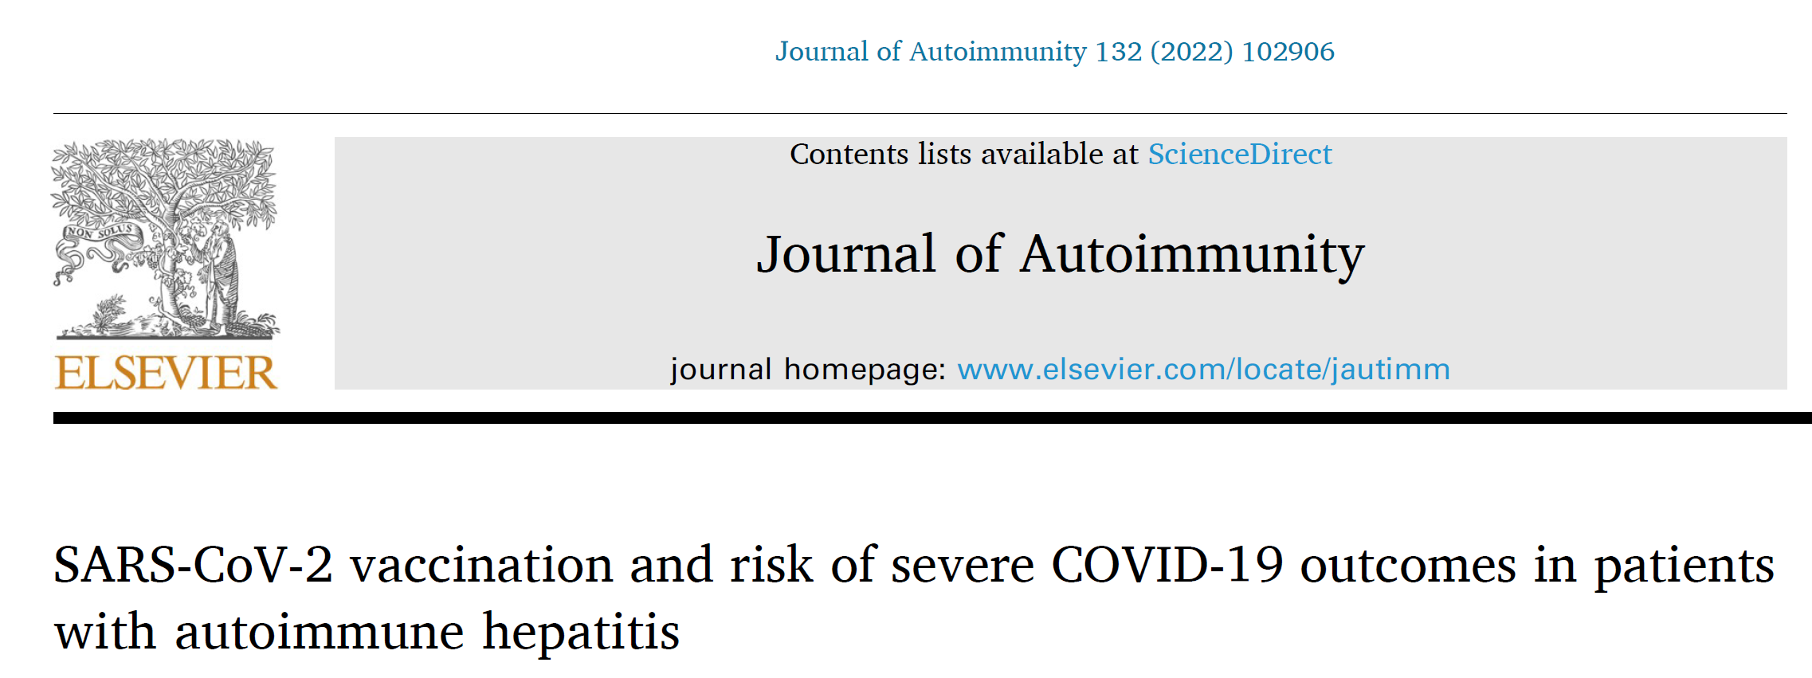
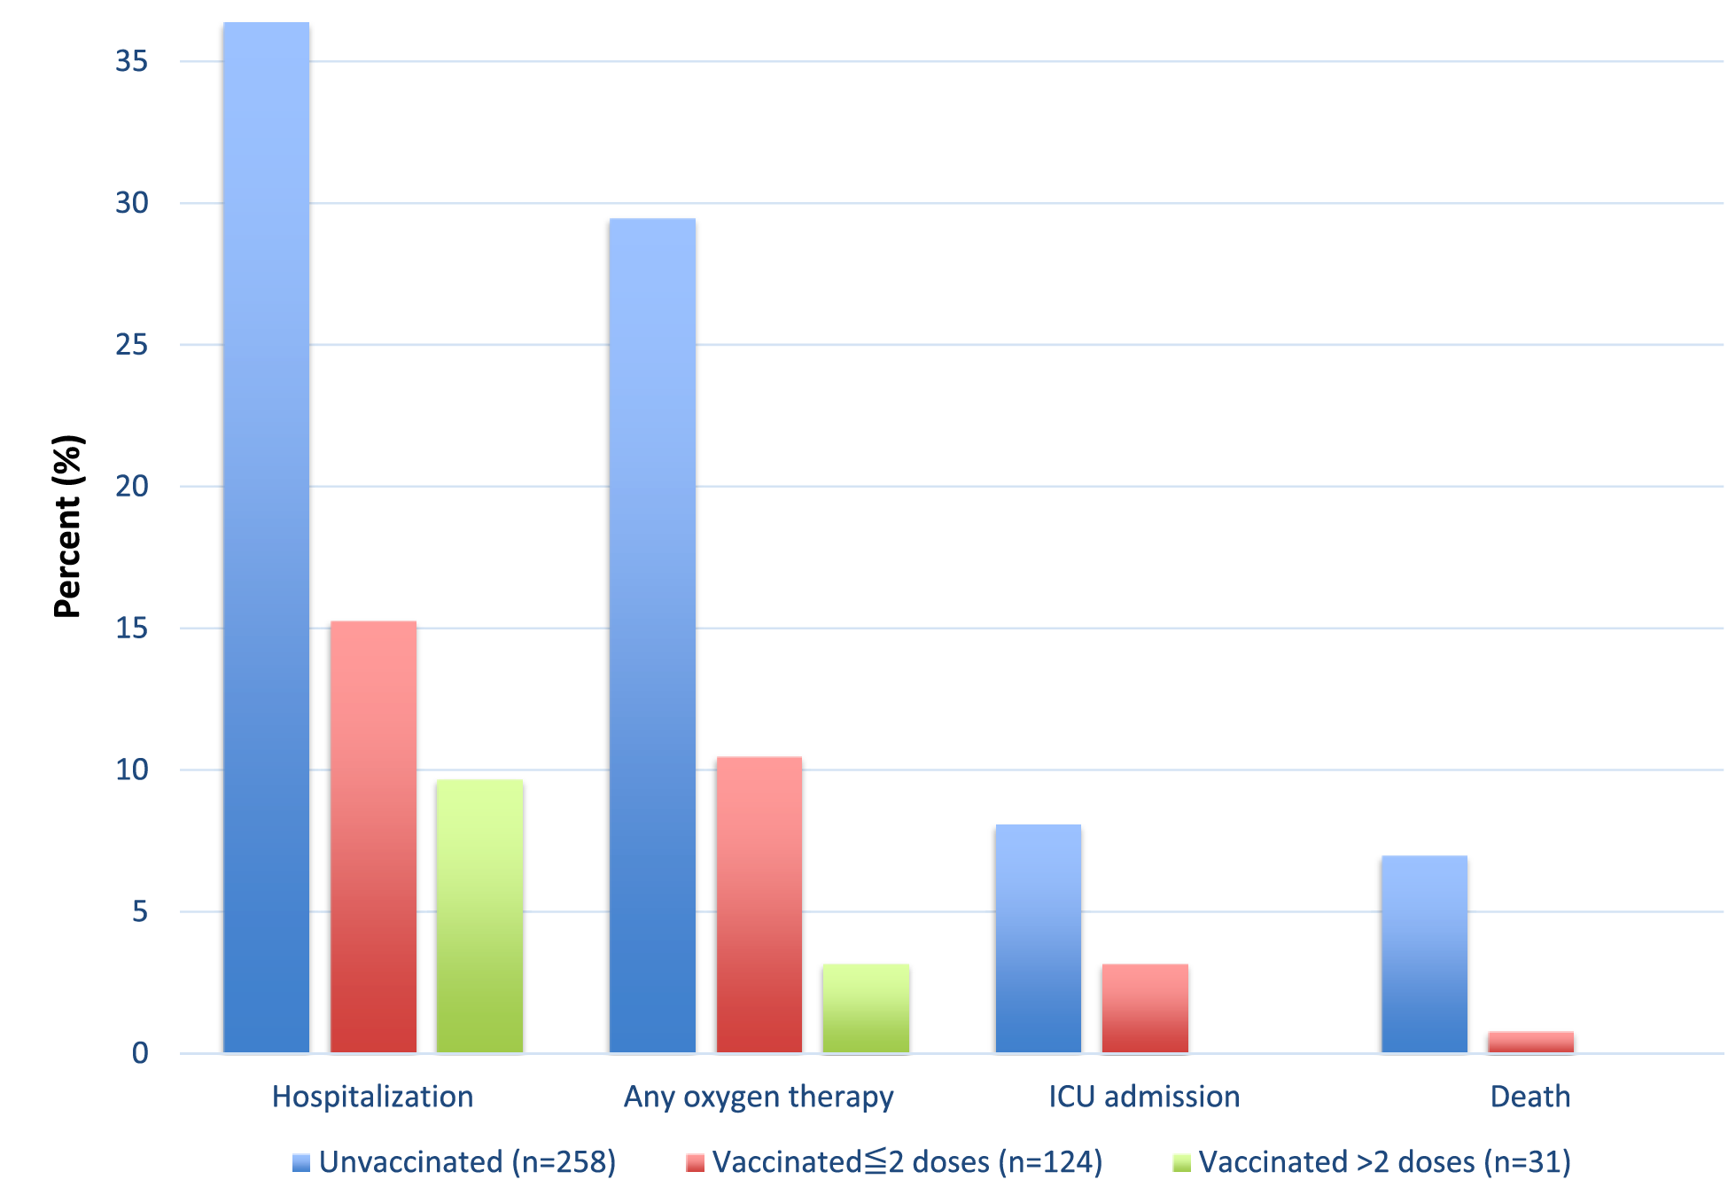
We included 413 (258 unvaccinated and 155 vaccinated) patients (81%, female) with a median age of 52 (range: 17–85) years at COVID-19 diagnosis. The rates of hospitalization were (36.4% vs. 14.2%), need for any supplemental oxygen (29.5% vs. 9%) and mortality (7% vs. 0.6%) in unvaccinated and vaccinated AIH patients with COVID-19. Having received at least one dose of SARS-CoV-2 vaccine was associated with a significantly lower risk of worse COVID-19 severity, after adjusting for age, sex, comorbidities and presence of cirrhosis (adjusted odds ratio [aOR] 0.18, 95% confidence interval [CI], 0.10–0.31). Overall, vaccination against SARS-CoV-2 was associated with a significantly lower risk of mortality from COVID-19 (aOR 0.20, 95% CI 0.11–0.35).

Slide 11
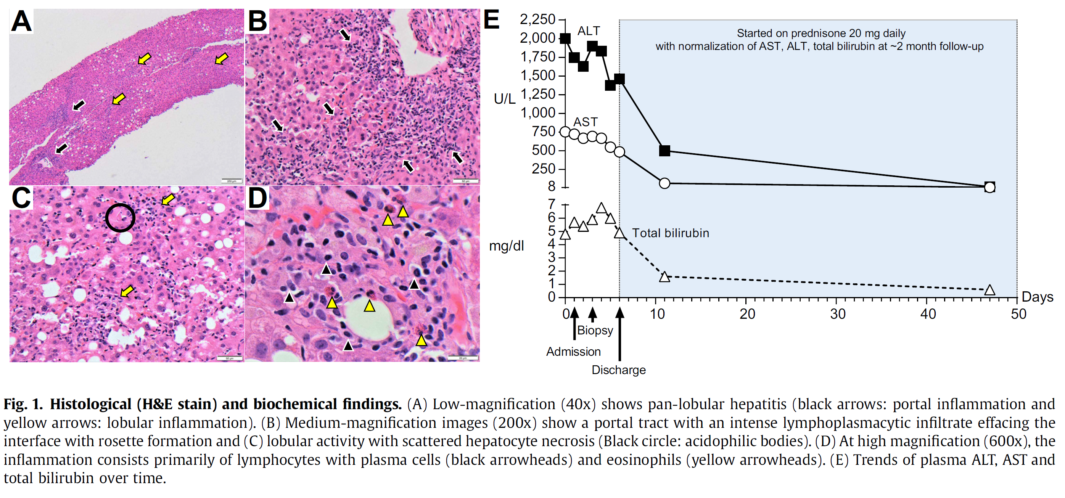
We have recently treated a 35-year-old Caucasian female in her third month postpartum, who developed autoimmune hepatitis after COVID-19 vaccination. During pregnancy, she was diagnosed with gestational hypertension and started on labetalol 100 mg bid. C-section was performed without any complications,
and patient was discharged from the hospital on labetalol for blood pressure control. She resumed her job as a healthcare provider in mid-December, and received her first dose of Pfizer-BioNTech COVID-19 vaccine on January 4th. After 1 week, she started developing generalized pruritus, then choluria, and finally noticed jaundice, presenting to the emergency room on day +13 after COVID-19 vaccination.

Slide 12
