Slide 1
Modelli di storia naturale delle malattie epatiche
Cirrosi epatica
Gennaro D’Amico
gedamico@libero.it

Slide 2
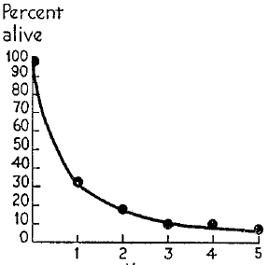
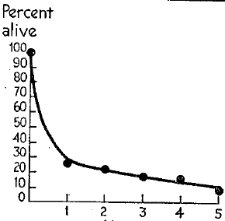
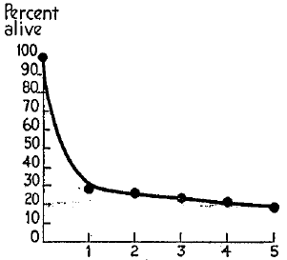
The natural history of cirrhosis
Ratnoff & Patek Medicine 1942;21:207-268
…. The first syntomps of Laennec’s cirrhosis may be vague and ill-defined, so that the patients history is of questionable reliability...
….. For these reasons, the data are analyzed with respect to certain specific signs, i.e, ascites, jaundice and hematemesis, which permit fairly accurate recognition by the patient
Ascites
Jaundice
Hematemesis

Slide 3
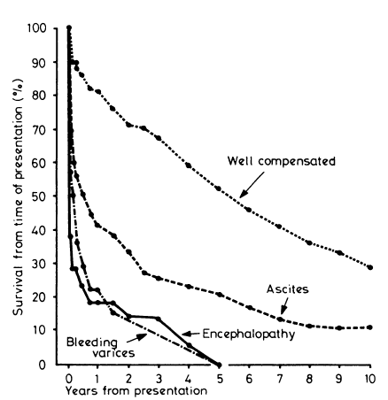
Baker Am J Med 1959;26:228-237
Saunders BMJ1981;282:263-266

Slide 4
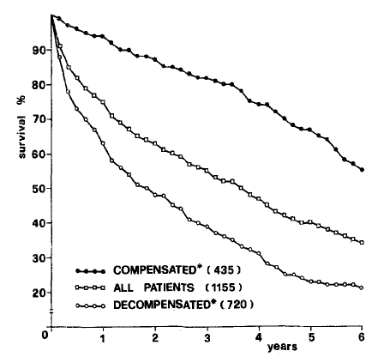
Compensated and decompensated cirrhosis
Compensated
n=435
All (n=1155)
Decompensated
n=720
D’Amico, Morabito, Pagliaro Dig Dis Sci 1986;31:468-476
Gines P. Hepatology 1987;7:122-128

Slide 5
The natural history of cirrhosis
Heterogeneity of survival in 118 studies
compensated
decompensated
100
100
80
80
60
survival at the end of follow-up (%)
40
60
20
40
0
Compensated
Decompensated
0
12
24
36
48
60
72
84
96
20
mean follow-up (months)
1 yr 2yrs
1 yr 2yrs
D’Amico G, Garcia-Tsao G, Pagliaro L. J Hepatol 2006;44:217-231

Slide 6
The concept of clinical stages in cirrhosis
Compensated
cirrhosis
Death
Decompensated
cirrhosis
D’Amico G, Garcia-Tsao G, Pagliaro L. J Hepatol 2006;44:217-231

Slide 7
Competing risks in the clinical course of cirrhosis
D’Amico G. APT 2014;39;1180-1193

Slide 8
Prognostic stages of cirrhosis
5-year outcome (494 patients)
0
769 patients without previous decompensation
0
compensated
.
1
No decompensation
g
0
n
8
i
.
v
0
bleeding
i
v
0
r
6
ascites
u
.
s
0
he
jaundice
n
0
o
4
i
t
.
r
0
o
combi
p
0
o
2
r
.
P
0
0
0
.
decompensated
0
0
365
730
1095
1460
1825
days
Unpublished data from multicenter euro-latino American cohort
D’Amico APT 2014; 39: 1180–1193

Slide 9
Multistate model for NAFLD/NASH cirrhosis
Allen A. Jhepatol 2022;77:1237–1245

Slide 10
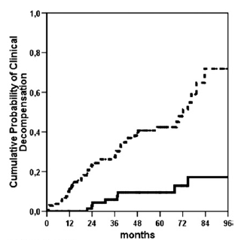
Substages of compensated cirrhosis without varices clinically significant (CSPH) or Mild (MPH) portal hypertension
Baveno VII consensus on LSM interpretation
CSPH (HVPG≥10)
MPH (HVPG<10)
Sensitivity and NPV >95%
Ripoll C et al. Gastroenterology 2007;133:481-488
Baveno VII. JHEP 2022;76:959-974

Slide 11
Further decompensation new, Baveno VII
Further decompensation is associated with higher mortality than that associated with first decompensation and is defined as follows:
a) Second event :ascites, variceal haemorrhage or hepatic encephalopathy and/or jaundice;
b) rebleeding, ascites requiring ≥3 large-volume paracenteses within 1 year, SBP and/or HRS-AKI, recurrent encephalopathy
c) In patients presenting with bleeding alone, development of ascites, encephalopathy, or jaundice after recovery from bleeding.

Slide 12
Acute decompensation and ACLF
Acute decompensation
Bleeding
Grade 2-3 ascites in <2weeks
Acute encephalopathy
Sepsis
PREDICT. JHEP 2020;73:842–854
Gustot T. Hepatology 2015;62:243-252
Impact of AD
The incidence of AD is not yet established
One large prospective study shows that the incidence of ACLF is 2.5% per year in compensated cirrhosis and 18.7% in decompensated (Piano S. J Hepatol 2017;67:1177–1184)
In the CANONIC and PREDICT studies, 77% of patients had had ≥1 previous decompensating event
These observations suggest that AD and ACLF mostly represent further decompensation and more rarely the first decompensation.

Slide 13
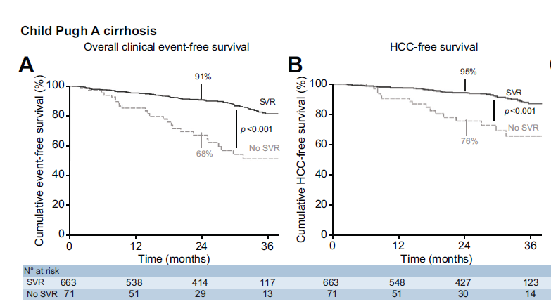
Treatments outcome modifying in cirrhosis
Decompensated cirrhosis: Non-etiological treatments
Compensated cirrhosis
Anti-viral treatment in HCV
Target population | Treatment | Indication | Risk reduction
variceal bleeding | (Early-) TIPS | Early TIPS criteria or refractory bleeding | Further decompensation and death
 | NSBB+EVL | Prevention of rebleeding | Further decompensation
ascites | NSBB or carvedilol | Prevention of variceal bleeding | Further decompensation
 | TIPS | Refractory or recurrent ascites | Further decompensation and death
recompensation
Removal/suppression/cure of the primary aetiology of cirrhosis;
Resolution of ascites (off diuretics), encephalopathy (off lactulose/rifaximin) and absence of recurrent variceal haemorrhage (for at least 12 months);
Stable improvement of liver function tests (albumin, INR, bilirubin).
Krassenburg L. JHEP 2021;74:1053–1063
Same direction effect in compensated patients after
HBV suppression
Alcohol abstinence
Life style changes and weight reduction in NASH
Baveno VII. J Hepatol. 2022 Apr;76:959-974

Slide 14
Towards a comprehensive model for cirrhosis
compensated
decompensated
AD
Bleeding
Ascites 2-3
HE, sepsis
ACLF
No/Mild PH
UDC
SDC
CSPH
No varices
OLT
Further deco
Death
Varices
NAD
Ascites
HE, Jaundice
Bleeding alone
Single non bleeding
≥ 2 deco
recompensation
Increasing mortality risk
Modified from: D’Amico G, Angeli P, Bernardi M. J Hepatol 2022;76:202–207

Slide 15
Cumulative number of new proposed prognostic scores for mortality in cirrhosis after 1980
The most used is MELD
BUT
9 versions proposed
8 settings requiring exceptions
C-statistics ranges from 0.66 to 0.83
Calibration almost unknown
52
50
14284 patients included, overall
45
42
40
37
MELD-TIPS (n=776)
S₀ and R₀ from the derivation study
32
7
30
.
C-statistic= 0.68(0.63-0.73)
O/E = 0.30(0.24-0.36)
Cumulative N of published scores
6
23
.
20
5
Similar results in a nonTIPS (n=445) population
MELD
.
13
4
.
10
12-month observed mortality rate
3
3
.
2
.
0
1985
1990
1995
2000
2005
2010
2015
2020
1
Publication year
.
0
0
.1
.2
.3
.4
.5
.6
.7
12-month predicted mortality
D’Amico G. JHEP 2021;75:1355-1366

Slide 16

Modelling cirrhosis towards personalized medicine
Presentation | N defining items | N combi | Strata
 |  |  | Pugh | MELD | treatment
Compensated | 3: no CSPH & no varices; CSPH no varices; varices | 3 | 2 | 7 | 2
Decompensated
Acute decompensation | 4: bleeding; ascites; HE; sepsis | 15 | 8 | 28 | 2
Non acute decompensation | 3: ascites; HE; jaundice | 7 | 8 | 28 | 2
Further acute decompensation | 4: bleeding; ascites; HE; sepsis | 15 | 8 | 28 | 2
Further non acute decompensation | 3: ascites; HE; jaundice | 7 | 8 | 28 | 2
Total possible presentations |  | 47 | 358 | 9898 | 19796

Slide 17

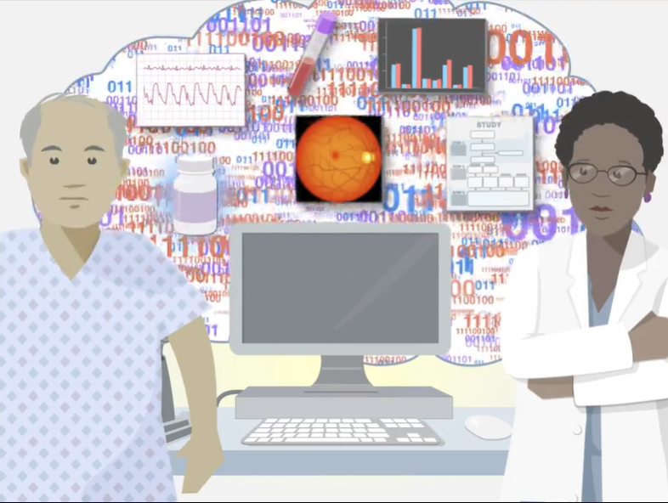
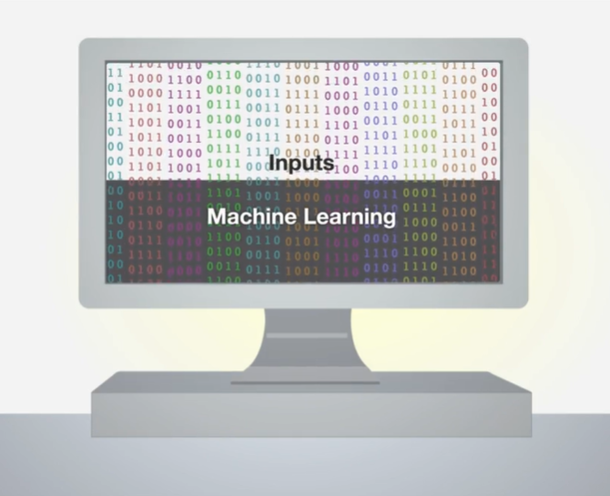
machine learning potential
Vignettes from Rajkomar A. N Engl J Med 2019; 380:1347-1358
To manage so many individual outcome probabilities requires joining different specialists experience
Physicians’ judgement may use such algorithms for faster and more individualized clinical decisions
Computer systems may learn huge amounts of experience and elaborate individualized algorithms

Slide 18
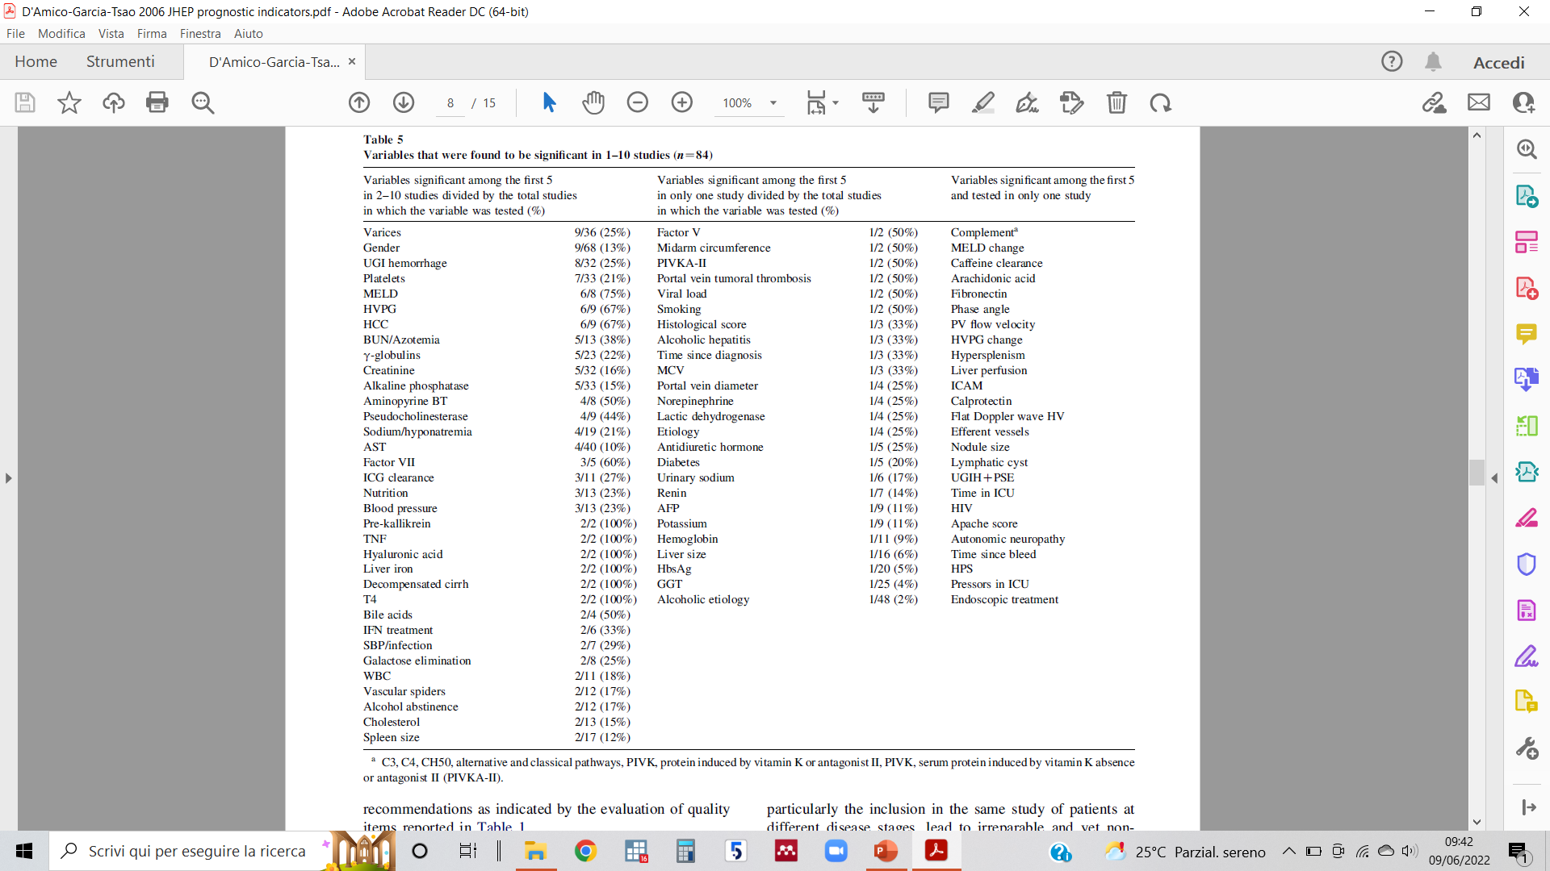
Exploring more variables
ML may assess much more vars and their interactions, allowing for
More accurate predictions
Detection of unknown associations raising new hypotheses or providing new explanations
84 variables had been reported to be significant death predictors in cirrhosis before 2006
The MELD includes only 3 of them
D’Amico G. JHEP 2006;44:217-231

Slide 19
ML 1 to 8 year mortality risk prediction in individual patients
107939 patients: 66.7% in ML training and 33.3 in testing set
13 variables
55 years, COPD, non-African American ethnicity, Na 133,bilirubin 2.4 mg/dl, 151 PLT, hemoglobin 8.8, AST/ALT ratio>2, no encephalopathy, with ascites, no HCC
C-statistics > Meld-Na at any time
1 to 8 years mortality risk from today for a simulated patient
Kanawal. JAMA Network Open. 2020;3(11):e2023780

Slide 20
ECG to diagnose cirrhosis and assess its severity
18821 patients in ML training, 2592 in validation and 5067 in test sets
Ahn JC.Am J Gastroenterol 2022;117:424–432

Slide 21
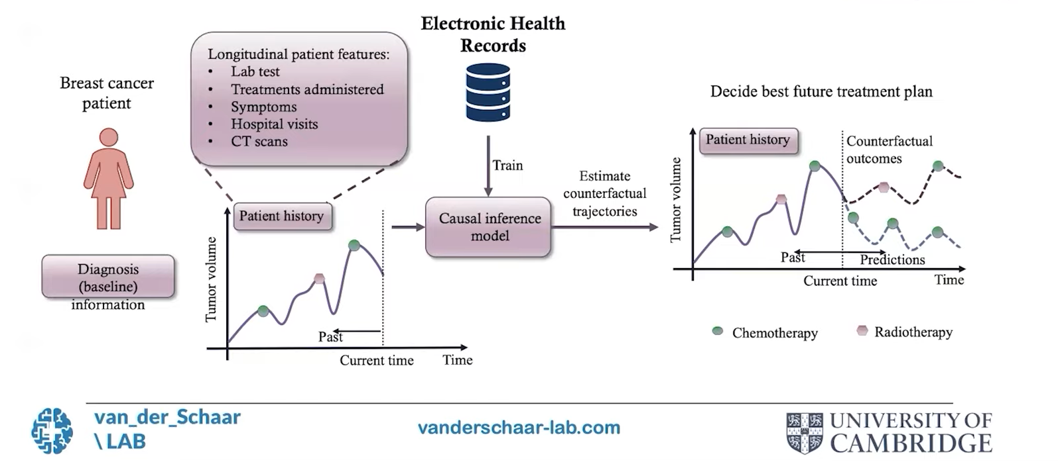
ML treatment decision making
Ascites & varices
Death risk
Death risk
TIPS
SOC
Adapted from

Slide 22
Issues with ML
Area
Argument
Possible approach
Quality, consecutivity and completeness
Block-chain technology
Input data
Standardized assessment and recording tools
Interobserver error
Different models yield different outputs
Consensus on model selection
ML model
Output model
ROB assessment
External validation
Validity
Performance in different regions/ countries
Generalizability

Slide 23
Take home messages
We still lack a satisfactorily comprehensive model for cirrhosis with major gaps in mild PH, incidence of AD, ACLF, further decompensation, and their overall impact
Current evidence supports a model with 3 clinical compensated and 3 decompensated states, including further decompensation
Although model refinements are expected by ML, the clinical methodology for its use needs to be refined
Major issues with ML are quality and completeness of input data, validation and generalizability

