Slide 1
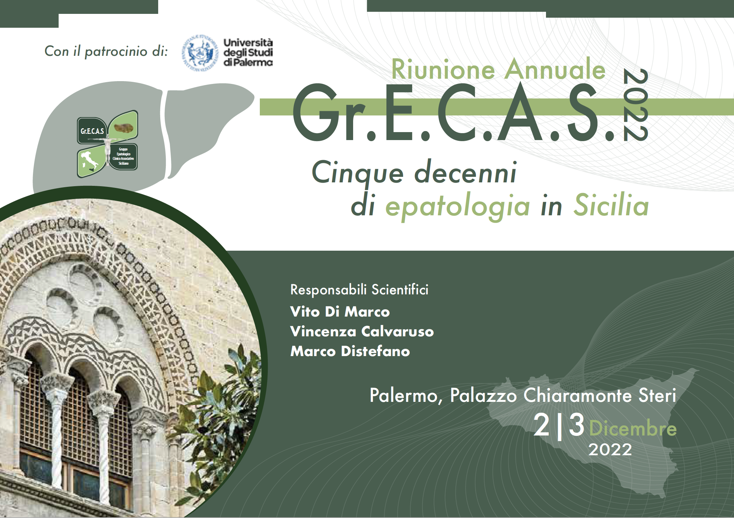


HCV in Sicilia:
Una storia lunga 5 decadi
Antonio Craxì

Slide 2
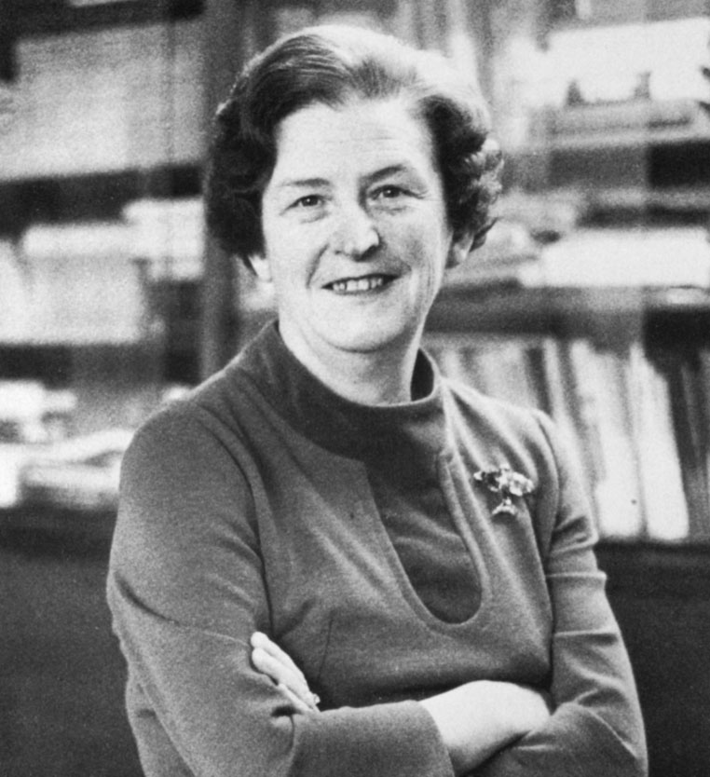
Chronic viral hepatitis: an uncertain beginning

Slide 3
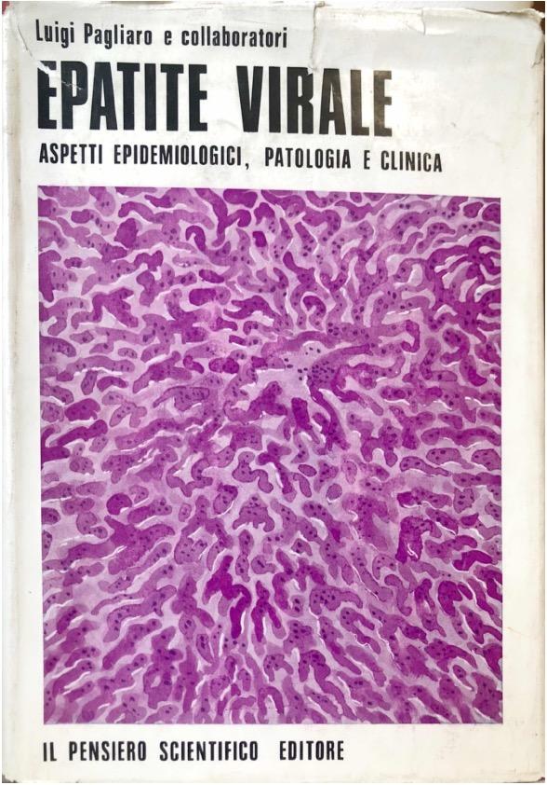
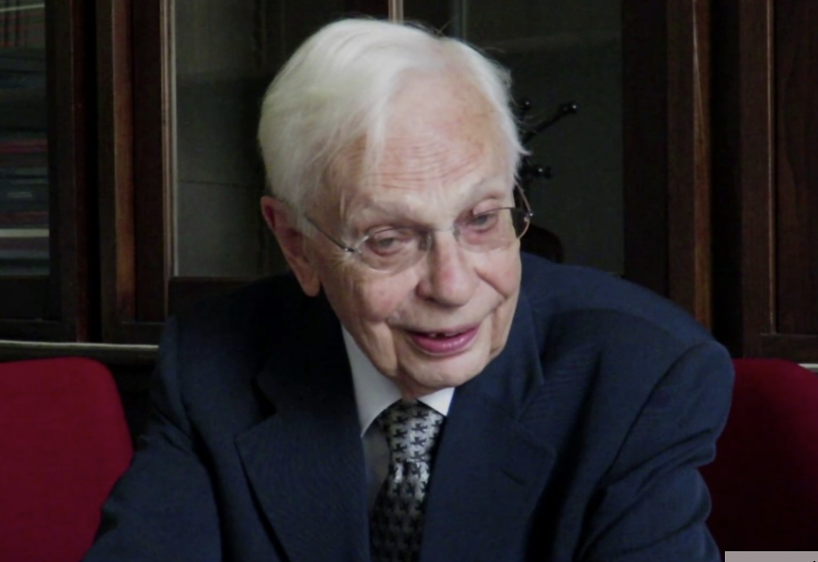

Slide 4
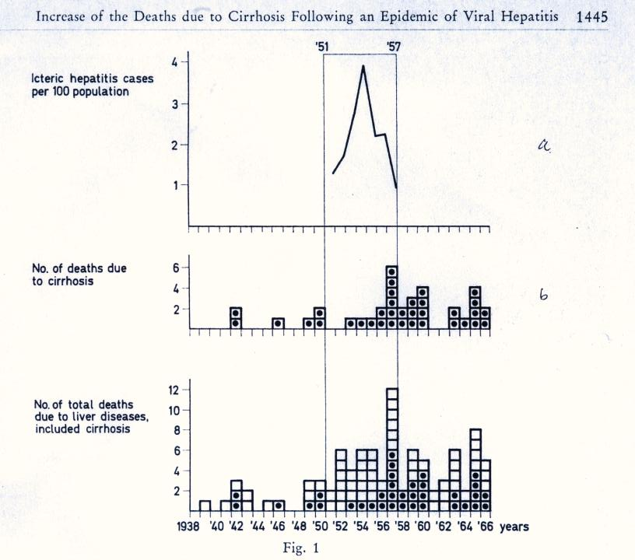
Chronic viral hepatitis: an uncertain beginning
1969
L. Pagliaro & L. Dardanoni. Increase of deaths due to cirrhosis following an epidemic of viral hepatitis. VIII Intern. Congress Gastroenterology, Prague, 1968; in: Modern Gastroenterology, FK Schattauer, 1969: 1444-48

Slide 5
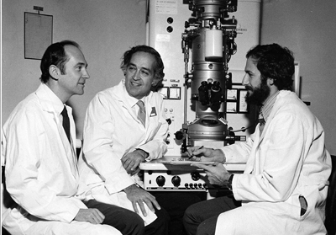
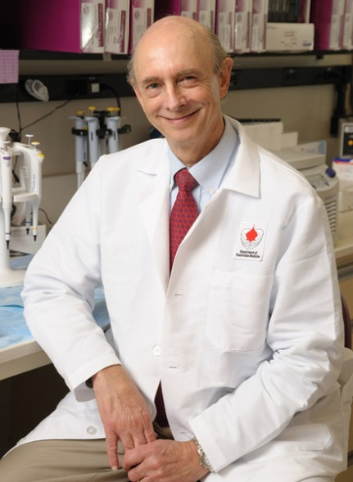
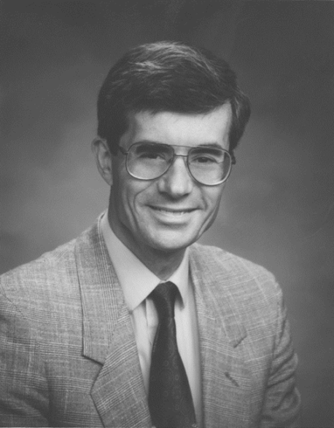
The First Description of Non A non B Hepatitis in Blood Transfusion Recipients
April 10, 1975 THE NEW ENGLAND JOURNAL OF MEDICINE
TRANSFUSION-ASSOCIATED HEPATITIS NOT DUE TO VIRAL HEPATITIS TYPE A OR B
Stephen M. Feinstone, M.D., Albert Z. Kapikian, M-D., Robert H. Purcell, M.D.,
Harvey J. Alter, M.D., and Paul V. Holland, M.D.
Feinstone SM et al, N Engl J Med 1975;292:767–770

Slide 6
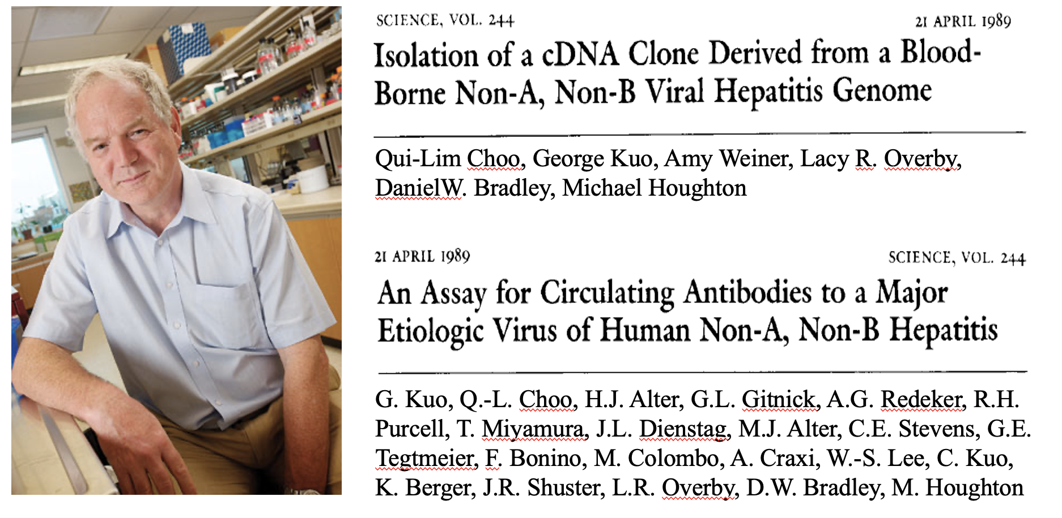
The Discovery of the Hepatitis C Virus and Development of a Serological Assay
Choo et al, Science 1989;244:359–362. Kuo et al, Science 1989;244:362–364

Slide 7
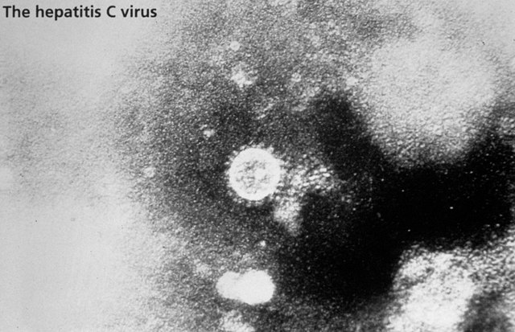
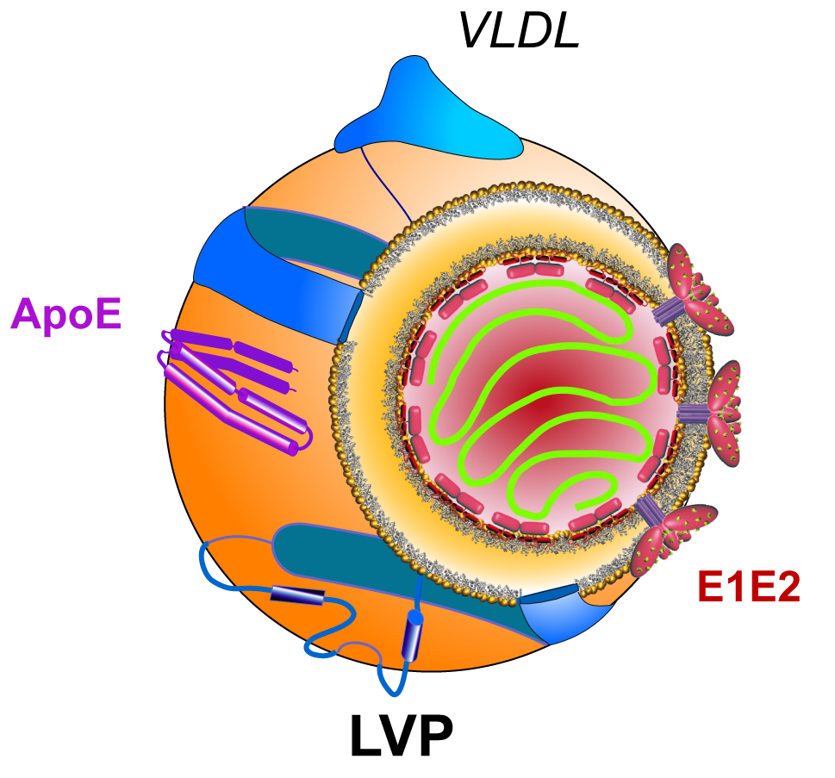
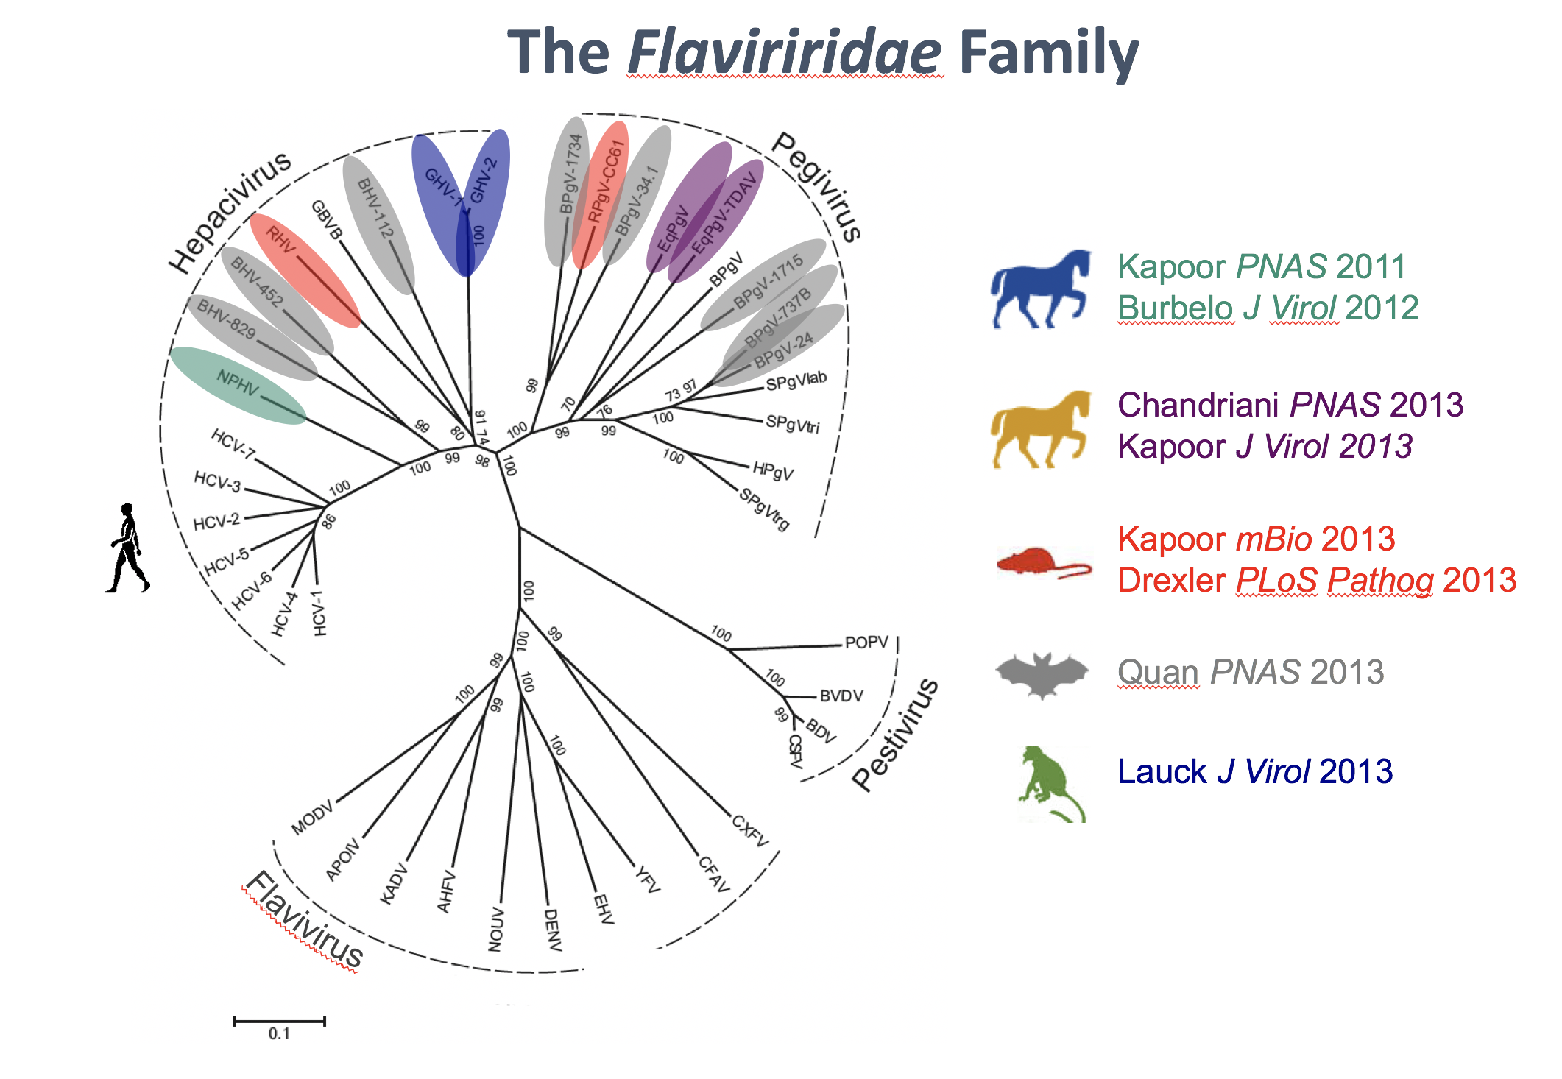
The Hepatitis C Virus
+ SS RNA 9.6 Kb
Flaviviridae family
Hepacivirus genus
High error rate during replication leads to the formation of quasispecies

Slide 8
Milestones in HCV research and cure
Establishment
of replicon
system
HCV genome organization
and polyprotein processing
Approval of first DAAs
(protease inhibitors)
Description of
non-A, non-B
hepatitis
Production of
infectious HCV in
cell culture
Completion of the
HCV life cycle
in mice
First infectious
clone of HCV
DAA-based mass treatments
1975
1989
1993
1996
1997
1998
1999
2003
2005
2009
2011
2013
2014
2015-2022
2030
Identification
of HCV as a
major human pathogen
IFN-α and riba-
virin combination
therapy
IL28B genetic polymor-
phisms determine HCV
clearance
First 3D structure of
an HCV protein
(NS3-4A protease)
Proof-of-concept study
of an HCV protease inhibitor
Approval of first oral
DAA therapy
HCV eradication
(?)
Modified from Moradpour D et al. Nat Rev Microbiol 2007;5:453-463.

Slide 9
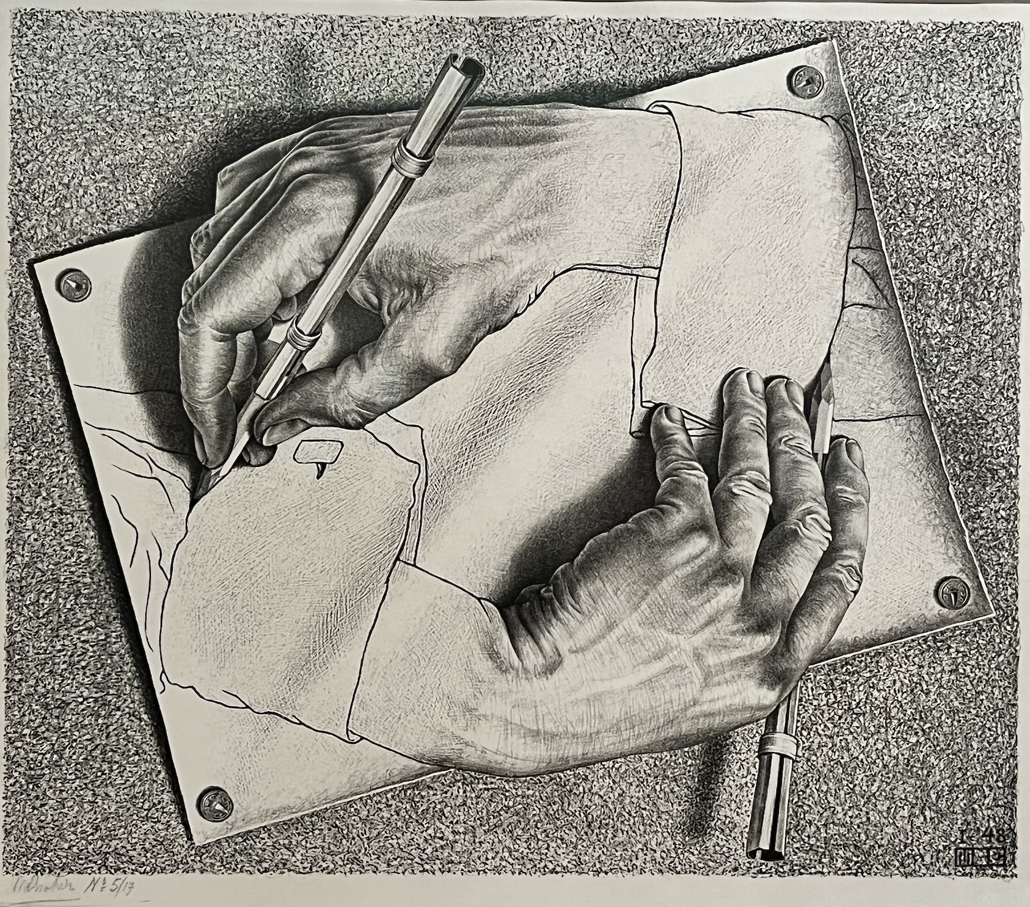
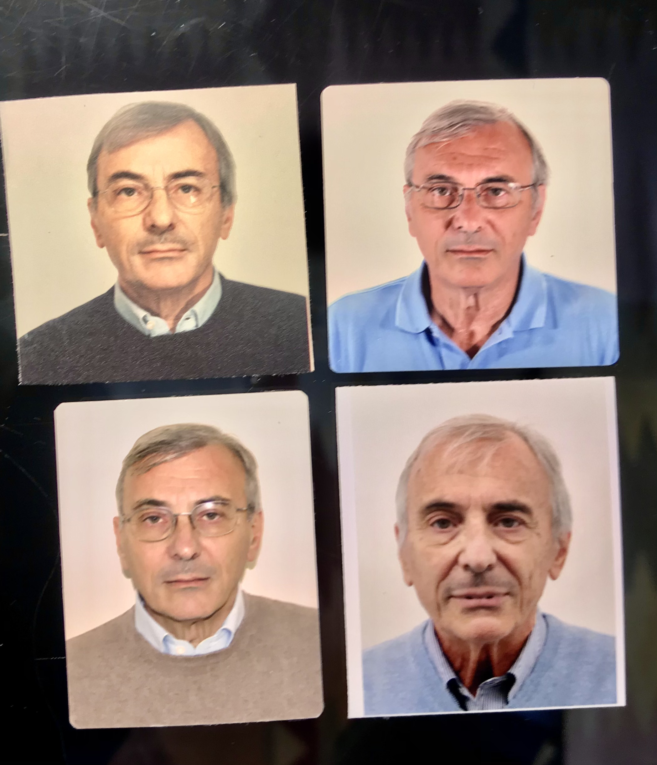
Craxì
HCV
La storia Siciliana dell’HCV

Slide 10
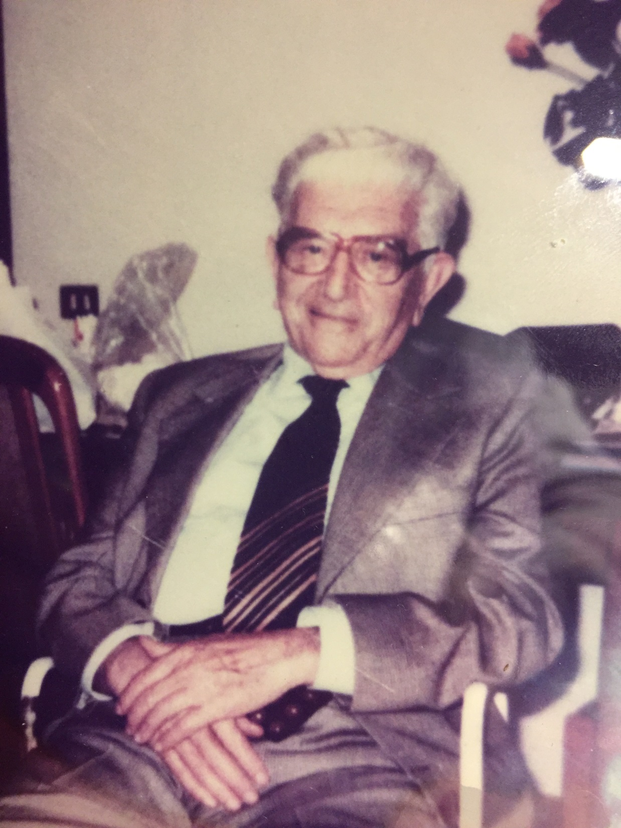
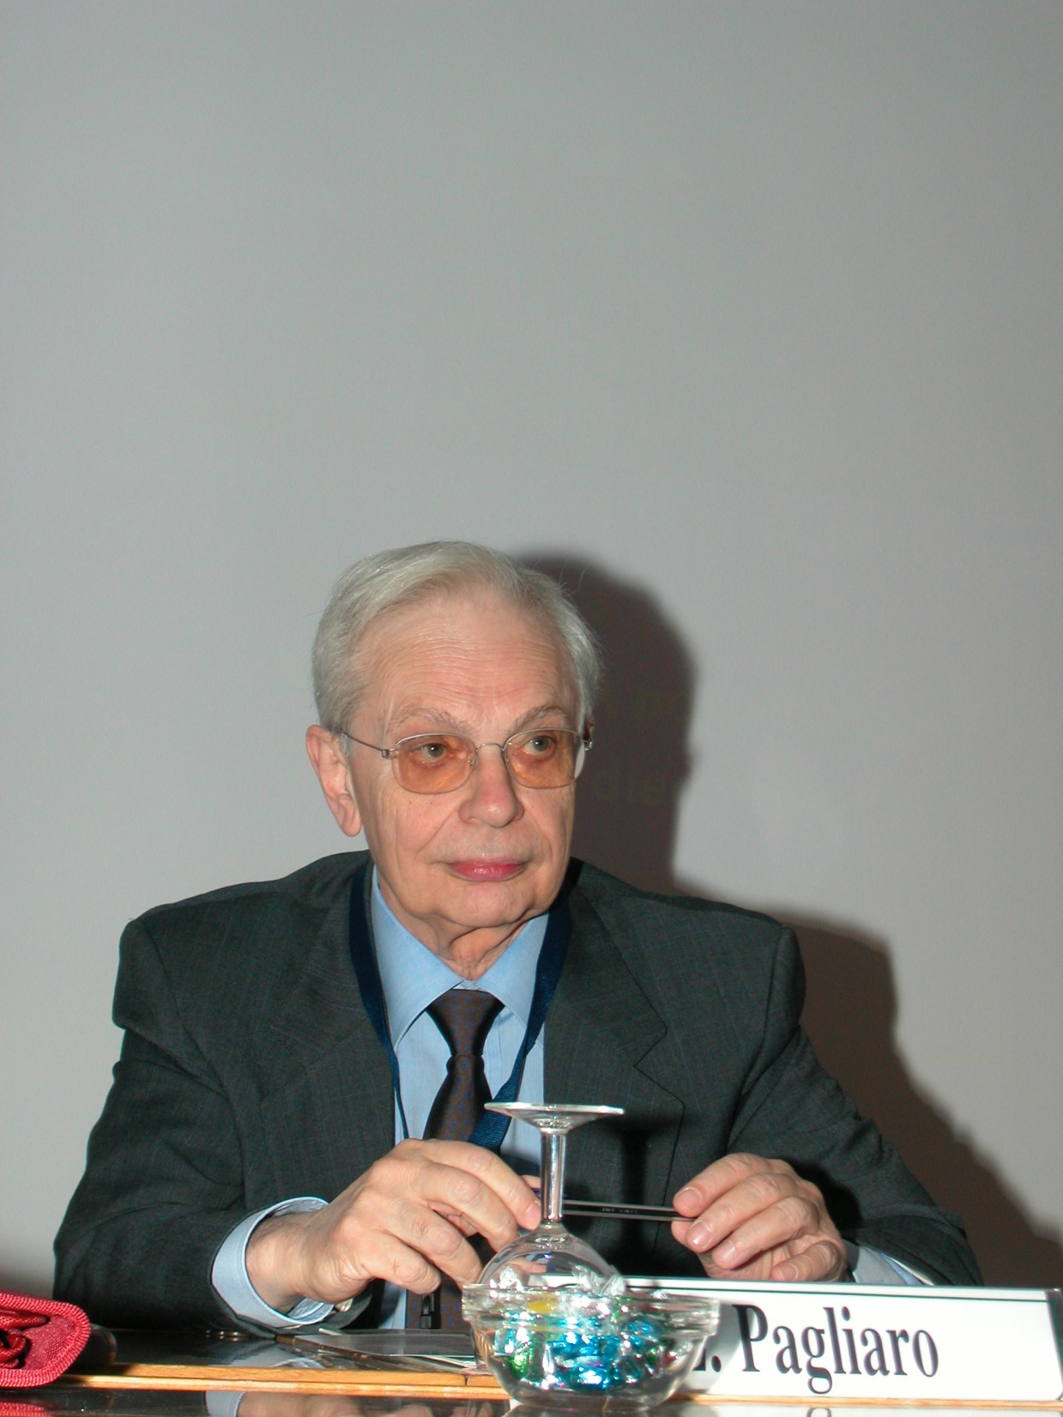
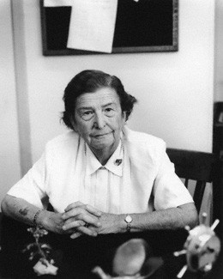
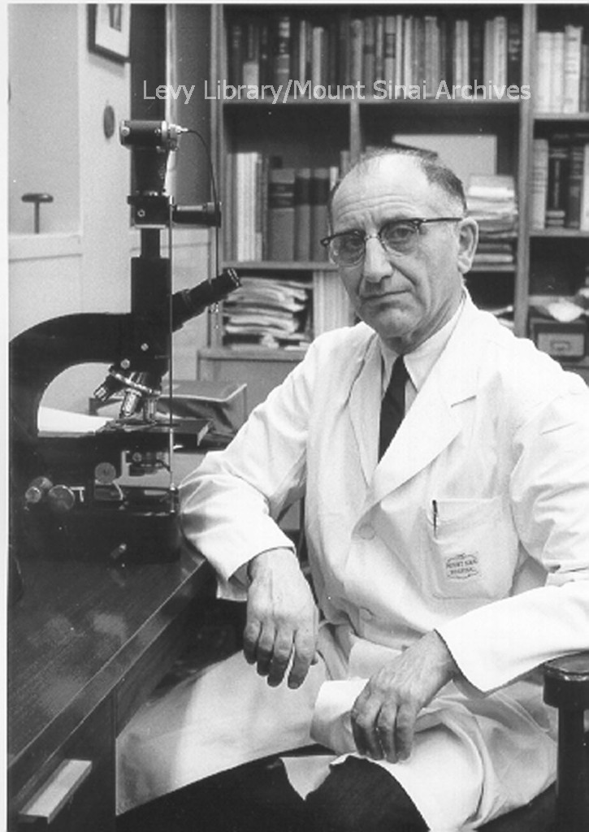
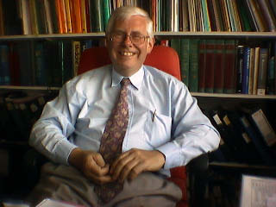
I Maestri
Prof. Paolo Craxì
Prof. Luigi Pagliaro
Prof. Sheila Sherlock
Siamo frutto dei geni, dell’educazione
e magari anche del caso
Clare Wilson
Internazionale 2 ottobre 2022
Prof. Hans Popper
Prof. Howard Thomas.

Slide 11
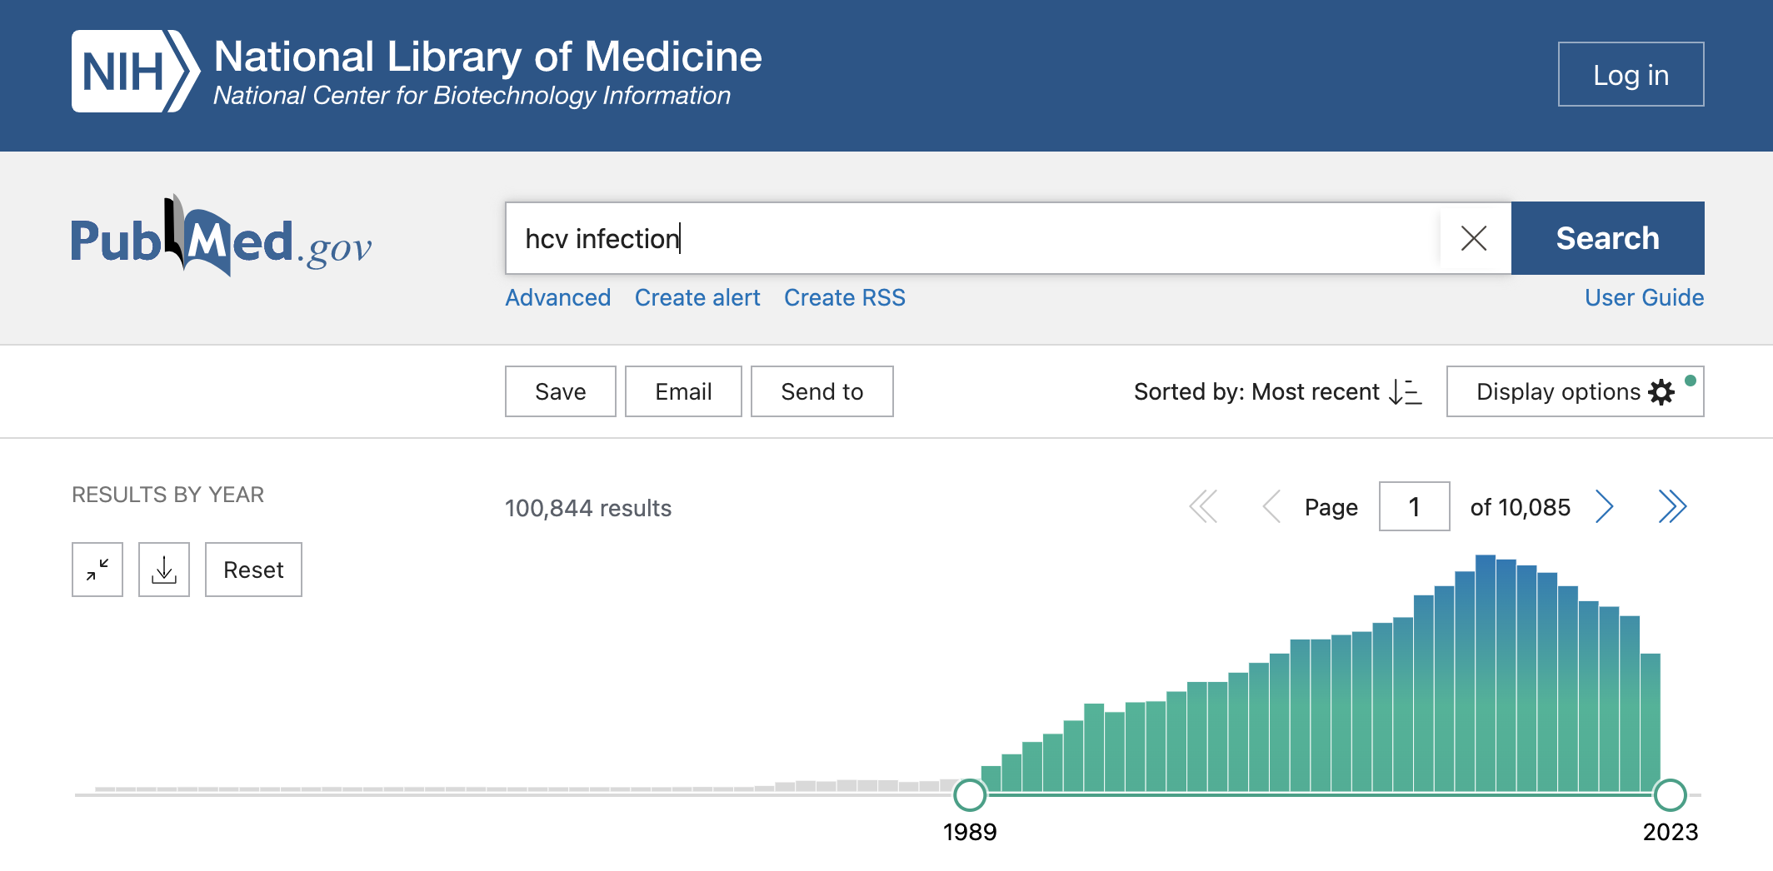

Slide 12
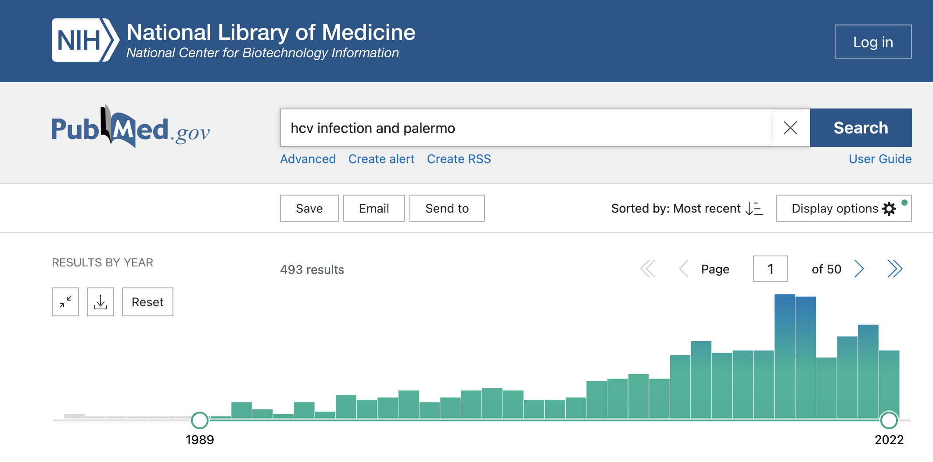

Slide 13
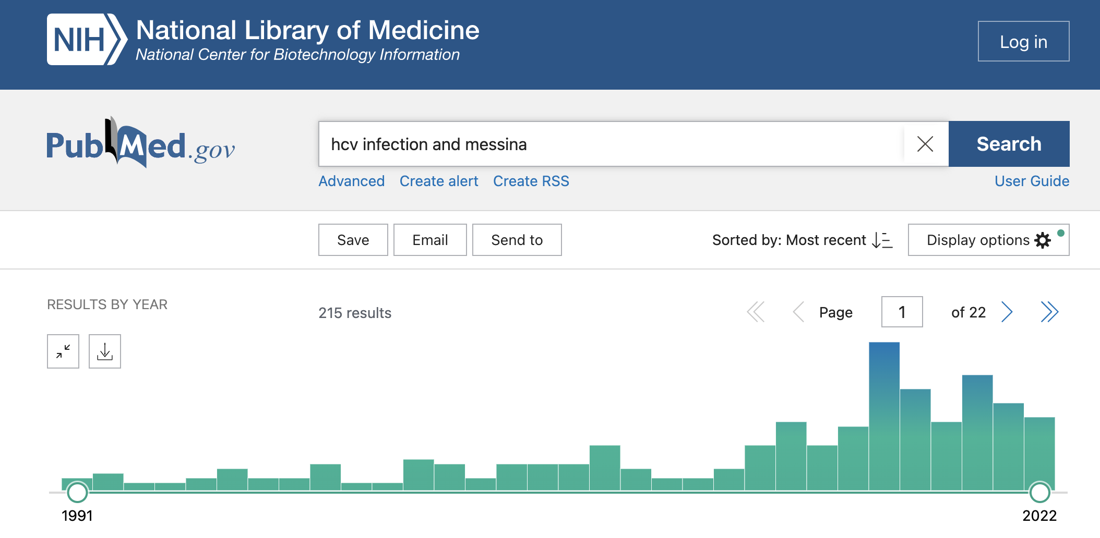

Slide 14
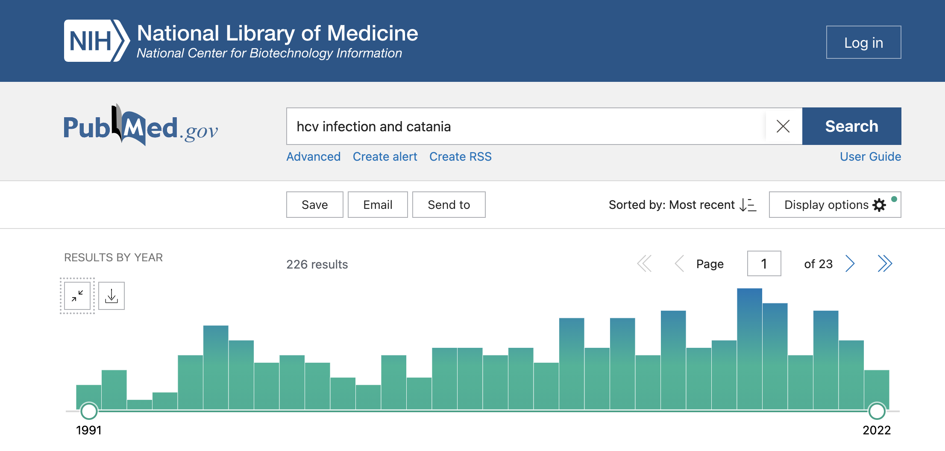

Slide 15
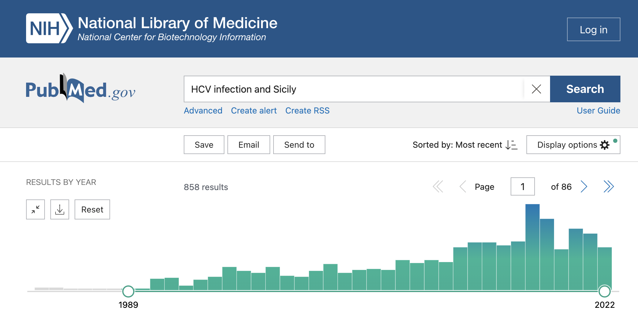

Slide 16
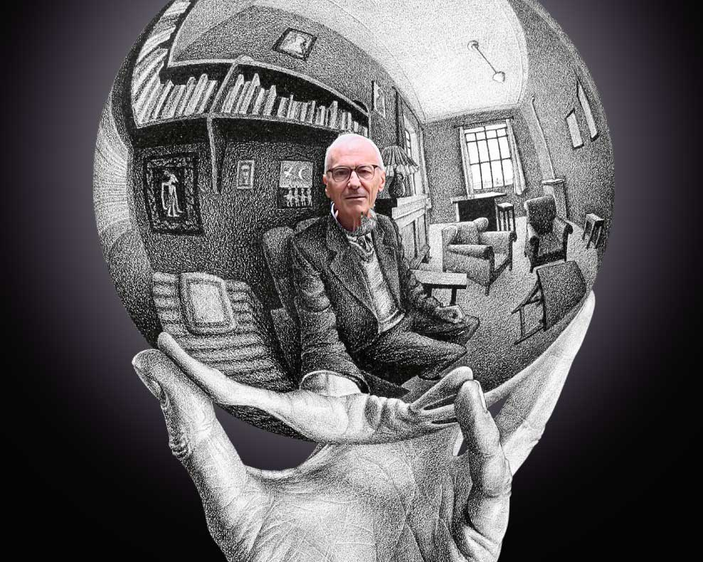

Slide 17
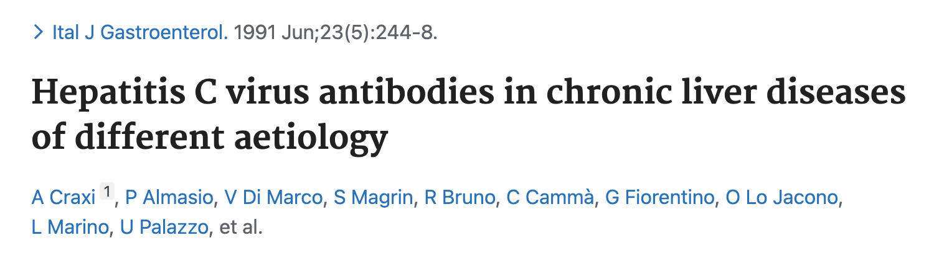
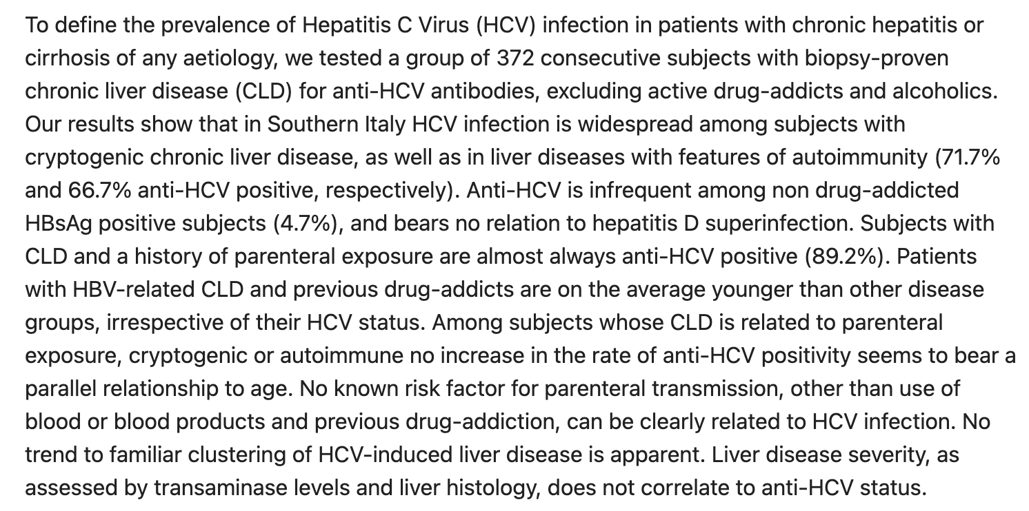
Il primo articolo

Slide 18
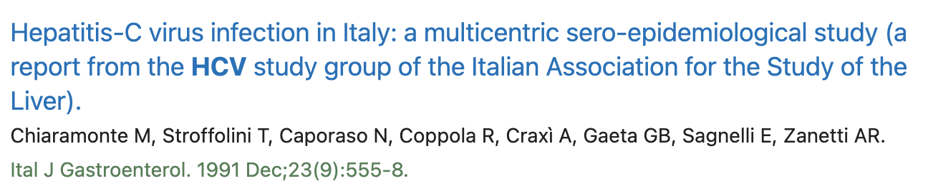
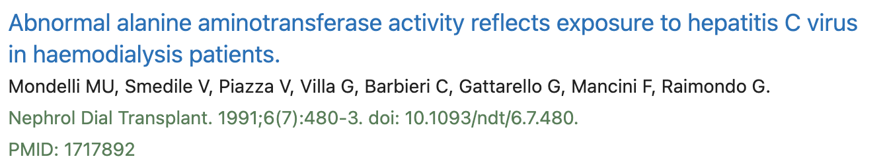
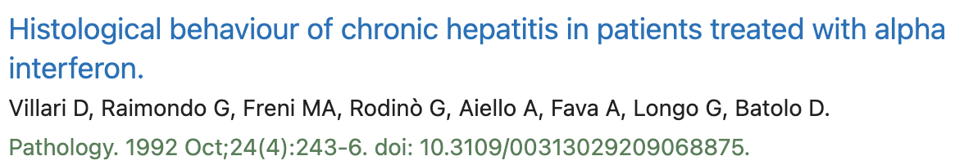

Slide 19
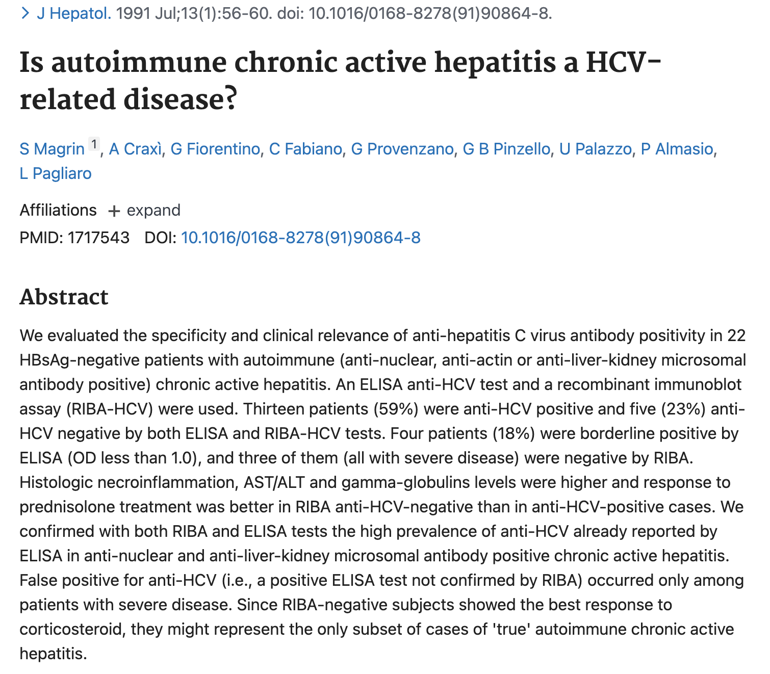
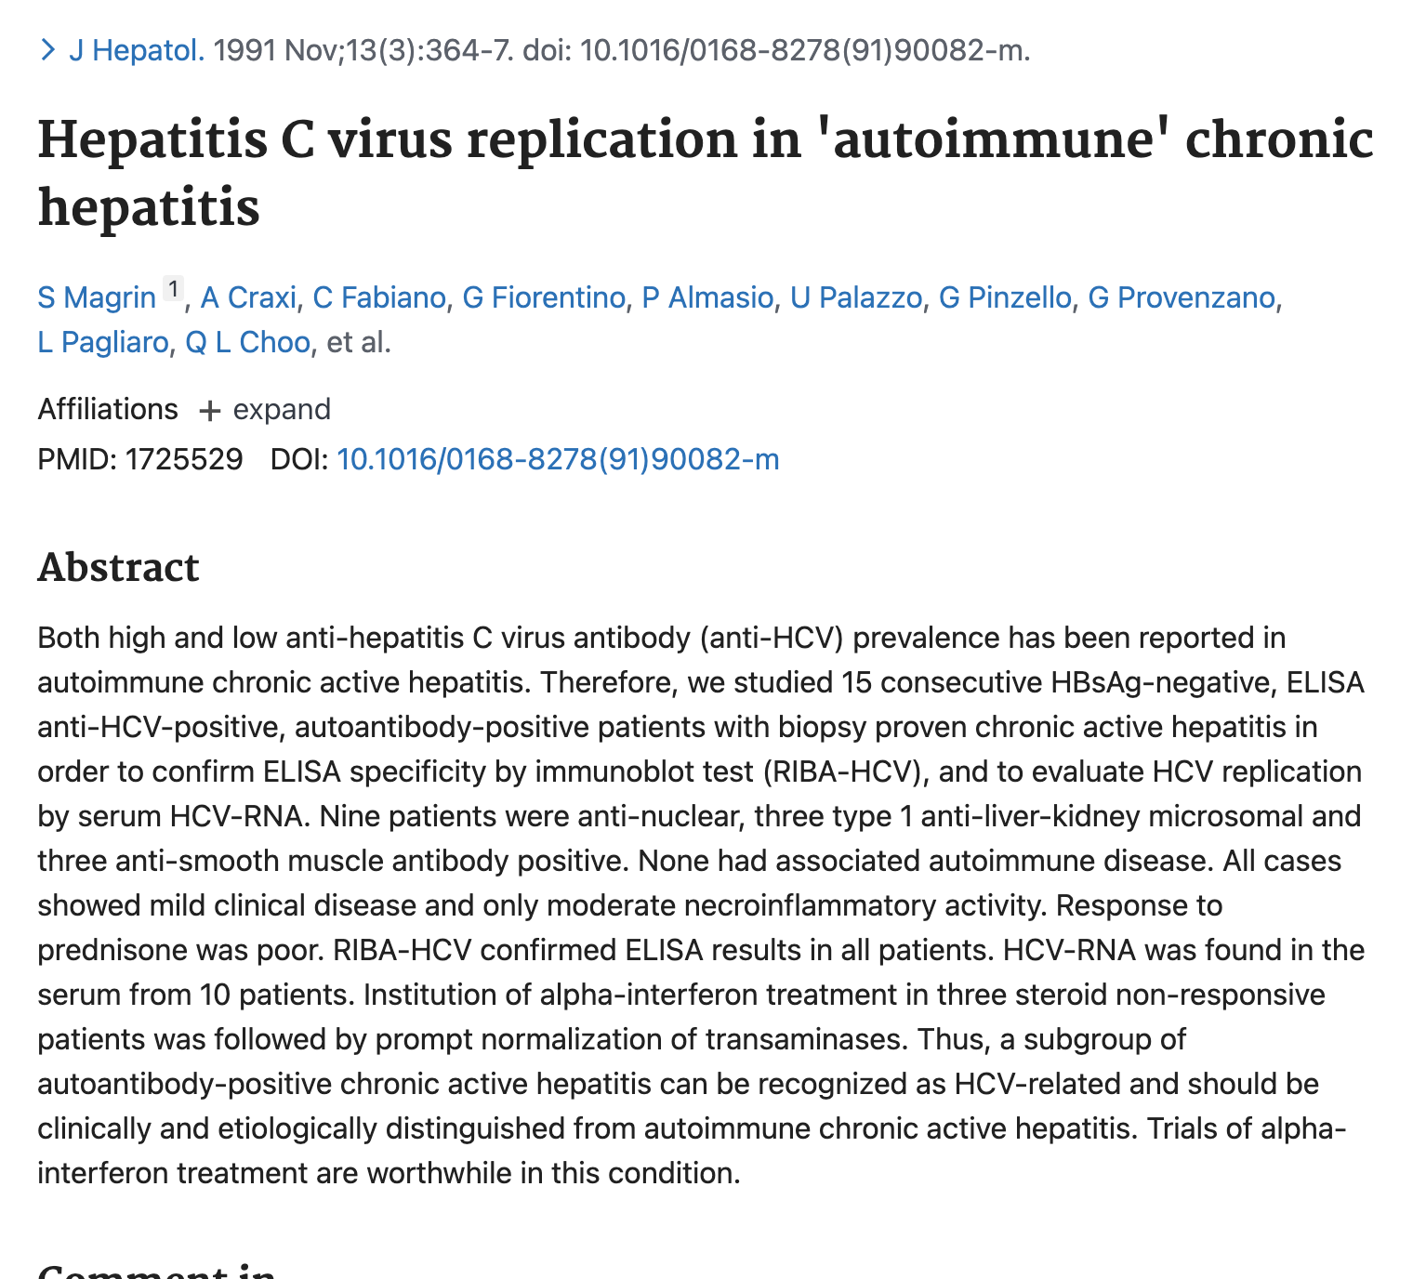
I primi tentativi sulla eziopatogenesi

Slide 20
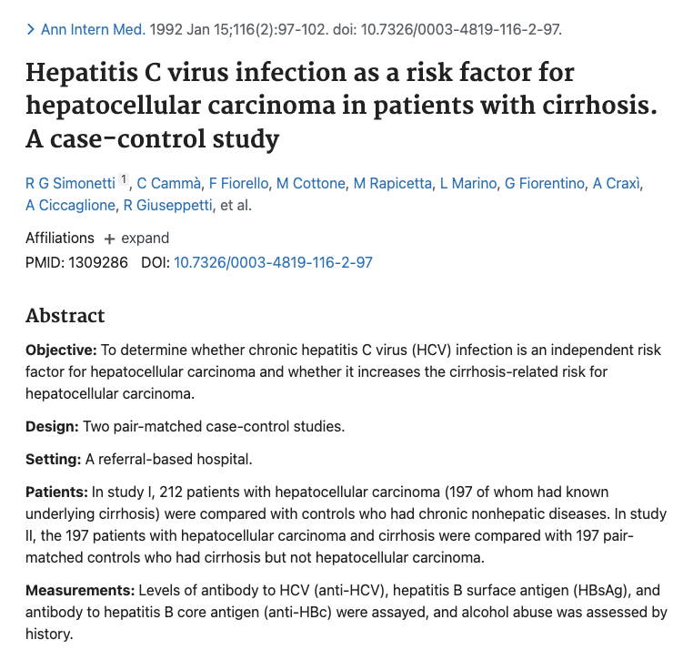

Slide 21
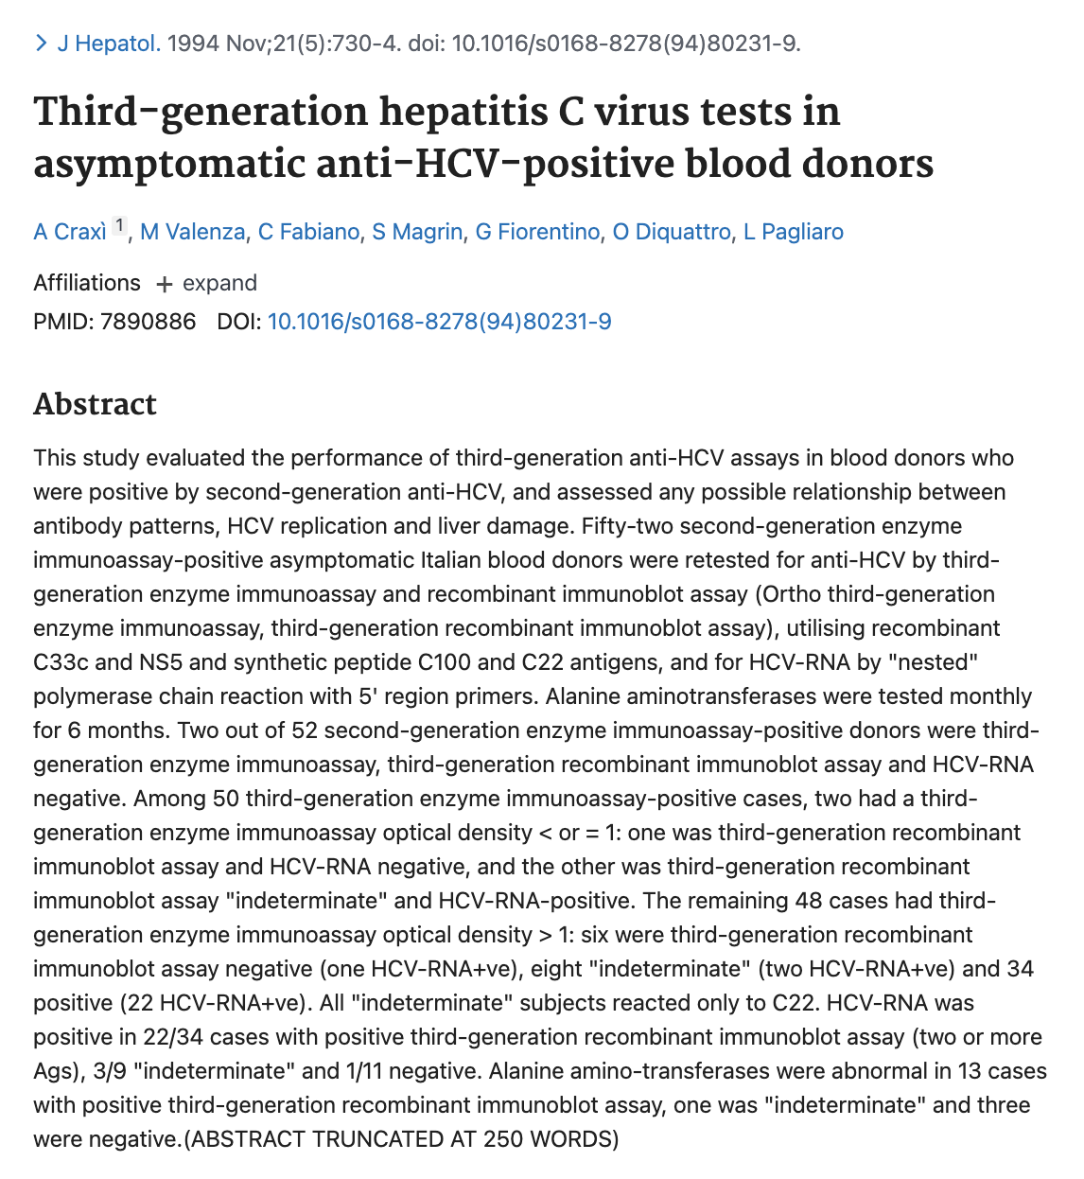

Slide 22
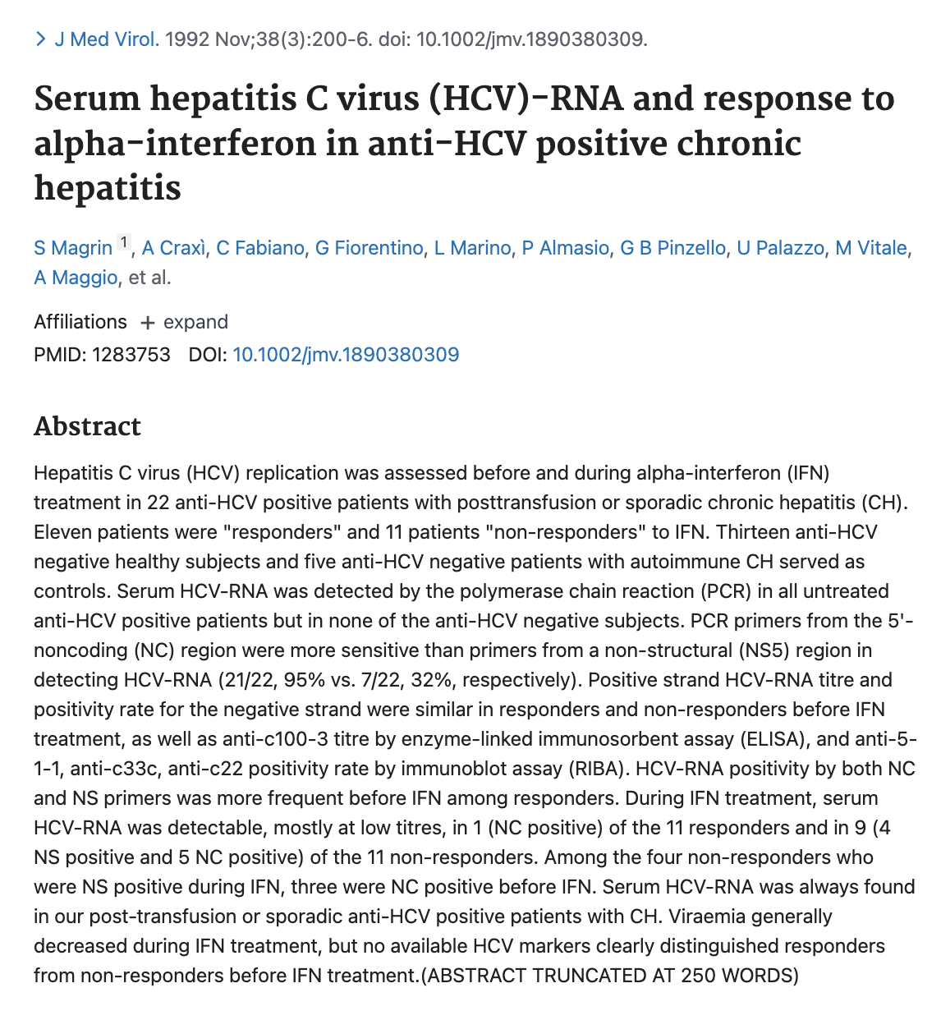
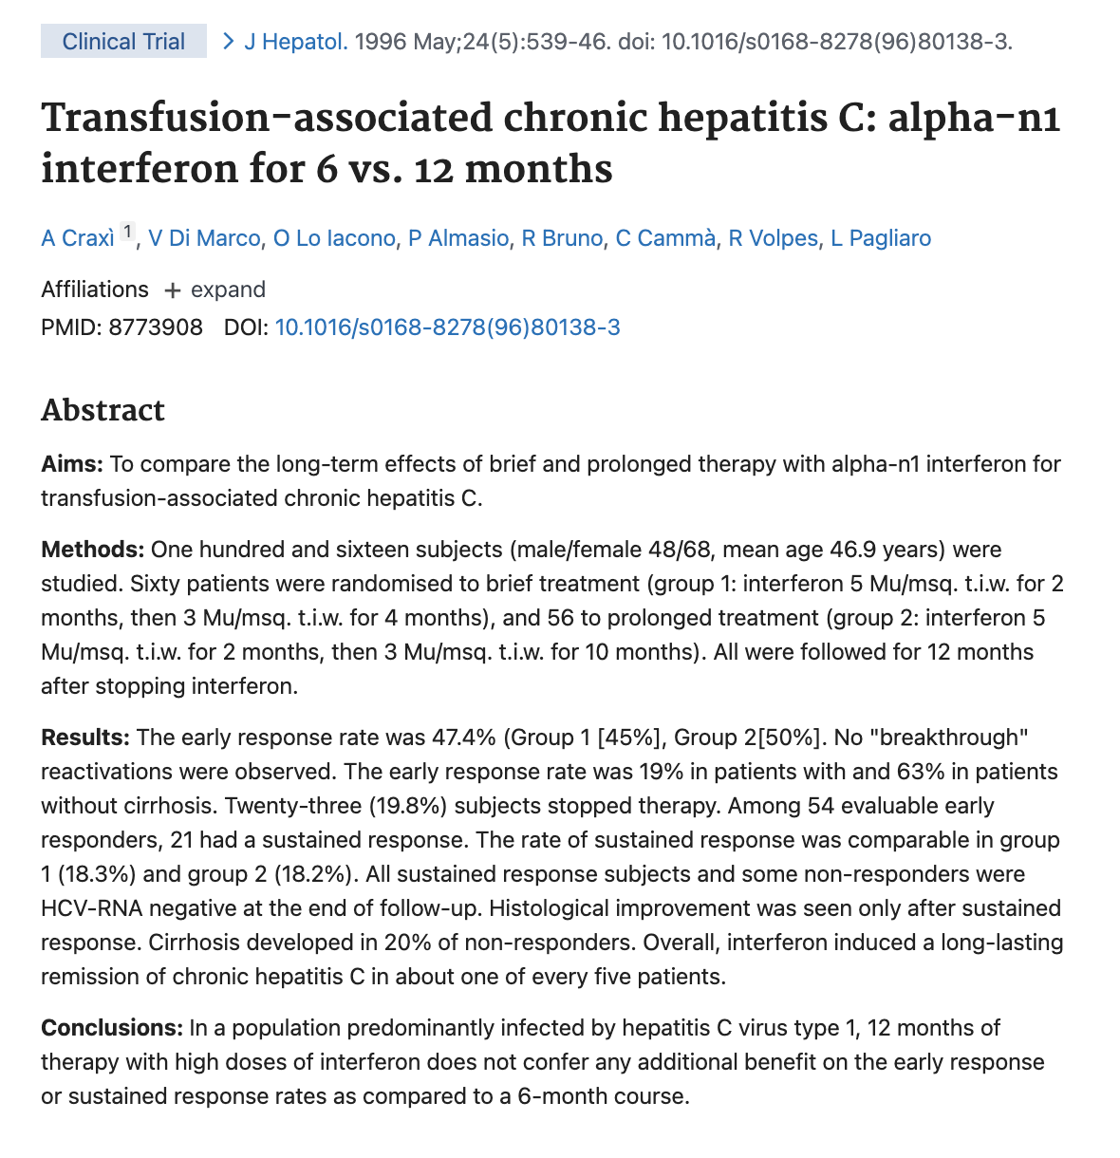
Le prime terapie: alfa-interferon

Slide 24
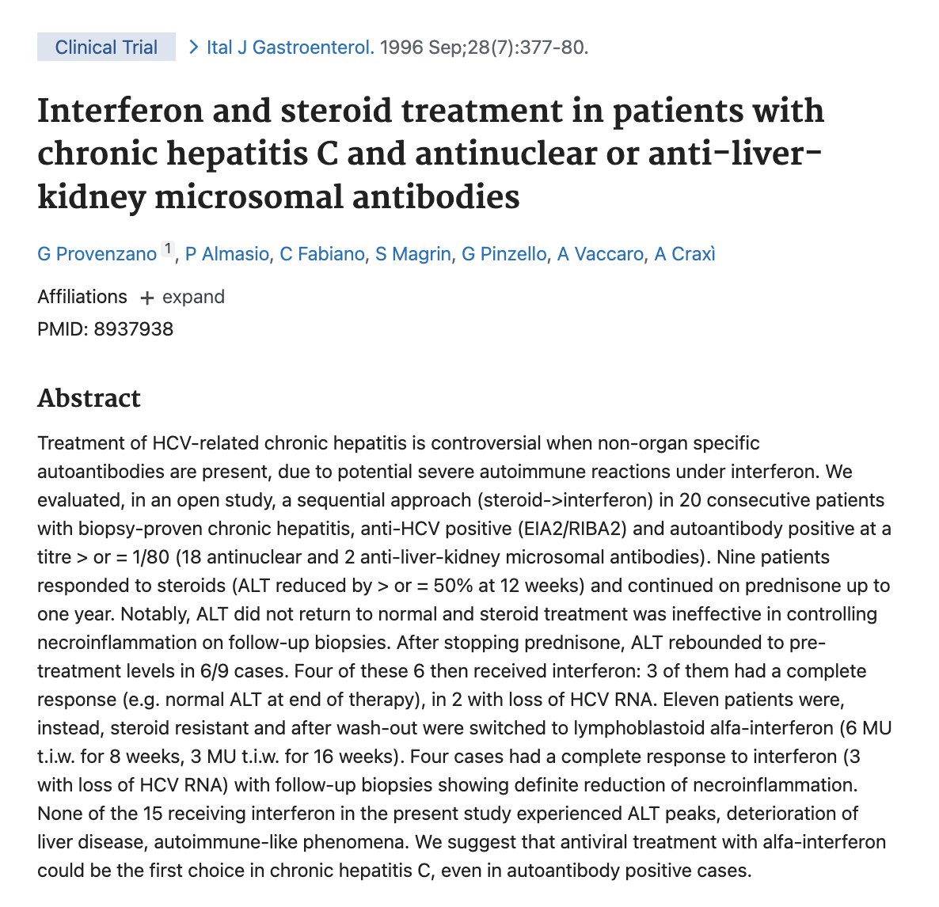

Slide 25
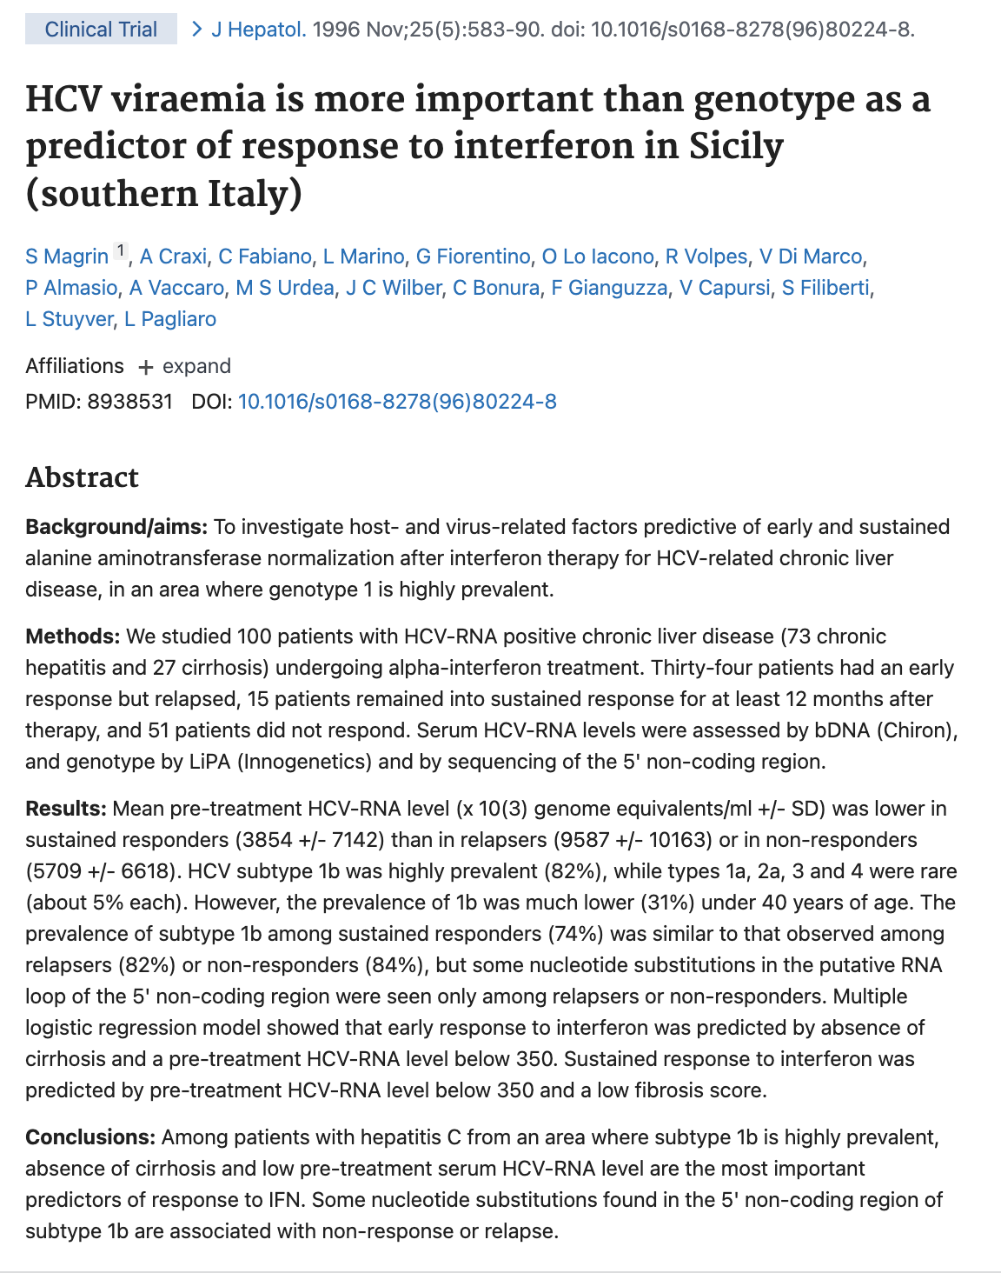

Slide 26
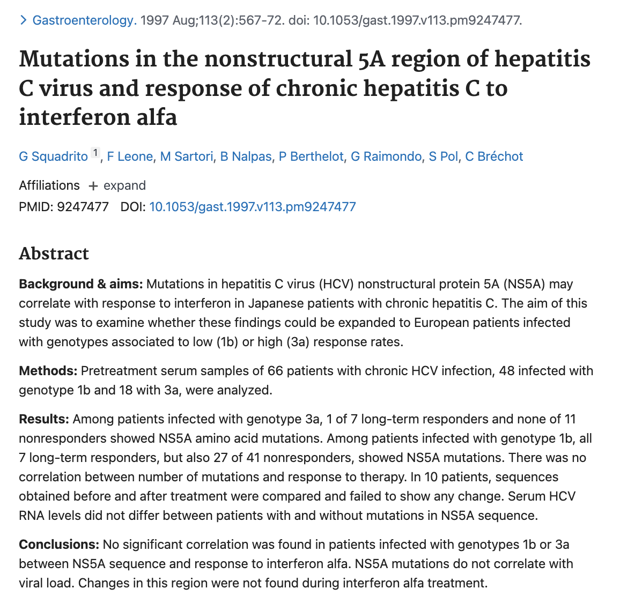

Slide 27
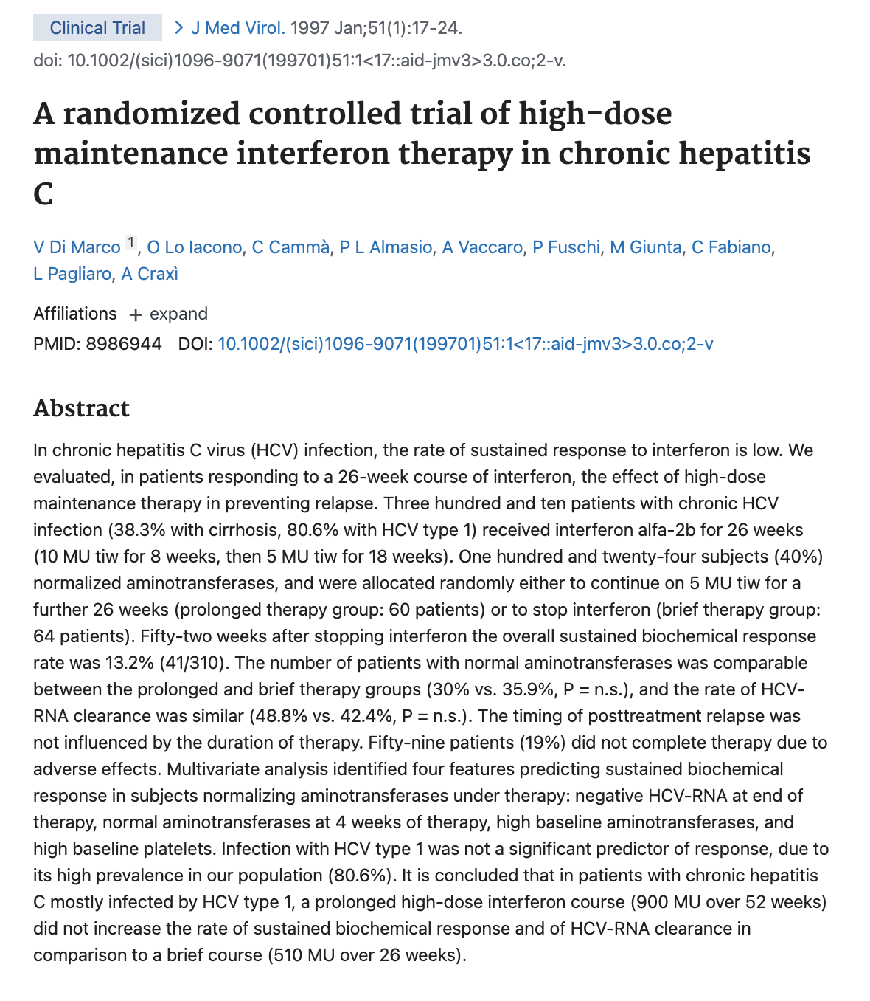
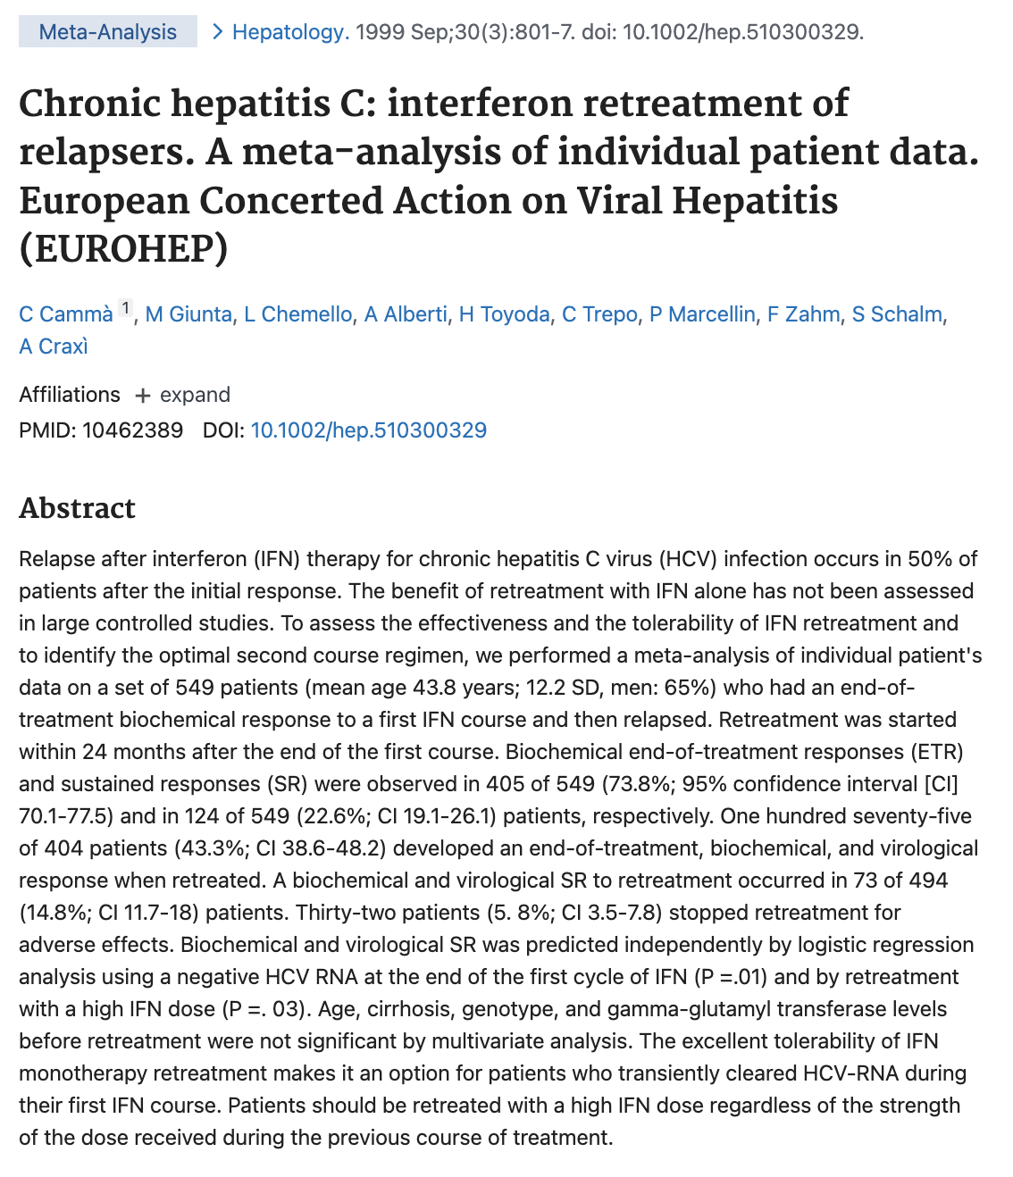
La prima meta-analisi

Slide 29
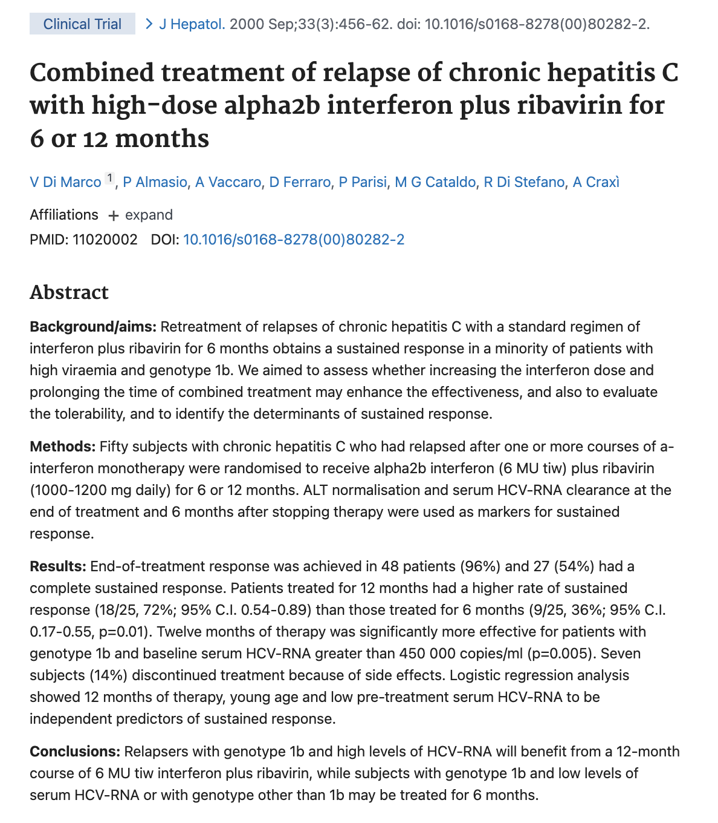
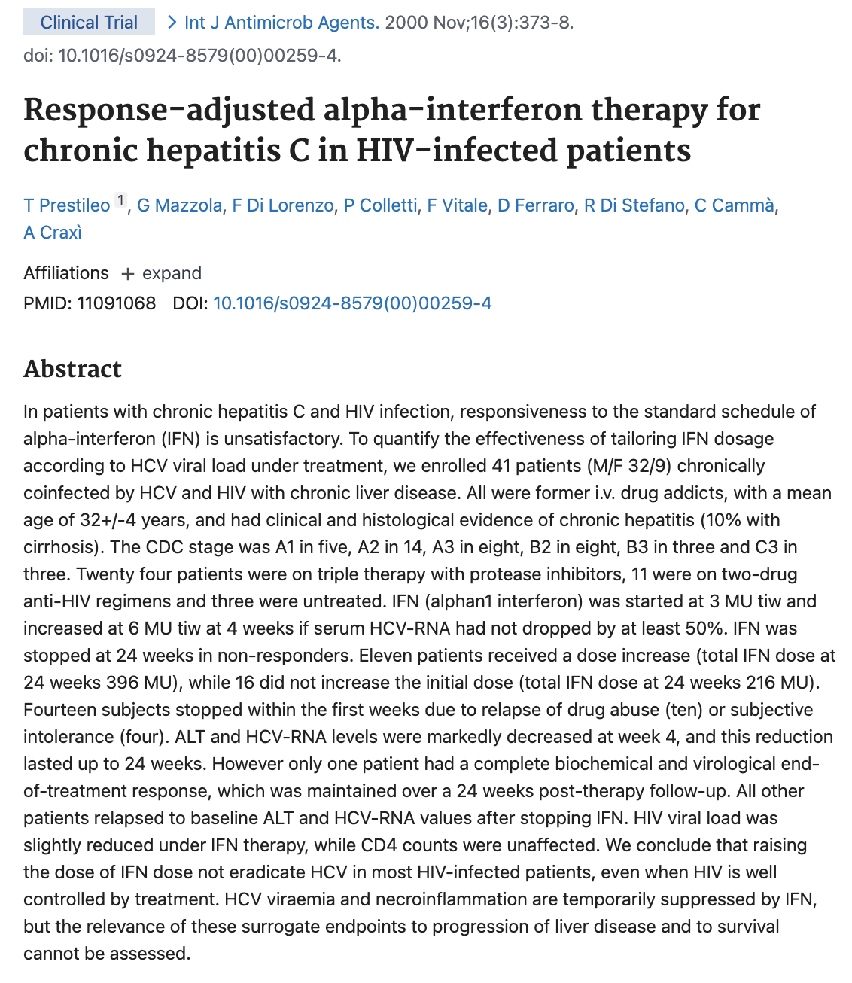
L’interferon e la Ribavirina

Slide 31
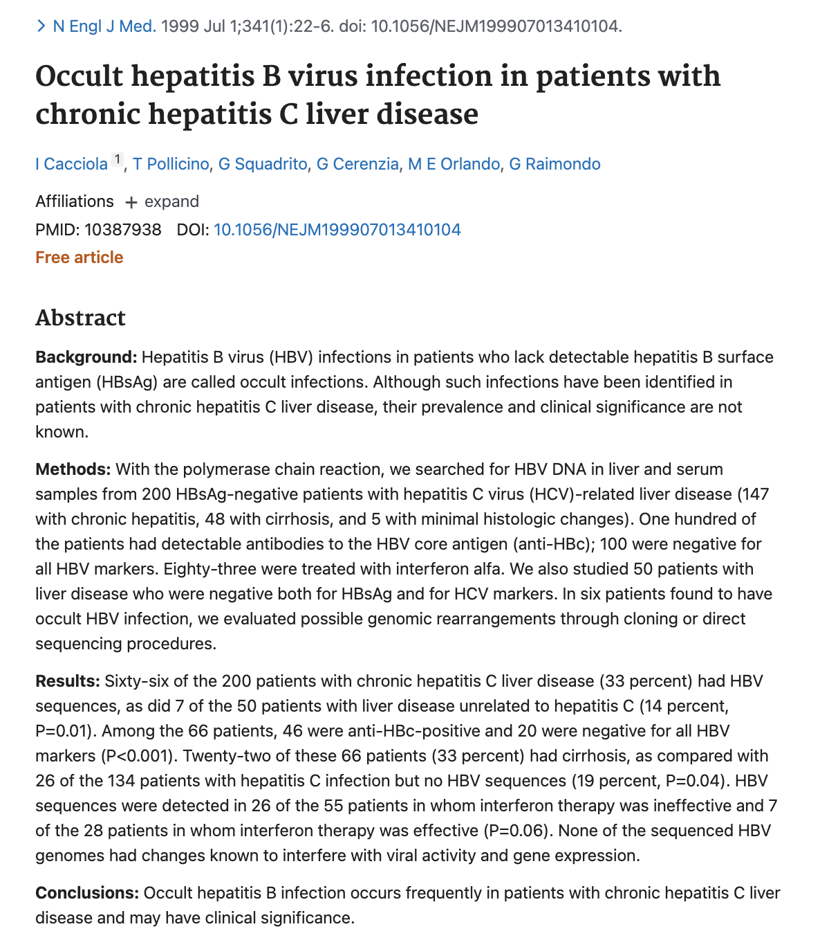
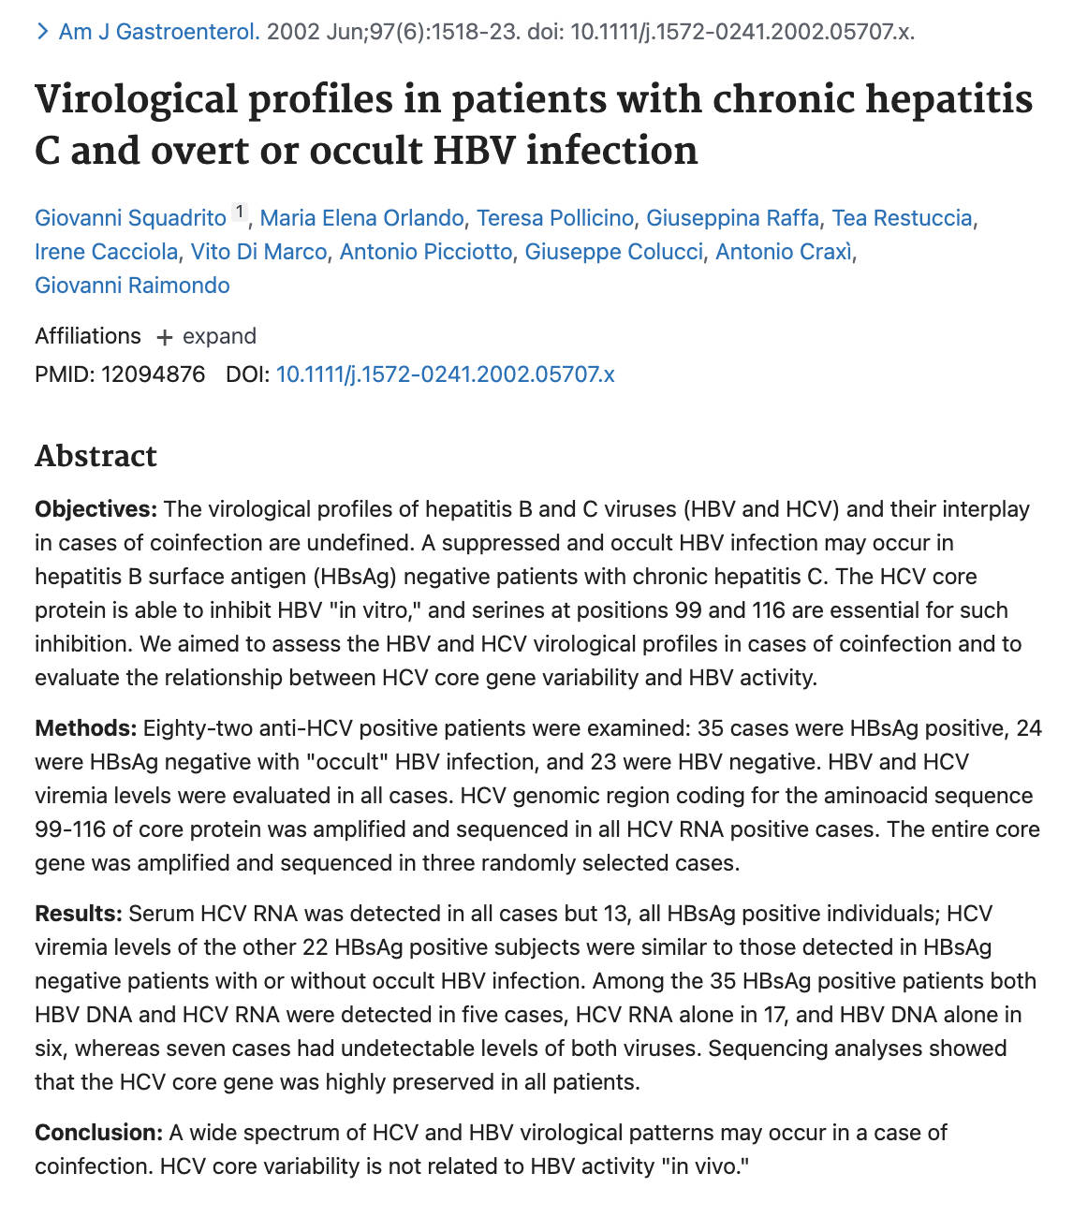
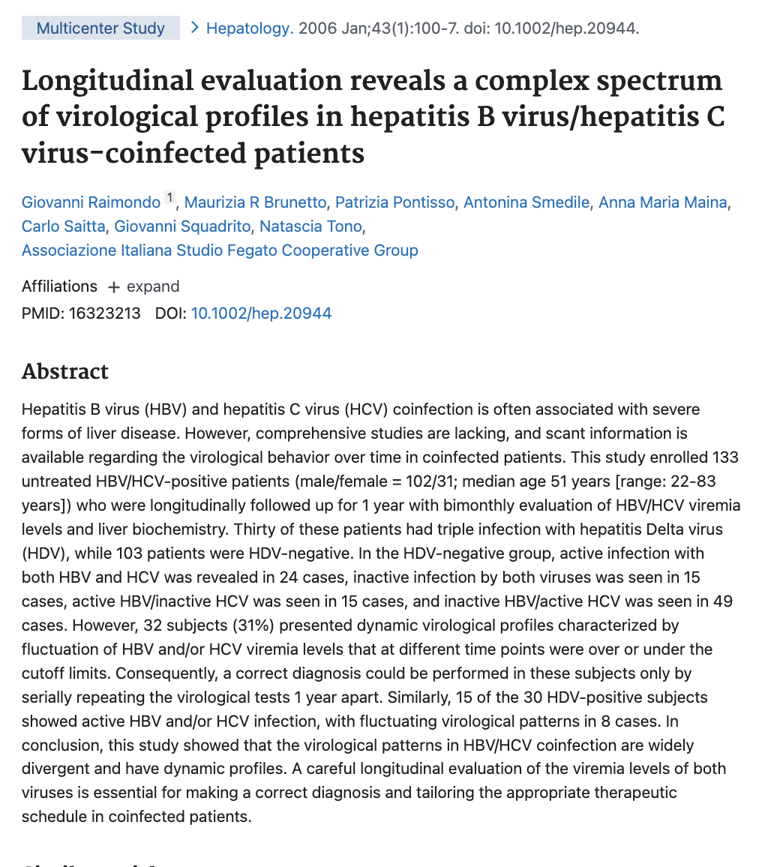
L’infezione occulta da HBV nei pazienti con epatite da HCV

Slide 33
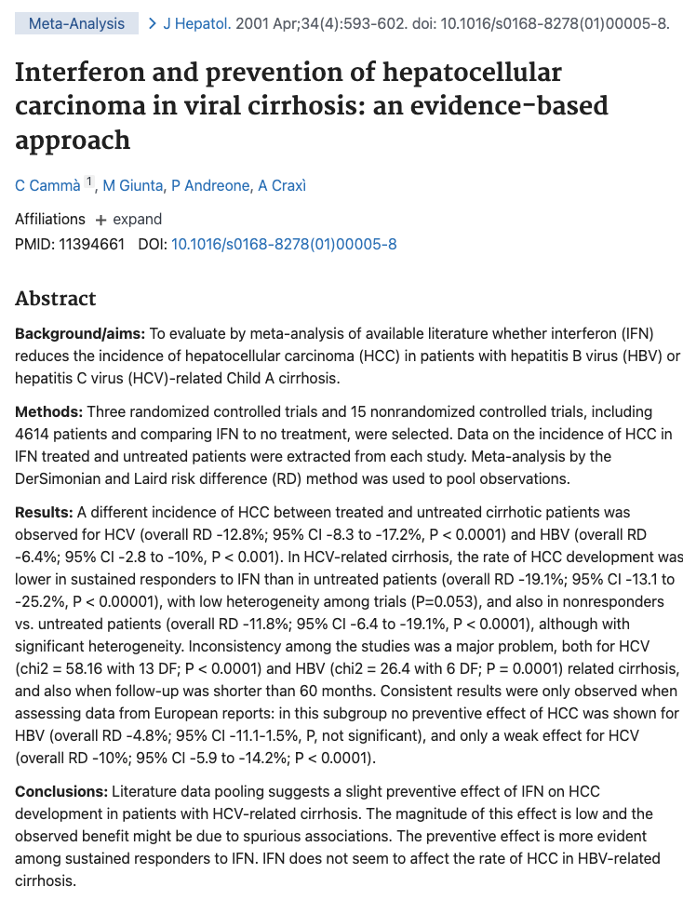

Slide 35
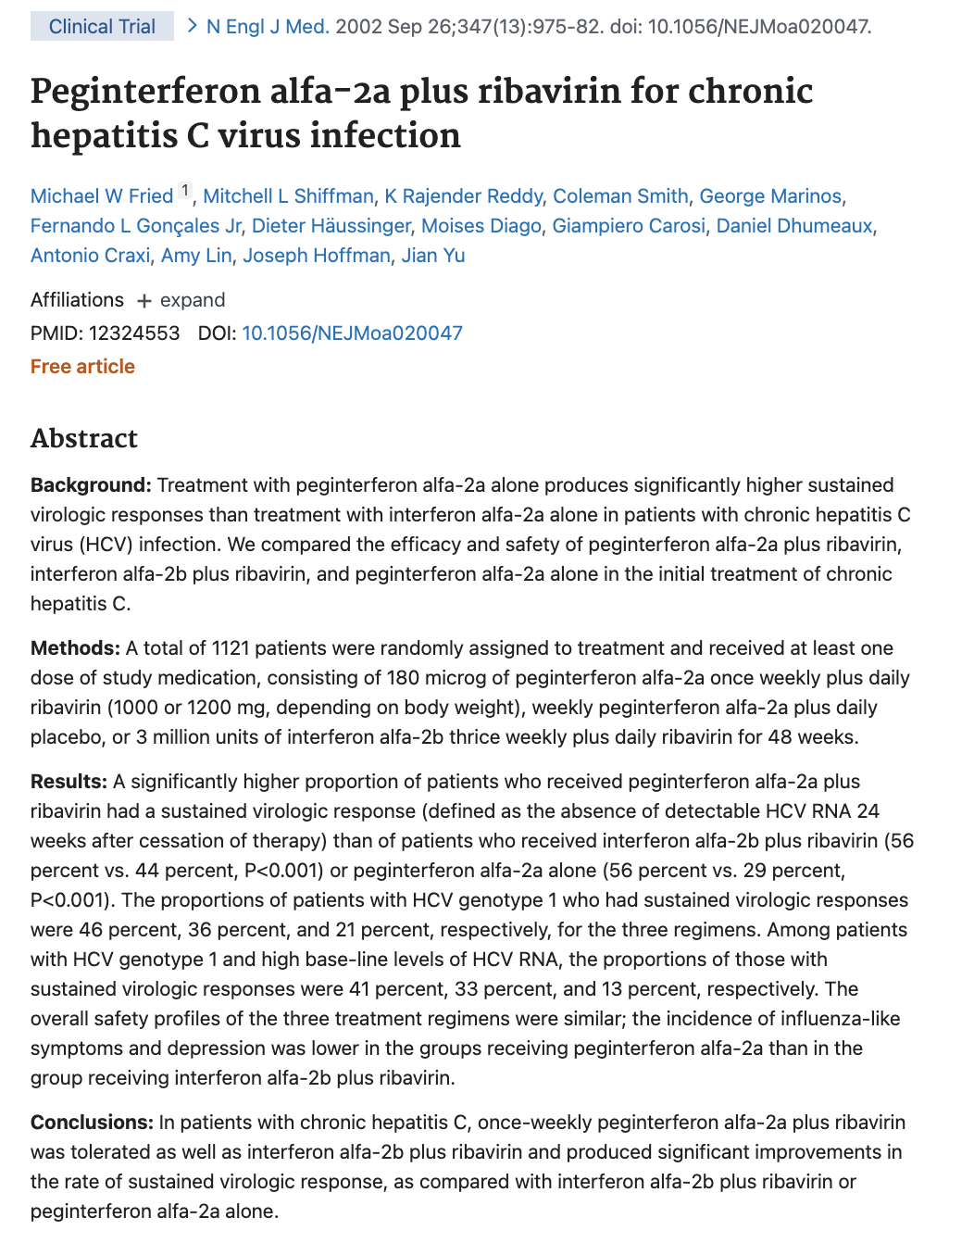

Slide 36
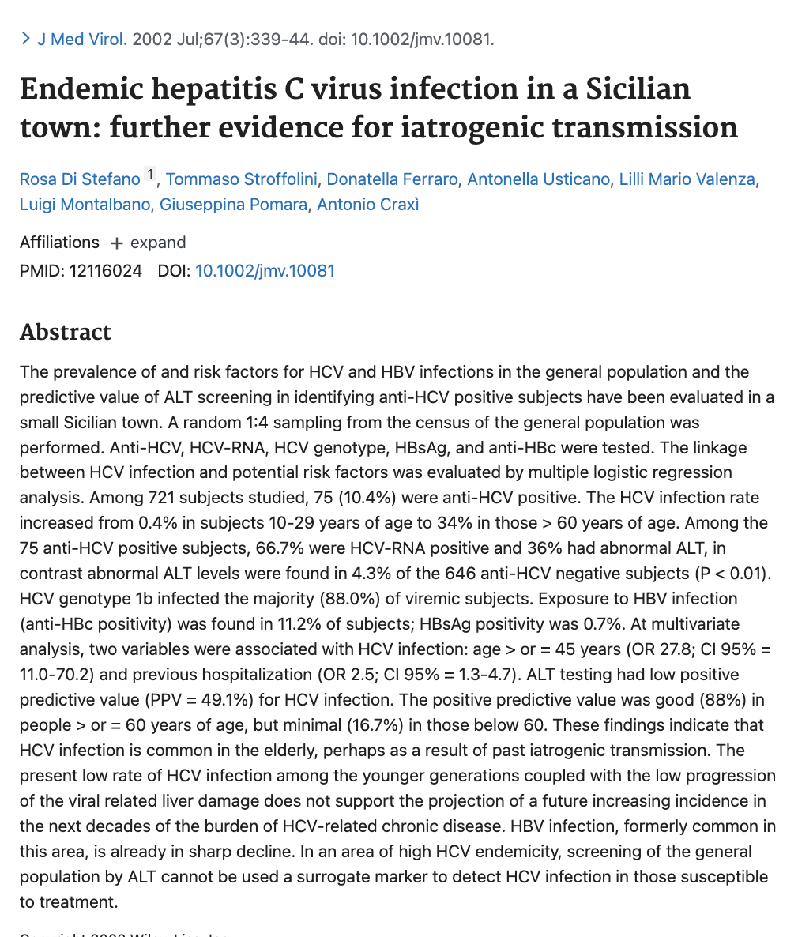
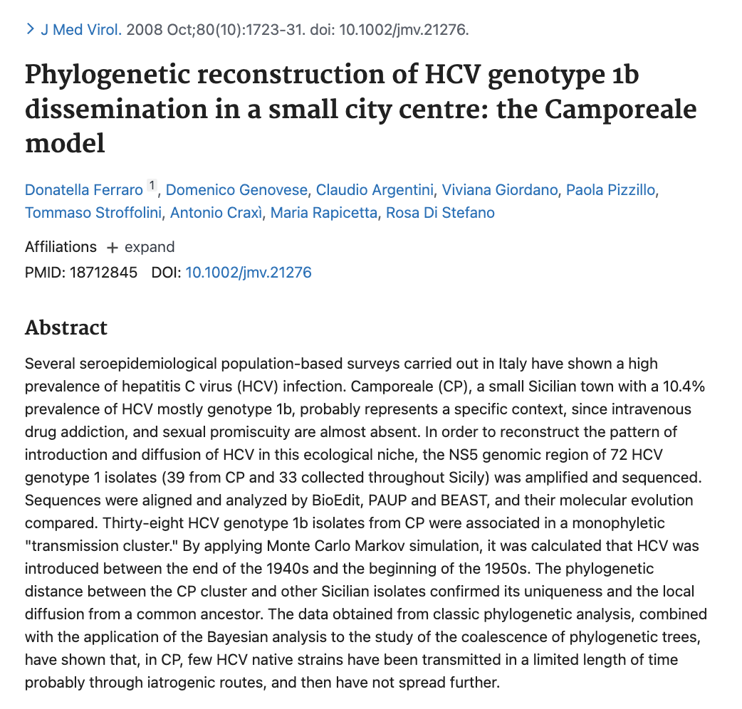

L’epidemiologia in Sicilia

Slide 37


Slide 39


Slide 40


Slide 42


L’epatite C e gli aspetti metabolici

Slide 44


Slide 45


HCV e Ipertensione portale

Slide 46


Slide 47


Slide 49


Slide 50


Slide 51


Slide 53


Slide 54


Slide 55


Slide 56


Slide 57



Slide 58


Slide 59


HCV e malattie cardiovascolari

Slide 61



Terapia per HCV e ipertensione portale

Slide 64



Slide 66


Slide 67


Slide 68


Slide 69


Trattamento antivirale e HCC I risultati di RESIST HCV

Slide 71


Slide 72


Slide 73


Slide 74


Slide 75


La collaborazione GRECAS-CLEO

Slide 77


Slide 78


Slide 79


Slide 80


Slide 81


Slide 82


Slide 83


Gli Studi RESIST HCV

Slide 86


Slide 87

L’infezione da virus epatitici nella popolazione migrante

Slide 88


Slide 89


Slide 91


Slide 92


Slide 93



Slide 94


Trend of Hospitalizations for HCV Liver Cirrhosis Trend of Hospitalizations for HCV Liver Cancer
Years: 2012-2015 2015-2019 Years: 2012-2015 2015-2019
Hospitalizations for HCV and HCV-related diseases in the last decade: data analysis of records of hospital discharge (SDO) at national level
Mennini FS, Sciatella P, Simonelli C, Marcellusi A, Kondili LA. EASL 2022 presentation (submitted manuscript)

Slide 95


Andamento del tasso di mortalità per Cirrosi epatica. Sicilia 2010-2018
Dati forniti dall’Osservatorio Epidemiologico dell’Assessorato della Salute

Slide 96


Andamento del tasso di mortalità per tumore del fegato. Sicilia 2010-2018
Dati forniti dall’Osservatorio Epidemiologico dell’Assessorato della Salute

Slide 97

Quattro generazioni di epatologi a Palermo

Slide 98


Slide 99

Old soldiers never die, they just fade away….

