Slide 1




Come abbiamo contribuito: NAFLD
Salvatore Petta
Gastroenterologia, PROMISE,
Università di Palermo salvatore.petta@unipa.it

Slide 2
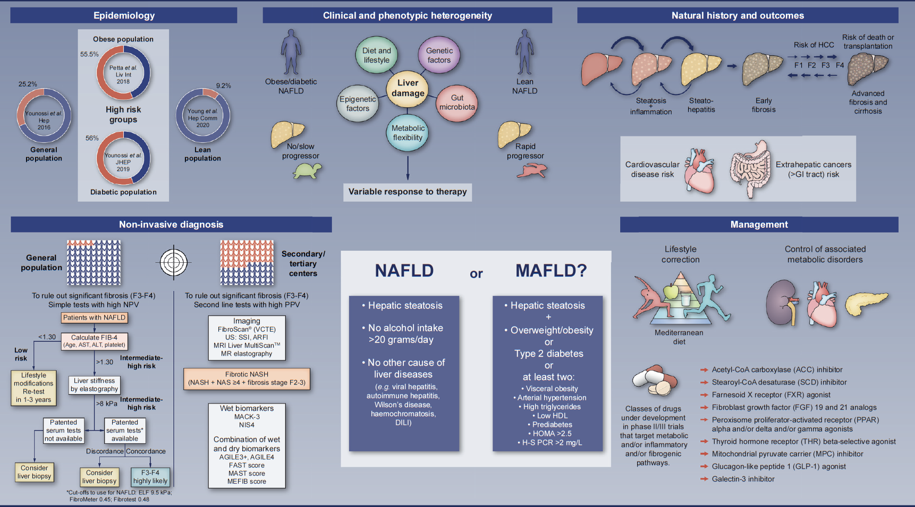

NAFLD

Slide 3
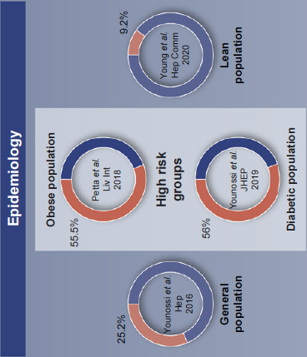
NAFLD Epidemiology

Slide 4


The Epidemic of NAFLD:
Data from Palermo General Population
Petta S et al, Liv Int 2018

Slide 5
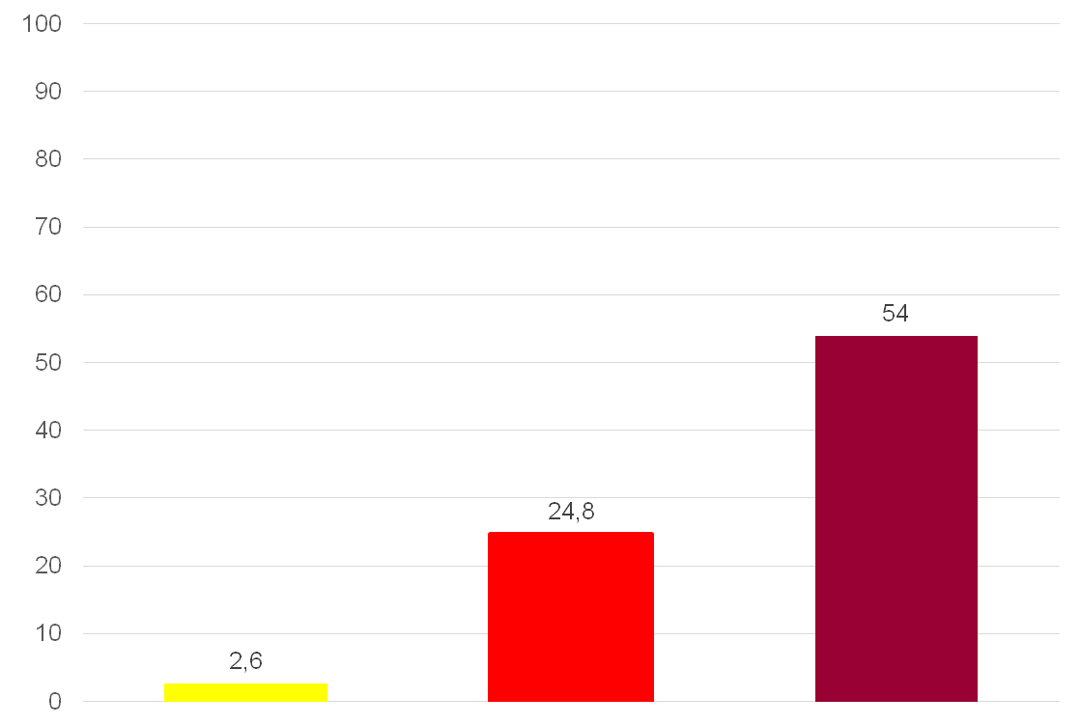
The Epidemic of NAFLD:
Data from Palermo General Population:
Obesity
Steatosis by CAP >288
Steatosis Prevalence
BMI <25
BMI 25-29.9
BMI ≥30
Petta S et al, Liv Int 2018

Slide 6
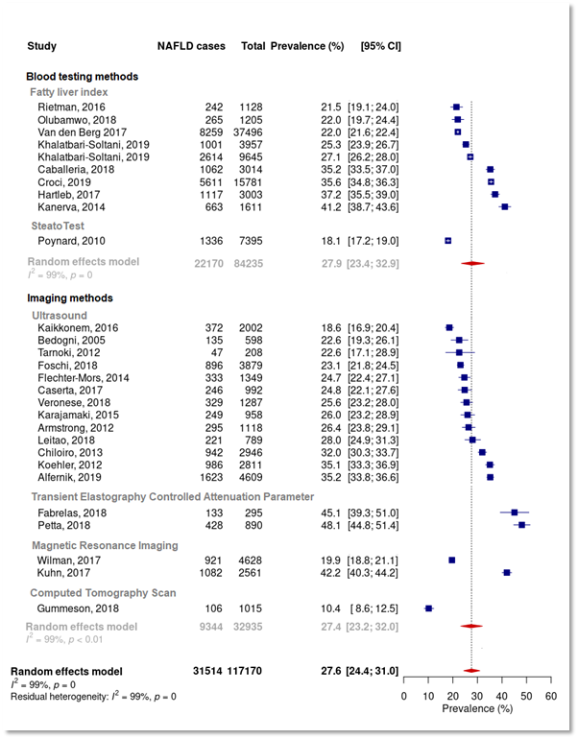
The Epidemic of NAFLD
NAFLD prevalence
in European studies
  Overall NAFLD prevalence estimated in the random effects meta-analysis model was 27.6% (95% CI 24.4 31.0; 28 studies) without difference by imaging or blood test methods
Petta S, et al. DILC 2020; THU053

Slide 7
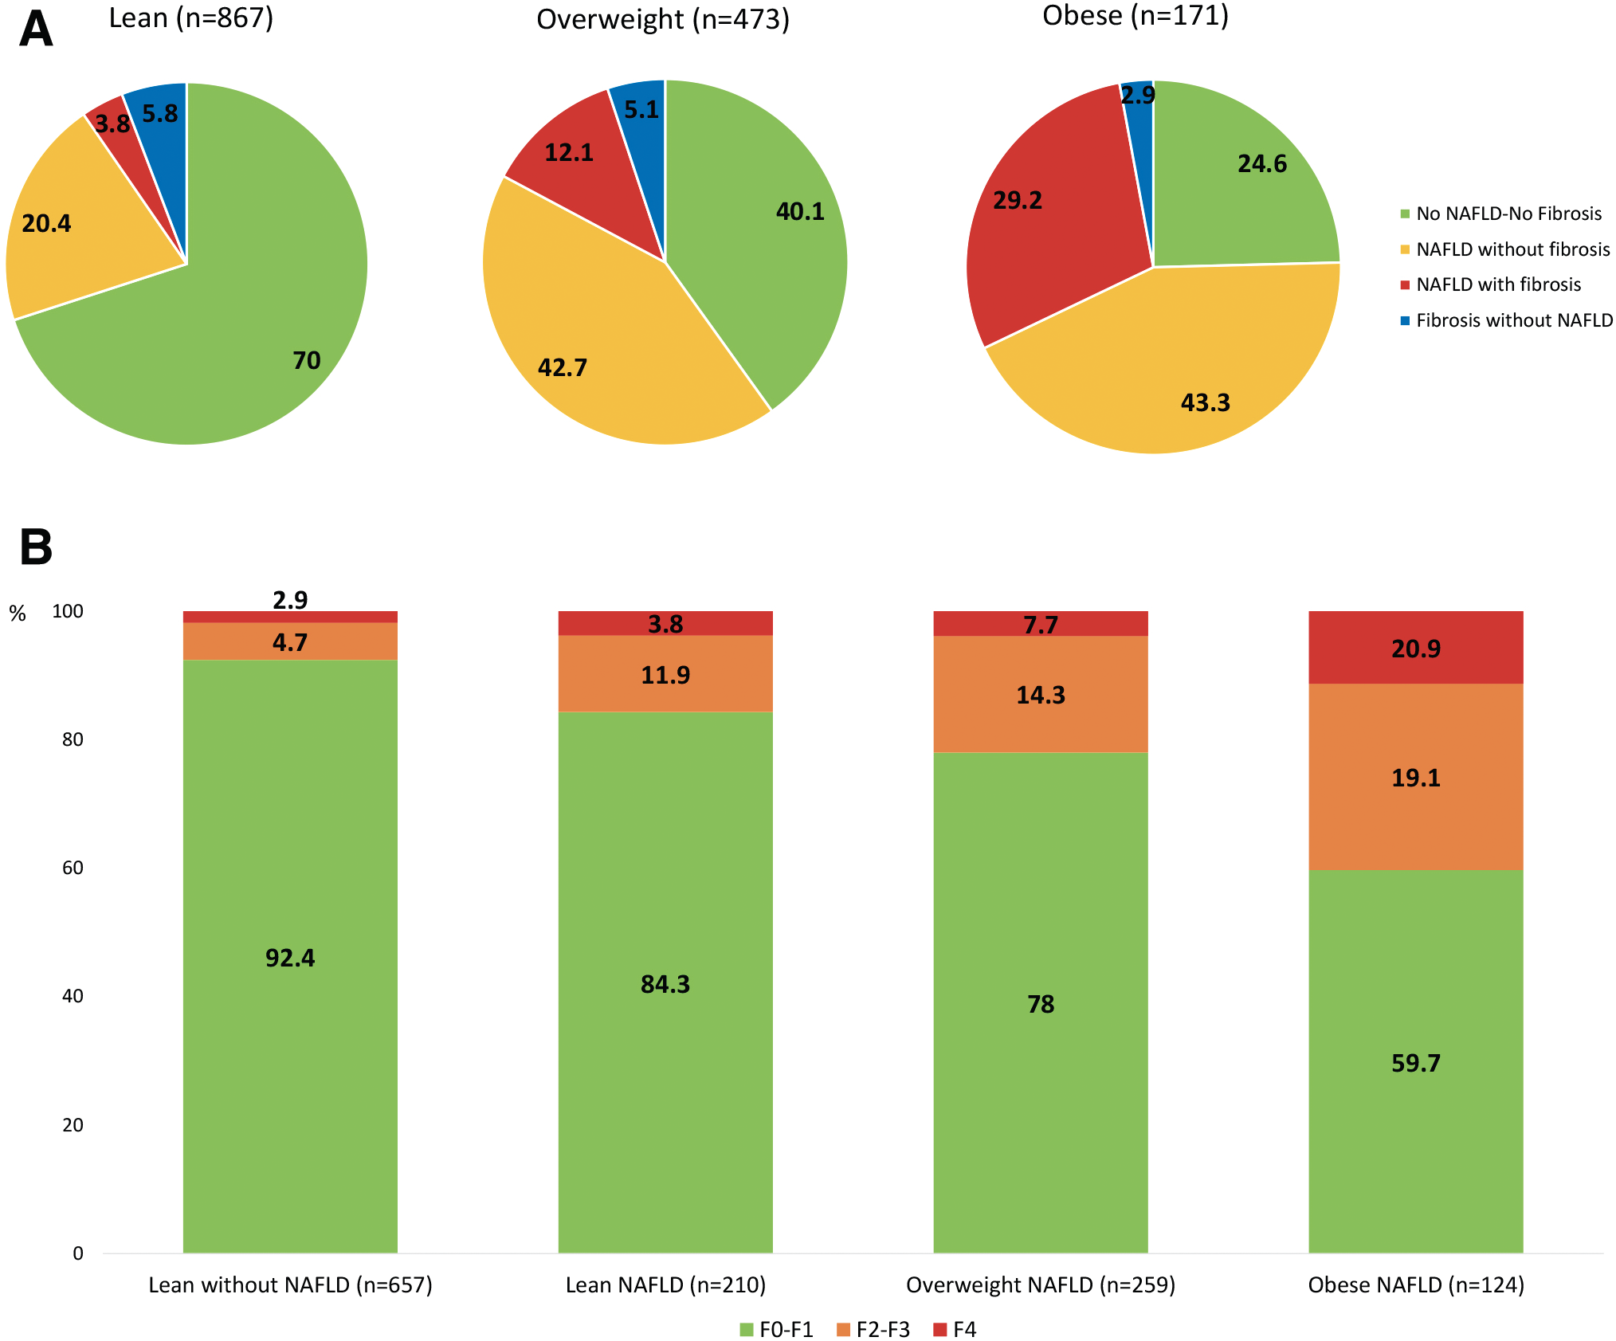
The Epidemic of NAFLD in HIV monoinfected patients
Cervo A, et al, Clin Inf Dis 2020

Slide 8
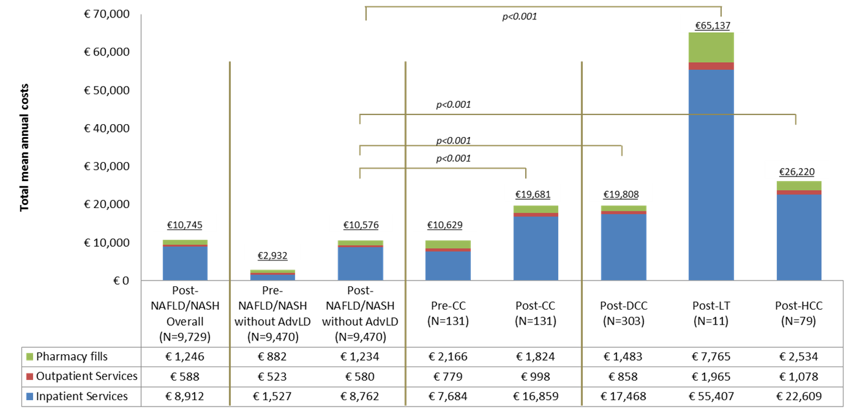
Mean Annual All-Cause Healthcare Costs by Liver Disease Severity in Italy
9,729 NAFLD patients from 2011 to 2017 identified by Administrative databases of Italian local health units
Mean per-patient total annual costs increased with disease severity
Post-index costs in patients with AdvLD is at least 86% higher vs. patients without AdvLD (p<0.001 for all)
Costs primarily driven by inpatient stays
Petta S et al, NMCD 2020

Slide 9
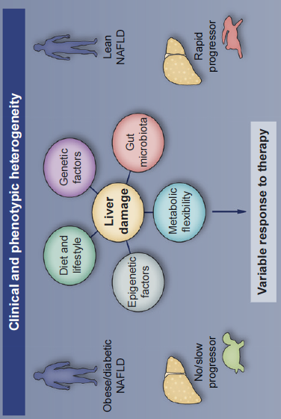
NAFLD Risk Factors
Petta S and Bugianesi E, JHEP 2022

Slide 10
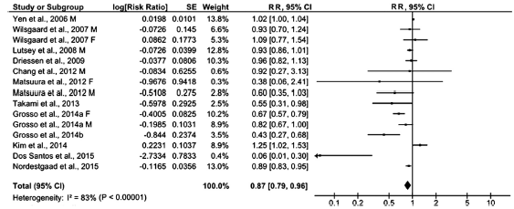
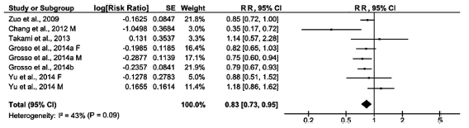
Coffee, Tea and Risk of MS/NAFLD
High vs Low Coffe Intake
High vs Low Tea Intake
Marventa, Salomone et al, Clin Nutr 2016

Slide 11
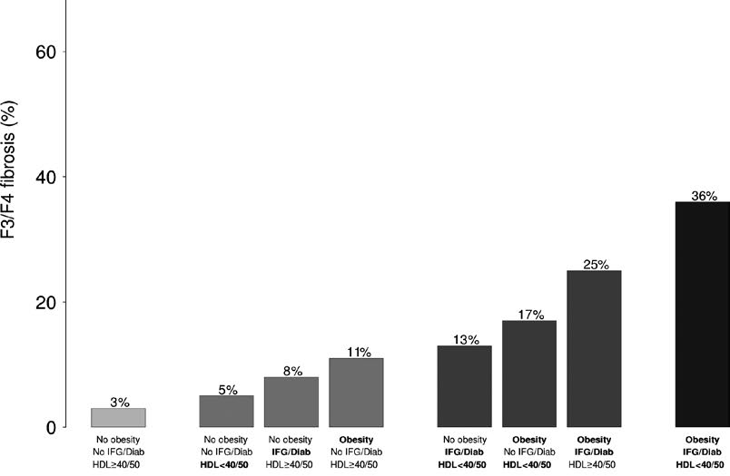
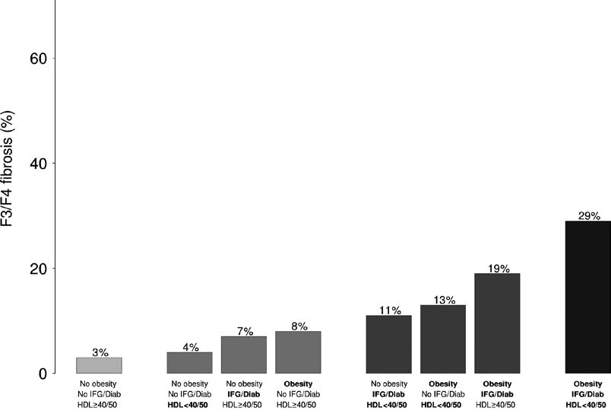
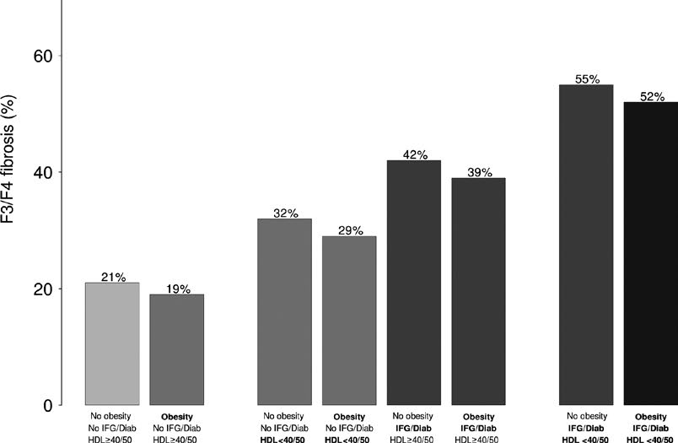
Metabolic Disorders and NAFLD Risk
Age < 41 years
Age 41-54 years
Age > 54 years
Among patients with NAFLD, the metabolic profiles associated with risk for severe fibrosis varied among age groups. Low HDL, obesity and IFG/diabetes were prevalent among patients in the lower and middle age tertiles. HDL and IFG/diabetes but not visceral obesity were prevalent among those in the highest age tertile
Petta S et al, Liv Int 2017

Slide 12
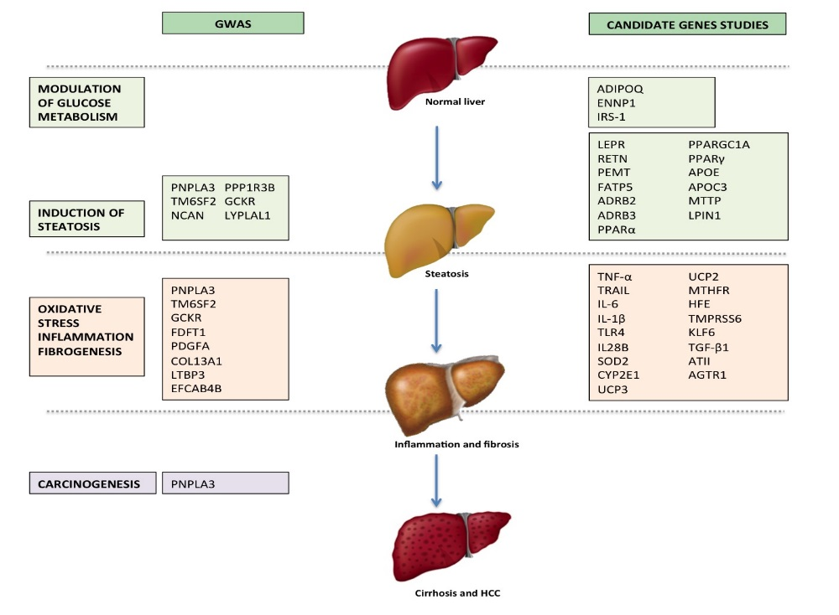
Genetic and NAFLD
Cardiovascular Risk
TM6SF2
PNPLA3
Modified from Petta S et al, WJG 2016

Slide 13
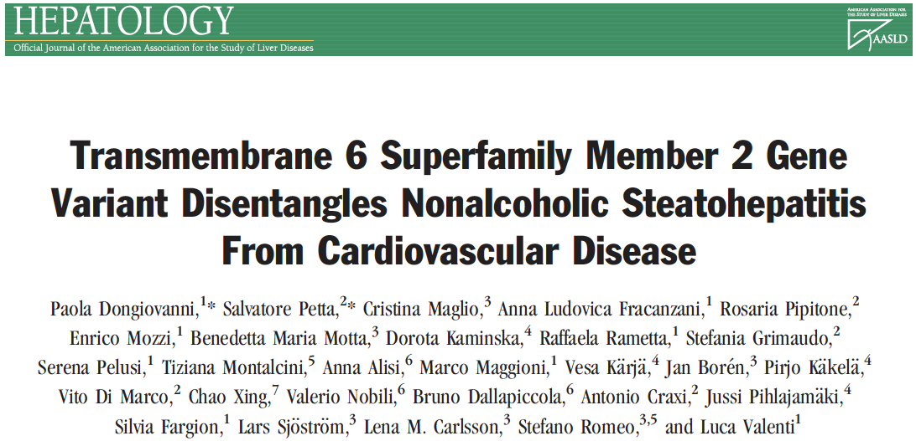
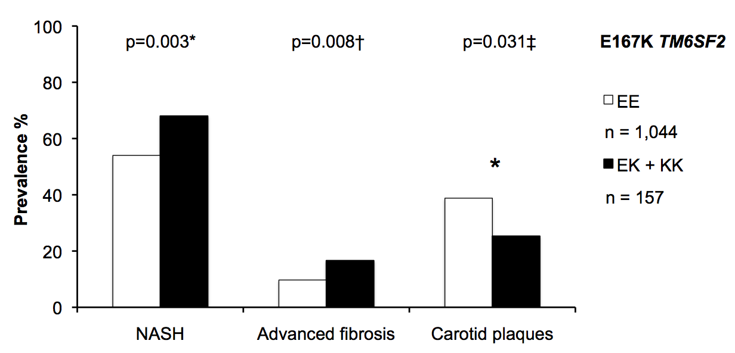
Adjusted for age, sex, BMI, presence of impaired fasting glucose or diabetes, and PNPLA3 I148M alleles
Dongiovanni P, Petta S et al, Hepatology 2014

Slide 14
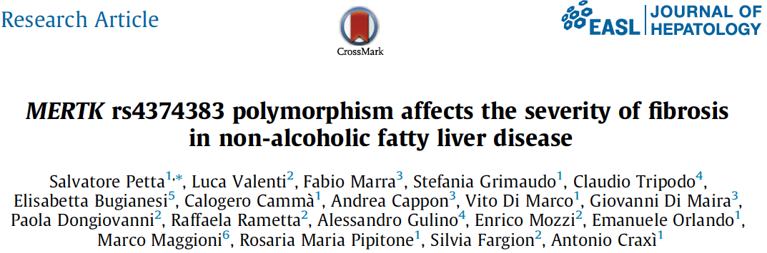
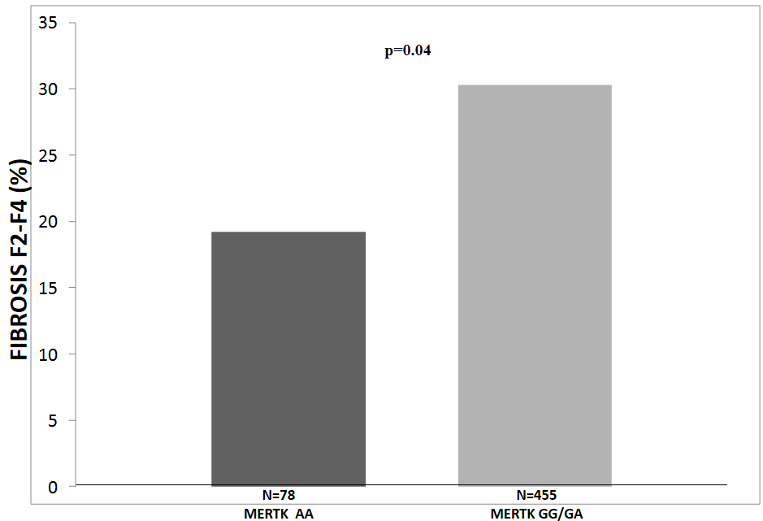
MERTK variant associated with lower prevalence of F2-F4 fibrosis after adjusting for clinical, metabolic and genetic confounders
MERTK is a tyrosin kinase involved in HCS activation
Petta S et al, JHEP 2016

Slide 15
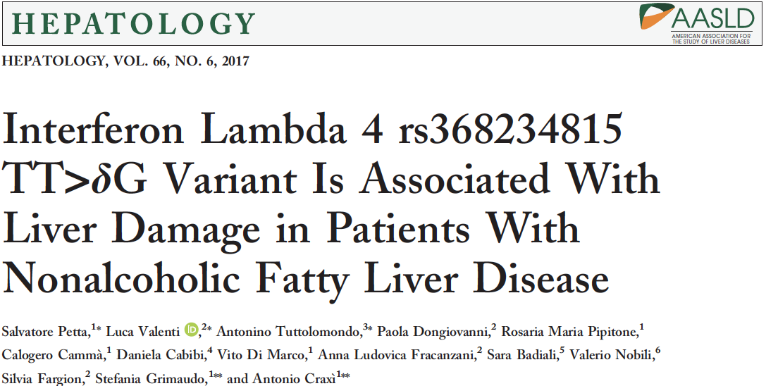
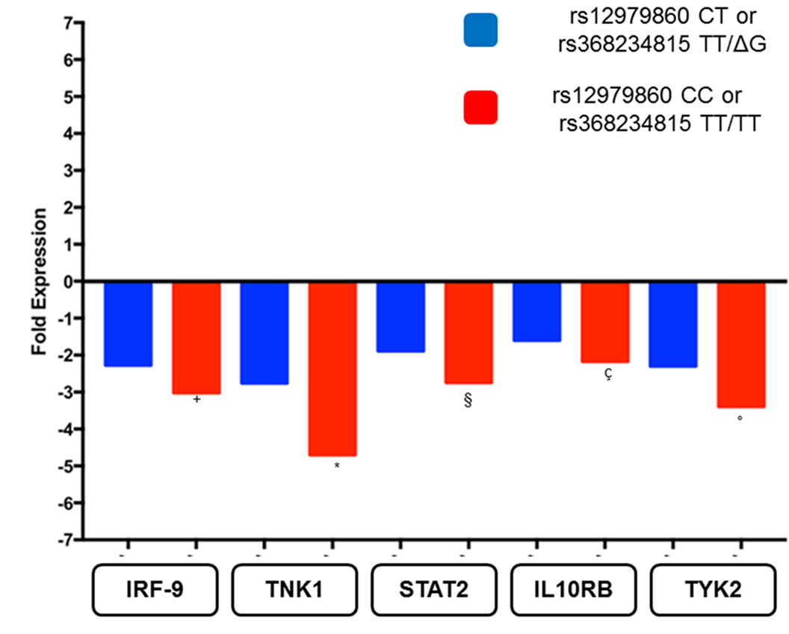
IFNL4 Genotype independently associated with the severity of steatosis, severity of lobular inflammation and NASH especially in nonobese NAFLD
Petta S et al. Hepatology 2017
Notes:
Therefore we tested this gene in our cohort of NAFLD patients, observing that patients homozygous for the C allele of interleukin 28B gene, the same genotype associated with SVR in chrnonic hepatit C, in NAFLD patients was associated with a higher prevalence of both liver inflammation and fibrosis

Slide 16
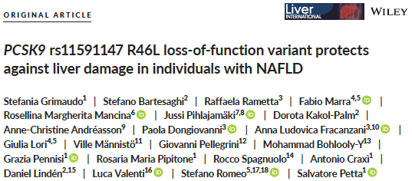
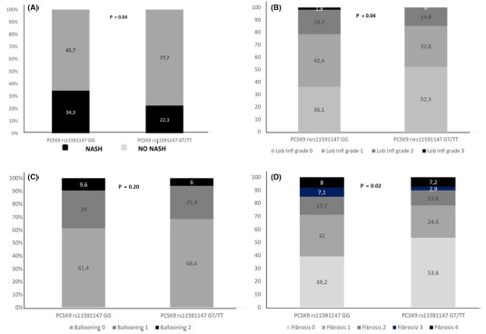
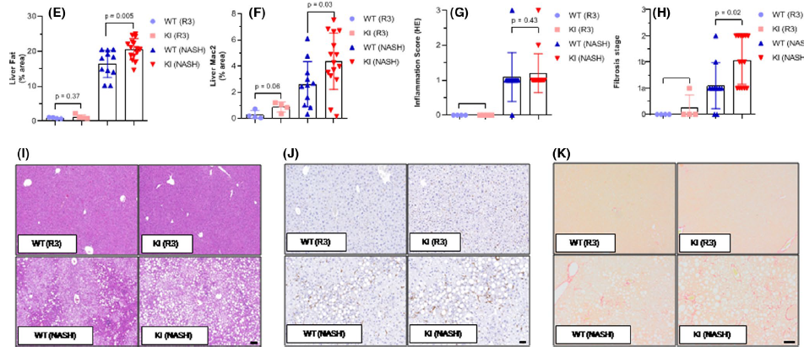
Carriers of PCSK9 rs11591147 had lower circulating LDL-C levels and were protected against nonalcoholic fatty liver disease (NAFLD) (OR: 0.42), NASH (OR: 0.48) and more severe fibrosis (OR: 0.55). PCSK9 hepatic expression was directly correlated with liver steatosis (P = .03). Finally, liver-specific overexpression of human PCSK9 in male mice drives NAFLD and fibrosis upon a dietary challenge.
Grimaudo S et al. Liv Int 2020
Notes:
Therefore we tested this gene in our cohort of NAFLD patients, observing that patients homozygous for the C allele of interleukin 28B gene, the same genotype associated with SVR in chrnonic hepatit C, in NAFLD patients was associated with a higher prevalence of both liver inflammation and fibrosis

Slide 17
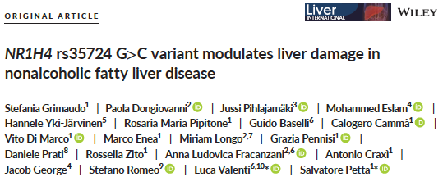
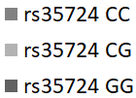
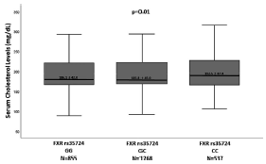
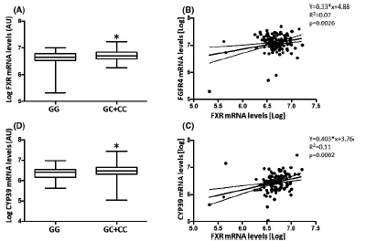
The NR1H4 rs35724 CC genotype was protective against steatohepatitis (GG vs CC OR 0.62) and severity of fibrosis (GG vs CC OR 0.83). The C allele was associated with higher total circulating cholesterol (P = .01). Patients carrying the NR1H4 rs35724 C allele had significantly higher hepatic mRNA levels of FXR and were associated with higher hepatic FGFR4 and Cyp39A1 that are in turn involved in bile acid synthesis.
Grimaudo S et al. Liv Int 2021
Notes:
Therefore we tested this gene in our cohort of NAFLD patients, observing that patients homozygous for the C allele of interleukin 28B gene, the same genotype associated with SVR in chrnonic hepatit C, in NAFLD patients was associated with a higher prevalence of both liver inflammation and fibrosis

Slide 18
Genetic Risk Factors and NAFLD

Slide 19
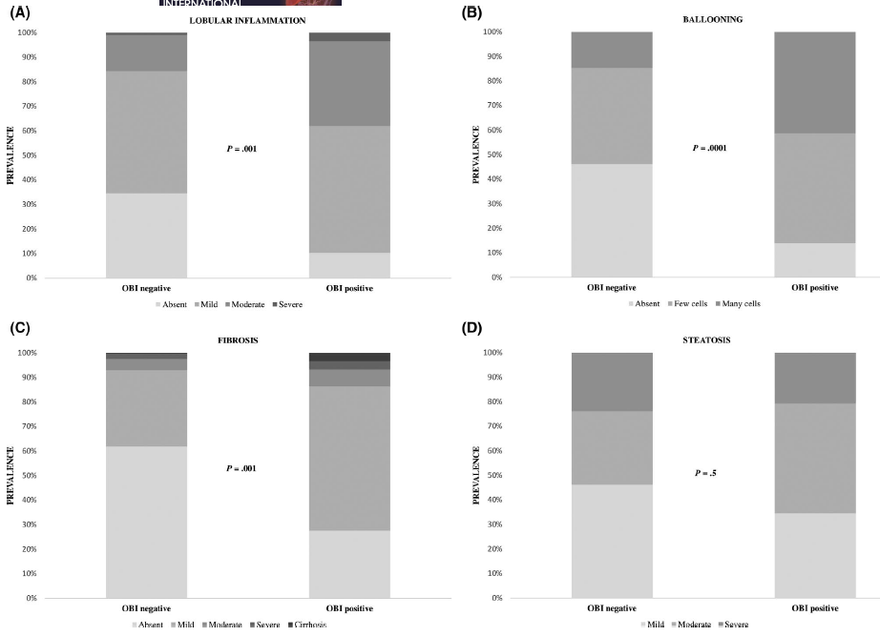
Occult HBV Infection and NAFLD
226 subjects consecutively underwent
bariatric surgery in two Italian liver centers
Older age (P = .03, O R 1 .034), ALT values (P = .005, OR 1.023), insulin resistance/diabetes (P = .02, OR 2.257), TM6SF2 polymorphism (P = .04, OR 3.168) and OBI (P = .004, OR 5.503) were independent predictors of NASH
Raimondo G et al, Liv Int 2020

Slide 20
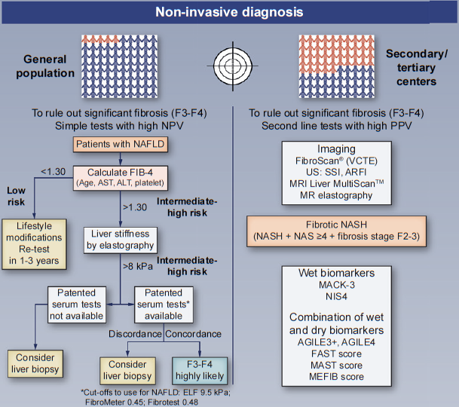
NAFLD Noninvasive Diagnosis
Petta S and Bugianesi E, JHEP 2022

Slide 21
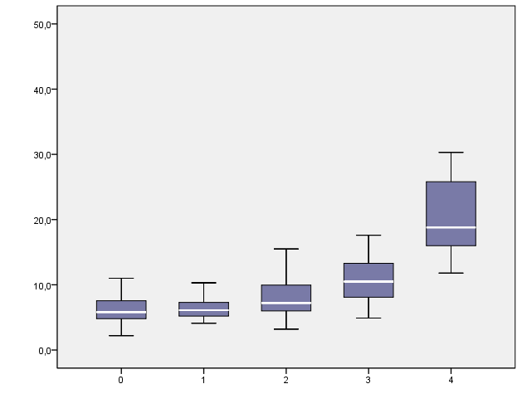
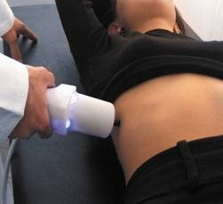
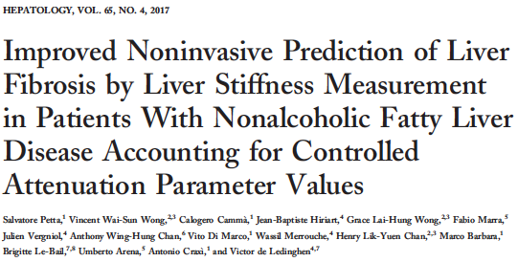
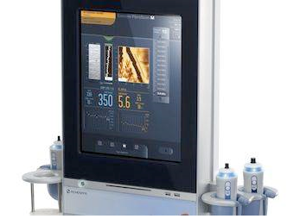
Liver Stiffness by Transient Elastography and NAFLD
N=253
Stiffness (Kpa)
Stages of Fibrosis
LSM 8.4 Kpa: Sensitivity 77.4%, specificity 77.6%, AUC 0.866 for F3-F4 fibrosis
Petta S et al, HEP 2015

Slide 22
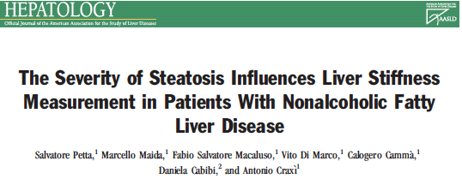
Liver Stiffness by Transient Elastography and NAFLD

Slide 23
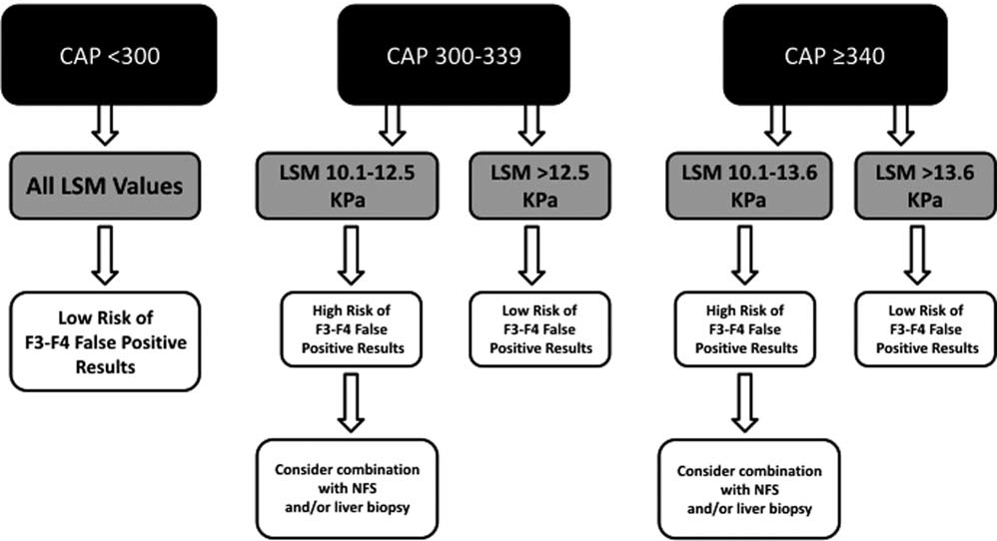
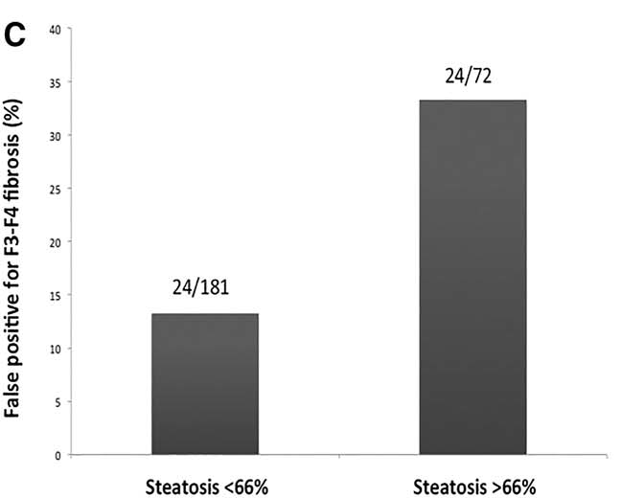
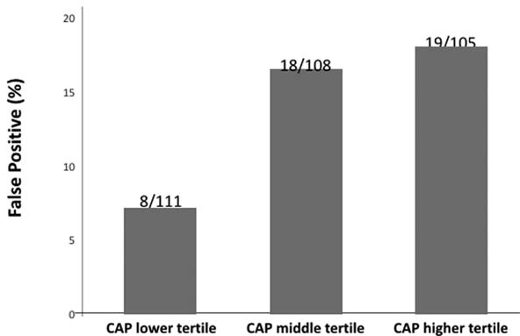
Liver Stiffness by Transient Elastography and NAFLD
False positive results for F3-F4 fibrosis accounting for steatosis or CAP
Petta S et al, HEP 2015
Petta S et al, HEP 2016
Petta S et al, HEP 2015

Slide 24
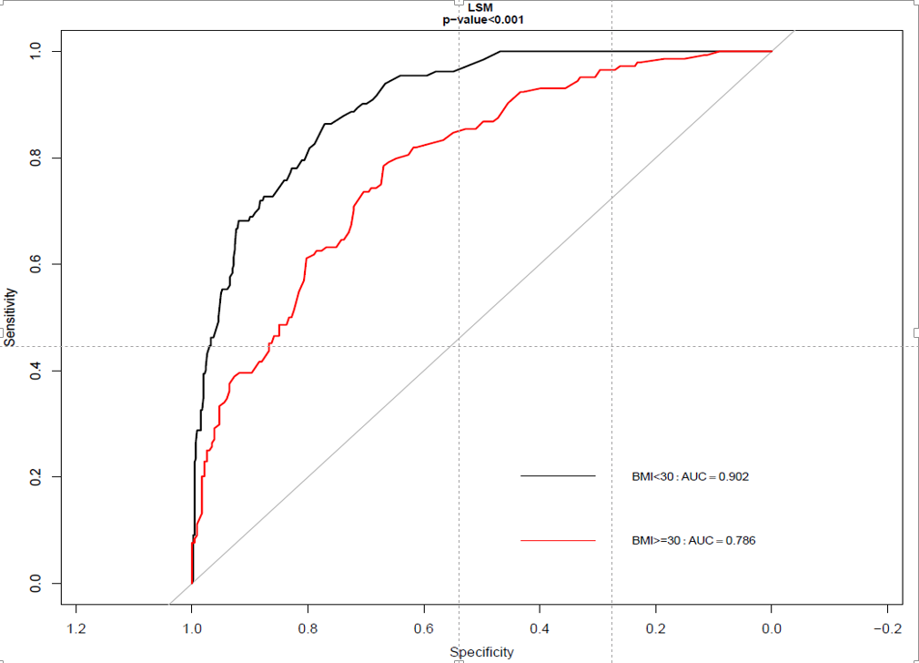
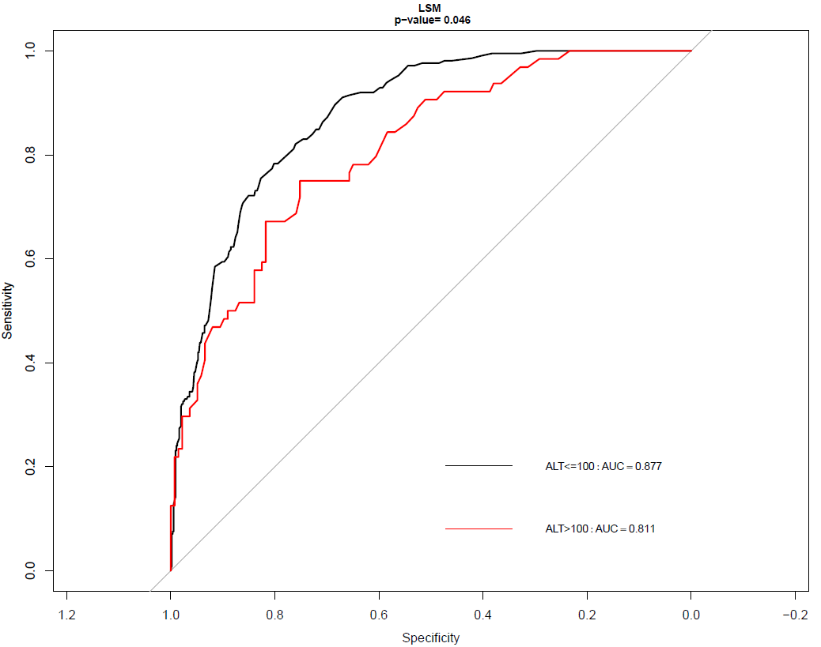
What Confounders for Liver Stiffness by Fibroscan? BMI and ALT
968 NAFLD Patients
Petta et al, AJG 2019

Slide 25
Noninvasive scores for F3-F4 Fibrosis in NAFLD
FIB-4, LSM and AGILE 3+ for the prediction of F3-F4 in NAFLD
Prediciton of Advanced Fibrosis
520 patients with biopsy-proven NAFLD
AGILE 3+, according to the clinical setting and to availability of TE for LSM, can be a valid alternative to both FIB-4 and LSM because reducing the proportion of patients where ruling out or ruling in advanced fibrosis is not possible (grey area)
Pennisi G et al, CGH 2022
Notes:
25
25

Slide 26
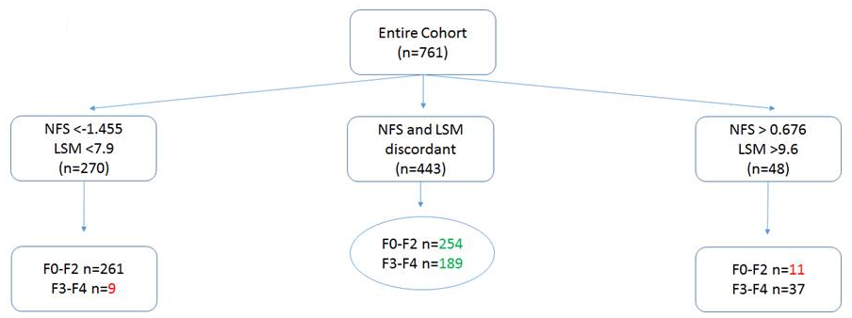
Paralell combination of LSM and Noninvasive Scores
 | Accuracy (%) | Uncertainty area (%) | Wrong Classification (%) | False positive (%) | False negative (%)
Fibroscan + NFS | 298/761 (39.1%) | 443/761 (58.2%) | 20/761 (2.6%) | 11/526 (2.1%) | 9/235 (3.8%)
Petta S et al, APT 2017

Slide 27
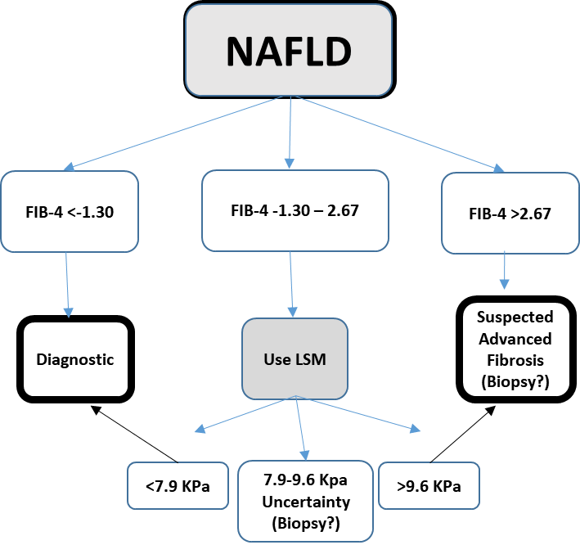
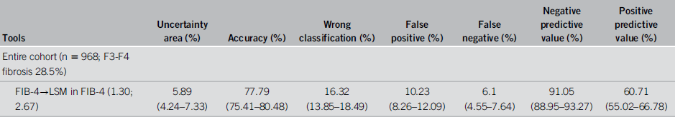
Sequential combination of FIB-4 and LSM
Petta S et al, AJG 2019

Slide 28
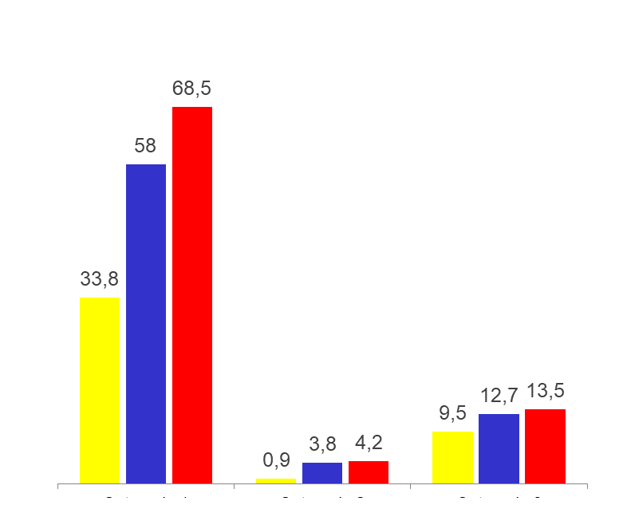
Noninvasive Assessment of VNT in NAFLD Cirrhosis
NAFLD cirrhosis criteria: PLT>110,000 and LSM<30 KPa for M probe
Baveno VI
Expanded Baveno VI
NAFLD Cirrhosis Criteria
Training Set
N=314
Validation Set
N=338
Spared EGD
Missed VNT
Missed
small EV
Spared EGD
Missed VNT
Missed
small EV
Petta S et al, JHEP 2018

Slide 29
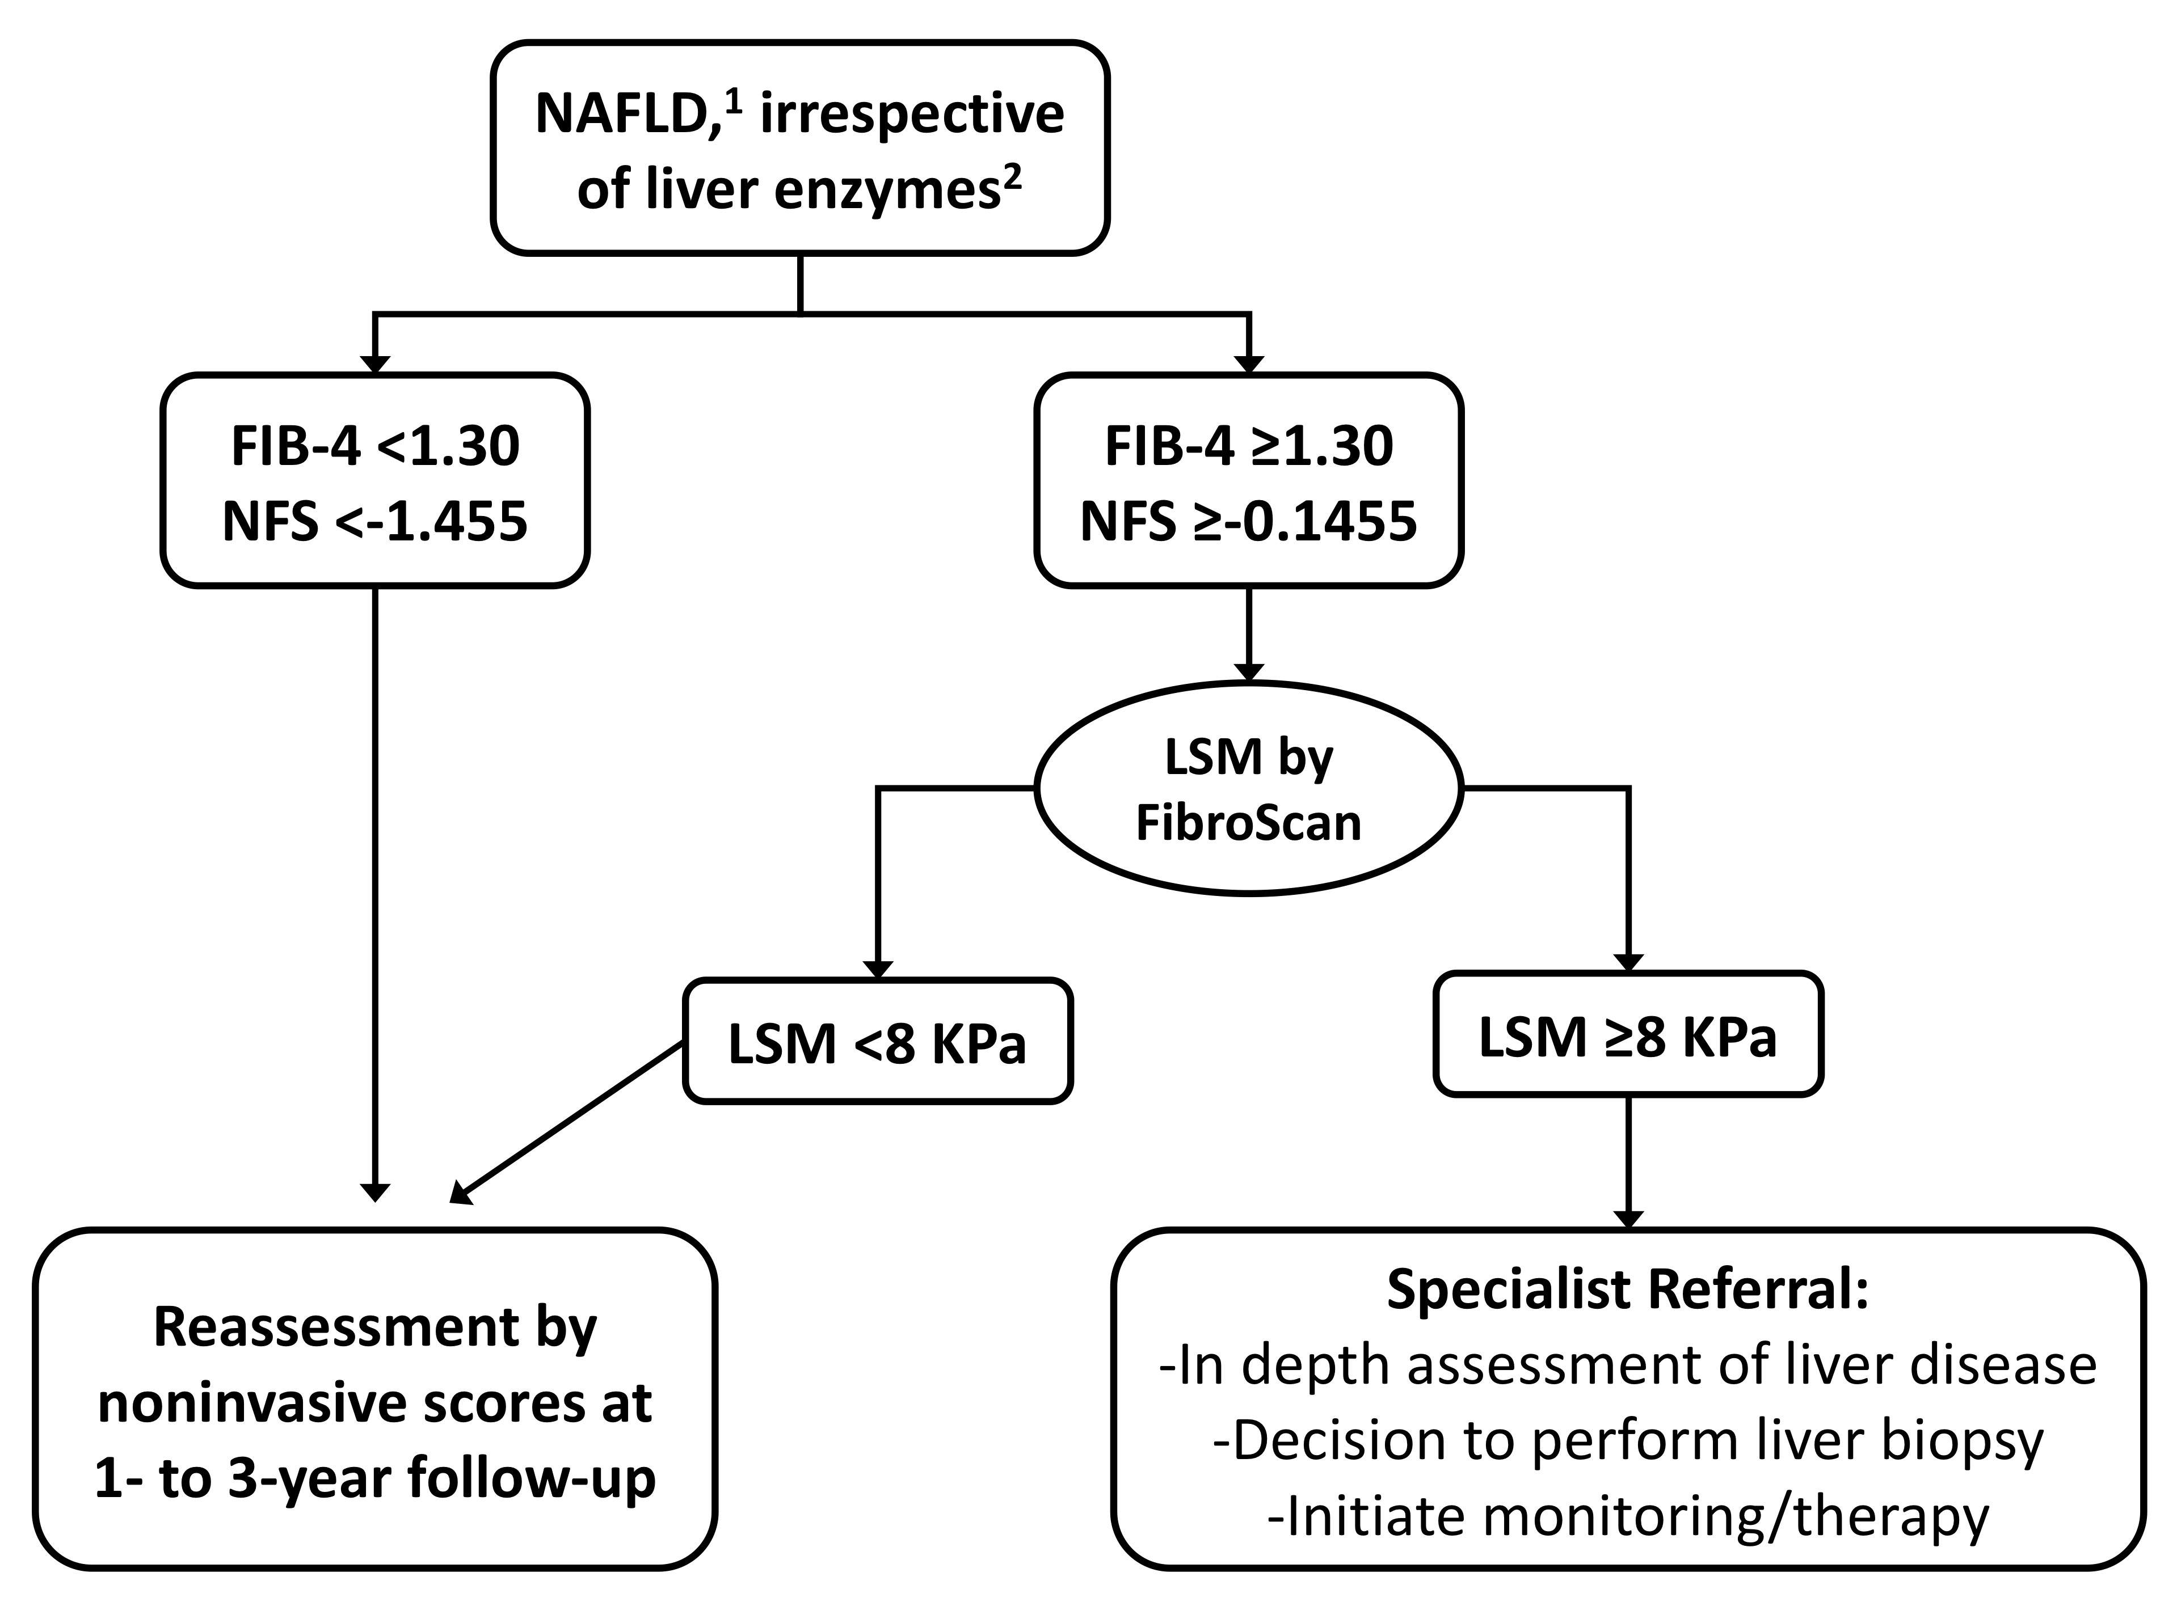

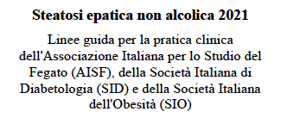
Linee Guida NAFLD AISF, SID, SIO

Slide 30
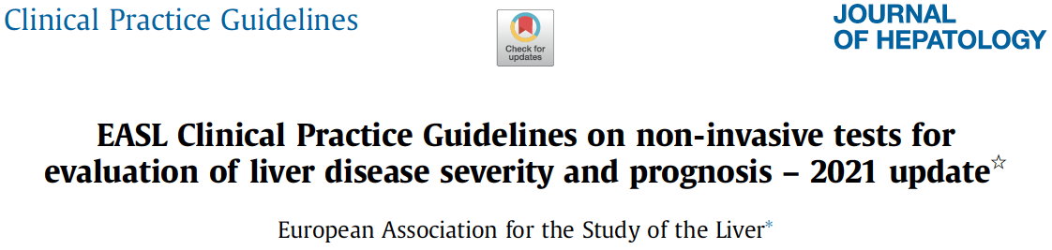
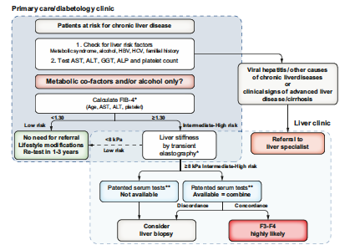
Linee Guida EASL

Slide 31
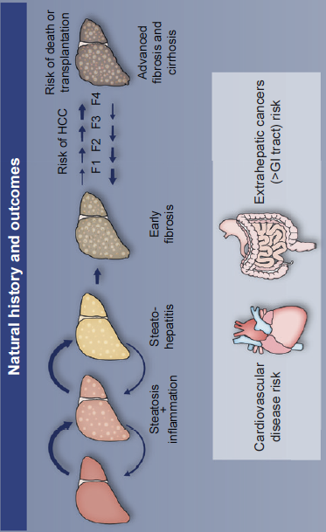
NAFLD Natural History
Petta S and Bugianesi E, JHEP 2022

Slide 32
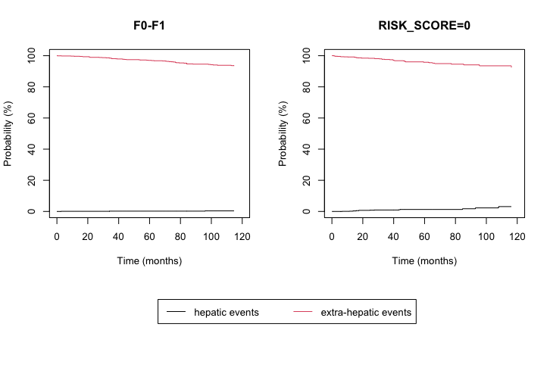

Liver-Related and Extra-hepatic Events in NAFLD
A Competitive Risks Model
2,135 patients with biopsy-proven NAFLD → F0-F1=1136; F2=362; F3-F4=637
2,790 patients with clinical NAFLD → Low=1365; Intermediate=286; High risk of F3-F4 by LSM=1,139
F0-F1 fibrosis
Low risk of developing advanced fibrosis by LSM
Histological cohort
Validation cohort
 | 12 | 36 | 60 | 120
HE (%) | 0.1 | 0.2 | 0.2 | 0.4
EHE (%) | 0.4 | 1.9 | 3 | 6.6
 | 12 | 36 | 60 | 120
HE (%) | 0.2 | 0.9 | 1.3 | 3.1
EHE (%) | 0.8 | 2.4 | 4.2 | 7.6
Pennisi et al, APT 2022

Slide 33
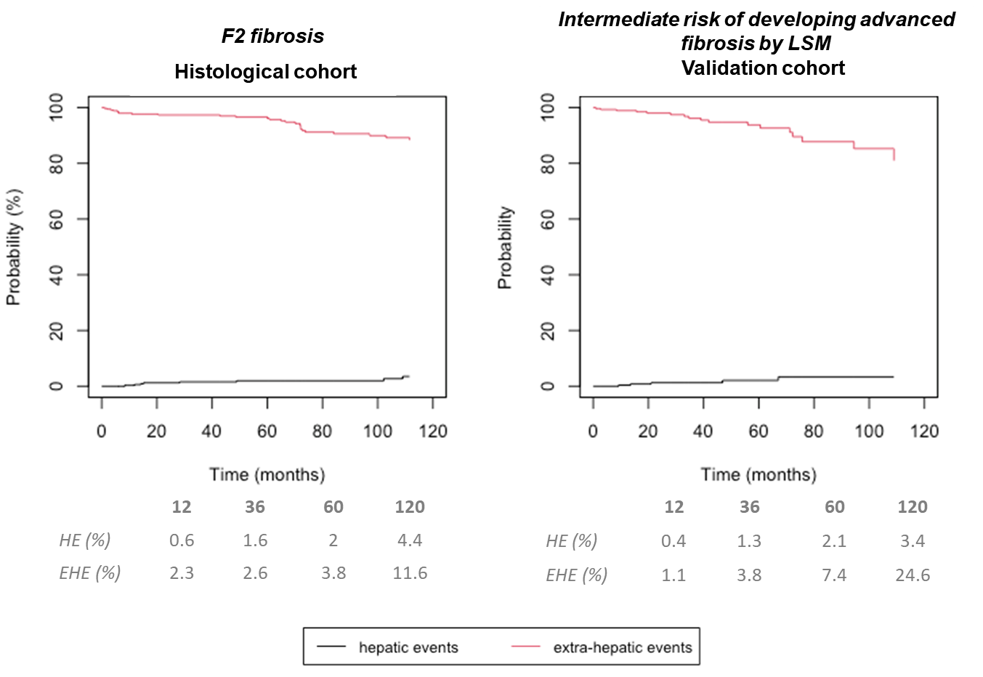
Liver-Related and Extra-hepatic Events in NAFLD
A Competitive Risks Model
2,135 patients with biopsy-proven NAFLD → F0-F1=1136; F2=362; F3-F4=637
2,790 patients with clinical NAFLD → Low=1365; Intermediate=286; High risk of F3-F4 by LSM=1,139
Pennisi et al, APT 2022

Slide 34
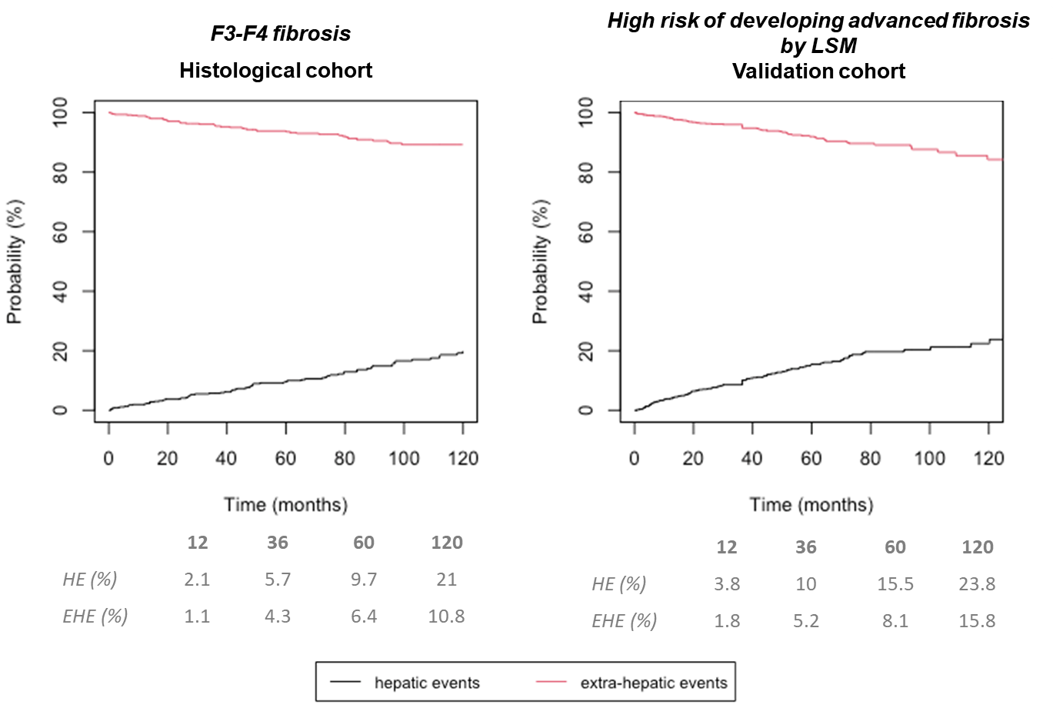
Liver-Related and Extra-hepatic Events in NAFLD
A Competitive Risks Model
2,135 patients with biopsy-proven NAFLD → F0-F1=1136; F2=362; F3-F4=637
2,790 patients with clinical NAFLD → Low=1365; Intermediate=286; High risk of F3-F4 by LSM=1,139
Pennisi et al, APT 2022

Slide 35
Liver-Related and Extra-hepatic Events in NAFLD
A Competitive Risks Model
2,135 patients with biopsy-proven NAFLD → F0-F1=1136; F2=362; F3-F4=637
2,790 patients with clinical NAFLD → Low=1365; Intermediate=286; High risk of F3-F4 by LSM=1,139
 | FIRST LIVER-RELATED EVENT | SECOND EXTRAHEPATIC EVENT |  | FIRST EXTRAHEPATIC EVENT | SECOND LIVER-RELATED EVENT
F0-F1 (n=1136) | E 7 (0.61%) | E 0 (0%) |  | E 66 (5.8%) | E 1 (1.51%)
 | LD 4 (0.35%) | CVE 0 (0%) |  | CVE 31 (2.72%) | LD 1 (1.51%)
 | HCC 3 (0.26%) | EHC 0 (0%) |  | EHC 35 (3.08%) | HCC 0 (0%)
F2 (n=362) | E 6 (1.65%) | E 0 (0%) |  | E 36 (9.94%) | E 1 (2.77%)
 | LD 1 (0.27%) | CVE 0 (0%) |  | CVE 16 (4.42%) | LD 0 (0%)
 | HCC 5 (1.38%) | EHC 0 (0%) |  | EHC 20 (5.52%) | HCC 1 (2.77%)
F3-F4 (n=637) | E 77 (12.09%) | E 4 (5.2%) |  | E 60 (9.41%) | E 4 (6.67%)
 | LD 53 (8.32%) | CVE 1 (1.3%) |  | CVE 33 (5.18%) | LD 3 (5%)
 | HCC 24 (3.77%) | EHC 3 (3.9%) |  | EHC 27 (4.23%) | HCC 1 (1.67%)
Pennisi et al, SUBMITTED

Slide 36

Baseline Liver Stiffness Predicts Decompensation in cACLD NAFLD
1039 patients NAFLD patients with cACLD with a median follow-up time of 35 months
Baseline LSM was independently associated with occurrence of hepatic decompensation (HR 1.03, 95%CI 1.02-1.04, p<0.001)
Petta S et al, CGH 2020
Notes:
36
36

Slide 37

Delta Liver Stiffness Predicts
Decompensation in cACLD NAFLD
533 patients NAFLD patients with cACLD with a median follow-up time of 42 months
Δ−LSM –together with baseline LSM- was independently associated with hepatic decompensation (HR 1.66, 95%CI 1.05-2.63, p=0.02)
Petta S et al, CGH 2020
Notes:
37
37

Slide 38

Delta Liver Stiffness Predicts
HCC in cACLD NAFLD
533 patients NAFLD patients with cACLD with a median follow-up time of 42 months
Δ-LSM was independently associated with HCC (HR 1.79, 95%CI 1.01-3.15, p=0.04)
Petta S et al, CGH 2020
Notes:
38
38

Slide 39
Noninvasive scores Predict
Liver-related Events in NAFLD
FIB-4, LSM and AGILE 3+ for the predicition of LRE in NAFLD
Prediciton of Liver Related Events
520 patients with biopsy-proven NAFLD and 94 with clinical
NAFLD compensated cirrhosis
AGILE 3+, according to the clinical setting and to availability of TE for LSM, can be a valid alternative to both FIB-4 and LSM because demonstrating the highest accuracy for predicting LRE and the highest net benefit for ruling out LRE occurrence.
Pennisi G et al, CGH 2022
Notes:
39
39

Slide 40
Biochemical Cholestatic Pattern Predicts
Liver-related Events in NAFLD
582 (training set) and 1281 (validation set) patients with NAFLD
Petta S et al, Liv Int 2021
Notes:
40
40

Slide 41


NAFLD:
Genetic Predictors of Fibrosis Progression
430 patients with paired FIB-4 (median follow-up 53.9 months). Fibrosis progression in 20.7% and independently associated with PNPLA3 rs738409 variant (OR 1.65; 95% CI, 1.12–2.42; P=0.01)
342 patients with paired LSM (median follow-up 53.2 months). Fibrosis progression in 13.4% and independently associated with PNPLA3 rs738409 variant (OR 1.90; 95% CI, 1.05–3.42; P=0.03)
Pennisi G et al, Clin Gastr Hep 2020

Slide 42

PNPLA3 and Hepatic Decompensation
Entire Cohort (N=471)
Multivariate Model
Variable | Adjusted Model HR (95% C.I.) p value
Age >57 yrs | 6.33 (0.83-48.0) 0.07
BMI≥30 kg/m² | 0.48 (0.19-1.18) 0.11
PLT <190*10³/mmc | Inf (NA) <0.001
Albumin <4 g/L | 2.20 (0.96-5.05) 0.06
IFG/Type 2 Diabetes | 0.66 (0.27-1.63) 0.37
PNPLA3 CC vs CG vs GG | 2.10 (1.03-4.29) 0.04
Advanced Fibrosis/Cirrhosis | Inf (NA) <0.001
Grimaudo S & Petta S, CGH 2019

Slide 43

PNPLA3 and HCC Occurrence
Entire Cohort (N=471)
Multivariate Model
Variable | Adjusted Model HR (95% C.I.) p value
Age >57 yrs | 4.23 (0.49-35.9) 0.18
BMI≥30 kg/m² | 0.87 (0.21-3.56) 0.85
PLT <190*10³/mmc | 5.22 (0.57-47.5) 0.14
Albumin <4 g/L | 1.26 (0.35-4.47) 0.72
IFG/Type 2 Diabetes | 0.90 (0.23-3.56) 0.88
PNPLA3 CC vs CG vs GG | 2.68 (1.01-7.26) 0.04
Advanced Fibrosis/Cirrhosis | Inf (NA) 0.001
Grimaudo S & Petta S, CGH 2019

Slide 44



Genetic and risk of Liver-Related Events
GEMS score based on: age, PLTs, albumin, HDL , TM6SF2 rs58542926, HSD17B13 rs72613567, interactions between PNPLA3 rs738409 and male sex and between PNPLA3 rs738409 and diabetes
Palermo Cohort N=546
FIB>1.3 N=229
UK Biobank Cohort N= 303,075
AUCs for GEMS prediction of SLD at 1, 3, and 5 years in the entire population were 0.70, 0.69, and 0.67, respectively
But…
Pennisi et al, Hep Comm 2021

Slide 45




NAFLD and Cardiovascular Risk

Slide 46

NAFLD Treatment

Slide 47

Clinical Endpoint in Phase 3 Trials: High Eterogeneity among Untreated Patients
Meta-regression analysis showed that phase 3 vs phase 2 trials, older age and higher baseline AST levels were risk factors for more rapid histological progression.
Pennisi et al, NMCD in press

Slide 48
Drug Therapy and NASH:
What Targets?
Participation in Phase 2 and 3 Clinical Trials on NASH
Vuppalanchi et al, Gastroenterology 2021

Slide 49



NAFLD Pharmacological Treatment
A Network Meta-analysis
Look at Trials for
Combination Theraphy
Pennisi et al, NMCD in press

Slide 50

NAFLD Endoscopic Treatment
26 patients with NAFLD-related advanced fibrosis by transient elastography and underwent intragastric balloon and 6 month follow-up
Salomone et al, Liv Int 2021

Slide 51
How have we obtained this???
Attending Specialization School
Dietitian
Physicians
Nurse
Dedicated outpatient clinic
Biologists and Lab
NAFLD
Local and Regional Collaboration
Participation in Clinical trials
National and International Networks

Slide 52
















The Journey of Liver Research
in NAFLD

Slide 53

RESIST-NASH
To record Sicilian prospective data about epidemiology, risk factors, natural history, noninvasive prognosis/prediction and treatment efficacy of NAFLD patients

