Slide 1





Come abbiamo contribuito:
Epatocarcinoma
Giuseppe Cabibbo
Ciro Celsa
Carlo Cammà

Slide 2

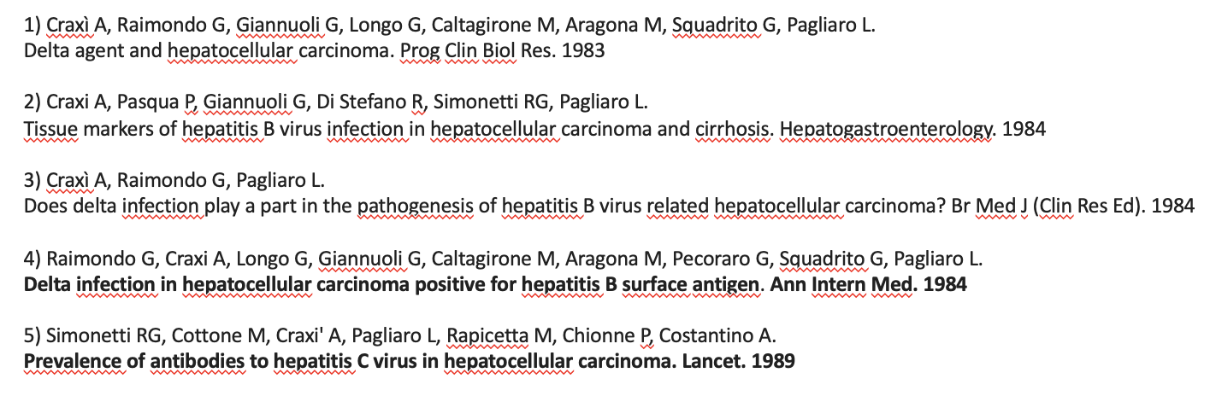
1980s (I): Hepatitis viruses and risk of Hepatocellular Carcinoma
Craxì A, Raimondo G, Giannuoli G, Longo G, Caltagirone M, Aragona M, Squadrito G, Pagliaro L.
Delta agent and hepatocellular carcinoma. Prog Clin Biol Res. 1983
Raimondo G, Craxi A, Longo G, Giannuoli G, Caltagirone M, Aragona M, Pecoraro G, Squadrito G, Pagliaro L.
Delta infection in hepatocellular carcinoma positive for hepatitis B surface antigen. Ann Intern Med. 1984
1980s

Slide 3
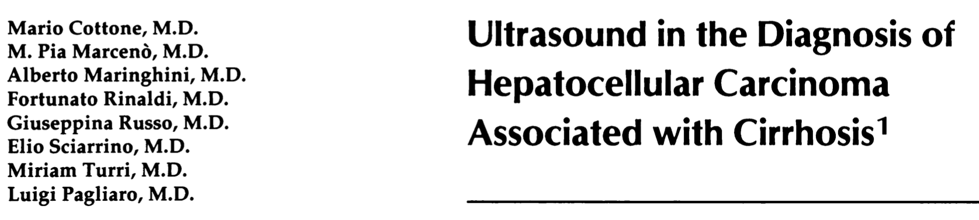
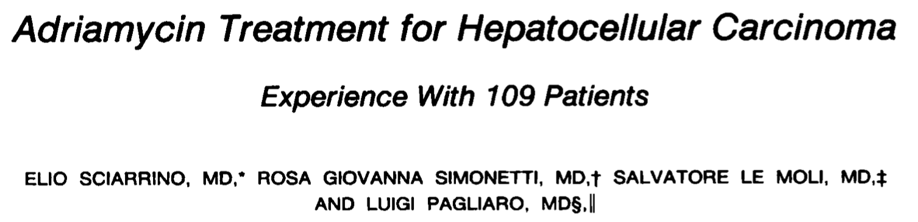
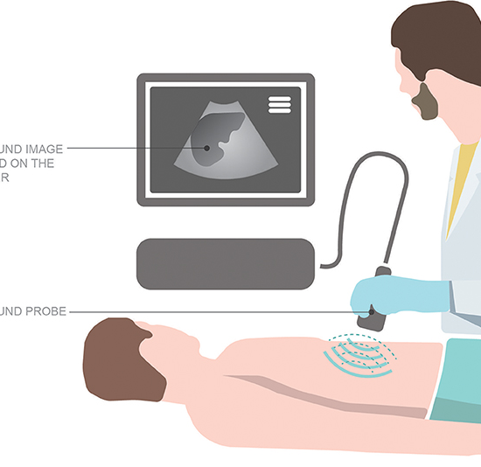
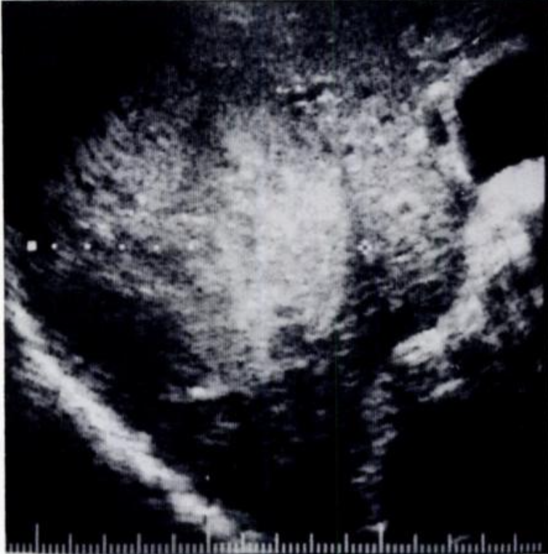
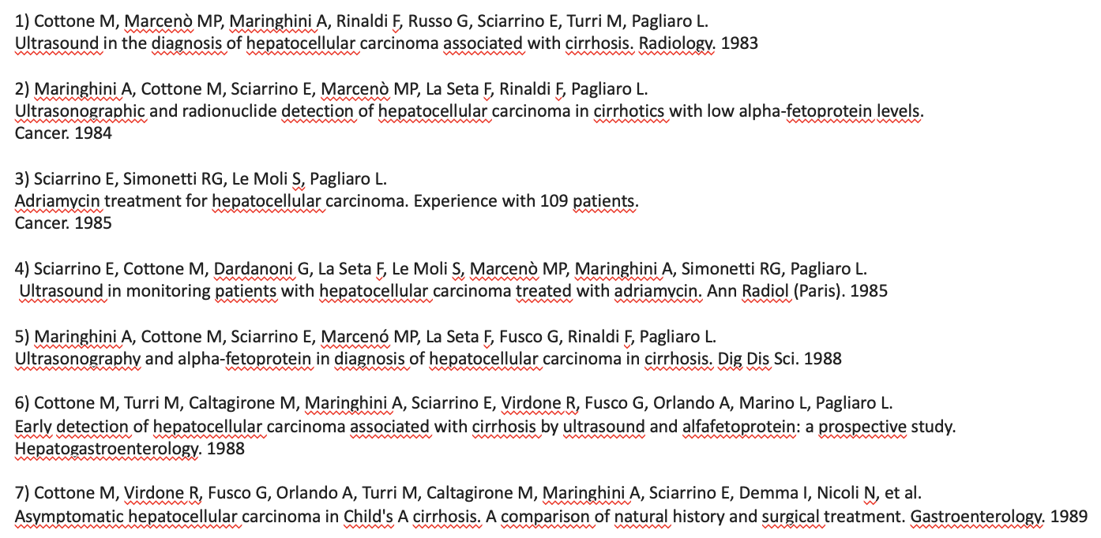
1980s (II): Role of ultrasonography in the diagnosis of HCC
and Proof-of-Concept data on systemic therapies
Radiology 1983
Cancers 1985
1980s

Slide 4

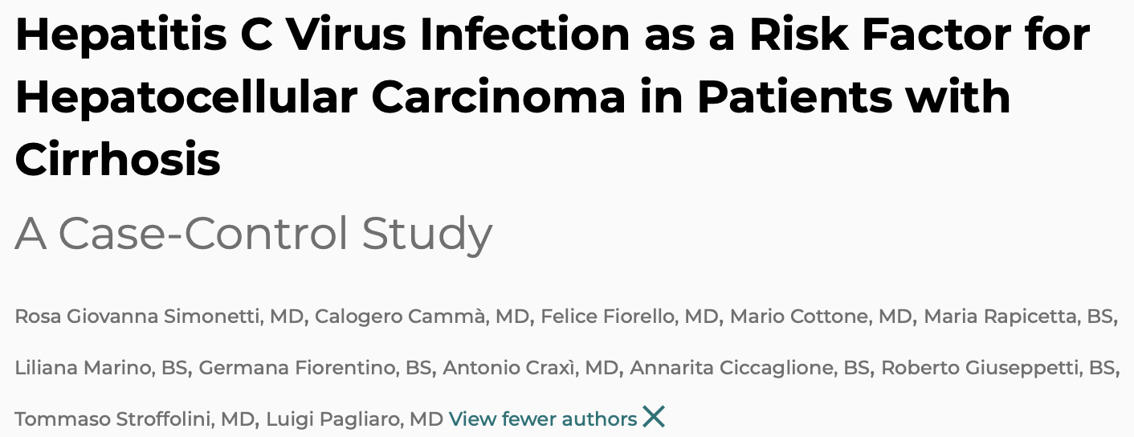
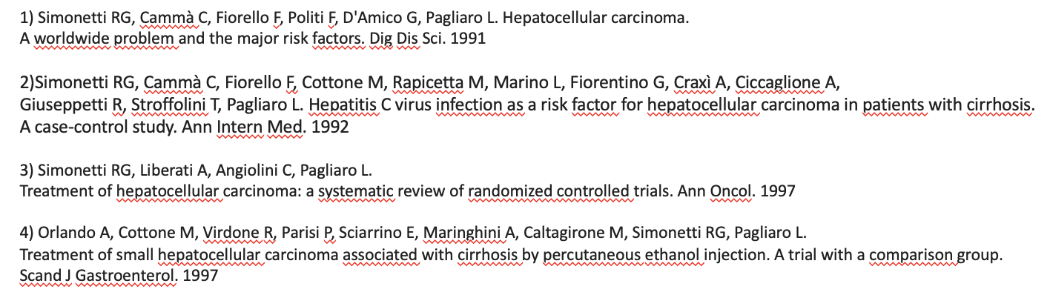
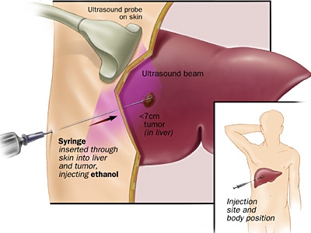
1990s and early 2000s: management of HCC
1980s
1990s

Slide 5
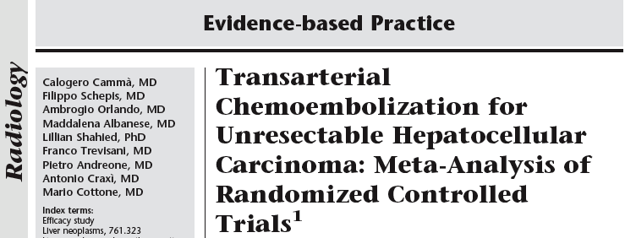
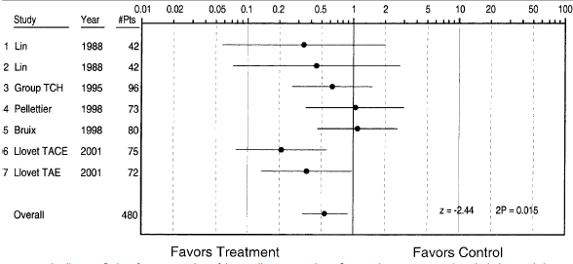
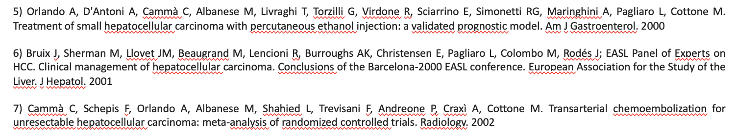
1990s and early 2000s: management of HCC
1992
1980s
1990s
2000s
2002

Slide 6

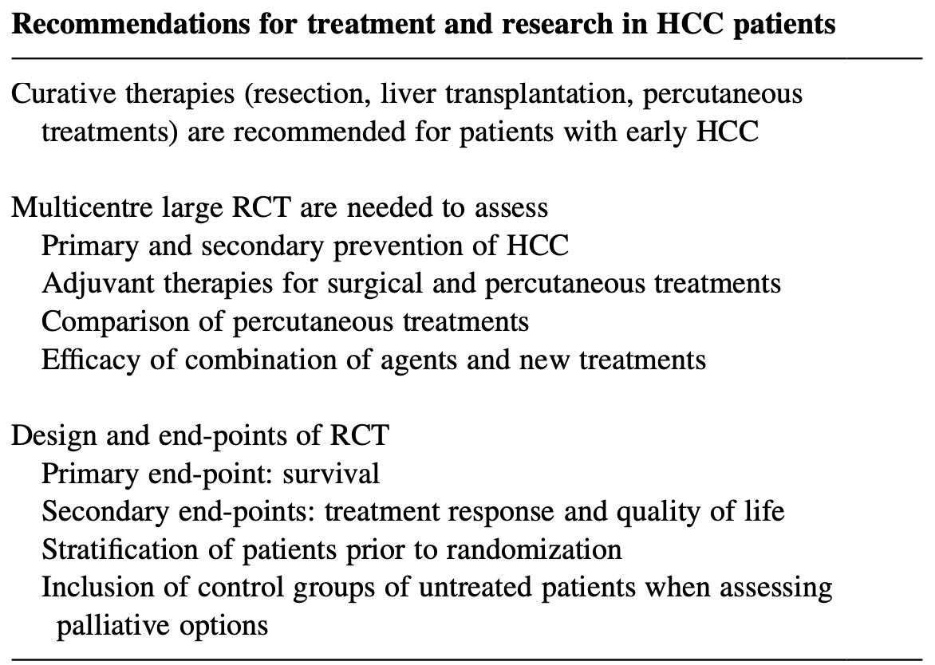
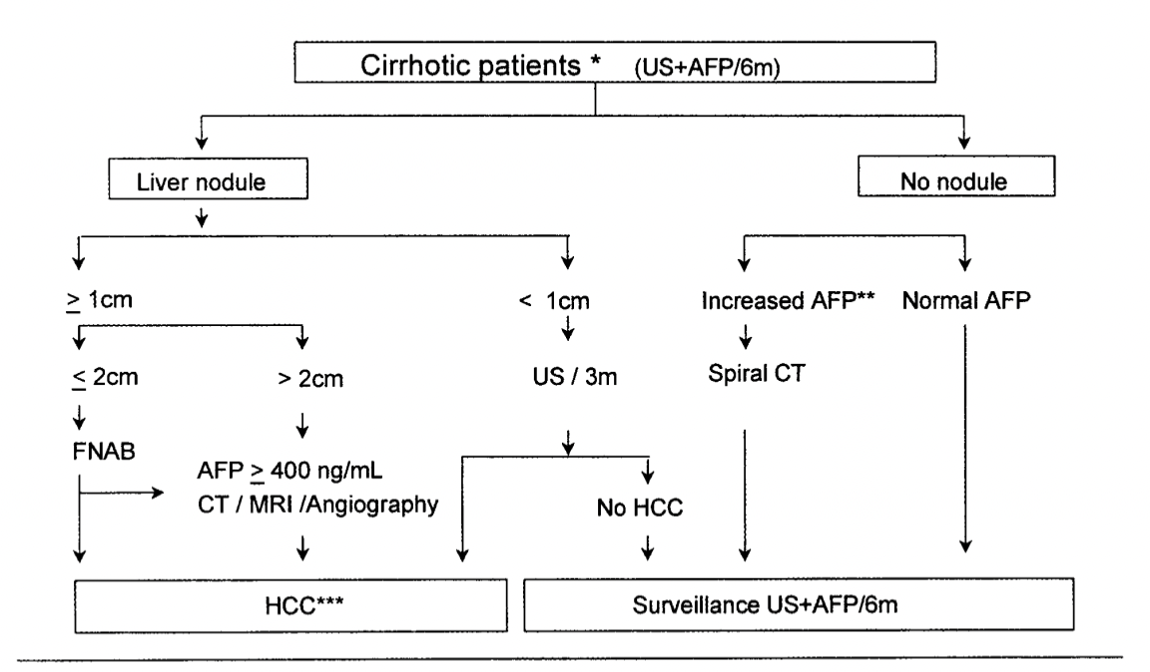
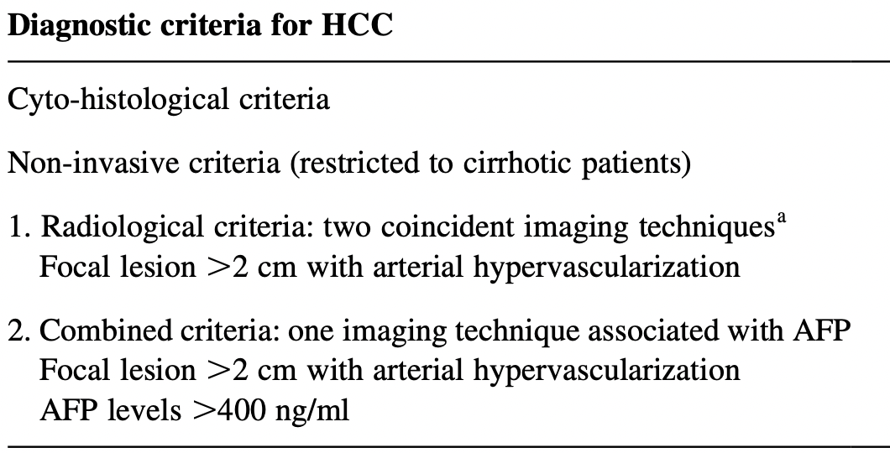
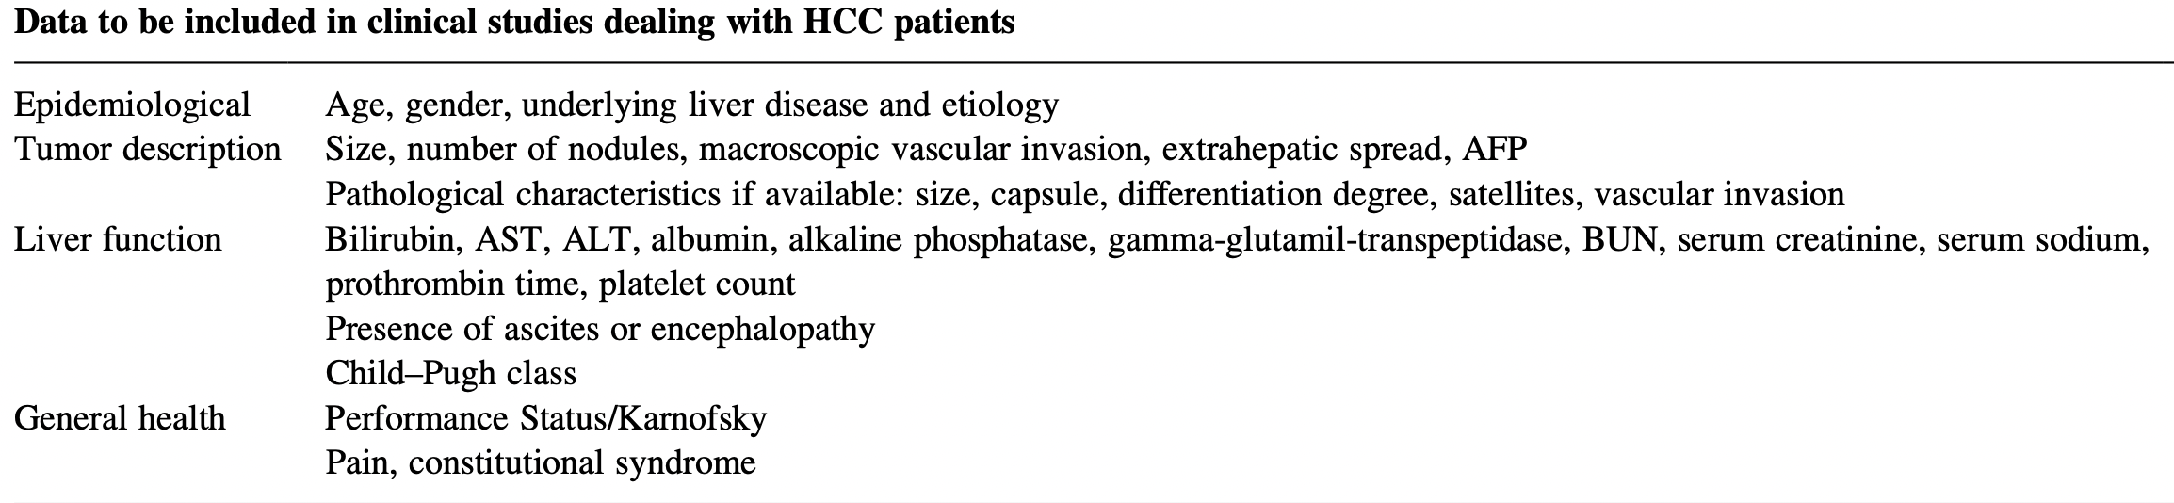

Citations: 3757

Slide 7

202 patients
Journal of Hepatology 2005
Predictors of Survival after RFA:
Complete response; b) diameter < 3 cm; c) albumin levels
Complete response
Treatment failure
151 pts
PLOS ONE 2013

Slide 8

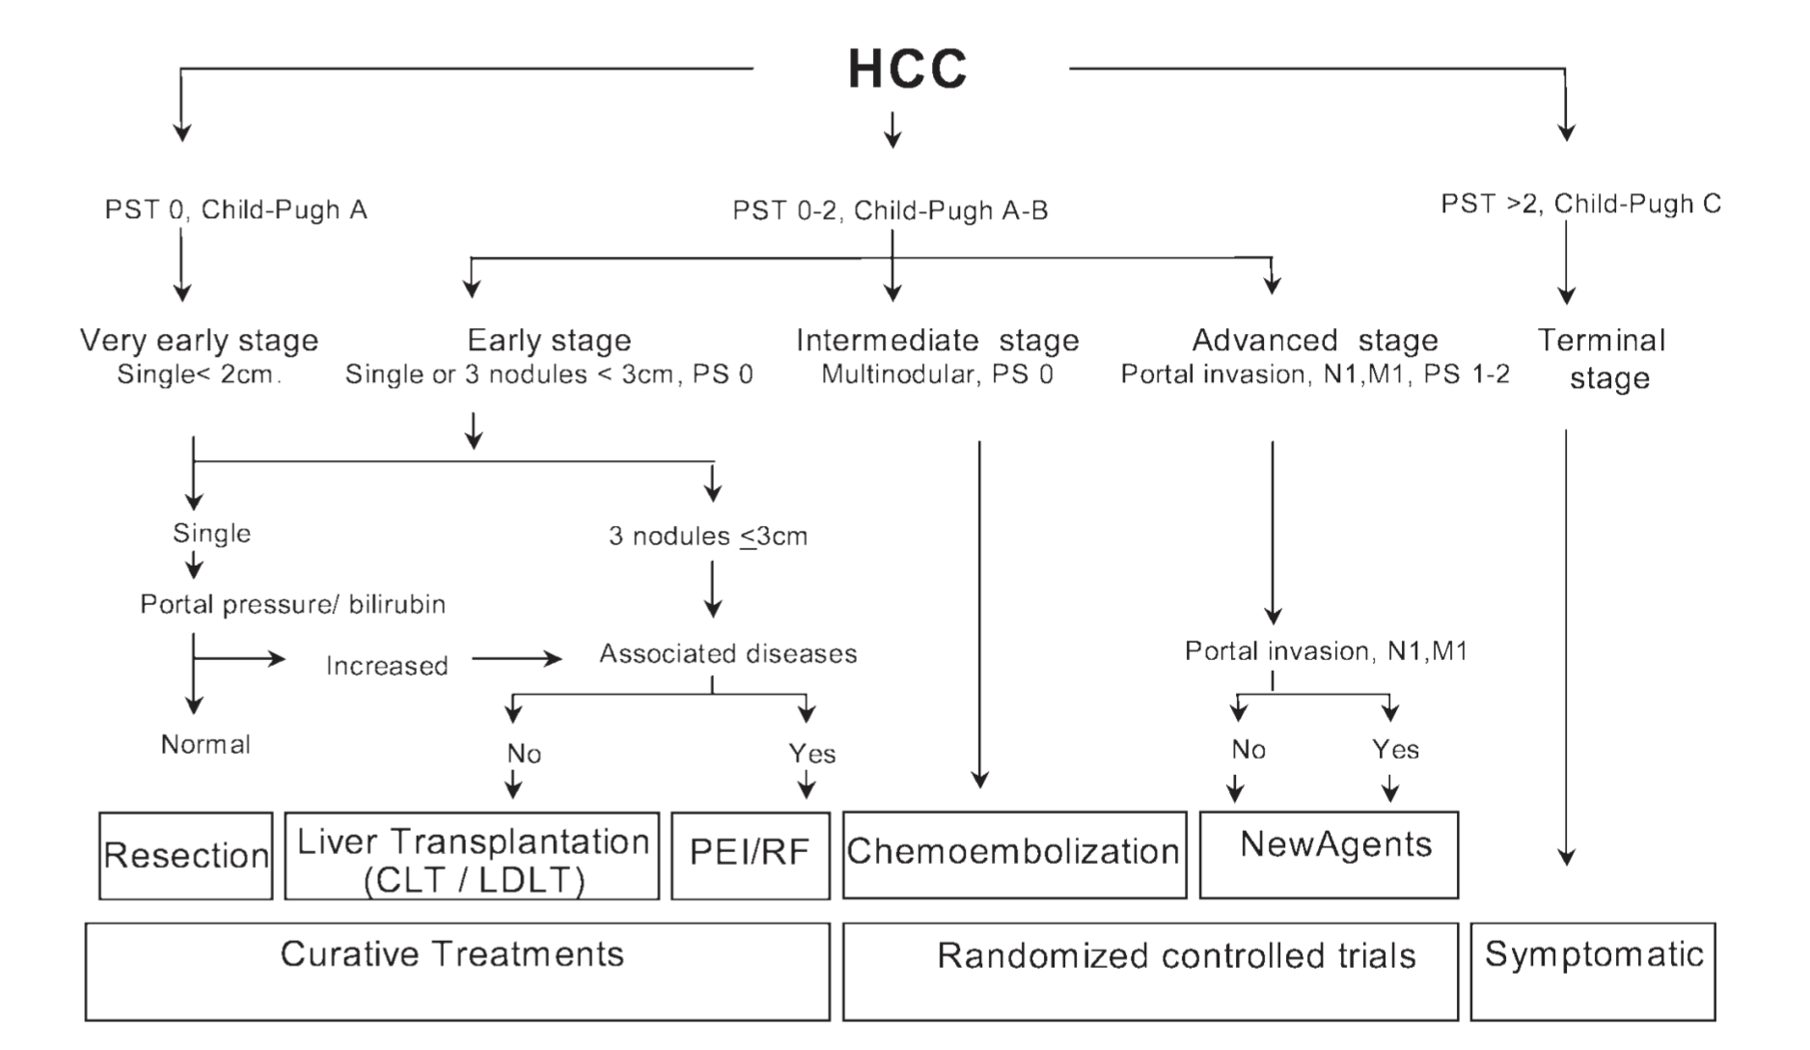

Slide 9
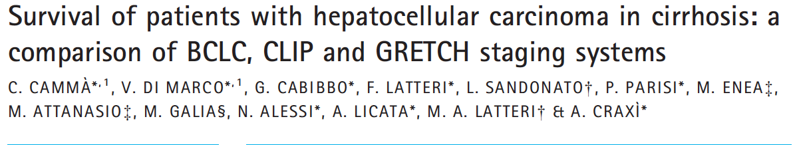
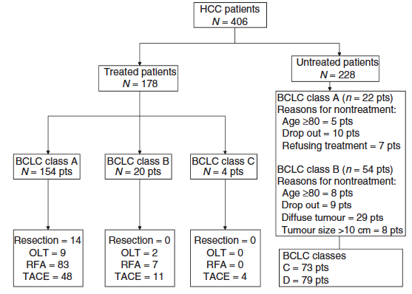
2008
Conclusions
None of the scoring systems provided confident prediction of survival in individual patients;
CLIP achieved the best discriminative capacity in the entire HCC cohort and in the untreatable cases;
BCLC was the ablest in predicting survival in treated patients.
Cammà et al. Aliment Pharmacol Ther 2008
Cammà C. et al. APT 2008

Slide 10

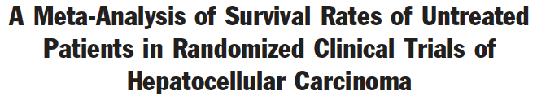
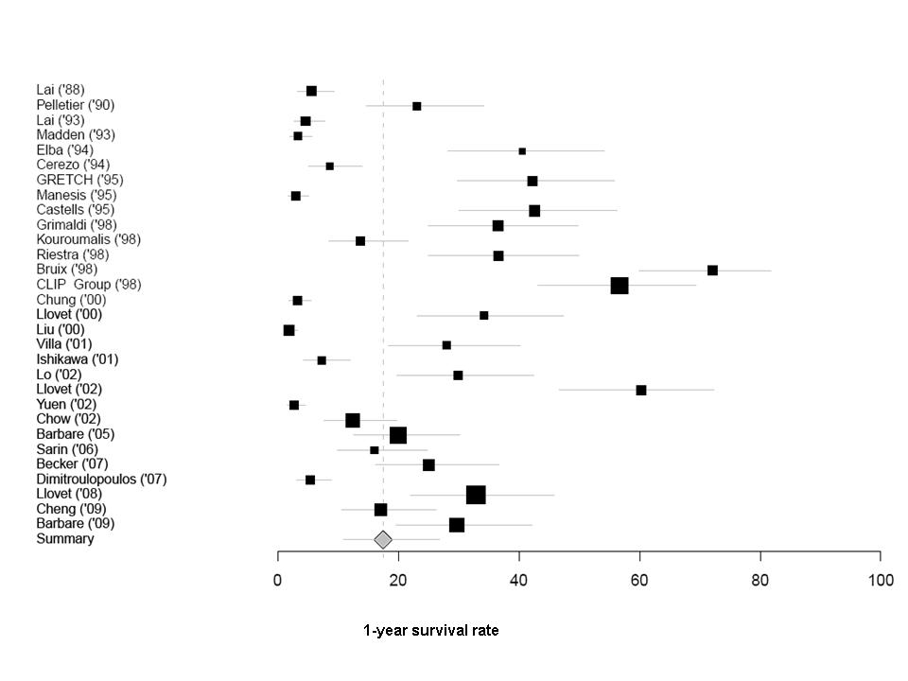
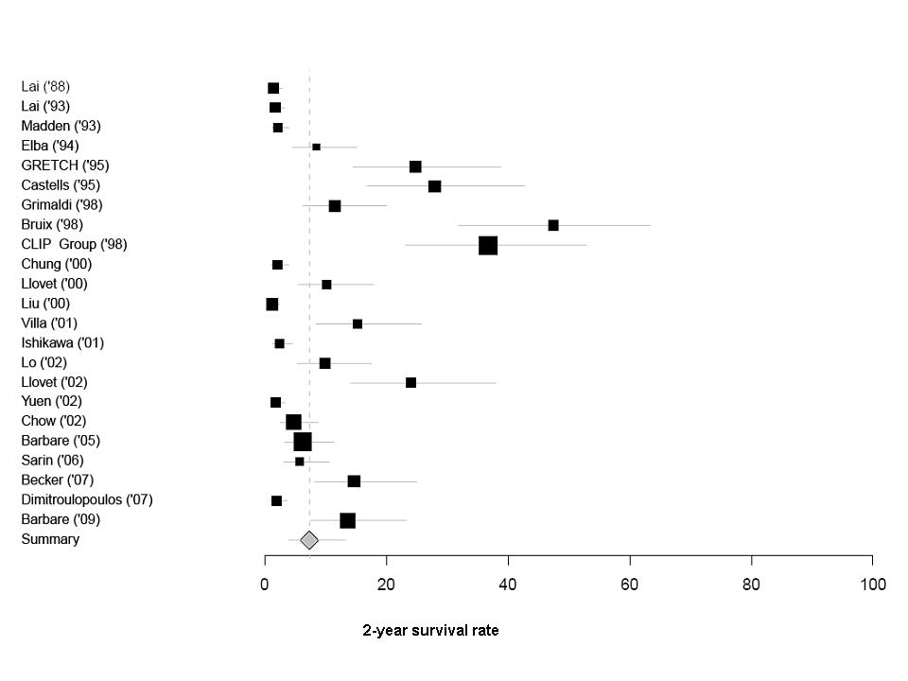
Untreated control groups of 30 RCTs
17.5%
p for heterogeneity < 0.0001
7.3%
Range 0 – 75% Range 0 – 50%
Cabibbo et al. Hepatology 2010

Slide 11
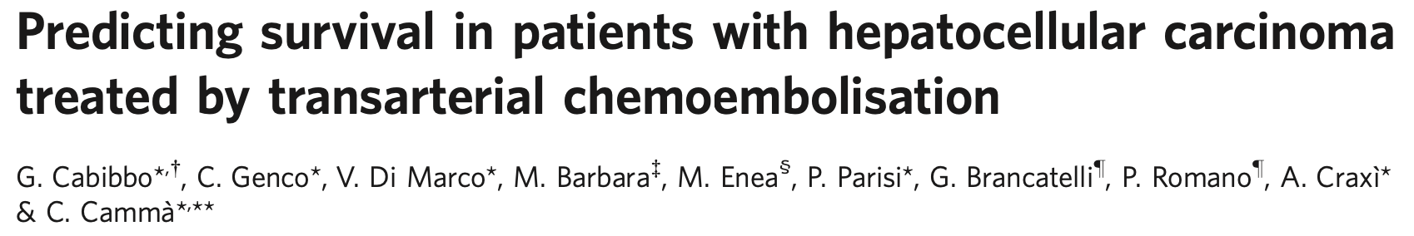
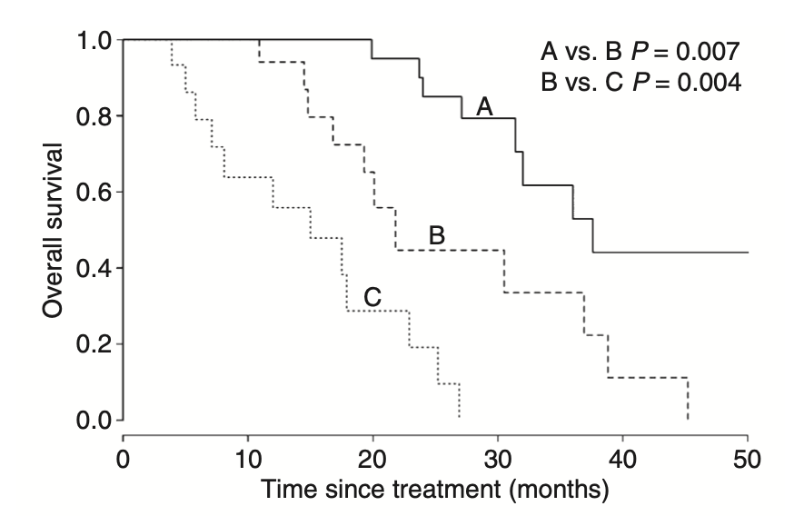
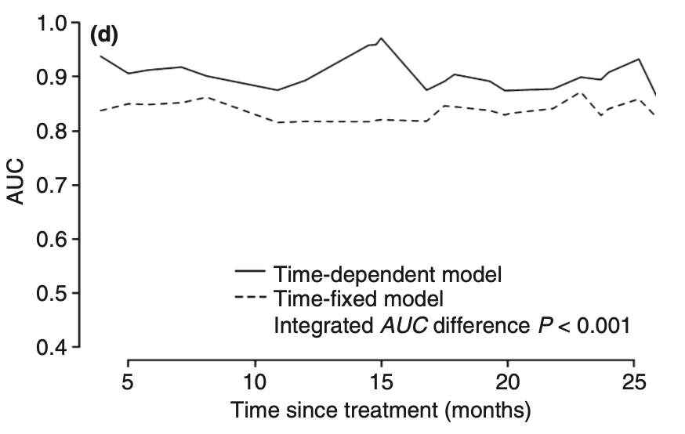
2011
Cabibbo et al. APT 2011

Slide 12
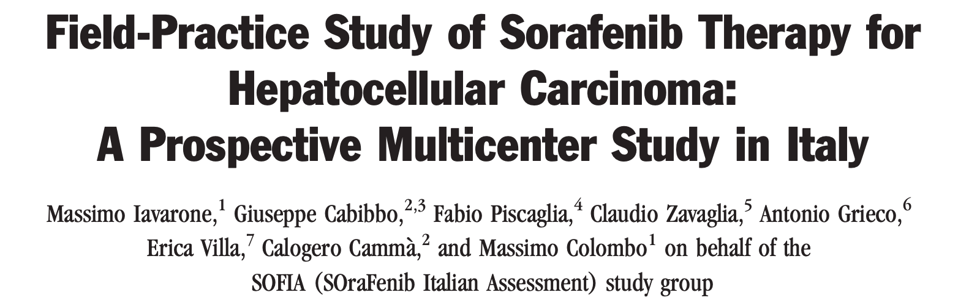
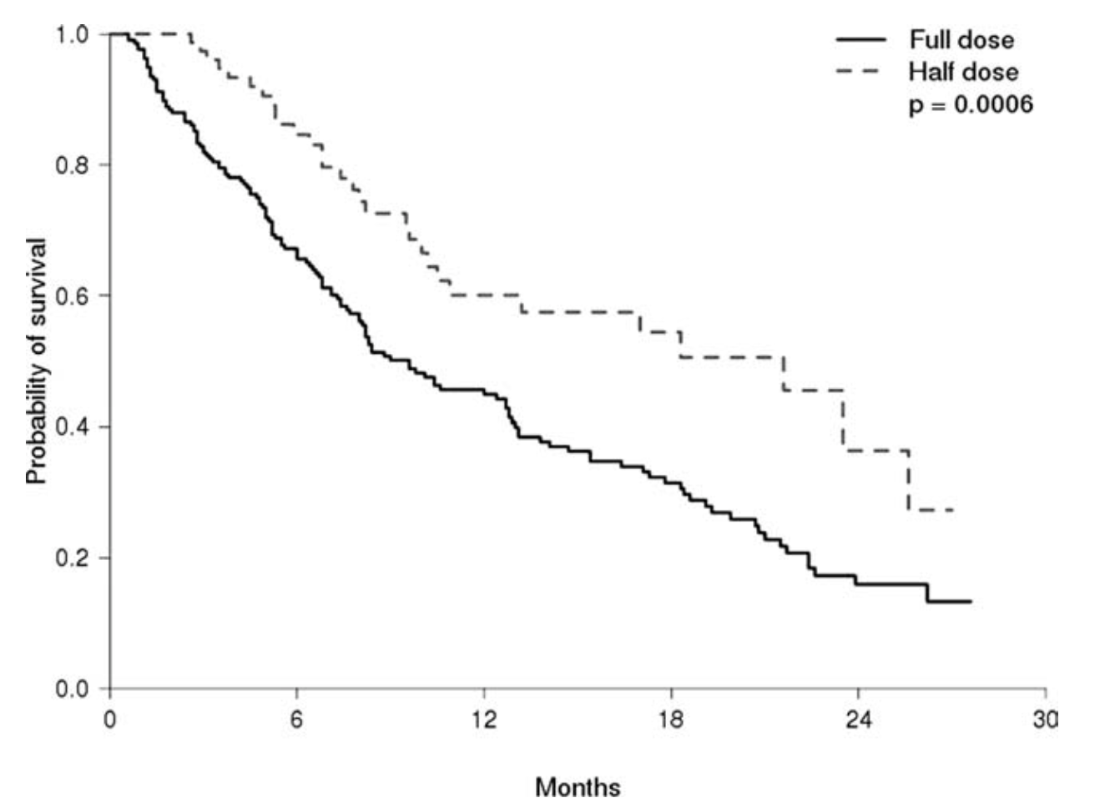
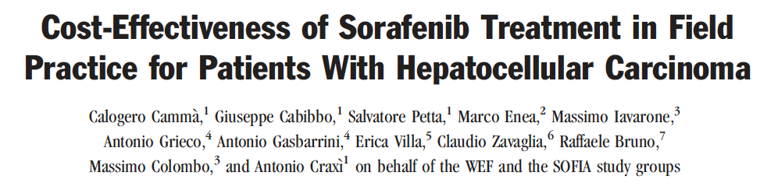
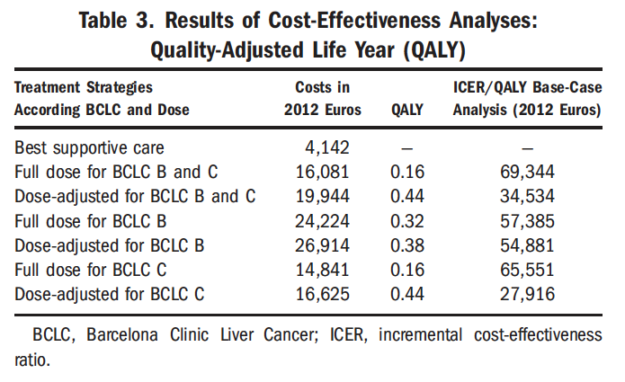
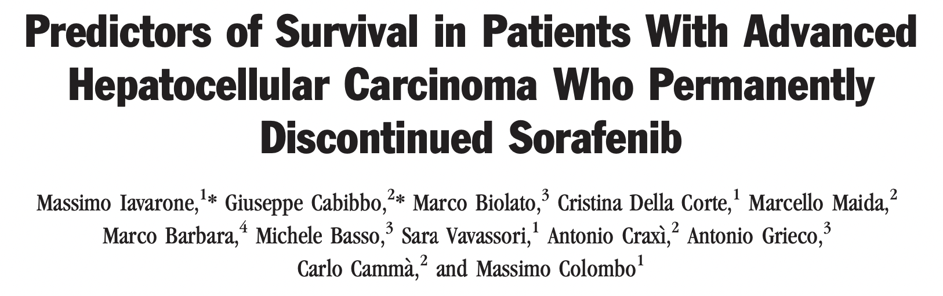
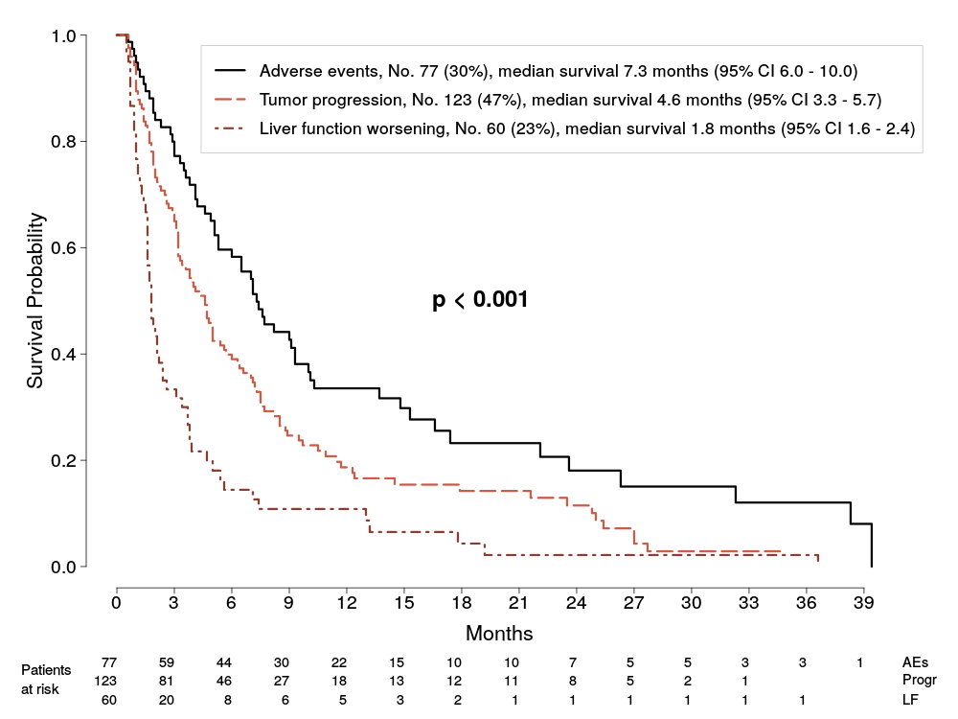
SOFIA studies
2011
2013
2015

Slide 13
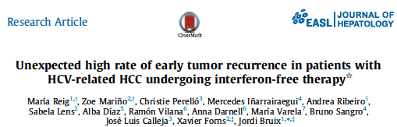
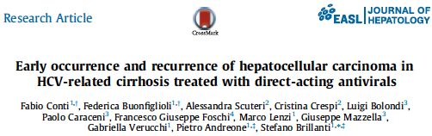
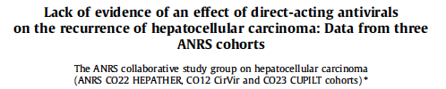

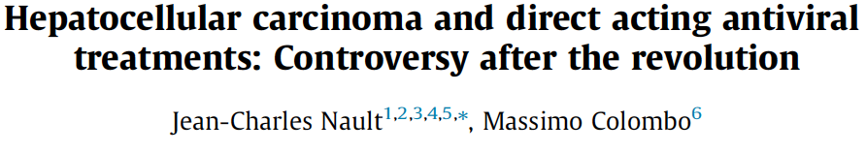

Kolly P. et al. J Hep 2016
Pol. et al. J Hep 2016
Yang JD. et al. J Hep 2016
Cammà C. et al. J Hep 2016
Zavaglia C. et al. J Hep 2017
Pol. et al. J Hep 2016

Slide 14
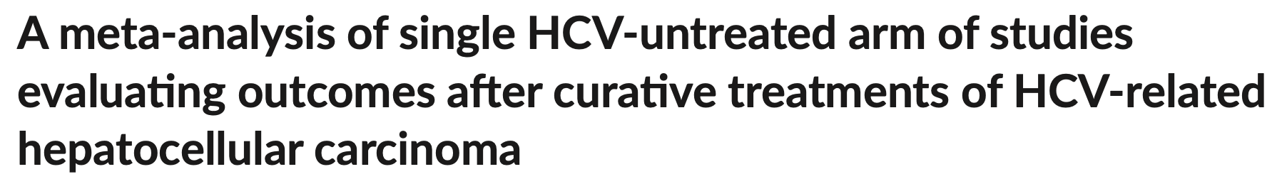
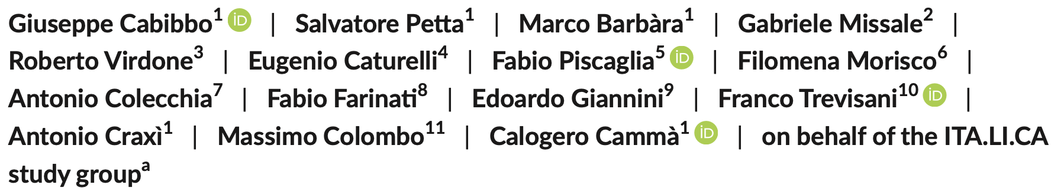
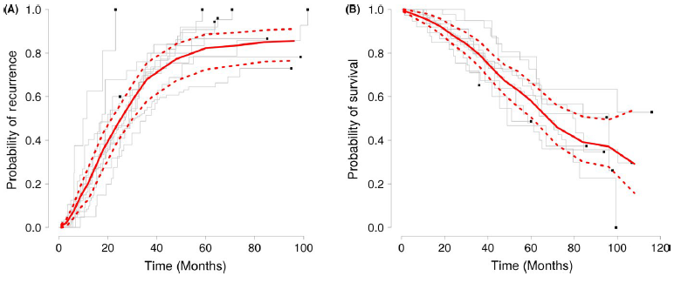
Pooled Actuarial Recurrence Rate
- 24 months: 47% (Range: 32-100%)
Pooled Survival Recurrence Rate
- 5 years : 59% (Range: 47-78%)
Cabibbo et al. Liv Int 2017

Slide 15
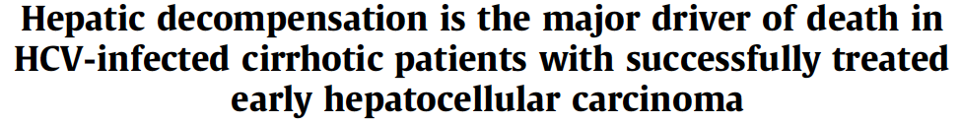
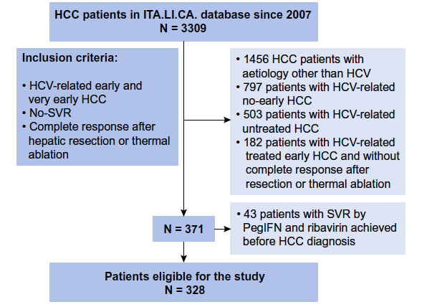
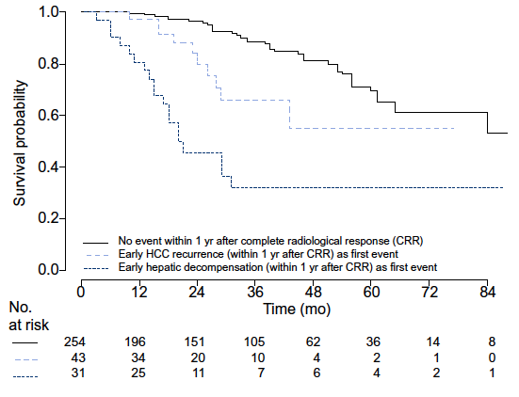
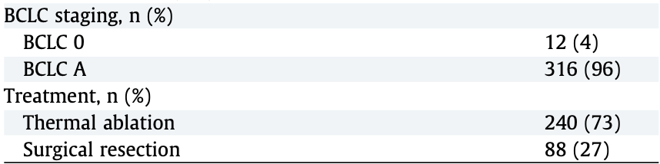

Time dependent Cox model (MV analysis)
Predictor of Survival | HR | 95%CI | P-value
Early recurrence | 2.5 | 1.2-5.1 | 0.01
Early hepatic decompensation | 7.5 | 4.2-13.5 | <0.0001
Cabibbo G. et al, on behalf ITA.LI.CA. Group. J Hep 2017

Slide 16
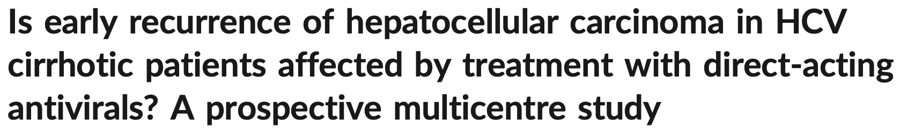
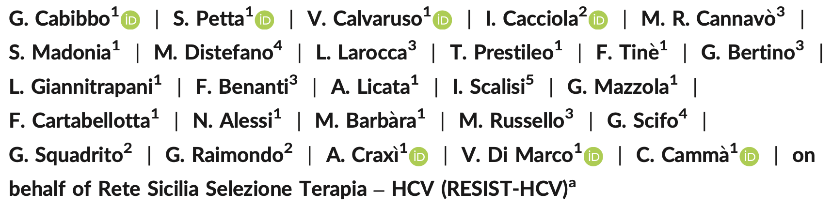
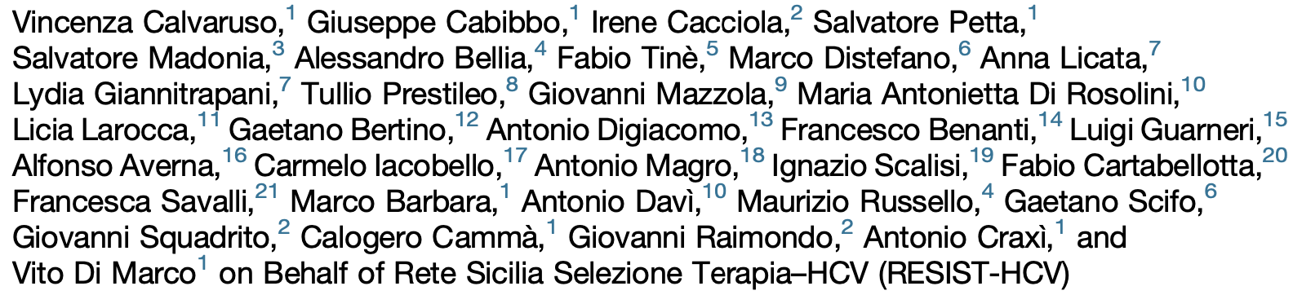
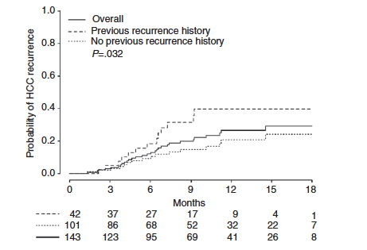
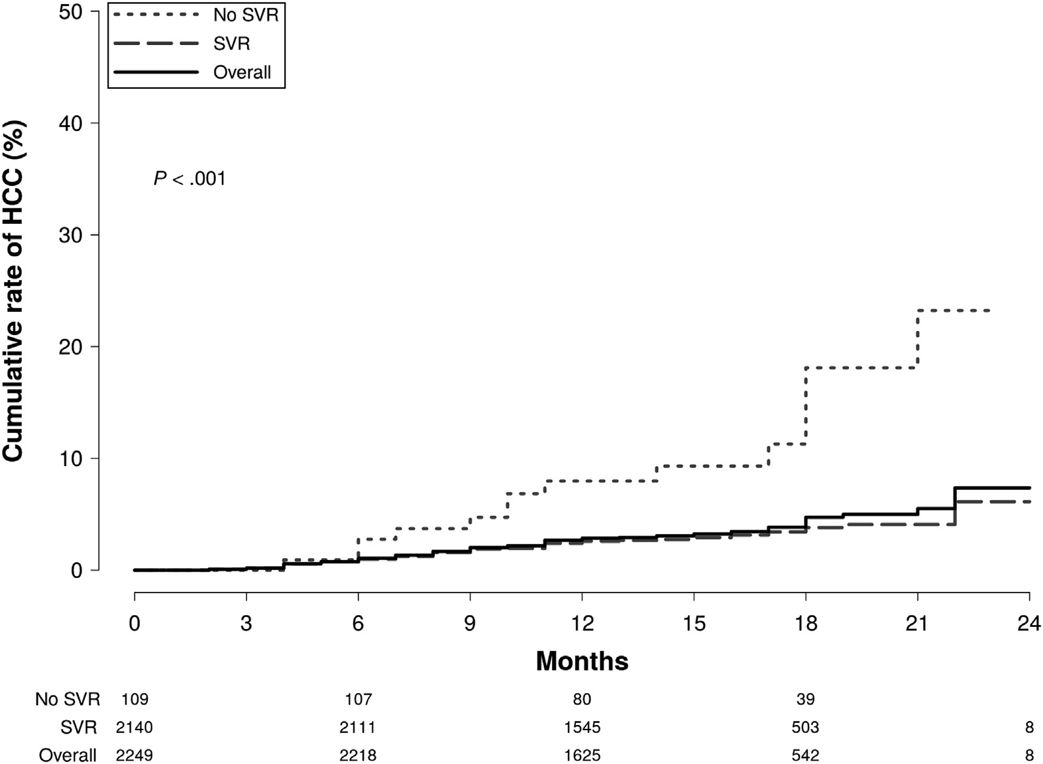
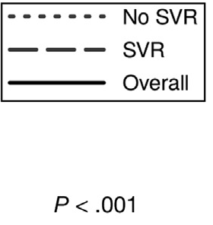
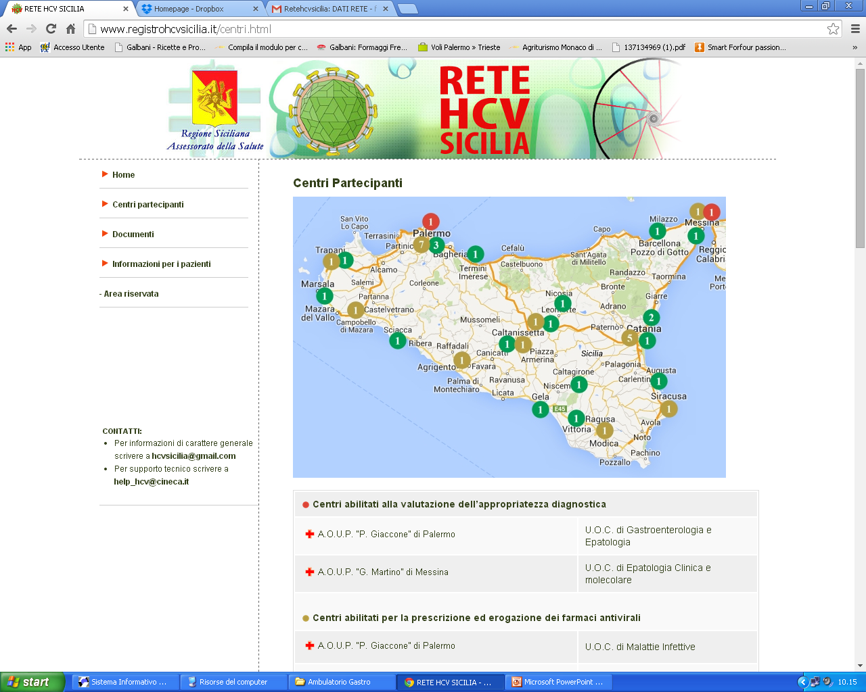
Residual risk
Cabibbo, et al. APT 2018
Calvaruso, et al. Gastroenterology 2018

Slide 17
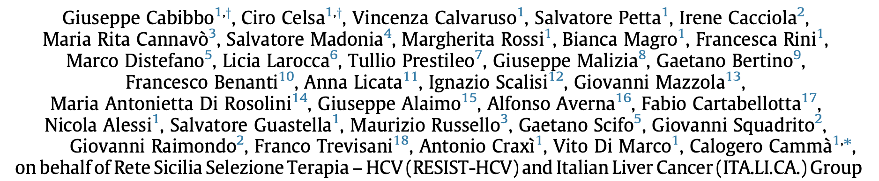


Hepatic decompensation
Survival
Improvement in overall survival seems due to significant reduction in hepatic decompensation
Cabibbo G. et al, on behalf RESIST-HCV & ITA.LI.CA. J Hep 2019

Slide 18





2021
, …
DAA therapy does not increase the risk of recurrence of HCC;
Previous studies have shown that DAA therapy may improve overall survival and reduce the risk of hepatic decompensation.
N=977
Data from 328 DAA-unexposed control patients were obtained from the retrospective study of the prospective ITA.LI.CA. data-base.

Slide 19






Structure of Markov Model
A: Progression Free Survival of first-line. B: Overall survival of second-line.
Cabibbo, Reig et al. Liver Cancer 2021

Slide 20




Terzi et al. J Hep 2017
Singal et al. J Hep 2022

Slide 21


https://doi.org/10.1016/j.dld.2022.01.122
Digestive and Liver Disease 2022

Slide 22


Competing risk for survival in intermediate/advanced HCC patients
Cabibbo & Singal. Journal of Hepatology 2021
Strazzabosco, Cabibbo, Colombo. Gastroenterology 2022
Cabibbo, Celsa, et al. Lancet Oncology 2022
Cabibbo & Bruix. Journal of Hepatology 2022
Cabibbo, Celsa, et al. Hepatology. Accepted
Cabibbo et al. Digestive and Liver Disease 2022

Slide 23






… and what about the HCC molecular characterization?
- Dongiovanni P, et al.
Neurotensin up-regulation is associated with advanced fibrosis and hepatocellular carcinoma in patients with MAFLD.
Biochim Biophys Acta Mol Cell Biol Lipids. 2020
Donati B, et al.
Telomerase reverse transcriptase germline mutations and hepatocellular carcinoma in patients with nonalcoholic fatty liver disease.
Cancer Med. 2017
2019

Slide 24
Future perspective…
Search for biomarkers (invasive or not) of treatment response, risk of recurrence, risk of progression;
Search for mechanisms of resistance to systemic therapies;
Evaluation of gut microbiota;
Role of radiomic in HCC diagnosis and prognosis;
Potential role of adjuvant therapies;
Role of Combination therapies;
…

Slide 25
Rete multidisciplinare per la diagnosi e la terapia dei tumori primitivi del fegato: un modello di gestione integrata e avanzata tra centri HUB e centri SPOKE (decreto assessoriale D.D.G.n.3 69/2020)
Accesso alla rete (centri SPOKE di gastroenterologia, oncologia, medicina interna, malattie infettive )
Finanziamento PSN Euro 850.000
Centri HUB del PSN LIVER CANCER (epatologi, radiologi, chirughi, trapiantologi, oncologi)
Palermo – Unità di Gastroenterologia Policlinico
Palermo- Unità di Medicina Interna Cervello
Palermo- ISMETT
Catania – Unità di Epatologia Garibaldi-Nesima
Messina- Unità di Medicina Interna e Epatologia Policlinico
Definizione della diagnosi e accesso alla terapia
(5 centri HUB)
Gestione multidisciplinare e comunicazione tra i centri HUB
- Tx locoregionali
Tx chirurgiche /OLT
Tx sistemiche
«Disponibilità nella Rete di ogni opzione terapeutica»
Individuale
(Benefit)
Survival
Valutazione della cura
(art. 32 Costituzione)
Collettivo
(Utility)
Riduzione dei costi per complicanze, ricoveri e mobilità passiva

Slide 26


Piattaforma web-based:
Scheda CINECA PSN (attiva per tutti i centri da Gennaio ’22)
Pazienti Arruolati (01.12.2022): report quindicinale
N. Centro | Centro | N. pazienti arruolati
1 | A.O.U.P. P. GIACCONE | 311
2 | ISMETT PALERMO | 254
3 | A.O. CERVELLO-VILLA SOFIA | 180
4 | ARNAS GARIBALDI-NESIMA | 142
5 | A.O.U.P. DI MESSINA G. MARTINO | 138
6 | A.O.U.P. VITTORIO EMANUELE | 21
7 | PRESIDIO OSPEDALIERO DI ACIREALE | 14
8 | PRESIDIO OSPEDALIERO UMBERTO I | 6
9 | ARNAS CIVICO-DI CRISTINA-BENFRATELLI | 5
10 | OSPEDALE BUCCHERI LA FERLA FATEBENEFRATELLI | 5
11 | ISTITUTO ONCOLOGICO MEDITERRANEO DI CATANIA | 4
12 | OSPEDALE DI CEFALU | 2
13 | PRESIDIO OSPEDALIERO S. GIOVANNI DI DIO | 2
14 | OSPEDALE DI ENNA | 1
15 | PRESIDIO OSPEDALIERO DI AUGUSTA | 0
16 | OSPEDALE DI TRAPANI | 0
17 | OSPEDALE DI CALTAGIRONE | 0
18 | PRESIDIO OSPEDALIERO COMISO | 0
19 | OSPEDALE DI MARSALA/MAZZARA | 0
20 | OSPEDALE PAPARDO-PIEMONTE DI MESSINA | 0
21 | OSPEDALE DI MODICA | 0
22 | OSPEDALE CANNIZZARO DI CATANIA | 0
23 | OSPEDALE DI CASTELVETRANO | 0
24 | PRESIDIO OSPEDALIERO M. RAIMONDI | 0
25 | OSPEDALE DI TAORMINA | 0
26 | OSPEDALE LA MADDALENA PALERMO | 0
27 | OSPEDALE DI GELA | 0
28 | CENTRO CATANESE DI ONCOLOGIA HUMANITAS | 0
Numero totale di pazienti arruolati |  | 1085
Imaging storage

Slide 27
Atezolizumab plus bevacizumab in METastatic
Hepatocellular carcinoma Italian Safety TriAl
Palermo Enrollment time: November 2020 to June 21
~150 PATIENTS FROM 21 SITES ACROSS ITALY
Top recruiter
Top recruiter

Slide 28

Prescrivibilità Atezolizumab+Bevacizumab
https://www.regione.sicilia.it/sites/default/files/2022-06/Integrazione%20aggiornamento%20n.71.pdf

Slide 29

Local
therapies
Natural
history
Viruses
Prognosis
HCC
5 Decenni di Studio
dell’Epatocarcinoma
in Sicilia
Systemic
therapies
Modelling

Slide 30


Facile guardare lontano, stando in alto …
… ma non bisogna cadere
e fare la frittata…
… e…

Slide 31
Grazie per l’attenzione
giuseppe.cabibbo@unipa.it

