Slide 1

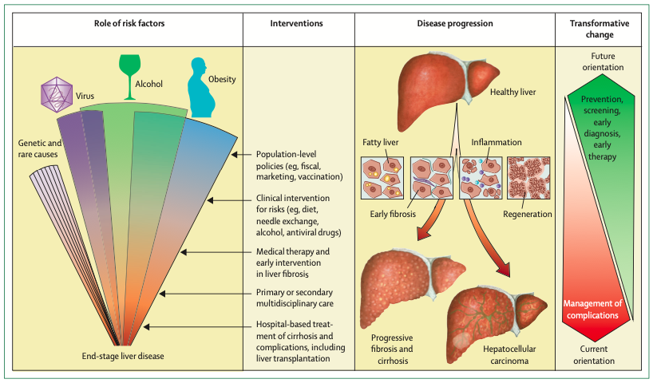
Karlsen TH, Lancet 2022

Slide 2

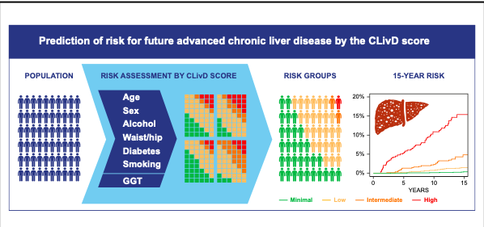
Aberg F, J Hepatol 2022

