Slide 1




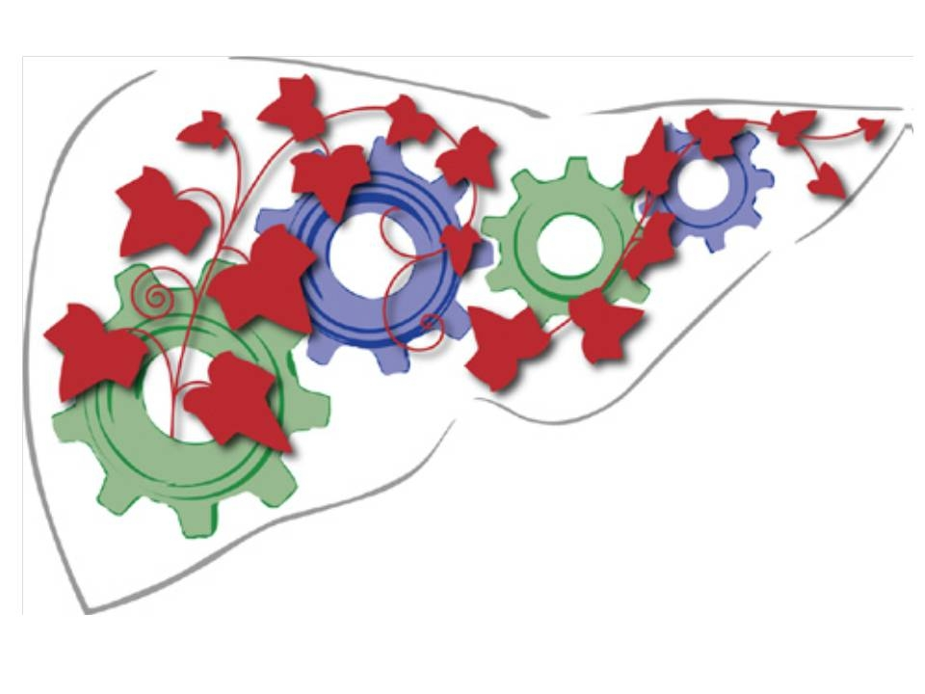
Padova Downtown
Acute on chronic liver failure (ACLF)
P. Angeli, Dept. of Medicine,
Unit of Internal Medicine and Hepatology (UIMH),
University of Padova (Italy)
pangeli@unipd.it
UIMH
Le sfide del trapianto di fegato nel 2023
Lucca, 14-15 Aprile 2023

Slide 2
MANAGEMENT OF PATIENTS WITH CIRRHOSIS
UIMH
2023
Disclosures
2016-2023: Biovie; Advisory Board, Patent
2014-2022: CSL Bhering; Speaker invitation and travel grant
2018-2022: Grifols; Speaker invitation and travel grant
2022-2023: Kedrion; Speaker invitation
2021-2023: Biomarin ; Advisory Board

Slide 3
MANAGEMENT OF PATIENTS WITH CIRRHOSIS
UIMH
2023
Agenda
Pathophysiology of decompensation and organ failures in patients with cirrhosis
Evolution and classification of decompensation in patients with cirrhosis
New insights on the management of decompensation in patients with cirrhosis

Slide 4
MANAGEMENT OF PATIENTS WITH CIRRHOSIS
UIMH
2023
Natural history of cirrhosis
Liver fibrosis
Portal pressure
Hyperdynamic circulation
Activation of endogenous vasoconstrictor factors
 Portal pressure
 Hyperdynamic circulation
 Activation of endogenous vasoconstrictor factors
 Portal pressure
  Hyperdynamic circulation
  Activation of endogenous vasoconstrictor factors
Chronic liver disease
Compensated cirrhosis
Decompensated cirrhosis
Further
decompensated cirrhosis
No varices
Varices
Variceal hemorrhage
Ascites
Encephalopathy
Jaundice
Recurrent variceal hemorrhage
Hyponatremia
Refractory ascites
HRS
Bacterial infection
Hepatocellular carcinoma
Adapted from A. Albillos et al. Dis. Markers. 2011 ; 31 : 121-128
Notes:
References:
Albilllos A, Garcia-Tsao G. Classification of cirrhosis: the clinical use of HVPG measurements. Dis Markers. 2011;31(3):121-8.
2. Jalan R, Yurdaydin C, Bajaj JS, et al. Toward an improved definition of acute-on-chronic liver failure. Gastroenterology. 2014;147(1):4-10.

Slide 5
MANAGEMENT OF PATIENTS WITH CIRRHOSIS
UIMH
2023
Increase in endogenous systemic vasoactive and sodium-retaining molecules in cirrhosis
*
5
*
4.5
Refractory ascites
4
3.5
3
2.5
2
1.5
1
0.5
0
* = times versus compensated cirrhosis
M. Bernardi et al. J. Hepatol. 2015 ; 63 : 1272-1284

Slide 6
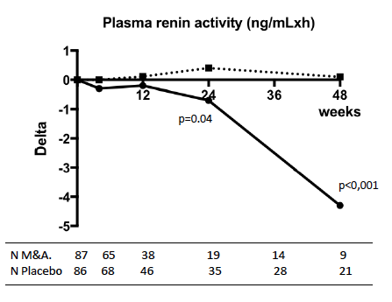
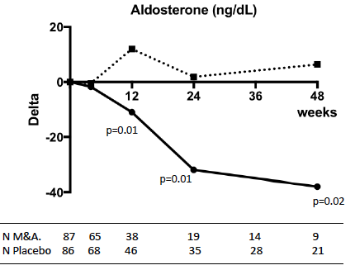
MANAGEMENT OF PATIENTS WITH CIRRHOSIS
UIMH
2023
Effects of albumin (A) at a dose of 40g/15 days plus midodrine (M) at a a dose of 15-30 mg/day versus placebo in patients with cirrhosis and ascites
placebo
placebo
A + M
A + M
E. Sola et al. J Hepatol. 2018 ; 69 : 1250-1259

Slide 7
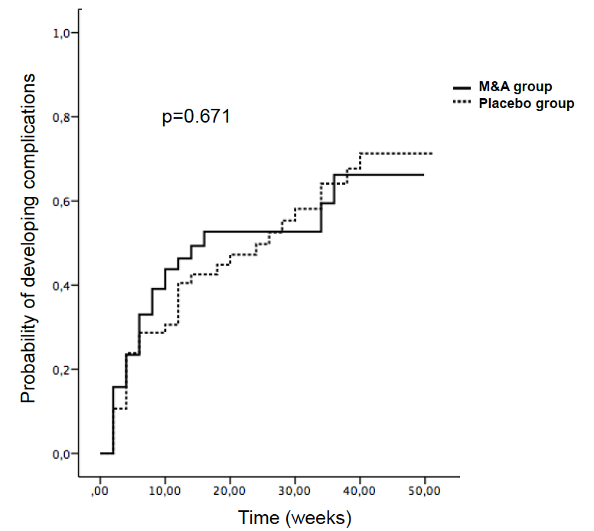
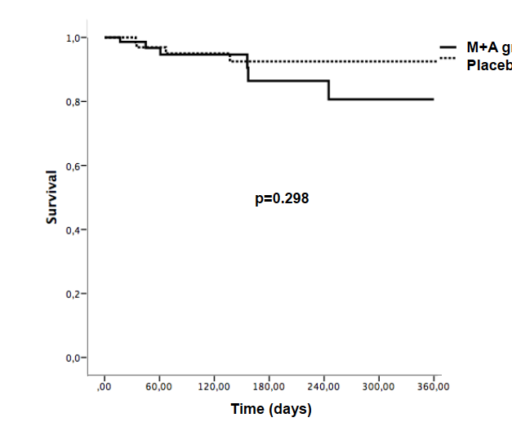
MANAGEMENT OF PATIENTS WITH CIRRHOSIS
UIMH
2023
Effects of albumin (A) at a dose of 40g/15 days plus midodrine (M) at a a dose of 15-30 mg/day versus placebo in patients with cirrhosis and ascites
Probability of developing complications
One year survival
placebo
placebo
placebo
placebo
A + M
A + M
A + M
E. Sola et al. J Hepatol. 2018 ; 69 : 1250-1259

Slide 8
MANAGEMENT OF PATIENTS WITH CIRRHOSIS
UIMH
2023
Natural history of cirrhosis
Chronic liver disease
Compensated cirrhosis
Decompensated cirrhosis
Further
decompensated cirrhosis
Acute on chronic liver failure (ACLF)
Adapted from R. Jalan et al. Gastroenterology 2014 ; 147 : 4-10
Notes:
References:
Albilllos A, Garcia-Tsao G. Classification of cirrhosis: the clinical use of HVPG measurements. Dis Markers. 2011;31(3):121-8.
2. Jalan R, Yurdaydin C, Bajaj JS, et al. Toward an improved definition of acute-on-chronic liver failure. Gastroenterology. 2014;147(1):4-10.

Slide 9
MANAGEMENT OF PATIENTS WITH CIRRHOSIS
UIMH
2023
EASL CLIF diagnostic criteria
Cirrhosis
Acute decompensation
Development of organ failure/s
28 day mortality rate > 15 %
R. Moreau et al. (Canonic study) Gastroenterology 2013 ; 144 : 1426-1437

Slide 10
MANAGEMENT OF PATIENTS WITH CIRRHOSIS
UIMH
2023
Individual values of plasma renin concentration (PRC) and IL-8 in patients with ACLF
8000
•
•
•
•
8000
•
6000
•
•
•
•
•
•
•
•
•
•
•
3000
•
•
4000
•
•
•
•
•
•
•
•
•
•
2000
•
•
•
2000
•
•
•
•
•
•
•
•
•
•
•
800
•
•
•
•
•
•
•
•
•
•
•
410
•
•
•
800
•
•
•
•
•
•
•
•
•
•
•
•
•
•
•
600
•
310
•
•
•
•
•
•
•
•
•
•
•
•
•
•
•
μIUl/ml
•
•
400
•
•
Pg/ml
•
•
•
•
•
•
•
•
•
•
•
•
•
•
•
•
•
210
•
•
•
•
•
•
•
•
•
•
•
•
•
•
•
•
•
•
•
•
•
•
•
•
•
•
•
•
•
•
•
•
•
•
•
•
•
•
•
•
•
•
•
•
•
•
200
•
•
•
•
•
•
•
•
•
•
•
•
•
•
•
•
•
•
•
•
•
•
•
•
•
•
•
•
•
•
•
•
•
•
•
•
•
•
•
•
•
•
•
110
•
•
•
•
•
•
•
•
•
•
•
•
•
•
•
•
•
•
•
•
•
•
•
•
•
•
•
•
•
•
•
•
150
•
•
•
•
•
•
•
•
•
•
•
•
•
•
•
•
•
•
•
•
•
•
•
•
•
•
•
•
•
•
•
•
•
•
•
•
•
•
•
•
•
•
•
•
•
•
•
•
•
•
•
•
•
•
•
•
•
•
•
•
•
•
•
•
•
•
•
•
•
•
•
•
•
•
•
•
•
•
•
•
•
•
•
•
•
•
•
•
•
•
•
•
•
•
•
•
•
•
•
•
•
•
•
•
•
•
•
•
•
•
•
•
•
•
•
•
•
•
•
•
•
•
•
•
•
•
•
•
•
•
•
•
•
•
•
10
•
•
100
•
•
•
•
•
•
•
•
•
•
•
•
•
•
•
•
•
•
•
•
•
•
•
Upper limit of normal range
•
•
•
•
•
•
50
•
•
•
•
•
•
5
•
•
•
•
•
•
•
•
•
•
•
•
Upper limit of normal range
•
•
•
•
•
•
•
•
•
•
•
•
•
•
•
•
•
•
•
•
•
•
•
•
•
•
•
•
•
•
•
•
•
•
•
•
•
•
•
•
•
•
•
•
•
•
•
•
•
•
•
•
•
•
•
0
•
0
PRC
IL-8
J. Claria et al. Hepatology 2016 ; 64 : 1249-1264

Slide 11
MANAGEMENT OF PATIENTS WITH CIRRHOSIS
UIMH
2023
C reactive protein values in patients with acute decompensation and in those with organ failures
* = p < 0.01 versus with acute decompensation
(mg/l)
Upper normal value
Upper normal value
R. Moreau et al. (Canonic study) Gastroenterology 2013 ; 144 : 1426-1437

Slide 12
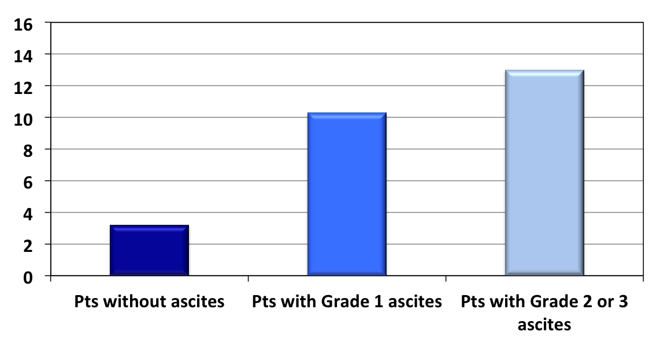
MANAGEMENT OF PATIENTS WITH CIRRHOSIS
UIMH
2023
C-reactive protein in patients with cirrhosis according to the type of ascites
P < 0.001
P < 0.05
P < 0.05
(mg/l)
Upper normal value
Upper normal value
M. Tonon et al. Clin. Gastroenterol. Hepatol. 2021 ; 19 : 358-366

Slide 13
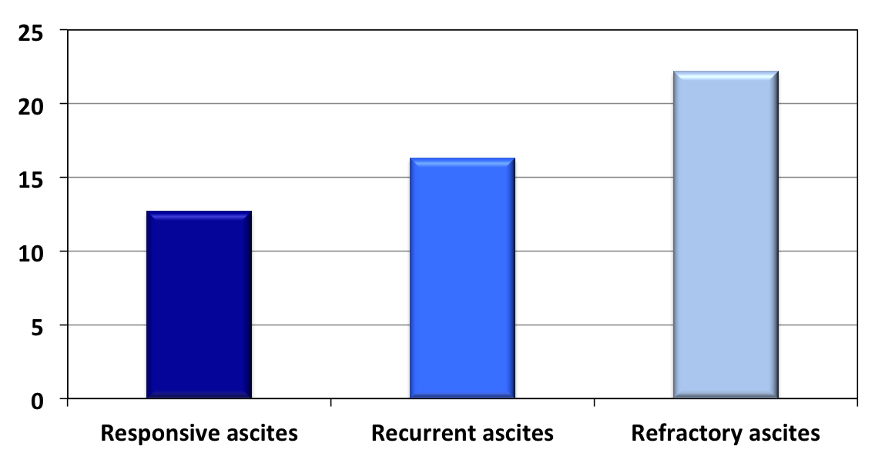
MANAGEMENT OF PATIENTS WITH CIRRHOSIS
UIMH
2023
C-reactive protein in patients with cirrhosis according to the type of ascites
P < 0.05
(mg/l)
Upper normal value
Upper normal value
M. Tonon et al. Clin. Gastroenterol. Hepatol. 2020 ; 19 : 358-366

Slide 14
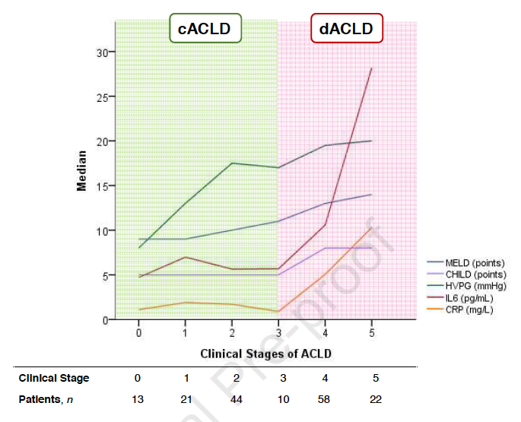
MANAGEMENT OF PATIENTS WITH CIRRHOSIS
UIMH
2023
Dynamics of median MELD, CTP, HVPG, CRP, and IL-6 serum levels across compensated (c) and decompensated (d) stages of chronic liver diseases (ACLD)
D. Costa et al. J. Hepatol. 2021 ; 74 : 819-828

Slide 15
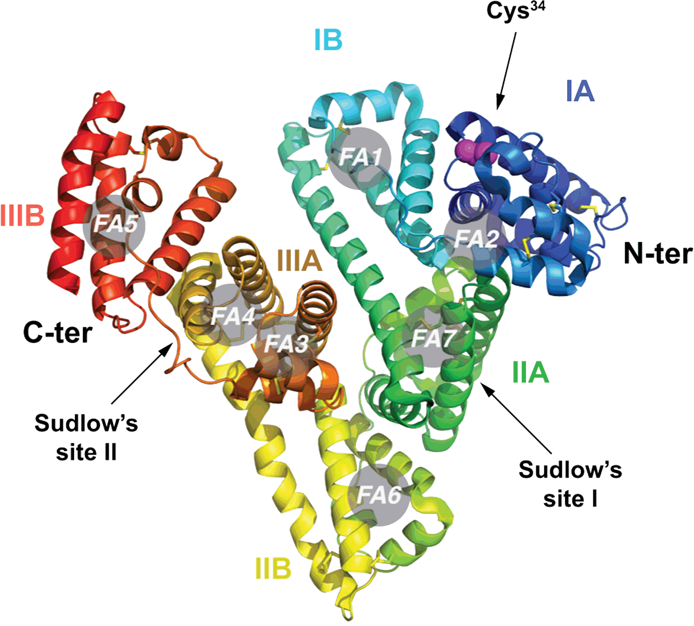
MANAGEMENT OF PATIENTS WITH CIRRHOSIS
UIMH
2023
Albumin molecule with the main binding domains
ROS
R. Jalan et al. Hepatology 2013 ; 59 : 918-920

Slide 16
MANAGEMENT OF PATIENTS WITH CIRRHOSIS
UIMH
2023
Albumin oxidation fractions in patients with cirrhosis
 | Healthy Subjects (n° = 40) | AD (n°= 285) | ACLF (n° = 237) | P
HMA (%) | 71 (68-74) | 53 (42.62) | 45 (33-56) | < 0.001
HNA₁+ HNA₂ (%) | 28 (25-30) | 46.4 (37.5-56.9) | 51.8 (42.2-65.6) | <0.001
HNA₂ (%) | 1.3 (0.3-0.9) | 4.5 (2.5-8.8) | 9.8 (5.6-14.8) | < 0.001
J. Claria et al. Hepatology 2016 ; 64 : 1249-1264

Slide 17
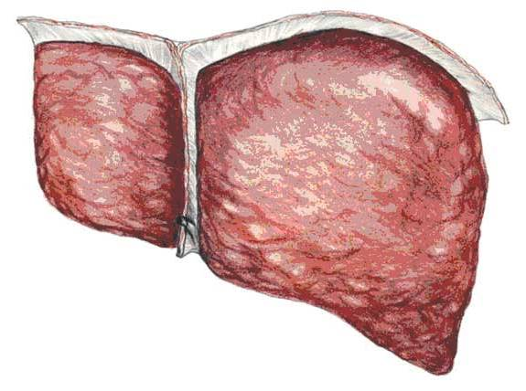
MANAGEMENT OF PATIENTS WITH CIRRHOSIS
UIMH
2023
New pathophysiological hypothesis
Other mechanisms?
Portal hypertension/liver failure
Bacterial translocation
PFs
Inflammatory/Oxidative state
Severe inflammatory/oxidative state
Splanchnic vasodilation
Cardiac dysfunction
Reduction of effective circulating volume
PFs
Activation of endogenous vasoconstrictor
and sodium and water retaining factors
Ascites
Organ failures
Adapted from M. Bernardi et al. J. Hepatol. 2015 ; 63 : 1272 - 1284

Slide 18
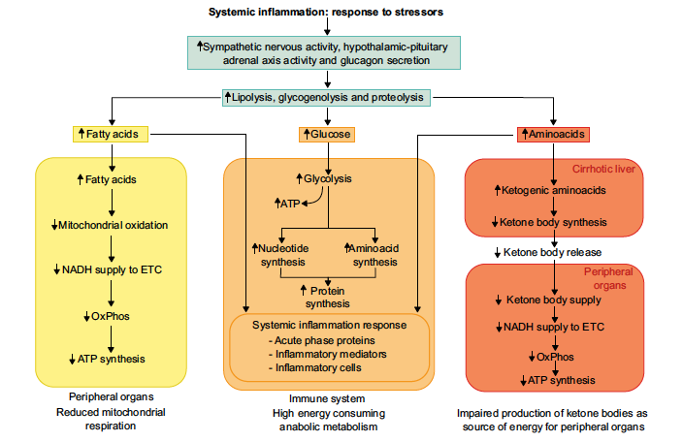
MANAGEMENT OF PATIENTS WITH CIRRHOSIS
UIMH
2023
Impaired function and damage of mitochondria in patients with AD
V. Arroyo et al. J. Hepatol. 2021 ; 74 : 670-685
Notes:
Ahora tratemos de entender cómo la inflamación sistémica puede causar daño y disfunción de órganos e introduzco las 2 diapositivas más complejas de mi presentación. En la primera, los conceptos fundamentales son 2: 1) la inflamación del sistema y la propia oxidación estimulan la proteólisis y la lipólisis, pero la mayoría de los productos metabólicos resultantes se desvían hacia las células del sistema inmunitario y luego se eliminan de las células de los órganos periféricos. 2) la producción de otros productos metabólicos, capuchones de cetonas, se reduce en el hígado.

Slide 19
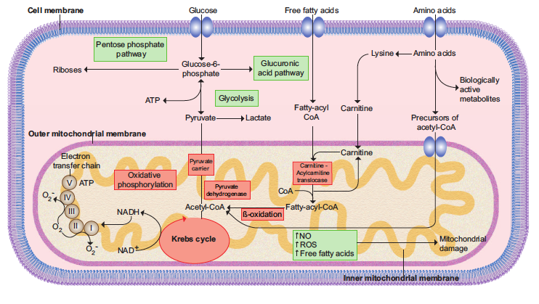
MANAGEMENT OF PATIENTS WITH CIRRHOSIS
UIMH
2023
Impaired function of mitochondria and mitochondria damage in patients with AD
V. Arroyo et al. J. Hepatol. 2021 ; 74 : 670-685
Notes:
En el segundo vemos cómo los productos de la inflamación sistémica y el estrés oxidativo determinan una disfunción y daño mitocondrial por lo que la glucosa es desviada hacia el citosol con un menor rendimiento energético y la beta oxidación de los ácidos grasos se ve gravemente comprometida. Por lo tanto, se crea un déficit de energía severo en las células de los órganos periféricos.

Slide 20
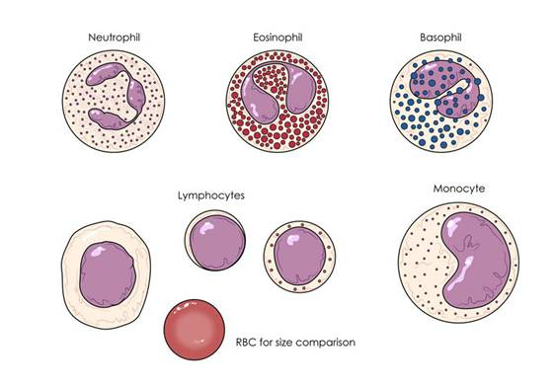

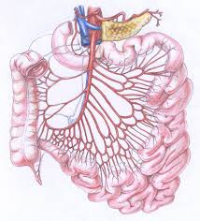
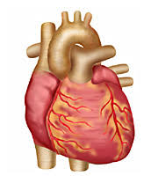
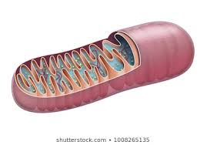

MANAGEMENT OF PATIENTS WITH CIRRHOSIS
UIMH
2023
Patogenesis of organ failure/s
Proinflammatory
citokines
PAMPs or DAMPs
APC
NO
ROS
Cardiovascular dysfunction
Mitochondrial dysfunction
Organ failure/s
Notes:
Para simplificar los conceptos, puede ver en esta diapositiva cómo el desarrollo de la respuesta inmunitaria a los PAMP o DAMP crea una infusión sistémica y roba energía. Los NOS y ROS que se producen como consecuencia de la inflamación sistémica y el estrés oxidativo determinan por un lado la disfunción cardio-circulatoria y por otro lado la disfunción/daño mitocondrial con el consiguiente déficit energético en las células de los órganos periféricos.

Slide 21
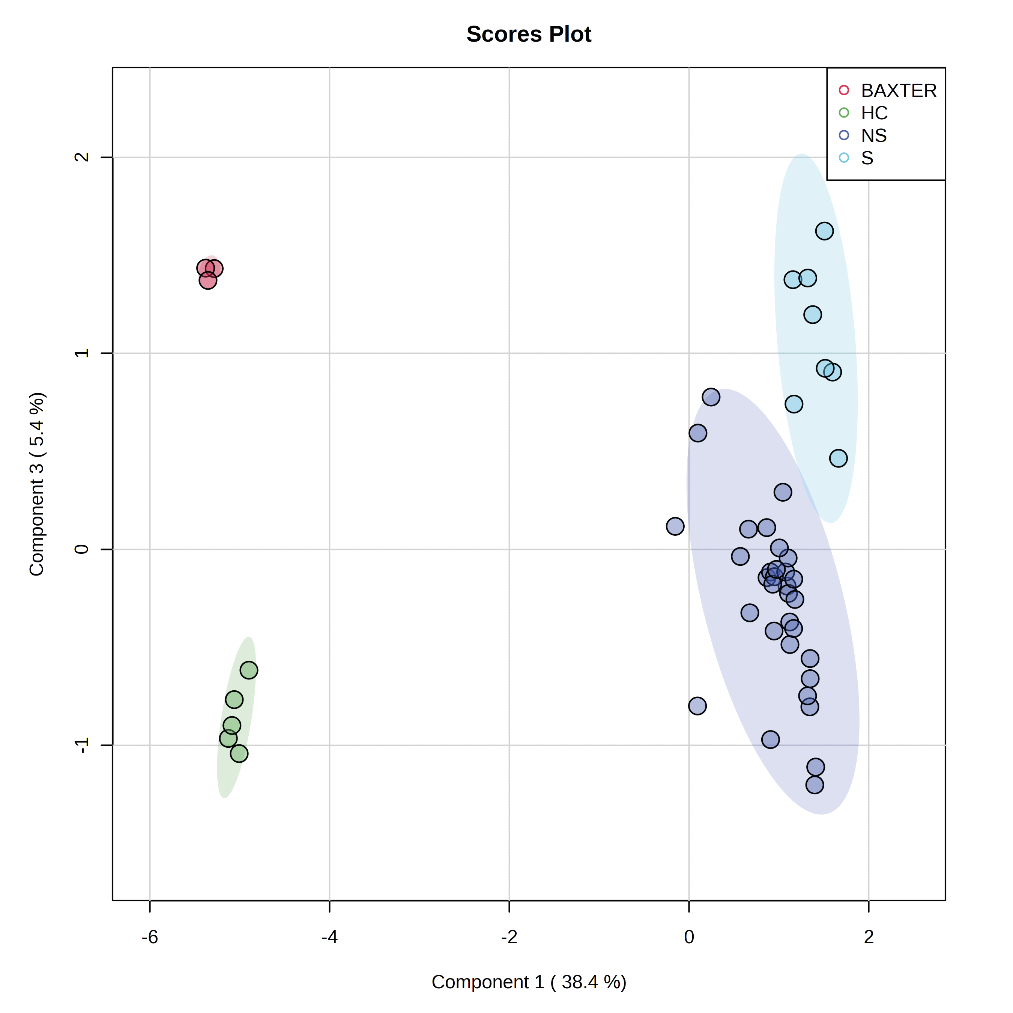
MANAGEMENT OF PATIENTS WITH CIRRHOSIS
UIMH
2023
Albumin-bounded metabolomics profile in patients with ALF
ALF S
Baxter sol
HS
ALF NS
N. Sharma et al. J. Hepatol. 2023 ; (in press)

Slide 22
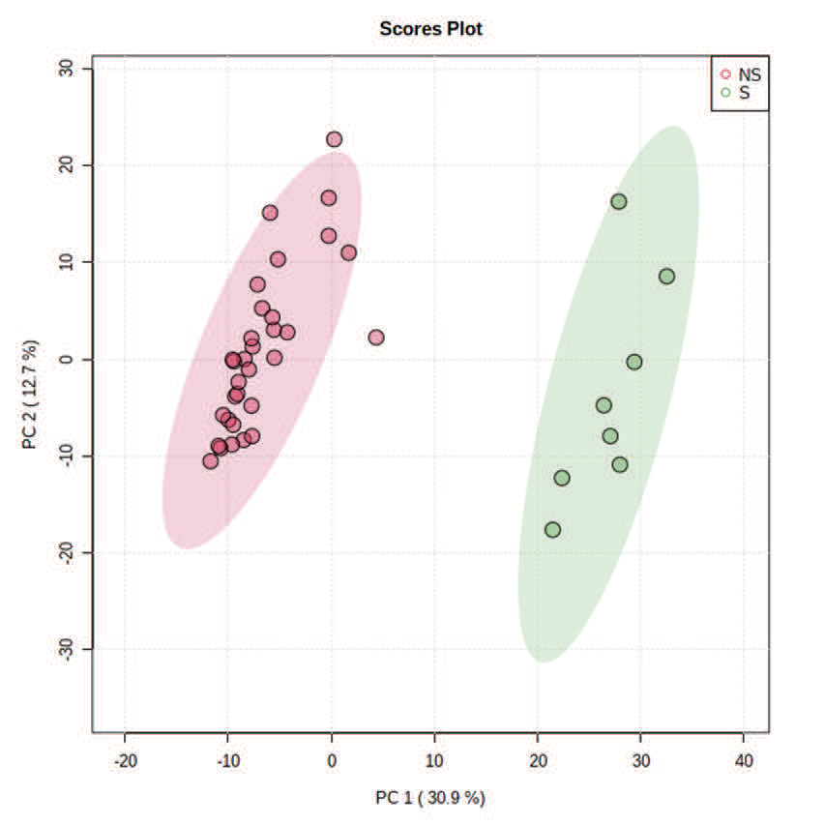
MANAGEMENT OF PATIENTS WITH CIRRHOSIS
UIMH
2023
Segregation of ALF-non survivors on the basis of the principal component analysis of albumin-bounded multi-omics signatures
ALF NS
ALF S
N. Sharma et al. J. Hepatol. 2023 ; (in press)

Slide 23
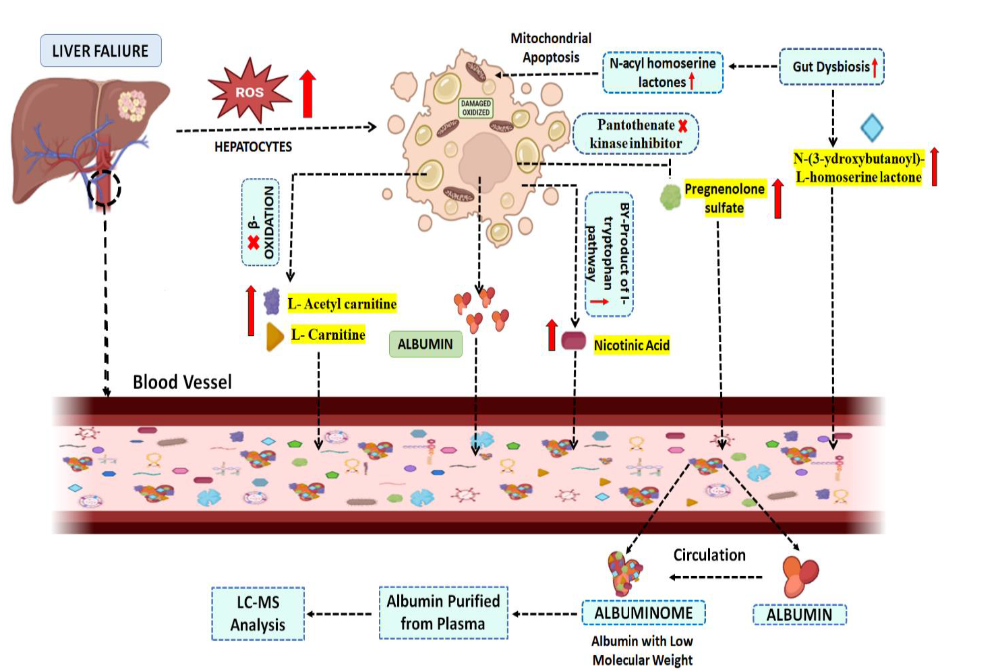
MANAGEMENT OF PATIENTS WITH CIRRHOSIS
UIMH
2023
Evidence of iperinflammation and mithocondrial failure by albuminome
N. Sharma et al. J. Hepatol. 2023 ; (in press)

Slide 24
MANAGEMENT OF PATIENTS WITH CIRRHOSIS
UIMH
2023
Agenda
Pathophysiology of decompensation and organ failures in patients with cirrhosis
Evolution and classification of decompensation in patients with cirrhosis

Slide 25
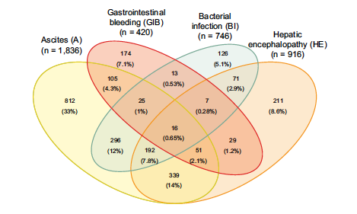
MANAGEMENT OF PATIENTS WITH CIRRHOSIS
UIMH
2023
Combinations of major complications at AD development
V. Arroyo et al. J. Hepatol. 2021 ; 74 : 670-685

Slide 26
MANAGEMENT OF PATIENTS WITH CIRRHOSIS
UIMH
2023
Dynamics and classification of decompensation in patients with cirrhosis
Acute on chronic
liver failure (ACLF)
20.3%
Mortality rate at 3 months = 53.7%
?
Acute decompensation (AD)
21.7%
Unstable decompensated
cirrhosis (UDC)
57.8%
Mortality rate at 3 months = 21.0%
Stable decompensated
cirrhosis (SDC)
Mortality at 1 year of only 9.5%
J. Trebicka et al. J. Hepatol. 2020 ; 73 : 842-854

Slide 27

MANAGEMENT OF PATIENTS WITH CIRRHOSIS
UIMH
2023
Prevention is better than cure
Bernardino Ramazzini (Carpi, 4 ottobre 1633 – Padova, 5 novembre 1714) «Thought developed during the bovine plague of the Venetian Republic in the early eighteenth century»

Slide 28
MANAGEMENT OF PATIENTS WITH CIRRHOSIS
UIMH
2023
Number of prevalent cases of compensated and decompensated cirrhosis in 1990 and 2017
7,9 %
9,5 %
(milion)
Lancet 2020 ; 5 : 245-266

Slide 29


MANAGEMENT OF PATIENTS WITH CIRRHOSIS
UIMH
2023
New definition of decompensation in patients with cirrhosis
Acute onset
Bleeding
Grade 3 ascites
Grade 3 or 4 encephalopathy
Bacterial infection
AD
ACLF
First
decompensating event
?
OLT
Compensated cirrhosis
?
Further decompensation
?
DEATH
Progressive onset
Grade 2 ascites
Grade 1 or 2 encephalopathy
Jaundice
NAD
Adapted from G. D’Amico et al. J Hepatol. 2022 ; 76 : 202-207

Slide 30
MANAGEMENT OF PATIENTS WITH CIRRHOSIS
UIMH
2023
Dynamics and classification of decompensation in patients with cirrhosis
Patients with compensated
cirrhosis
(n°= 749)
Acute on chronic
liver failure (ACLF)
20.3%
Mortality rate at 3 months = 53.7%
Acute decompensation (AD)
n°= 163 (21.8%)
n°= 207 (27.6%)
21.7%
Unstable decompensated
cirrhosis (UDC)
n°= 83 (50.9%)
57.8%
Mortality rate at 3 months = 21.0%
Non Acute
Decompensation
(NAD)
Stable decompensated
cirrhosis (SDC)
Cirrhosis with ascites
Mortality at 1 year of only 9.5%
M. Tonon et al. ILC 2022
J. Trebicka et al. J. Hepatol. 2020 ; 73 : 842-854

Slide 31
MANAGEMENT OF PATIENTS WITH CIRRHOSIS
UIMH
2023
CRP level according according to the type of decompensation
P < 0.001
M. Tonon et al. ILC 2022

Slide 32
MANAGEMENT OF PATIENTS WITH CIRRHOSIS
UIMH
2023
Probability of survival according to the type of decompensation
months
M. Tonon et al. ILC 2022

Slide 33
MANAGEMENT OF PATIENTS WITH CIRRHOSIS
UIMH
2023
Dynamics and classification of decompensation in patients with cirrhosis
Patients with compensated
cirrhosis
(n°= 749)
Acute on chronic
liver failure (ACLF)
20.3%
Mortality rate at 3 months = 53.7%
Acute decompensation (AD)
n°= 163 (21.8%)
n°= 207 (27.6%)
21.7%
Unstable decompensated
cirrhosis (UDC)
n°= 83 (50.9%)
57.8%
Mortality rate at 3 months = 21.0%
Non Acute
Decompensation
(NAD)
Stable decompensated
cirrhosis (SDC)
Cirrhosis with ascites
?
Mortality at 1 year of only 9.5%
M. Tonon et al. ILC 2022
J. Trebicka et al. J. Hepatol. 2020 ; 73 : 842-854

Slide 34
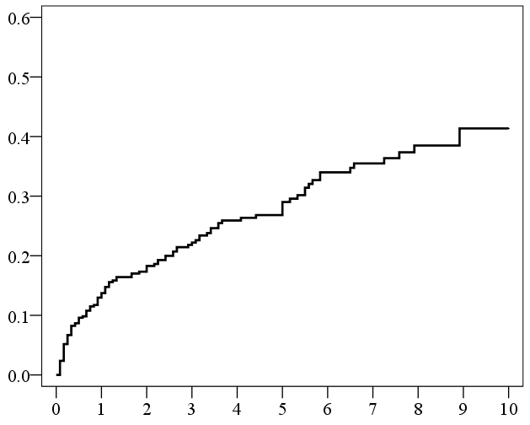
MANAGEMENT OF PATIENTS WITH CIRRHOSIS
UIMH
2023
Cumulative probability to develop ACLF in outpatients with cirrhosis
Probability of developing ACLF
41%
29%
14%
Time (Years)
S. Piano et al. J. Hepatol. 2017 ; 67 : 1177-1184

Slide 35
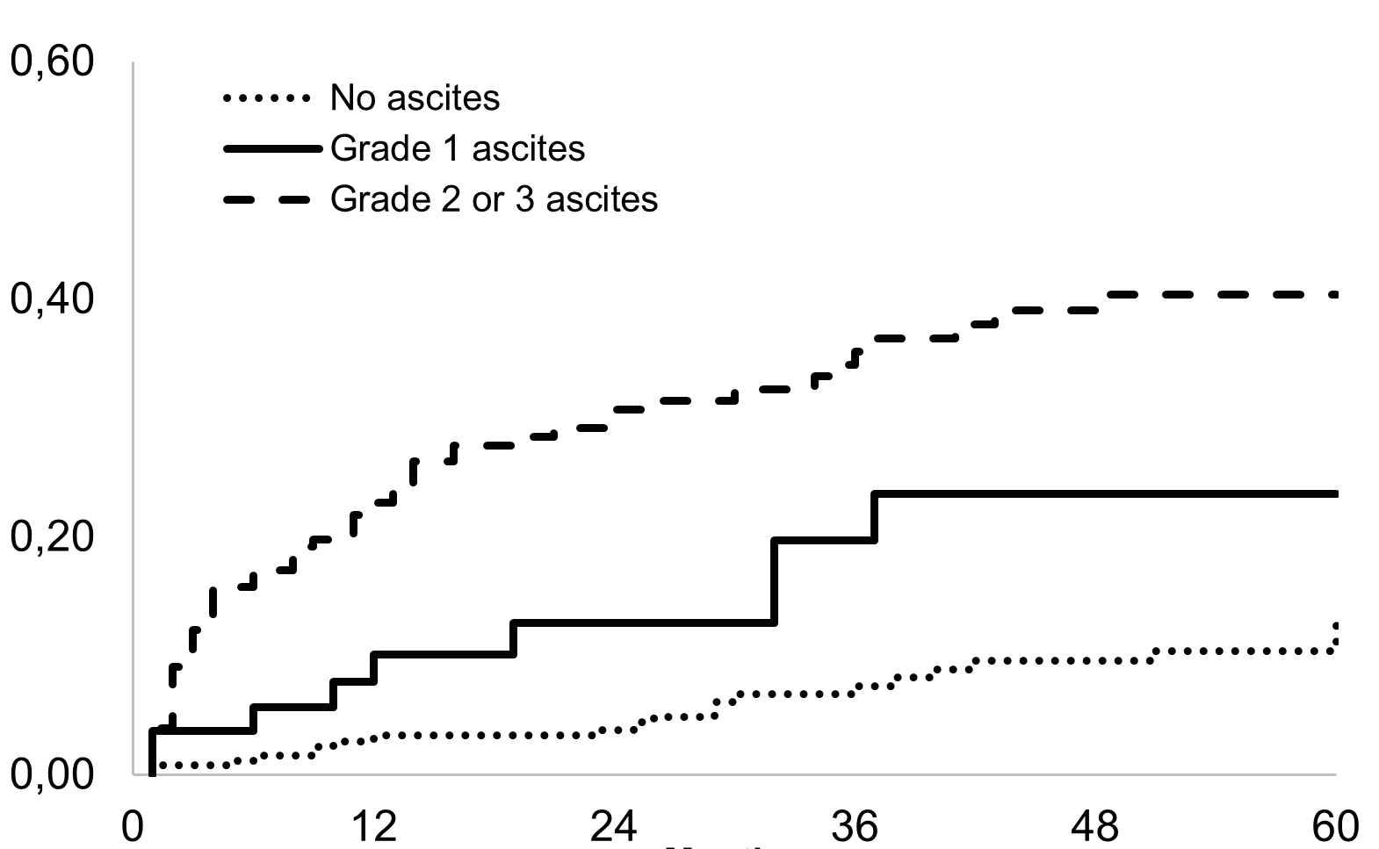
MANAGEMENT OF PATIENTS WITH CIRRHOSIS
UIMH
2023
Probability to develop ACLF according to the presence and the grade of ascites in patients with cirrhosis
mo
P < 0.001, without ascites vs grade 1; P < 0.038, without ascites vs grade 2 or 3; P < 0.001, grade 1 ascites vs grade 2 or 3
M. Tonon et al. Clin. Gastroenterol. Hepatol. 2021 ; 19 : 358-366

Slide 36
MANAGEMENT OF PATIENTS WITH CIRRHOSIS
UIMH
2023
Incidence, predictors and outcome of acute-on-chronic liver failure in outpatients with cirrhosis
Parameter | HR (CI) | P
Presence of ascites | 3.00 (0.93-0.99) | 0.026
MAP | 0.96 (0.01-0.81) | 0.005
MELD | 1.29 (1.20-1.40) | 0.001
Haemoglobin | 0.09 (0.01-0.81) | 0.032
S. Piano et al. J. Hepatol. 2017 ; 67 : 1177-1184.

Slide 37
MANAGEMENT OF PATIENTS WITH CIRRHOSIS
UIMH
2023
Agenda
Pathophysiology of decompensation and organ failures in patients with cirrhosis
Evolution and classification of decompensation in patients with cirrhosis
New insights on the management of decompensation in patients with cirrhosis
Prevention

Slide 38
MANAGEMENT OF PATIENTS WITH CIRRHOSIS
UIMH
2023
Dynamics and classification of decompensation in patients with cirrhosis
Patients with compensated
cirrhosis
(n°= 749)
Acute on chronic
liver failure (ACLF)
Acute decompensation (AD)
n°= 163 (21.8%)
n°= 207 (27.6%)
Unstable decompensated
cirrhosis (UDC)
n°= 83 (50.9%)
Non Acute
Decompensation
(NAD)
Stable decompensated
cirrhosis (SDC)
Cirrhosis with ascites
M. Tonon et al. ILC 2022
J. Trebicka et al. J. Hepatol. 2020 ; 73 : 842-854

Slide 39
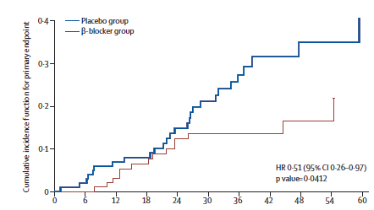
MANAGEMENT OF PATIENTS WITH CIRRHOSIS
UIMH
2023
Probability to develop decompensation according to the use of β-blockers in patients with cirrhosis and HVPG ≥ 10 mm Hg
mo
C. Villanueva et al. Lancet 2019 ; 393 : 1597-1608

Slide 40
MANAGEMENT OF PATIENTS WITH CIRRHOSIS
UIMH
2023
The role of «FIVE» to identify patients with compensated Advanced Chronic Liver Disease (cACLD) at risk of clinically relevant decompensating events
Risk of decompensation
Platelet count ≥ 150.000/mm³
Platelet count < 150.000/mm³
5 kPa
10 kPa
15 kPa
20 kPa
25 kPa
Suspect cACLD
Assume cACLD
Assume cACLD
Exclude cACLD
Exclude CSPH
Assume CSPH
Possibility of recompensation
Adapted from R. De Franchis et al. J. Hepatol. 2022 ; 76 : 959-974

Slide 41

MANAGEMENT OF PATIENTS WITH CIRRHOSIS
UIMH
2023

Slide 42
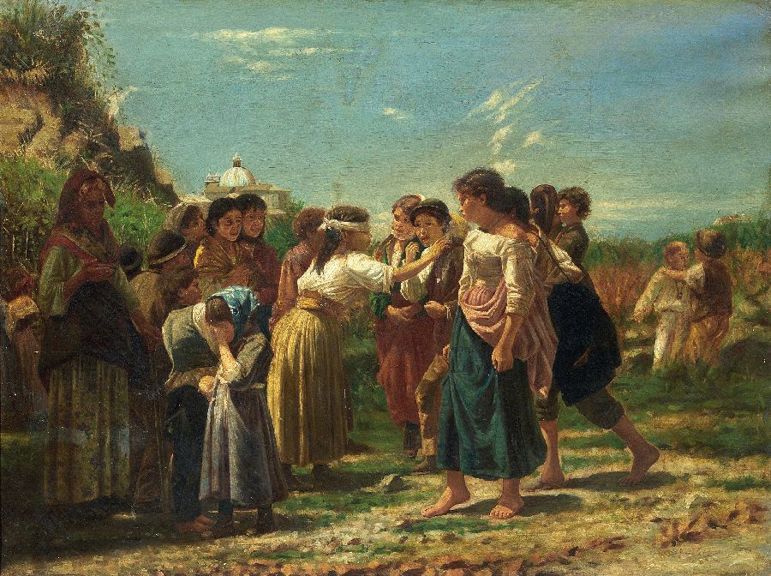
MANAGEMENT OF PATIENTS WITH CIRRHOSIS
UIMH
2022
Use of Non Selective Beta-Blockers (NSBB) in patients with end-stage liver disease
Non
responder
Physician
Responder
Responder
Unknown Italian painter in the nineteenth century

Slide 43
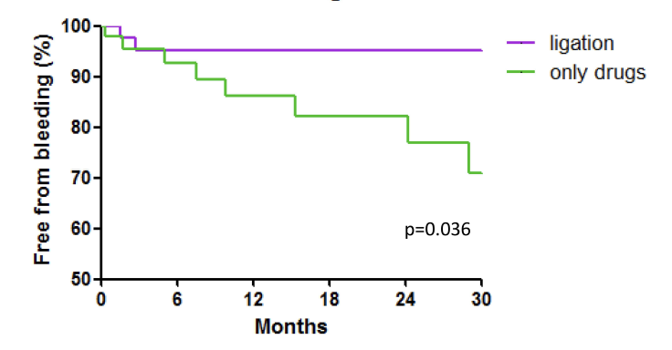
MANAGEMENT OF PATIENTS WITH CIRRHOSIS
UIMH
2023
Probability to be free from bleeding according to the prophylactic strategy in patients with cirrhosis with worsening esophageal varices while on 𝛃-blockers
V. Pepe et al. Clin. Exp. Pharmacol. 2022 ; 15 : 59-65

Slide 44
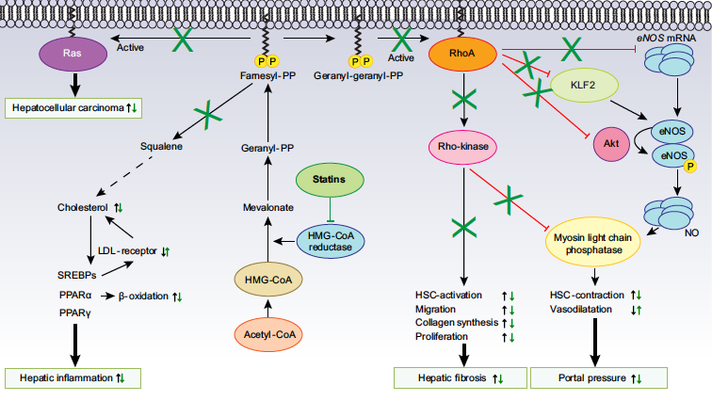
MANAGEMENT OF PATIENTS WITH CIRRHOSIS
UIMH
2023
Molecular basis of the effect of statins within the liver
E. Pose et al. J. Hepatol. 2019 ; 70 : 194-202

Slide 45
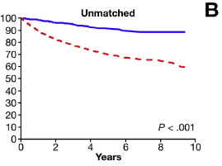
MANAGEMENT OF PATIENTS WITH CIRRHOSIS
UIMH
2023
Probability to be free from decompensation according to the use of statins
User
Non user
A. Mohanty et al. Gastroenterology 2016 ; 150 : 430-440

Slide 46
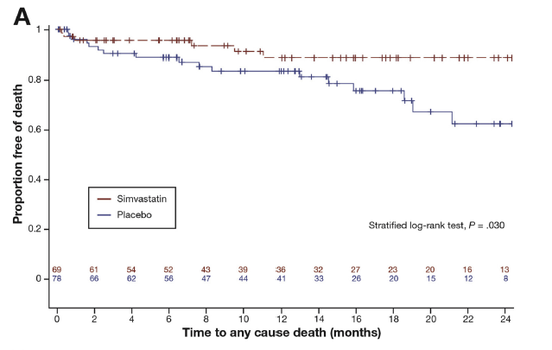
MANAGEMENT OF PATIENTS WITH CIRRHOSIS
UIMH
2023
Probability of survival in patients with cirrhosis treated with simvastatin or placebo
mo
J.G. Albrades et al. Gastroenterology 2016 ; 150 : 1160-1170

Slide 47
MANAGEMENT OF PATIENTS WITH CIRRHOSIS
UIMH
2023
Dynamics and classification of decompensation in patients with cirrhosis
Patients with compensated
cirrhosis
(n°= 749)
Acute on chronic
liver failure (ACLF)
Acute decompensation (AD)
n°= 163 (21.8%)
n°= 207 (27.6%)
Unstable decompensated
cirrhosis (UDC)
n°= 83 (50.9%)
Non Acute
Decompensation
(NAD)
Stable decompensated
cirrhosis (SDC)
Cirrhosis with ascites
M. Tonon et al. ILC 2022
J. Trebicka et al. J. Hepatol. 2020 ; 73 : 842-854

Slide 48
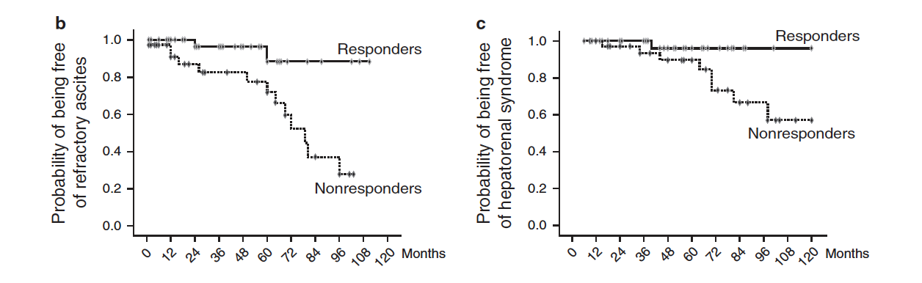
MANAGEMENT OF PATIENTS WITH CIRRHOSIS
UIMH
2023
Probability of development of refractory ascites and hepatorenal syndrome in patients with according to hemodynamic response (defined as a decrease in HVPG > 10 % from baseline)
Refractory ascites
Hepatorenal syndrome
P = 0.007
P = 0.027
V. Hernandez-Gea et al. Am. J. Gastroenterol. 2012 ; 107 : 418-427

Slide 49

MANAGEMENT OF PATIENTS WITH CIRRHOSIS
UIMH
2023
Simvastatin plus rifaximin vs placebo in patients with decompensated cirrhosis to prevent ACLF development: a multicenter, double-blind, placebo controlled randomized clinical trial
Primary endpoint
Incidence of AD and ACLF and rate of mortality at 12 months

Slide 50
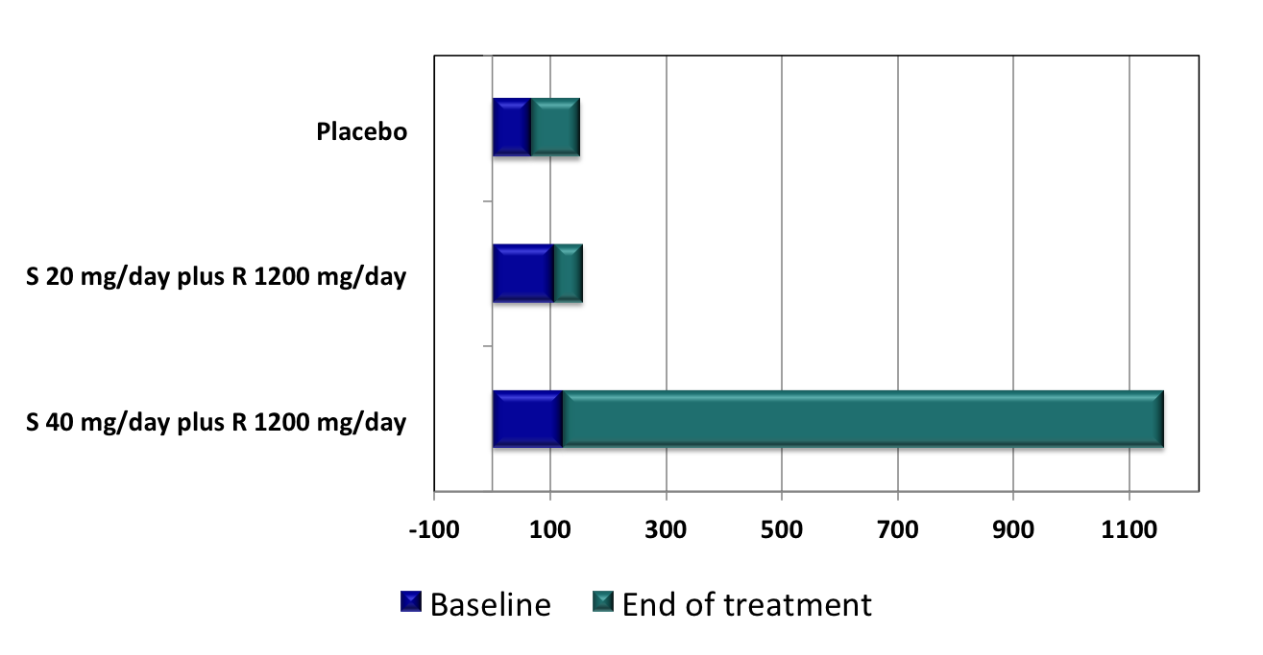
MANAGEMENT OF PATIENTS WITH CIRRHOSIS
UIMH
2023
Effects of two different doses of simvastatin (S) and rifaximin (R) on creatine kinase (IU/l)
E. Pose et al. et al. Lancet Gastroenterol. Hepatol. 2020 ; 5 : 31-41

Slide 51
MANAGEMENT OF PATIENTS WITH CIRRHOSIS
UIMH
2023
Efficacy study
Embargo
E. Pose et al. et al. EASL Congress - Late breaking abstract ; June 2023

Slide 52
MANAGEMENT OF PATIENTS WITH CIRRHOSIS
UIMH
2023
420 Patients with cirrhosis and uncomplicated ascites
ongoing treatment with anti-aldosteronics (≥ 200 mg/day) and furosemide (≥ 25 mg/die)
Randomization
1:1
Stratified by:
LVP in the last month
Serum sodium 135 mmol/L
Standard Medical Treatment
+
Albumin 40 grams x 2/week
for the initial 2 weeks,
then 40 grams/week
Standard
Medical
Treatment
END OF THE STUDY
Death
TIPS
OLT
3 paracentesis/month
Lost follow-up or medical judgment
End follow-up: 18 months
Notes:
52

Slide 53
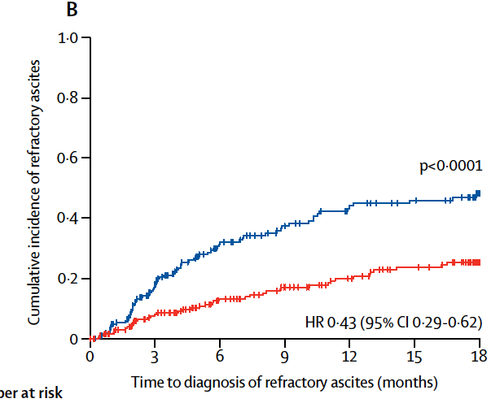
MANAGEMENT OF PATIENTS WITH CIRRHOSIS
UIMH
2023
Cumulative incidence of refractory ascites
SMT
SMT+HA
P. Caraceni et al . Lancet 2018 ; 391 : 2417-2429

Slide 54
MANAGEMENT OF PATIENTS WITH CIRRHOSIS
UIMH
2023
Complications of cirrhosis
CLINICAL EVENT | IRR* | p-value
SBP (diagnosed or suspected) | 0.30 (-70%) | <0.001
HE episodes (grade III-IV) | 0.47 (-53%) | <0.001
Renal impairment (creatinine >1.5 mg/dl) | 0.43 (-57%) | <0.001
Non-SBP bacterial infections | 0.74 (-26%) | <0.05
Variceal bleeding | 0.98 (-2%) | 1.000
*Incidence Rate Ratio (SMT+HA/SMT)
P. Caraceni et al . Lancet 2018 ; 391 : 2417-2429

Slide 55
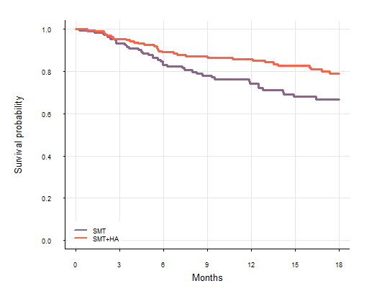
MANAGEMENT OF PATIENTS WITH CIRRHOSIS
UIMH
2023
Overall survival
SMT+HA
SMT
p < 0.025
P. Caraceni et al . Lancet 2018 ; 391 : 2417-2429

Slide 56

MANAGEMENT OF PATIENTS WITH CIRRHOSIS
UIMH
2023
The Real World Evidence (RWE)
RCTs
RWE
H.J. Scünemann et al. Res. Synth. Methods 2013 ; 4 : 49-62.

Slide 57
MANAGEMENT OF PATIENTS WITH CIRRHOSIS
UIMH
2023
Real world evidence on Long-term Treatment with Human Albumin Solution (LT-HAS) in patients with decompensated cirrhosis
(% Reduction of secondary endpoints)
Secondary endponit | % reduction LT-HAS versus SOC | P
Refractory ascites | - 44.2 | < 0.025
SBP | -52.7 | < 0.01
HRS | - 62.4 | < 0.005
HE | -13.1 | N.S.
Hospital admissions | -24.6 | < 0.05
W. Laleman et al. 2023 ; (Abstract submitted at ILC)

Slide 58
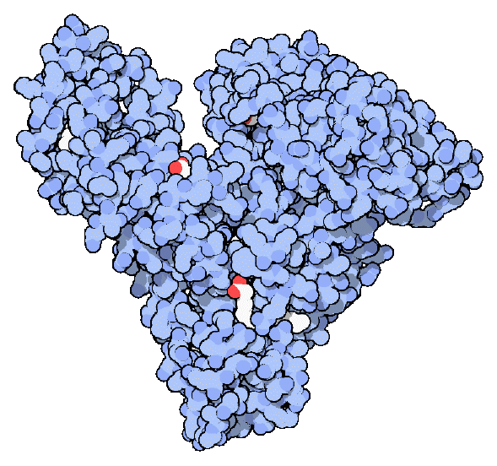
MANAGEMENT OF PATIENTS WITH CIRRHOSIS
UIMH
2023
Properties of albumin
Oncotic
Non oncotic
Solubilization and transport
Binding of endogenous and exogenous compounds including drugs
Antioxidant
Free radical and metal ion scavenging
Hemostatic effect
No binding at Cys-34
Regulation of
fluid distribution
Endothelial stabilization
Immunomodulation and
antioxidant properties
Negative net charge
High molecular weight
High plasma concentration
Immunomodulation
Endotoxins binding, modulation of intracellular redox state, TNFα inhibition,
PGE binding
Regulation of extracellular pH
Binding of H⁺
Anti-inflammatory action

Slide 59
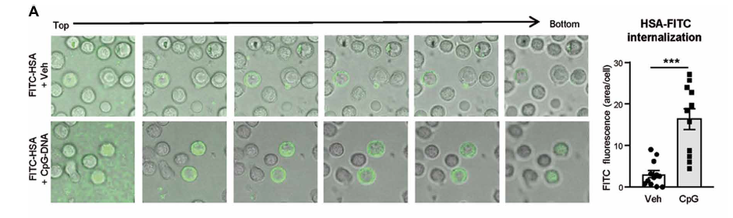
MANAGEMENT OF PATIENTS WITH CIRRHOSIS
UIMH
2023
Human albumin internalization in leukocytes
M. Casulleras et al. Sci. Transl. Med. 2020 ; 12 (566) : eaax5135

Slide 60
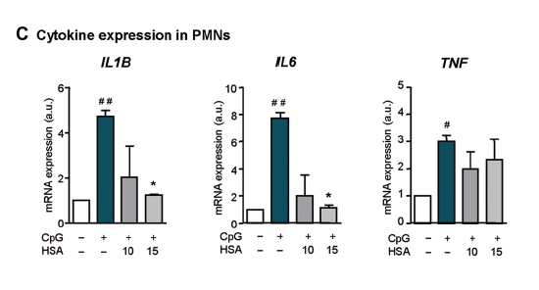
MANAGEMENT OF PATIENTS WITH CIRRHOSIS
UIMH
2023
HAS blocks a DAMP induced cytokine release in leukocytes
M. Casulleras et al. Sci. Transl. Med. 2020 ; 12 (566) : eaax5135

Slide 61
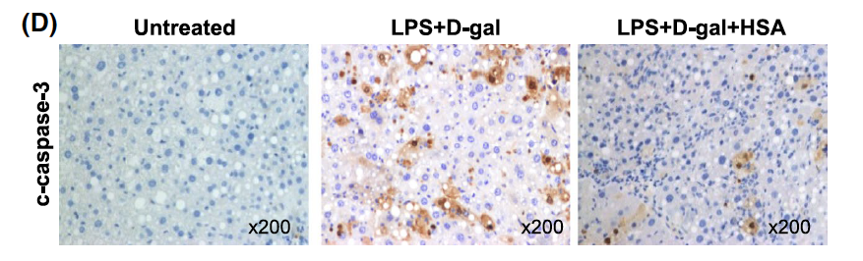
MANAGEMENT OF PATIENTS WITH CIRRHOSIS
UIMH
2023
Cytoprotective effect of Human albumin solution (HAS) on hepatocytes
M. Duran-Guell et al. FASEB 2021 ; 35 : e21365

Slide 62
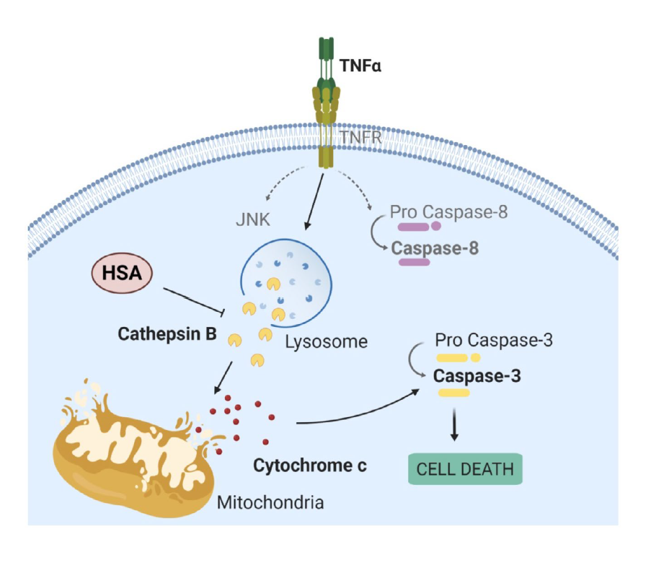
MANAGEMENT OF PATIENTS WITH CIRRHOSIS
UIMH
2023
Cytoprotective effect of Human albumin solution (HAS) on hepatocytes
M. Duran-Guell et al. FASEB 2021 ; 35 : e21365

Slide 63
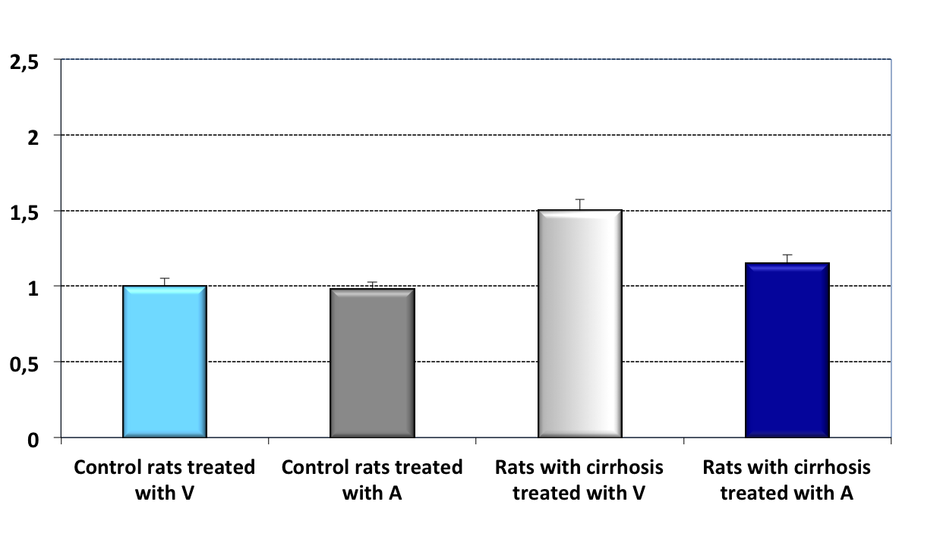
MANAGEMENT OF PATIENTS WITH CIRRHOSIS
UIMH
2023
Effects of albumin on TNF-α protein expression in the cardiac tissue according to treatment with vehicle (V) or albumin (A)
* p<0.05 vs controls
# p<0.05 vs rats with cirrhosis treated with V
Protein expression
(fold of increase)
*
#
A. Bortoluzzi et al. Hepatology 2013 ; 57 : 266-276

Slide 64
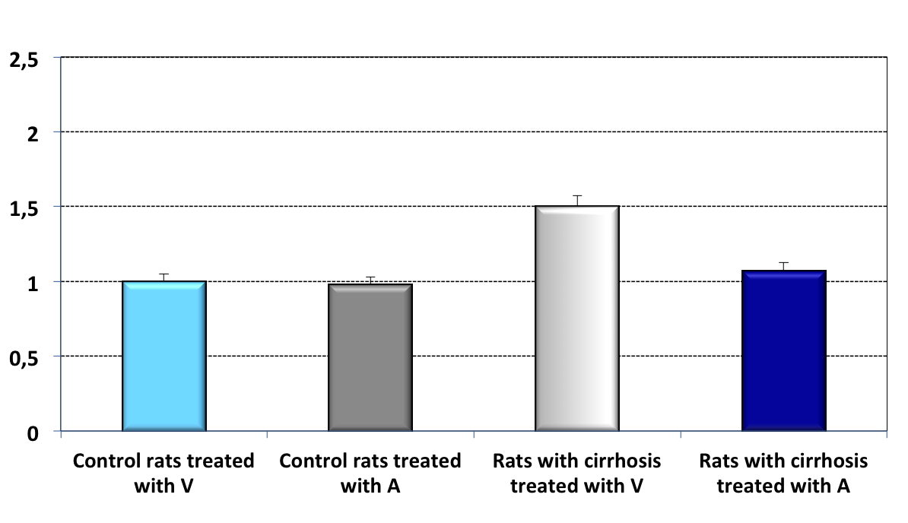
MANAGEMENT OF PATIENTS WITH CIRRHOSIS
UIMH
2023
Effects of albumin on iNos protein expression in the cardiac tissue according to treatment with vehicle (V) or albumin (A)
* p<0.05 vs controls
# p<0.05 vs rats with cirrhosis treated with V
*
Protein expression
(fold of increase)
#
A. Bortoluzzi et al. Hepatology 2013 ; 57 : 266-276

Slide 65
MANAGEMENT OF PATIENTS WITH CIRRHOSIS
UIMH
2023
Effects of albumin on cardiac contractility in cirrhotic rats
25
Control
Cirrhotic + starch
20
Cirrhotic + albumin
*
15
*
Cirrhotic
LVDP (mm Hg)
10
Δ
5
* = P < 0.01
0
-10.0
-9.5
-9.0
-8.5
-8.0
Log . Isoproterenol
A. Bortoluzzi et al. Hepatology 2013 ; 57 : 266-276

Slide 66
MANAGEMENT OF PATIENTS WITH CIRRHOSIS
UIMH
2023
Effects of albumin administration on cardiocirculatory function
P=.09
P=.04
LAlbD
HAlbD
(1 g/Kg body weight every 2 weeks)
(1.5 g/Kg body weight every week)
J. Fernandez et al. Gastroenterology 2019 ; 157 : 149-162

Slide 67
MANAGEMENT OF PATIENTS WITH CIRRHOSIS
UIMH
2023
Ratio between the final value and baseline value of serum concentration of IL -6
%
Baseline
(1.5 g/Kg body weight every week)
On treatment
Baseline
(1 g/Kg body weight every 2 weeks)
On treatment
J. Fernandez et al. Gastroenterology 2019 ; 157 : 149-162

Slide 68

MANAGEMENT OF PATIENTS WITH CIRRHOSIS
UIMH
2023
Prevention of Mortality with Long-Term Administration of Human Albumin in Subjects with acute decompensation and ascites
Primary endpoint
12-month transplant free survival

Slide 69
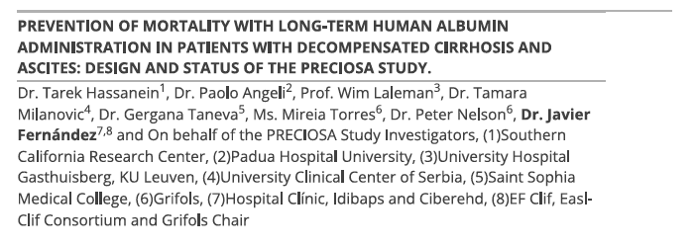
MANAGEMENT OF PATIENTS WITH CIRRHOSIS
UIMH
2023

Slide 70

MANAGEMENT OF PATIENTS WITH CIRRHOSIS
UIMH
2023
Albumin is not a magic potion

Slide 71
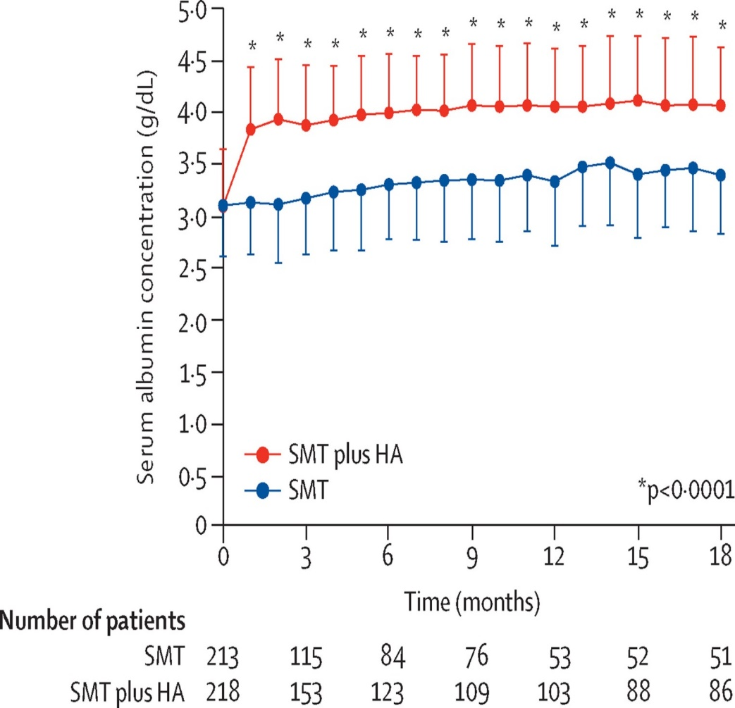
MANAGEMENT OF PATIENTS WITH CIRRHOSIS
UIMH
2023
Changes in the plasma albumin concentration of the Answer and Macht trials
ANSWER TRIAL
MACHT TRIAL
Placebo
P=0.684
A + M
Total amount of albumin administered in 63 days:
MACHT: 160 grams
ANSWER: 400 grams
P. Caraceni et al. J Hepatol. 2021 ; 75 Suppl 1 :S118-S134.

Slide 72
MANAGEMENT OF PATIENTS WITH CIRRHOSIS
UIMH
2023
Effects of albumin (A) at a dose of 40g/15 days plus midodrine (M) at a a dose of 15-30 mg/day versus placebo in patients with cirrhosis and ascites
Probability of developing complications
One year survival
placebo
placebo
placebo
placebo
A + M
A + M
A + M
E. Sola et al. J Hepatol. 2018 ; 69 : 1250-1259

Slide 73
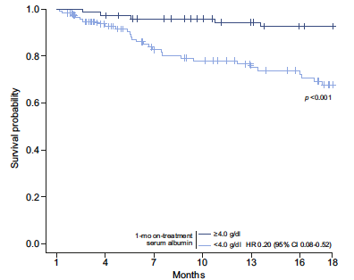
MANAGEMENT OF PATIENTS WITH CIRRHOSIS
UIMH
2023
On treatment 1-month serum albumin level and survival
2-3 mo
Albumin ≥ 4.0 g/dl
Albumin < 4.0 g/dl
P. Caraceni et al. J. Hepatol. 2021 ; 74 : 340-349

Slide 74
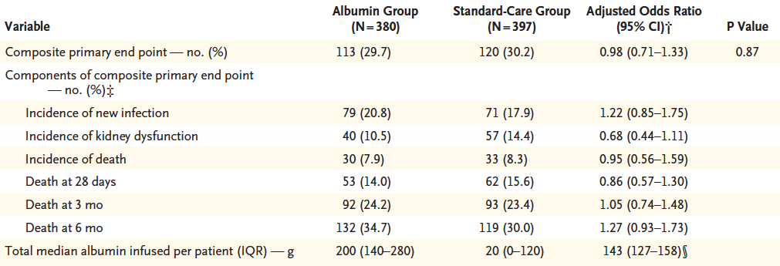
MANAGEMENT OF PATIENTS WITH CIRRHOSIS
UIMH
2023
Impact of i.v. albumin andiministration during the hospitalization on complications other than ascites and on mortality
L. China et al. N. Engl. J. Med. 2021 ; 384 : 808-817

Slide 75
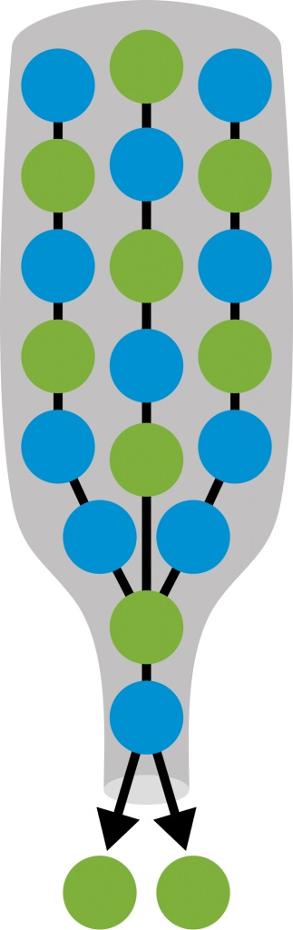
MANAGEMENT OF PATIENTS WITH CIRRHOSIS
UIMH
2023
Strategies to implement the use of human albumin in the management of decompensated cirrhosis
To be selective in its prescription
To use it properly
To remove the logistic barriers for its long-term use
To investigate how to improve the quality of its solution

Slide 76
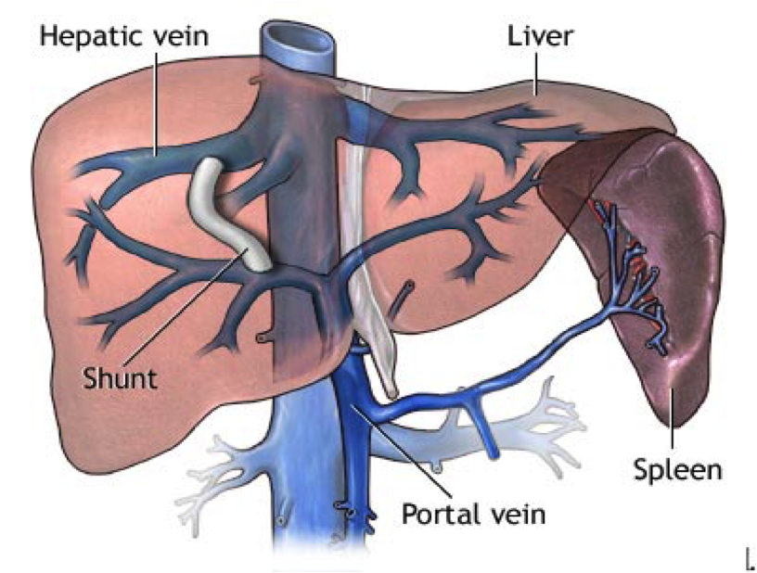
MANAGEMENT OF PATIENTS WITH CIRRHOSIS
UIMH
2023
Transjugular porto-systemic shunt (TIPS)

Slide 77
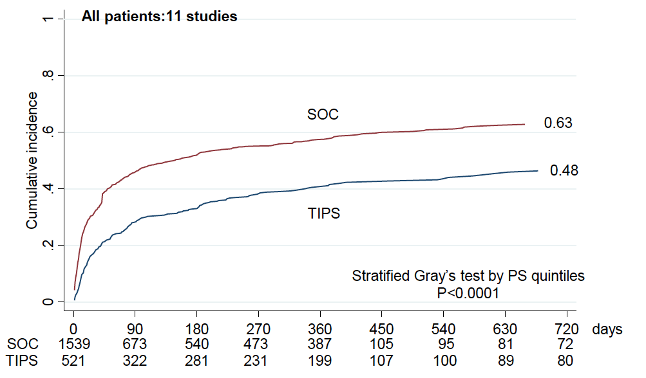
MANAGEMENT OF PATIENTS WITH CIRRHOSIS
UIMH
2023
The use of TIPS in the prevention of further decompensation
H. Larrue et al. J. Hepatol. 2023 (in press)

Slide 78
MANAGEMENT OF PATIENTS WITH CIRRHOSIS
UIMH
2023
Take away messages
  Portal hypertension, systemic inflammation, and oxidative state, concur in the pathogenesis of decompensation and development of organ or system dysfunction/failure in patients with cirrhosis.
  Two patterns of decompensation may occur in patients with cirrhosis: non acute decompensation (NAD) and acute decompensation (AD).
  More than fifty percent of the patients who developed NAD then develop AD.
  In patients with NAD, the long-term use of human albumin solution improves survival, quality of life, and can prevent AD and ACLF.
  TIPS may be useful in the prevention of further decompensation in patients with cirrhosis.

