Slide 1



TAORMINA
29-30 Maggio 2023
Update su stadiazione e trattamento dell’HCC
Giuseppe Cabibbo
GI & Liver Unit
University of Palermo, Italy
giuseppe.cabibbo@unipa.it

Slide 2

Update su stadiazione e trattamento dell’HCC
«concetti strettamente…
ma non rigidamente connessi…»

Slide 3
Why have prognostic and staging models?
assess course and potential outcome of a disease;
stratify patients in Randomized Controlled Trials;
assess the validity of surrogate endpoints;
formulate strategies for treatments;
aid to decision making.

Slide 4

Staging of Cancer
Prognosis of cancer and treatment options are usually determined by:
  Anatomical extent of tumor (stage)
  Biological aggressiveness (grade)
  Functional status (Comorbidity? Frailty? Tumor symptoms?)

Slide 5
Staging of Hepatocellular Carcinoma
Prognosis of cancer and treatment options are usually determined by:
  Anatomical extent of tumor (stage)
  Biological aggressiveness (grade)
  Functional status (Comorbidity? Frailty? Tumor symptoms? Liver disease symptoms?)
  Cirrhosis severity (Child-Pugh, MELD, ALBI, portal hypertension…)

Slide 6

Development of clinical prognostic scores for HCC
BCLC
CUPI
ITA.LI.C.A.
Okuda
GRECH
AJCC
And so on...
Child-Pugh
CLIP
VISUM
JIS
Tokyo
1973
1985
1998
1999
2001
2002
2003
2005
2016
The fact that there are multiple staging systems for HCC is testimony to there being no ideal system.
Modified from Maida, …, Cabibbo. World J Gastroenterol. 2014

Slide 7
The Barcelona Clinic Liver Cancer (BCLC)
Staging Classification for HCC
 | BCLC stage | Performance status (PS) | Tumor volume, number and invasiveness | Child-Pugh*
0 | Very early | 0 | Single < 2 cm | A
A | Early | 0 | Single or 3 nodules < 3 cm | A – B
B | Intermediate | 0 | Large/Multinodular/ infiltrative | A – B
C | Advanced | 1 – 2 | Portal invasion and/or Extrahepatic spread N1M1 | A – B
D | Terminal | > 2 | Any of above | C
* MELD, ALBI, and so on….
Llovet JM et al. J Gastroenterol 2005; 40: 225-235
Notes:
₇
Il sistema di stadiazione BCLC considera variabili correlate allo stadio del tumore, allo stato di funzionalità epatica, allo stato fisico, e a sintomi correlati al tumore, legando i 4 stadi con un algoritmo di trattamento.
Llovet JM et al. J Gastroenterol 2005; 40: 225-235

Slide 8

The Barcelona Clinic Liver Cancer (BCLC)
Staging Classification for HCC
 | BCLC stage | Performance status (PS) | Tumor volume, number and invasiveness | Child-Pugh*
0 | Very early | 0 | Single < 2 cm | A
A | Early | 0 | Single or 3 nodules < 3 cm | A – B
B | Intermediate | 0 | Large/Multinodular/ infiltrative | A – B
C | Advanced | 1 – 2 | Portal invasion and/or Extrahepatic spread N1M1 | A – B
D | Terminal | > 2 | Any of above | C
??
PS
- Comorbidity?
- Frailty?
- Tumor symptoms?
- Liver disease symptoms?
* MELD, ALBI, and so on….
  Biological aggressiveness?
  (Grade? AFP? …?)
Llovet JM et al. J Gastroenterol 2005; 40: 225-235
Notes:
₈
Il sistema di stadiazione BCLC considera variabili correlate allo stadio del tumore, allo stato di funzionalità epatica, allo stato fisico, e a sintomi correlati al tumore, legando i 4 stadi con un algoritmo di trattamento.
Llovet JM et al. J Gastroenterol 2005; 40: 225-235

Slide 9

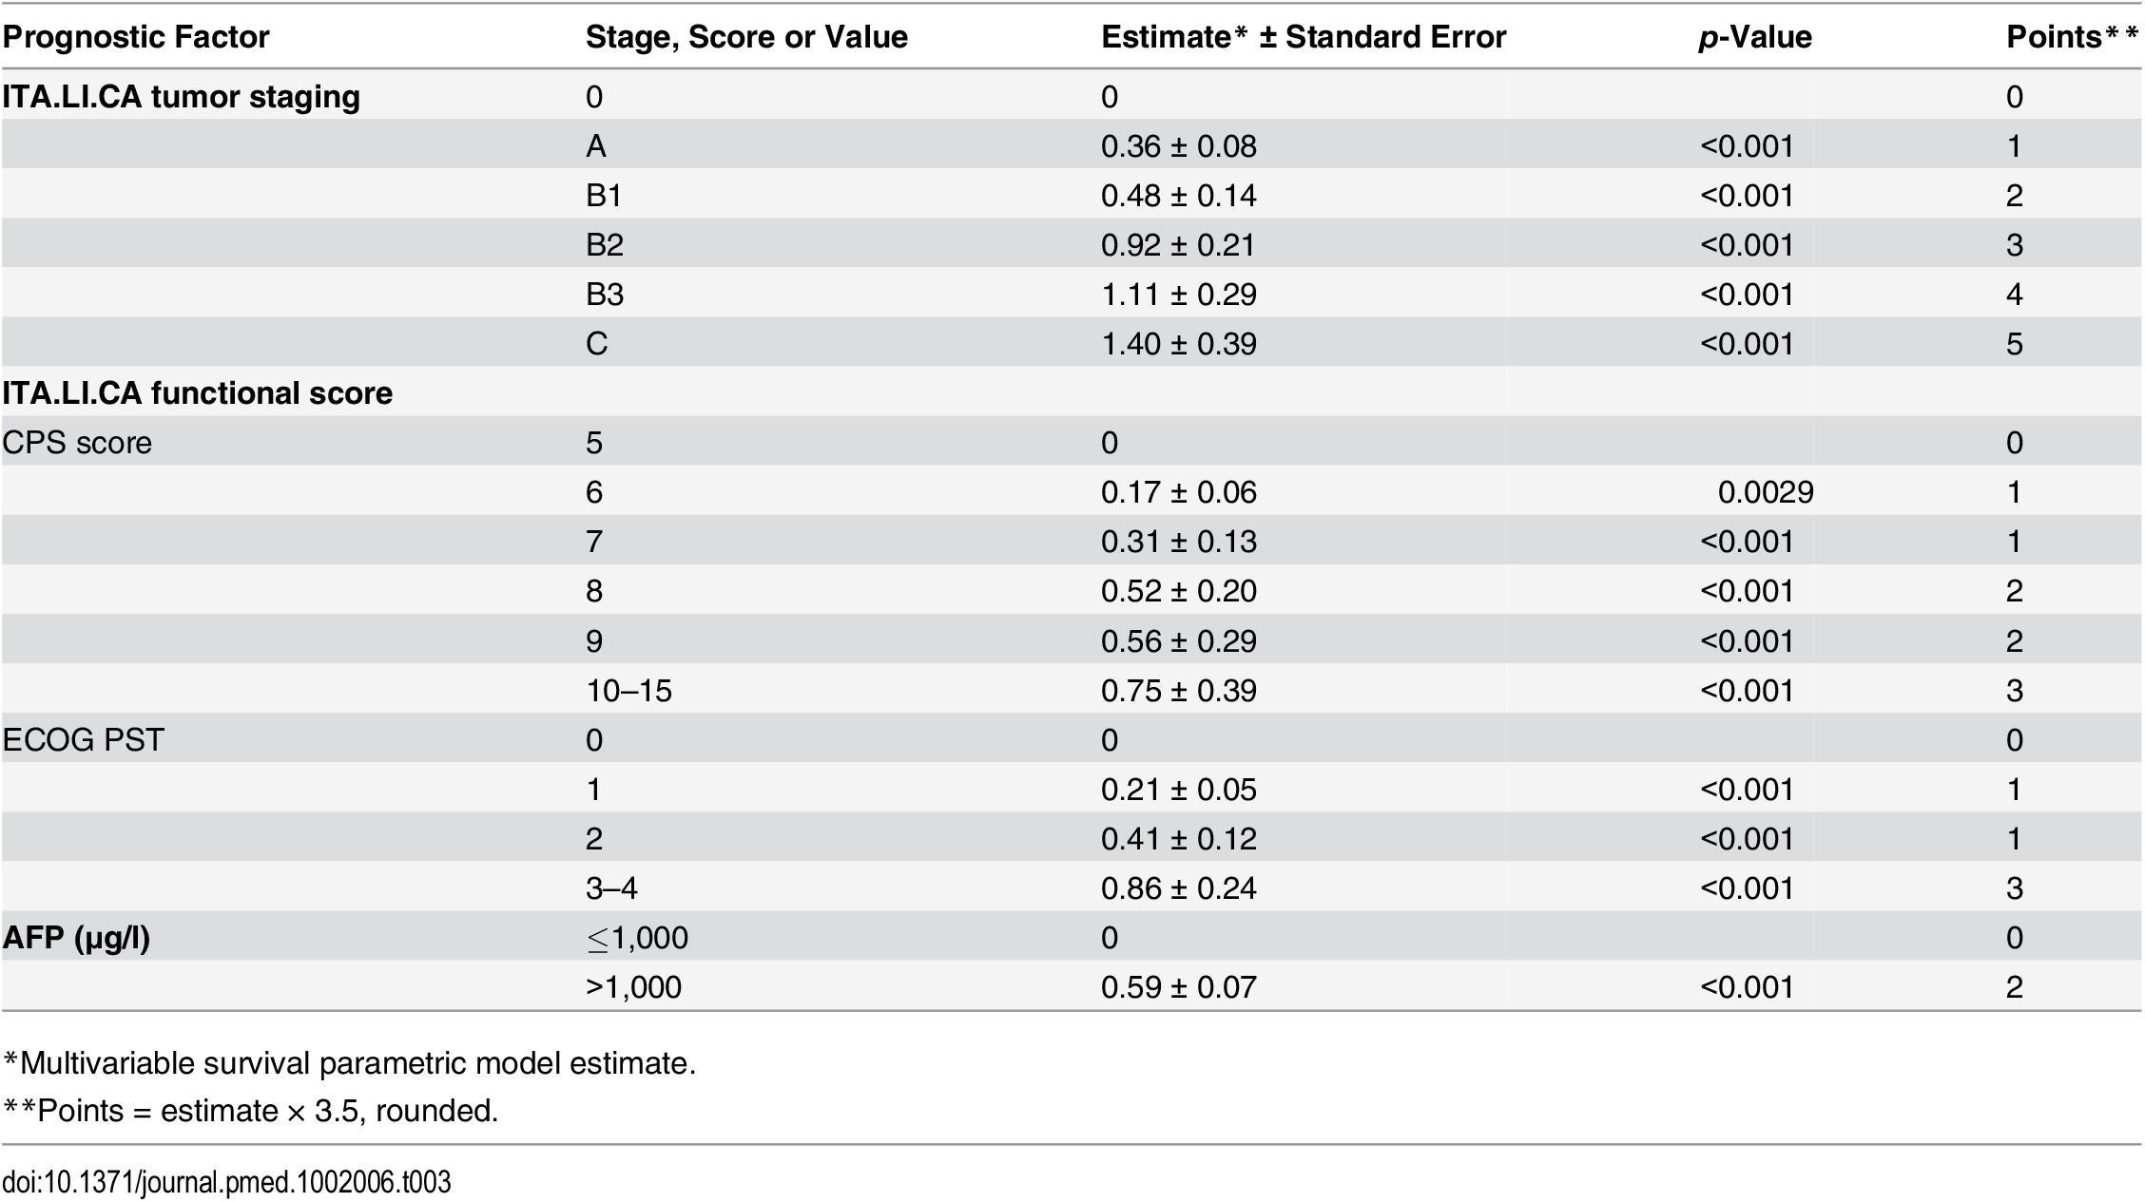
The ITA.LI.CA «prognostic score»
ITA.LI.CA score: 0 → 13
Farinati F et al, for ITA.L.ICA., PLoS Med 2016;13(4):e1002006

Slide 10

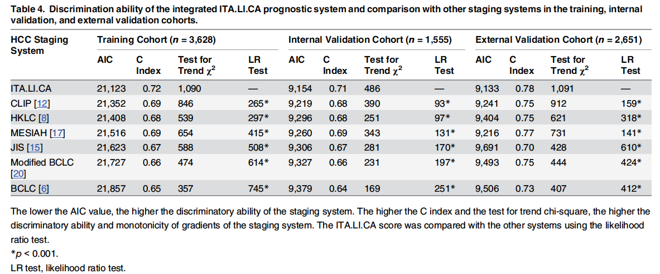
The ITA.LI.CA «prognostic score»
ITA.LI.CA
The lower the AIC, the higher the intra-stratum homogeneity and monotonicity of gradients.
The higher the C Index, the higher the discriminatory ability.
The higher the χ² test for trend, the higher the discriminatory ability and monotonicity of gradients.
Farinati F et al. for ITA.L.ICA, PLoS Med 2016

Slide 11
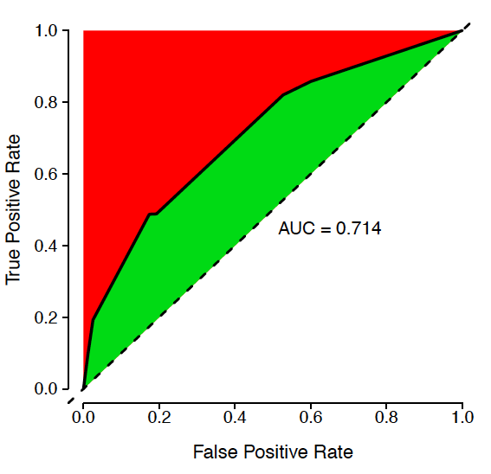
Accuracy of clinical prognostic systems (ROC CURVE)
«Unexplained!!!»
AUC = 0.75

Slide 12
“There is no worldwide consensus on the use of any given HCC staging system, and which is the preferred remains controversial”.°
° AASLD HCC Guidelines. Hepatology 2005

Slide 13


BCLC: Main weaknesses…
- Rigidity in the treatment indications.
- Negative prognostic factors considered as contra-indications.

Slide 14
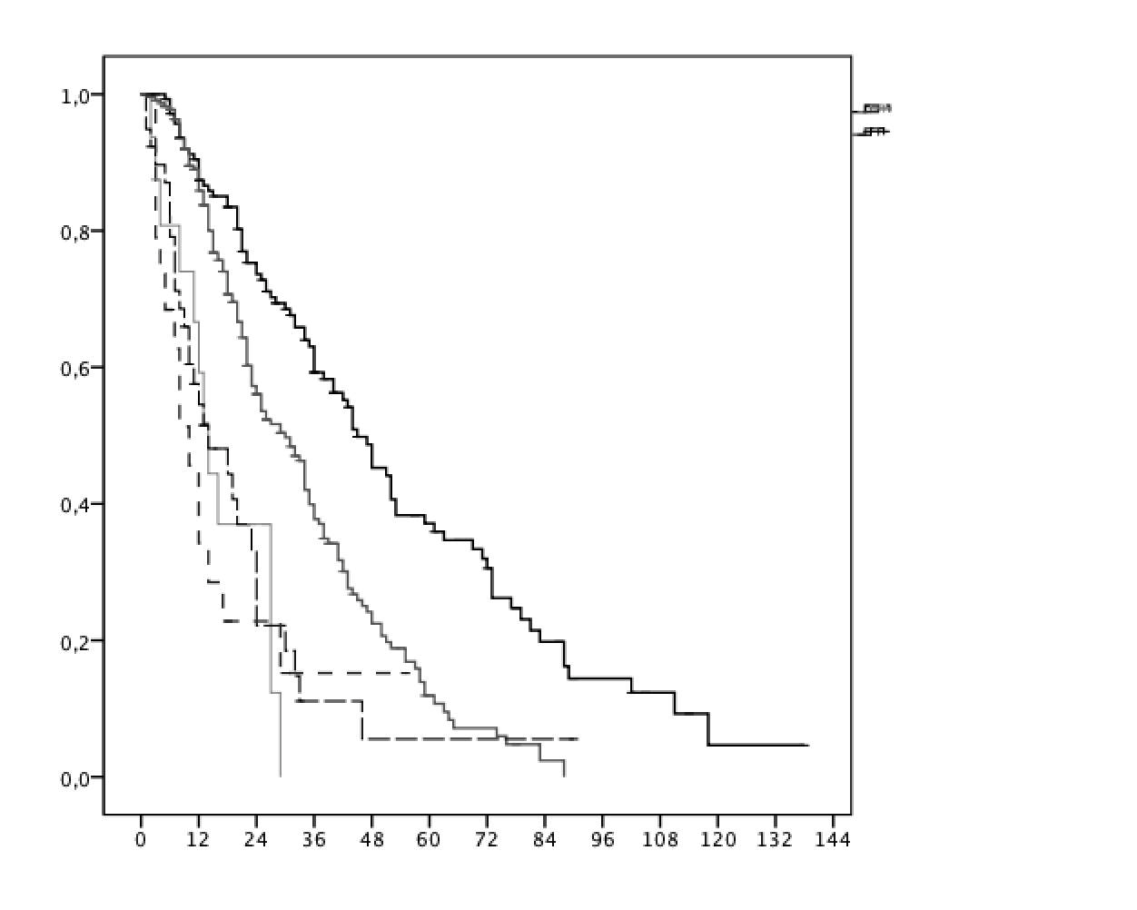
Curative therapies are superior to TACE in intermediate stage HCC
Survival by treatment of 456 BCLC-B patients
Curative treatments:
n. 145
TACE
(standard of care): n. 233
Sorafenib:
n. 18
Upward treatment
Other treatments:
n. 39
Best Supportive Care: n.21
Overall survival
Treatment remained a prognostic factor after:
adjustment for other predictors (Cox)
propensity score matching.
Months
Pecorelli A et al., for ITA.L.ICA. Liver Int 2016

Slide 15
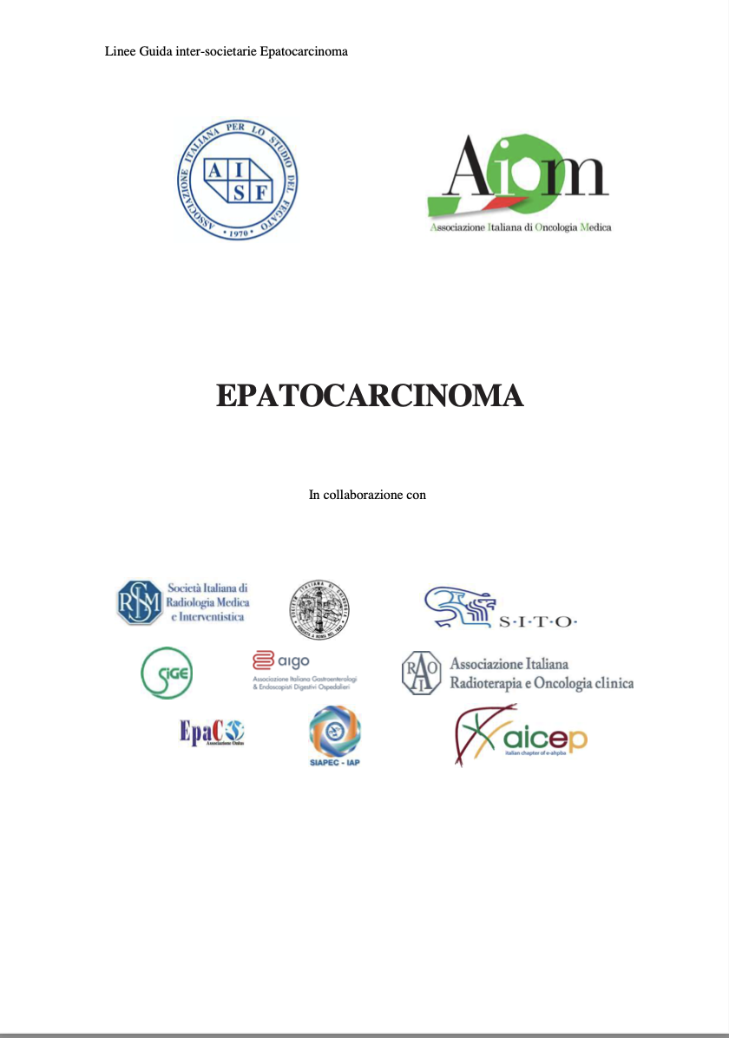

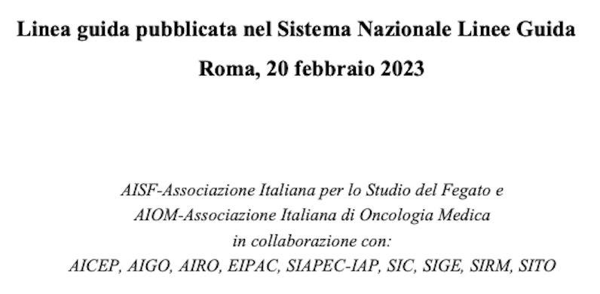


Slide 16

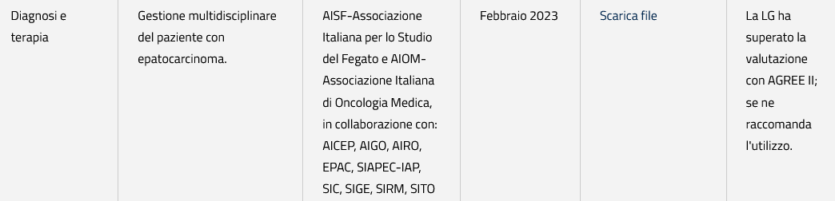
10 Società Scientifiche
1 Associazione Pazienti
20 PICO (Population, Intervention, Comparator, Outcome)
618 pagine
Valutazione evidenze con metodo GRADE (Grading of Recommendations, Assessment, Development and Evaluation)

Slide 17

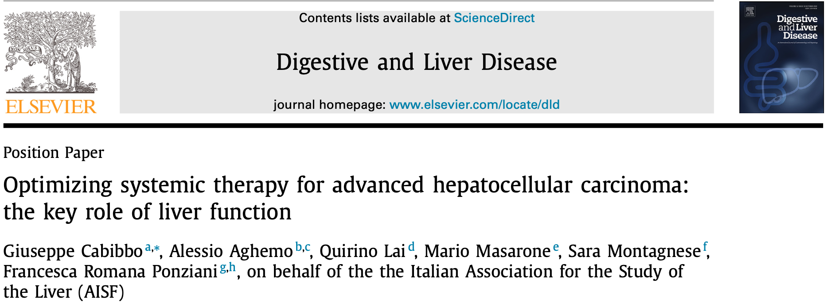

Slide 18
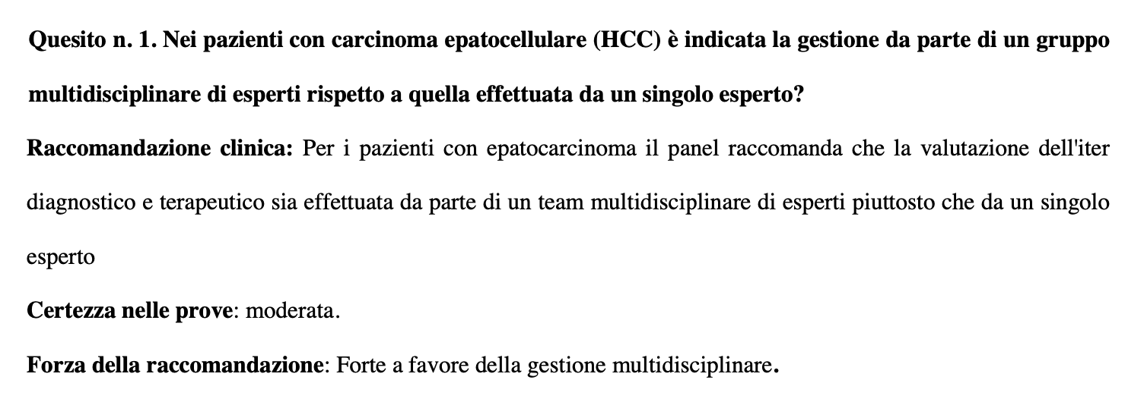

Gestione multidisciplinare del paziente con HCC
https://snlg.iss.it

Slide 19

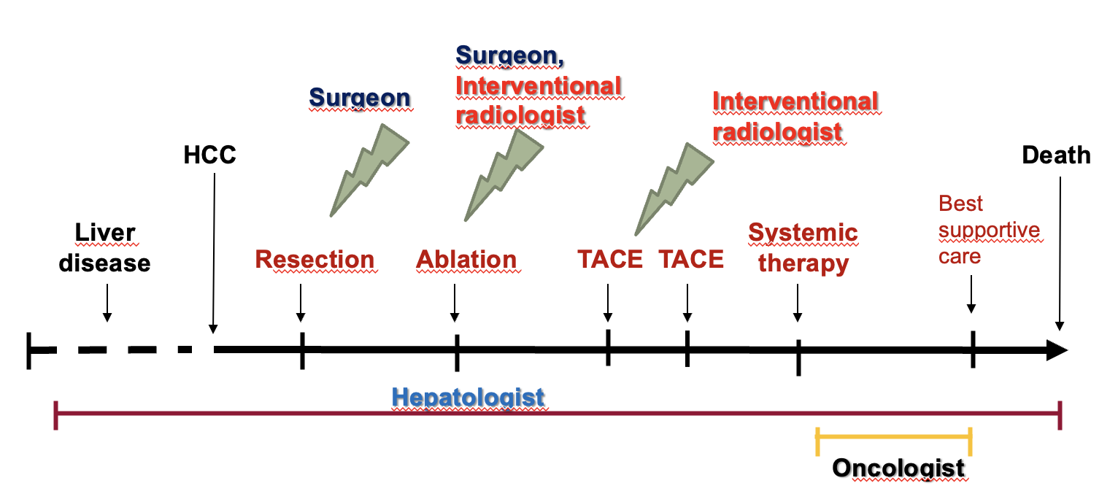
L’epatologo rappresenta la figura di riferimento e collegamento, in tutte le fasi della storia clinica del paziente, mentre gli altri componenti del gruppo gestionale assumono, di volta in volta, ruoli operativi fondamentali, a seconda dello stadio del tumore e della scelta terapeutica condivisa.
https://snlg.iss.it

Slide 20

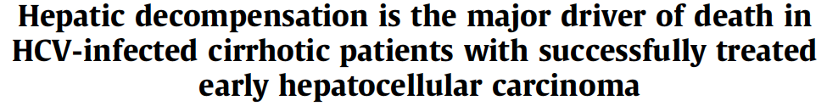
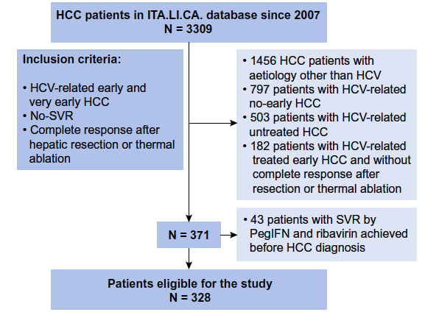
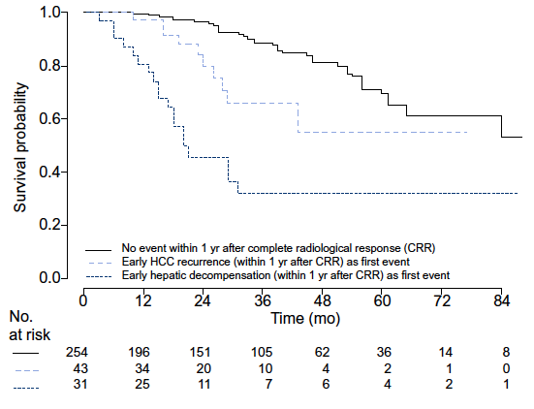
Time dependent Cox model (MV analysis)
Predictor of Survival | HR | 95%CI | P-value
Early recurrence | 2.5 | 1.2-5.1 | 0.01
Early hepatic decompensation | 7.5 | 4.2-13.5 | <0.0001
Cabibbo G. et al, on behalf ITA.LI.CA. Group. J Hep 2017

Slide 21
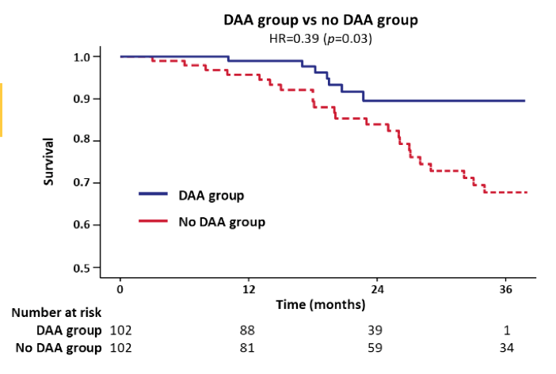
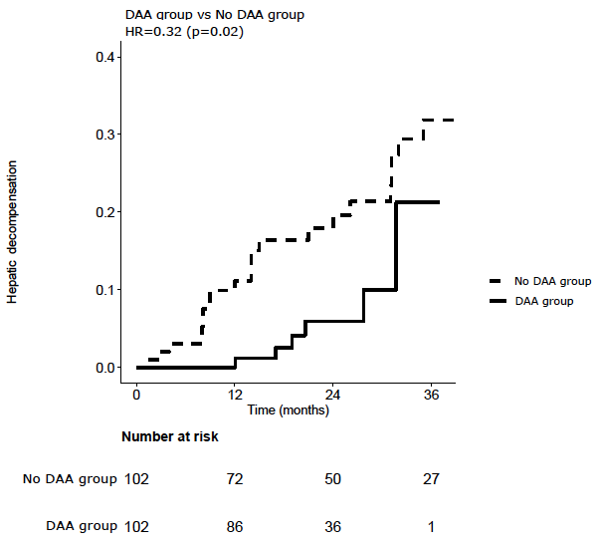
Hepatic decompensation
Survival
Improvement in overall survival seems due to significant reduction in hepatic decompensation
Cabibbo G. et al, on behalf RESIST-HCV & ITA.LI.CA. J Hep 2019

Slide 22

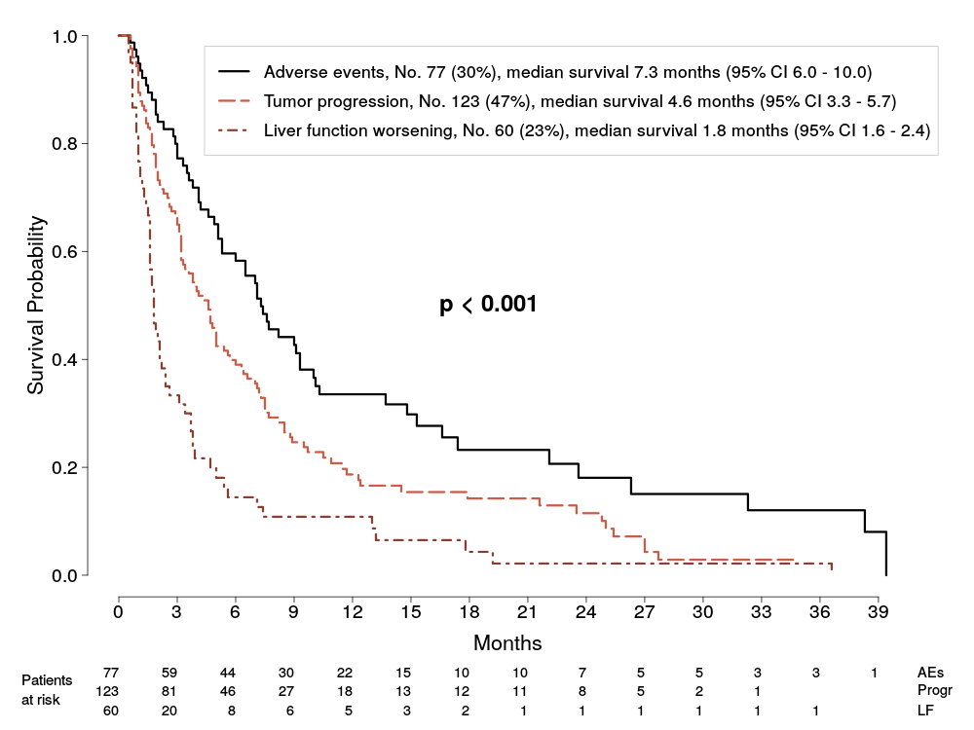
Predictors of Survival of Patients with Advanced HCC Who Permanently
Discontinued Sorafenib
Conclusions:
1) The survival following sorafenib discontinuation is significantly influenced by reason for drug withdrawal, i.e. adverse effects, liver impairment and tumour progression pattern.
2) In patients eligible to 2nd line trials, survival is determined by reason of sorafenib discontinuation, performance status and extrahepatic tumor burden.
3) In real life practice, these results are keys in prognostic prediction and design/analysis of second line trials.
Iavarone, Cabibbo et al. Hepatology 2015

Slide 23

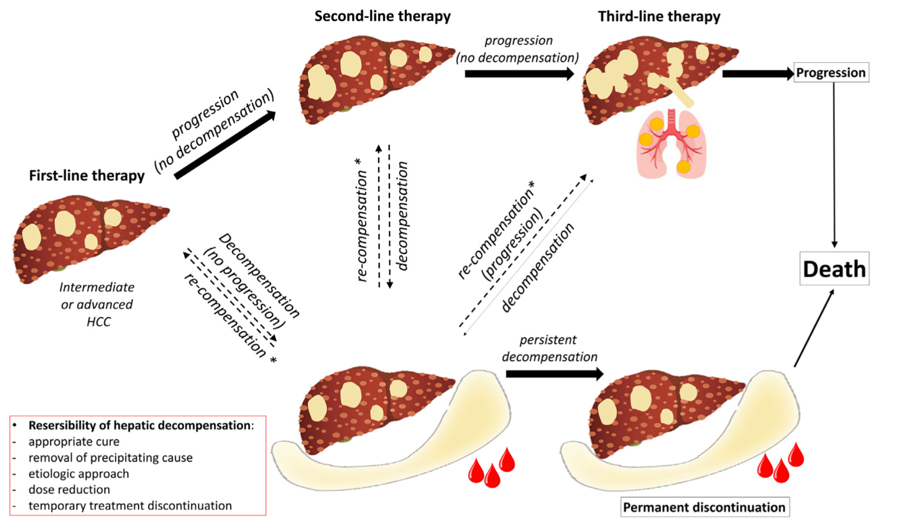

Competing risk for survival in intermediate/advanced HCC patients
Cabibbo & Singal. Journal of Hepatology 2021
Strazzabosco, Cabibbo, Colombo. Gastroenterology 2022
Cabibbo, Celsa, et al. Lancet Oncology 2022
Cabibbo & Bruix. Journal of Hepatology 2022
Cabibbo, Celsa, et al. Hepatology 2023
Cabibbo & Edeline. Liver International 2023
Cabibbo et al. Digestive and Liver Disease 2022

Slide 24

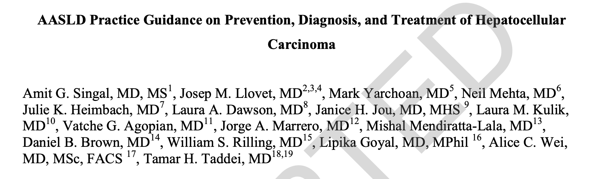
Hepatology 2023

Slide 25
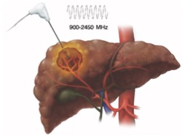
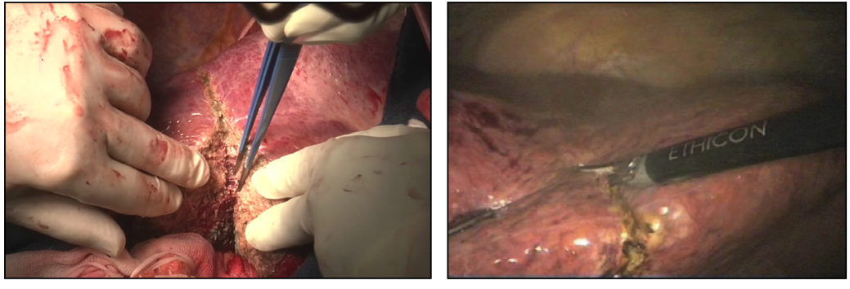
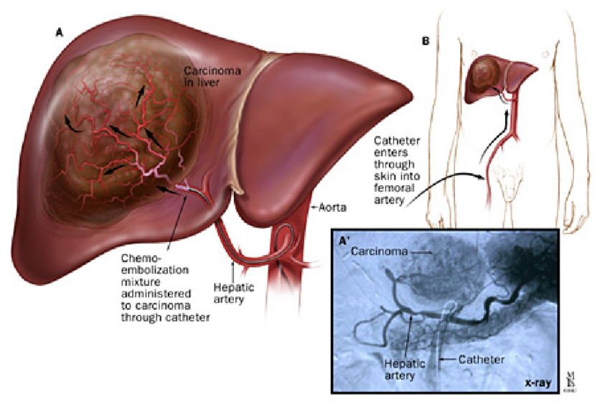


Hepatocellular Carcinoma treatment options
- Thermal ablation (RFA or MWA)
Liver Transplantation
- Surgical resection
(laparotomic or laparoscopic)
- Transarterial therapies (TAE, TACE, TARE)
- Systemic therapies
- Combined treatments…

Slide 26
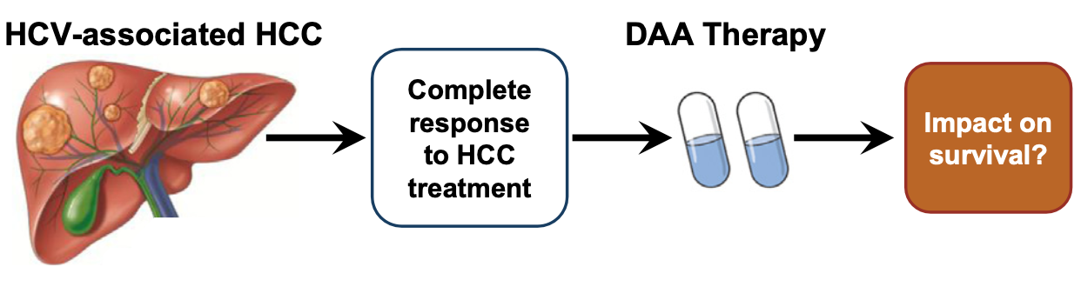
Adjuvant Therapy Setting
«The risk of recurrence following surgical resection remains high, approaching 50%–70% at 5 years, with the highest risk in the first year after resection»
Impact on Recurrences?
Factors associated with recurrence:
degree of liver dysfunction,
tumor size,
number, grade/differentiation
microvascular and macrovascular invasion,
presence of satellite lesions,
and AFP level.
1. Imamura et al. J Hepatol 2003. 2. Yao et al. Ann Surg Oncol 2022.
Singal et al. Hepatology 2023

Slide 27
DAA Adjuvant Therapy in HCV-related HCC patients
Hepatic decompensation
Survival
Improvement in overall survival seems due to significant reduction in hepatic decompensation
Cabibbo G. et al, on behalf RESIST-HCV & ITA.LI.CA. J Hep 2019

Slide 28
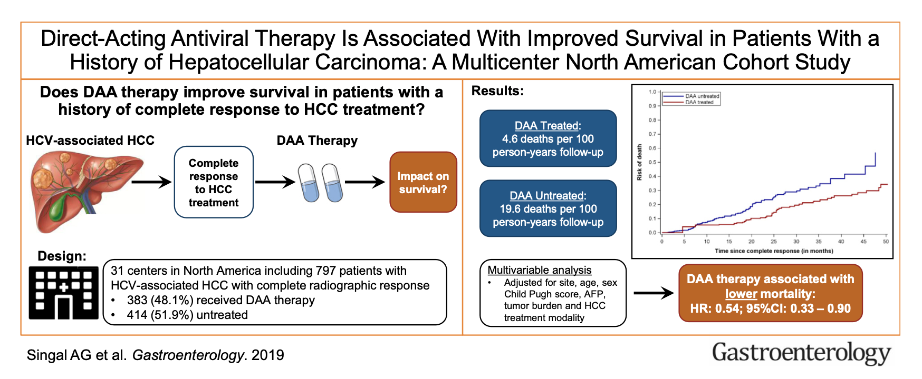
DAA Adjuvant Therapy in HCV-related HCC patients

Slide 29
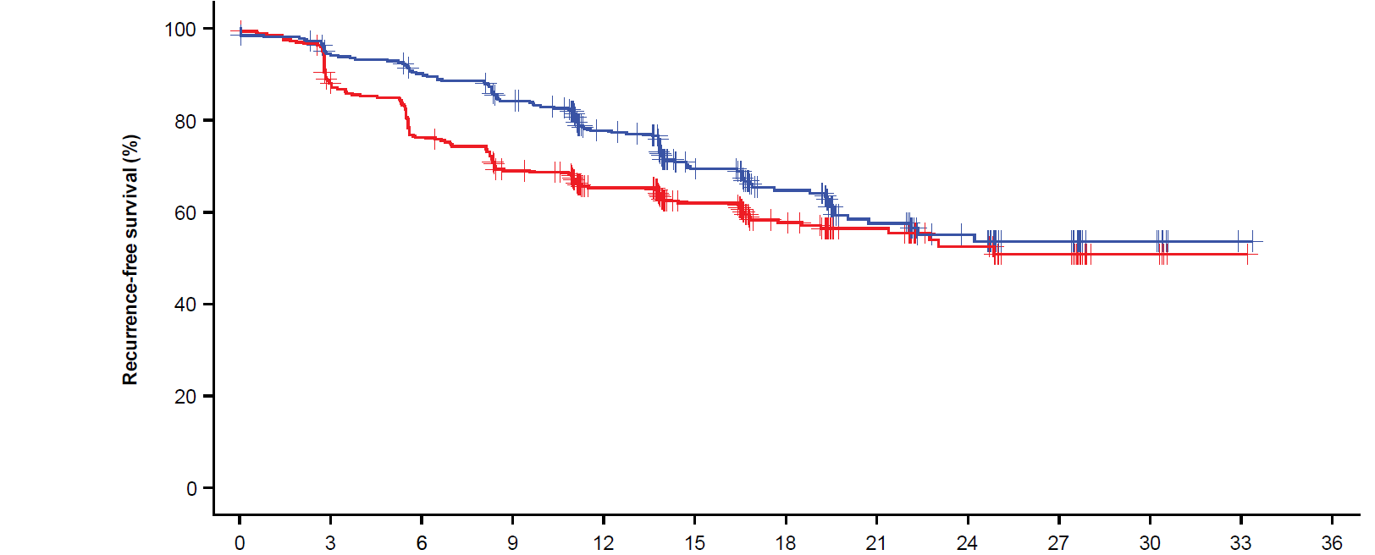
Primary endpoint: IRF-assessed RFS was significantly improved with atezo + bev vs active surveillance
High-risk features include: tumor >5 cm, >3 tumors, microvascular invasion, minor macrovascular invasion Vp1/Vp2, or Grade 3/4 pathology.
78% (73, 82)
65% (60, 71)
12-mo IRF-RFS event-free rate (95% CI), %
Median FU:
17.4 mo
Median IRF-RFS (95% CI), mo:
Atezo + bev Active surveillance
NE (22.1, NE)
NE (21.4, NE)
HR=0.72 (95% CI: 0.56, 0.93)
P value=0.012
Clinical cutoff: October 21, 2022; median follow-up duration: 17.4 mo. At clinical cutoff, 110 of 334 patients (33%) in the atezo + bev arm and 133 of 334 (40%) in the active surveillance arm experienced disease recurrence or death.
FU, follow-up; NE, not estimable. HR is stratified. P value is a log rank.
Chow et al IMbrave050 https://bit.ly/3ZPKzgM

Slide 30
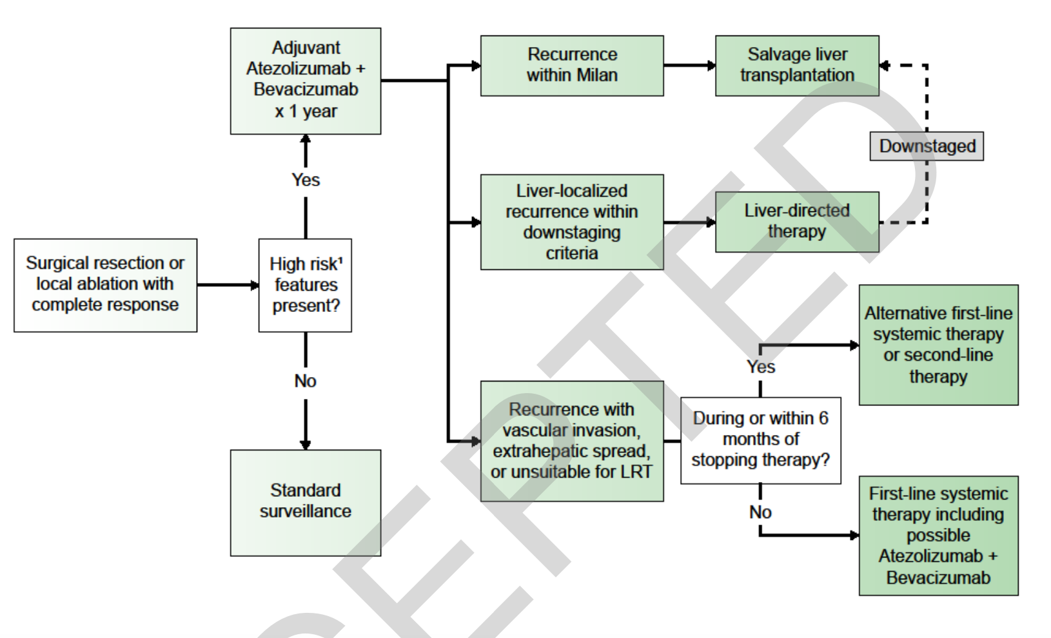
AASLD Practice Guidance: management of HCC recurrence
Salvage transplant
Downstaging
High-risk features include:
- tumor >5 cm,
- >3 tumors,
- microvascular invasion,
- minor macrovascular invasion Vp1/Vp2, or
- Grade 3/4 pathology.
Systemic therapies
Singal et al. Hepatology 2023

Slide 31
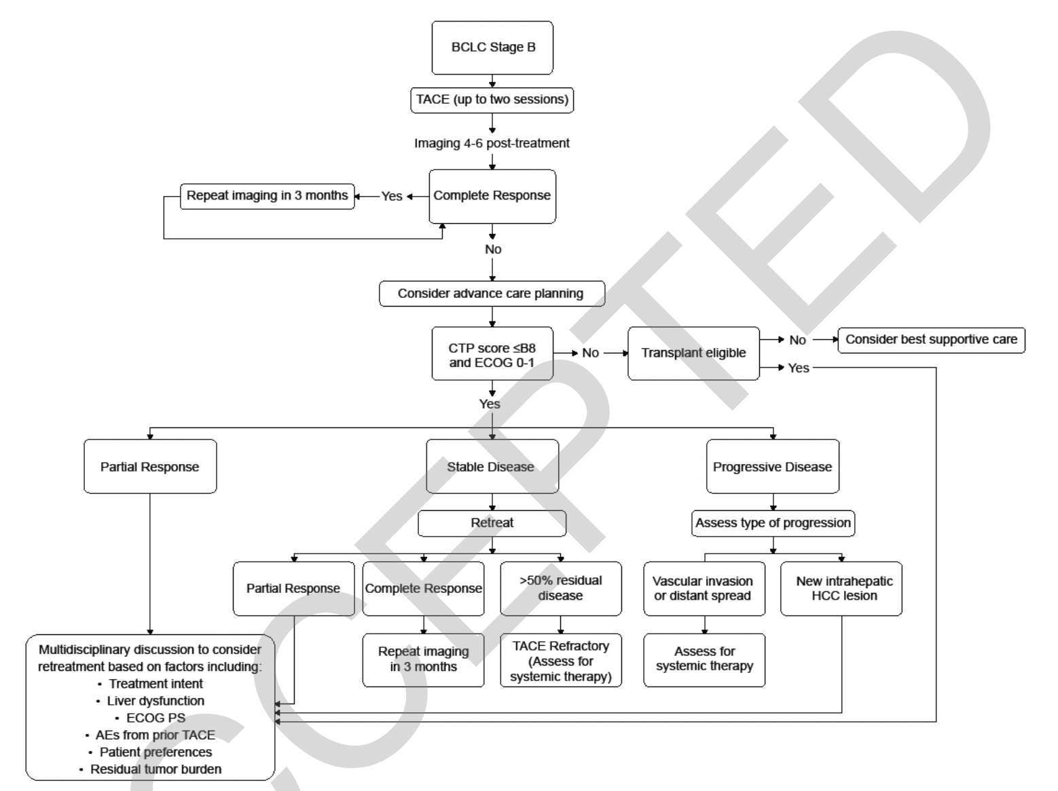
AASLD Practice Guidance: management after TACE
Multidisciplinary discussion to consider retreatment based on:
- Treatment intent,
- Liver dysfunction,
- ECOG PS,
- AEs from prior TACE,
- Patients preferrences,
- Residual tumor burden.
Singal et al. Hepatology 2023

Slide 32
Approved Systemic Therapies for HCC
First line systemic therapy
- Sorafenib (2008)
Lenvatinib (2018)
Atezolizumab-bevacizumab (2020)
Durvalumab-Tremelimumab (2022)
…
Drug | Target
Sorafenib | RAF/MEK/ERK pathway VEGFR/PDGFR
Lenvatinib | VEGFR; PDGFR; FGFR
Atezolizumab-Bevacizumab | PD-L1 (Atezo); VEGFR-1 e VEGFR-2 (Beva)
Durvalumab-Tremelimumab | PD-L1(Durva); CTLA 4 (Treme))
Second line systemic therapy
Regorafenib (2017)
Cabozantinib (2018)
Ramucirumab (2019)
Pembrolizumab (2018) [FDA]
Nivolumab-Ipilimumab (2020) [FDA]
…
Drug | Target
Regorafenib | VEGF1/VEGF2/VEGF3/ PDGFR/FGFR/KIT/RET/RAF-1/ BRAF
Cabozantinib | MET/VEGFR2/FLT3/c-KIT/ RET
Ramucirumab | VEGFR-2
Pembrolizumab | PD-1
Nivolumab-Ipilimumab | PD-1 (Nivo); CTLA-4 (IPI)

Slide 33
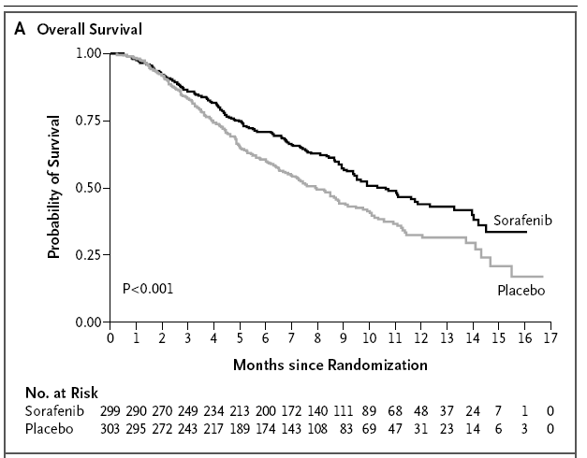
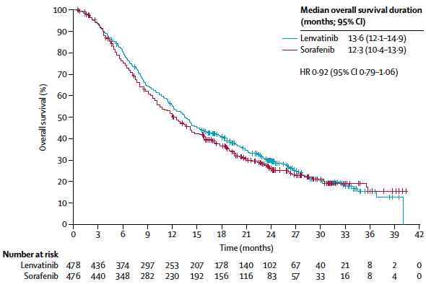
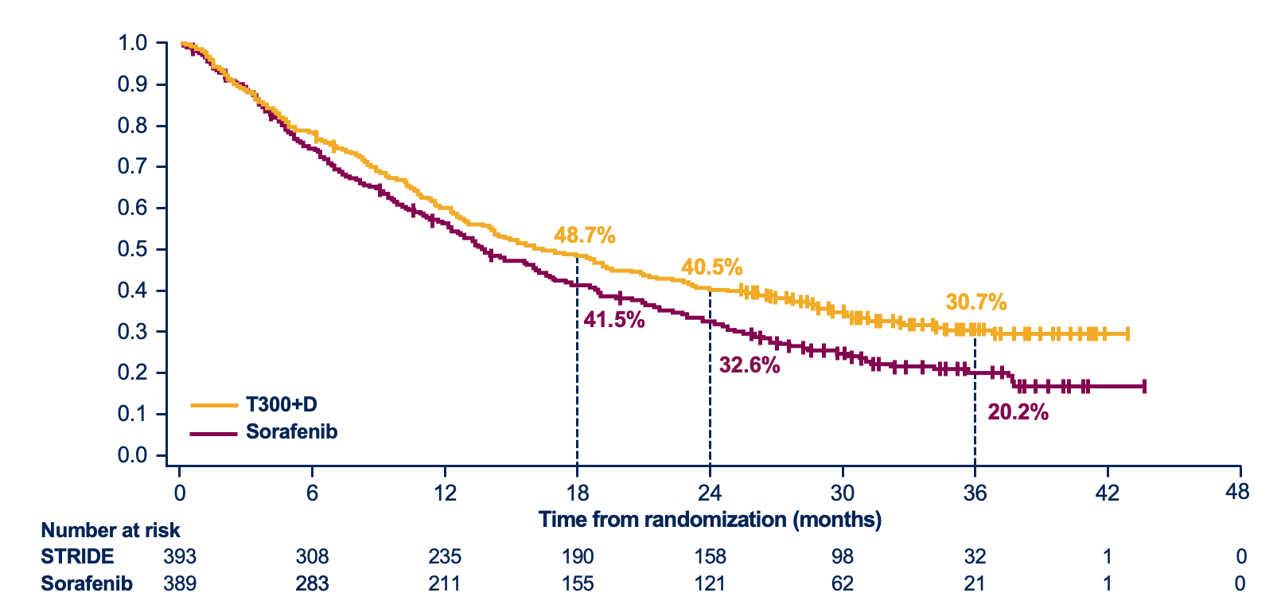
First-line Systemic Therapies for HCC
Study (Journal, year) | Arms | Median Overall Survival (months) | Median PFS (months)
SHARP (NEJM, 2008) | Sorafenib | 10.7 | 2.8 (TTP)
 | placebo | 7.9 | 5.5 (TTP)
REFLECT (Lancet 2018) | Lenvatinib | 13.6 | 7.3
 | Sorafenib | 12.3 | 3.7
IMbrave150 (NEJM 2020) | Atezo+beva | 19.2 | 6.8
 | Sorafenib | 13.4 | 4.3
HIMALAYA (NEJM Evidence 2022) | T300+ Durvalumab | 16.4 | 3.8
 | Durvalumab | 16.6 | 3.6
 | Sorafenib | 13.8 | 4
REFLECT
Imbrave 150
SHARP
HIMALAYA

Slide 34
https://doi.org/10.1016/j.dld.2022.01.122
Digestive and Liver Disease 2022

Slide 35
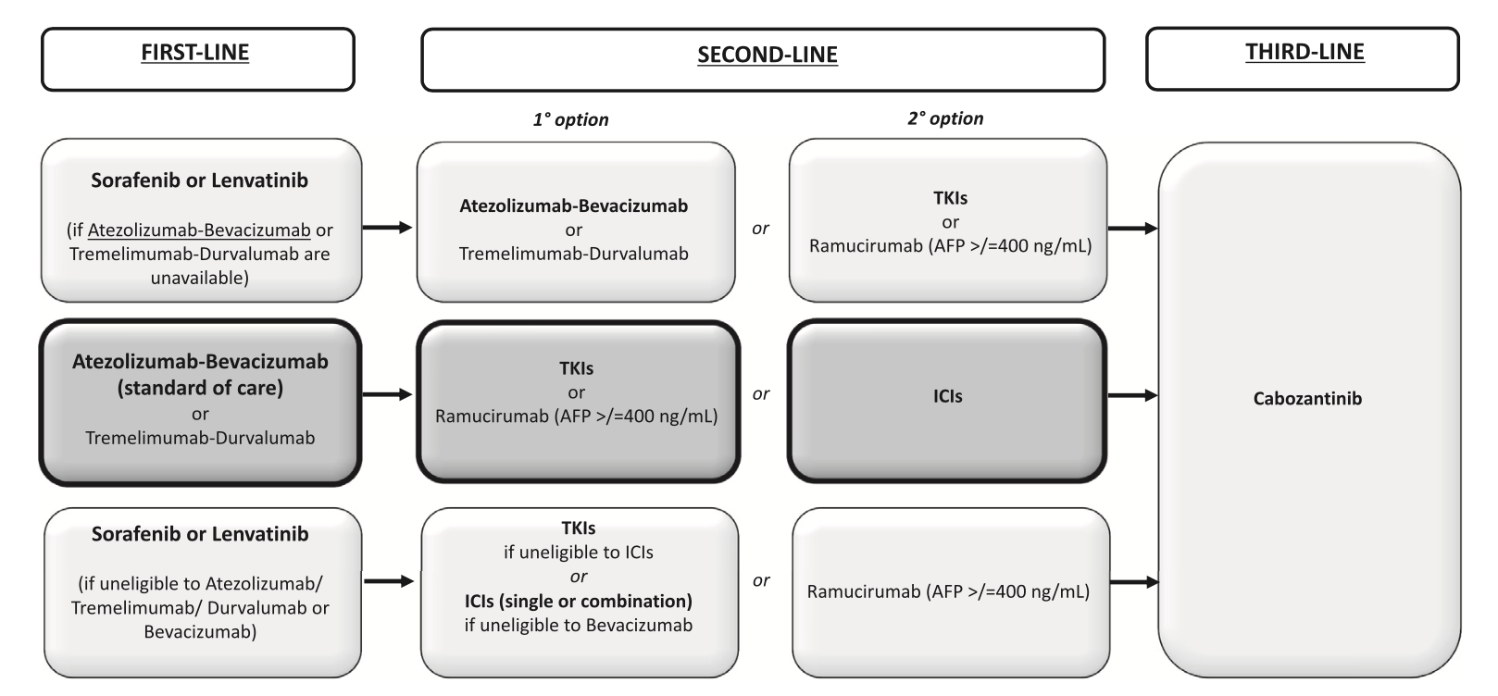
Proposed sequential systemic treatment approach driven by the
concept of "drug class change”
Digestive and Liver Disease 2022

Slide 36


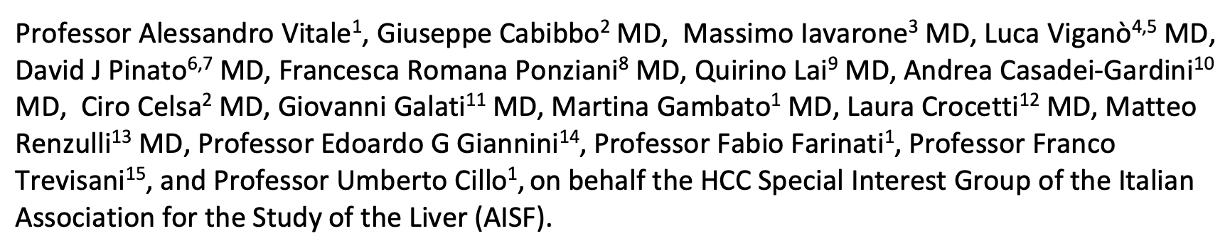

Personalized management of patients with hepatocellular carcinoma: the concept of multi-parametric therapeutic hierarchy

Slide 37
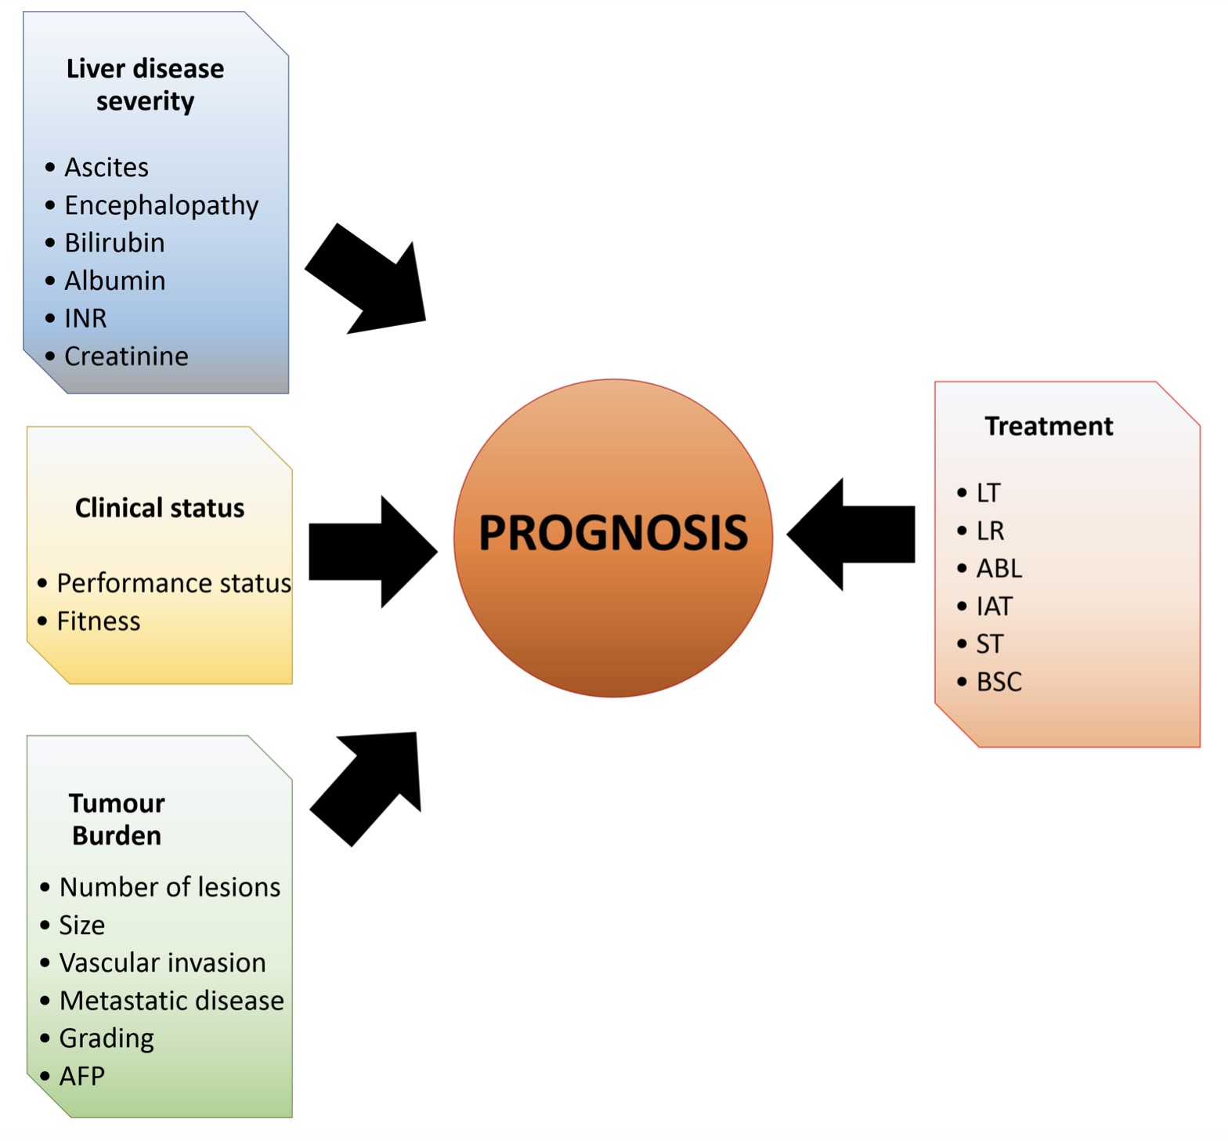
Stage-dictated treatment
Ordinal treatment hierarchy
Stage
Vitale A, Cabibbo G , et al. Lancet Oncology 2023

Slide 38
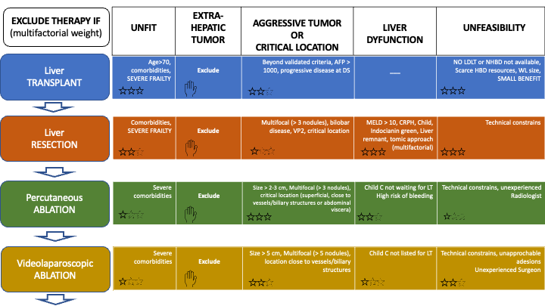
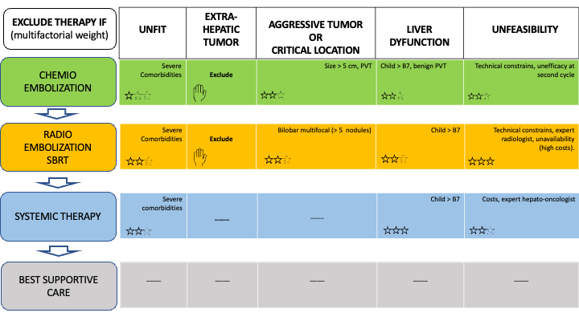
Stars indicate the importance
THERAPEUTIC HIERARCHY
Conversion and adjuvant approach
Vitale A, Cabibbo G , et al. Lancet Oncology 2023

Slide 39
Personalized management of patients with hepatocellular carcinoma: the concept of multi-parametric therapeutic hierarchy
Ordinal
Therapeutic
Hierarchy
Multidisciplinary
Team Evaluation
Impact of new therapies on local disease control (Complete or partial response).
LEFT TO RIGHT
Treatment (stage) migration
RIGHT TO LEFT
Vitale A, Cabibbo G , et al. Lancet Oncology 2023

Slide 40
Grazie per l’attenzione
giuseppe.cabibbo@unipa.it

Slide 41

Idealmente … dovremmo discutere al board (con tutti i membri) tutti i pazienti, alla diagnosi e ad ogni snodo decisionale della storia clinica!!!!
Se si seguono molti pazienti …
IMPOSSIBILE!!!

Slide 42
PRAGMATISMO….
- HCC con metastasi→ Chirurgo? Chirurgo trapiantologo? Radiologo interventista?
- HCC su cirrosi in classe C di Child?→ Oncologo?
- HCC con invasione macro-vascolare su cirrosi in classe C di Child?→ Oncologo?
Chirurgo? Chirurgo trapiantologo? Radiologo interventista?
- … and so on…
E’ davvero necessario che i componenti del board siano
sempre tutti presenti?
PS: è una domanda retorica…..

Slide 45
Think outside the box
Stage-dictated treatment
Therapeutic hierarchy
Stage
Stage
Vitale A, Cabibbo G , et al. Lancet Oncology 2023

Slide 46
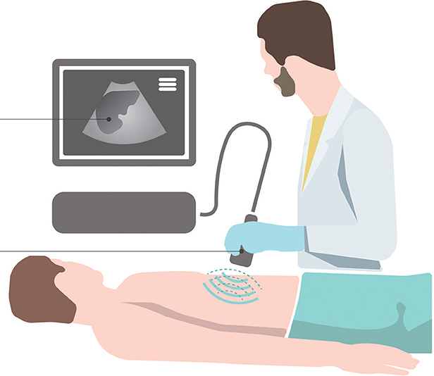
AASLD Practice Guidance
AASLD recommends HCC surveillance using a combination of liver ultrasound and AFP;
AASLD advises diagnostic evaluation with multiphasic contrast-enhanced CT or MRI in patients with AFP ≥ 20 ng/ml or rising AFP.

Slide 47
AASLD Practice Guidance
The BCLC staging system is most commonly applied and remains the staging system recommended by the AASLD given its incorporation of liver dysfunction and Eastern Cooperative Oncology Group performance status (ECOG PS) into staging assessments, external validation in multiple cohorts, and ease of use in clinical practice;

Slide 48
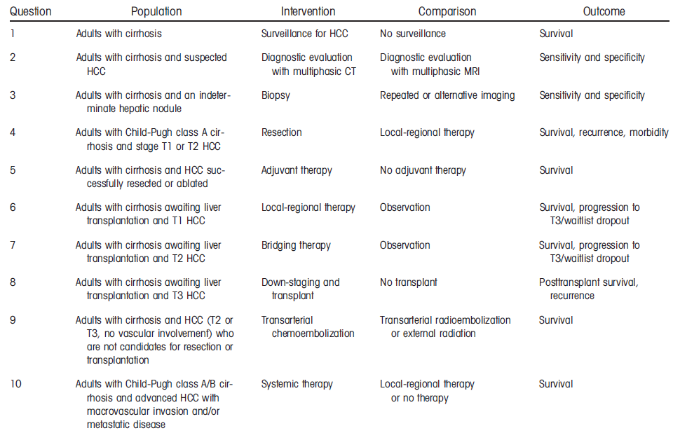
AASLD Guidelines for the treatment of Hepatocellular Carcinoma 2018
PICO
Population
Intervention
Comparison
Outcome
Heimbach JK et al, Hepatology 2018

Slide 49

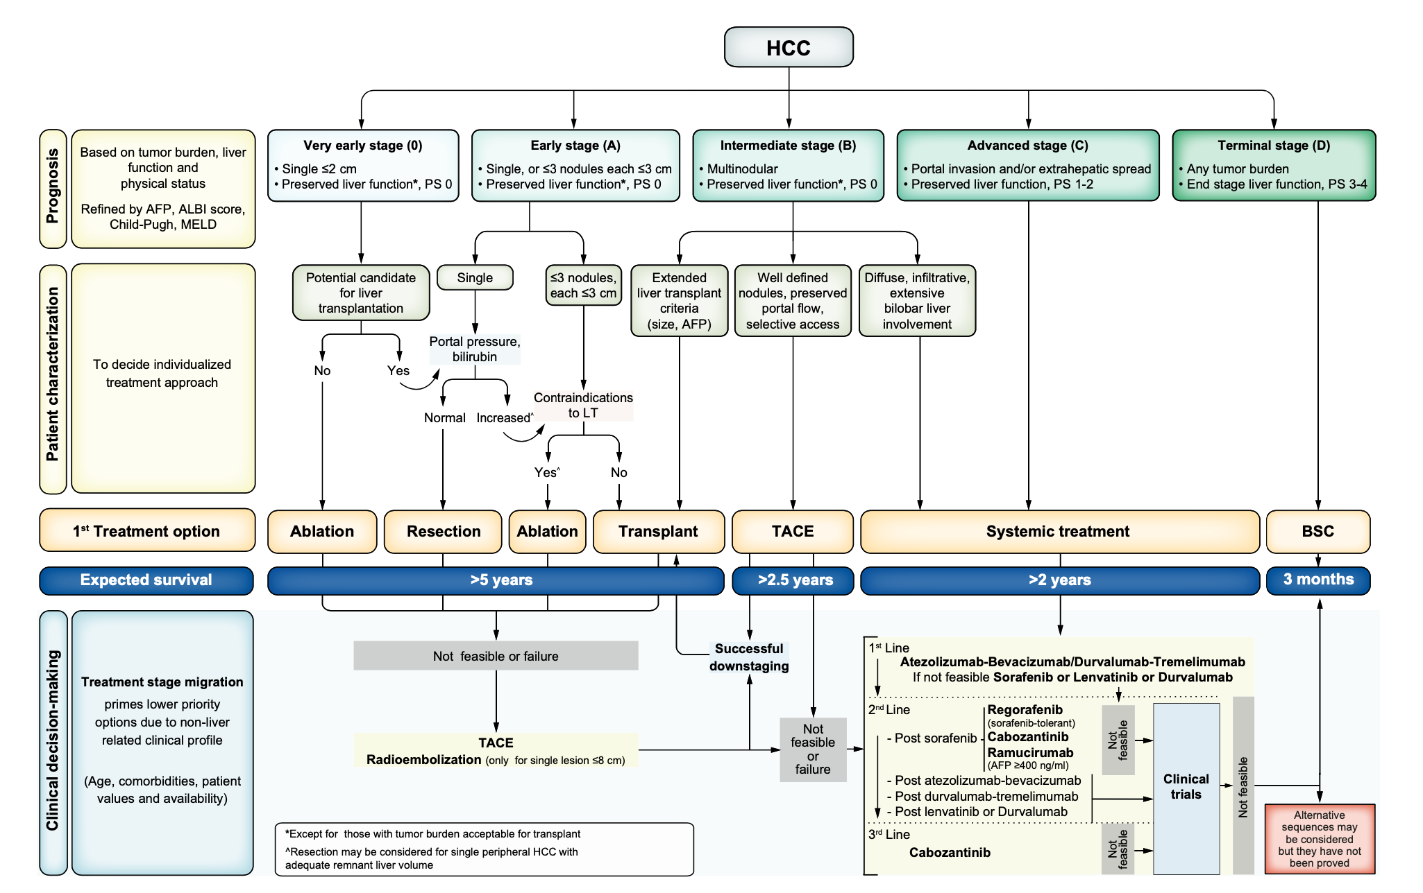
Reig et al. J Hep 2022

Slide 50
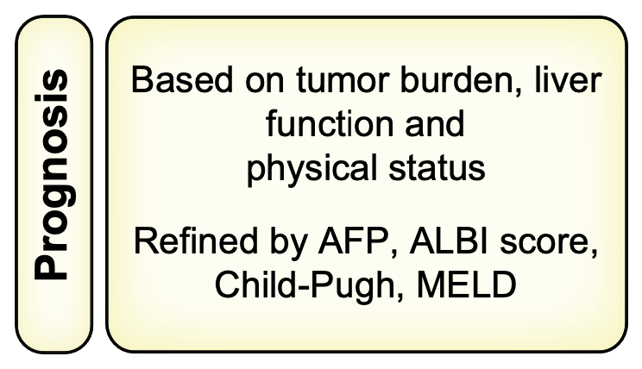
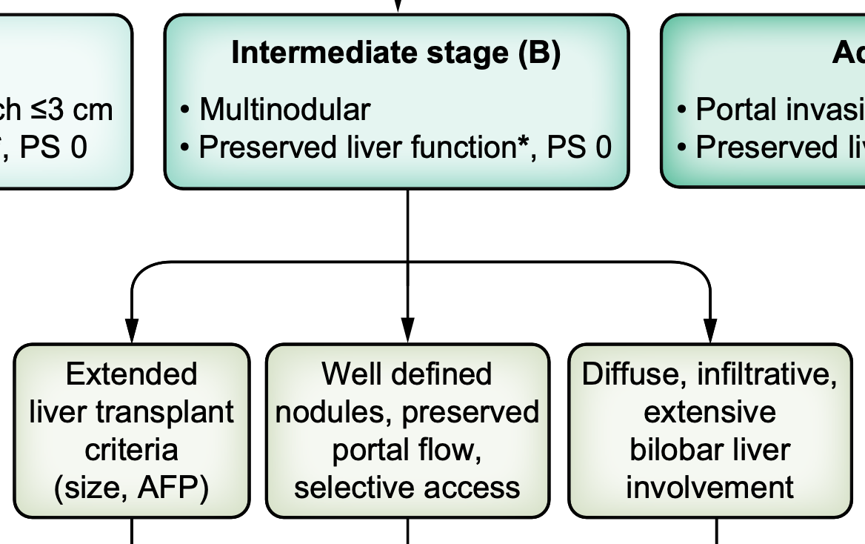
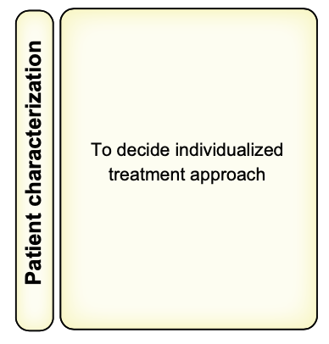
AFP
Individualized
Treatment
approach
«The multidisciplinary approach is key from the initial diagnosis and tumour staging through to defining the best initial and sequential treatment strategy.»
Reig et al. J Hep 2022

Slide 51
Bimodal recurrence after HCC resection
1° wave:
Potential main target of adjuvant therapies
0.5
Recurrence rate after resection peaks at around 1 year, then gradually decreases over the next
2 years.¹ Current consensus is that these recurrences are from micro-metastases
A second lower postoperative recurrence peak occurs at
4-5 years¹
The second peak is currently understood to be due to
de novo tumors associated with underlying liver disease²
Recurrence rate per year
0.4
0.3
0.2
2° wave:
Potential impact of underlying
cirrhosis therapies
0.1
0.0
0
1
2 3
Time (years)
4
5
1. Imamura et al. J Hepatol 2003. 2. Yao et al. Ann Surg Oncol 2022.

