Slide 1
TAORMINA
29-30 Maggio 2023
Terapia sistemica con ICIs
CCC = C³
Calogero Cammà
Giuseppe Cabibbo
Ciro Celsa
University of Palermo, Italy
calogero.camma@unipa.it

Slide 2
Agenda
Flaws of ICI treatment RCTs
Surrogate endpoints
First and second line ICI treatment
Adjuvant trial of ICIs
Competing risks in HCC setting
Use of Hazard Ratio (HR) as measure of efficacy

Slide 3
Agenda
Flaws of ICI treatment RCTs
Surrogate endpoints
First and second line ICI treatment
Adjuvant trial of ICIs
Competing risks in HCC setting
Use of Hazard Ratio (HR) as measure of efficacy

Slide 4
Which goal when treating HCC?
True endpoints: OS, patient-reported outcomes (QoL)
BENEFIT
time-independent (%)
Objective response rate (ORR)
Surrogate endpoints: imaging-based
time-dependent (mo.)
Progression-free survival (PFS)
Recurrence free survival
Time to progression (TTP)
Time to recurrence

Slide 5
Surrogate endpoints
Smaller sample size needed for RCTs
Shorter trials duration and earlier results
Lower costs of RCTs, but unfortunately not for drug
Surrogate endpoint needs to be VALIDATED

Slide 6
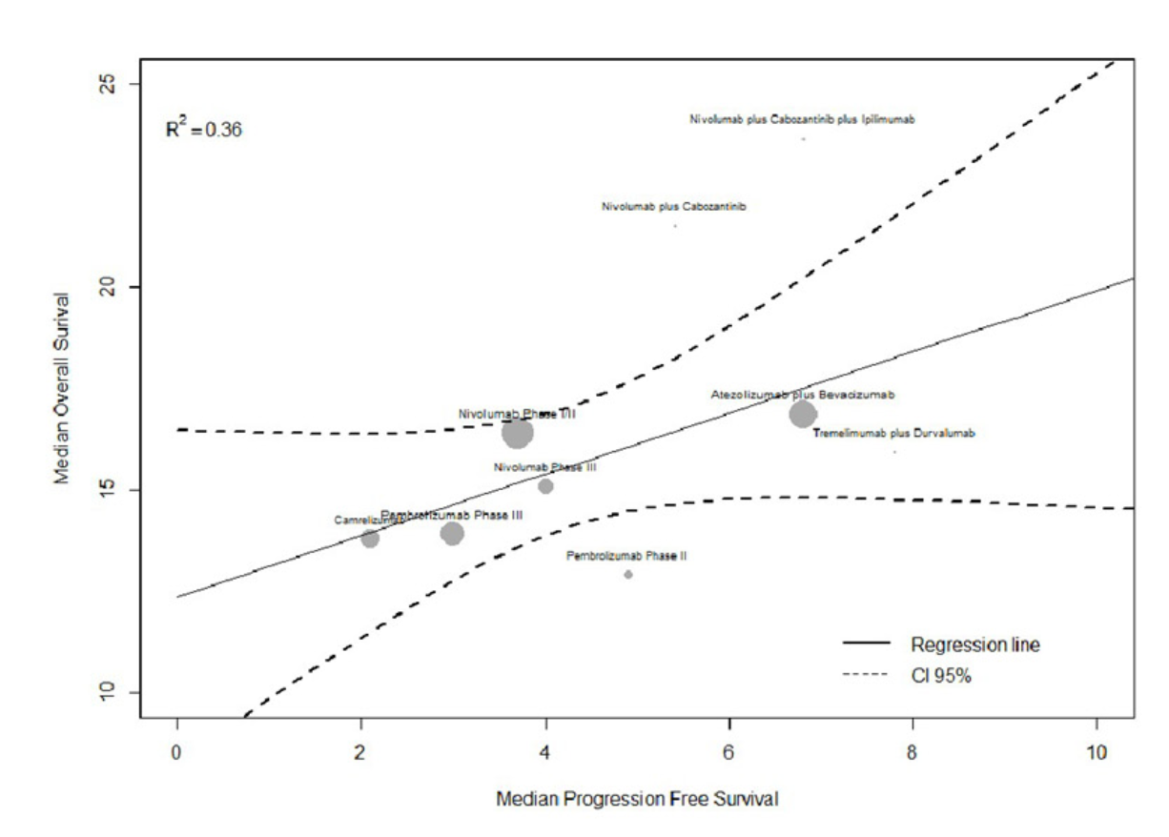
PFS
OS
OS
PFS
Cancers 2021

Slide 7
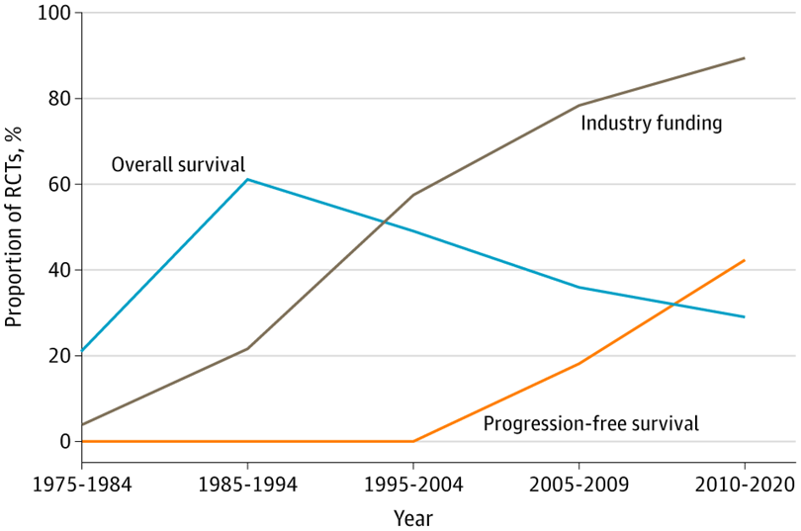
Time-dependent
Progression-Free Survival, PFS (t, mo)
50% of cancer drugs approved by FDA and EMA according to PFS benefit, were shown to improve OS
HCC setting ???
Del Paggio et al. JAMA oncology 2022

Slide 8
Biased evaluation of PFS
PFS
Toxicity
APPARENT HIGHER PFS (EFFICACY)
Toxicity but also
hepatic decompensation
in HCC setting
High drop-out rate for toxicity before progression
Tannock et al. JAMA oncology 2022

Slide 9
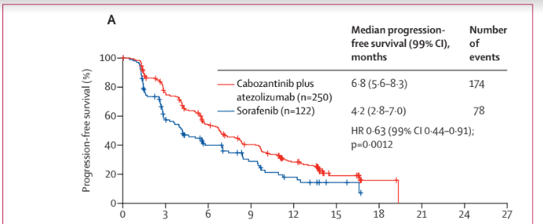
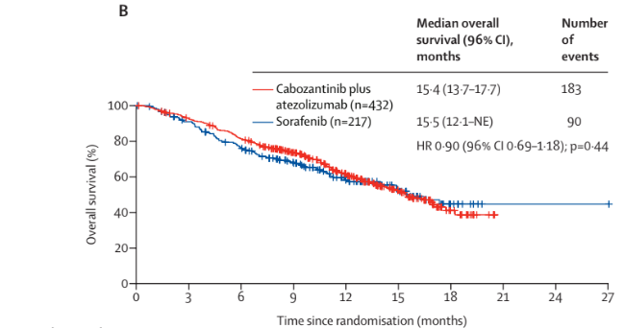
PFS
OS
Kelley et al. Lancet Oncology 2022

Slide 10
Agenda
Flaws of ICI treatment RCTs
Surrogate endpoints
First and second line ICI treatment
Adjuvant trial of ICIs
Competing risks in HCC setting
Use of Hazard Ratio (HR) as measure of efficacy

Slide 11
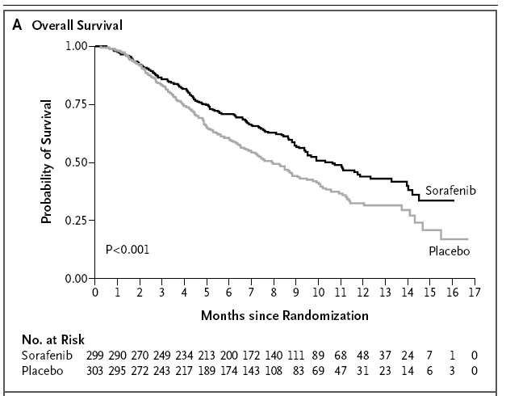
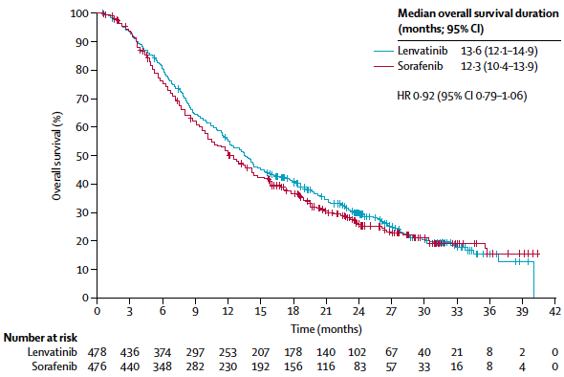
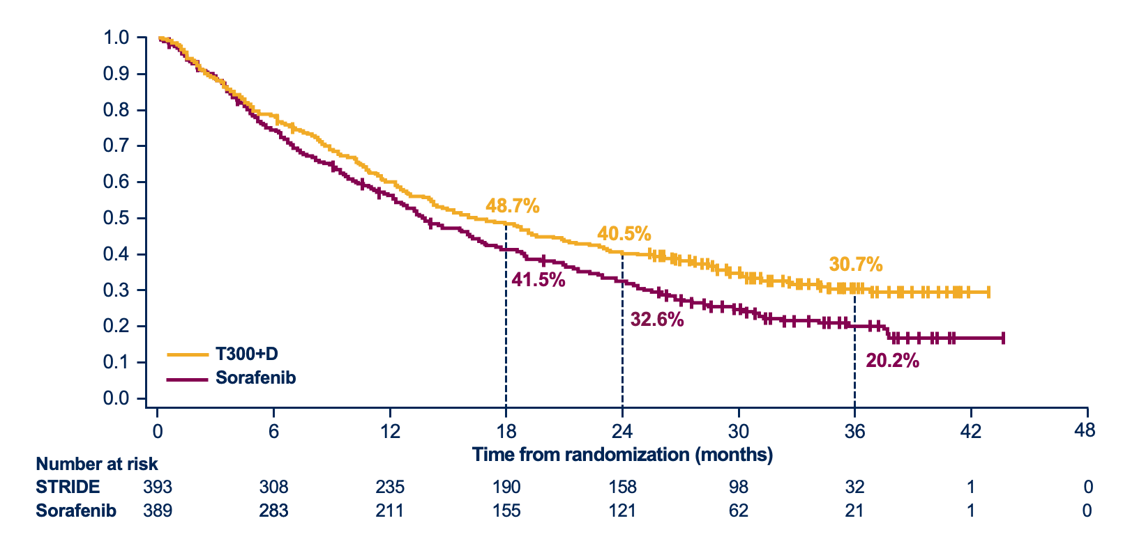
First-line Systemic Therapies for HCC
Study (Journal, year) | Arms | Median Overall Survival (months) | Median PFS (months)
SHARP (NEJM, 2008) | Sorafenib | 10.7 | 2.8 (TTP)
 | placebo | 7.9 | 5.5 (TTP)
REFLECT (Lancet 2018) | Lenvatinib | 13.6 | 7.3
 | Sorafenib | 12.3 | 3.7
IMbrave150 (NEJM 2020) | Atezo+beva | 19.2 | 6.8
 | Sorafenib | 13.4 | 4.3
HIMALAYA (NEJM Evidence 2022) | T300+ Durvalumab | 16.4 | 3.8
 | Durvalumab | 16.6 | 3.6
 | Sorafenib | 13.8 | 4
REFLECT
Imbrave 150
SHARP
HIMALAYA

Slide 12
Background
First-line systemic treatments for HCC: open issues
Majority of treatments were compared vs Sorafenib (no head to head RCTs).
It is not clear which class of drug is best associated with ICIs.
5 Previous network meta-analyses (NMAs):
- aggregate data
not include recent combinations
Separately assessment efficacy and safety

Slide 13
Network meta-analysis of first-line systemic therapies for advanced hepatocellular carcinoma
Ciro Celsa^{1,2}, Giuseppe Cabibbo¹, Giacomo Emanuele Maria Rizzo^{1,2}, Paolo Giuffrida¹, Gabriele Di Maria¹, Michela Antonucci³, Carmelo Marco Giacchetto¹, Gabriele Rancatore¹, Maria Vittoria Grassini¹, Roberta Ciccia¹, Alessandro Grova¹, Mauro Salvato¹, Salvatore Battaglia⁴, Marco Vaccaro⁴, Marco Enea¹, Calogero Cammà¹
This network meta-analysis (NMAs):
- individual patient data
include recent combinations
Evaluated combination of efficacy and safety
Liver Cancer 2023, in press

Slide 14
Background
First-line systemic treatments for HCC
Monotherapies
Tyrosine-kinase inhibitors (TKIs):
Sorafenib (2008)
Lenvatinib (2018)
Immune checkpoint inhibitors (ICIs):
Nivolumab (anti-PD1) (2019)
Combination therapies
ICI + anti-VEGF:
Atezolizumab (anti-PD-L1) + Bevacizumab (2020)
Sintilimab + IBI305 (2021)
ICI + ICI:
Durvalumab (anti-PD-L1) + Tremelimumab(anti-CTLA4) (2022)
ICI + TKI:
Atezolizumab (anti-PD-L1) + Cabozantinib (2022)
Pembrolizumab (anti-PD1) + Lenvatinib (2022)
Camrelizumab (anti-PD1) + Apatinib (2022)
Overall survival significantly improved
Overall survival non-inferiority
Overall survival not significantly improved

Slide 15
Results

Slide 16
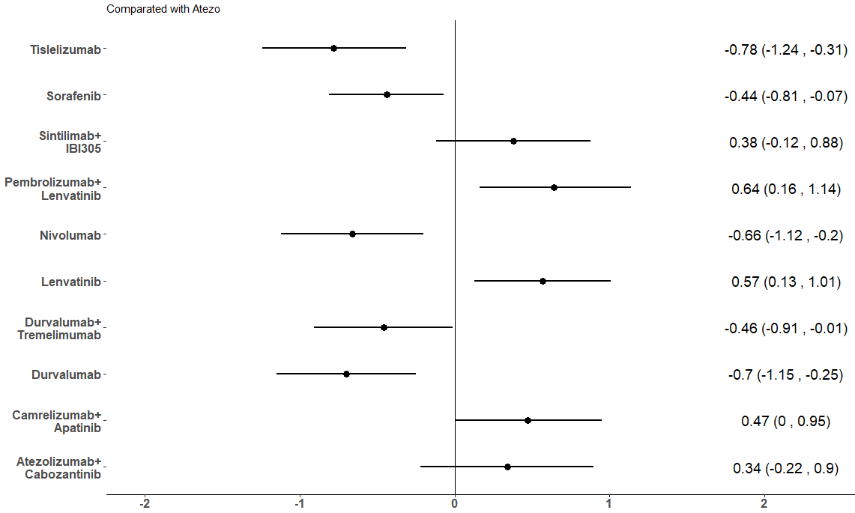
Results: 6-month PFS
Compared with Atezolizumab plus Bevacizumab
Treatment | SUCRA
Pembrolizumab+ Lenvatinib | 0.926
Lenvatinib | 0.858
Camrelizumab+ Apatinib | 0.786
Sintilimab+IBI305 | 0.712
Atezolizumab+ Cabozantinib | 0.695
Atezolizumab+ Bevacizumab | 0.518
Sorafenib | 0.347
Durvalumab+ Tremelimumab | 0.324
Nivolumab | 0.153
Durvalumab | 0.107
Tislelizumab | 0.070
MD (95% CI)

Slide 17
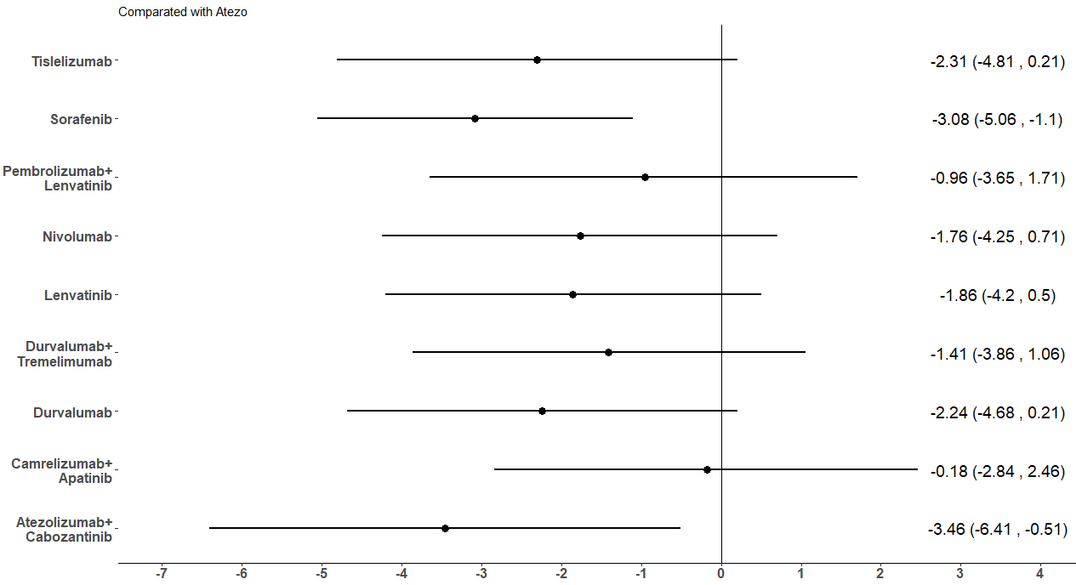
Results: 30-month OS
Compared with Atezolizumab plus Bevacizumab
Treatment | SUCRA
Atezolizumab+ Bevacizumab | 0.883
Camrelizumab+ Apatinib | 0.865
Pembrolizumab+Lenvatinib | 0.722
Durvalumab+ Tremelimumab | 0.626
Nivolumab | 0.506
Lenvatinib | 0.466
Tislelizumab | 0.352
Durvalumab | 0.342
Atezolizumab+ Cabozantinib | 0.120
Sorafenib | 0.114
MD (95% CI)

Slide 18
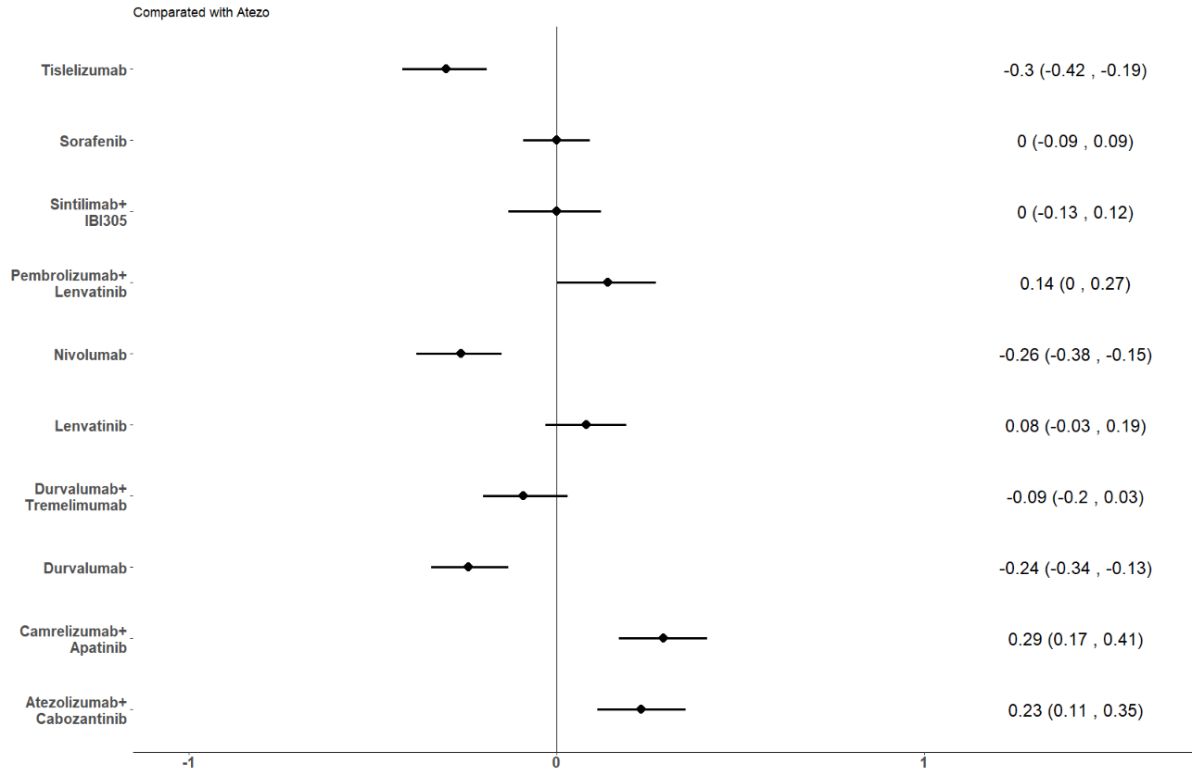
Results: Severe Adverse Events (SAEs)
Compared with Atezolizumab plus Bevacizumab
Proportion difference (95% CI)
Treatment | SUCRA
Tislelizumab | 0.972
Nivolumab | 0.895
Durvalumab | 0.833
Durvalumab plus Tremelimumab | 0.686
Sintilimab plus IBI305 | 0.504
Sorafenib | 0.497
Atezolizumab plus Bevacizumab | 0.493
Lenvatinib | 0.373
Pembrolizumab plus Lenvatinib | 0.203
Atezolizumab plus Cabozantinib | 0.091
Camrelizumab plus Apatinib | 0.015

Slide 19
Innovative methods combination of efficacy and safety
ISER = Incremental safety effectiveness ratio
ISER=
SAEs Treatment A – SAEs Treatment B
OS Treatment A – OS Treatment B
1.Cabibbo, Celsa et al. Cancers, 2020
2. Cabibbo, Reig et al. Liver Cancer, 2021

Slide 20
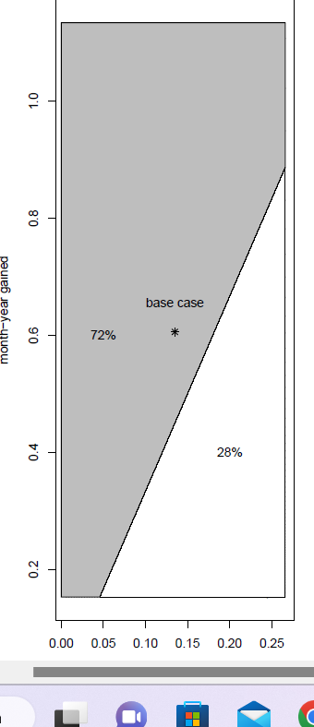
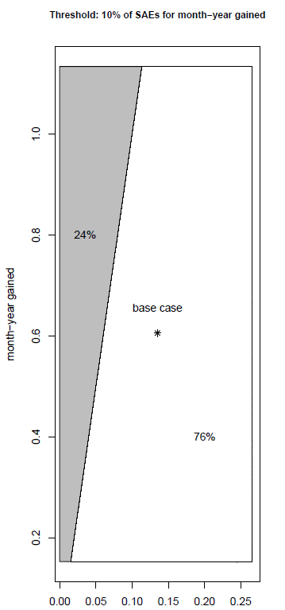
Global Benefit Atezo –Beva vs Lenva - Pembro
Low risk profile
+10% of SAEs for month-year gained
High risk profile
+30% of SAEs for month-year gained
Pembro+Lenva favored in 72% of cases
Atezo+Beva favored in 76% of cases

Slide 21
Conclusions: first line ICIs
The combination of ICI with anti-VEGF (Atezolizumab plus Bevacizumab) is the most effective therapy in improving OS
The combination of ICI + TKI (Lenvatinib ± Pembrolizumab) is the most effective in improving PFS.
ICI monotherapies (Tislelizumab, Durvalumab and Nivolumab) were the safest.

Slide 22
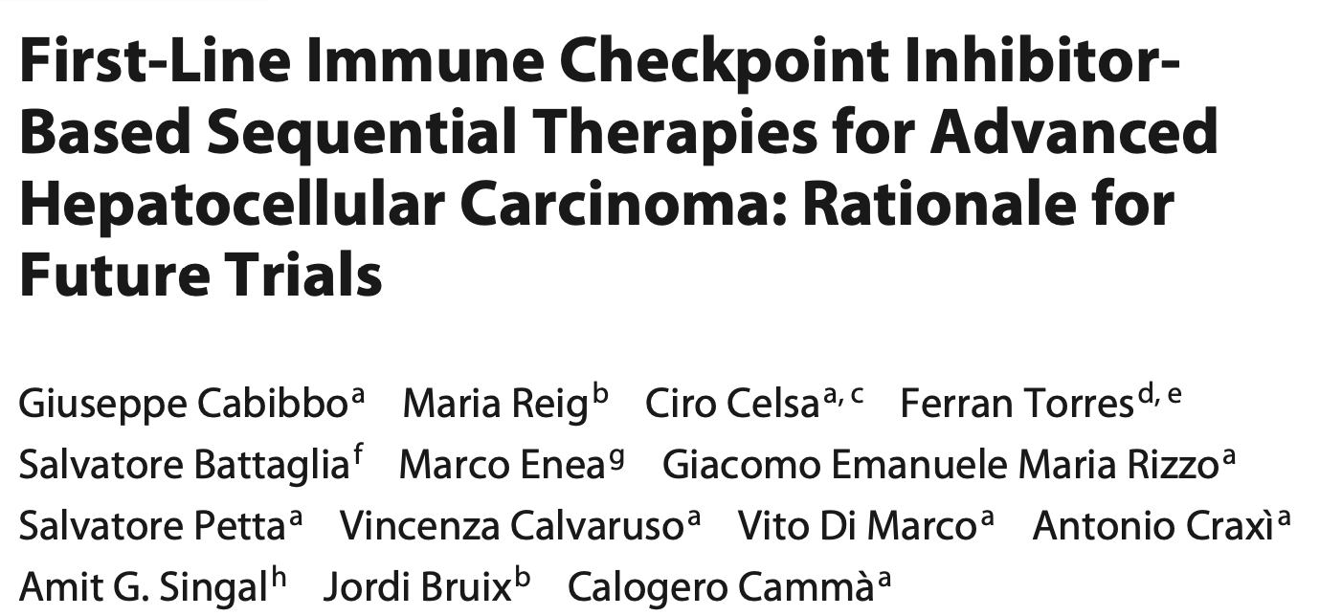
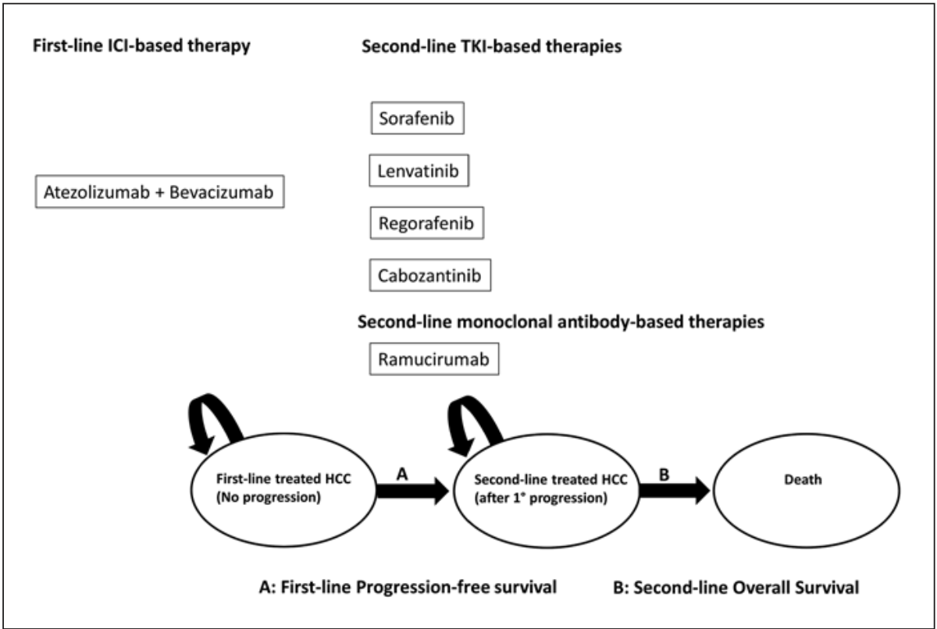
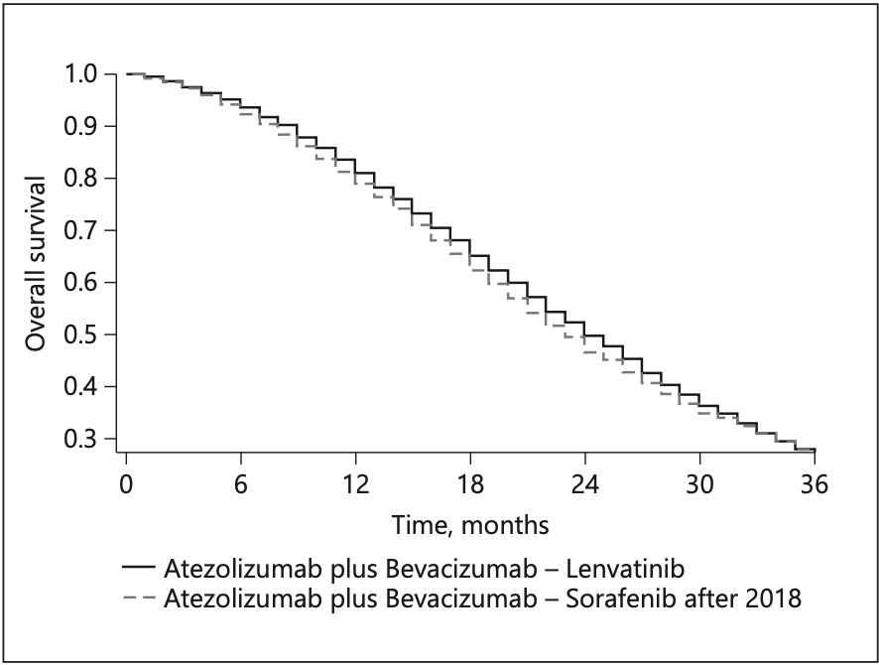
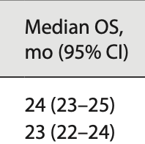
Second-line treatment
Median OS 24 mo.
Structure of Markov Model
A: Progression Free Survival of first-line. B: Overall survival of second-line.
Cabibbo, Reig et al. Liver Cancer 2021

Slide 23
Agenda
Flaws of ICI treatment RCTs
Surrogate endpoints
First and second line ICI treatment
Adjuvant trial of ICIs
Competing risks in HCC setting
Use of Hazard Ratio (HR) as measure of efficacy

Slide 24
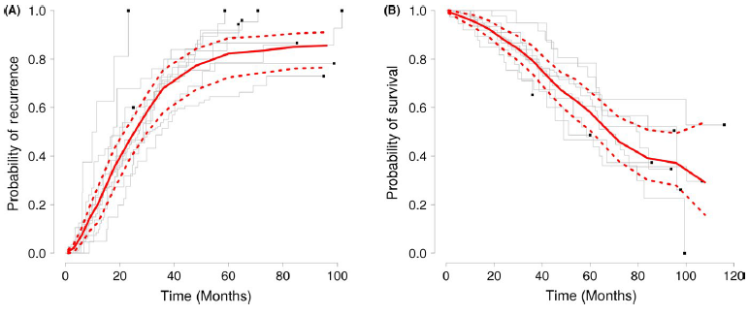
Pooled Actuarial Recurrence Rate
- 24 months: 47% (Range: 32-100%)
Pooled actuarial survival Rate
- 5 years : 59% (Range: 47-78%)
Cabibbo et al. Liv Int 2017

Slide 25
IMbrave050 study design
Patient Population
Confirmed first diagnosis of HCC and had undergone curative resection or ablation
Disease free
Child-Pugh class A
High risk of recurrenceª
No extrahepatic disease or macrovascular invasion (except Vp1/Vp2)
ECOG PS 0 or 1
12 months or 17 cycles
Atezolizumab 1200 mg q3w + bevacizumab 15 mg/kg q3w (n=334)
Recurrence^{b} or unacceptable toxicity
Survival follow-up
4-12 weeks
R 1:1
1 cycle of TACE, if
indicated
Active surveillance (n=334)
Stratification
Crossover permitted
Region (APAC excluding Japan vs rest of world)
High-risk features and procedures:
Ablation
Resection, 1 risk feature, adjuvant TACE (yes vs no)
Resection, ≥2 risk features, adjuvant TACE (yes vs no)
Primary endpoint
Recurrence-free survival assessed by the independent review facility^{b}
ClinicalTrials.gov, NCT04102098. ECOG PS; Eastern Cooperative Oncology Group performance status; Q3W, every three weeks; R, randomization; TACE, transarterial chemoembolization.
ª High-risk features include: tumor >5 cm, >3 tumors, microvascular invasion, minor macrovascular invasion Vp1/Vp2, or Grade 3/4 pathology.
^{b} Intrahepatic recurrence defined by EASL criteria. Extrahepatic recurrence defined by RECIST 1.1.
Chow et al IMbrave050 https://bit.ly/3ZPKzgM 5

Slide 26
High-risk criteria by curative treatment
Curative treatment | Criteria for high risk of HCC recurrence
Resection | ≤3 tumors, with largest tumor >5 cm regardless of vascular invasion,ª or poor tumor differentiation (Grade 3 or 4) ≥4 tumors, with largest tumor ≤5 cm regardless of vascular invasion,ª or poor tumor differentiation (Grade 3 or 4) ≤3 tumors, with largest tumor ≤5 cm with vascular invasion,ª and/or poor tumor differentiation (Grade 3 or 4)
Ablation^{b} | 1 tumor >2 cm but ≤5 cm Multiple tumors (≤4 tumors), all ≤5 cm
ª Microvascular invasion or minor macrovascular portal vein invasion of the portal vein—Vp1/Vp2.
^{b} Ablation must be radiofrequency ablation or microwave ablation.
Chow et al IMbrave050 https://bit.ly/3ZPKzgM 7

Slide 27
Baseline characteristics were balanced across treatment arms
Characteristic | Atezo + bev (n=334) | Active surveillance (n=334)
Median age (range), years | 60 (19-89) | 59 (23-85)
Male sex, n (%) | 277 (82.9) | 278 (83.2)
Ethnicity, n (%)
Asian | 276 (82.6) | 269 (80.5)
White | 35 (10.5) | 41 (12.3)
Other | 23 (6.9) | 24 (7.2)
Geographic region, n (%)
Asia Pacific excluding Japan | rest of world | 237 (71.0) | 97 (29.0) | 238 (71.3) | 96 (28.7)
ECOG PS score, n (%)
0 | 1 | 258 (77.2) | 76 (22.8) | 269 (80.5) | 65 (19.5)
PD-L1 status, n (%)^{a,b}
≥1% | <1% | 154 (54.0) | 131 (46.0) | 140 (50.2) | 139 (49.8)
Etiology, n (%)
Hepatitis B | 209 (62.6) | 207 (62.0)
Hepatitis C | 34 (10.2) | 38 (11.4)
Non viral | unknown | 45 (13.5) | 46 (13.8) | 38 (11.4) | 51 (15.3)
BCLC stage at diagnosis, n (%)
0 | 2 (0.6) | 3 (0.9)
A | 287 (85.9) | 277 (82.9)
B | 25 (7.5) | 32 (9.6)
C | 20 (6.0) | 22 (6.6)
Asian 80%
HBV 60%
Clinical cutoff: October 21, 2022; median follow-up duration: 17.4 mo. BCLC; Barcelona Clinic Liver Cancer.
ª n=285 for atezo + bev and 279 for active surveillance. ^{b} PD-L1 expression is defined as the total percentage of the tumor area covered by tumor and immune cells stained for PD-L1 using the SP263 immunohistochemistry assay (VENTANA).
Chow et al IMbrave050 https://bit.ly/3ZPKzgM 10

Slide 28
Baseline characteristics—curative procedures
Characteristic | Atezo + bev (n=334) | Active surveillance (n=334)
Resection, n (%) | 293 (87.7) | 292 (87.4)
Longest diameter of the largest tumor at diagnosis, median (range), cmª | 5.3 (1.0-18.0) | 5.9 (1.1-25.0)
Tumors, n (%)
1 | 266 (90.8) | 260 (89.0)
2 | 20 (6.8) | 29 (9.9)
3 | 4 (1.4) | 2 (0.7)
4+ | 3 (1.0) | 1 (0.3)
Adjuvant TACE following resection, n (%) | 32 (10.9) | 34 (11.6)
Any tumors >5 cm, n (%) | 152 (51.9) | 175 (59.9)
Microvascular invasion present, n (%) | 178 (60.8) | 176 (60.3)
Minor macrovascular invasion (Vp1/Vp2) present, n (%) | 22 (7.5) | 17 (5.8)
Poor tumor differentiation (Grade 3 or 4), n (%) | 124 (42.3) | 121 (41.4)
Ablation, n (%) | 41 (12.3) | 42 (12.6)
Longest diameter of the largest tumor at diagnosis, median (range), cm | 2.5 (1.2-4.6) | 2.6 (1.5-4.6)
Tumors, n (%)
1 | 29 (70.7) | 31 (73.8)
2 | 11 (26.8) | 8 (19.0)
3 | 1 (2.4) | 3 (7.1)
Resezioni 88%
Clinical cutoff: October 21, 2022; median follow-up duration: 17.4 mo.
ª 1 patient in the atezo + bev arm was excluded from the calculation due to data entry error.
Chow et al IMbrave050 https://bit.ly/3ZPKzgM 11

Slide 29
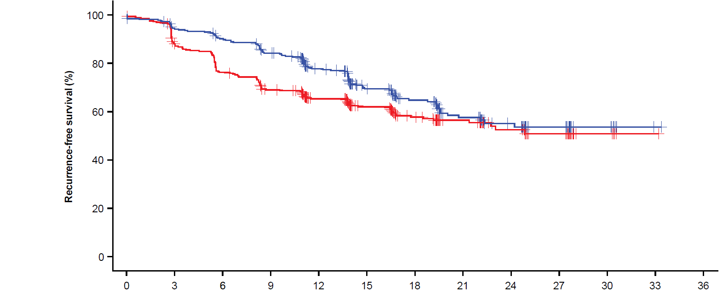
Primary endpoint: IRF-assessed RFS was significantly improved with atezo + bev vs active surveillance
78% (73, 82)
65% (60, 71)
12-mo IRF-RFS event-free rate (95% CI), %
Median FU:
17.4 mo
Median IRF-RFS (95% CI), mo:
Atezo + bev Active surveillance
NE (22.1, NE)
NE (21.4, NE)
HR=0.72 (95% CI: 0.56, 0.93)
P value=0.012
Clinical cutoff: October 21, 2022; median follow-up duration: 17.4 mo. At clinical cutoff, 110 of 334 patients (33%) in the atezo + bev arm and 133 of 334 (40%) in the active surveillance arm experienced disease recurrence or death.
FU, follow-up; NE, not estimable. HR is stratified. P value is a log rank.
Chow et al IMbrave050 https://bit.ly/3ZPKzgM 12

Slide 30
Open Issues
Proportionality of Hazards
Constant efficacy over time
Recurrence free survival
?
?
Overall Survival

Slide 31
Agenda
Flaws of ICI treatment RCTs
Surrogate endpoints
First and second line ICI treatment
Adjuvant trial of ICIs
Competing risks in HCC setting
Use of Hazard Ratio (HR) as measure of efficacy

Slide 32
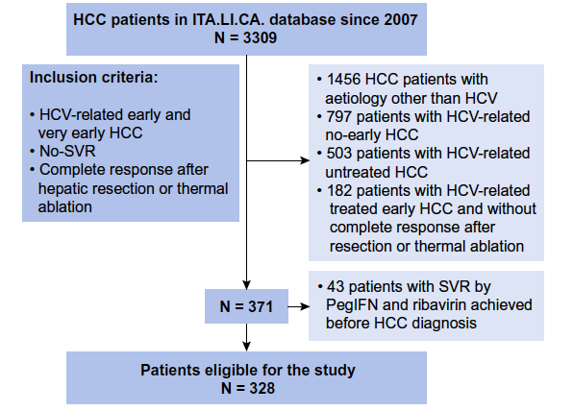
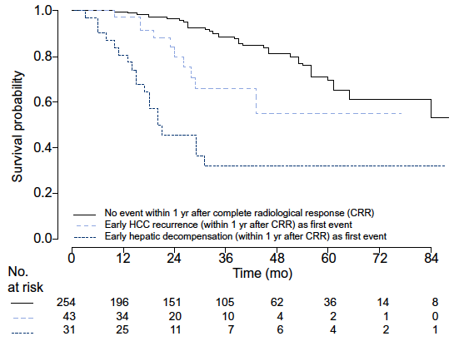
Time dependent Cox model (MV analysis)
Predictor of Survival | HR | 95%CI | P-value
Early recurrence | 2.5 | 1.2-5.1 | 0.01
Early hepatic decompensation | 7.5 | 4.2-13.5 | <0.0001
Cabibbo G. et al, on behalf ITA.LI.CA. Group. J Hep 2017

Slide 33
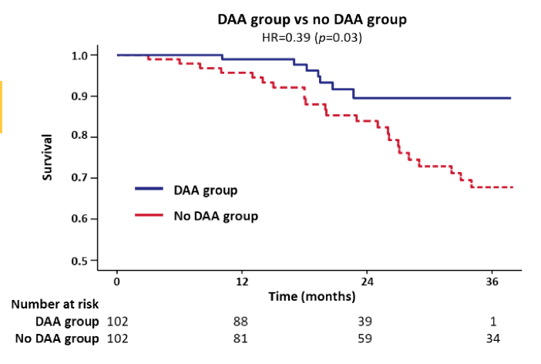
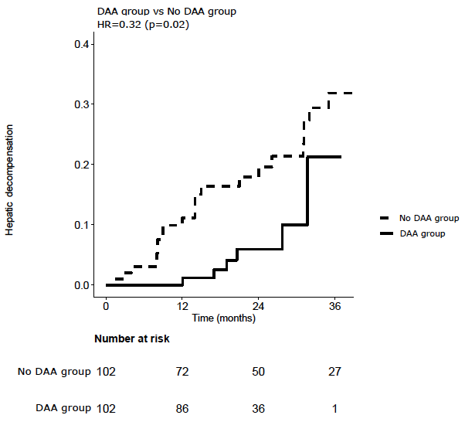
DAAs as First Adjuvant Therapy for HCC!
No differences in HCC recurrences
DAA group vs no DAA group
HR = 0.32 (p=0.02)
DAA group vs no DAA group
HR = 0.39 (p=0.03)
Hepatic decompensation
Survival
DAA group
No DAA group
Improvement in overall survival seems due to significant reduction in hepatic decompensation
Cabibbo, Celsa et al, on behalf RESIST-HCV & ITA.LI.CA. J Hep 2019

Slide 34
Competing risk for survival in intermediate/advanced HCC patients

Slide 35
Agenda
Flaws of ICI treatment RCTs
Surrogate endpoints
First and second line ICI treatment
Adjuvant trial of ICIs
Competing risks in HCC setting
Use of Hazard Ratio (HR) as measure of efficacy

Slide 36
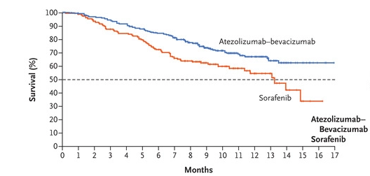
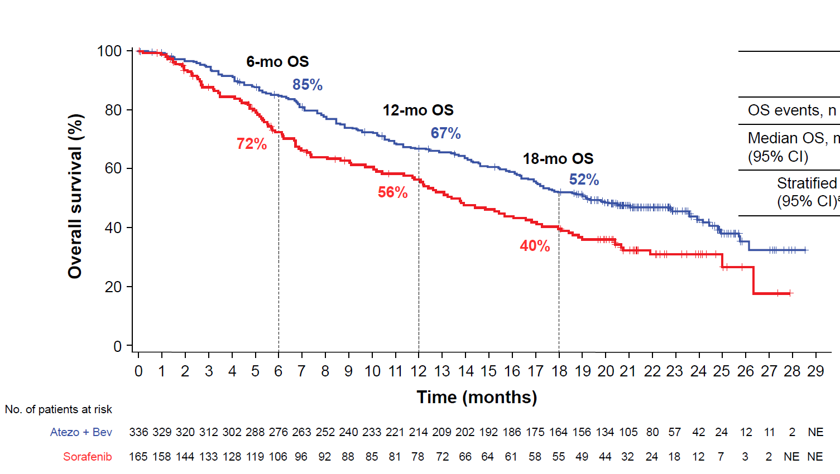
Hazard Ratio
Proportional HR
Constant efficacy over time
True benefit
Finn et al. NEJM 2020, Cheng et al. JHep, 2021. Ferrara et al. J Thorac Dis 2018

Slide 37
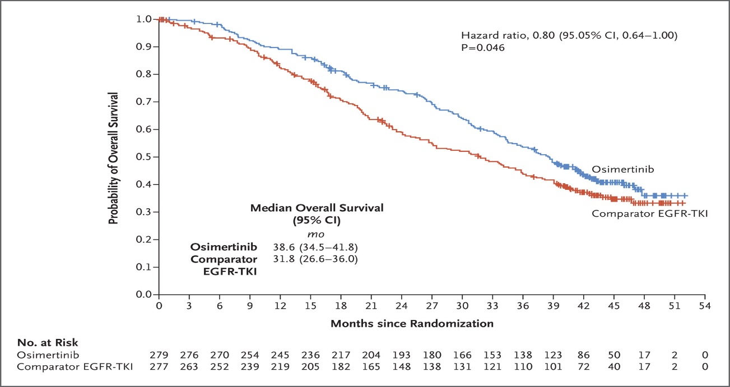
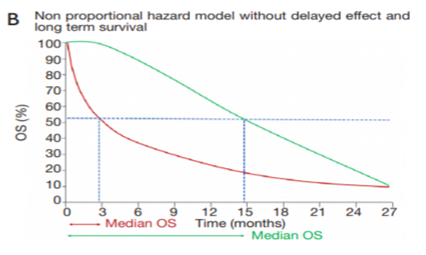
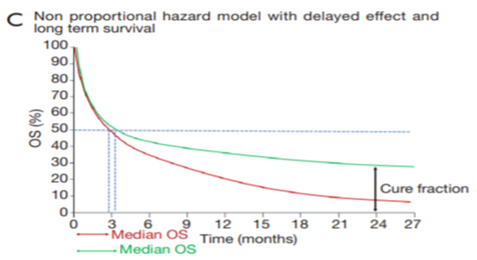
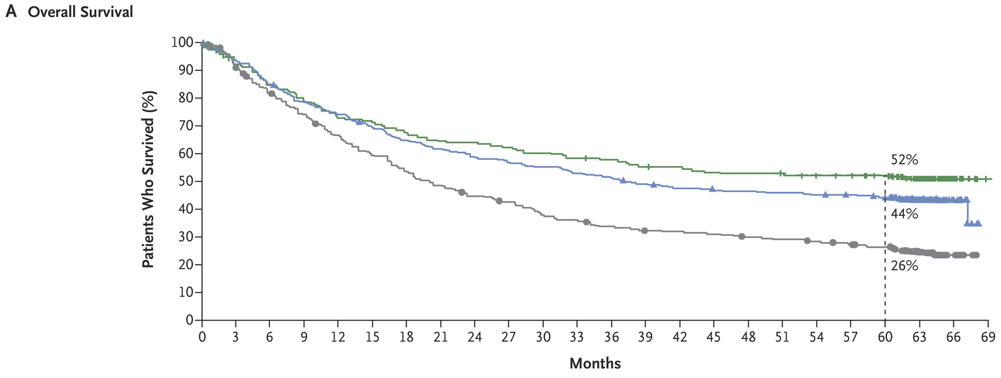
Hazard Ratio
Non Proportional HR
Apparent benefit
(secondary resistance?)
TKI in lung cancer
Long-term benefit for a subgroup
ICI in melanoma
Ramalingam et al. NEJM 2020, Larkin et al. NEJM 2019 Ferrara et al. J Thorac Dis 2018

Slide 38
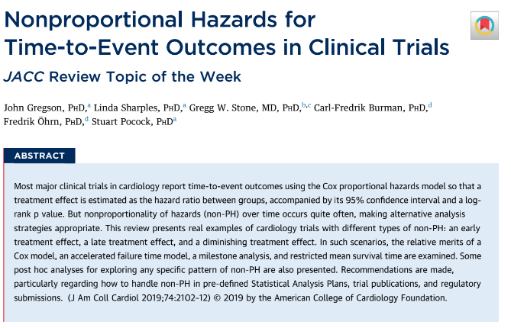
Hazard of Hazard Ratio
Nonproportionality of hazard occurs often
Alternative methodologies

Slide 39
Conclusions
ATEZOLIZUMAB+BEVACIZUMAB represents the first-line systemic therapy in intermediate/advanced hepatocellular carcinoma;
TKIs, alone or in combination, could play an important role in second line after ATEZO+BEVA (or after TREME+DURVA);
Decompensation-free survival should be reported and included as endpoint in trial designs of systemic or locoregional therapies.

