Slide 1



Impatto della eradicazione di HCV su morbilità e mortalità
Antonio Craxì
Scuola di Medicina
Università di Palermo

Slide 2
Relevant Disclosures
Grant and research support: AbbVie, Advanz, Alfasigma, Bayer, BMS, Gilead Sciences, Intercept, MSD, Roche
Advisory committees: AbbVie, Advanz, Alfasigma, Bayer, BMS, Gilead Sciences, Intercept, MSD, Roche
Speaking and teaching: AbbVie, Advanz, Alfasigma, Bayer, BMS, Gilead Sciences, Intercept, MSD, Roche

Slide 3
Journal of Hepatology 2020 vol. 73 j 1548–1556

Slide 4
The natural history of HCV related chronic liver disease
Development of HCC
Increasing liver fibrosis
and neo-angiogenesis
DAAs
Chronic hepatitis
Compensated cirrhosis
Decompensated cirrhosis
Death
DAAs
DAAs
DAAs
Variceal hemorrhage
Ascites
Encephalopathy
Jaundice
Esophageal Varices
< 5
5-10
12
> 12
Hepatic Venous Pressure Gradient (HVPG) (mm Hg)

Slide 5
Outcomes of etiological treatment
Reduce significantly HVPG
Halt the occurrence or the progression of varices
Reduce decompensation events and mortality

Slide 6
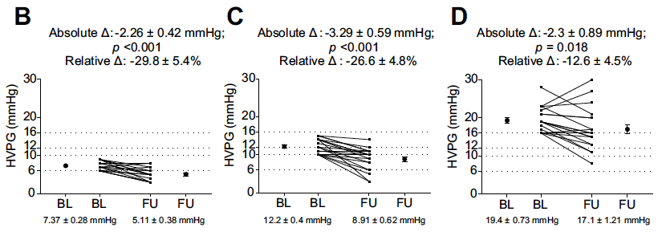
The evolution of portal pressure after viral suppression
with Interferon-free therapies
Mandorfer M, et al. Journal of Hepatology 2016 vol. 65 j 692–699

Slide 7
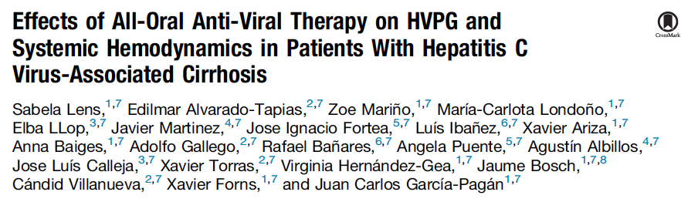
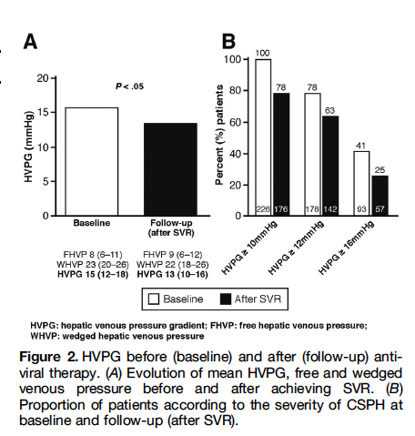

Slide 8
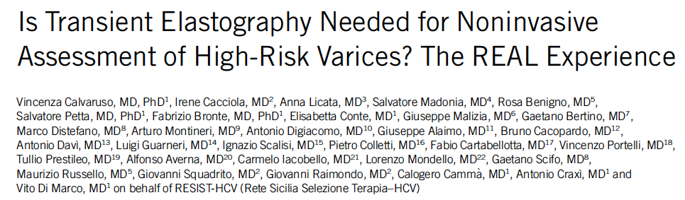
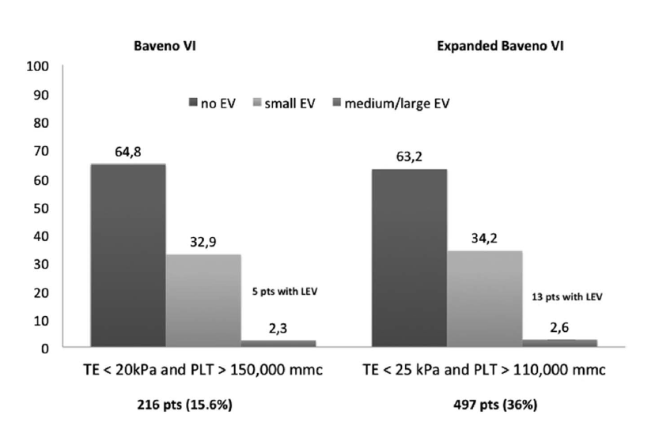
Calvaruso V et al. Am J Gastroenterol 2019;114:1275–1282.

Slide 9
HVPG before and after DAAs according to RESIST-HCV criteria at baseline
RESIST-HCV IN: PLT >120.000 mmc + Alb > 3.6 g/dl
RESIST-HCV IN (n=16)
RESIST-HCV OUT (n=30)
HVPG before DAAs
HVPG after SVR by DAAs
HVPG before DAAs
HVPG after SVR by DAAs
p<0.001
p<0.001
Calvaruso V, Celsa C et al. American Journal of Gastroenterology 2022

Slide 10
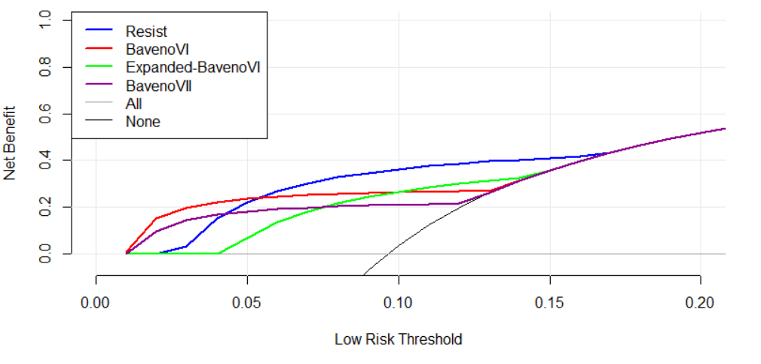
Decision curve analysis of RESIST-HCV, Baveno VI Expanded Baveno VI criteria for ruling out VNT after direct-acting antiviral (DAA) treatment in 353 patients with HCV-related compensated cirrhosis and low-risk EV
100
80
60
Endoscopies avoided per 100 patients
40
20
0
Threshold probability of missing HRV (false negative)
Calvaruso V, Celsa C et al. American Journal of Gastroenterology 2022

Slide 11

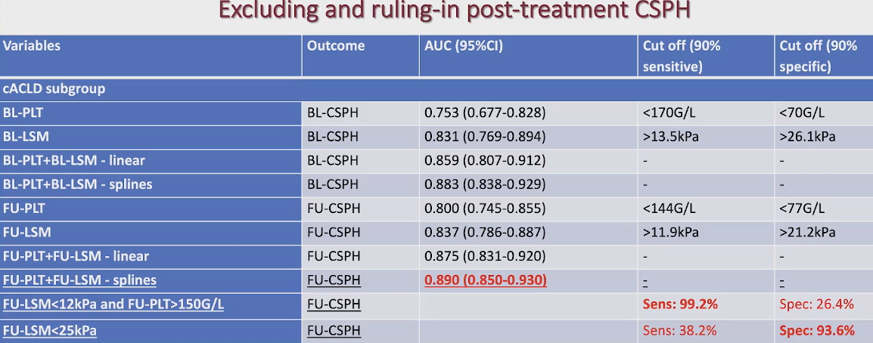
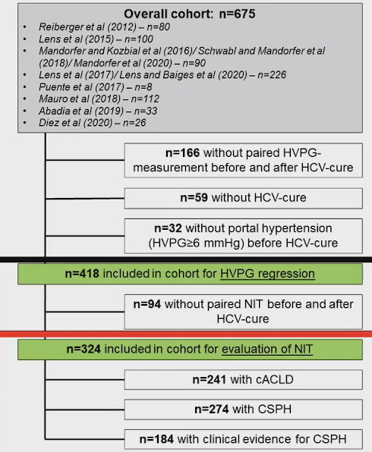
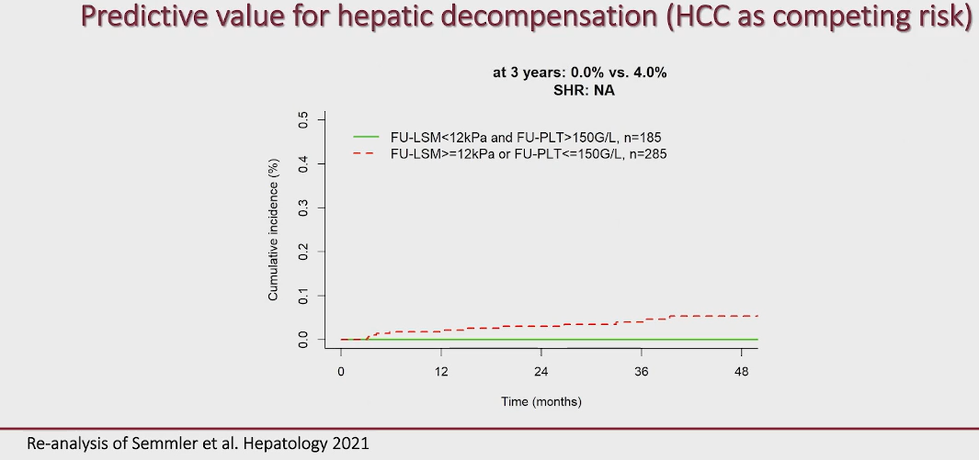
Individual patient data meta-analysis
Median follow-up after HCV treatment: 28 weeks
Notes:
Reasons for choosing strict criteria (LSM < 12 kPa AND PLT > 150/mmc) for excluding CSPH

Slide 12
Outcomes of etiological treatment
Reduce significantly HVPG
Halt the occurrence or the progression of varices
Reduce decompensation events and mortality

Slide 13
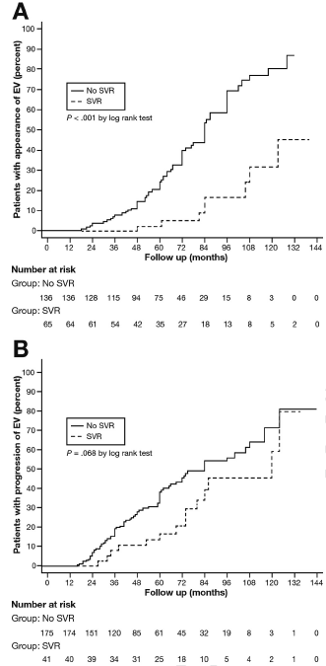
Effect of viral eradication on occurrence/progression of esophageal varices in patients with HCV cirrhosis after Peg/RBV
Occurrence of EV
Progression of EV
V. Di Marco et al. Gastroenterology 2016;151:130–139

Slide 14
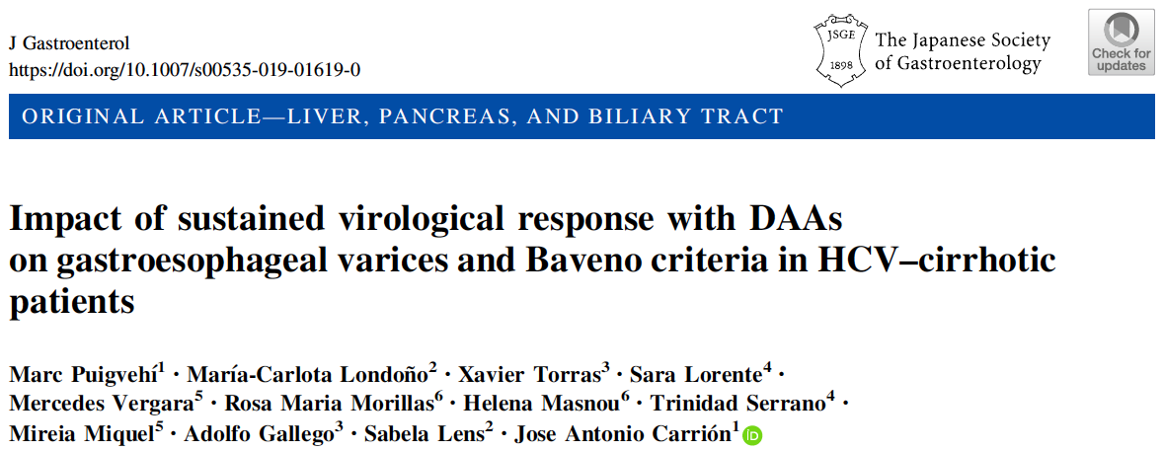

Slide 15
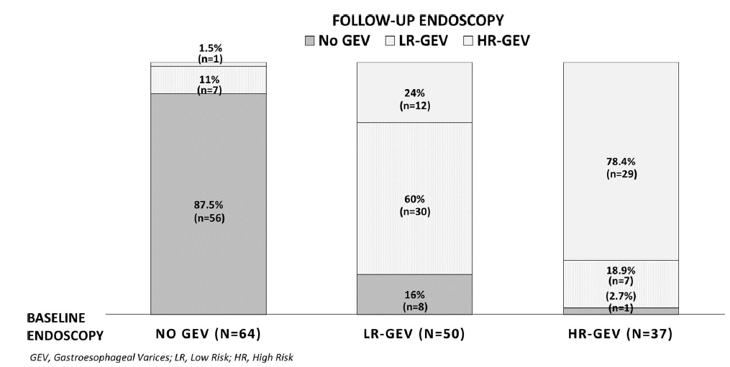
Evolution of GEV after SVR according
to baseline endoscopic findings

Slide 16
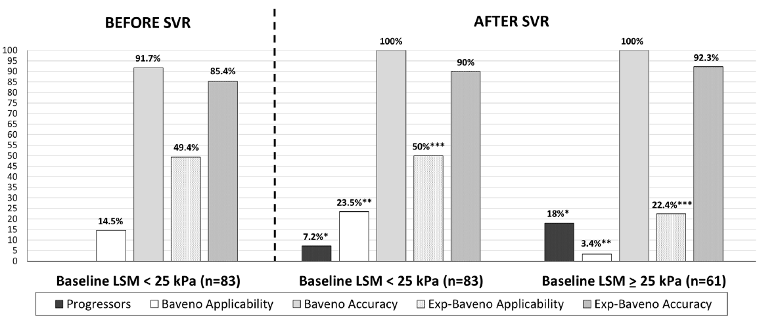
GEV progression, applicability and negative predictive value of Baveno and expanded-Baveno criteria according to baseline
LSM, before and after SVR
HCV–cirrhotic patients can develop HRGEV after SVR. Surveillance is especially recommended in those with GEV before antiviral treatment.
Baveno and Expanded-Baveno criteria can be safely applied after SVR.

Slide 17

cACLD / CSPH: Surveillance Endoscopy
 | HCV No SVR | HCV SVR
No Varices | 2 y | 3 y
Small Varices | 1 y | 2 y
Adapted by De Franchis R et al. Journal of Hepatology 2015 vol. 63 j 743–752

Slide 18
Outcomes of etiological treatment
Reduce significantly HVPG
Halt the occurrence or the progression of varices
Reduce decompensation events and mortality

Slide 19
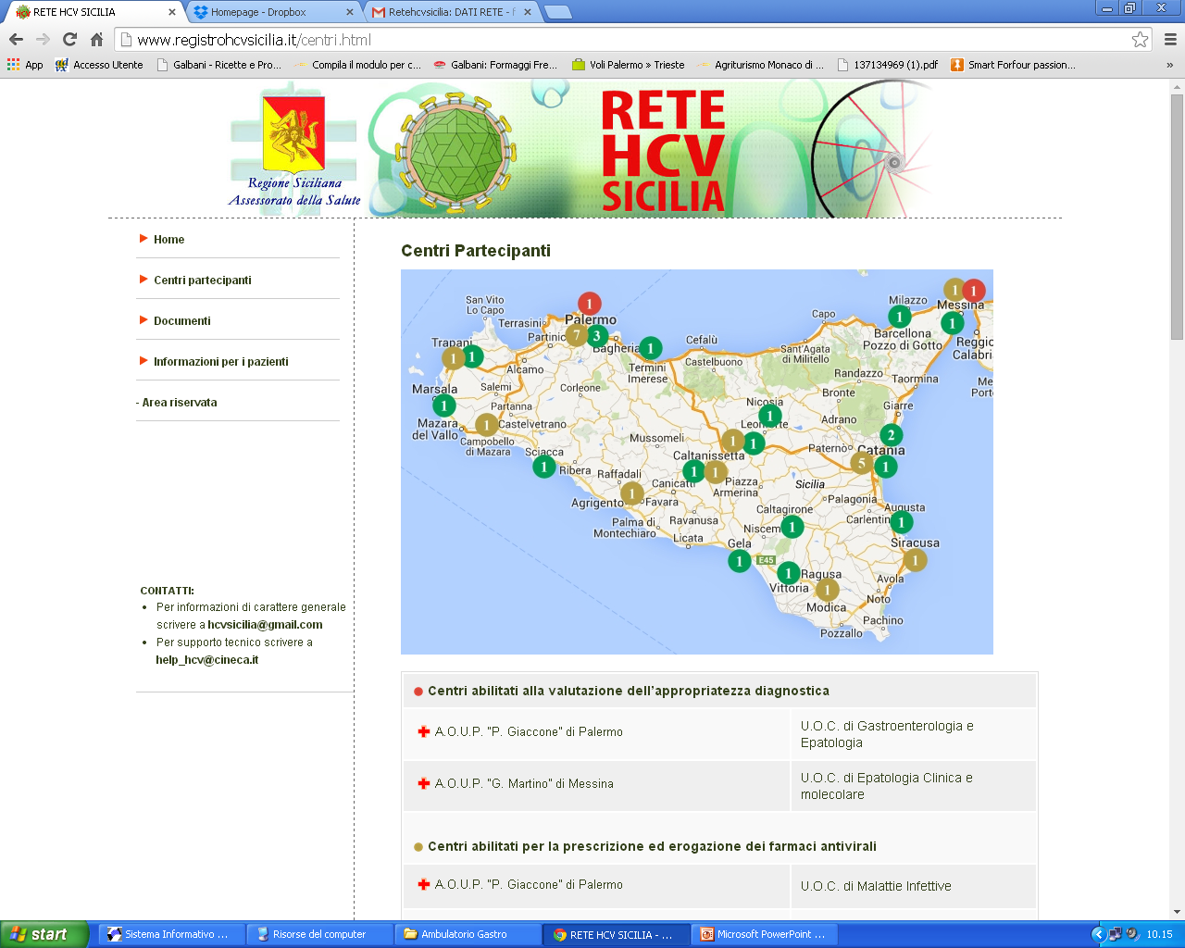
Liver Disease Outcomes of 4,468 patients included in RESIST-HCV cohort and treated with DAAs: mITT analysis (mean follow-up 72 ± 32 weeks)
Disease events | Chronic Hepatitis 990 (22.1%) |  |  | Child-Pugh A cirrhosis 3,095 (69.3%) |  |  | Child-Pugh B cirrhosis 383 (8.6%)
 | SVR 957 pts | No SVR 34 pts | p | SVR 2,939 pts | No SVR 156 pts | p | SVR 339 pts | No SVR 44 pts | p
Liver decompensation (%) | 0 | 0 | - | 47 (1.5) | 8 (5.1) | 0.005 | 30 (7.6) | 6 (13.6) | 0.1
de novo HCC (%) | 2 (0.02) | 0 | - | 65 (2.2) | 13 (8.3) | <0.001 | 22 (7.3) | 3 (6.8) | 0.9
Liver Transplant (%) | 0 | 0 | - | 0 | 0 |  | 4 (1.2) | 1 (2.2) | 0.4
Calvaruso V et al. Journal of Viral Hepatitis 2021
Notes:
Rate of HCC occurrence confirmed results of previous analysis
18(38.3)/ 47 liver decompensation in CPA svr were diabetes.
4/8 CPA no SVR

Slide 20
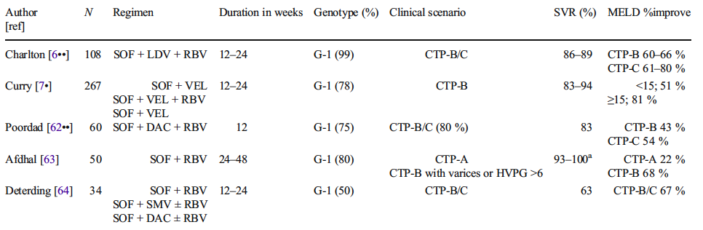
Direct-acting antiviral treatment effect in decompensated cirrhosis
Charlton M. Ledipasvir and sofosbuvir plus ribavirin for treatment of HCV infection in patients with advanced liver disease. Gastroenterology. 2015;149(3):649–59.
Curry MP. Sofosbuvir and velpatasvir for HCV in patients withdecompensated cirrhosis. N Engl J Med. 2015;373(27):2618–28.
Poordad F. Daclatasvir with sofosbuvir and ribavirin for HCV infection with advanced cirrhosis or post-liver transplant recurrence.Hepatology. 2016;63(5):1493–505.
Afdhal N et al. Sofosbuvir and ribavirin for the treatment of chronicHCV with cirrhosis and portal hypertension with and without decompensation: early virologic response and safety. J Hepatol. 2014;60:S28.
Deterding K et al. Improvement of liver function parameters in advanced HCV-associated liver cirrhosis by IFN-free antiviral therapies. Aliment Pharmacol Ther. 2015;42(7):889–90

Slide 21

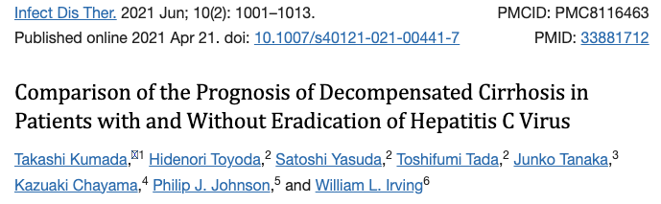
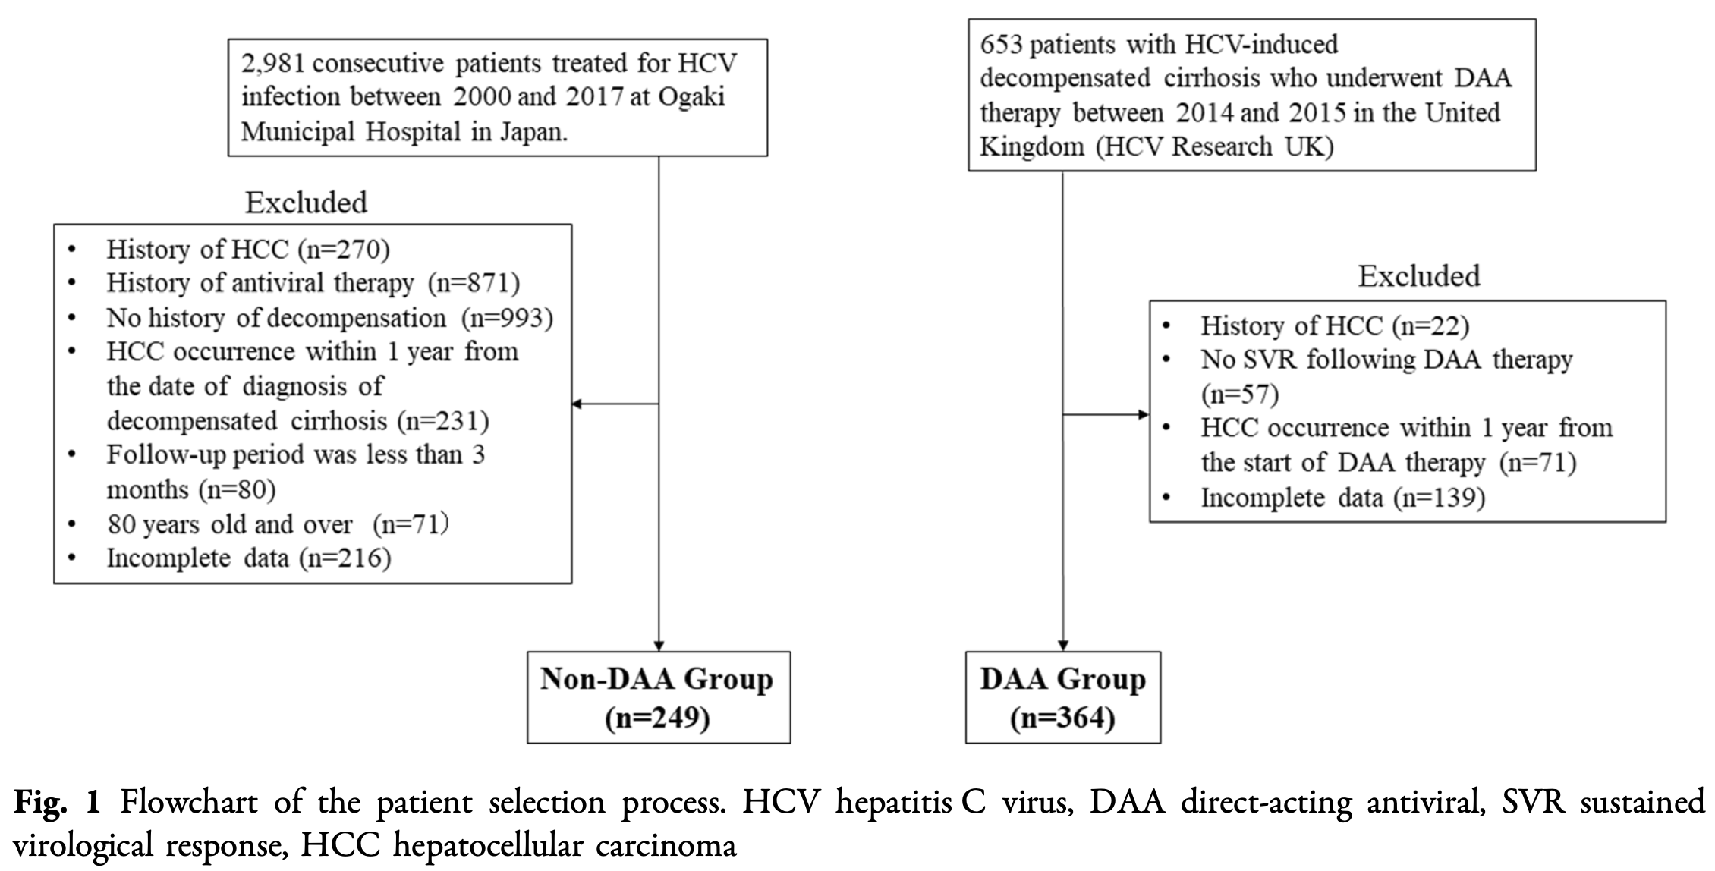
Kumada T. Infect Dis Ther 2021
Notes:
364 pazienti con DC che hanno ricevuto antivirali ad azione diretta (DAA) e hanno ottenuto una risposta virologica sostenuta (SVR) nel Regno Unito (gruppo DAA) sono stati confrontati con 249 pazienti con DC che non hanno ricevuto DAA e che sono stati sottoposti a trattamento sintomatico in Giappone (gruppo non DAA)

Slide 22
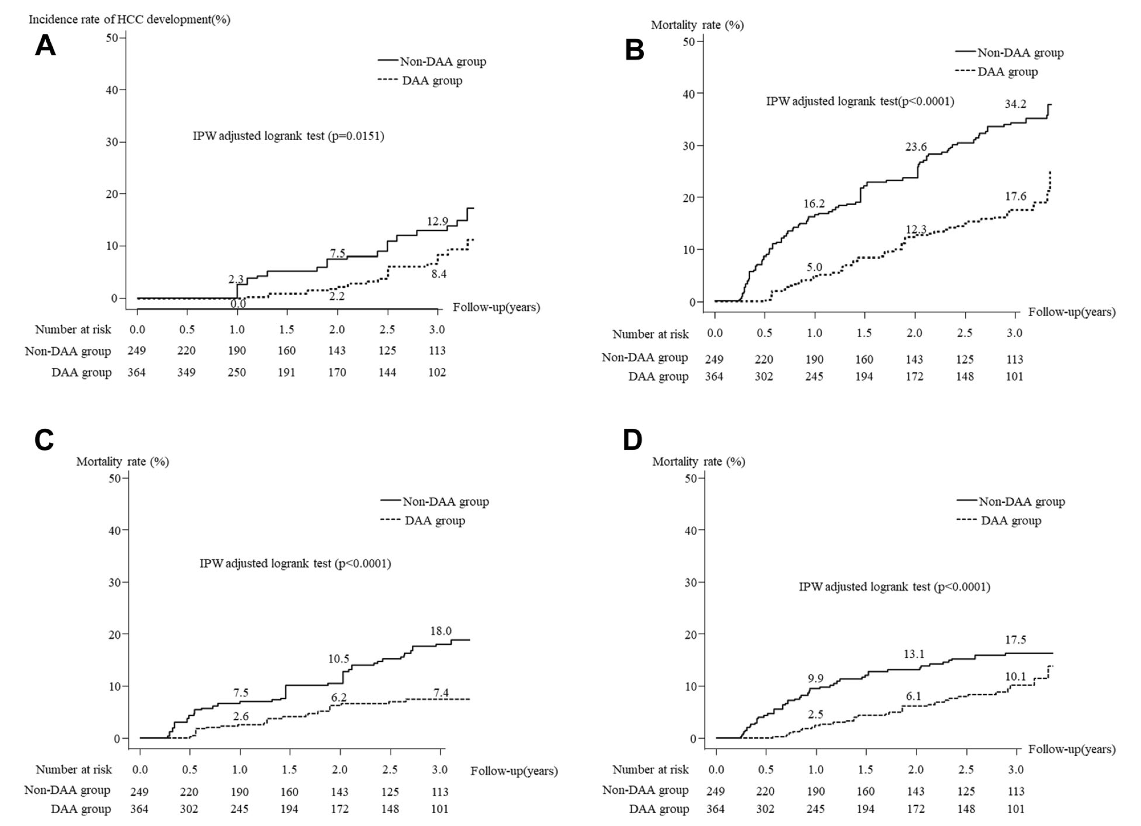
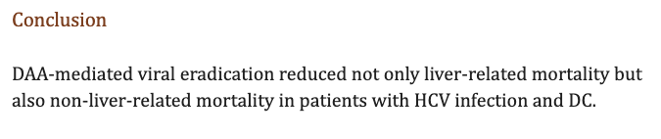
Kumada T. Infect Dis Ther 2021
Notes:
Anche nel pz con cirrosi scompensata, il trattamento con DAA ha dimostrato di ridurre la mortalità correlata al fegato ma anche la mortalità non correlata al fegato
l tasso cumulativo di mortalità per tutte le cause nel gruppo DAA era significativamente inferiore a quello del gruppo non DAA (p< 0,0001, test log-rank aggiustato IPW). I tassi cumulativi di incidenza della mortalità sia correlata al fegato che non correlata al fegato erano significativamente più bassi nel gruppo DAA rispetto a quelli del gruppo non DAA (p < 0,0001 per entrambi)..

Slide 23

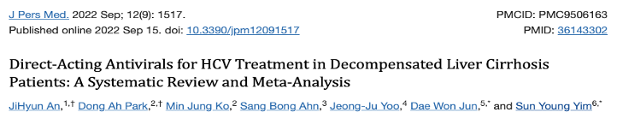
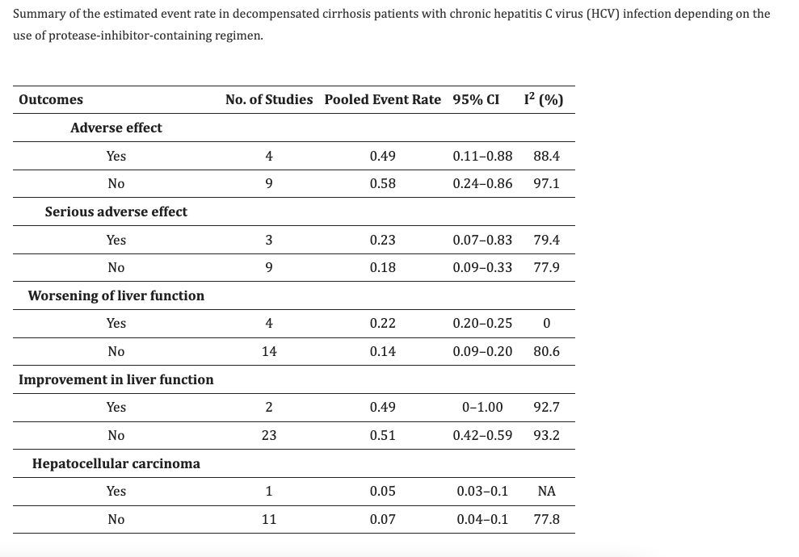
. The pooled SVR for 6315 PI-based DAA-treated DC patients was 85% (95% CI: 0.75–0.91), which did not differ from the non-PI-based treated group (n = 7866), with an SVR of 86% (95% CI: 0.84–0.89)
. PI did not have a significant impact on either AEs or SAEs, with pooled rates of 49% vs. 58% and 23% vs. 18% in PI- and non-PI-based treatments, respectively
. Patients treated with a PI-containing regimen (n = 2244) were more likely to be associated with the deterioration of liver function with a pooled event rate of 22% (95% CI: 0.20–0.25), while non-PI-based regimens (n = 2661) showed a pooled event rate of 14% (95% CI: 0.09–0.2)
Notes:
Ribadendo che i PI in Italia non sono indicati nella cirrosi scompensata
Il presente studio è il primo a valutare il tasso di SVR aggregato e gli eventi clinici che si verificano nei pazienti DC dopo il trattamento con DAA.
La SVR aggregata per 6315 pazienti DC trattati con DAA basati su PI era dell'85% (95% CI: 0,75-0,91), che non differiva dal gruppo trattato senza PI (n = 7866), con una SVR di 86 %
I pazienti trattati con un regime contenente PI (n = 2244) avevano maggiori probabilità di essere associati al deterioramento della funzionalità epatica con un tasso di eventi aggregati del 22% (IC 95%: 0,20-0,25), mentre i regimi non basati su PI (n = 2661) ha mostrato un tasso di eventi aggregati del 14% (IC 95%: 0,09-0,2)
Al contrario, il miglioramento della funzionalità epatica è stato comparabile tra questi due gruppi: 49% vs. 51% (n = 204, 95% CI: 0–1 e n = 3496, 95% CI: 0,42– 0,59) con un risultato simile tasso di mortalità del 5% vs. 6% (n = 690, 95% CI: 0,04-0,07 e n = 5094, 95% CI: 0,04-0,09)

Slide 24
. The improvement in liver function was comparable between these two groups: 49% vs. 51% (n = 204, 95% CI: 0–1 and n = 3496, 95% CI: 0.42– 0.59) with a similar pooled mortality rate of 5% vs. 6% (n = 690, 95% CI: 0.04–0.07 and n = 5094, 95% CI: 0.04–0.09)
Notes:
Al contrario, il miglioramento della funzionalità epatica è stato comparabile tra questi due gruppi: 49% vs. 51% (n = 204, 95% CI: 0–1 e n = 3496, 95% CI: 0,42– 0,59) con un risultato simile tasso di mortalità del 5% vs. 6% (n = 690, 95% CI: 0,04-0,07 e n = 5094, 95% CI: 0,04-0,09)
la presenza di malattia epatica avanzata all'inizio del trattamento è il principale fattore predittivo degli esiti a lungo termine, indipendentemente dalla SVR o dall'Aes dei DAA [24]. Pertanto, la diagnosi precoce dell'infezione da HCV è giustificata prima della progressione della malattia.
abbiamo affrontato l'efficacia e la sicurezza dei DAA basati su PI nei pazienti con CHC scompensato. I pi sono metabolizzati dal fegato e i pazienti con funzionalità epatica compromessa sono successivamente esposti a concentrazioni sieriche elevate di pi. Sebbene ci siano studi limitati che includono pazienti con cirrosi epatica scompensata negli studi clinici, sono state riportate l'efficacia e la sicurezza del PI nel mondo reale [15,21,49]. Il miglioramento della funzionalità epatica è stato paragonabile tra quelli trattati con PI e quelli che non lo hanno fatto, con un tasso simile di Aes e mortalità tra questi due gruppi, dimostrando che i regimi basati su PI possono essere presi in considerazione per i pazienti DC.

Slide 25

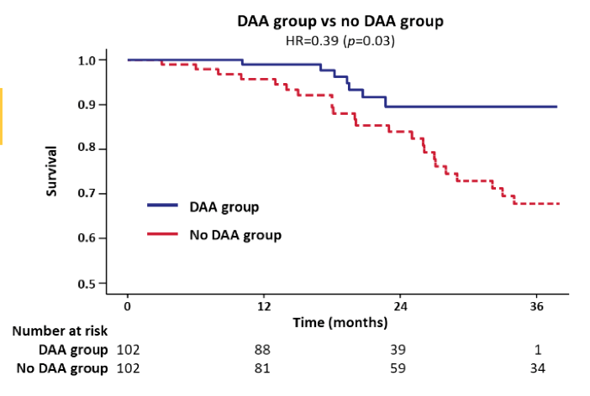
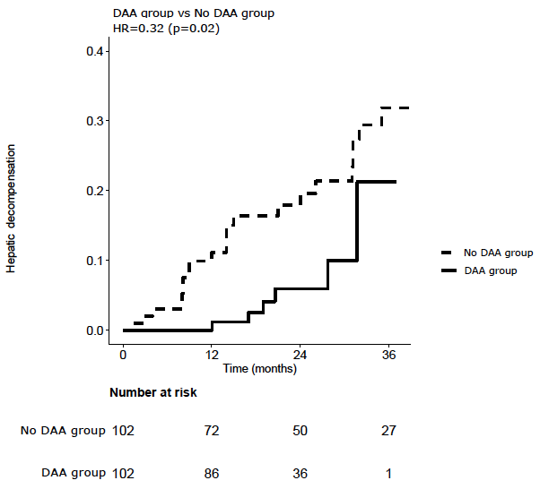
Hepatic decompensation
Survival
Improvement in overall survival seems due to significant reduction in hepatic decompensation
Cabibbo G, Celsa C, Calvaruso V et al, on behalf RESIST-HCV & ITA.LI.CA. J Hep 2019
Notes:
Multicenter prospective study comparing with matching propensity score DAAs treated of RESIST to DAAs untreated of ITALICA
DAA improve survival through reducing liver decompensation and not affect the HCC recurrence

Slide 26

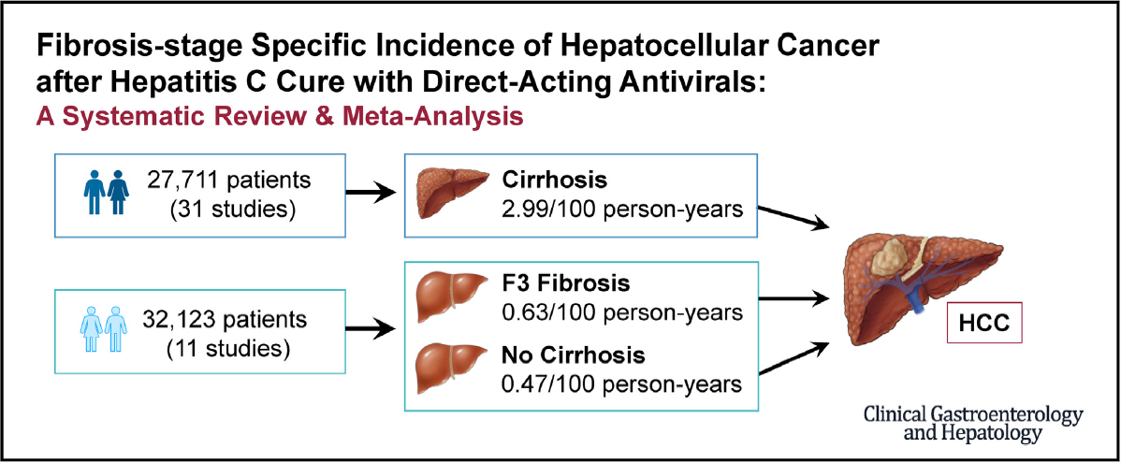
HCC Risk After DAA-Induced SVR
Data from National Veterans Affairs healthcare system
Data from a meta-analysis
CIRRHOSIS YES/NO | FIB-4 | Number of Patients | Number who Developed HCC (%) | HCC INCIDENCE
CIRRHOSIS | FIB-4≥ 3.25 | 4987 | 529 (10.6%) | 3.66%
 | FIB-4<3.25 | 2546 | 90 (3.5%) | 1.16%
NO CIRRHOSIS | FIB-4≥ 3.25 | 4682 | 167 (3.6%) | 1.22%
 | FIB-4<3.25 | 16,818 | 121 (0.7%) | 0.24%
Ioannou G. Gastro 2019; 157: 1264-1278
Kim N. CGH 2022; Online ahead of print

Slide 27
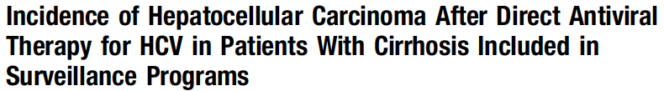
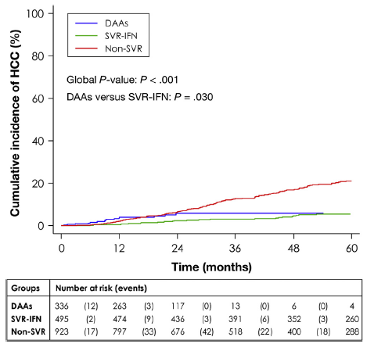
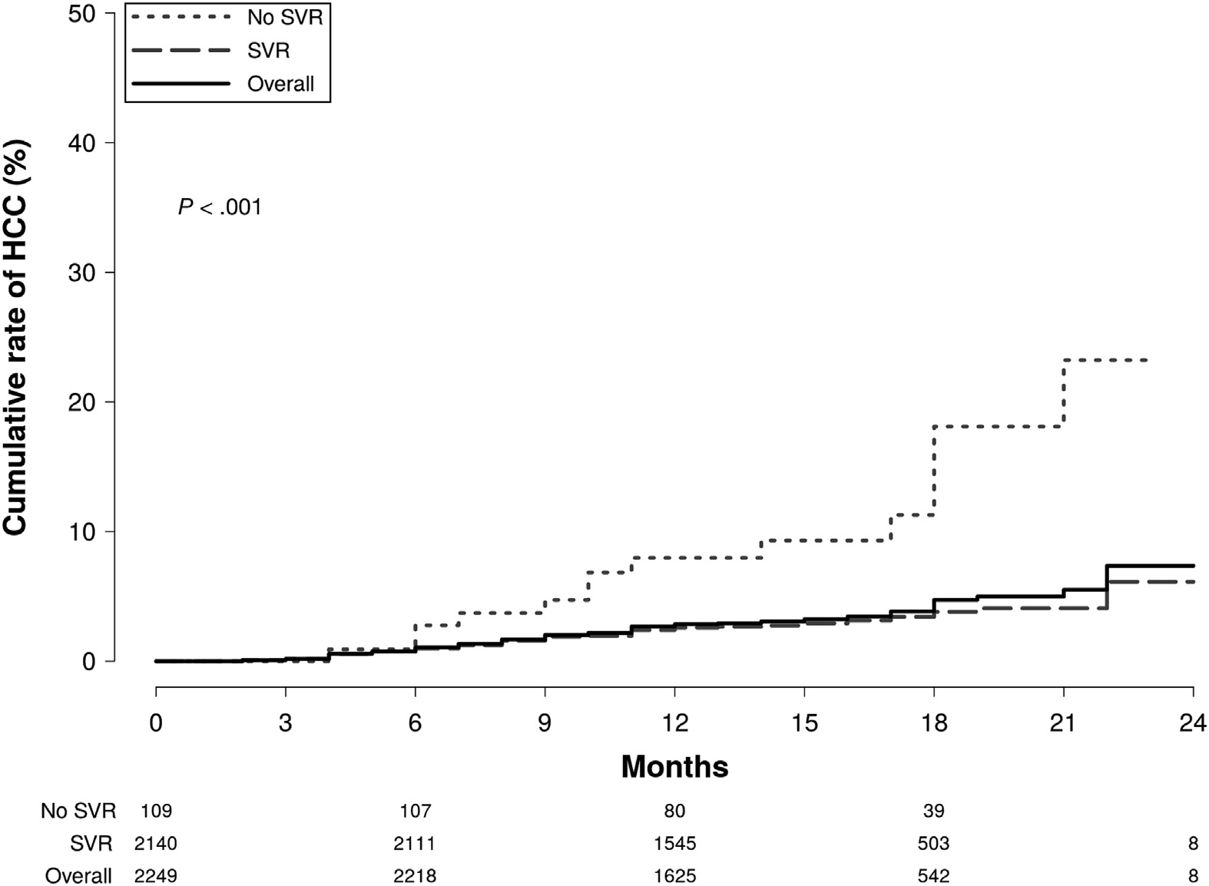
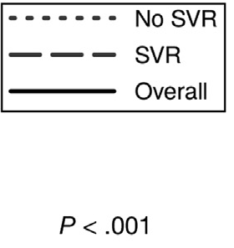
Prospective; controlled (IFN-based) by propensity analysis
Prospective; uncontrolled
Residual risk
Residual risk
Median follow-up since starting DAAs: 14 months (range 2-22)
High occurrence risk: non-SVR, Child-Pugh B cirrhosis, portal hypertension, and diabetes
Calvaruso, et al. Gastroenterology 2018
Nahon et al. Gastroenterology 2018
Notes:
In these two prospective studies (the first uncontrolled while the second controlled) you can see the residual HCC risk after SVR in cirrhotic patients who obteined SVR after treatment with DAAs

Slide 28
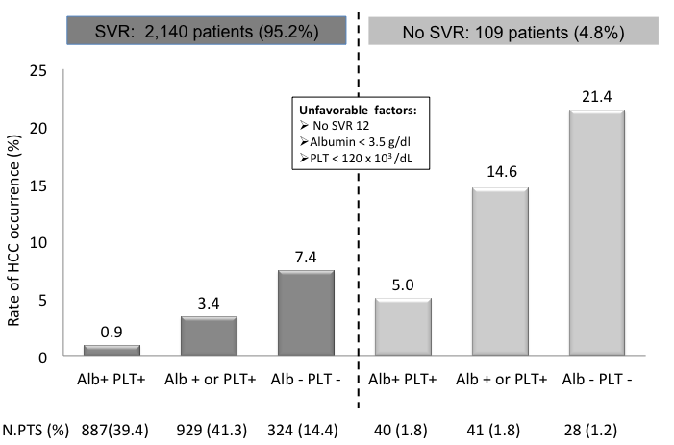
HCC occurrence according to risk factors in 2,249 patients
Calvaruso V. Gastroenterology 2018

Slide 29
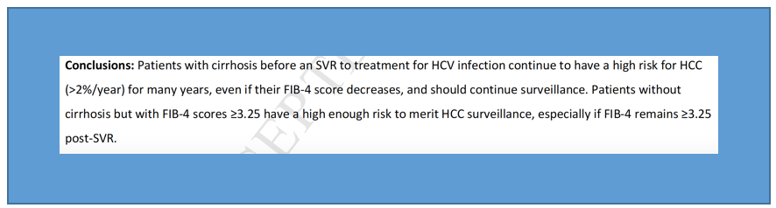
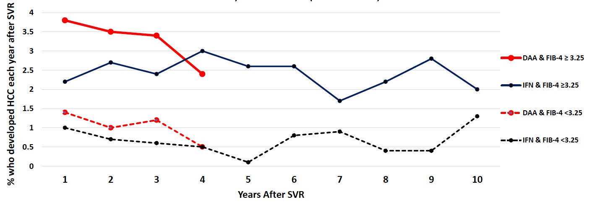
Increased Risk of HCC Persists up to 10 Years After Virus Eradication in Patients with Advanced HCV
29,033 VA patients with an SVR to DAA and 19,102 with an SVR to IFN
During 5.4 yr follow-up, 1509 incident HCCs were identified
Ioannou GN et al Hepatology 2019

Slide 30
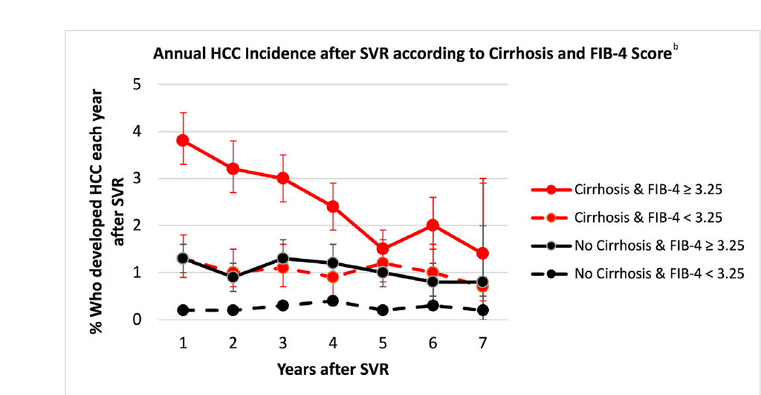
Does HCC Risk Decline Over Time After DAA-Induced SVR?
Kim NJ. Gastroenterology 2022;163: 1104-1106

Slide 31

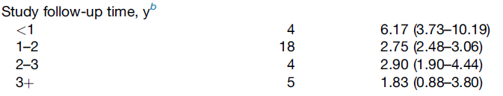
Does HCC Risk Decline Over Time After DAA-Induced SVR?
Conclusion:
Studies with longer follow-up
had lower average HCC risk
Kim N. CGH 2022

Slide 32
Does HCC Risk Decline Over Time After DAA-Induced SVR?
Longer time since SVR is associated with lower HCC risk in calendar year 2019 in patients with cirrhosis
Number of Years since SVR | Number of Patients | Number with HCC in 2019 | HCC Incidence (%) | Adjusted Hazard Ratio
CIRRHOSIS
>1-2 | 3670 | 95 | 2.71 | 1
>2-4 | 12,047 | 245 | 2.11 | 0.79
>4-6 | 2125 | 34 | 1.65 | 0.63
>6 | 1836 | 30 | 1.68 | 0.62
NO CIRRHOSIS
>1-2 | 13,089 | 30 | 0.23 | 1
>2-4 | 30,212 | 81 | 0.27 | 1.25
>4-6 | 3083 | 8 | 0.26 | 1.31
>6 | 9903 | 24 | 0.25 | 1.28
Vutien P. AASLD, The Liver Meeting 2022

Slide 33
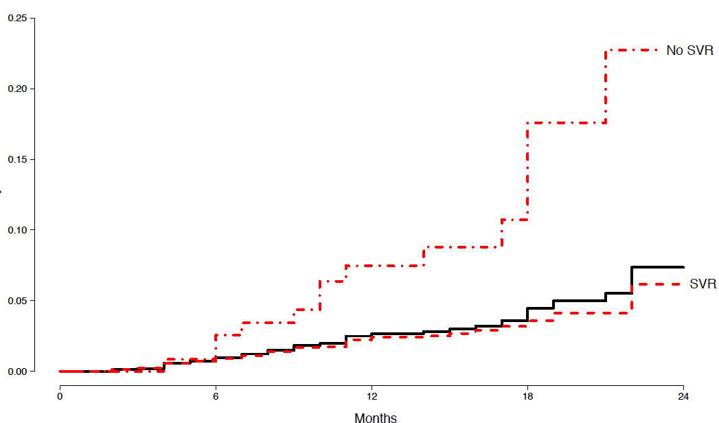
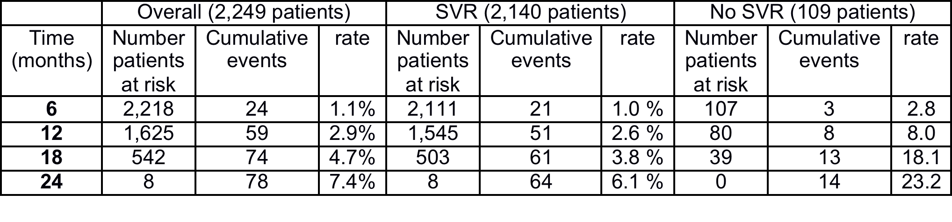
Cumulative incidence of HCC by Kaplan-Meier analysis
2,249 patients with HCV cirrhosis treated with DAAs
and evaluated for HCC occurrence
No SVR
Cumulative Rate of HCC (%)
Overall
SVR
Calvaruso V. Gastroenterology 2018

Slide 34
HCC occurrence according to risk factors in 2,249 patients
Calvaruso V. Gastroenterology 2018

Slide 35
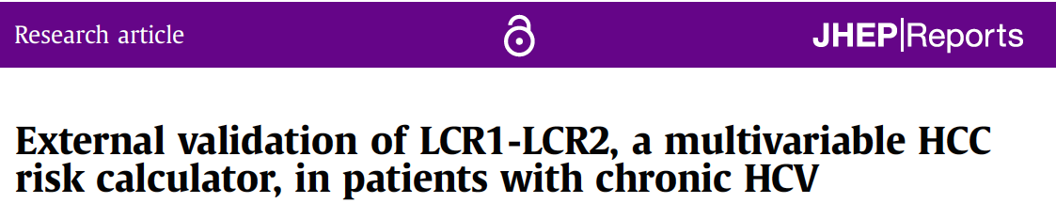
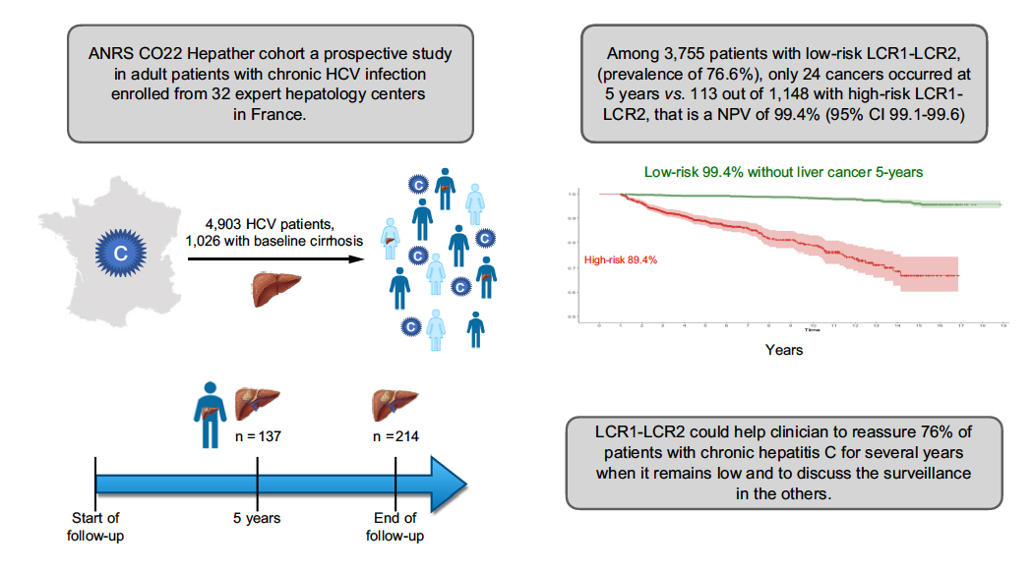
JHEP Reports 2021 vol. 3 j 100298
Notes:
LCR1 combines proteins involved in liver cell
repair (apolipoprotein A1 and haptoglobin), known risk factors
(sex, age, and gamma glutamyl transpeptidase) and a marker of
fibrosis (alpha2-macroglobulin), with a very high negative predictive
value (NPV) for the occurrence of HCC.11
Liver Cancer
Risk test algorithm (LCR1-LCR2)
HCC is the fourth leading cause of cancer-related death
worldwide and the fastest growing cause of cancer
deaths in the USA.
The American Association for the Study of Liver Diseases
recommends surveillance every 6 months only in patients
with cirrhosis.
The LCR1-LCR2 algorithm is a multianalyte blood test
combining proteins involved in cell repair, fibrosis and
liver cancer.
The LCR1-LCR2 algorithm was able to identify patients
with chronic HCV at very low risk of HCC at 5 years.
This algorithm could help clinicians to reassure a percentage
of patients with chronic HCV that their risk of
developing HCC remains low.

Slide 36
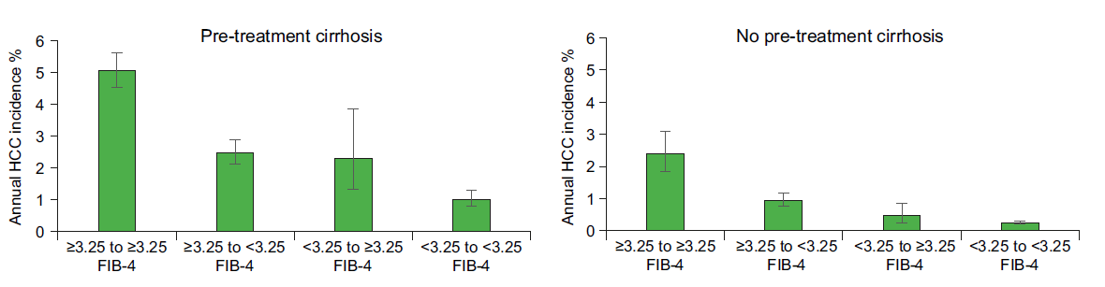
Decline of FIB-4 After SVR → Decline in HCC Risk
FIB-4
BEFORE SVR | High | High | Low | Low
AFTER SVR | High | Low | High | Low
High | High | Low | Low
High | Low | High | Low

Slide 37
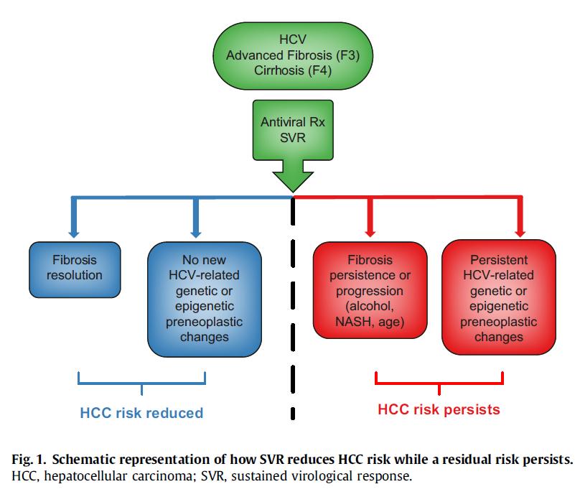
HCV eradication reduces HCC risk…but substantial risk persists
Ioannou G. J Hep 2021;74(2):458-465

Slide 38
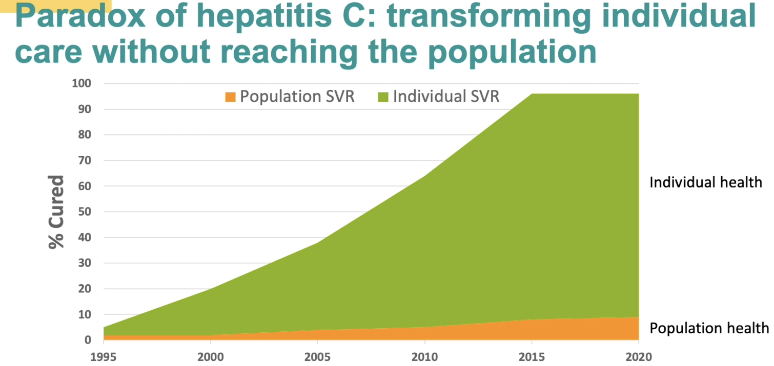
The HCV paradox: transforming individual care without reaching the population

Slide 39
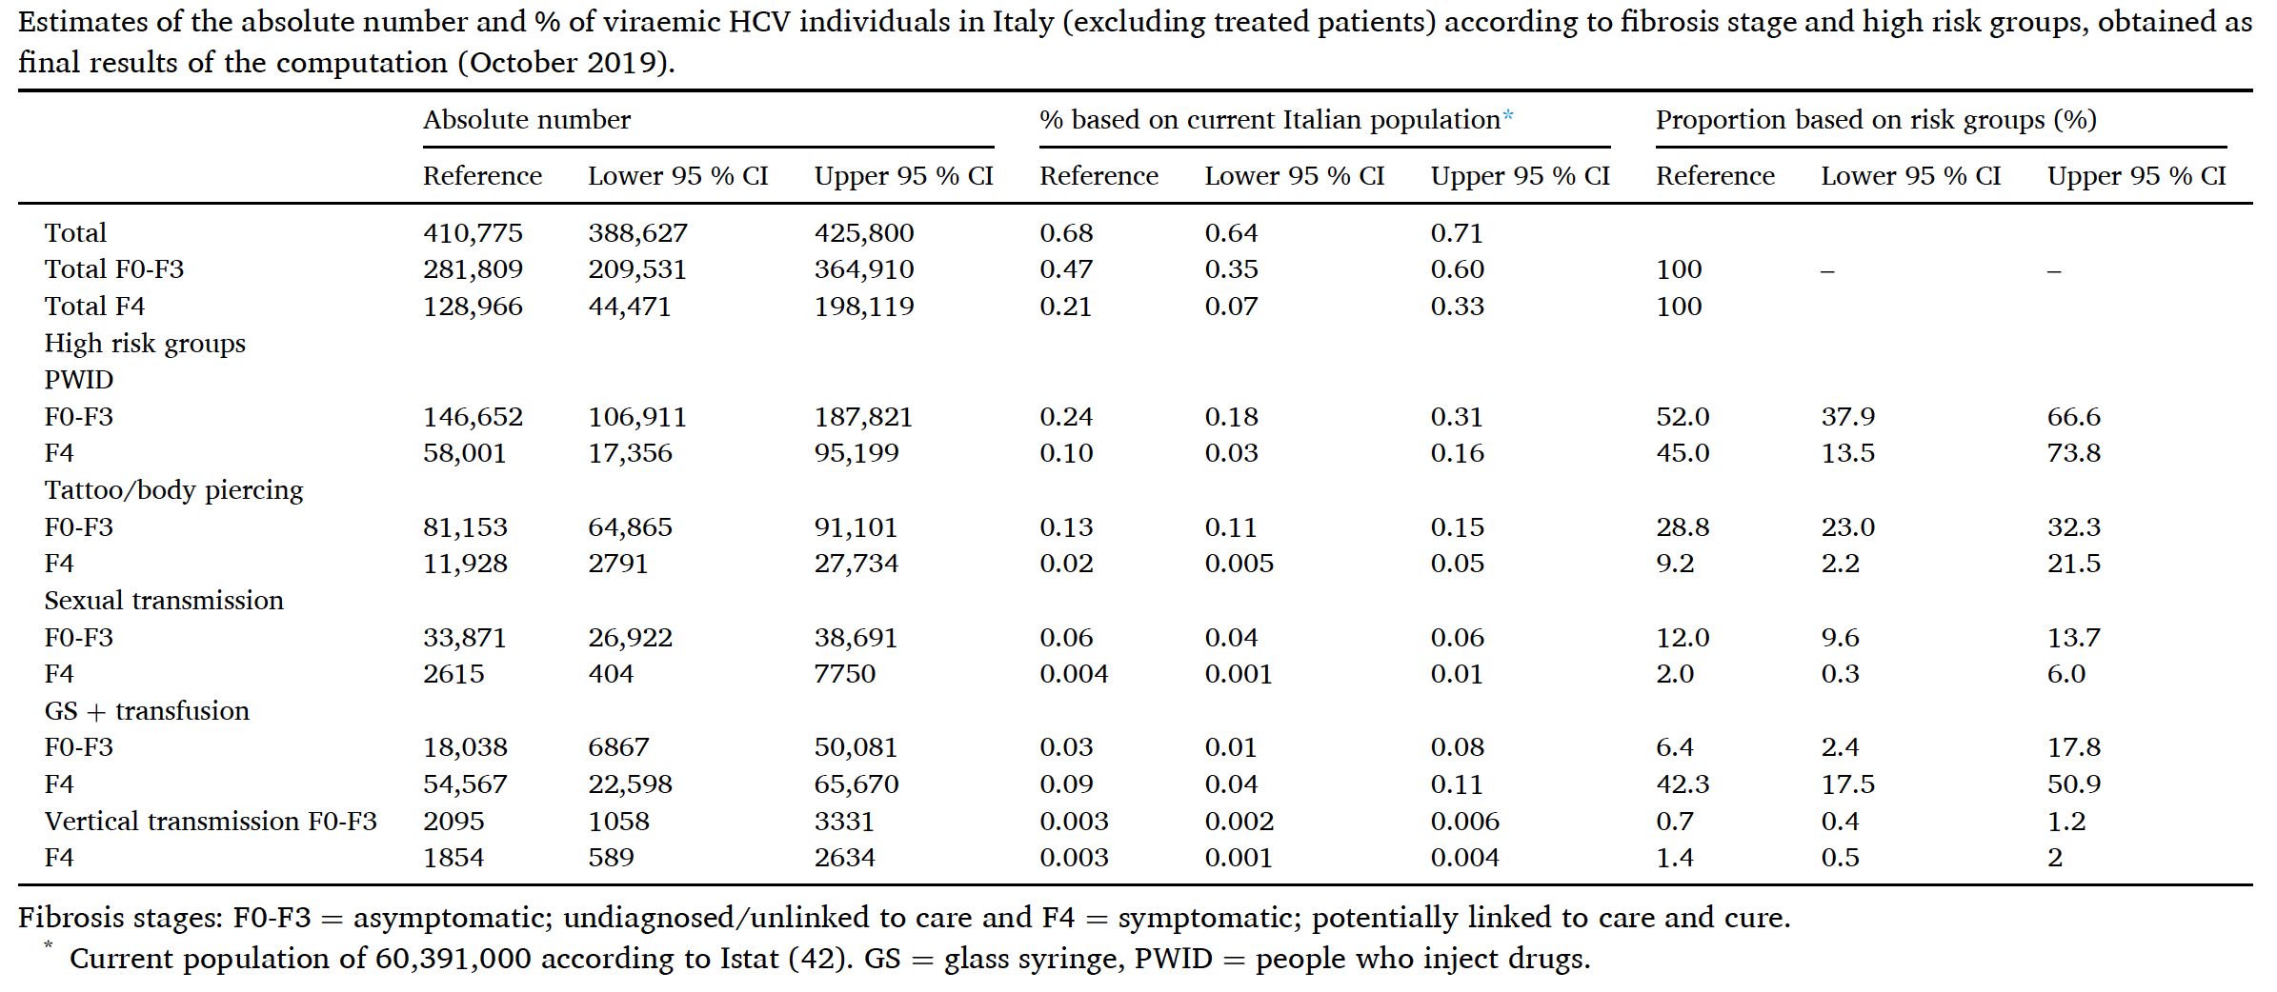
Kondili LA. Epidemics 2021
Notes:
Torniamo alle stime
Ad Ottobre 2019, in Italia si stimava come fossero presenti 410.775 pazienti HCV viremici, di cui 128.966 affetti da cirrosi epatica

Slide 40
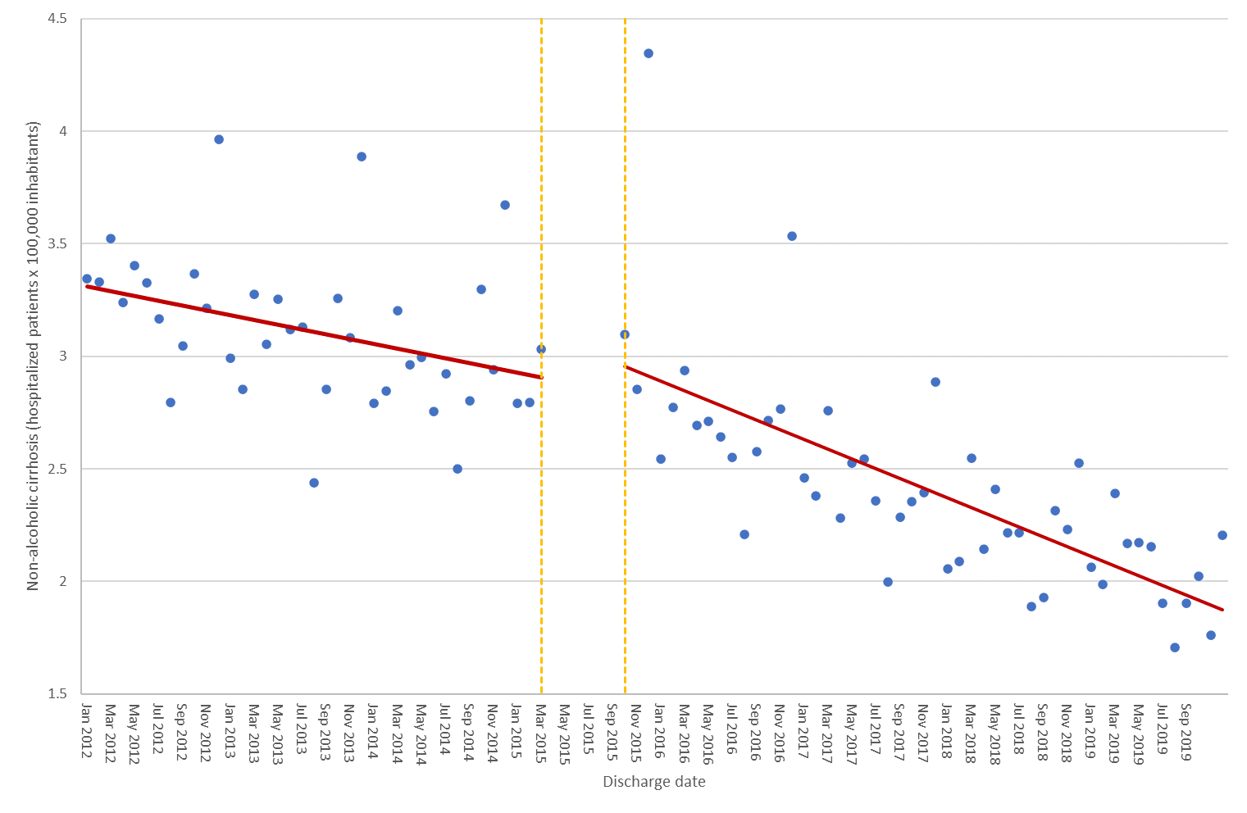
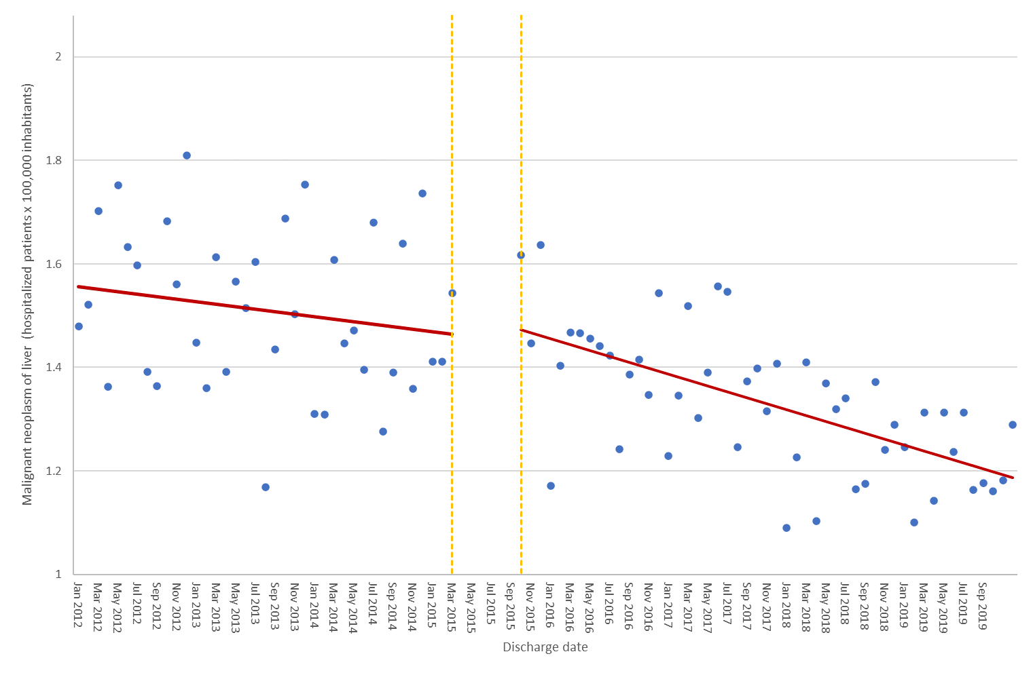
Trend of Hospitalizations for HCV Liver Cirrhosis Trend of Hospitalizations for HCV Liver Cancer
Years: 2012-2015 2015-2019 Years: 2012-2015 2015-2019
Hospitalizations for HCV and HCV-related diseases in the last decade: data analysis of records of hospital discharge (SDO) at national level
Mennini FS, Sciatella P, Simonelli C, Marcellusi A, Kondili LA. EASL 2022 (manuscript submitted)

