Slide 1

Scenari Futuri di
Trattamento di HBV
Giovanni Raimondo
Dipartimento di
Medicina Clinica e Sperimentale
Università di Messina

Slide 2
HBV treatment in 2023
Essentially based on Entecavir and Tenofovir treatments for more than ten years
The advent of these drugs has revolutionized the therapy of chronic hepatitis B, dramatically improving its clinical outcome

Slide 3
Entecavir and Tenofovir
Potent and efficient inhibitors of HBV replication
Very high genetic barrier: virtually no emergence of drug-resistant variants
Prevent development of cirrhosis in CHB.
Prevent decompensation in patients with previously established cirrhosis
Improve portal hypertension (regression of cirrhosis?)
Reduce the risk of HCC development
Safe over time (TAF will solve the few side effects of Tenofovir)
Improved survival

Slide 4
The available NUC therapies are very effective in suppressing HBV replication and preventing occurrence of liver cirrhosis or cirrhosis decompensation
WHY…
… both scientists and pharmaceutical companies are so hardly engaged in finding new therapeutic approaches for HBV cure?
BECAUSE…
…only in few, occasional cases HBsAg clearance and anti-HBs seroconversion
occur under NUC treatment
2. …discontinuation of treatment implies virologic and clinical reactivation
3. …the risk of HCC development persists
4. …OBI may be a threat

Slide 5
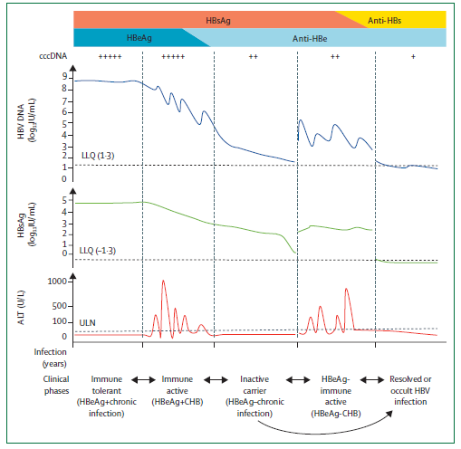
Phases of Chronic HBV Infection
Wen-Juei Jeng, George V Papatheodoridis, Anna S F Lok The Lancet Vol 401 March 25, 2023

Slide 6
Comparison of overt and occult HBV infection
Mechanisms potentially involved in HBV inhibition and OBI induction
G.Raimondo, S.Locarnini, T.Pollicino, M.Levrero, F.Zoulim, A,S.Lok & the Taormina Workshop on OBI Faculty Members, J Hepatol 2019

Slide 7
HBV: concepts about «cure»
Sustained suppression of viral replication
  undetectable viremia with sensitive HBV-DNA assays
Functional cure
  HBsAg loss
  “off therapy” persistent HBV suppression [make patients true ”inactive carriers”]
Complete/sterilizing cure
  elimination of cccDNA
  elimination of infected hepatocytes, including cells with integrated HBV DNA
++
Viral Suppression
Functional cure
Complete cure
±
Long-term suppression
of viral replication
(NUCs)
Suppression
of viral replication
Immune control
(IFNa)
- ±
±
- -
- -

Slide 8
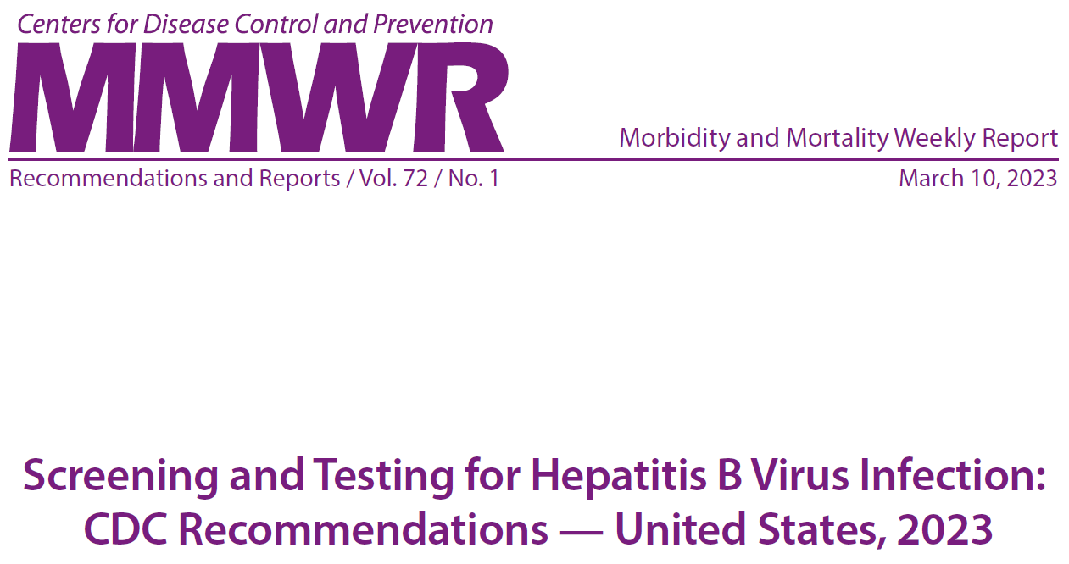

Slide 9
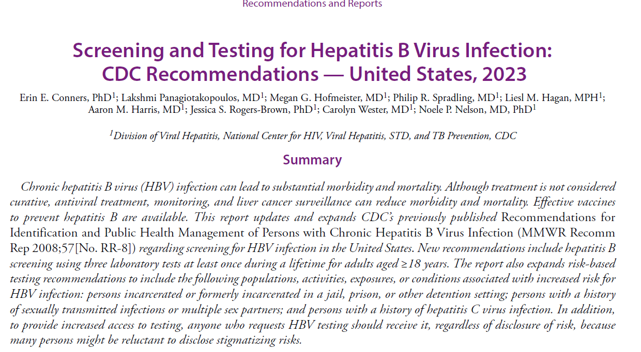

Slide 10
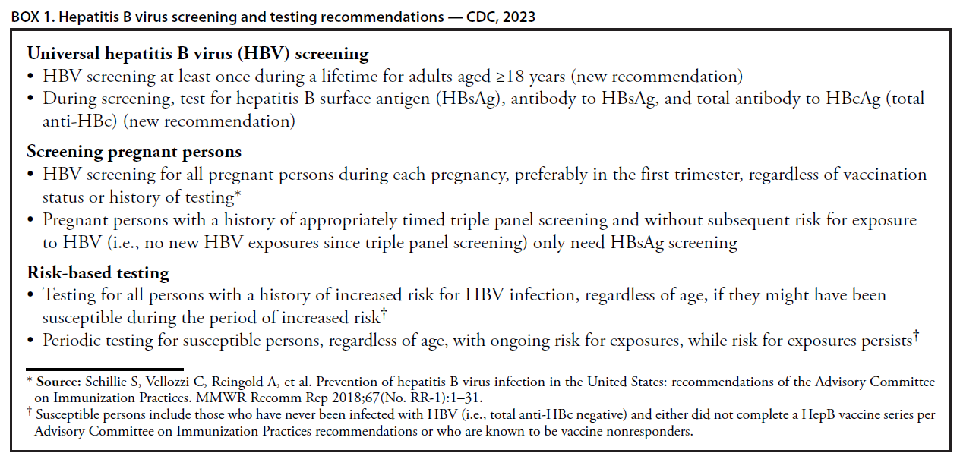

Slide 11
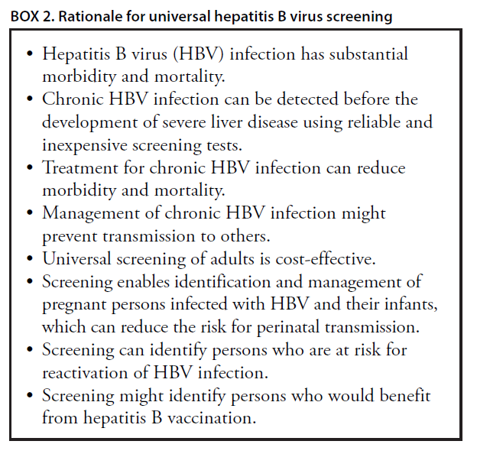

Slide 12
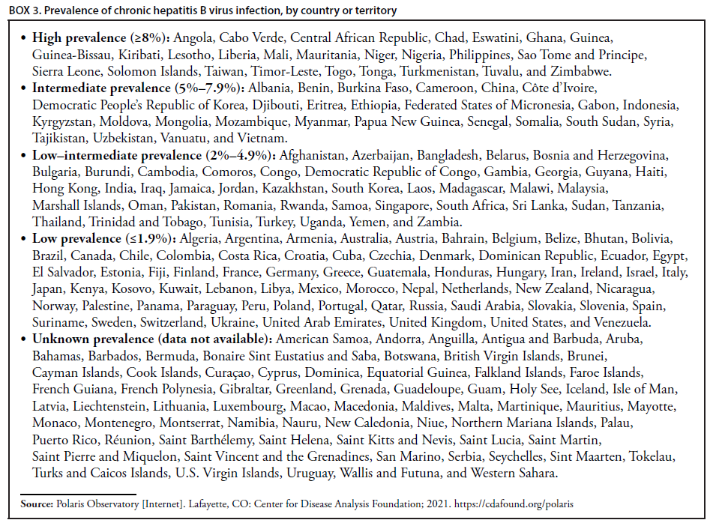

Slide 13
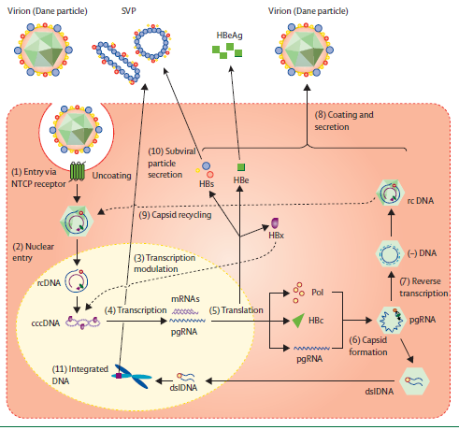
Lifecycle of HBV and the potential sites of action of antivirals
Wen-Juei Jeng, George V Papatheodoridis, Anna S F Lok The Lancet Vol 401 March 25, 2023
Notes:
Figure 2: Lifecycle of HBV and the potential sites of action of antiviral therapies, approved and in clinical development
(1) HBV enters hepatocytes through attachment to the NTCP receptor. (2) After uncoating, the rcDNA in the viral capsid enters the hepatocyte nucleus where the second strand HBV DNA is completed, forming the cccDNA. (3, 4) cccDNA serves as a template for transcription of pgRNA and mRNAs; this step is modulated by HBx protein. (5) HBV mRNAs are translated into viral proteins (core, polymerase, X, e [processed from precore or core] and S [large, middle, and small]). (6) pgRNA, core, and polymerase proteins are packaged into capsids, inside which (7) pgRNA is reverse transcribed into HBV DNA. (8) Capsids with rcDNA can be enveloped with surface proteins for secretion as virions or (9) recycled back to the nucleus to replenish the cccDNA pool. (10) HBV also secretes an excess of subviral particles that contain HBs proteins but not HBV DNA. (11) A minority of pgRNA is reverse transcribed into dslDNA which can be integrated into host DNA. Integrated HBV DNA is not replication competent but can be translated into S proteins and are secreted as SVP. Sites of action of antiviral therapies in HBV lifecycle: entry inhibitors (1), transcription modulation (3), capsid assembly modulators (6, and possibly 2 and 9), translation inhibitors (5), nucleos(t)ide analogues at reverse transcription (7), secretion inhibitors (8, 10). dslDNA=double-stranded linear DNA. HBc=hepatitis B core. HBs=hepatitis B surface. HBsAg=hepatitis B virus surface antigen. HBx=hepatitis B X. HBV=hepatitis B virus. NTCP=sodium taurocholate cotransporting polypeptide. pgRNA=pregenomic RNA. cccDNA=covalently closed circular DNA. Pol=polymerase. rcDNA=relaxed circular DNA.

Slide 14

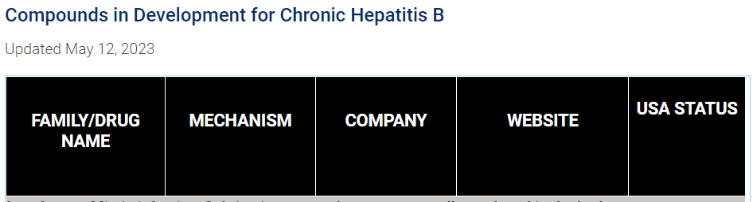
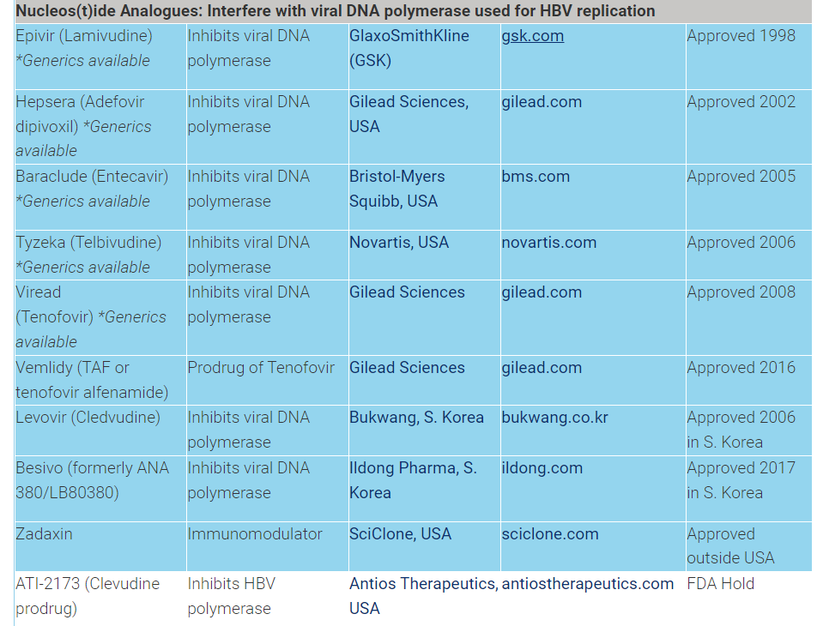

Slide 15
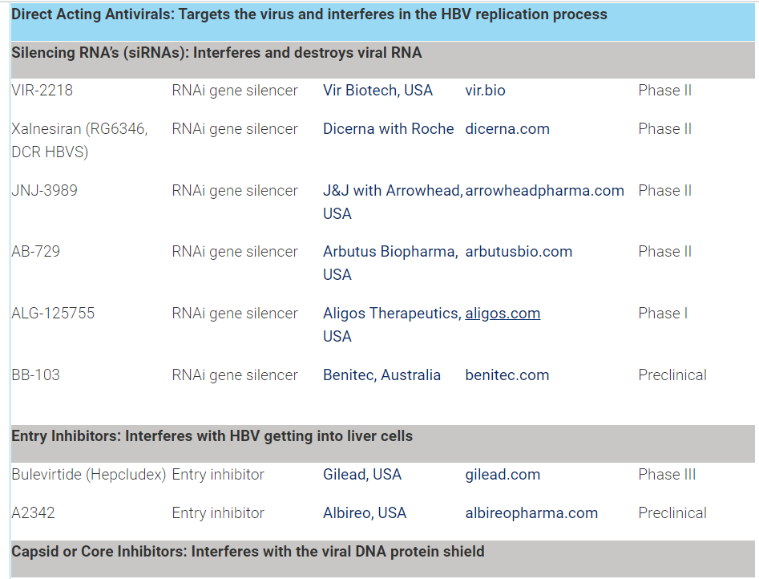

Slide 16
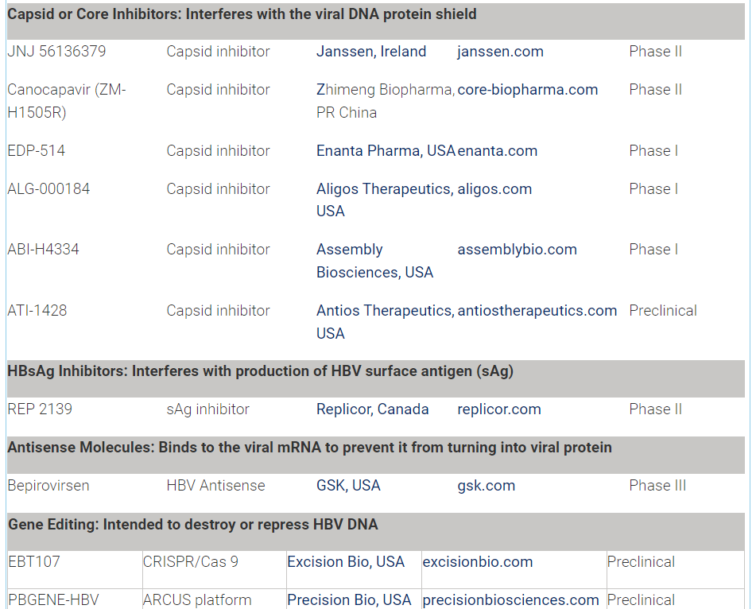

Slide 17
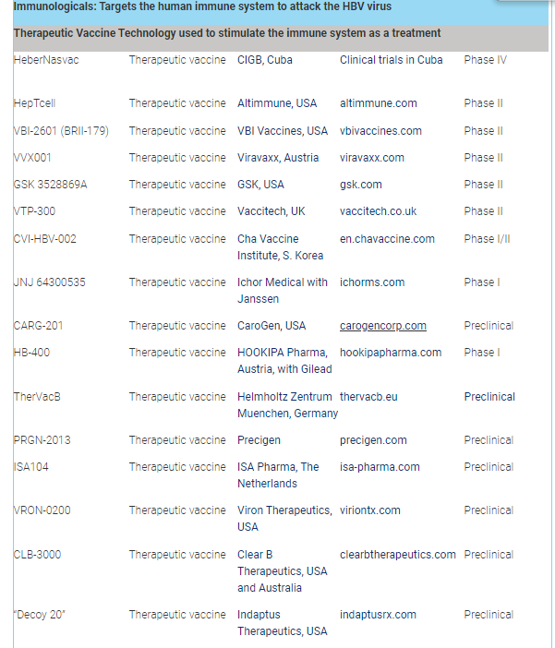

Slide 18
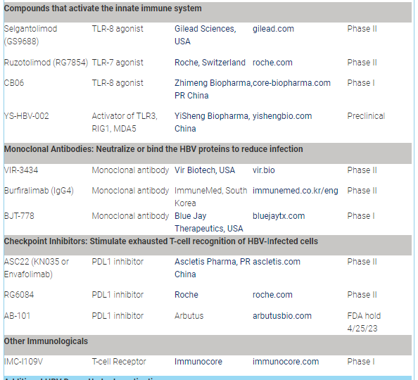

Slide 19
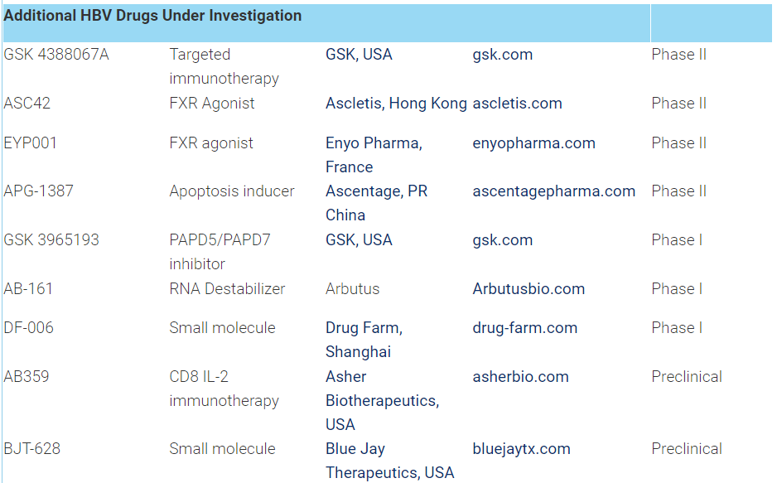

Slide 20
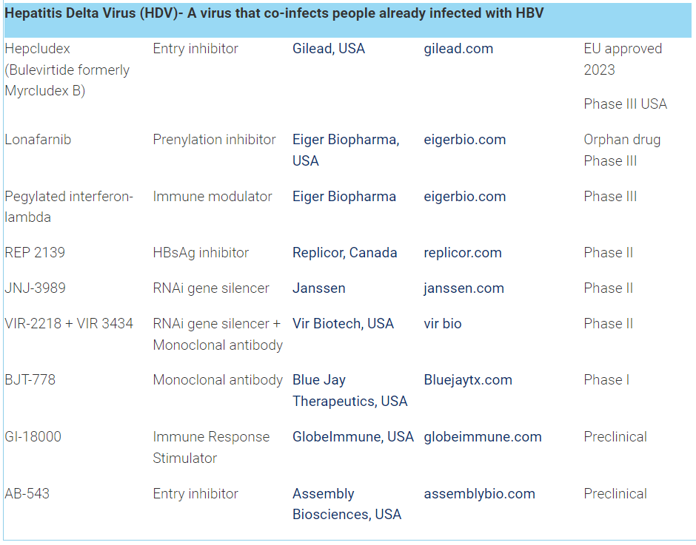

Slide 21
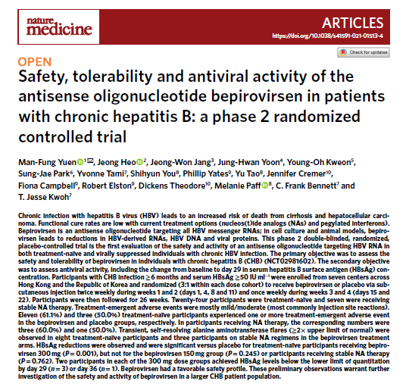

Slide 22
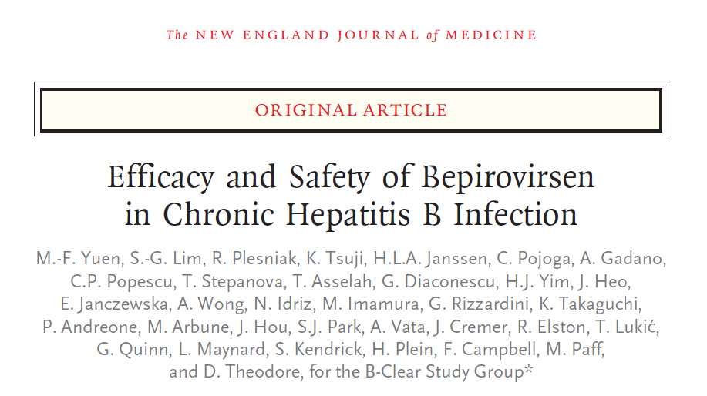
n engl j med 387;21 nejm.org november 24, 2022

Slide 23
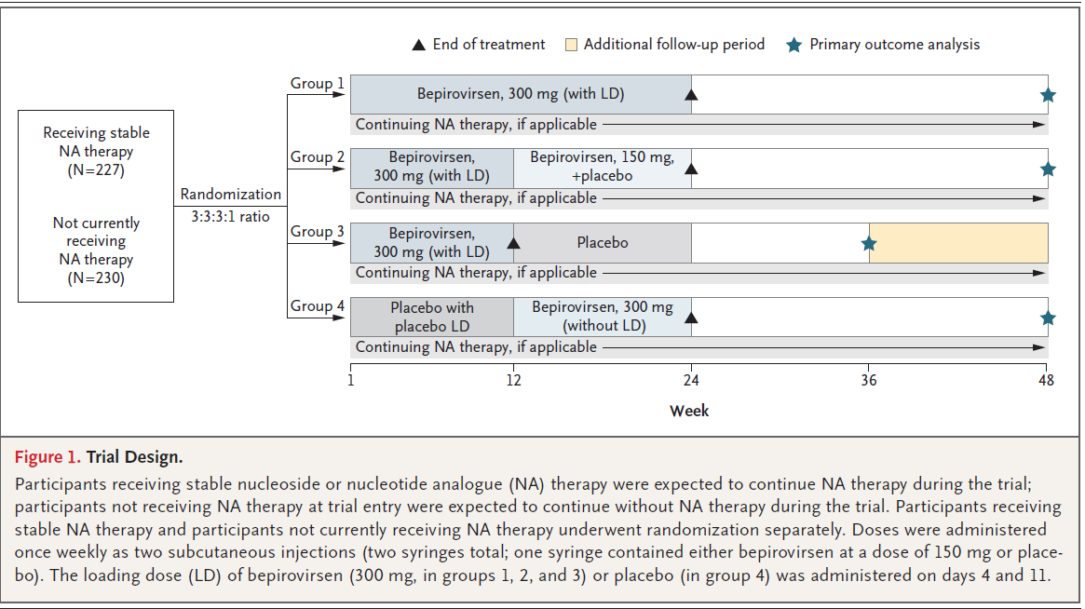
Trial design
n engl j med 387;21 nejm.org november 24, 2022

Slide 24
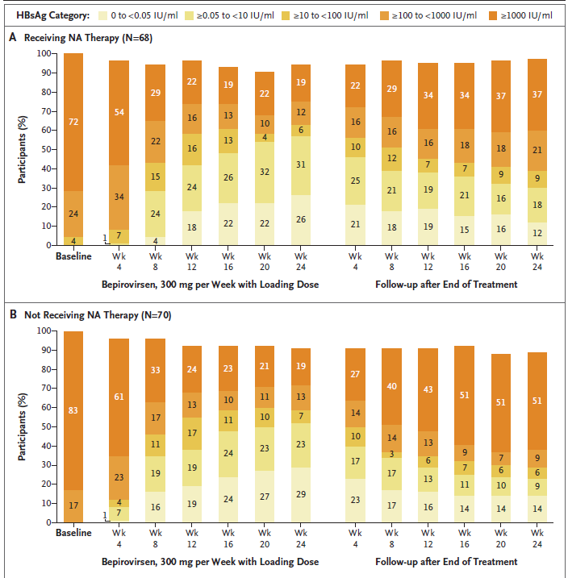
HBsAg Categories of Enrolled Patients over Time
Yuen et al NEJM 2022

Slide 25
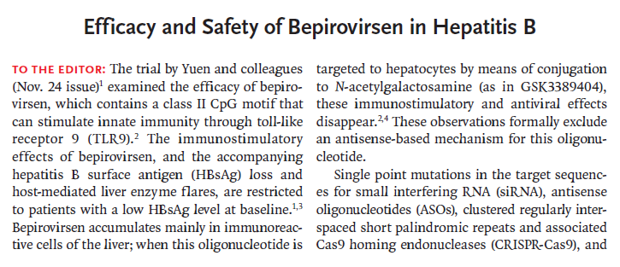
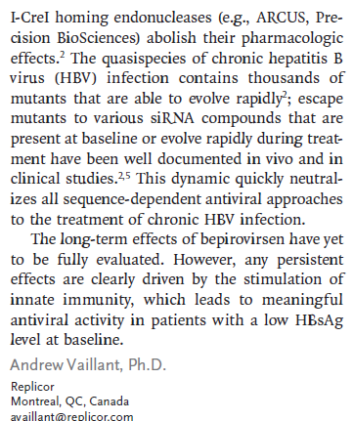

Slide 26
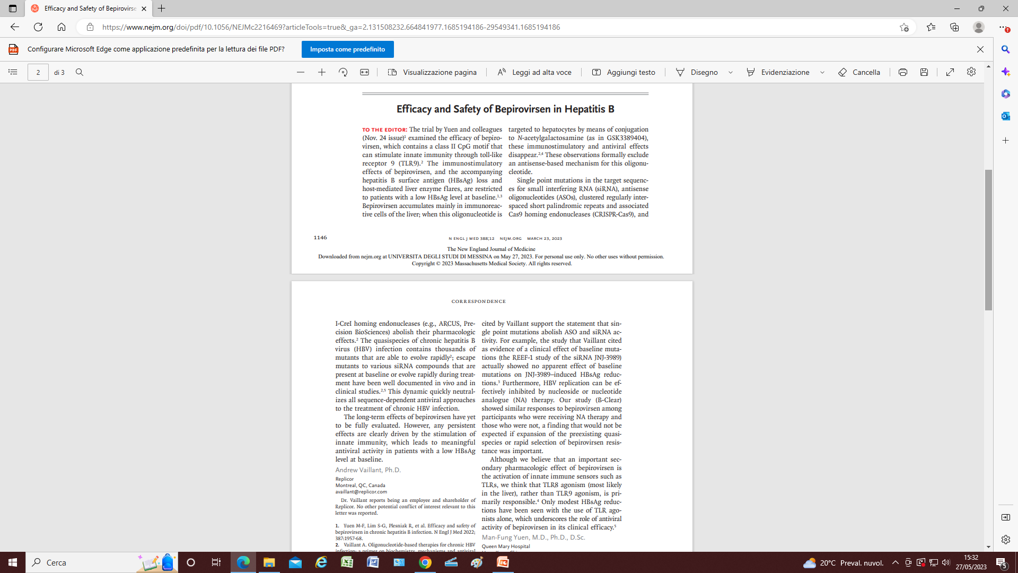
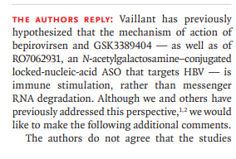
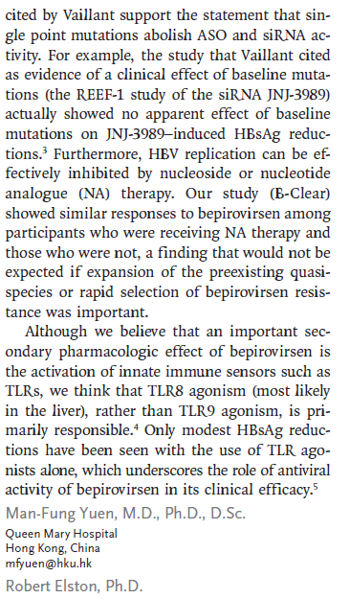

Slide 27
