Slide 1


Coagulopathy in patients with Advanced Chronic Liver Disease (ACLD)
Paolo Gallo
UOC Medicina Clinica ed Epatologia
Fondazione Policlinico Universitario
Campus Biomedico di Roma

Slide 2
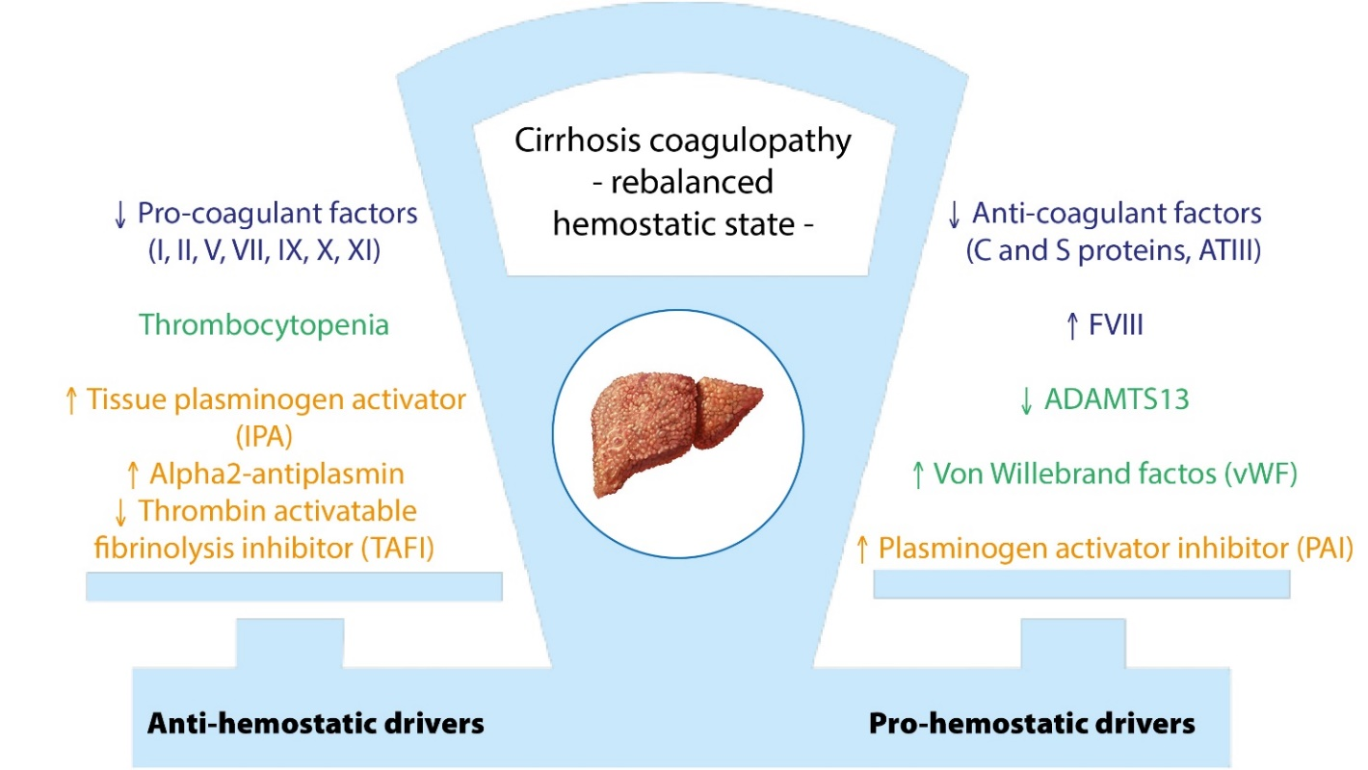
Hemorrhage and thrombosis are multifactorial
Gallo P, World J Gastroenterol. 2022

Slide 3


THE COAGULOPATHY OF CIRRHOSIS: AN EVOLVING PARADIGM
Cirrhosis as an hemorrhagic disease
Rebalanced hemostasis in cirrhosis
Cirrhosis as a pro-thrombotic disease
From bench to bedside

Slide 4
THE COAGULOPATHY OF CIRRHOSIS: AN EVOLVING PARADIGM
Doctrinal stones
Causal relationship between hemostasis tests and bleeding
Screening patients with hemostasis tests
Treating patients in order to improve or correct abnormal identified tests prior to invasive procedures

Slide 5
THE COAGULOPATHY OF CIRRHOSIS
Clinical evidence of thrombosis
Patients with cirrhosis have a RR of VTE of 2 (CI95% 1.5-2.6) and of ischemic stroke of 1.7 (CI95% 1.3-2.3) (Jepsen P et al, Hepatology 2021).
In another large case-control study, the RR of VTE was found to be 1.74 (CI95% 1.54-1.95) compared with patients without liver disease (Søgaard et al, Am J Gastroenterol 2009).
Cirrhosis is associated with an increased risk of splancnic venous thrombosis and enoxaparin was safe and effective in preventing PVT in patients with cirrhosis (Villa et Al, Gastroenterology 2012).

Slide 6
THE COAGULOPATHY OF CIRRHOSIS: AN EVOLVING PARADIGM
The challenge
Most common hemorrhagic event (gastrointestinal bleeding) is poorly correlated with conventional coagulation tests.
Coagulation defects do not predict transfusional need during liver transplantation.

Slide 7
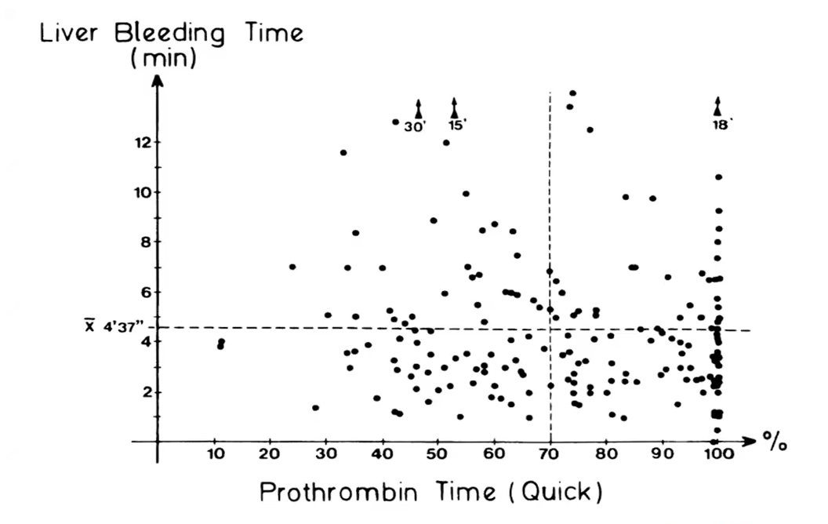
Ewe K, Dig Dis Sci, 1981

Slide 8
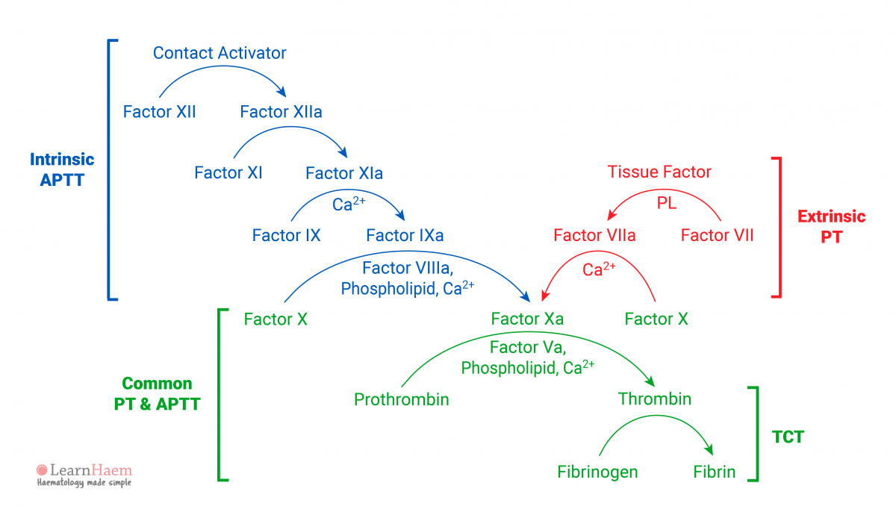
Coagulation cascade
Inadequate tests to reflect the coagulation balance in cirrhosis:
responsive only to procoagulant factors!

Slide 9
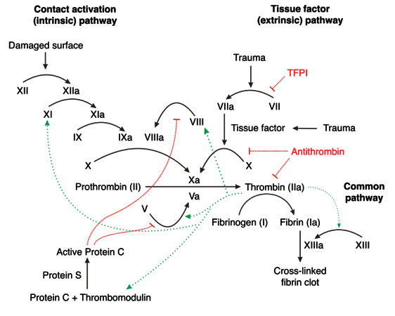
Protein C and antithrombin are reduced.
Protein C in vitro is activated to a limited extent in the absence of thrombomodulin (mostly endothelial cells vs plasma).
Underestimation of anti-coagulation power.

Slide 10
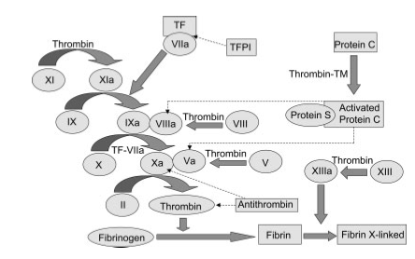
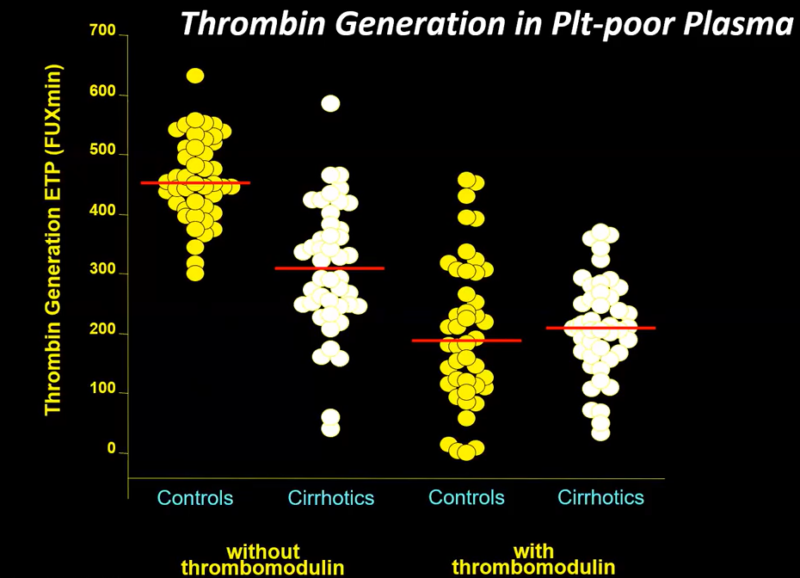
Tripodi A et al, Hepatology 2005

Slide 11
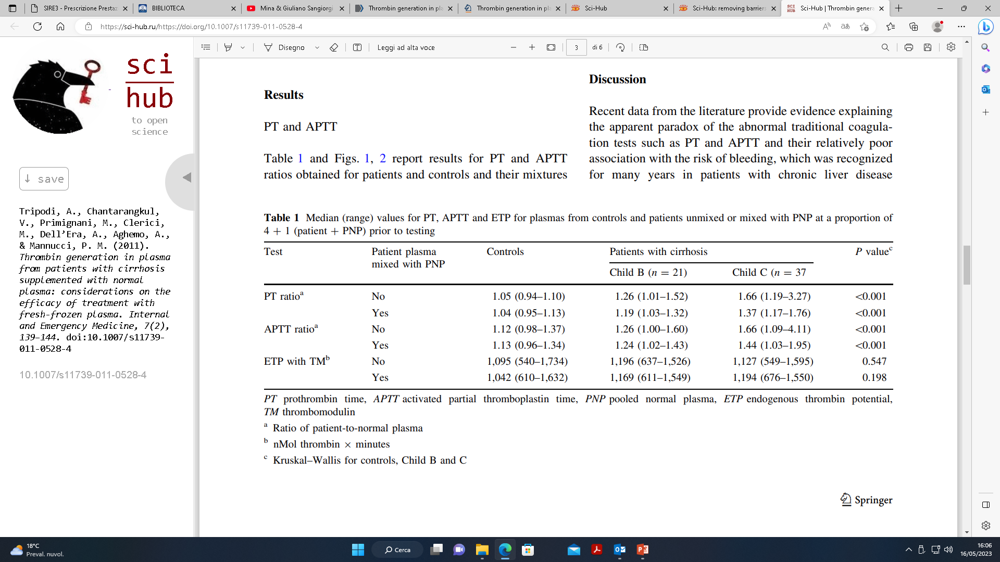
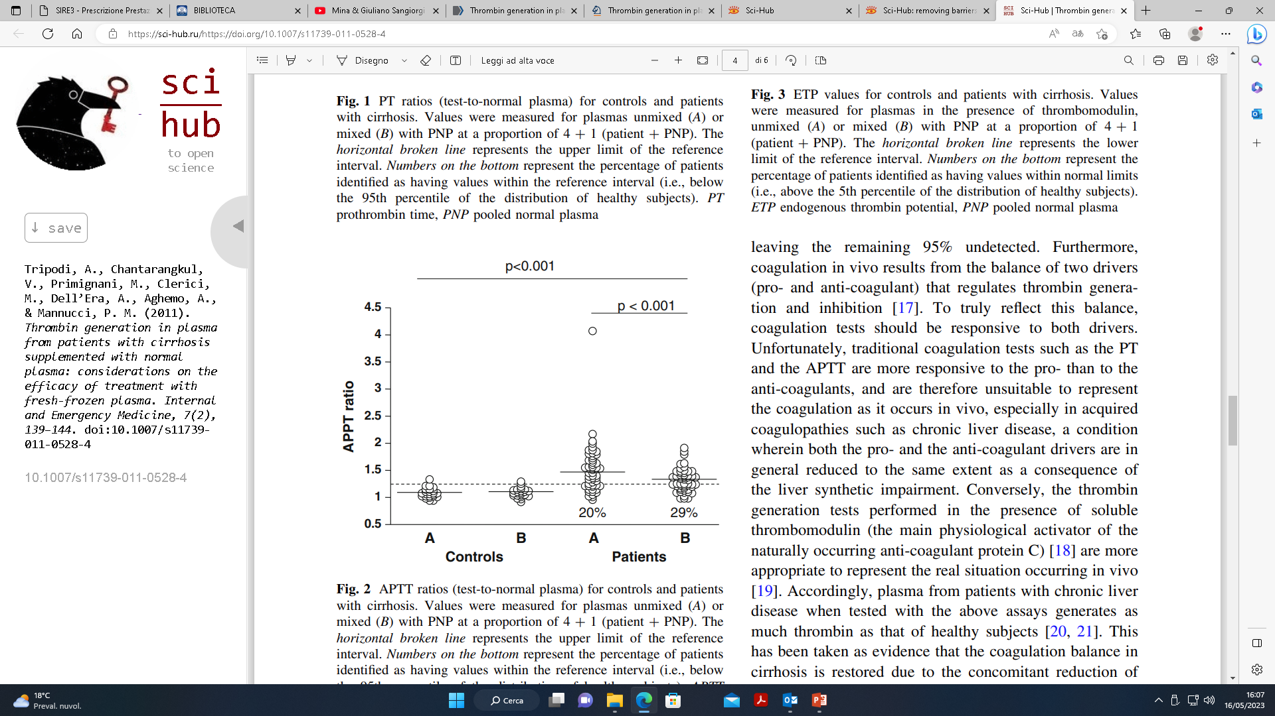
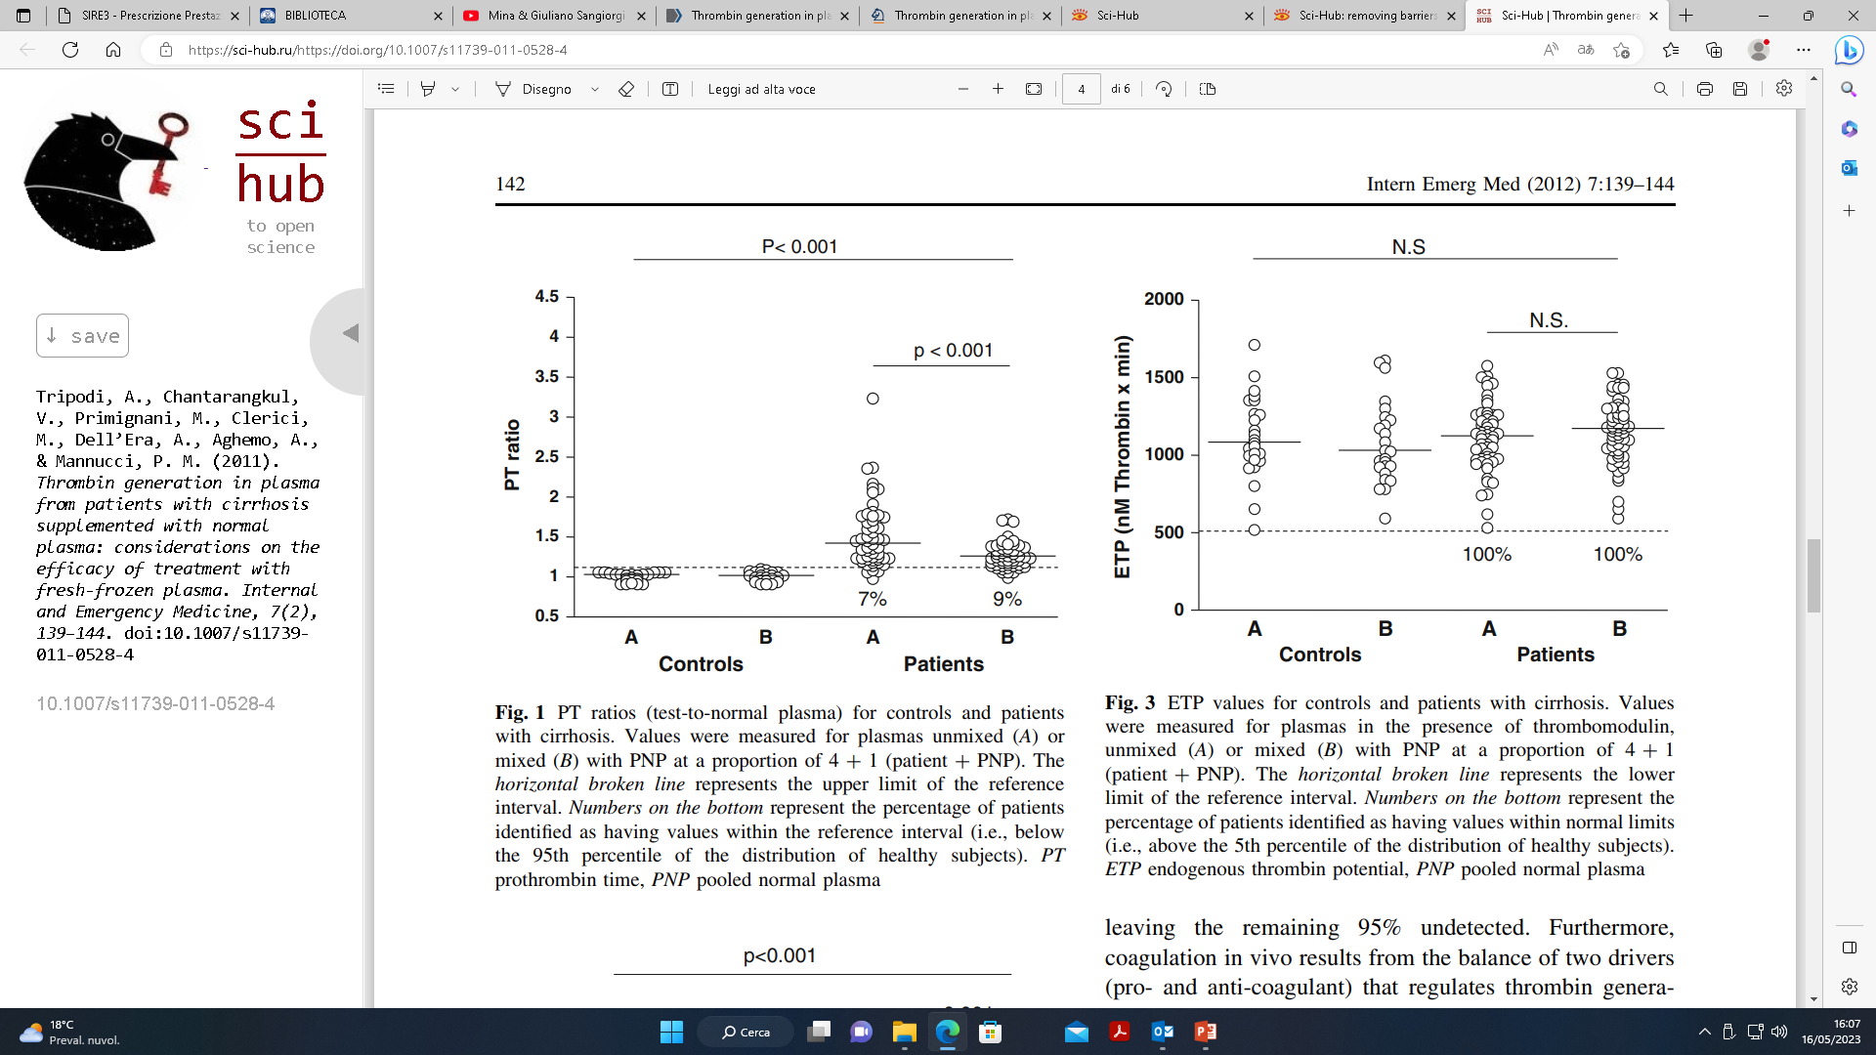
Tripodi A et al, Intern Emerg Med 2012

Slide 12
Vieira da Rocha E, Clin Gastroenterology and Hepatol 2009

Slide 13
Transfusion and bleeding
No studies have shown that giving prophylactic transfusion of fresh frozen plasma to correct an elevated INR reduces the risk of bleeding.
Trasfusion of fresh frozen plasma does not increase coagulation power since it supplies both anticoagulant and procoagulant factors.
Acutely ill patient with cirrhosis are at increased risk for transfusion-related lung injury and circulatory overload.

Slide 14
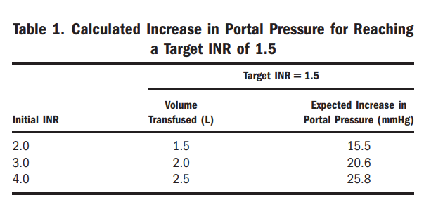
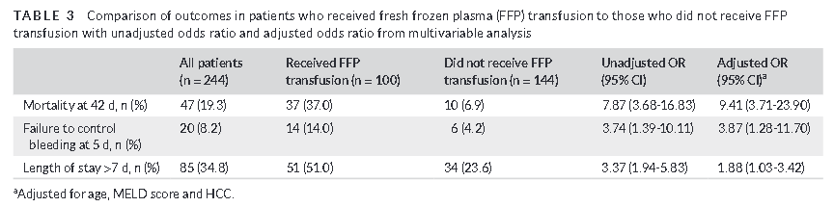
Transfusion overload and… bleeding
Giannini E et al, Hepatology 2014
Mohanty A et al, Liv International 2021

Slide 15

PT and aPTT
Inadequate tests to reflect the coagulation balance\counterbalance in cirrhosis
Unable to evaluate anti-coagulants deficiency or efficacy
Able to identify pro-coagulants deficiency

Slide 16
Rebalanced primary hemostasis
Gallo P, World J Gastroenterol. 2022

Slide 17
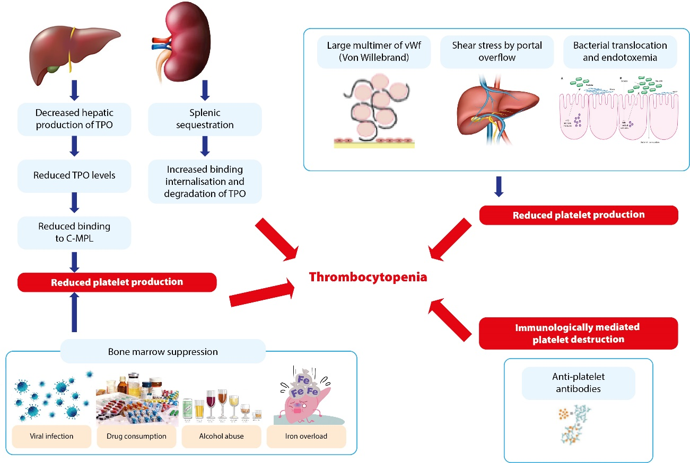
Primary hemostasis and thrombocytopenia
Gallo P, World J Gastroenterol. 2022
Notes:
Intern Emerg Med (2012

Slide 18
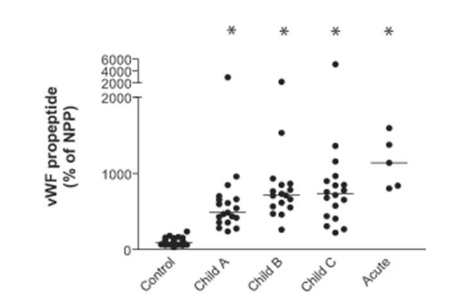
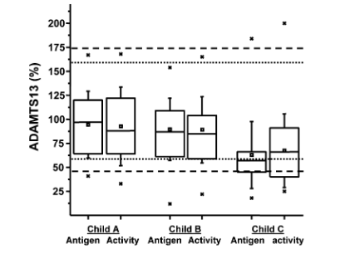
Rebalanced primary hemostasis
Lisman et al, Hepatology 2006
Feis HB et al, Hepatology 2006

Slide 19
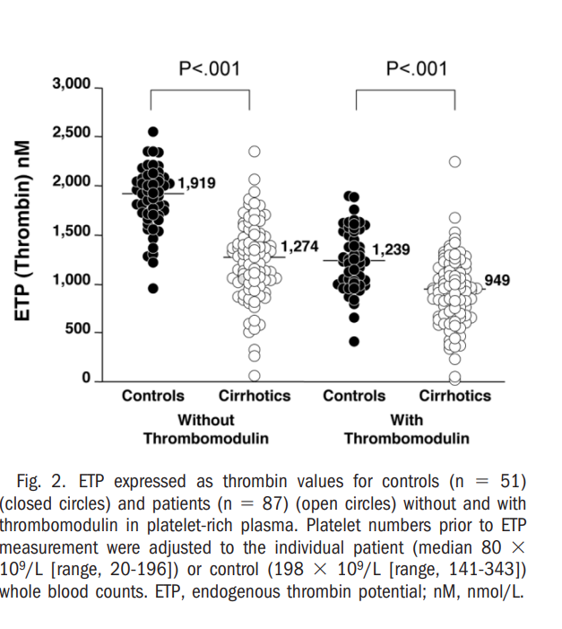
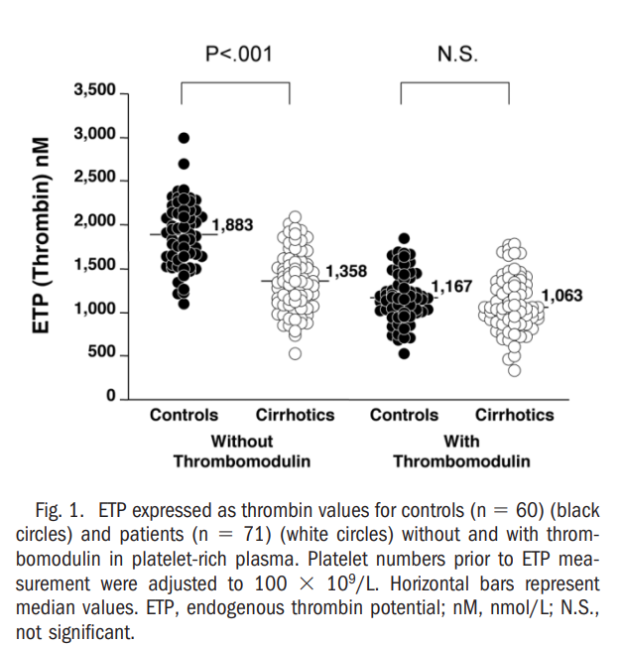
Platelets and thrombin generation
PLTs count adjusted to 100000/mL
Original patient’s count
Tripodi A et al, Hepatology 2006

Slide 20
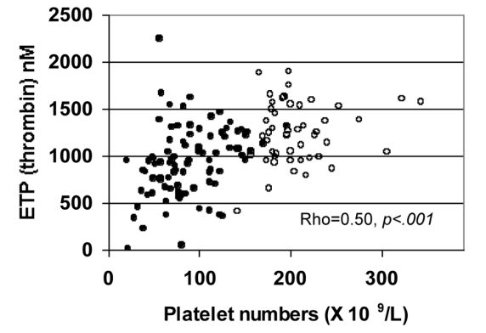
Platelets and thrombin generation
56
Tripodi A et al, Hepatology 2006
Notes:
The ETP for the whole population (patients and controls) when measured in platelet-rich plasma (platelet numbers adjusted to correspond to whole blood counts) in the presence of thrombomodulin correlated with platelet counts ( 0.50; P .001) (Fig. 3). The analysis of the linear regression of the above results allows a rough estimate of the platelet numbers (i.e., 56 109/L) that can generate 875 nmol/L thrombin (i.e., the 10th percentile of the distribution of values recorded in the control population.

Slide 21
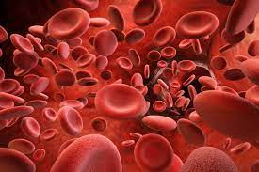

Platelets and thrombin generation..and thresholds
No high-quality data with clinical bleeding endpoints and placebo controls on appropriate thresholds to increase platelet counts to prevent bleeding in liver disease

Slide 22
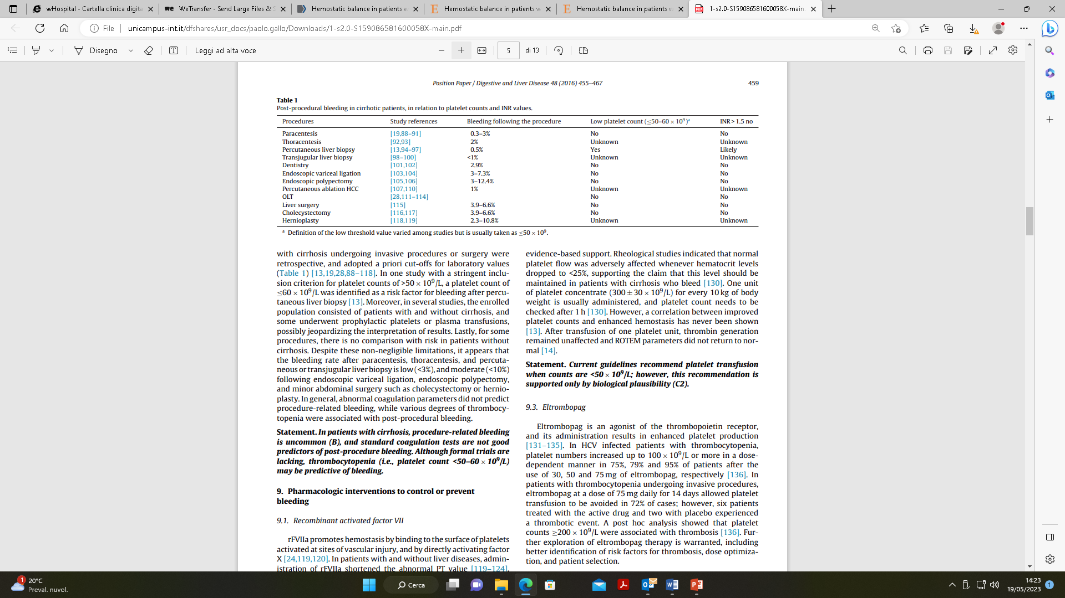
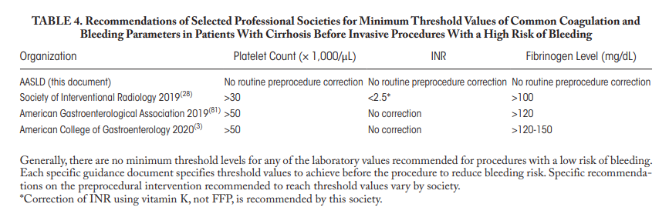
Guidelines for platelet and INR correction
Position Paper AISF-SIMI, Dig Liver Dis. 2016
Northup et al, Hepatology 2021

Slide 23
In patients with cirrhosis and abnormal laboratory tests (INR, APTT, platelet count, fibrinogen), attempting to correct these tests by administering blood products or factor concentrates, with the aim of preventing spontaneous bleeding, is not recommended (LoE 3, strong recommendation).
In patients with cirrhosis, the use of traditional haemostasis tests, or viscoelastic tests, cannot be generally indicated to predict procedural bleeding risk, although they can be used to assess severity of disease or haemostatic status and to provide an initial benchmark to guide management in the case of post-procedural bleeding (LoE 3, strong recommendation)
EASL Guidelines, Journal of Hepatology 2022

Slide 24
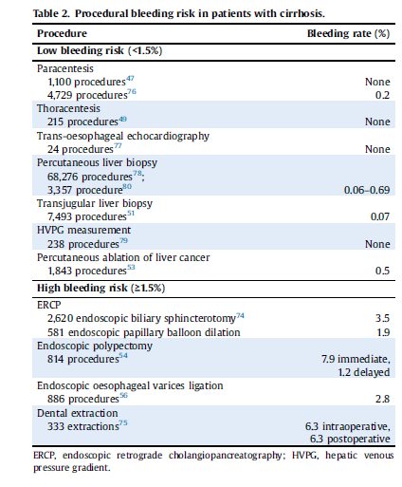
Procedural bleeding risk
EASL Guidelines, Journal of Hepatology 2022
Notes:
Data from literature and experts’ consensus indications, derived mainly from evidence obtained in patients without liver disease.
High risk: also when even minor bleeding may lead to severe consequences, or death, as in the case of intracranial bleeding

Slide 25

Northup et al, Hepatology, 2021

Slide 26
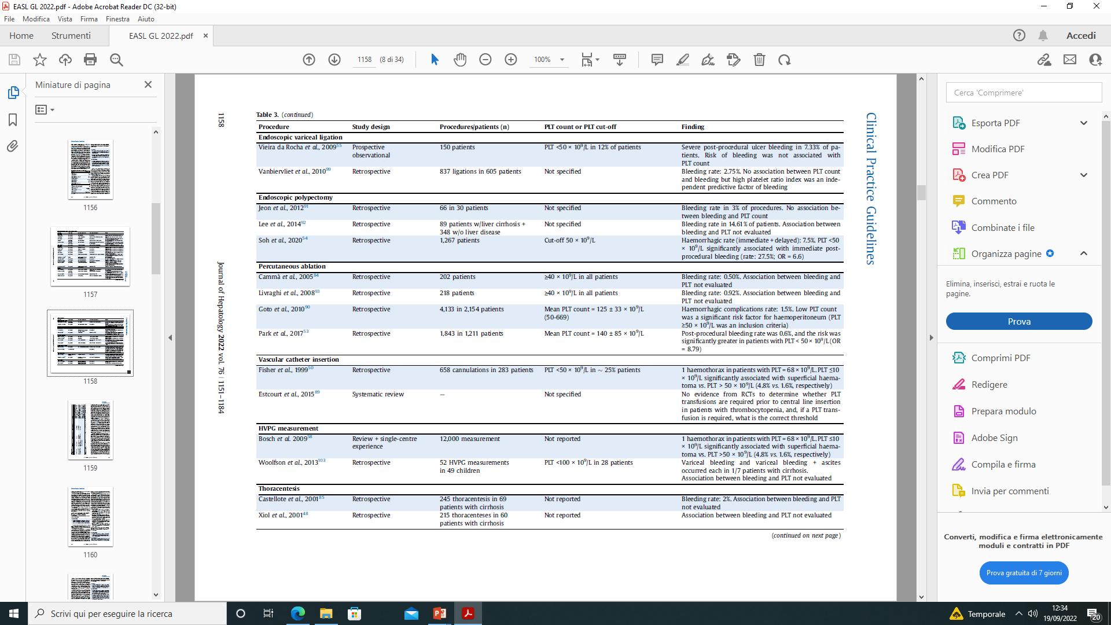
EASL Guidelines, Journal of Hepatology 2022

Slide 27
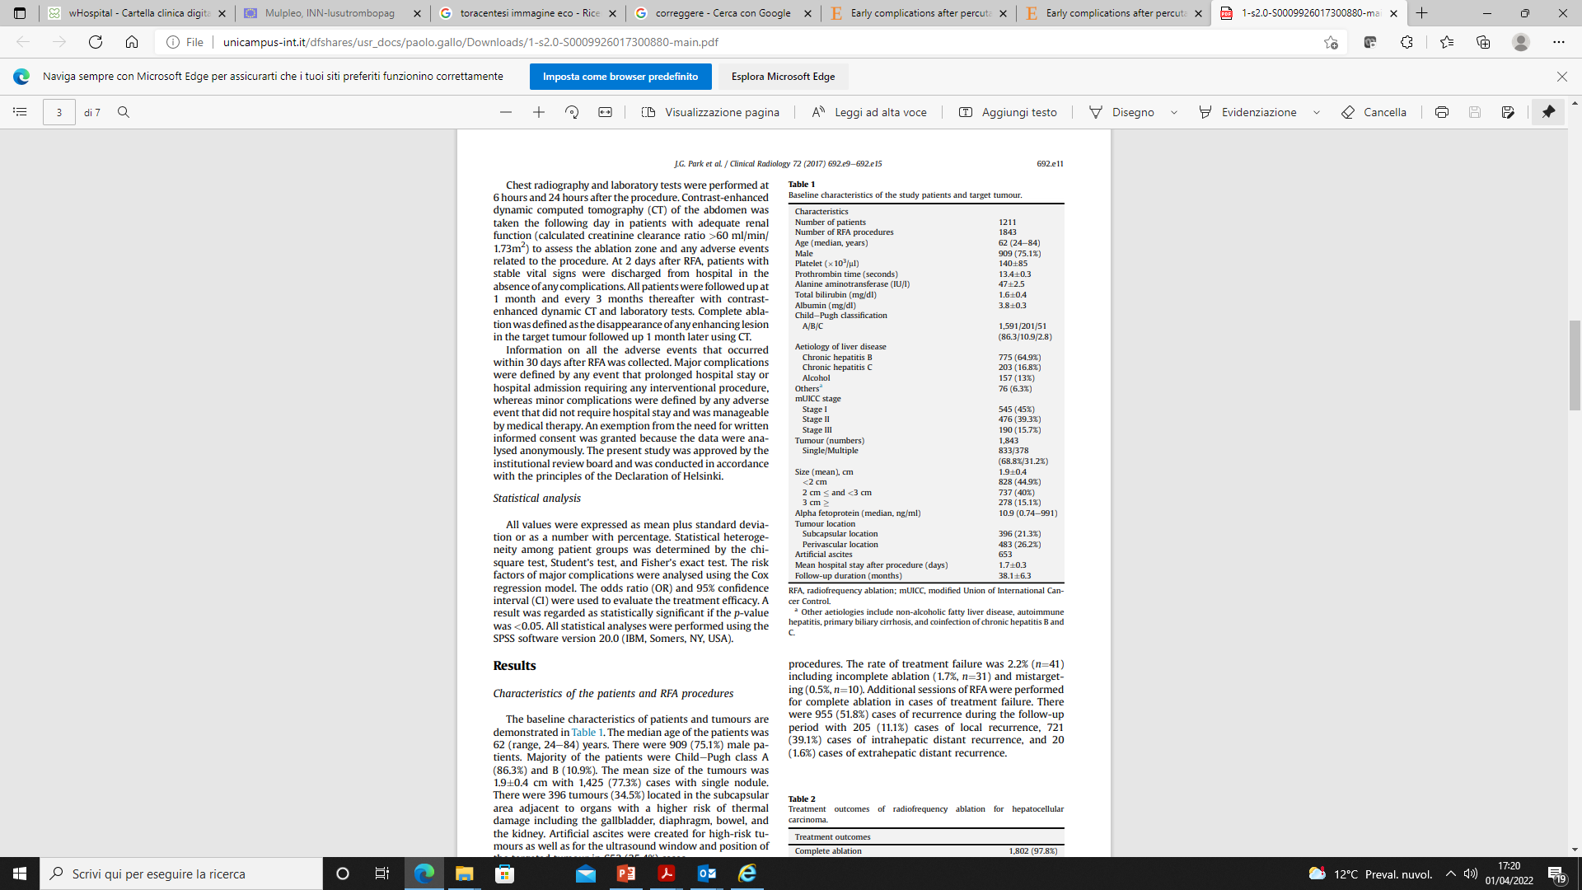
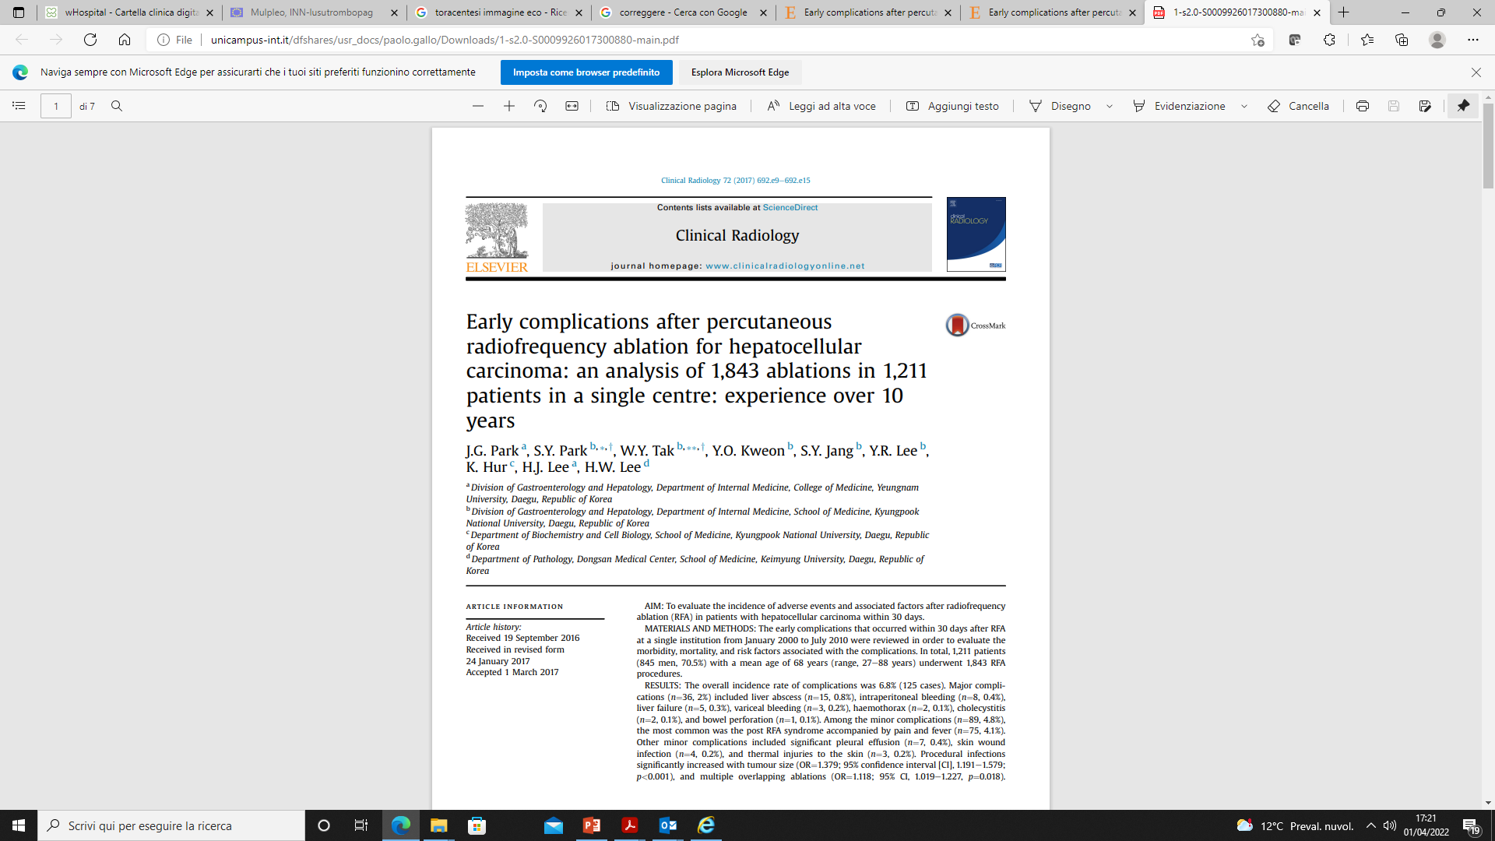
Park JG, Clinical Radiology 2017
Notes:
Percutaneous ablation of hepatocellular carcinoma is another procedure where the riskof bleeding is considered low, although in the largest series reporting the occurrence of haemorrhagic complications (0.5% in 1,834 procedures), median platelet count was 140 × 109/L and patients with a pre-procedural platelet count <50 × 109/L received 10 units of packed platelets as prophylaxis.

Slide 28
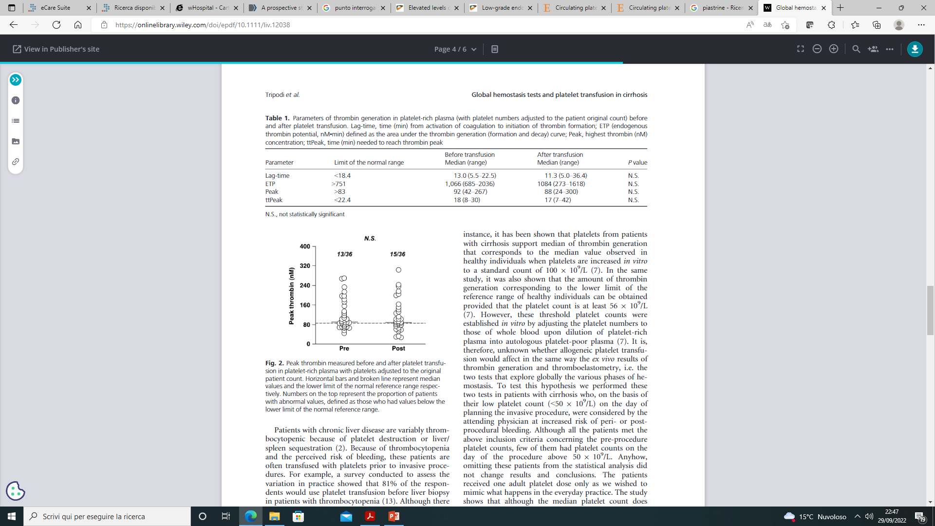
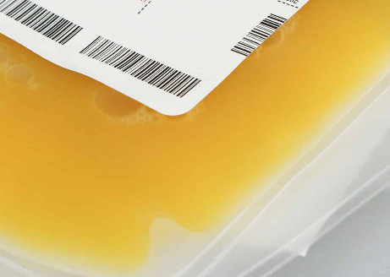
No\little evidence that prophylactic platelet transfusion improves thrombin generation and haemostatic potential.
Tripodi A, et al. Liver Int. 2013
Notes:
In this study, transfusion of 1 standard adult platelet dose slightly increased platelet count (pre-vs. post-infusion: 39 × 109/L (16-64) vs. 52 × 109/L (19-91), p <0.001), without significant effects on ex vivo haemostatic tests. However, another study showed similar increases in platelet count (from 28 ×109/L (21-41)before to 43×109/L (39-64) after platelet transfusion, with increases in in vivo of some markers of haemostasis activation. In addition, study performed with the FFP+PLTs

Slide 29
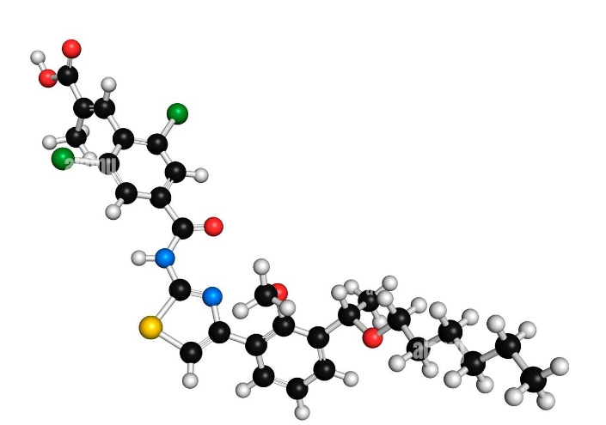
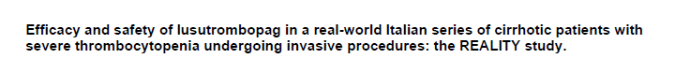
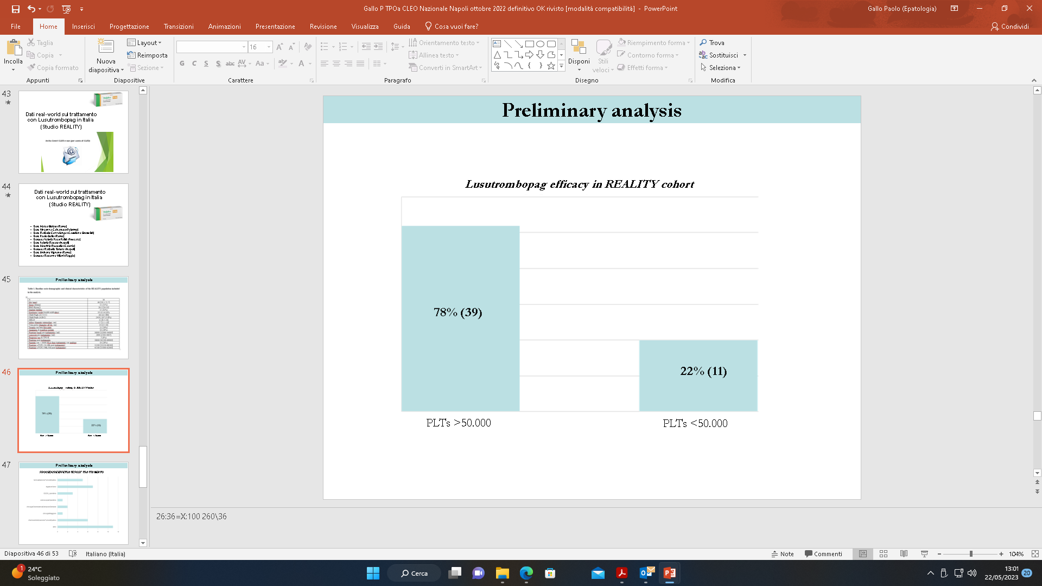
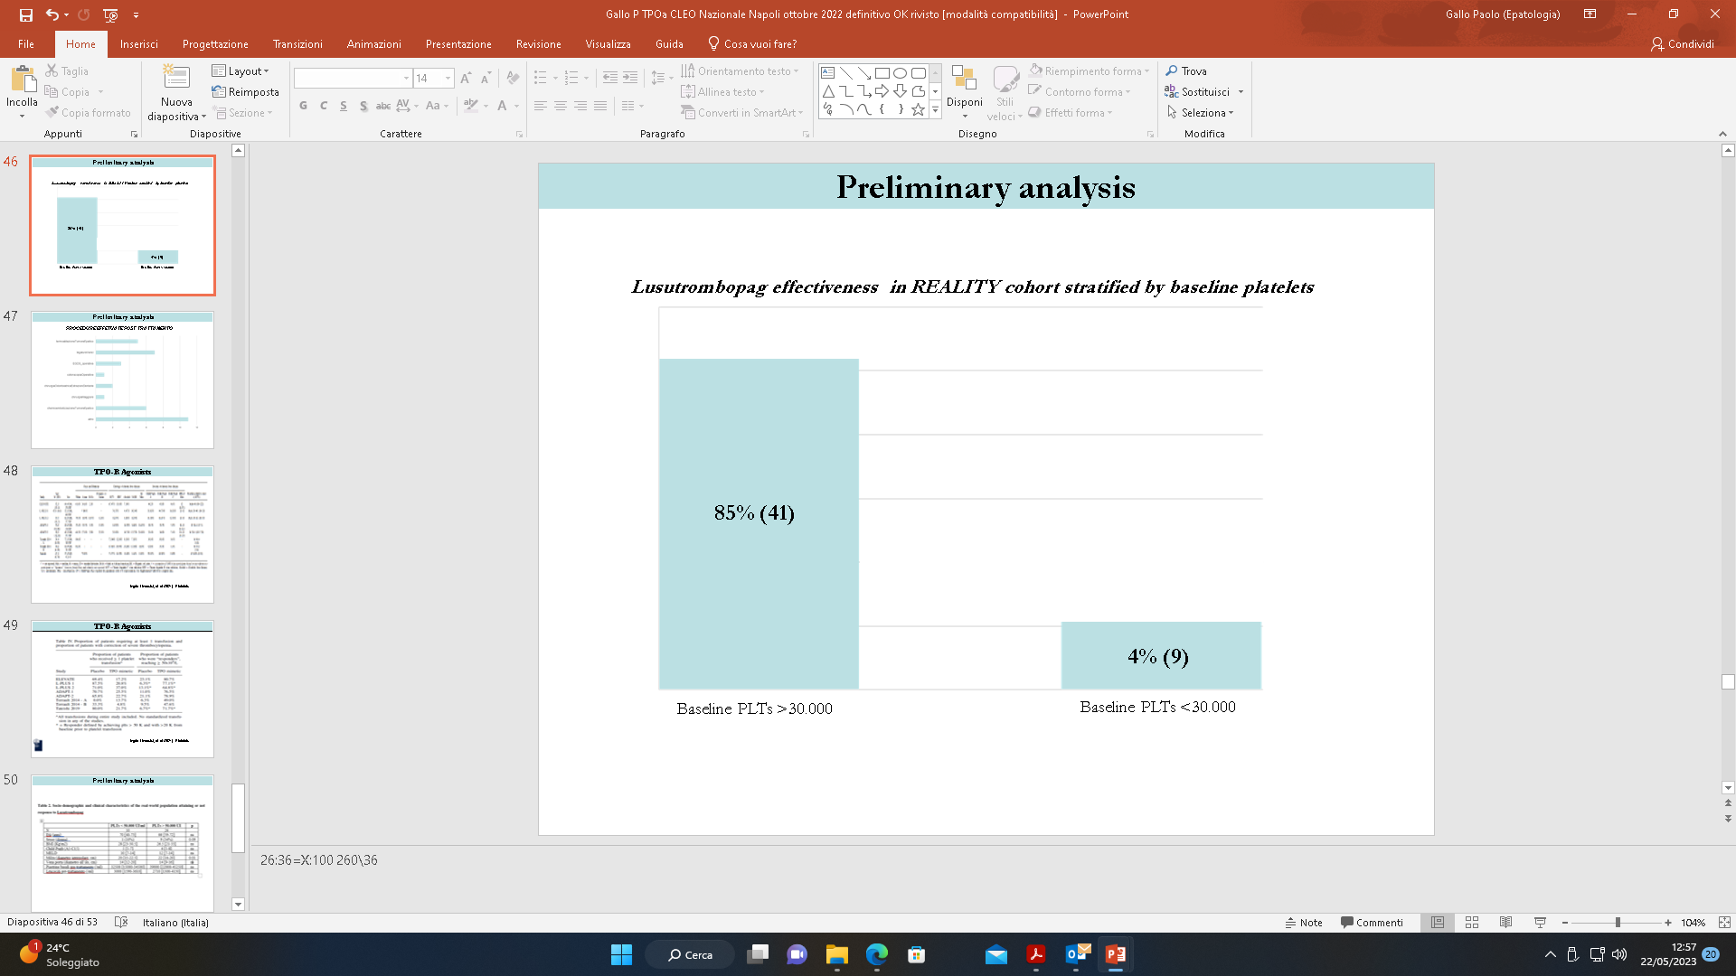
Gallo P, Oral presentation EASL 2023

Slide 30
Why do they bleed (or develop thrombosis)?

Slide 31
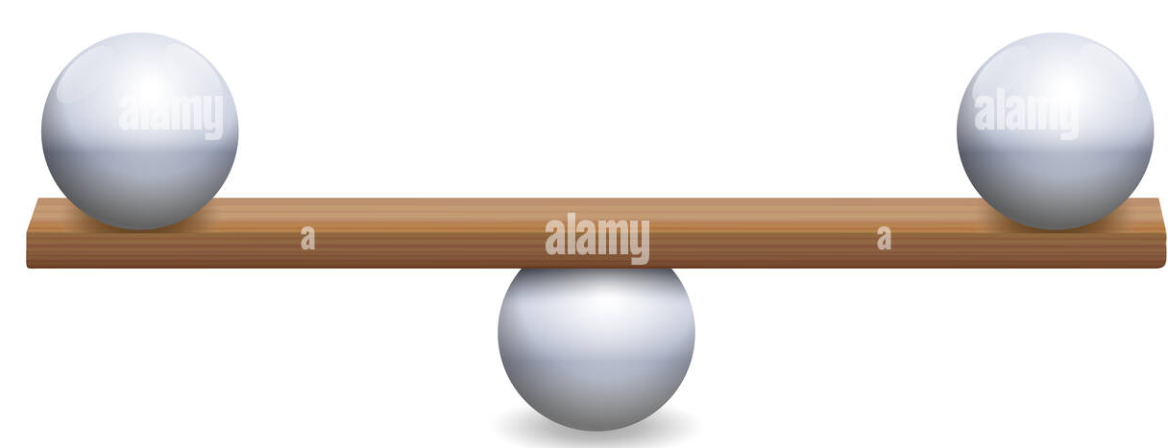
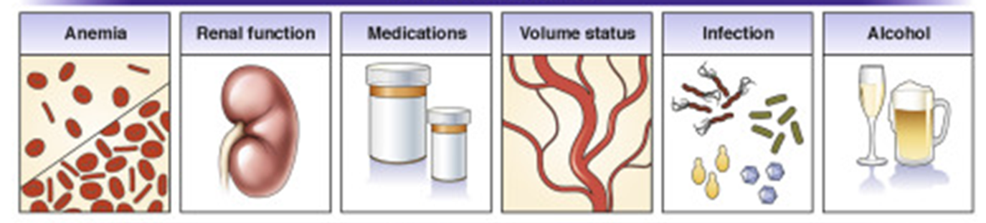
Why do they bleed (or develop thrombosis)?
Unstable hemostasis
The new hemostatic balance is not stable as in healthy people.
Minor alterations may favor hemorrhage or thrombosis!
Tailored therapeutic interventions

Slide 32

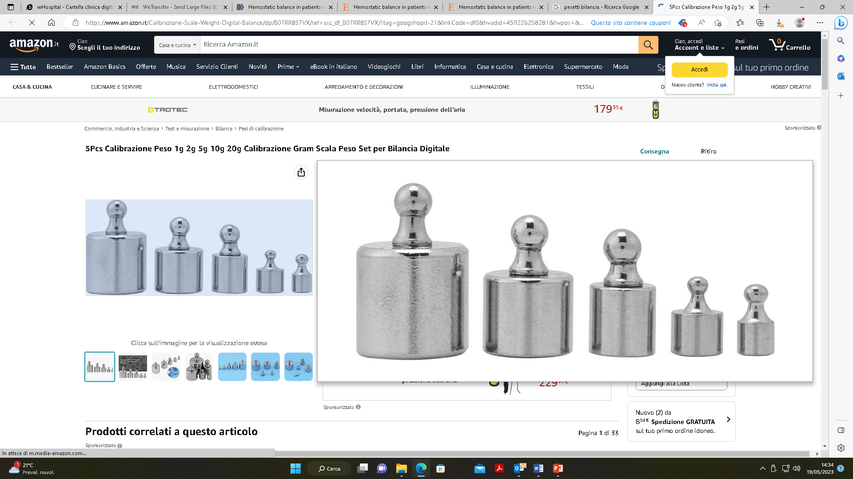
Bleeding risk
Cirrhosis and portal hypertension
Haemostatic parameters
Technical issues
Sepsis - AKI
Decompensated disease or ACLF
Notes:
The risk of bleeding following an invasive procedure is based on various factors that are not reflected by alterations in haemostatic parameters alone, but that include technical issues, and factors that are inherent to a given procedure where the event can be mitigated in the course of the procedure itself by reactive, non-coagulation related measures (e.g., such as in dental extractions or endoscopic polypectomy).
Furthermore, the same procedure may carry different bleeding risks when it is carried out in different clinical situations, as in patients with stable disease or in those with concomitant acute events such as sepsis or acute kidney injury.
For example, in patients with stable cirrhosis and deranged coagulation tests (mean platelet count 50.4 × 109/L, mean INR 1.7) no bleeding events were reported following paracentesis carried out by trained nurses, whereas a post-paracentesis bleeding rate of 3% was observed in patients with acute-on-chronic liver failure undergoing the same invasive procedure

Slide 33
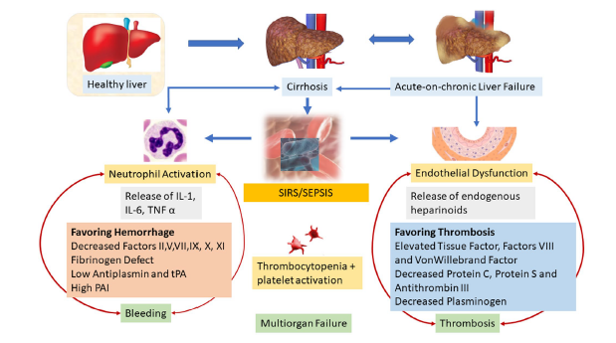
Premkumar MD et al, Clinical Liver disease 2020

Slide 34


Slide 35

Data transfer from bench to bedside!
Uselessness of PT and aPTT to assess bleeding risk (do not screen nor correct)!
Cirrhotic patients are not “auto-anticoaugulated”!
Tailored RCTs ….and universally accepted threshold for platelets!
Notes:
Large observational studies are recommended to collect data, in patients with cirrhosis undergoing invasive procedures, on real-life incidence of bleeding and on complications associated with these events and with inherent therapies.
Placebo controlled, randomized trials including a large proportion of patients with cirrhosis and very low platelet counts undergoing high-risk invasive procedures should be performed, with clinically significant bleeding as a primary endpoint.

Slide 36

paolo.gallo@policlinicocampus.it

