Slide 1





REVERSIBILITA’ DELLA CIRROSI: MITO O REALTA?
MASSIMO PINZANI, MD, PhD, FRCP, FAASLD, MAE
Sheila Sherlock Chair of Hepatology
UCL Institute for Liver and Digestive Health
Royal Free Hospital, London, UK
m.pinzani@ucl.ac.uk
www.ucl.ac.uk/medicine/liver-and-digestive-health

Slide 2
Disclosures
Massimo Pinzani
I disclose the following financial relationship(s) with a commercial interest:
SAB/Consultancy: ChemomAb (Israel); Takeda (USA); Dicerna (USA); Galecto (Sweden); Astra Zeneca (UK); Resolution Therapeutics (UK); Novo Nordisk (DK); Boehringer Ingelheim (Germany)
Co-founder, Chair SAB and shareholder Engitix Therapeutics Ltd (UCL Spin-out) (UK)
Chief Medical Advisor and shareholder Aculive Therapeutics Ltd (Cambridge University Spin-out) (UK)

Slide 3
Stratification of Cirrhosis: desperately seeking for innovation
1.- The term “cirrhosis” does not recapitulate anymore the clinical features of advanced chronic liver disease and does not allow flexibility in terms of regression or resolution
2.- It is increasingly clear that different etiologies lead to different type of “cirrhosis”
3.- There is need for a classification of advanced liver disease not just based on fibrosis
4.- New aetiological treatments have opened important perspectives in term of disease regression or stabilization

Slide 4
Stratification of Cirrhosis: desperately seeking for innovation
1.- The term “cirrhosis” does not recapitulate anymore the clinical features of advanced chronic liver disease and does not allow flexibility in terms of regression or resolution
2.- It is increasingly clear that different etiologies lead to different type of “cirrhosis”
3.- There is need for a classification of advanced liver disease not just based on fibrosis
4.- New aetiological treatments have opened important perspectives in term of disease regression or stabilization

Slide 5
Natural History of Cirrhosis: Mostly “Observational”!
HVPG > 12 mm Hg
“Decompensating Event”
Stage 3
HVPG: 5-12 mm Hg
Bleeding
Stage 1
No Varices
No Ascites
Stage 4
SEPSIS
Renal
Failure
Death or
OLT
?
First non
bleeding
decompensation
Stage 5
Varices
No Ascites
Second
decompensation
Stage 2
Hepatocellular Carcinoma
Compensated Cirrhosis
Decompensated Cirrhosis
Modified from Arvaniti V. et al., Gastroenterology 2010; 139:1246-1256

Slide 6
Compensated Cirrhosis: A Stage with Limited Diagnostic Resources
“Decompensating Event”
Stage 3
Bleeding
Stage 1
No Varices
No Ascites
Stage 4
SEPSIS
Renal
Failure
Death or
OLT
?
First non
bleeding
decompensation
Years
Months
Stage 5
Varices
No Ascites
Second
decompensation
Stage 2
Hepatocellular Carcinoma
?
?
?
Compensated Cirrhosis
Decompensated Cirrhosis
Modified from Arvaniti V. et al., Gastroenterology 2010; 139:1246-1256

Slide 7
Summary
1.- Define the biology of cirrhosis
2.- Define the clinical stage of cirrhosis
3.- Define the relative end-points of treatment
4.- Is it possible to reverse cirrhosis to non-cirrhosis?

Slide 8
Summary
1.- Define the biology of cirrhosis
2.- Define the clinical stage of cirrhosis
3.- Define the relative end-points of treatment
4.- Is it possible to reverse cirrhosis to non-cirrhosis?

Slide 9
Etiology-Driven Liver Fibrosis
HCV
HBV
Cholestasis
Alcohol
One or many
types of fibrosis ??
Drugs
NASH
Others
Autoimmune
disorders

Slide 10
Etiology-Driven Liver Fibrosis
Portal tract expansion in post-necrotic fibrosis
Normal hepatic lobule
Pericentral fibrosis
Biliary fibrosis
portal tract
Capillarization of sinusoids
Capillarization of sinusoids
CLV
CLV
CLV
CLV
e.g. : chronic viral hepatitis, autoimmune hepatitis
e.g. : chronic alcoholic hepatitis, NASH
e.g. : Primary Biliary Cholangitis, Primary Sclerosing Cholangitis
Porto-central with early involvement of CLV – Sinusoidal arterialization- Neo-angiogenesis
Zone 3 fibrosis with progressive pan-lobular capillarization of sinusoids
Portal-portal with progressive cholestasis
Direction of fibrosis development
Friedman SL and Pinzani M. Hepatology February 2022

Slide 11
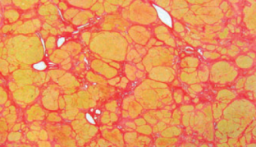
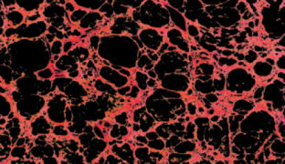
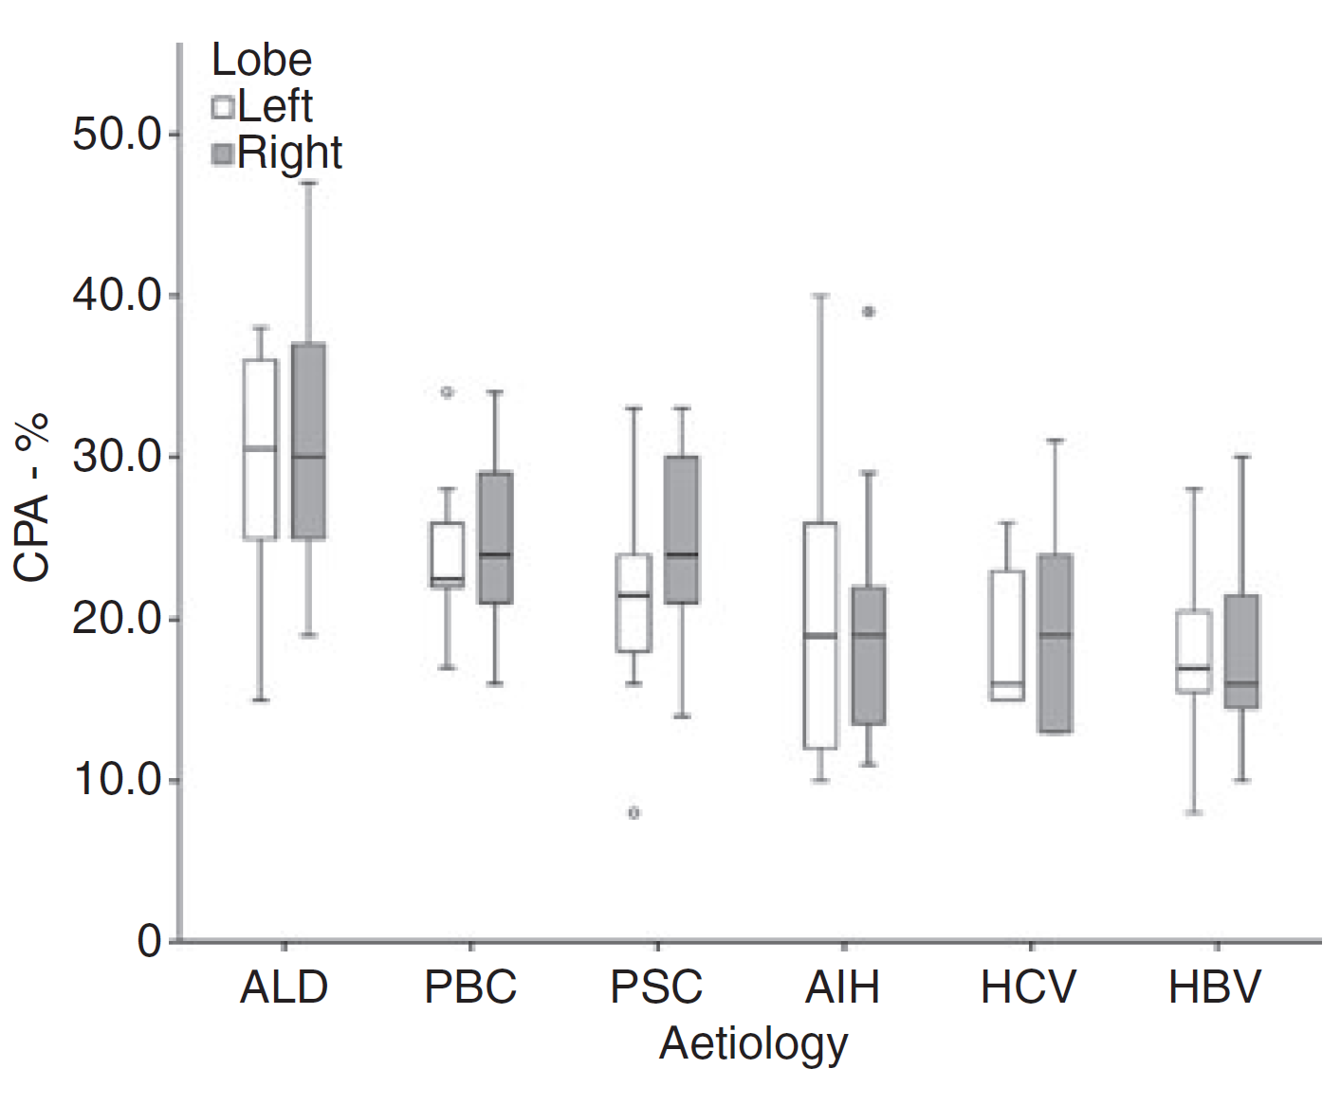

Different Fibrogenic Patterns Lead to Different Types of Cirrhosis
Post-necrotic:
Viral Hepatitis, Autoimmune Hepatitis
Biliary:
Primary Biliary Cirrhosis
Primary Sclerosing Cholangitis
Secondary Biliary Cirrhosis
Pericellular:
Alcoholic Steatohepatitis
Non Alcoholic Steatohepatitis
(Haemochromatosis/Wilson Disease)
Hall A. et al., Histopathology 2012; 60:270-277

Slide 12
Different Types of Cirrhosis with Different Biology?
1. – The matrisome
2. – Predisposition to HCC
3. – Portal hypertension
4. – Reversibility of tissue fibrosis in cirrhotic liver

Slide 13
Different Types of Cirrhosis with Different Biology?
1. – The matrisome
2. – Predisposition to HCC
3. – Portal hypertension
4. – Reversibility of tissue fibrosis in cirrhotic liver

Slide 14
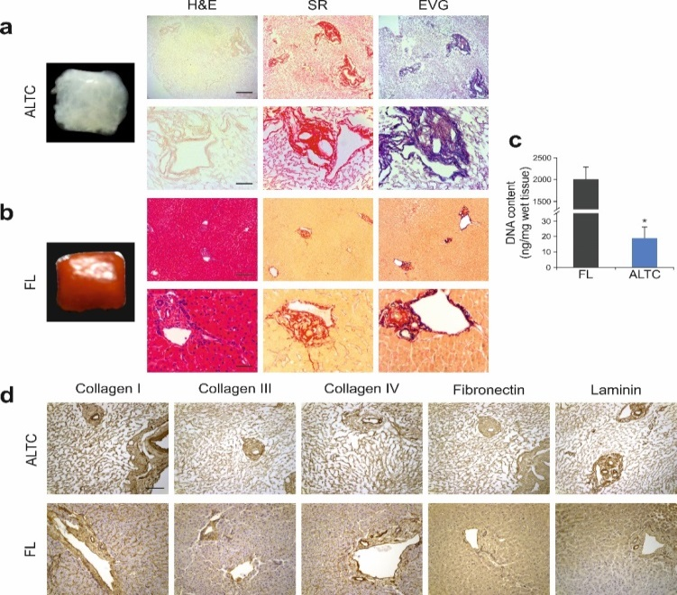
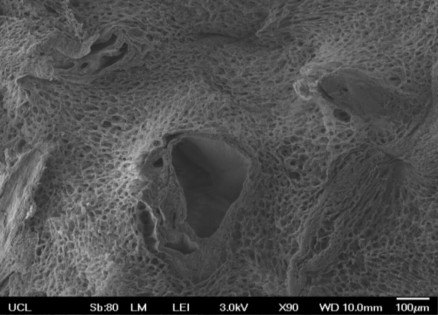
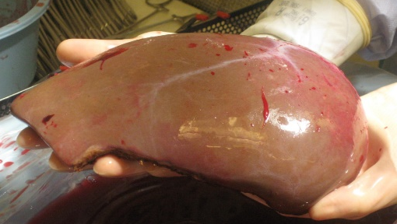
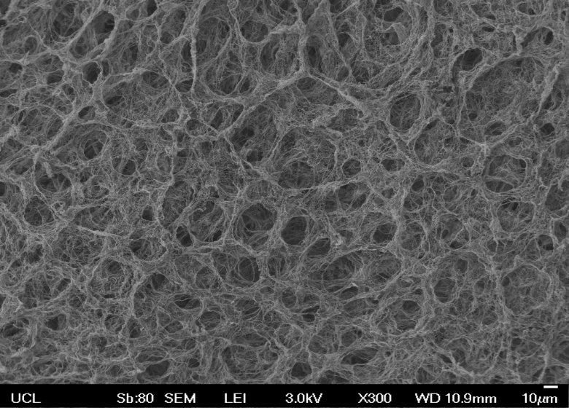
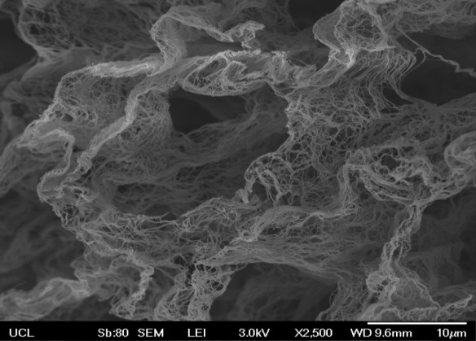
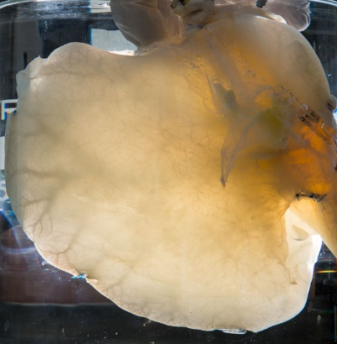
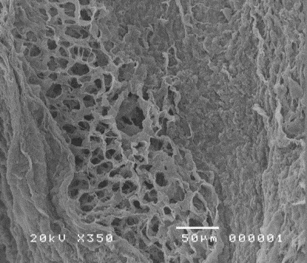
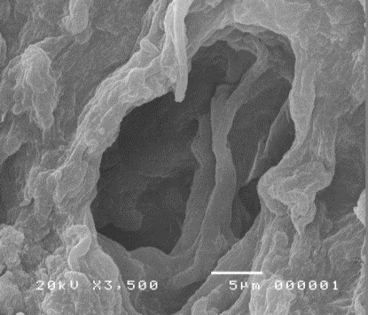
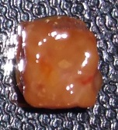
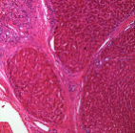
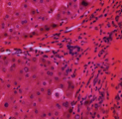
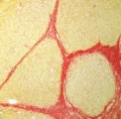
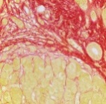
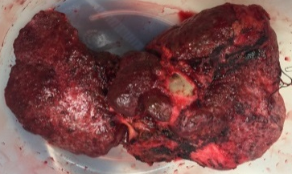
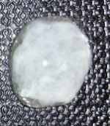
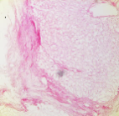
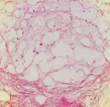
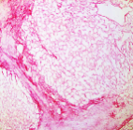
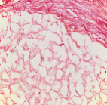
Lessons from Decellularized Human Liver
Donor healthy human liver
Explanted cirrhotic liver
Mazza G et al, Scientific Report 2015; Mazza G et al, Scientific Report 2017

Slide 15
The Matrisome
Recent development of experimental techniques (e.g., tissue decellularization) have allowed the characterization of ECM composition by proteomic and other “omic” approaches to provide new insights into ECM biology

Slide 16


Target and Biomarker Discovery
Differential protein and gene expression in cirrhotic vs healthy liver
  Liver ECM
TMT MS proteomic analysis
matrisome
Healthy
TMT MS proteomic analysis
peptidomic analysis
RNAseq
secretome
+
stromal cells
exome
cirrhotic
+
peptidomic analysis
matrikines
proteases

Slide 17
Cirrhotic Human Liver Scaffolds Retain Unique Protein Signatures
Protein Representation at least 2 valid value in one group– Venn Diagram
Significantly changed proteins Student’s t-test p<0.05
TOTAL: 1114 PROTEINS
DECELLULARIZED HEALTHY LIVER
DECELLULARIZED CIRRHOTIC LIVER
226
813
75
DECELLULARIZED
HEALTHY LIVER
DECELLULARIZED
CIRRHOTIC LIVER
Quantitative proteomic analysis of cirrhotic (PSC) and healthy liver scaffolds was performed in order to identify extracellular related proteins. Our previous work (Mazza G et al Sci Rep 2017 and Mangione P, Mazza G et al J Proteomics 2017) firstly described the increase sensitivity of detecting extracellular proteins after decellularization. Quantitative proteomic of cirrhotic and healthy scaffolds identified a total of 1114 proteins. Although cirrhosis is mainly characterized by an increase (quantitative) in already present collagens is possible to identify unique proteins (quality signatures) in cirrhotic scaffolds with statistical significant change compared to healthy liver scaffolds

Slide 18
Chronic Liver Disease: Disease-specific Matrisome Signatures
ABCD3 ACAA1 ACSM3 ACSM5 ADH1C
ADH4 AKR1A1 AKR1C2 AKR1C3 AKR1C4
AKR7A3 ALDH8A1 AMBP APOC1
ATP5J2-PTCD1;ATP5J2 BCKDHB BDH1
CACNG1 CBR1 CCDC150 CGN CHST4
CLU CNDP2 CNOT3 COL3A1 COL4A3
COPG2;COPG1 CPT1A CTSG CYP2C8
CYP2C9 DEFA3;DEFA1 DNAH7 DOLK
ECHS1 ENPP6 FLAD1 FMO3 FMO5
FTCD GDF15 GGN GLUD1;GLUD2 GNB2L1
GOSR2 GSTA3;GSTA5;GSTA2;GSTA1
GSTM3 HADHA HGD HMGCS2 HP
HSD17B4 HSP90AB1 HSP90B1 KHK
LGALS4 LYZ MEST MTHFD1 PC
PDLIM5 PECR PGK1 PRG4 RIMS3 RPL7
RPS3A RPS4X SAR1B;DKFZp434B2017
SCP2 SDSL SEC14L2;SEC14L3
SEC23A;SEC23B SEL1L2 SEP_2 SLC25A13
SLC27A5 SLC38A3 STARD10 SURF4
TAGLN3 TF TLN1
TUBB4B;TUBB4A;TUBB2B;TUBB2A
UGT1A4 UGT1A9;UGT1A7;UGT1A8
UGT2B15;UGT2B17 WDR1 ZNF781
ANXA7 BGN BPIFB6 CDK11A;CDK11B
CFAP44 EIF3E EPHX1 FAM120B FBN3
FGA FGB FGG FSIP2 GPR179 GPR18
HNRNPD HNRNPK HSPD1 KANSL3
LAMC1 LPO NCBP2-AS2 NDRG4 NF2
NSD1 PSMC5 RIMKLB RPL18 SCN5A
SHISA7 TCP1 TGFBI TTF2 WRN
Healthy
38
13
NAFLD
90
29
9
47
ACTG2;ACTA1;ACTC1;ACTA2;ACTBL2
AGTPBP1 APRT ASUN ATL2 ATR
C16orf78 C19orf54 CANX CCT7 CKB
COL14A1 DNAJB9 FBLN1 FERMT2
FOXD4L1;FOXD4L4;FOXD4L2;FOXD4L5
GTF2IRD2;GTF2IRD2B HIST1H3A
HIST2H3A IGFBP7 IGKC LAMA4 LGALS1
LPAR2 MROH5 PRDM4 PRDX1 PSMC6 RELN RPL27A S100A8 S100A9 SERPINA1 SNX13 SULT1A2;SULT1A1 TMEM8B TUBB TUBB8
PSC
40

Slide 19
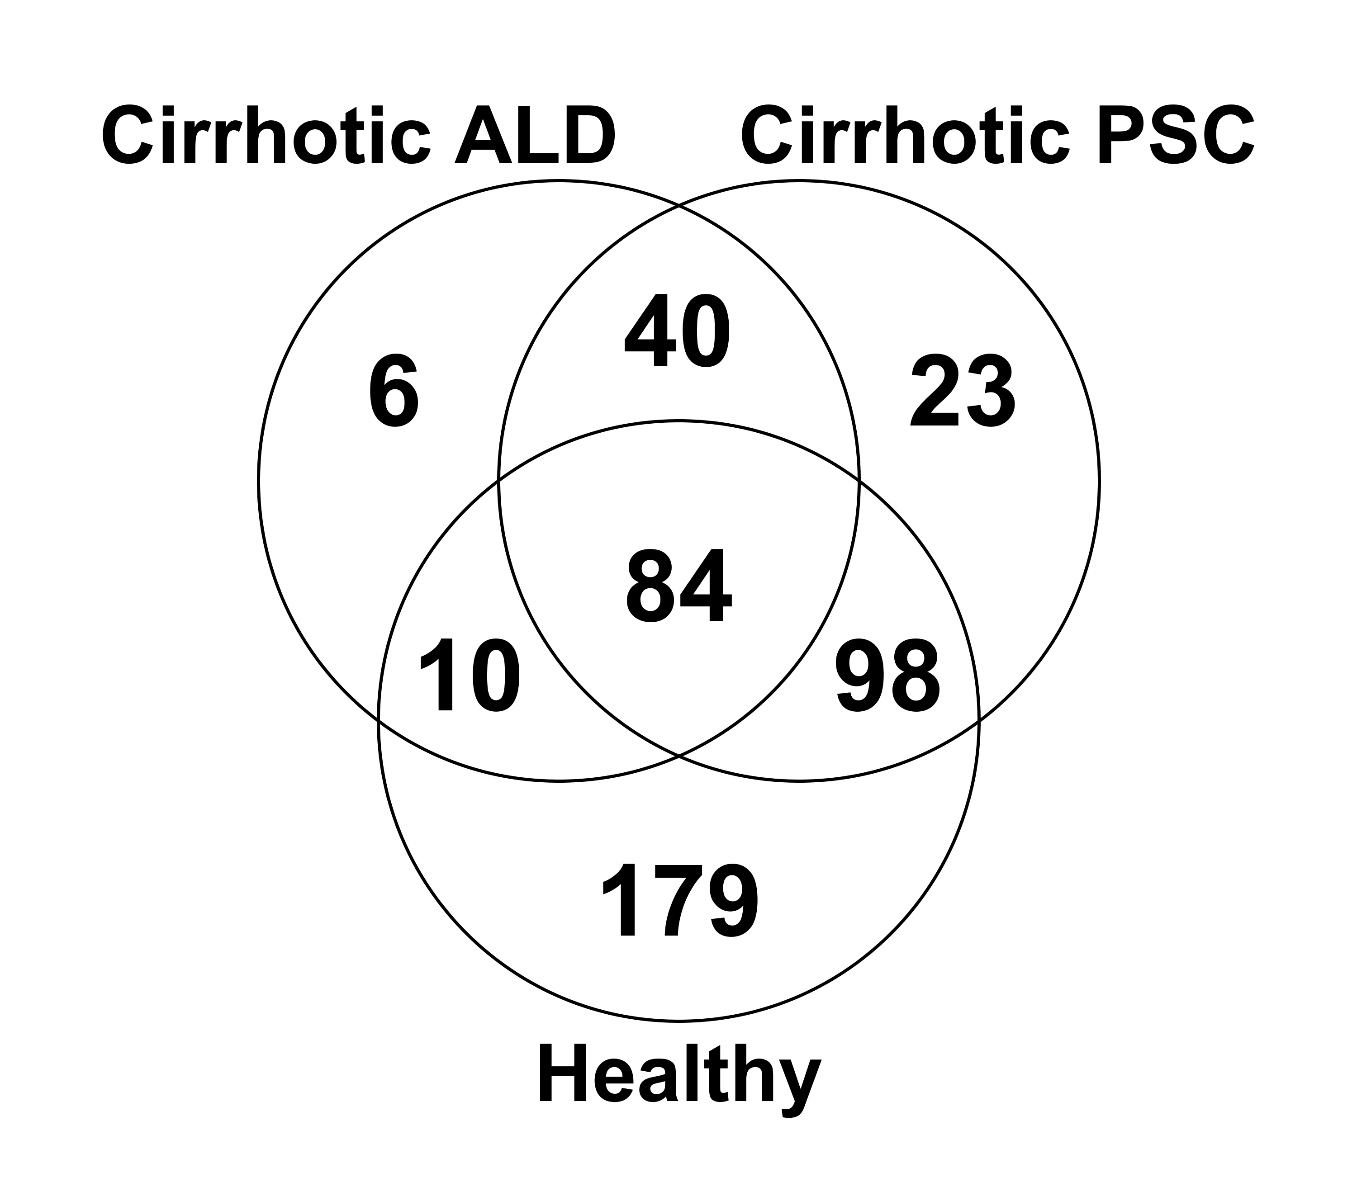


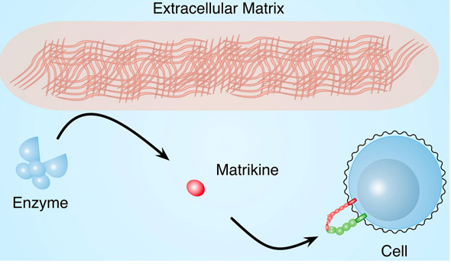
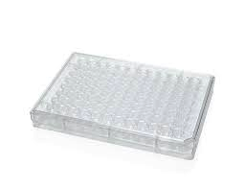
Matrikine Analysis for ALD vs. PSC
  LC-MS peptidomics reveal chronic liver disease-specific matrikines
ALD cirrhosis
PSC cirrhosis
Healthy
Fibrotic
+ HNE, MMP, Cath
Collect supernatant fractions, filter on 10KDa cut-off membrane
Healthy
Yasui Y. et al. Unpublished
TMT MS
Notes:
Used LS-MS label-free. Will get far greater sensitivity with TMT MS

Slide 20
Different Types of Cirrhosis with Different Biology?
1. – The matrisome
2. – Predisposition to HCC
3. – Portal hypertension
4. – Reversibility of tissue fibrosis in cirrhotic liver

Slide 21

Fibrosis Vs. Regeneration

Slide 22
Fibrosis Vs. Regeneration
Chronic wound healing/fibrogenesis
Chronic liver parenchymal damage
Cirrhosis (“regenerative nodules”)
Reduced regenerative potential of mature hepatocytes
Regeneration attempt by HPC
HCC

Slide 23
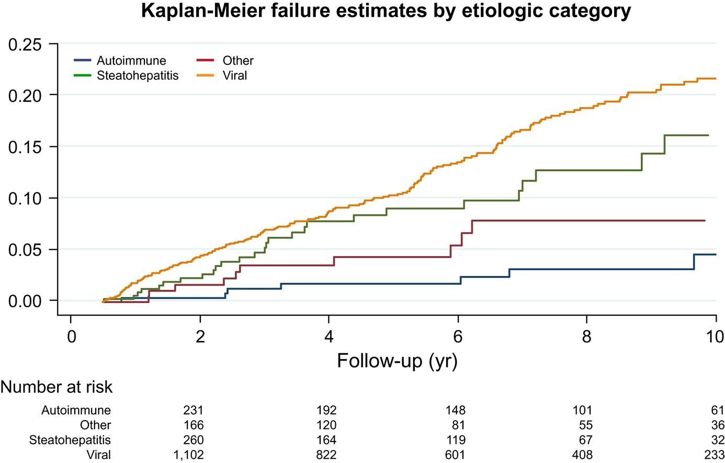
Etiology of Cirrhosis and Incidence of HCC
Toronto HCC risk index, cohort of > 2000 patients
Sharma SA et al. J Hepatol 2018; 68:92-99

Slide 24
Etiology of Cirrhosis and Incidence of HCC
Llovet J et al. Nature Review 2021

Slide 25
Different Types of Cirrhosis with Different Biology?
1. – The matrisome
2. – Predisposition to HCC
3. – Portal hypertension
4. – Reversibility of tissue fibrosis in cirrhotic liver

Slide 26
Portal Hypertension in the Natural History of Chronic Liver Disease
<10mmHg
No Varices
>10mmHg
No Varices
>10mmHg
Varices
>12mmHg
Varices, Bleeding
>16 mmHg >20mmHg
Ascites Refractory Ascites
Consensus/Standardization reached in the 1990s and largely on HCV cirrhosis
CSPH
Modified from Krag (Gut 2010)

Slide 27
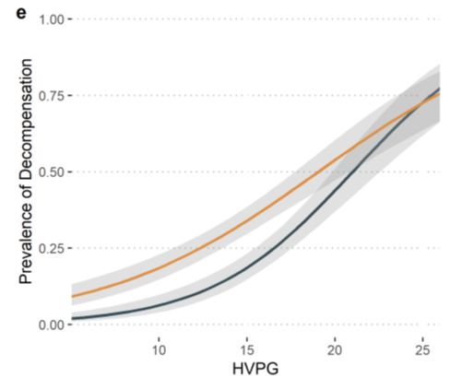
Ferrusquia-Acosta et al., J Hepatology 2021
1.00
NASH Cirrhosis
0.75
HCV Cirrhosis
0.50
Prevalence of decompensation
0.25
0.00
10
15
20
25
HVPG (mmHg)
Bassegoda O, et al. ILC 2021; 571

Slide 28
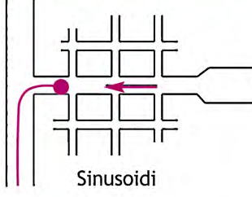

Hepatic Venous Pressure Gradient (HVPG) = WHVP - FHVP
Post-necrotic Fibrosis
Pericellular Fibrosis
FHVP
FHVP
Do standard HVPG thresholds equally reflect “sinusoidal” pressure in all types of cirrhosis?
Vena Cava
Portal Vein
Vena Cava
Portal Vein
Sinusoids
Sinusoids
WHVP
WHVP
Arterialization of sinusoids with early porto-central shunting
Portal hypertension more genuinely sinusoidal

Slide 29
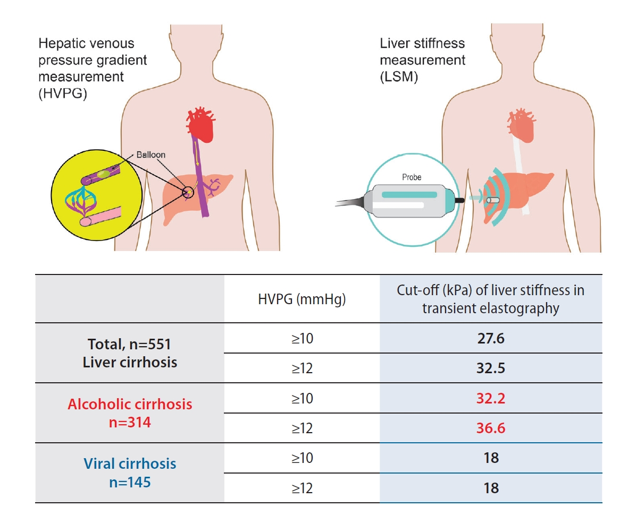
Can Non-invasive Methods help?
Ryu SR et al., Clin Mol Hepatol 2021; 27: 197-206

Slide 30
Summary
1.- Define the biology of cirrhosis
2.- Define the clinical stage of cirrhosis
3.- Define the relative end-points of treatment
4.- Is it possible to reverse cirrhosis to non-cirrhosis?

Slide 31
The Clinical Course of Cirrhosis: The Multi-stage Model
Disease Stage Model
Stratification Tools
Targets for Future Biomarkers
Compensated
Histology
HVPG
Stage 0 – no varices – MPH
Non-invasive markers
Increasing Fibrogenesis, Angiogenesis, Tissue Hypoxia
Stage 1 – no varices – CSPH
Clinical aims
Risk of decompensation
Suitability for aetiology-guided treatment
Assess treatment response
Stage 2 – varices
Increasing Portal Hypertension and Collateral Circulations
Death/LT
ACLF
Decompensated
Sarcopenia and Frailty Assessment
Transplant Scores (MELD, UKELD)
Stage 3 – variceal bleeding
Increasing Bacterial translocation, systemic inflammation and derangement of innate immunity
Stage 4 – first non bleeding complication
Clinical aims
Risk of death
Suitability for transplant
Stage 5 – > 2 decompensating events
Stage 6 – late decompensation
Refractory ascites; PSE/jaundice; HRS, other organs dysfunction; ACLF
Maurice J & Pinzani M; Hepatology Research 2020

Slide 32
Summary
1.- Define the biology of cirrhosis
2.- Define the clinical stage of cirrhosis
3.- Define the relative end-points of treatment
4.- Is it possible to reverse cirrhosis to non-cirrhosis?

Slide 33

Cirrhosis: Biological End-points of Treatment
1.- Reduce portal hypertension
2.- Promote liver function and regeneration
3.- Prevent/reduce neoplastic transformation

Slide 34
Cirrhosis: Clinical End-points of Treatment
Disease Stage Model
Compensated
Stage 0 – no varices – MPH
Regression of cirrhosis
Stage 1 – no varices – CSPH
Prevention of Decompensation
Stage 2 – varices
Death/LT
ACLF
Decompensated
Stage 3 – variceal bleeding
Return to a compensated stage
Stage 4 – first non bleeding complication
Stage 5 – > 2 decompensating events
Clinical stabilization and MELD reduction
Stage 6 – late decompensation
Refractory ascites; PSE/jaundice; HRS, other organs dysfunction; ACLF

Slide 35
Summary
1.- Define the biology of cirrhosis
2.- Define the clinical stage of cirrhosis
3.- Define the relative end-points of treatment
4.- Is it possible to reverse cirrhosis to non-cirrhosis?

Slide 36
Cirrhosis: Clinical End-points of Treatment
Disease Stage Model
Compensated
Stage 0 – no varices – MPH
Regression of cirrhosis
Stage 1 – no varices – CSPH
Prevention of Decompensation
Stage 2 – varices
Death/LT
ACLF
Decompensated
Stage 3 – variceal bleeding
Return to a compensated stage
Stage 4 – first non bleeding complication
Stage 5 – > 2 decompensating events
Clinical stabilization and MELD reduction
Stage 6 – late decompensation
Refractory ascites; PSE/jaundice; HRS, other organs dysfunction; ACLF

Slide 37
Reversibility of Liver Fibrosis According to the Pattern
Fibrosis Pattern | Early portal to central septa | Neo-angiogenesis | Pan lobular capillarization of sinusoids | Potential Reversibility
POST-NECROTIC (HBV, HCV, Autoimmune) | ++++ | ++++ | ++ | ++
PERICELLULAR-PERISINUSOIDAL (NASH, ASH, Hemochromatosis) | - | ++ | ++++ | +++
BILIARY (PBC. PSC) | - | ++ | - | +++
CENTRILOBULAR (Chronic heart failure, upstream vascular disorders) | - | + | - | ++++
Pinzani M., Baveno VII 2021

Slide 38
Reversible and Irreversible Fibrosis in Cirrhotic Liver
EVIDENT COMBINATION OF SEPTAL AND PERICELLULAR FIBROSIS
Reversible
Extensive fibrillar collagen cross-linking
Extensive elastin deposition
Downregulation of matrix metalloproteinases
Absence of inflammatory and cells able to ECM remodelling
Non Reversible
Lackner C and Tiniakos D, J Hepatology 2019

Slide 39
Reducing Fibrosis in Cirrhosis
1.- Etiological treatment (antivirals, alcohol abstinence, bariatric)
2.- Antifibrotic strategies (direct and indirect)
3.- Cell Therapy

Slide 40
Reducing Fibrosis in Cirrhosis
1.- Etiological treatment (antivirals, alcohol abstinence, bariatric)
2.- Antifibrotic strategies (direct and indirect)
3.- Cell Therapy

Slide 41
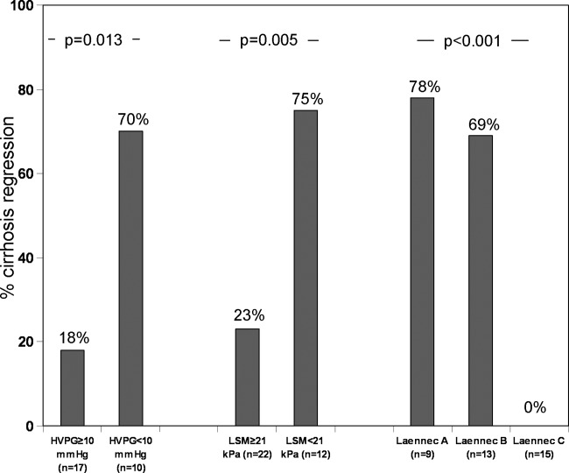
Cirrhosis: Clinical End-points of Treatment
HCV SVR
Disease Stage Model
Compensated
Stage 0 – no varices – MPH
Regression of cirrhosis
Stage 1 – no varices – CSPH
*Reduced Decompensation
Increased Survival
12% of patients to STAGE 2
*Survival increased only if pre-treatment HVPG < 10-12 mm Hg
34% of patients EV worsening
Stage 2 – varices
Prevention of Decompensation
Death/LT
ACLF
Decompensated
Stage 3 – variceal bleeding
Return to a compensated stage
Stage 4 – first non bleeding complication
Stage 5 – > 2 decompensating events
Portal pressure and liver stiffness measurements in the prediction of fibrosis regression 12 months after HCV SVR
Clinical stabilization and MELD reduction
Stage 6 – late decompensation
Refractory ascites; PSE/jaundice; HRS, other organs dysfunction; ACLF
Hepatology, Volume: 67, Issue: 5, Pages: 1683-1694, First published: 27 September 2017, DOI: (10.1002/hep.29557)
*Di Marco V. et al. Gastroenterology. 2016 Jul;151(1):130-139

Slide 42
Reducing Fibrosis in Cirrhosis
1.- Etiological treatment (antivirals, alcohol abstinence, bariatric)
2.- Antifibrotic strategies (direct and indirect)
3.- Cell Therapy

Slide 43
Fibrotic Diseases: Therapeutic Ambition
IPF: Idiopathic Pulmonary Fibrosis
ILD: Interstitial Lung Disease
SSc: Systemic Sclerosis

Slide 44
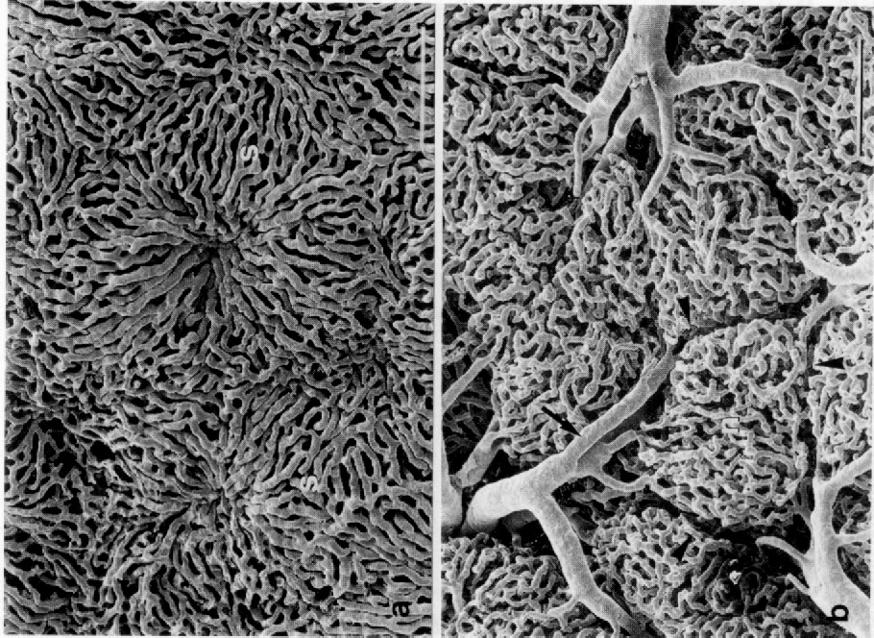
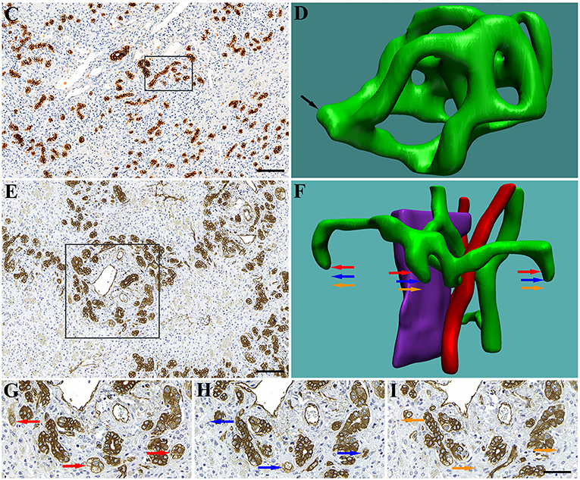
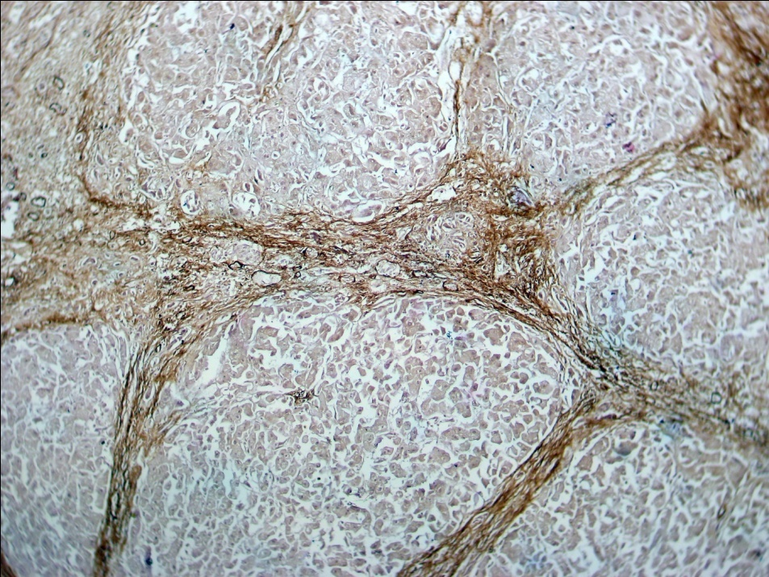
What is Not Reversible with Antifibrotics?
1. Parenchymal regenerative nodules
2. Vascular anastomosis
3. Vascularized septae
4. Biliary loops not connected with biliary tree

Slide 45
Reducing Fibrosis in Cirrhosis
1.- Etiological treatment (antivirals, alcohol abstinence, bariatric)
2.- Antifibrotic strategies (direct and indirect)
3.- Cell Therapy

Slide 46
Cirrhosis: Clinical End-points of Treatment
Disease Stage Model
Compensated
Stage 0 – no varices – MPH
Regression of cirrhosis
Stage 1 – no varices – CSPH
Prevention of Decompensation
Stage 2 – varices
Death/LT
ACLF
Decompensated
Stage 3 – variceal bleeding
Return to a compensated stage
Stage 4 – first non bleeding complication
Stage 5 – > 2 decompensating events
Clinical stabilization and MELD reduction
Stage 6 – late decompensation
Refractory ascites; PSE/jaundice; HRS, other organs dysfunction; ACLF

Slide 47
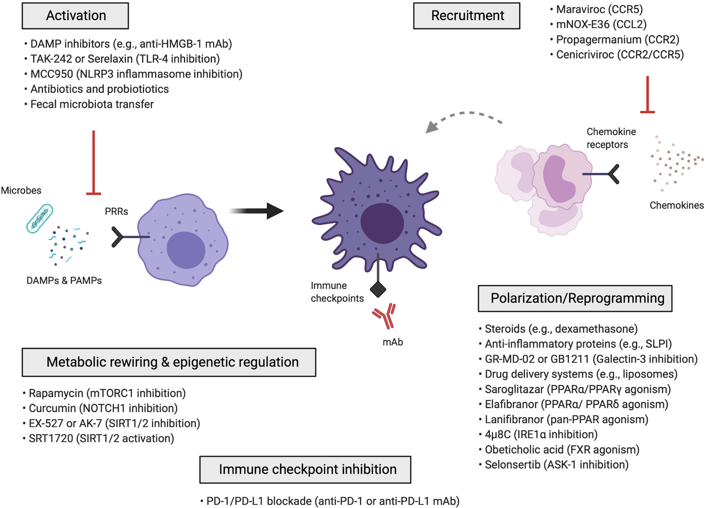
Macrophage Reprogramming
Classically Activated
Macrophages (M1)
Non-Classically Activated
Macrophages (M2)

Slide 48
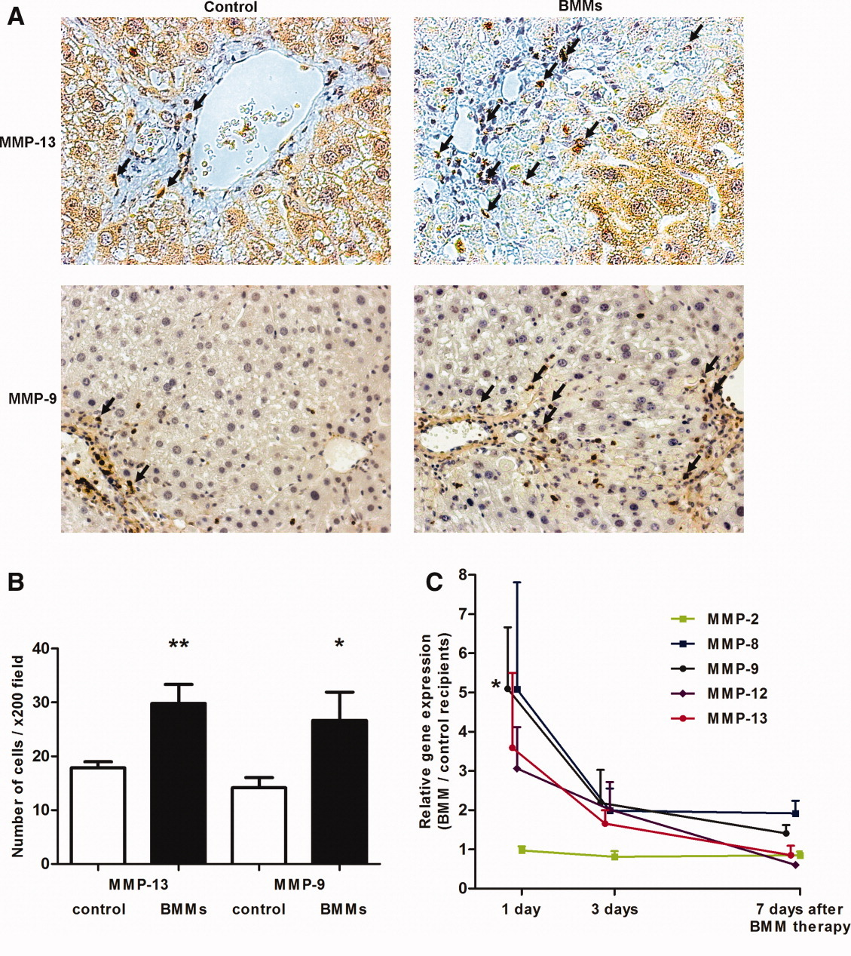
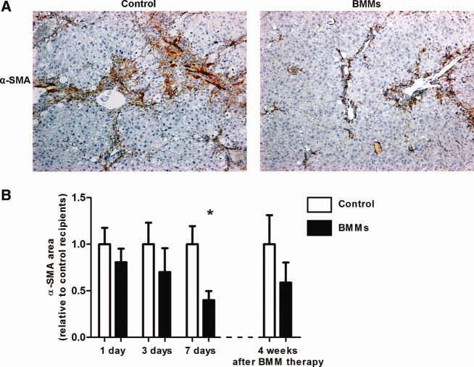
Macrophage therapy for murine liver fibrosis recruits host effector cells improving fibrosis, regeneration, and function
Thomas JA et al. Hepatology 2011; 53:2003-2015

Slide 49
Autologous Macrophage Cell Therapy
MATCH Phase 1

Slide 50
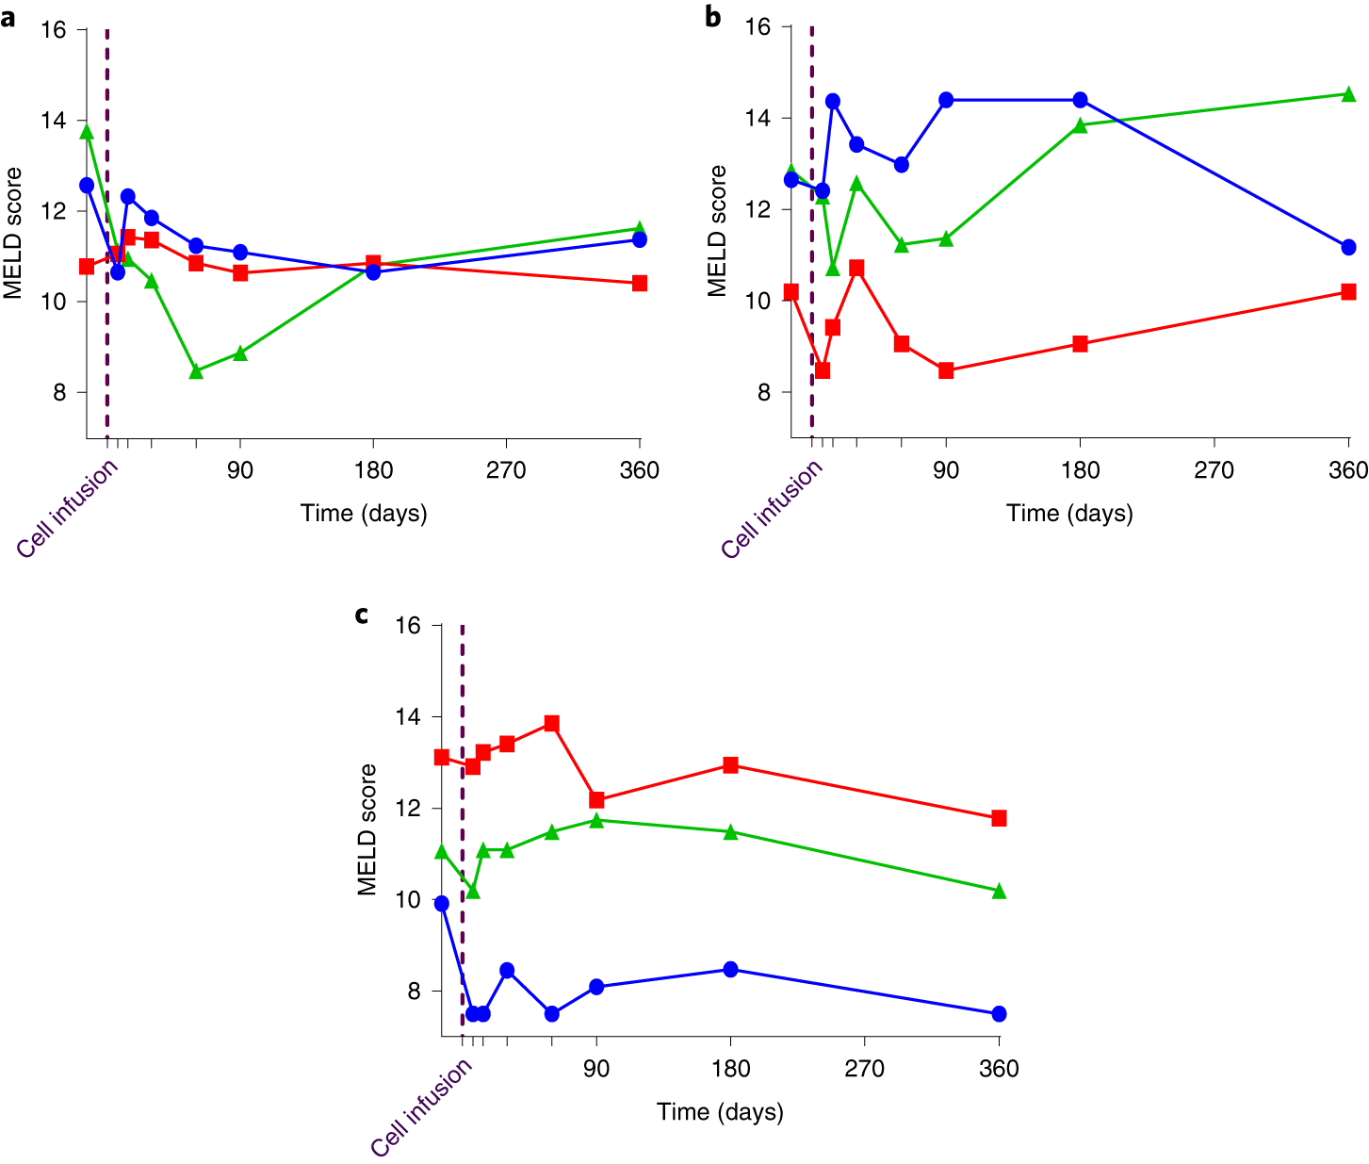
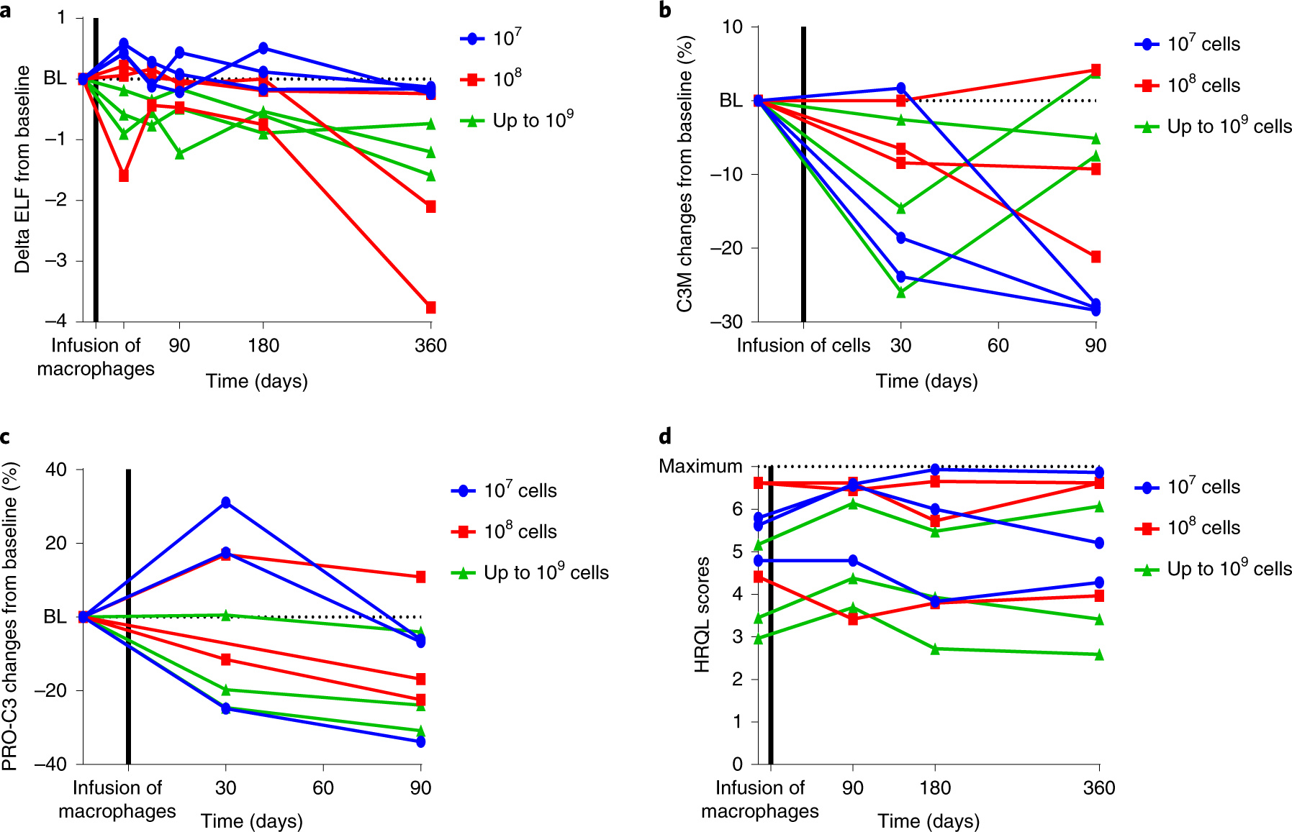
MATCH Phase 1: Autologous Macrophages
MELD Score per Cell Dose Group
Secondary Outcomes
10⁷
10⁸
Up to 10⁹
Moroni F et al. Nature Medicine 2019

Slide 51
MATCH Phase 2: Autologous Macrophages

Slide 52
Key Takeaways
1.- The biology of cirrhosis is related to the etiology of CLD and the prevalent pro-fibrogenic mechanisms
2.- The biology of cirrhosis influences the reversibility of tissue fibrosis and the achievement of therapeutic endpoints
3.- “Cirrhosis” is fully reversible only at a very early stage
4.- Reduction of fibrosis in a cirrhotic liver is a more realistic endpoint
5.- Treatment efficacy needs to translate into a significant reduction of portal pressure

Slide 53
