Slide 1

Terapie «bridge» e di combinazione con loco-regionale
Carlo Saitta
U.O.C. di Medicina ad Indirizzo Epatologico
A.O.U. di Messina

Slide 2
Terapie «bridge»
«Bridging»: treatment of accepted transplant candidates within Milan criteria while on the waiting list.
«Downstaging»: treatment used to bring patients whose tumour burden is outside accepted criteria for transplantation acceptable criteria.

Slide 3
Article
«Identification of an upper limit of tumor burden for downstaging in candidates with hepatocellular cancer waiting for liver transplantation: A West-East collaborative effort»
12 centres (Europe, US and Asia)
Intention to treat analysis using data available at first referral (3091 patients analyzed)
Identification of an upper limit of tumor burden for downstaging beyond which successful LT becomes an unrealistic goal.
Lai Q et al. Cancers 2020;12:452
Notes:
Paragonare al so-called “all-comers” policy

Slide 4
Article
«Are There Upper Limits in Tumor Burden for DOWN-STAGING of HCC to Liver Transplant? Analysis of the All-comers Protocol»
UCSF-DS criteria vs «all comers»
Successful DS to Milan in 64.8% of the AC group vs 84.2% of the UCSF-DS group (p<0.001)
The AC group had a significantly lower LT rate (13.5% vs 59.0%, p<0.001)
Sinha J et al. Hepatology 2019;70:1185-96

Slide 5
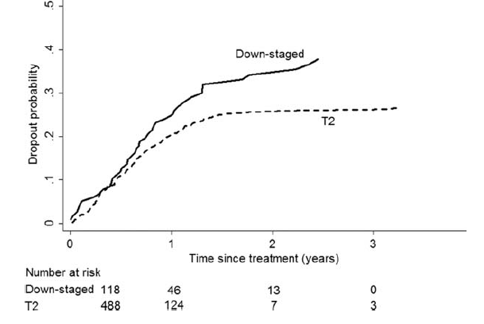
Article
Downstaging of Hepatocellular Cancer Before Liver Transplant: Long-Term Outcome Compared to Tumors Within Milan Criteria
Long term ITT outcome of
118 HCC patients undergoing DS
488 HCC patients
listed within Milan Criteria
P=0.04
Predictive drop-out factors: aFP > 1.000 (HR 2.42) CP B vs CP A (HR 2.19)
1 lesion > 5 and < 8 cm
2 or 3 lesions at least one > 3 and < 5 cm with total tumor diameter <8 cm
4-5 lesions each < 3 cm with total tumor diameter < 8 cm
Yao FY et al. Hepatology 2015;61:1968-77

Slide 6
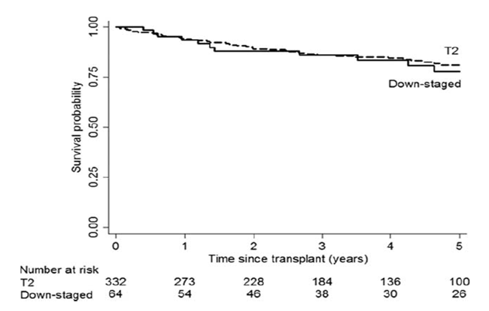
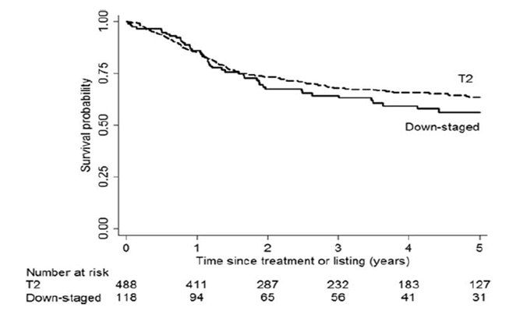
…
Fig. 1 Kaplan-Meier’s ITT survival probabilities of the downstaging group and the T2 group. Time zero represents the first downstaging treatment in the downstaging group and the time of listing for LT in the T2 group. The difference in survival was not statistically significant (P= 0.29)
Fig. 2 Kaplan-Meier’s post-transplant survival probabilities of tthe downstaging group and the T2 group. Time zero represents the date of LT in both groups. The difference in survival was not statistically significant (p=0.69)
Yao FY et al. Hepatology 2015;61:1968-77

Slide 7
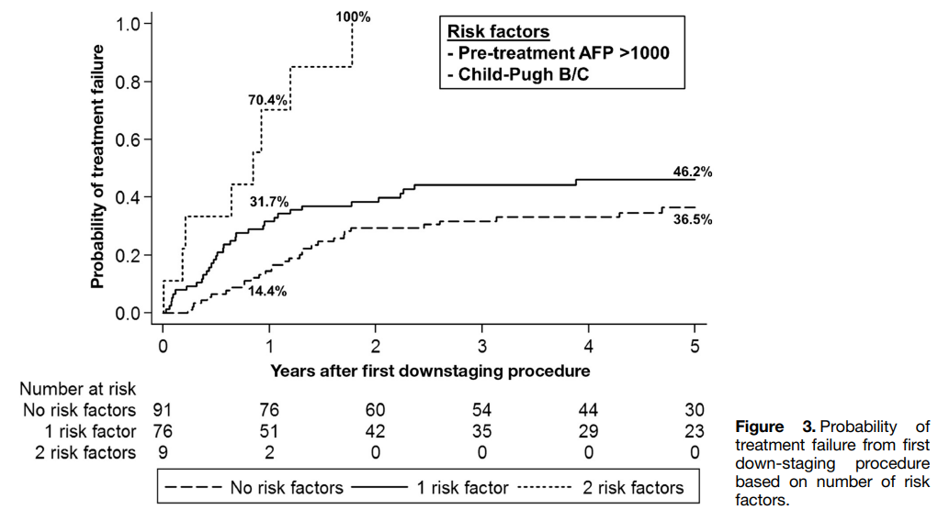
Article
“Excellent Outcomes of Liver Transplantation Following Down-Staging of Hepatocellular Carcinoma to Within Milan Criteria: A Multicenter Study
Retrospective multicenter study of 187 patients.
DS protocol: from UCSF-DS criteria to within Milan criteria.
Liver transplantation was performed after successful downstaging in 109 patients (58%).
Patients were removed from waitlist due to tumor progression in 59 cases (32%) or liver-related death without liver transplantation in 9 cases (5%).
Type of LRT performed: TACE 50.3%, TACE + RFA 43.3% RFA 6.4%.
Factors associated with treatment failure were pre-treatment levels of aFP >1000 ng/mL (HR 3.3; P < .001) and CP class B or C (HR 1.6; P < .001)
Mehta N et al. Clin Gastroenterol Hepatol 2018;16:955-64

Slide 8
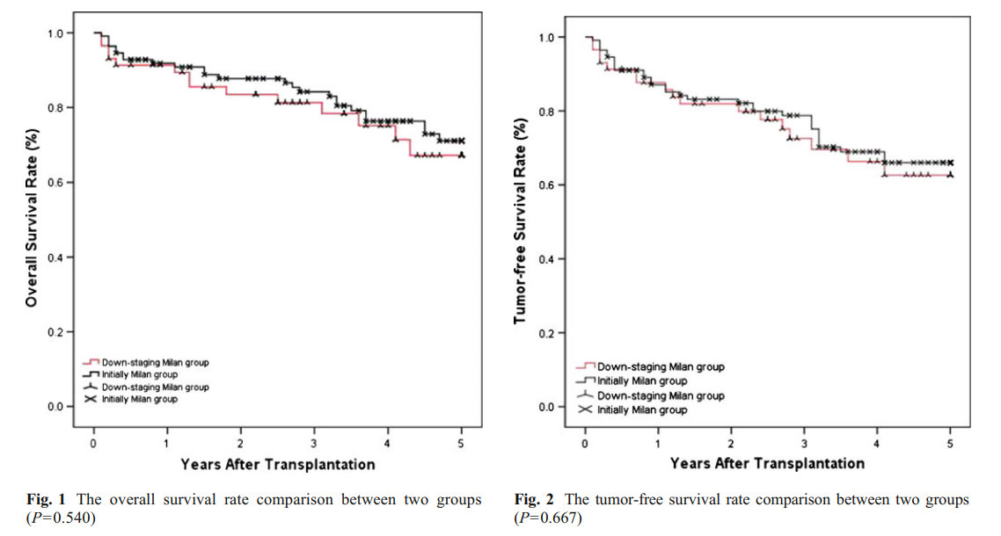
Article
“Downstaging Advanced Hepatocellular Carcinoma to the Milan Criteria May Provide a Comparable Outcome to Conventional Milan Criteria”
Lei J et al. J Gastrointest Surg 2013;17:1440-6

Slide 9
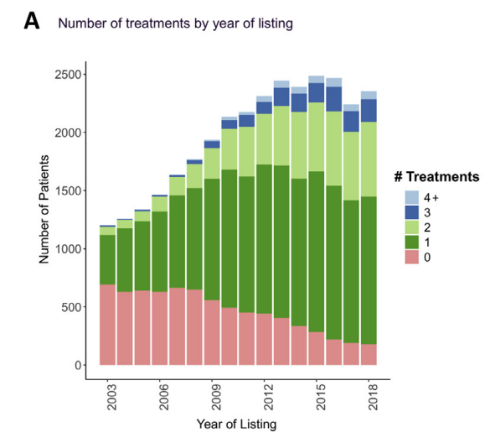
Article
“National Trends and Waitlist Outcomes of Locoregional Therapy Among Liver Transplant Candidates with Hepatocellular Carcinoma in the United States “
A mandated waiting time of 6 months before gaining exception points has been implemented in US. This policy change intentionally has lengthened waiting times for patients with HCC
All patients listed for HCC between 2003 and 2018 included 31,609 eligible liver transplant candidates
The proportion of patients with at least 1 LRT recorded increased from 42.3% in 2003 to 92.4% in 2018
…
Kwong AJ et al. Clin Gastroenterol Hepatol 2022;20:1142-50

Slide 10
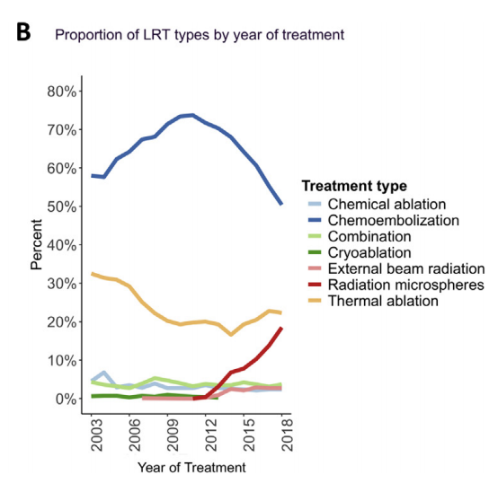
…
Increased incidence of LRT among patients with tumor burden beyond Milan criteria, higher aFP level, and more compensated liver disease.
Receipt of any type of LRT was associated with a lower risk of waitlist dropout; there was no significant difference by number of LRTs.
TARE or ablation as the first LRT were associated with a reduced risk of waitlist dropout compared with TACE
Chemoembolization remains the most frequent LRT, followed by thermal ablation, with a notable increase in TARE from 3% in 2013 to 19% in 2018.
Kwong AJ et al. Clin Gastroenterol Hepatol 2022;20:1142-50

Slide 11

Special Article HEPATOLOGY, VOL. 63, NO. 5, 2016
Squaring the Circle of Selection and Allocation in Liver Transplantation for HCC: An Adaptive Approach
Vincenzo Mazzafero
A minimal observation period after the conclusion of a given (combination) treatment is mandatory, because time is a surrogate of tumor aggressiveness and therefore an additional factor in the selection process.

Slide 12
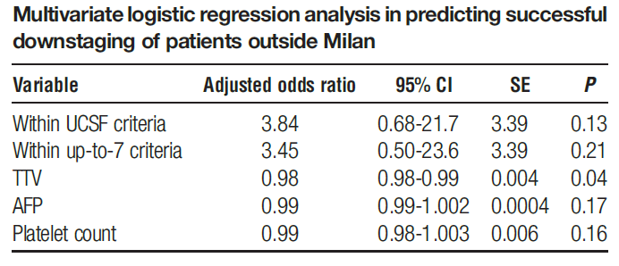
Article
Predictors of Successful Downstaging of Hepatocellular Carcinoma Outside Milan Criteria
Retrospective cohort study
90 patients Milano-out
59% successful DS, 31% fail DS
Murali AR et al. Transplantation 2016;100:2391-97

Slide 13
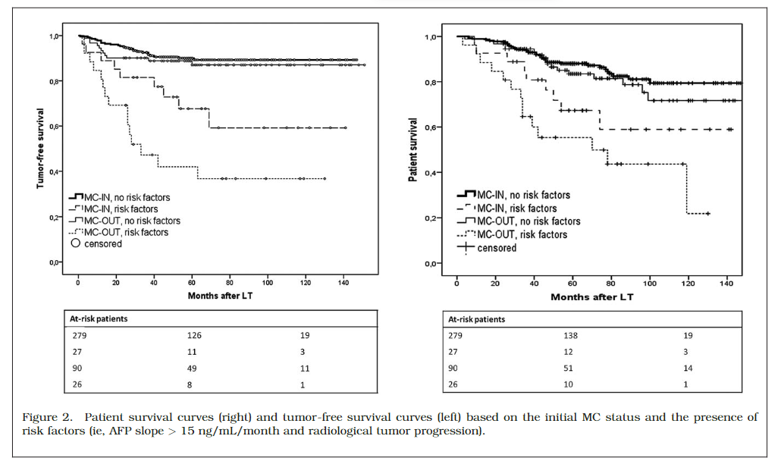

“Alpha-Fetoprotein and Modified Response Evaluation Criteria in Solid Tumors Progression After Locoregional Therapy as Predictors of Hepatocellular Cancer Recurrence and Death After Transplantation”
Lai Q. et al. Liver Transpl 2013;19:1108-18

Slide 14
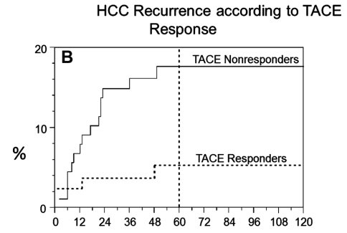
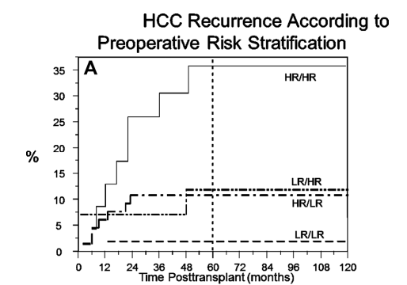
Article
Recurrence of Hepatocellular Carcinoma: Importance of mRECIST Response to Chemoembolization and Tumor Size”
P=0.01
HR/HR (Nonresponder/tumor size >3 cm)
HR/LR (Nonresponder/tumor size 3 cm)
LR/HR (Responder/tumor >3 cm)
LR/LR (Responder/tumor size 3 cm) group
Kim DJ et al. Am J Transplant 2014;14:1383-90

Slide 15
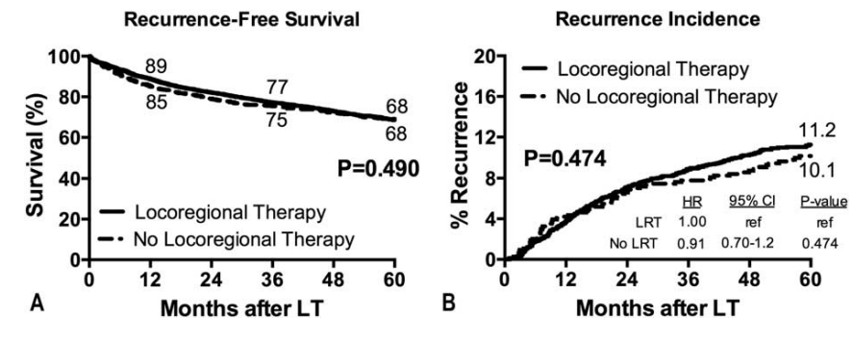
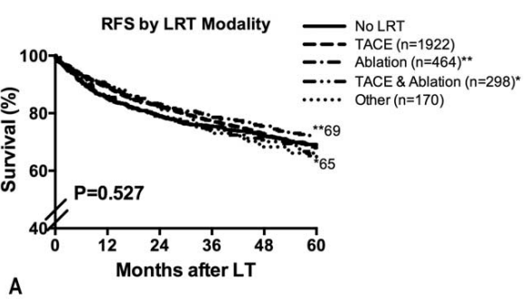
Article
“Impact of Pretransplant Bridging Locoregional Therapy for Patients With Hepatocellular Carcinoma Within Milan Criteria Undergoing Liver Transplantation”
Analysis of 3601 Patients from the US Multicenter HCC Transplant Consortium
…
Agopian VG et al. Ann Surg 2017;266:525-35

Slide 16
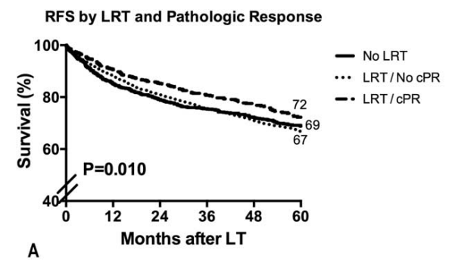
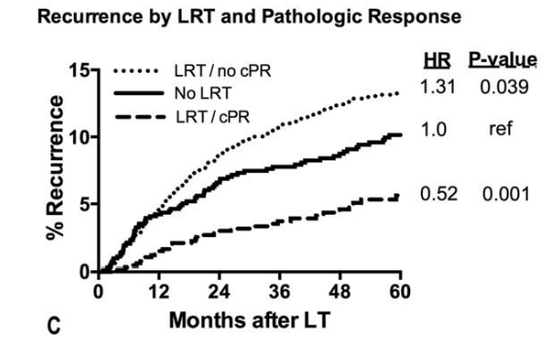
…
Agopian VG et al. Ann Surg 2017;266:525-35

Slide 17
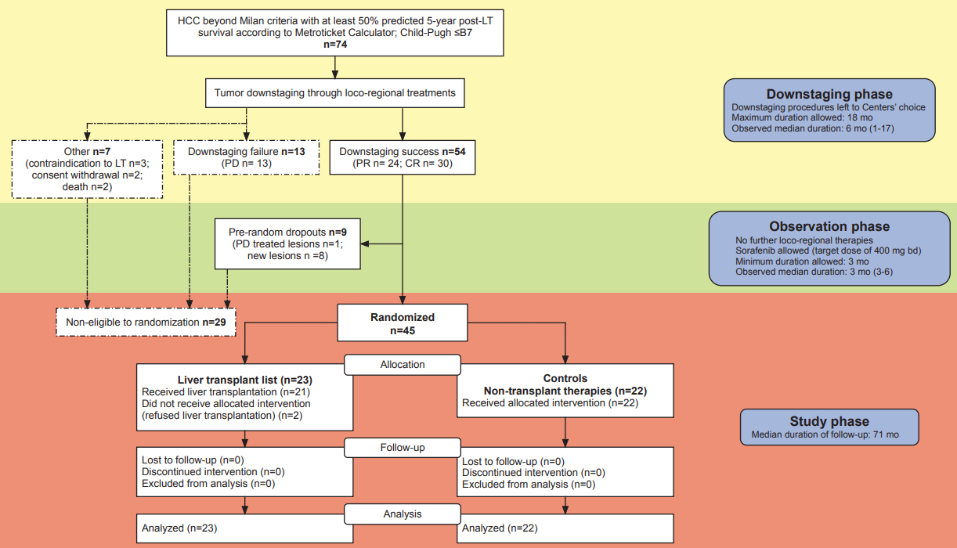
Liver transplantation in hepatocellular carcinoma after tumour downstaging (XXL): a randomised, controlled, phase 2b/3 trial
…
Mazzaferro V. et al. Lancet Oncol 2020; 21:947-56

Slide 18
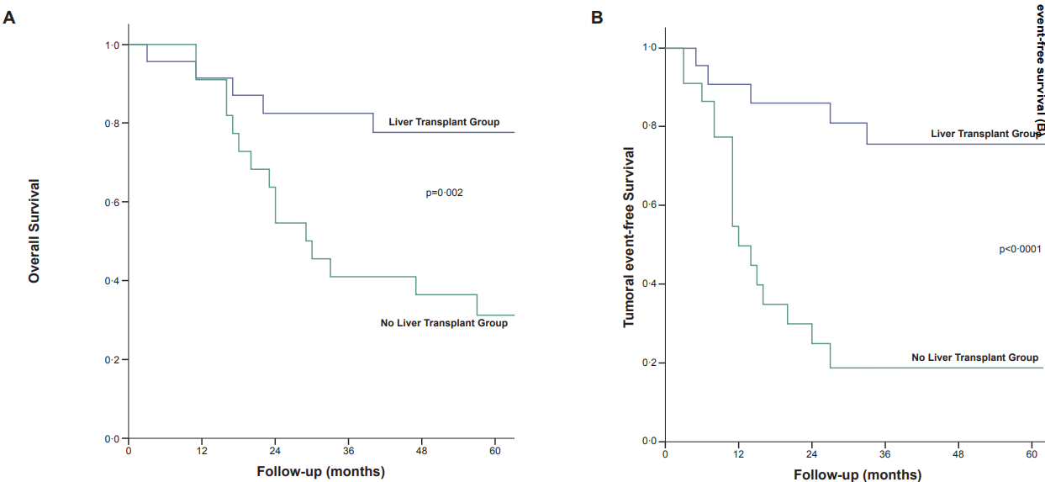
…
Mazzaferro V. et al. Lancet Oncol 2020; 21:947-56

Slide 19
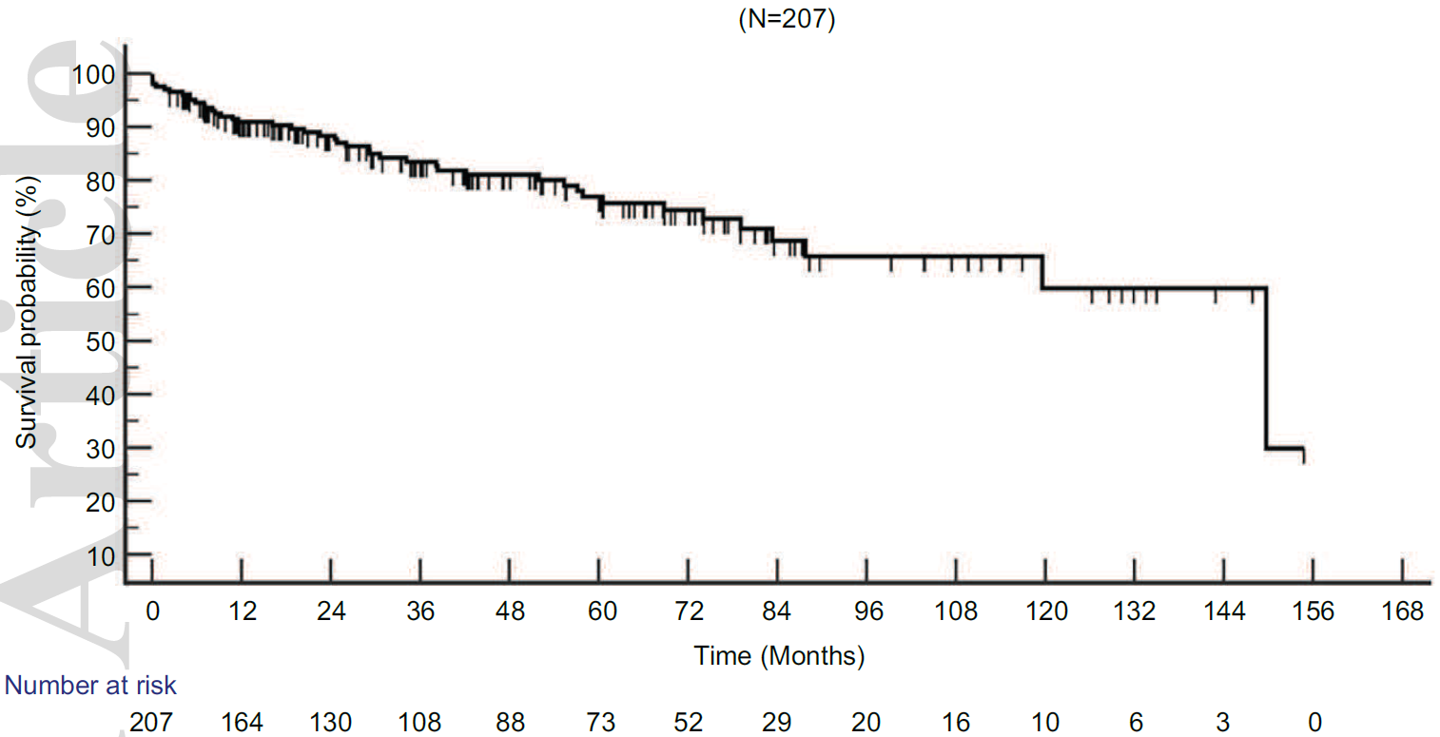
Liver Transplantation Following Yttrium-90 Radioembolization: 15-Year Experience in 207-Patient Cohort
207 patients TARE for downstaging/bridge to OLT
OS from LT 12.5 years
- 3 years OS rates were 84%.
- 5 years OS rates were 77%.
- 10 years OS rates were 60%.
24 pts developed recurrence with median RFS of 120 months
No differences in OS/RFS for bridged or downstaged patients
Gabr A et al. Hepatology 2021;73:998-1010

Slide 20
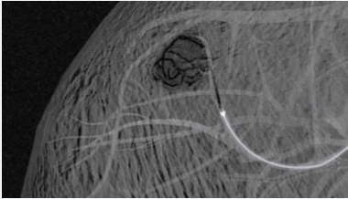
Article
“Y90 Radioembolization Significantly Prolongs Time to Progression Compared With Chemoembolization in Patients with Hepatocellular Carcinoma”
A longer TTP may result in a reduced drop-out rate from transplant waitlists
Salem R. et al. Gastroenterology 2016;151:1155-1163

Slide 21
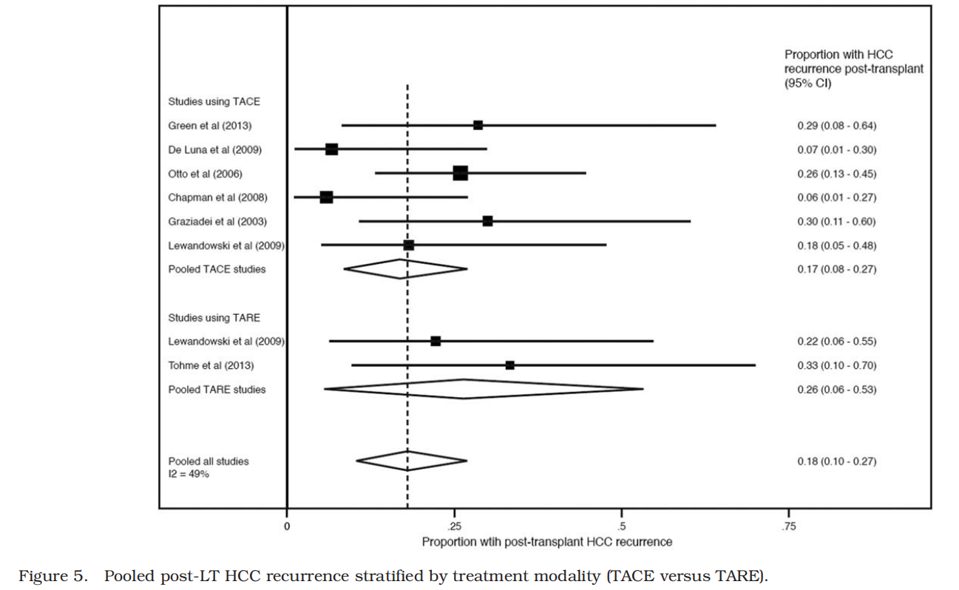
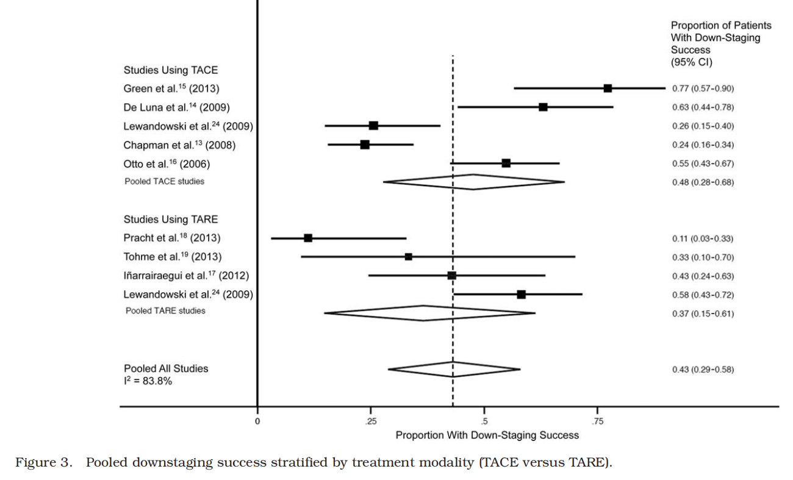
Article
“Downstaging Hepatocellular Carcinoma: A Systematic Review and Pooled Analysis”
Parikh ND et al. Liver Transplant 2015;21:1142-52

Slide 22
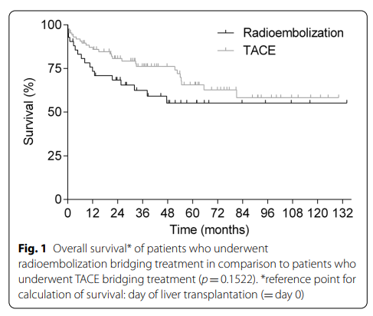
Article
“Bridging Treatment Prior to Liver Transplantation for Hepatocellular Carcinoma: Radioembolization or Transarterial Chemoembolization?”
131 patients treated with TARE (n.44) or TACE (n.87) neoadjuvant or DS
Increasing recipient age, male gender, complete tumor necrosis and absence of microvascular invasion were independently associated with decreased odds for HCC recurrence at multivariate analyisis
Increasing MELD score and tumor recurrence were independently associated with increased odds of post-transplant death
Benko T. et al. Eur J Med Res 2022;27:74

Slide 23
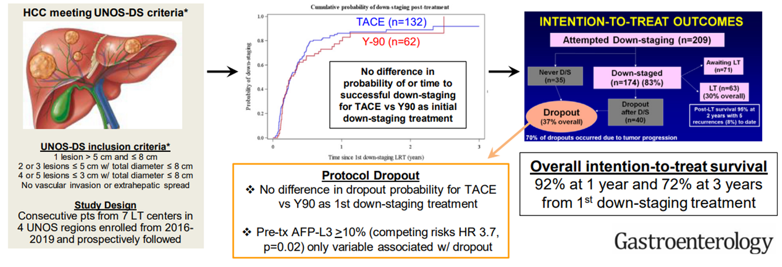
Article
Downstaging Outconmes for Hepatocellular Carcinoma: Results From the Multicenter Evaluation of Reduction in Tumor Size before Liver Transplantation (MERITS-LT) CONSORTIUM
Mehta N. et al. Gastroenterology 2021;161:1502-12

Slide 24
“Stereotactic body radiotherapy vs. TACE or RFA as a bridge to transplant in patients with hepatocellular carcinoma. An intention-to-treat analysis”
Aim: to ascertain the safety and efficacy of SBRT on an intention-to-treat basis compared with TACE and RFA as a bridge to liver transplantation.
379 patients were treated with
The drop-out rate was similar between groups
(16.7% SBRT group vs. 20.2% TACE group and 16.8% RFA group, p=0.7)
The 1,3 and 5-year actuarial patient survival from the time of listing was:
The 1, 3- and 5-year survival from the time of transplant was:
86%, 72% and 61% in the RFA group
95%, 81% and 73% in the RFA group
86%, 61% and 56% in the TACE group
96%, 75% and 69% in the TACE group
83%, 75% and 75% in the SBRT group
83%, 61% and 61% in the SBRT group
p=0.4
p=0.7
Sapisokin G. et al. J Hepatol 2017;67:92-99

Slide 25
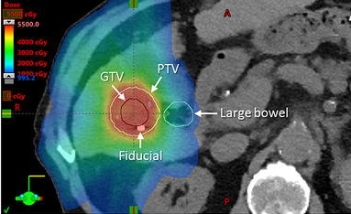
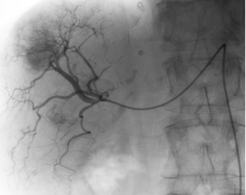
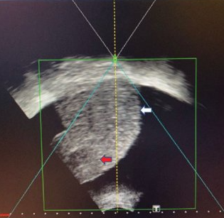
Article
“Prospective Study of Stereotactic Body Radiation Therapy for Hepatocellular Carcinoma on Waitlist for Liver Trtansplant”
150 patients evaluated
SBRT n. 40
TACE n. 59
HIFU n. 51
The tumor control rate at 1 year was significantly higher after SBRT compared with TACE and HIFU
(92.3%, 43.5%, and 33.3%, respectively P=0.02).
…
Wong TC. et al. Hepatology 2021;74:2580-94

Slide 26
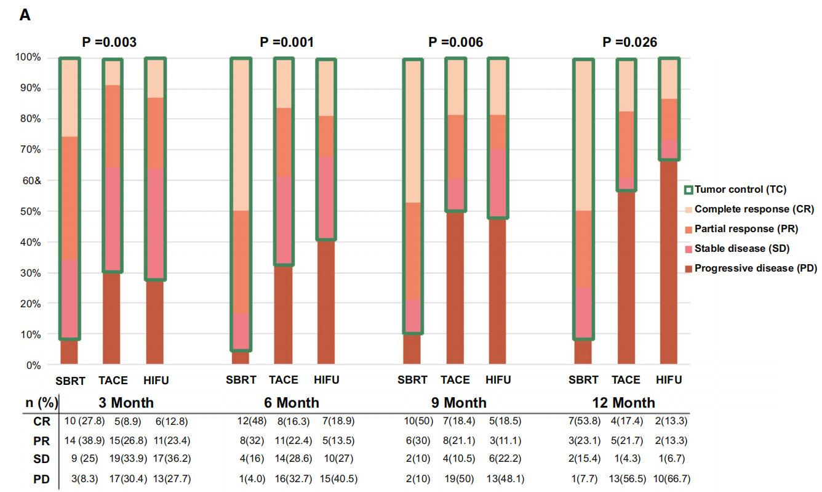
…
…
Wong TC. et al. Hepatology 2021;74:2580-94

Slide 27
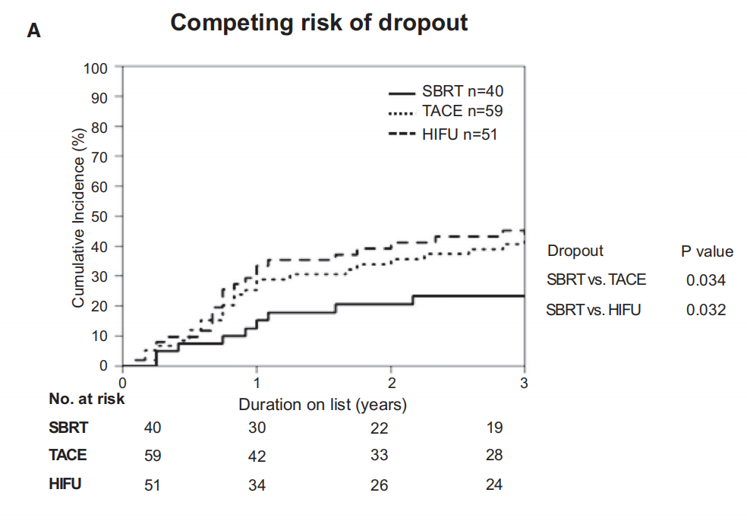
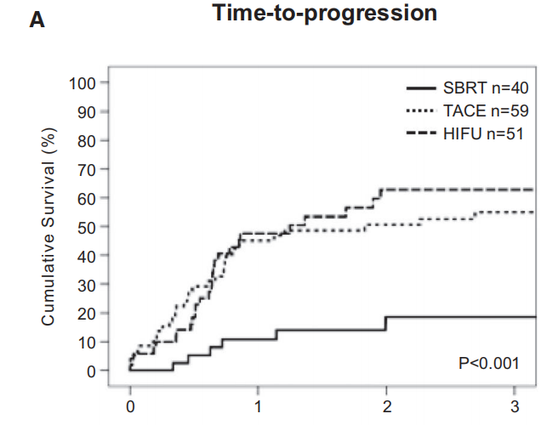
…
At multivariate analysis significantly reduced the risk of dropout
Tumor size <3 cm
CP class A
SBRT
alpha-fetoprotein <200 ng/mL
Wong TC. et al. Hepatology 2021;74:2580-94

Slide 28
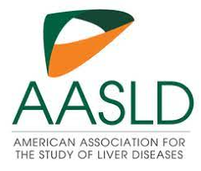
AASLD practice guidelines
Currently no one type of LRT is recommended over another for bridging therapy
AASLD does not recommend the routine use of systemic therapies as bridging therapy for transplantation; however, their use does not preclude LT eligibility.
Although immune checkpoint inhibitors (ICIs) can increase risk of rejection and graft loss, increasing case series suggest this practice is safe in some patients
Several questions remain including optimal time of discontinuation prior to LT, post-LT immunosuppression to reduce risk of early rejection, and any long-term sequelae of this approach.
If patients receive ICIs prior to LT, we recommend discontinuation of these agents at least 3 months prior to LT, while awaiting further safety data for use closer to the time of LT

Slide 29
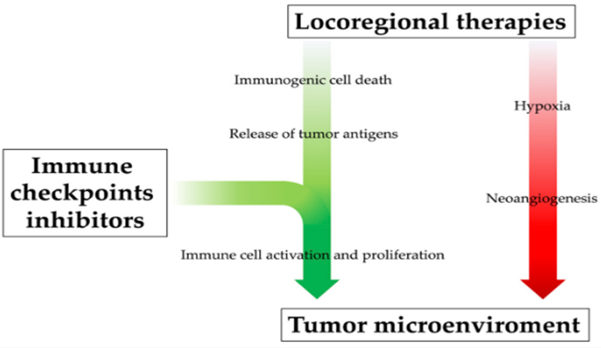
Rationale for combination of locoregional treatments and immunotherapy
Locoregional therapies can increase the level of pro-angiogenetic cytokines and promote neoangiogenesis
At the same time they promote systemic immune response by releasing neoantigens
The immunogical efficacy of locoregional treatments could be enhanced by their combination with immunoherapeutic drugs, positively influencing the tumor microenviroment.
Brandi N. et al. Int J Mol Sci 2023;24:8598

Slide 30
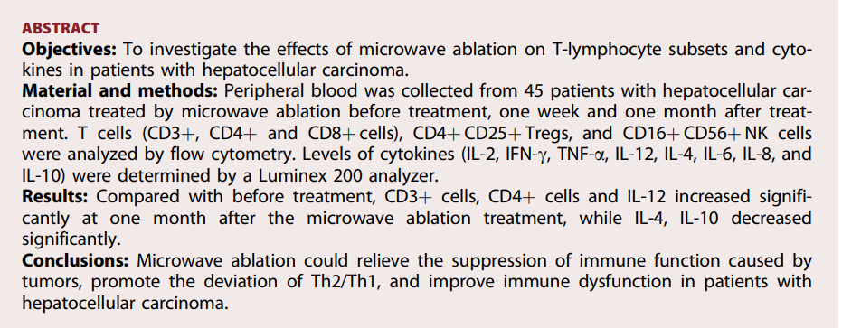
“Effects of microwave ablation on T-Cell subset and cytokines of patients with hepatocellular carcinoma”
Zhang H. et al. Minim Invasive Ther Allied Technol 2017;26:207-11

Slide 31
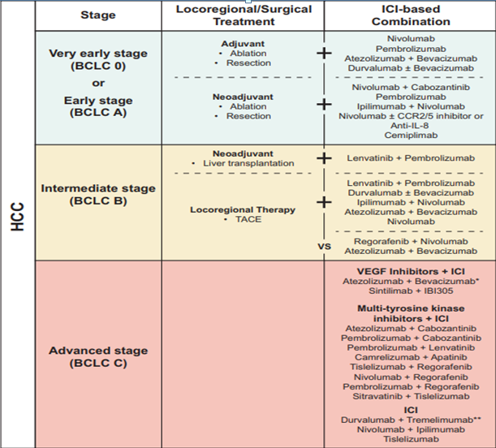

“Emerging immunotherapy for HCC: A Guide for Hepatologist”

Slide 32
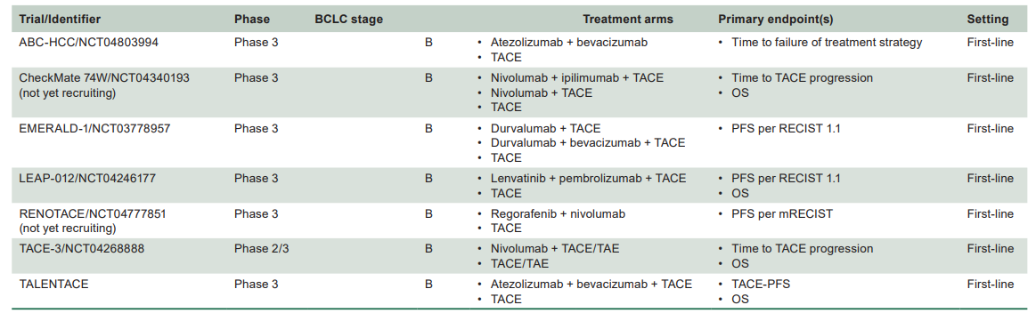
Phase 3 trials exploring combination of TACE and systemic treatment

Slide 33
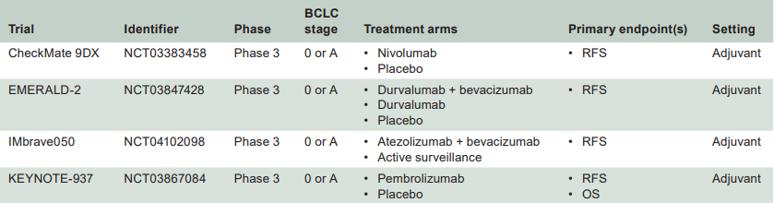
Clinical trials on adjuvant systemic immunotherapy after surgery or ablation

Slide 34
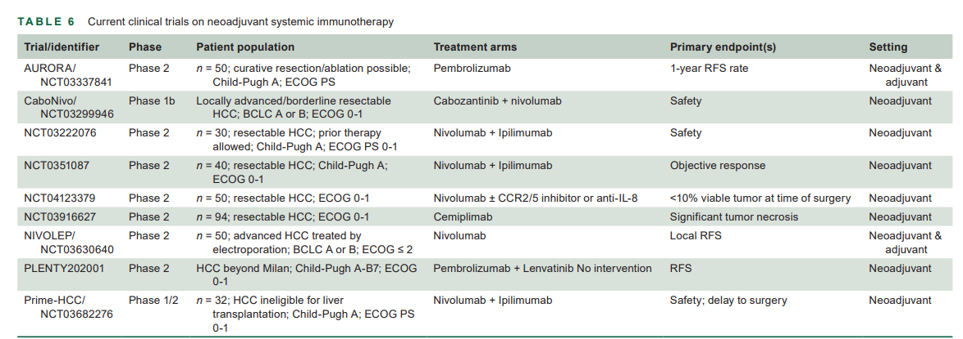
Clinical trials on neoadjuvant systemic immunotherapy

