Slide 1

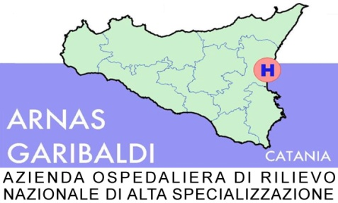
TAORMINA, 29-30 Maggio 2023
Impatto attuale e futuro delle malattie epatiche sulla popolazione generale.
Strategie di diagnosi e cure precoci
Maurizio Russello
UOSD EPATOLOGIA

Slide 2
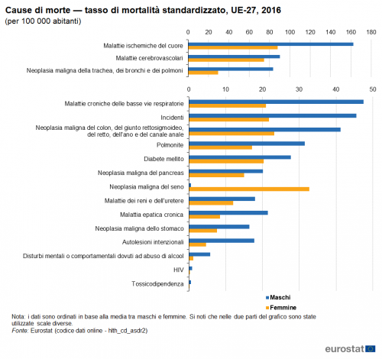
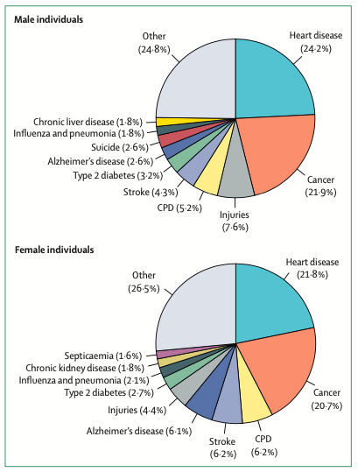
Percent Distribution of the Ten leading causes of Death,
by sex, in USA, 2017
Mauvais-Jarvis F, Lancet 2020
Notes:
In Europa le epatopatie sono al 6° posto nell’uomo escludendo incidenti e neoplasie
Anche in USA al 6° posto

Slide 3
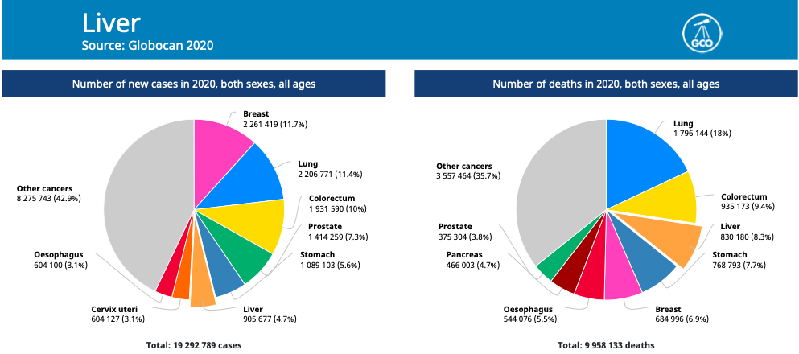
GLOBOCAN 2020
Notes:
Ritengo importante tracciare lo scenario attuale epidemiologico dell’hcc in un’era di passaggio da prevalenza di fattori di rischio virali verso fattori di rischio metabolici, allo scopo di attuare strategie di screening e sorveglianza adeguate alle mutate condizioni epidemiologiche.

Slide 4
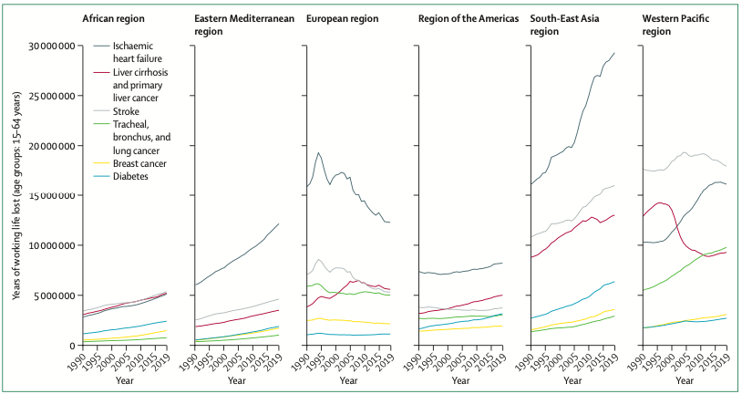
Anni di vita lavorativa persi per principali cause di malattia
2°
Karlsen TH, Lancet 2022

Slide 5
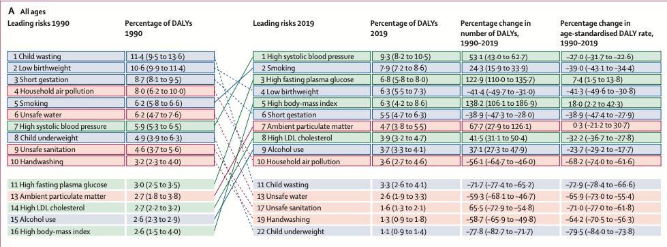
Global Burden of leading risk factors, 1990-2019
GBD 2019 Risk Factors Collaborators, Lancet 2020

Slide 6
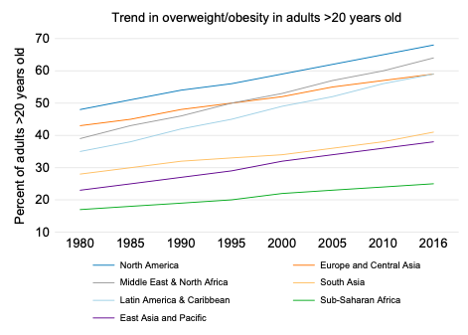
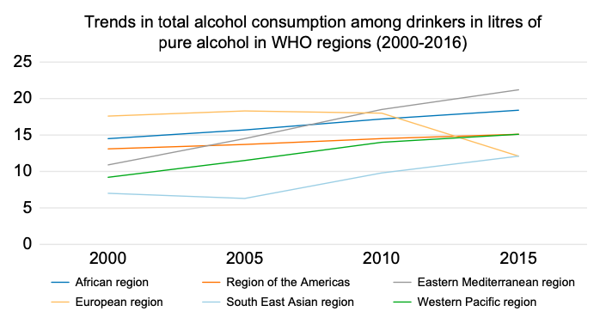
Trends in overweight/obesity and alcohol consumptions by geografical region
Impact of COVID-19
Shekar M, Popkin B. Obesity: health and economic consequences of an impending global challenge. 2020; https://openknowledge.worldbank. org/handle/10986/32383.
Global status report on alcohol and health. 2018; https://www.who.int/ publications-detail-redirect/9789241565639.
Notes:
Indagine precedente il covid

Slide 7
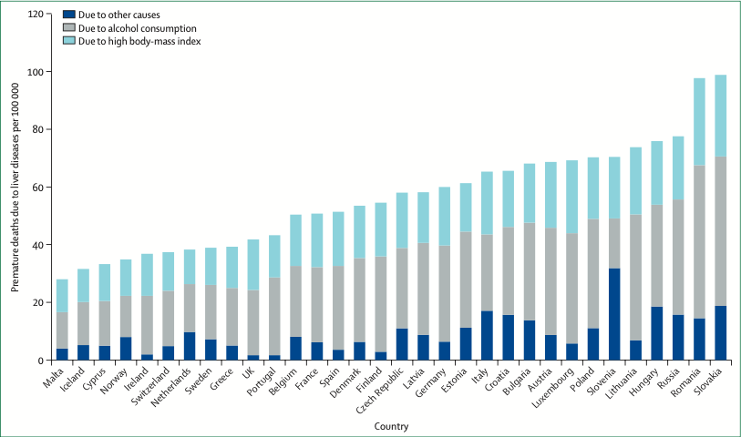
Premature deaths due to liver disease according to cause
Average 2020-2050 (calculated by OECD Strategic Public Health Planning)
Karlsen TH, Lancet 2022
Notes:
Oecd: organizzazione per la cooperazione economica e per la pianificazione di strategie politica sanitaria

Slide 8
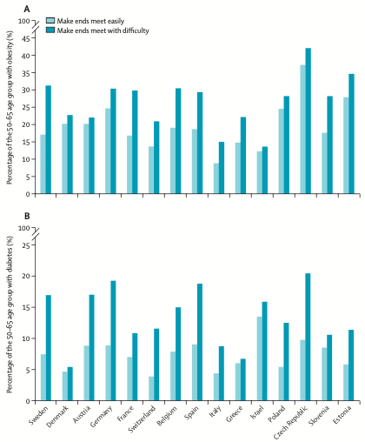
Obesity and T2DM by socioeconomic status
Karlsen TH, Lancet 2022

Slide 9
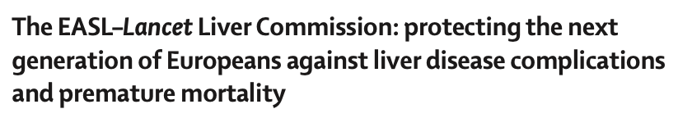
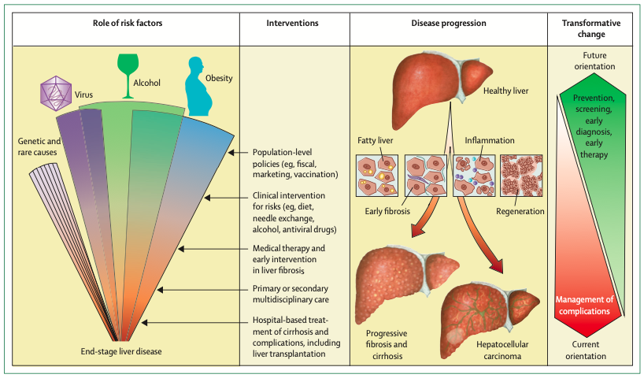
Karlsen TH, Lancet 2022

Slide 10
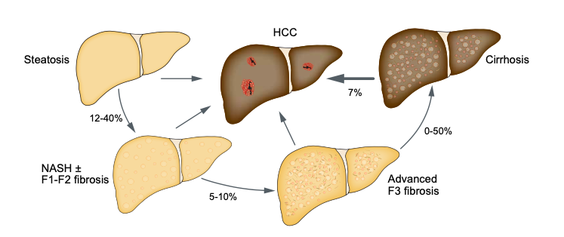
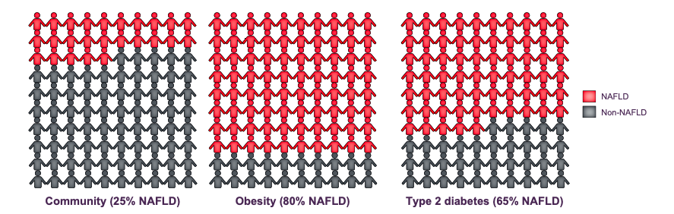

Prevalence of NAFLD in European Adults
Francque SM, JHEP Rep 2022

Slide 11
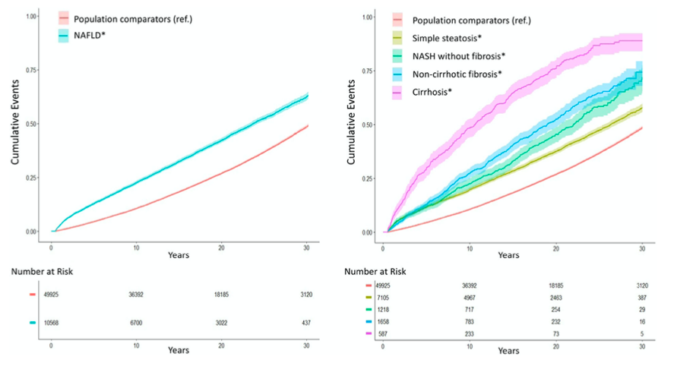
Cumulative incidence of all-cause mortality according to
the presence and histologic severity of NAFLD
Simon TG, Gut 2021

Slide 12
Modeling NAFLD disease burden in Italy between 2016-2030
210,000
440,000
- Aging population
- Rising prevalence of DM and obesity
Estes C, J Hepatol 2018

Slide 13
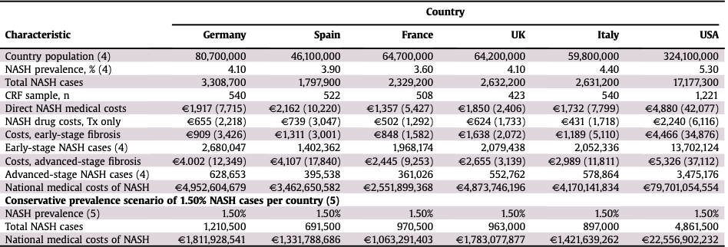
Costs of NASH in Europe and the USA
GAIN study
A retrospective real-world data on direct (medical and non-medical) and indirect costs associated with NASH
in Europe and USA
O’Hara J, JHEP Rep 2020

Slide 14
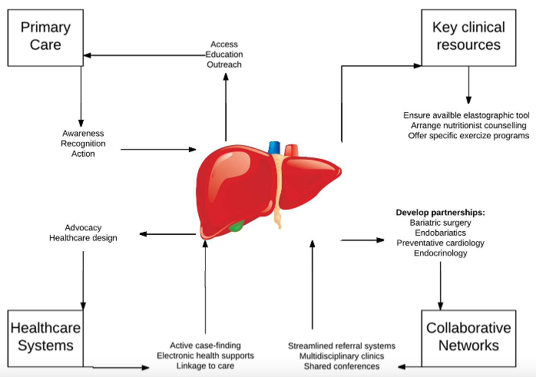
The central role of the Hepatologist in the fight against NAFLD
Tapper EB, Hepatology 2019

Slide 15
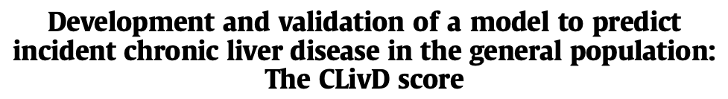
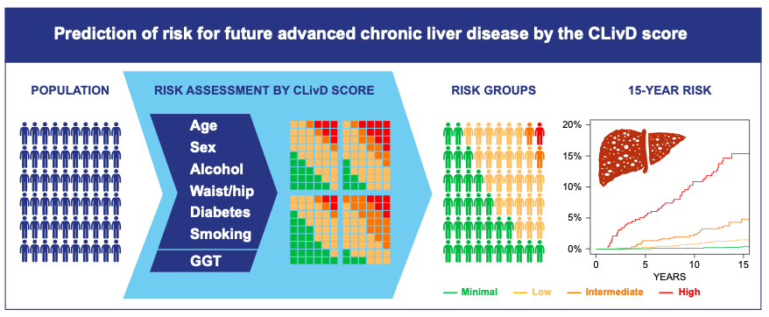
> 10 %
< 0.05 %
Aberg F, J Hepatol 2022
Notes:
Coorte di validazione: whitehall II registro di popol servizio civile; coorte ricavata da registro di abitanti di copenhagen

Slide 16
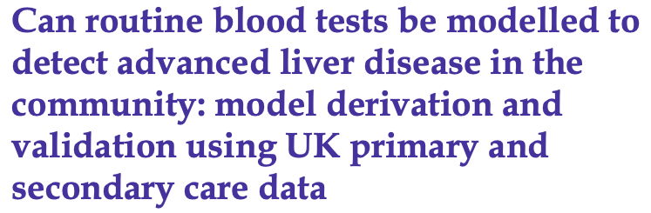
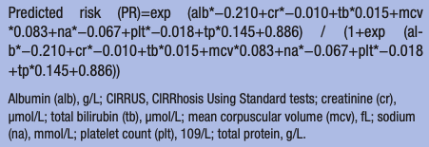
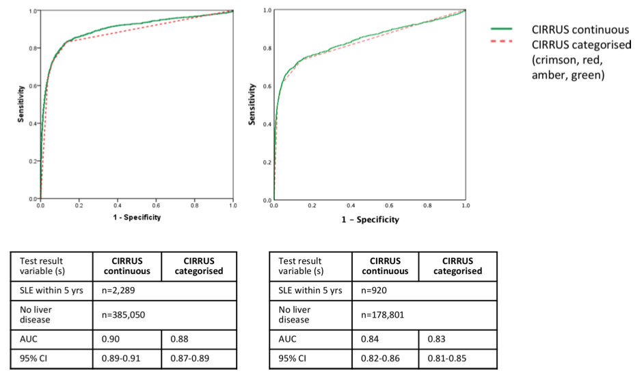

Hydes T, BMJ 2021

Slide 17
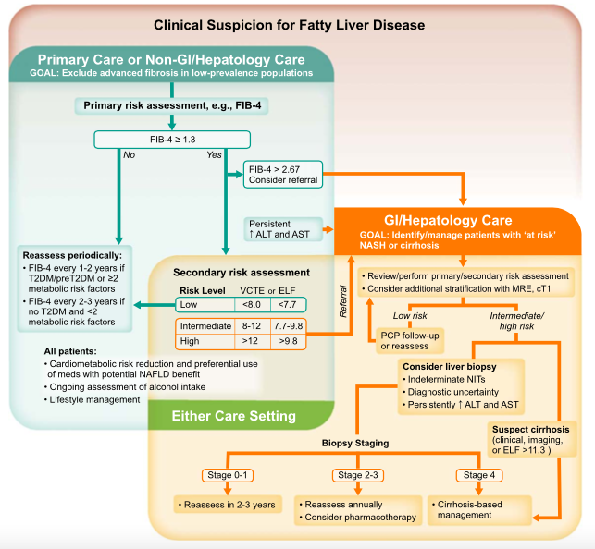
Algorithm for the evaluation of patients at risk
Rinella ME, AASLD CPG, Hepatology 2023

Slide 18
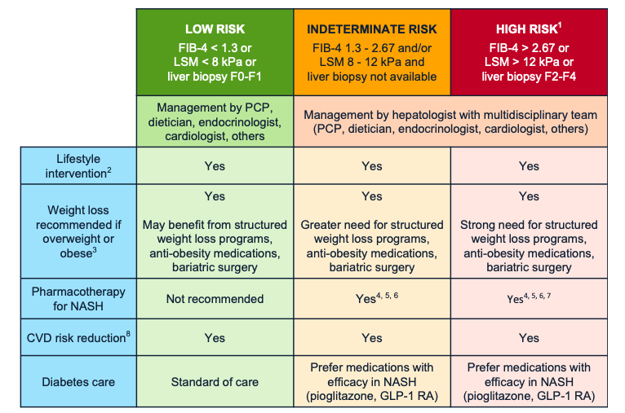
Management of NAFLD/NASH by risk
Kanwal F, Gastroenterology 2021

Slide 19
The central role of the Hepatologist in the fight against NAFLD
Tapper EB, Hepatology 2019

Slide 20
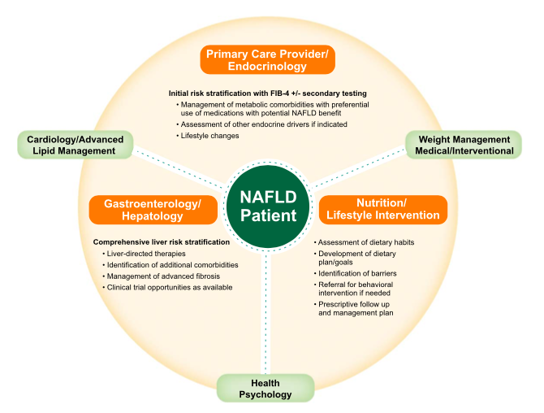
A multidisciplinary approach to patients with NAFLD
Rinella ME, AASLD CPG, Hepatology 2023

Slide 21
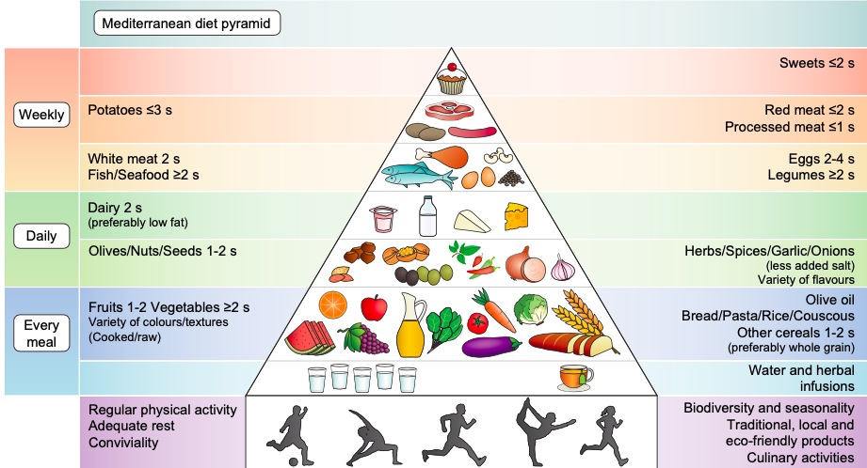

Slide 22
The central role of the Hepatologist in the fight against NAFLD
Tapper EB, Hepatology 2019

Slide 23

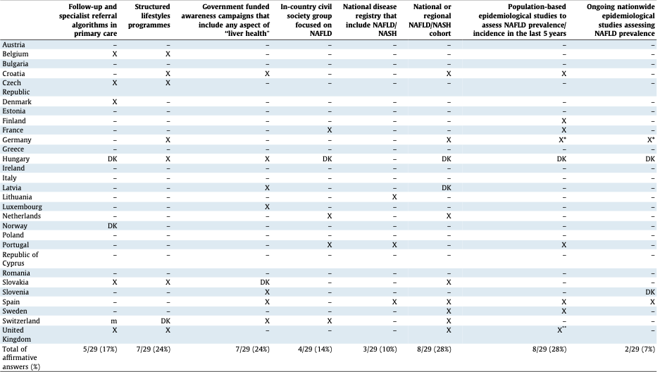
Lazarus JV, J Hepatol 2020

Slide 24
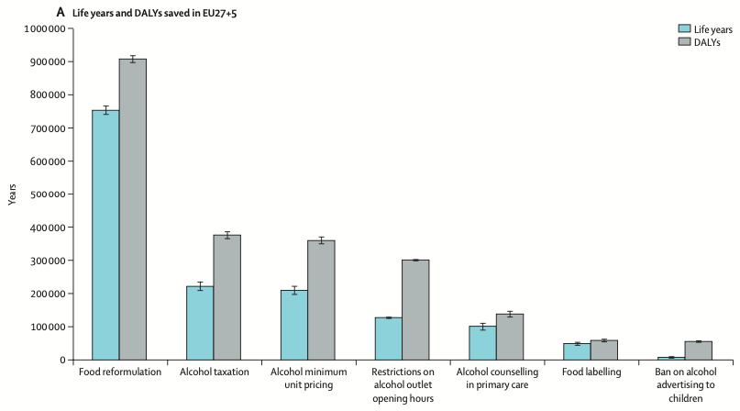
Health impact of different health policies
calculated by OECD Strategic Public Health Planning
Karlsen TH, Lancet 2022

Slide 25
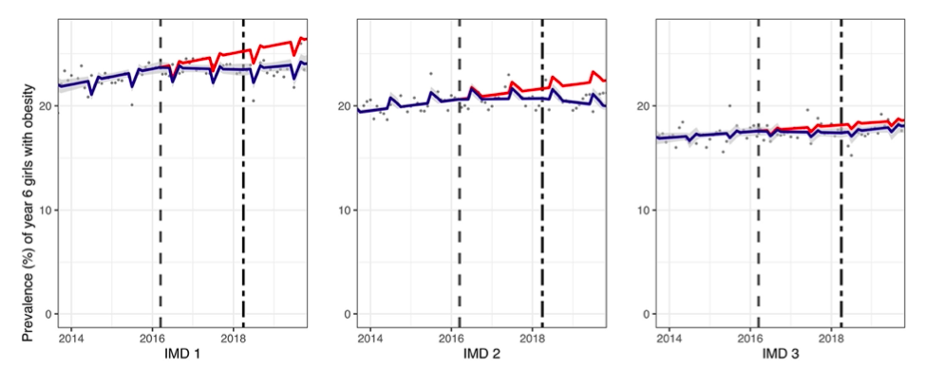
Observed and modelled prevalence of childhood obesity in UK
between 2014-2020
Soft drinks industry levy
Index of Multiple Deprivation (IMD)
Rogers NT, PLoS Med 2023

Slide 26
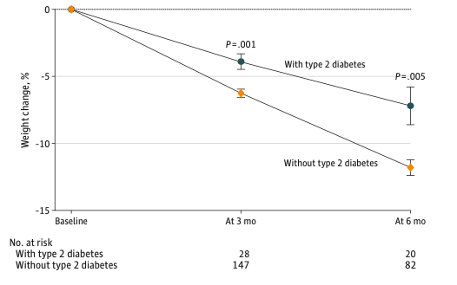
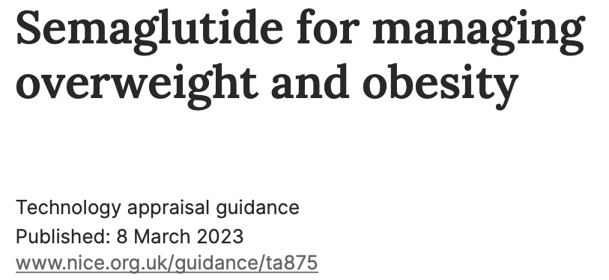
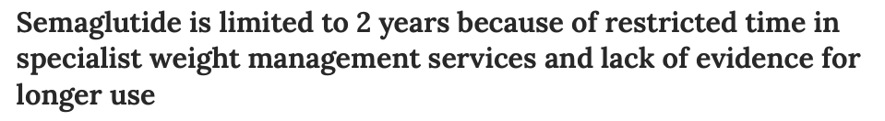
Guhsn W, JAMA 2022

Slide 27
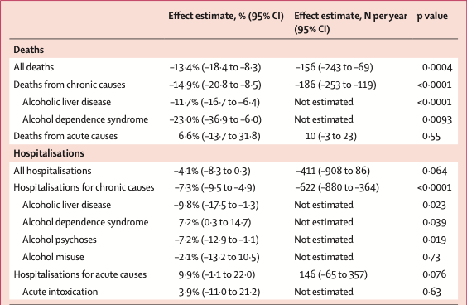
Impact of alcohol minimum unit pricing on deaths and hospitalisations in Scotland
Wyper GMA, Lancet 2023

Slide 28

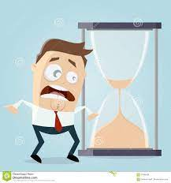
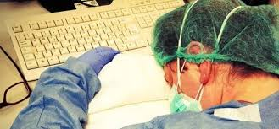
Grazie per l’attenzione
U.O.D. EPATOLOGIA
Mariarita Cannavò
Caterina Cocuzza
Roberto Faulisi
Maria Cristina Sapere
Martina Tavarelli
Alessandro Bellia
«we need to organize, build a team, and fight»
Tapper and Loomba, Hepatology 2019

