Slide 1
Progressive Familial Intrahepatic Cholestasis from childhood to adulthood….
Marco Sciveres MD
Epatologia pediatrica e trapianto di fegato
ISMETT IRCCS

Slide 2
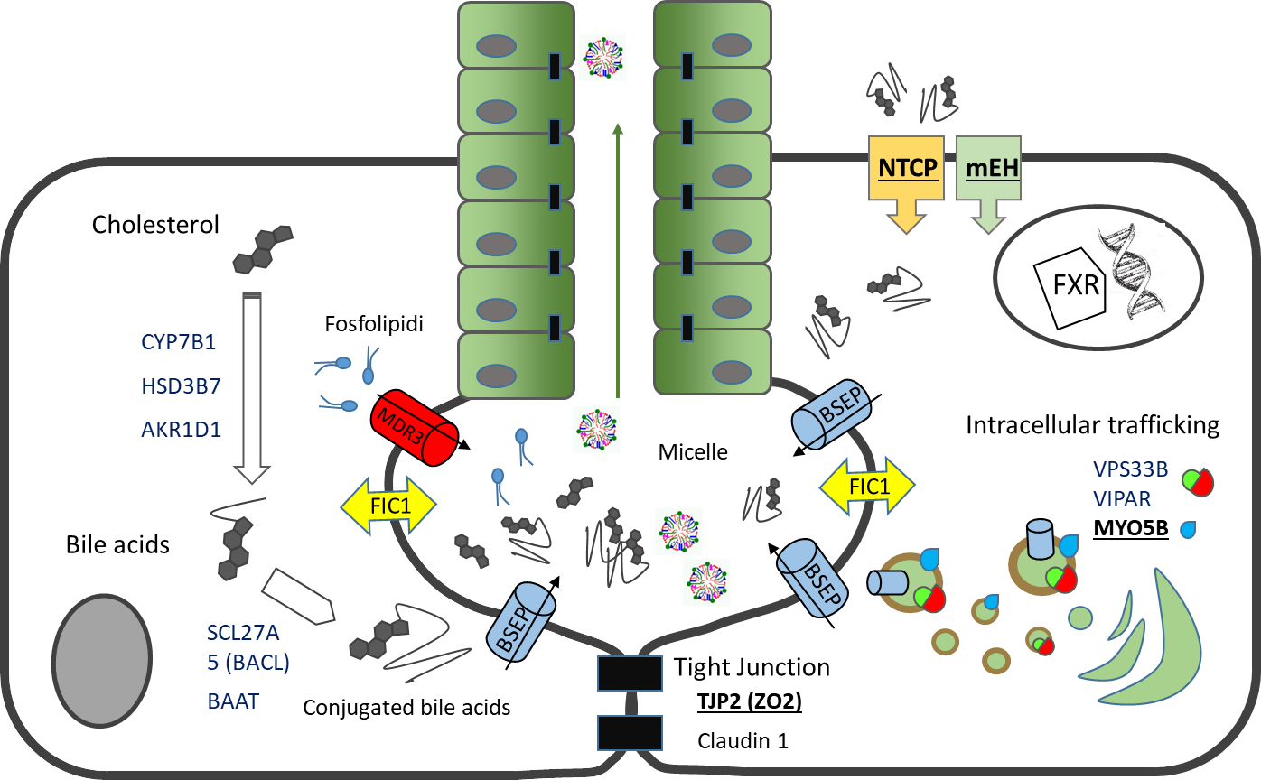
Bile acids metabolism
Figure developed by Dr Sciveres.

Slide 3
Enterohepatic circulation
The bile acid pool is 2–3g with
4–6 cycles per day
Only 5% of bile acids are lost
with stools
SLC10A2/ASBT
OSTα/OSTβ
Bile
Portal blood
SLC10A1/NTCP
ABCB11/BSEP
EPHX1/mEH
OATPB1/B3
OSTα/OSTβ (?)

Slide 4
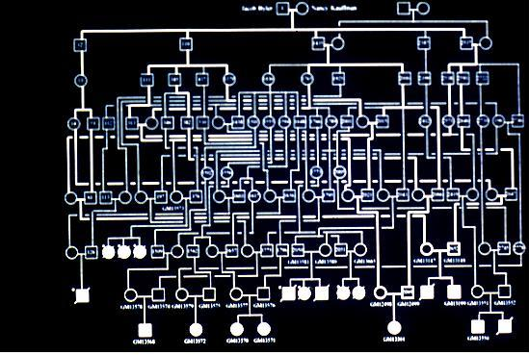
Byler disease
Jacob Byler
Nancy Kaufman
Image courtesy of Prof. Jauquemin.

Slide 5
PFIC?
Progressive – the disease worsens over time
Familial – represents a group of hereditary disorders
Intrahepatic – occurring within the liver/hepatocellular
Cholestasis – Impaired secretion/flow of bile
PFIC is an umbrella term to refer to different types of familial intrahepatic cholestatic diseases. Although these diseases may have overlapping symptoms, they are unique and may differ in their prognosis

Slide 6
PFIC is a generic term to refer to different types of familial intrahepatic cholestatic diseases
 | Gene name (protein)
PFIC1 | ATP8B1 (FIC1)
PFIC2 | ABCB11 (BSEP)
PFIC3 | ABCB4 (MDR3)
PFIC4 | TJP2 (TJP2)
PFIC5 | NR1H4 (FXR)
PFIC6 | SLC51A (OSTα)
PFIC7 | USP53 (USP53)
PFIC8 | KIF12 (KIF12)
PFIC9 | ZFYVE19 (ZFYVE19)
PFIC10 | MYO5B (MYO5B)
PFIC11 | SEMA7A (SEMA7A)
PFIC12 | VPS33B (VPS33B)
Different mechanisms of disease
Non functional transporters
Impaired intracellular trafficking
leaking tiight junctions
Ciliopathies

Slide 7
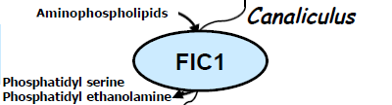
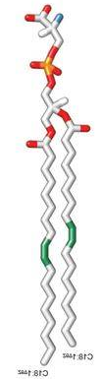
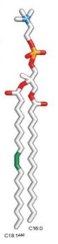
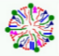

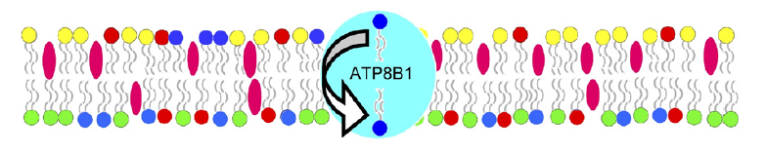
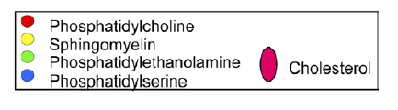
Progressive familial intrahepatic cholestasis type 1 (PFIC1)
Plasma membranes have an asymmetric phospholipid composition. This asymmetry is important for the barrier function of the membrane, to protect against high bile salt concentrations in the canalicular lumen
ATP8B1 works in synergy with ABCB4 allowing BS-mediated extraction of PC to the lumen while maintaining the integrity of the canalicular membrane.
ATP8B1 is essential for the normal functioning of several transporters, such as CFTR and (potentially) BSEP.
MDR3
FIC1
MDR3
FIC1
CFTR
FIC1
Figure developed by Dr Sciveres.
Figure from Groen A, et al. Gastroenterology 2011;141:1927–1937.¹

Slide 8
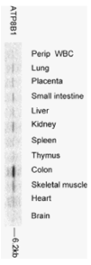
Progressive familial intrahepatic cholestasis type 1 (PFIC1)
ATP8B1 has ubiquitous expression
PFIC1 is a systemic disease
Extrahepatic symptoms
  Diarrhoea, especially post-OLTx
  Failure to thrive
  Pancreatic abnormalities
  Deafness
  Abnormal sweat test
Phenotype of liver disease: Chronic cholestasis
  Low γGT activity
  Pruritus, from moderate to severe
  Various degrees of fibrosis
Figure courtesy of Prof. Gonzales.

Slide 9
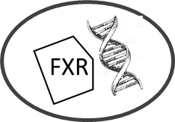


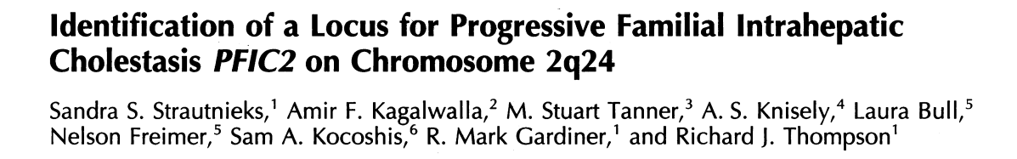

Progressive familial intrahepatic cholestasis type 2 (PFIC2)
ATP-binding cassette sub-family B member 11 (ABCB11) gene mutations cause PFIC2
Bile Salt Export Pump (BSEP) malfunction leads to impaired bile salt transport into the canaliculus and accumulation in hepatocytes
Low biliary bile salt does not allow a normal bile flow and exacerbates cholestasis
FIC1

Slide 10
Progressive familial intrahepatic cholestasis type 2 (PFIC2)
ABCB11 has only liver expression
Simple pathogenetic model
Phenotype of liver disease: Chronic cholestasis
  Low γGT activity
  Pruritus, usually severe
  Various degree of fibrosis
  High lithogenic bile
  High risk of carcinogenity
Clear relationship between residual BSEP function and disease severity
Mild or heterozygous mutations may result in other manifestations including episodic phenotype (BRIC), transient neonatal cholestasis, DIC, and low γGT ICP

Slide 11
Low γGT PFIC (PFIC1, PFIC2): Common features
Clinical: Jaundice, cholestasis, pruritus
Phenotypical variants: Episodic disease (BRIC), low γGT ICP, etc.
Biochemical: Low γGT activity, high serum bile acids
Bile biochemistry: Low concentration of bile acids:
(PFIC1: 3–7 mmol/L; PFIC2 <1 mmol/L)
Histological: Intracellular and canalicular cholestasis, biliary metaplasia, scarce ductular proliferation, various degrees of fibrosis, giant cells
Imaging: Normal biliary tree
Outcome: Possible evolution to biliary cirrhosis

Slide 12
Low γGT PFIC (PFIC1, PFIC2): Differences
 | PFIC1 | PFIC2
Cholestasis onset | Early infancy | Usually neonatal
Progression to ESLD | Late or absent | Early
Extrahepatic signs | Common | Absent
Lipophilic vitamins deficit | Unusual | Possible
Cholelithiasis | Absent | Common (30%)
ALT | 2–3 x N | 8–10 x N
AFP | ↑ (8 x N) | ↑↑↑ (36 x N)
Risk of liver cancer | Low | Very high

Slide 13
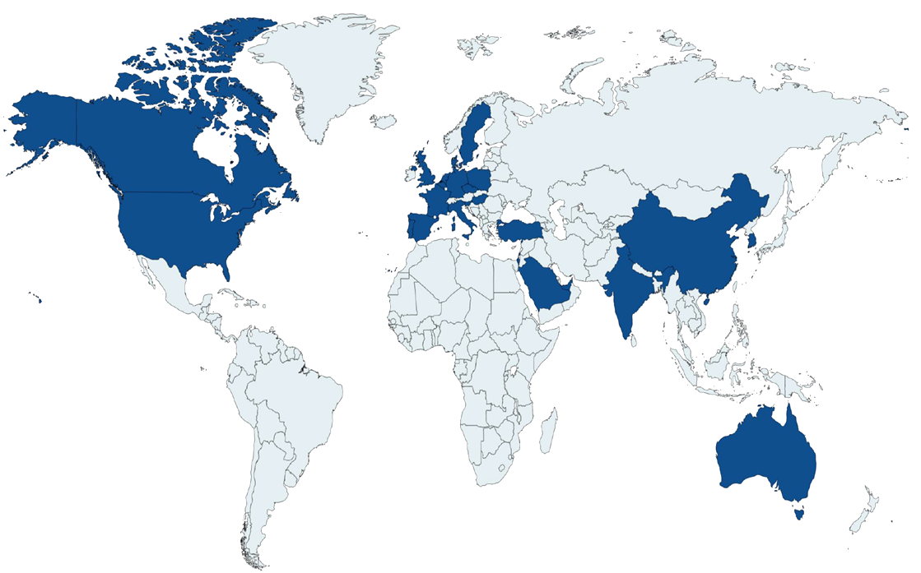

PFIC: Natural history
NAtural course and Prognosis of PFIC and Effect of biliary Diversion (NAPPED) Consortium
Retrospective data collection from 68 referral centres from Europe, North America, South America, Africa, Asia, and Australia
759 patients with low γGT phenotype (August 2020)

Slide 14
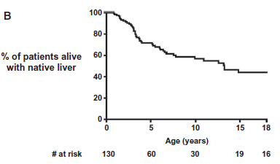
PFIC1: Patient survival with native liver
Proportion of patients alive with native liver
Figure from van Wessel DBE, et al. Hepatology 2021;74:892–906.¹

Slide 15
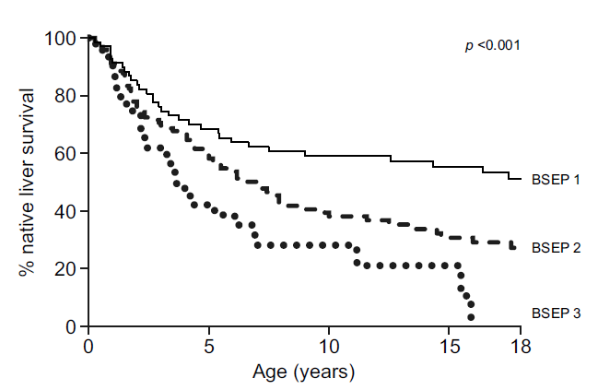
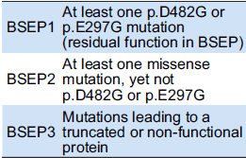
PFIC2: Patient survival with native liver
Proportion of patients alive with native liver
Figure from van Wessel DBE, et al. J Hepatol 2020;73:84–93.¹

Slide 16
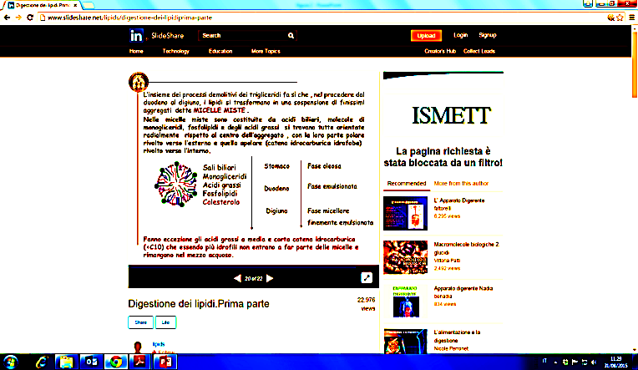
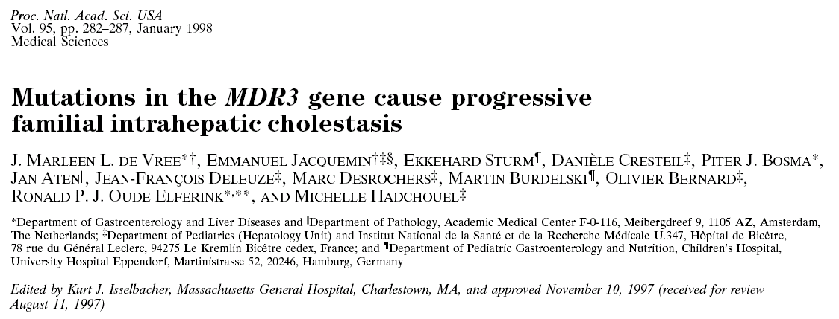
Progressive familial intrahepatic cholestasis type 3 (PFIC3)
Biallelic mutations in ABCB4 cause PFIC3, also known as multi-drug resistance protein 3 (MDR3) deficiency
ABCB4 encodes MDR3, the primary transporter of phospholipid into bile
The lack of phospholipids causes the formation of toxic micelles, because of the detergent effects of hydrophobic bile salts in the absence of phospholipids, and finally injury to the biliary epithelium
MDR3

Slide 17
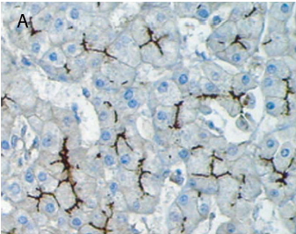
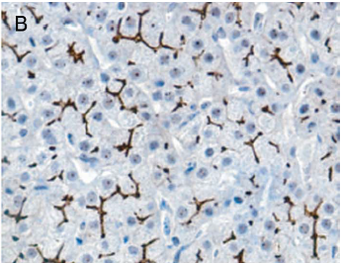
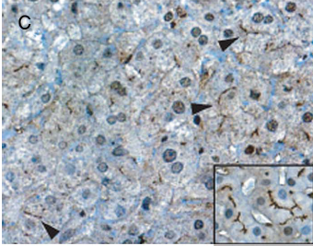
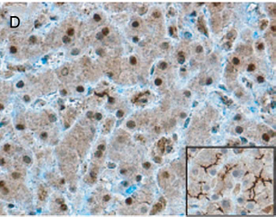
PFIC3: Clinical features
Onset of cholestasis in late infancy, childhood, or in young adulthood; signs of cholestasis are noted within the first year of life in only a third of patients
Patients present with jaundice, pruritus, signs of portal hypertension, and chronic (PFIC) or episodic (BRIC) cholestasis
High γGT activity, high serum bile acids
Low bile acid and very low phospholipids in bile
At liver biopsy: cholangitis with ductular proliferation, portal infiltrate, various degrees of fibrosis and MDR staining
Normal bile tree imaging
Evolution in most cases in advanced liver disease, correlation with residual MDR activity
Control
Patient
Patient
Figure adapted from Gordo-Gilart R et al. Gut 1015;64:147–155.
Patient

Slide 18
PFIC3: Natural history
PFIC3
Around 250 patients described
Colombo et al. 2011
28 patients
Median FU: 72 months
UDCA responders: 37%
1 death, 5 OLTx
Schatz SB et al. 2018
26 patients
FU: Unknown
Median age: 8.9 years
UDCA non-responders: 15%
16 OLTx
UDCA
Responders (60%)
Non-responders
Follow-up >10 years
Liver transplant
Mean age 9.6 years
Range (2.5–30 years)
50%
Biliary cirrhosis
Portal hypertension
50%
Mild chronic liver disease
1 HCC
Davit-Spraul A, et al. Semin Liver Dis 2010;30:134–146

Slide 19


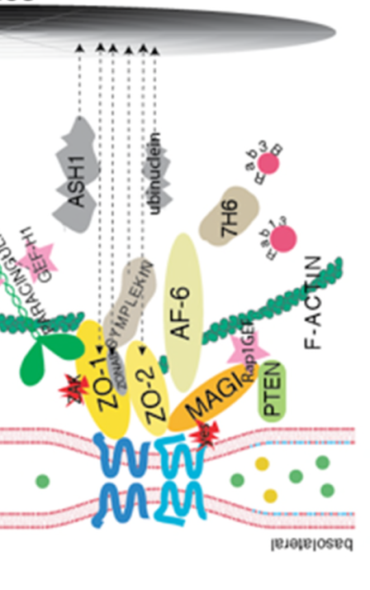
PFIC4: TJP2/ZO-2 deficiency
48 patients described to date
Wide phenotypical spectrum, from hypercholanemia to chronic cholestasis to end-stage liver disease
Low or «near» low γGT
4 cases of HCC reported (the youngest case was 6 months)
Incidence probably underestimated
19

Slide 20

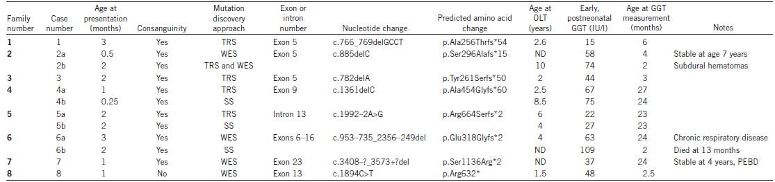
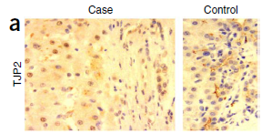
PFIC4: TJP2/ZO-2 deficiency
Truncating mutations: RT-PCR RNA <50%
Clinical picture of progressive cholestasis
Clinical and genetic characteristics of patients with TJP2 mutations¹
Sambrotta M, et al. Nat Genet 2014;46:326–328

Slide 21
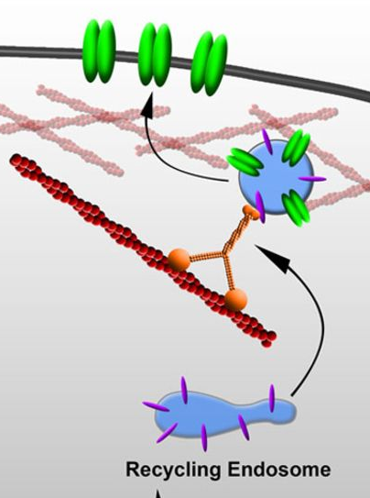
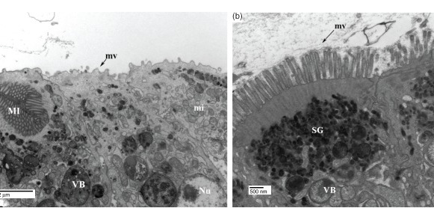
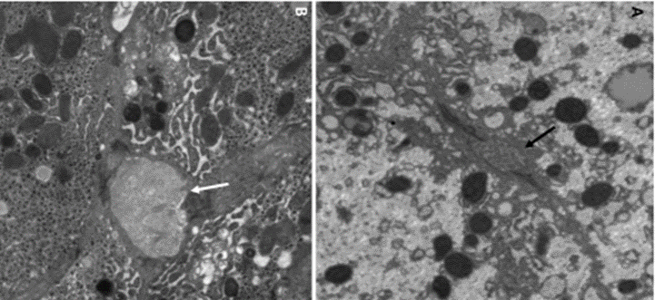
MYO5B: One gene, three phenotypes
Microvillous inclusion intestinal disease (MVID)
MVID and cholestasis
Isolated familial cholestasis (PFIC6/10)
MYO5B
RAB11
Figure from Schumacher-Bass SM, et al. Circ Res 2014;114:982–92.
Epatociti
Ultrastructural features of MVID
Ultrastructural features of the liver
Figure from Thoeni CE, et al. Traffic 2014;15:22–42.
Figure from Girard M, et al. Hepatology 2014;60:301–310.

Slide 22
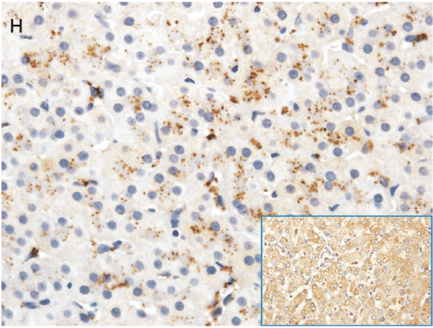
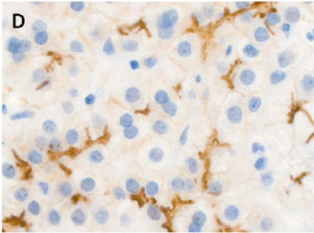
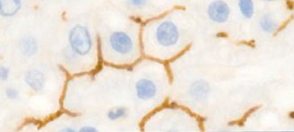
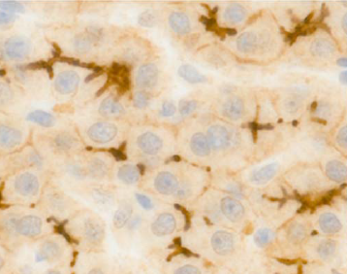
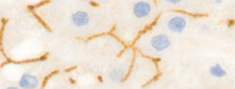
PFIC6/10: Clinical features
MYO5B
42 patients with isolated FIC described
Episodic, recurrent or chronic low γGT cholestasis, normal AFP
Jaundice, high serum BA, FSV deficency, growth failure
Pruritus from mild to severe
Histology: mild changes, canalicular and hepatocellular cholestasis, giant cells, mild fibrosis, peculiar MYO5B immunostaining
About one third of patients had various degrees of episodic or chronic diarrhoea spontaneously improving or resolving
Relatively mild outcome: 2 deaths, 1 OLTx, 2 cirrhosis cases out of 42
Majority of cases had a FU <5 years
Cholestasis may appear after intestinal transplantation and resolve after graft removal
BSEP
MDR3
Figures adapted from 1. Gonzales E, et al. Hepatol 2017;65:164–173.

Slide 23
PFIC overview
​ | PFIC1​ FIC1 | PFIC2​ BSEP | PFIC3 MDR3​ | PFIC4 TJP2​ | PFIC6​/10 MYO5B
Age at onset | Early infancy | Usually neonatal | All ages | Early infancy | Early infancy
Clinical Picture | CC | CC, ESLD | CC, ESLD | HC, CC, ESLD | CC
Extrahepatic symptoms | Common | None | None | Possible | Common
Pruritus | +/++ | ++/+++ | -/+ | +/++ | +/++
Serum γGT | - | - | +++ | -/+ | -
Serum bile acids​ | ++ | +++ | ++ | ++ | ++
AFP​ | -/+ | +++ | -/+ | - | -
Transaminases​ | ++ | +++ | ++ | -/++ | +/++
Risk of cancer | - | +++ | - | ++ | -/+
NLS 5 years | 70% | 40-70% | 50% | Unknown | >90%

Slide 24
PFIC: Histology overview
​ | PFIC1​ | PFIC2​ | PFIC3​ | PFIC4​ | PFIC5​ | PFIC6​/10
Peculiar finding | Cholestasis | Giant cells | Cholangitis Ductular prol. | Mild changes | Cholestasis | Giant cells
Immunohistochemistry | - | BSEP | MDR2 | TJP2 | FXR/BSEP | MYO5B/BSEP
BSEP control
PFIC 2/PFIC 5
PFIC 6/10
ARC (VIPAR, VPS33B)
Courtesy of Prof. Gonzales

Slide 25
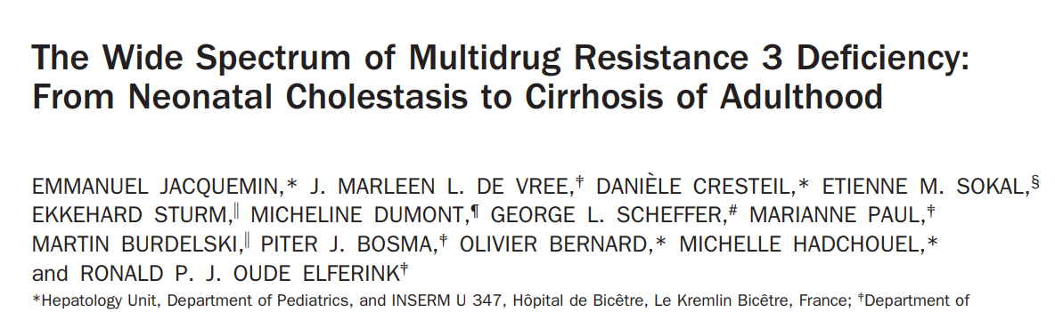




17 diagnosis of PFIC 3 over 31 patients
  12 with biallelic mutations
  5 with single allele mutation
Age at symptoms: 1 month → 21 years
Phenotype of heterozygous parents
  3 mothers with cholestasis of pregnancy
  2 relatives with early and recurring lithiasis
Genotype/phenotype correlation
MDR3 deficiency causes disease also in adults patients
Heterozigous individuals may have symptoms
Mutation severity affects phenotype
Intrahepatic Cholestasis of Pregnancy (ICP) may be a genetic disease !

Slide 26
Phenotype of PFIC genes mutations in adults
PFIC genes
LPAC
Episodic or chronic cholestasis
Recurrent gallstones
DIC
ICP
Unexplained biliary cirrhosis
BRIC – (Benign) Recurrent Intrahepatic Cholestasis
PFIC – Progressive Familial Intrahepatic Cholestasis
ICP – Intrahepatic Cholestasis of Pregnancy
DIC – Drug Induced Cholestasis
LPAC – Low Phospholipids-Associated Cholelythiasis

Slide 27
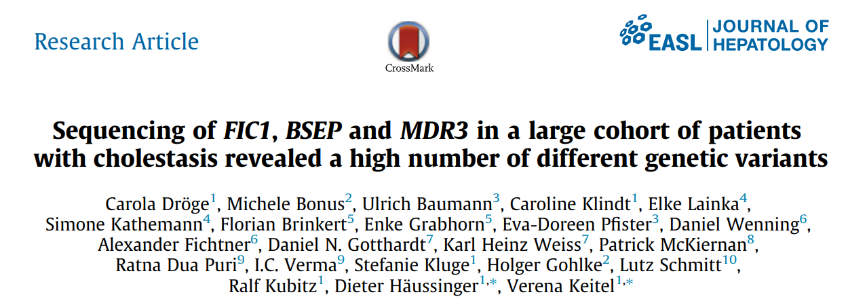
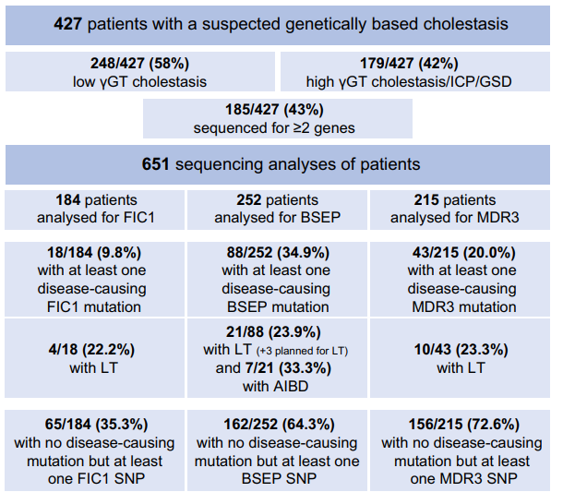
2017
In 427 patients with suspected inherited cholestasis, 149 patients carried at least one disease-causing mutation.
Overall, 154 different mutations were identified
Eighty-two percent of patients with at least one disease-causing mutation in either of the three genes were children.

Slide 28
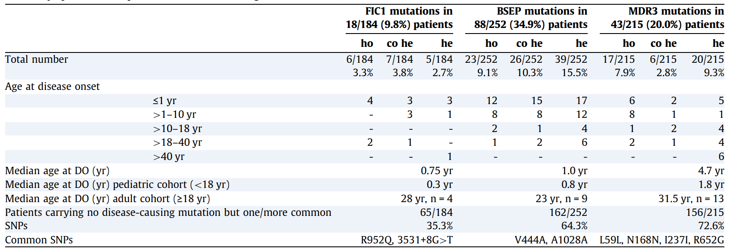

Slide 29
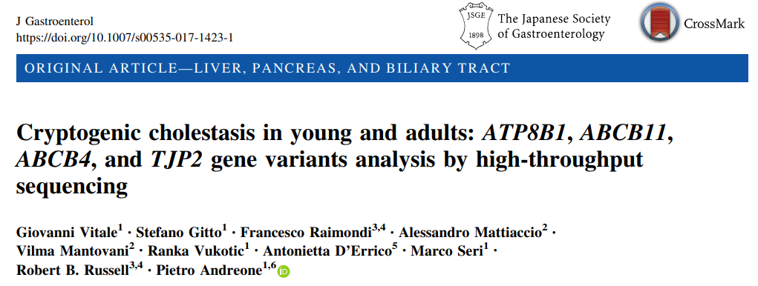
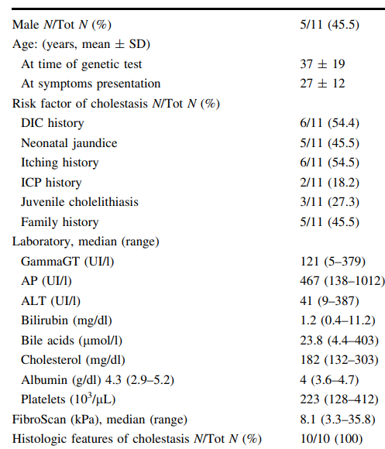
2017
VS 13,5%
VS 18,9%
48 patients > 6 years with cryptogenic cholestasis
11 patients with P/LP mutations, 4 bilallelic, 7 heterozygous.
2 ATP8B1 (PFIC1), 6 ABCB11 (PFIC2), 2 ABCB4 (PFIC3) 3 TJP2 (PFIC4).
VS 8,8%
VS 4,8
Only itching indipendent predictor of P/LP mutations in patients with CC

Slide 30
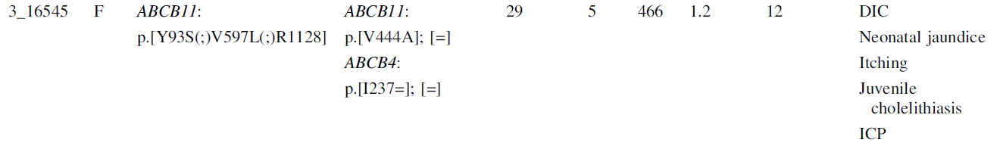
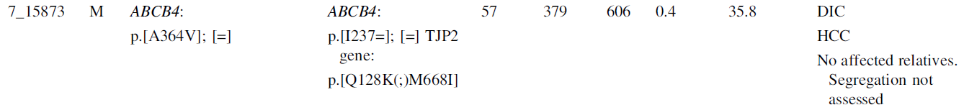
Young female (29 years) presenting with a history of neonatal jaundice, DIC, ICP, juvenile cholelithiasis, itching, normal GGT levels
P/LP x 3
57-year-old cirrhotic patient with DIC and hepatocellular carcinoma
VUS
P/LP
SNP
SNP

Slide 31
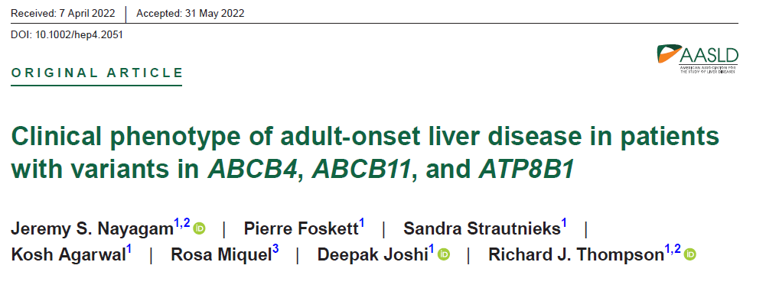
Adult-onset cryptogenic cholestasis
Aims
To describe variants in ABCB4, ABCB11 and ATP8B1 in a cohort of patients with adult-onset liver disease
To explore a genotype–phenotype correlation
Methods
Cholestatic patients tested over five years
Patients >18 years
Bioinformatic analysis of variants
Histology in cases with variants
2022
Results
A total of 356 individuals were identified for analysis
Females: n=219 (61.5%); median age at presentation was 36.2 years (IQR, 28.2–48.0)
Age at genetic testing was 39.4 years (IQR, 30.8–53.2)
A variant in ABCB4, ABCB11, or ATP8B1 was identified in 101 (28.4%) patients
Nine patients had variants in more than one gene (four ATP8B1 and ABCB11, four ATP8B1 and ABCB4, and one ABCB11 and ABCB4)

Slide 32
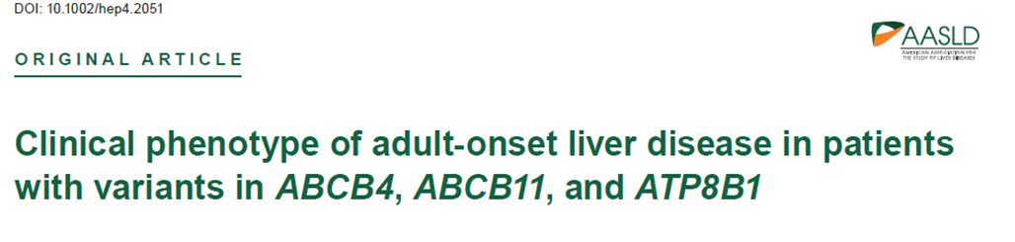
Results - Genotype
 | ABCB4 (n=46) | ABCB11 (n=35) | ATP8B1 (n=28)
Number of different variants | 32 | 29 | 17
Loss-of-function variants, n (%) | 12 (37.5%) | 3 (10.3%) | 1 (5.9%)
Number of patients with loss-of-function variants, n (%) | 17 (37%) | 5 (14.3%) | 1 (3.6%)
Missense variants (%) | 17 | 24 | 14
Predicted pathogenicity of missense variants, n (%)
SIFT deleterious | 15 (88.2%) | 13 (54.2%) | 4 (28.6%)
PolyPhen-2 probably damaging | 12 (70.6%) | 12 (50%) | 2 (14.3%)
Number of alleles affected in patients
1, n (%) | 30 (65.2%) | 31 (88.6%) | 24 (85.7%)
2, n (compound heterozygous/homozygous) (%) | 16 (9/7) (34.8%) | 4 (3/1) (11.4%) | 4 (3/1) (14.3%)

Slide 33
Results - Phenotype
 | ABCB4 (n=46) | ABCB11 (n=35) | ATP8B1 (n=28)
Number of patients, n (%) | 46 (12.9%) | 35 (9.8%) | 28 (7.9%)
Female, n (%) | 31 (67.4%) | 27 (77.1%) | 14 (50%)
Median age at presentation, years (IQR) | 33.5 (27.1–39.2) | 34.3 (27.0–45.9) | 31.8 (25.7–50.7)
Median age at testing, years (IQR) | 36.1 (31.3–49.4) | 36.9 (30.9–48.7) | 42.3 (31.1–55.5)
Clinical phenotype
Family history of liver disease, n (%) | 14 (30.4%) | 4 (11.4%) | 2 (7.1%)
Acute or episodic cholestasis, n (%) | 5 (10.9%) | 14 (40%) | 7 (25%)
Pregnancy-related liver dysfunction, n/number of reported pregnancies (%) | 15/20 (75%) | 14/17 (82.4%) | 0/3
Chronic liver disease, n (%) | 33 (71.7%) | 14 (40%) | 21 (75%)
HCC, n (%) | 2 (4.3%) | 0 | 1 (3.6%)
Liver transplant, n (%) | 4 (8.7%) | 1 (2.9%) | 3 (10.7%)

Slide 34
Results - Histology
 | ABCB4 (n=46) | ABCB11 (n=35) | ATP8B1 (n=28)
Number of samples | 20 | 12 | 16
Biliary disease, n (%) | 16 (80%)* | 4 (33%) | 7 (44%)*
Acute lobular injury (acute or cholestatic hepatitis), n (%) | 3 (15%) | 7 (58%)† | 4 (25%)†
Minor histological changes, n (%) | 1 (5%) | 1 (8%) | 1 (6%)
Fatty liver disease, n (%) | 1 (5%) | 1 (8%)† | 4 (25%)†
Nonspecific cirrhosis, n (%) | 1 (5%) | 0 | 3 (19%)
Advanced fibrosis, n (%) | 9 (45%) | 1 (8%) | 10 (63%)

Slide 35
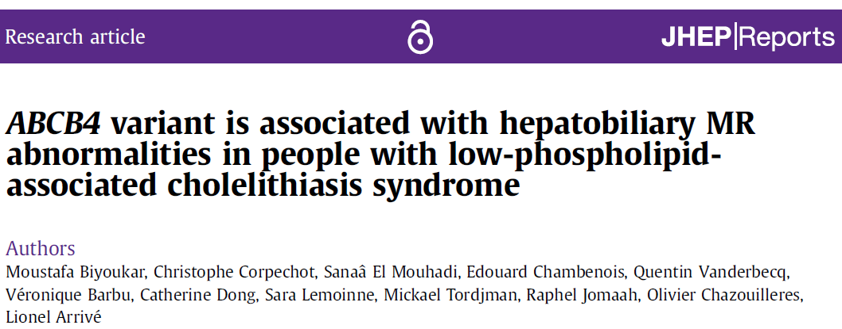
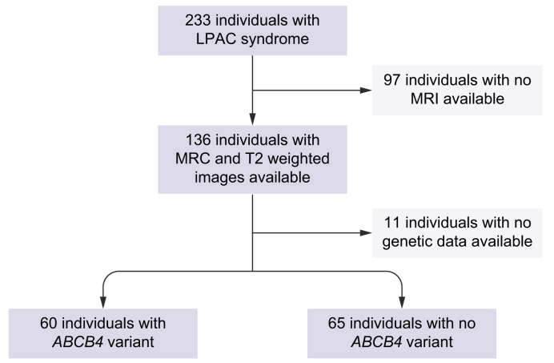

Low Phospholipid-Associated Cholelithiasis syndrome
2 of the following features:
Age at onset of biliary symptoms under 40 year
Recurrence of biliary symptoms after cholecystectomy
Hyperchoic intrahepatic foci or comet tail images within intrahepatic ducts

Slide 36
Low Phospholipid-Associated Cholelithiasis syndrome
 | ABCB4 variant (n = 60) | No ABCB4 variant (n = 65) | OR (95% CI) | p value
Sex, male/female | 17/43 | 27/38 | — | NS
Age at onset of symptoms | 28.9 | 33.3 | — | NS
Age at first MRI | 38.8 | 43.8 | — | NS
Cholecystectomy | 47 (78%) | 52 (80%) | — | NS
Chronic elevation of GGT (>2) | 12 (20%) | 14 (22%) | — | NS
MRI abnormalities | 40 (67%) | 21 (33%) | 4.1 (1.9–9.5) | 0.0001
Stones | 34 (56%) | 11 (17%) | 6.3 (2.6–16.2) | <0.0001
Bile duct dilatation | 36 (60%) | 12 (18%) | 6.5 (2.7–16.3) | <0.0001
Complications | 21 (35%) | 10 (15%) | 2.9 (1.2–7.8) | <0.05
Cholangiocarcinoma | 3 (5%) | 0 | - | -
60 patients with ABCB4 mutations, 57 heterozygous, 3 homozigous
63% disease causing mutations, 22% potentially pathogenic and 15% of uncertain significance

Slide 37
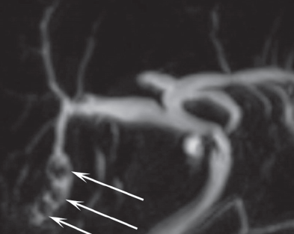
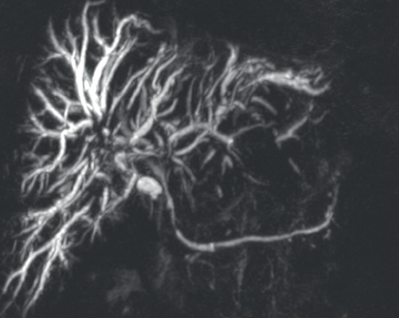
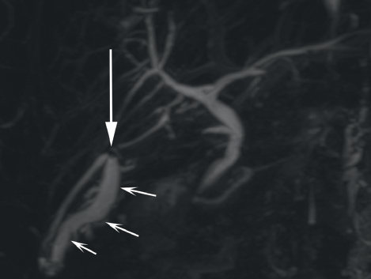
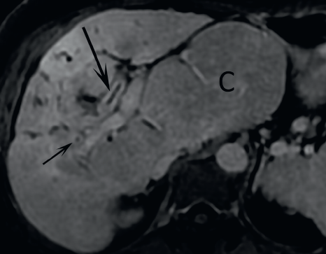
MR features in LPAC

Slide 38
PFIC spectrum:correlation of genotype–phenotype
Variants in ATP8B1, ABCB11, ABCB4, TJP2, FXR, MYO5B and other genes
may underlie a broad spectrum of cholestatic liver diseases
Increasing severity
Intrahepatic cholestasis
of pregnancy (ICP)
PFIC
Disease
Episodic forms of PFIC*
Cirrhosis
End-stage liver disease
Elevated
liver enzymes
(AST, ALT, GGT)
LPAC syndrome
Chronic
cholestasis
Phenotype
Cholelithiasis
Recurrent cholestasis
HCC, CCA
Intermittent jaundice
Example
mutations
Homozygous DAV
Compound heterozygous DAV
Nonsense/splice site/frameshift/deletion/insertion DAV
Heterozygous DAV mutations
Missense DAV
Common polymorphisms (SNPs)

Slide 39
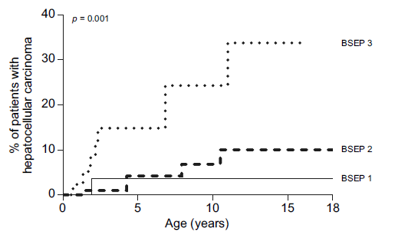
PFIC and liver cancers
Proportion of patients with hepatocellular carcinoma
BSEP deficiency (PFIC 2) s a well documented strong risk factors for HCC. 15% of native liver survivors develop cancer in pediatric age.
In TJP2 deficiency (PFIC 4) several HCC were described as early as 6 months of age.
MDR3 variants have been associated to CCA and HCC in a GWAS study on Icelandic population.
van Wessel DBE, et al. J Hepatol 2020;73:84–93.
Gudbjartsson, D.F.; et al.Nat. Genet. 2015, 47, 435–444.
Zhou, S et al. Hepatology 2015, 62, 1914–1916.
PFIC 2 – BSEP deficiency-

Slide 40
PFIC genes: potential pathways to cancerogenesis
Inflammation
Oxidative stress
Secondary BA
Fibrosis and cirrhosis
PFIC
High BA
Dysbiosis
Immunity
Chronic biliary damage
DNA damage
Resistance to apoptosis
Lipids metabolism
Vitale, G et al. Cancers 2022, 14, 3421.

Slide 41
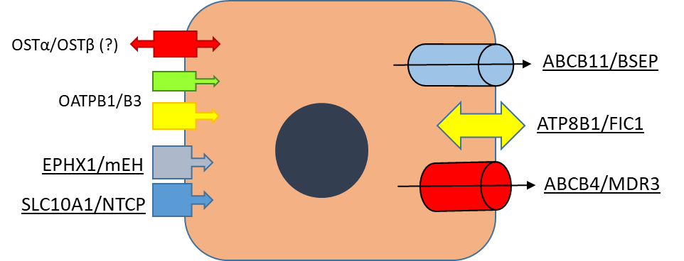



PFIC : mechanism of disease
PFIC1, PFIC2, PFIC3, MYO5b deficiency….
TJP2 deficiency….
TJP2

Slide 42
PFIC + IBAT inhibitors....
PFIC1, PFIC2, PFIC3, MYO5b deficiency….
TJP2 deficiency….
TJP2

Slide 43



Odevixibat (Bylvay®) is the only IBATi commercially available in Italy
In a real life study on 23 pediatric patients with PFIC in Italy 63% of patients showed a >70% reduction of BAs after a median of 170 days of treatment
In PEDFIC studies native liver survaival was increased in Odevixibat responders after 3 yeras of follow up.
Di Giorgio et al. ESPGHAN 2023 communication
Thompson et al. ESPGHAN 2023 communication

Slide 44
Take Home Messages
Perché un epatologo dell’adulto deve conoscere le PFIC?
Perché sempre più giovani adulti con diagnosi documentata gli verranno affidati in cura dal mondo dell’epatologia pediatrica
Perché fino al 30% delle colestasi croniche dell’adulto, con o senza cirrosi, sono correlate ai geni PFIC
Perché fino al 50% delle LPAC e delle DIC è correlato al gene ABCB4 (MDR3)
Perché la ICP può non essere una malattia benigna
Per mettere in atto una sorveglianza personalizzata per diagnosi precoce di cancro
Perché lo spettro di malattie correlate ai geni PFIC si possono curare !
Dosare gli acidi biliari!
Inviare studio genetico!

Slide 45

Thank you
Villa Malfitano, Palermo
msciveres@ismett.edu

