Slide 1

Le nuove sfide in epatologia
Taormina, 29-30 Maggio 2023
Il database ITA.LI.CA:
cosa abbiamo imparato negli
ultimi 10 anni?
Franco Trevisani
Dipartimento di Scienze Mediche e Chirurgiche
IRCCS Azienda ospedaliero-universitaria di Bologna

Slide 2

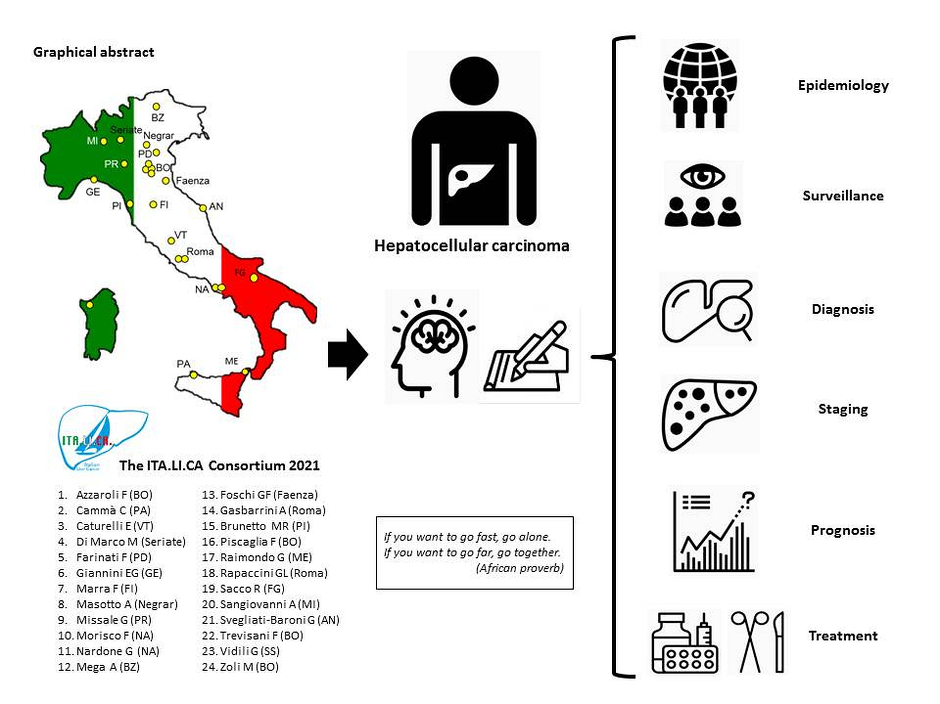
ITAlian.LIver.CAncer network 2023
(since 1998): 9370 pts
95 full papers
Trevisani F and Giannini EG. Ann Hepatol 2021; 27(Suppl 1):100564

Slide 3

ITAlian.LIver.CAncer network
(since 1998 to 2023)
http://progettoitalica.it

Slide 4
Epidemiology

Slide 5
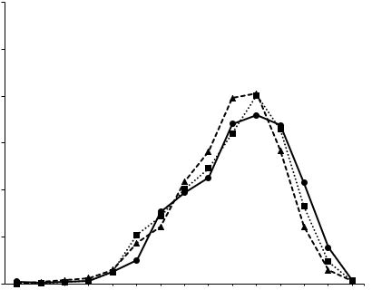


Age distribution in HCC patients: temporal trends
(ITA.LI.CA database 2018)
 | Total n. 6034 | 2004-2008 n. 1135 | 2009-2013 n. 2355 | 2014-2018 n. 2544 | P
Mean age (±SD) years |  | 66.3 ± 10.3 | 67.2 ± 10.7 | 68.3 ± 10.8 | 0.001
30
25
20
%
15
10
5
<5% before 50 years
0
<25
25-29
30-34
35-39
40-44
45-49
50-54
55-59
75-79
90+
60-64
65-69
70-74
80-84
85-89
Age
Garuti F et al., for ITA.LI.CA, Liver Int 2021; 41: 585-597

Slide 6
Aging of HCC population in Italy: causes
Aging of the Italian population
Systematic anti-HBV vaccination of children
Antiviral therapy for HBV and HCV (″slowing″ effect
on carcinogenesis)
Garuti F et al., for ITA.LI.CA, Liver Int 2021; 41: 585-597

Slide 7
Evolving aetiology of HCC
(ITA.LI.CA database 2018)
Vitale A et al., for ITA.LI.CA. Gut 2023; 72:141-152

Slide 8
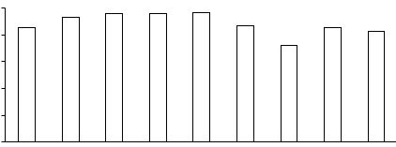
Prevalence of cirrhosis in HCC pts by aetiology
(ITA.LI.CA database 2018)
 | Total n. 5865 | 2004-2008 n. 1085 | 2008-2012 n. 2312 | 2013-2018 n. 2468 | P
Cirrhosis | 90.2% | 95.1% | 93.3% | 88.0% | <0.001
100
80
60
Patients (%)
40
20
0
HCV
Alcohol
Cryptogenic
NAFLD
Other
HBV (± HDV)
HBV+HCV (±HDV)
Multy-aetiology
Alcohol+NASH
Aetiology
Garuti F et al., for ITA.LI.CA, Liver Int 2021; 41: 585-597

Slide 9
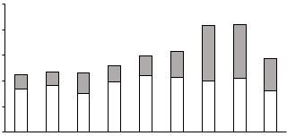


Fatness and HCC
(ITA.LI.CA database 2018)
Prevalence of overweight/obese patients
100
Viral
Non viral
80
60
Patients (%)
40
20
0
HCV
Alcohol
NAFLD
Other
HBV (± HDV)
Multy-aetiology
Cryptogenic
Alcohol+NAFLD
HBV+HCV (± HDV)
Garuti F et al., for ITA.LI.CA. Liver Int 2021; 41: 585-597

Slide 10

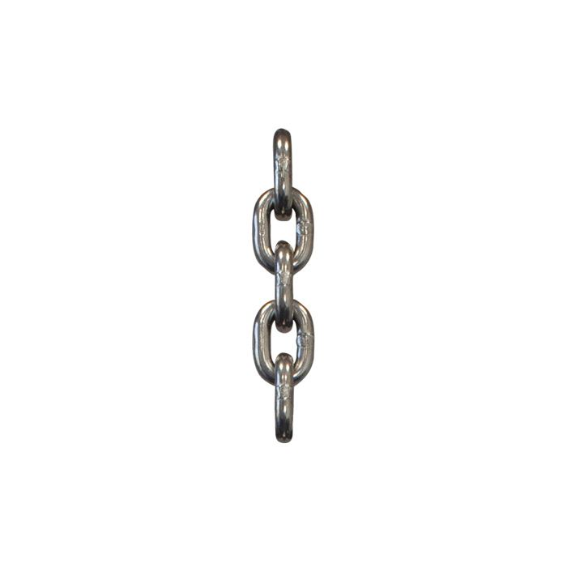

«Alcohol-related» HCC: is it still a correct definition in Italy?
(ITA.LI.CA database 2020)
Reggidori N et al., for ITA.LI.CA, JHep R 2023. (DOI:10.1016/j.jhepr.2023.100784)

Slide 11

The prototype
Old
Fatty
Comorbid

Slide 12
Diagnosis

Slide 13
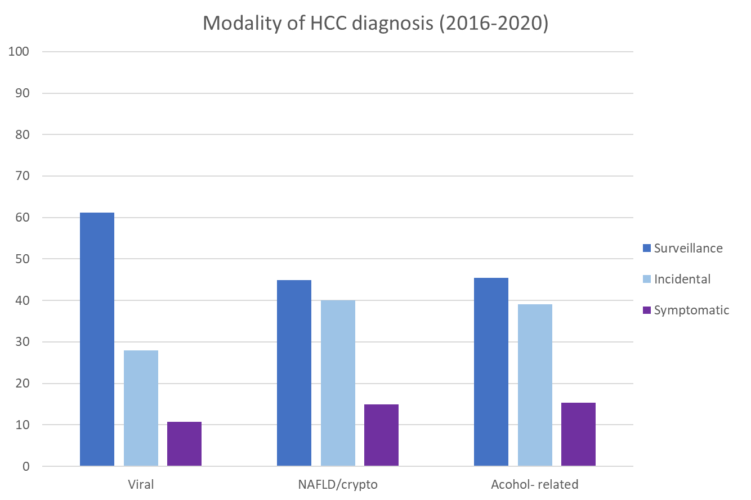

61%
Percentage
45%
45,5%
Viral
NAFLD/crypto
Alcohol-related
Reggidori N et al., for ITA.LI.CA. J Hep R 2023 (DOI: 10.1016/j.jhepr.2023.100784)

Slide 14
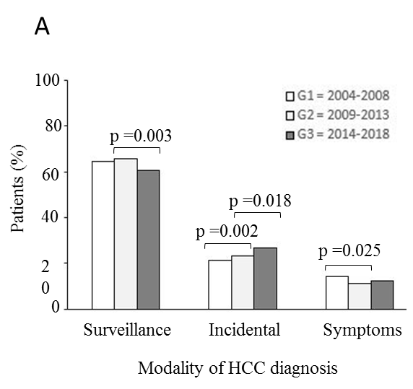
Evolving diagnosis of HCC
(ITA.LI.CA database 2018)
0
Garuti F et al., for ITA.LI.CA, Liver Int 2021; 41: 585-597

Slide 15
Staging and prognosis

Slide 16

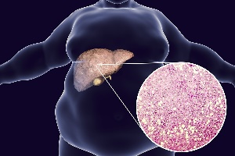


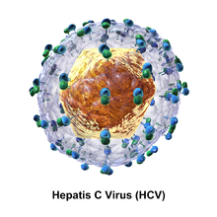
HCC stage distribution
(ITA.LI.CA database 2018)
BCLC stages in 2407 pts (2014-2018)
6.5%
Very early
Surveillance
Advanced 25%
Very early/early
55%
Intermediate
15%
Garuti F et al., for ITA.LI.CA, Liver Int 2021; 41: 585-597

Slide 17
ITA.LI.CA staging system
Intermediate HCC
Advanced HCC
ITA.LI.CA stage
0
A
B1
B2
B3
C
D
ITA.LI.CA
tumor stage
S
U
R
V
I
V
A
L
therapeutic hierachy
Farinati F et al, for ITA.L.ICA, PLoS Med 2016; 13(4): e1002006;
Vitale A et al. Hepatology 2020; 6: 2206-18

Slide 18
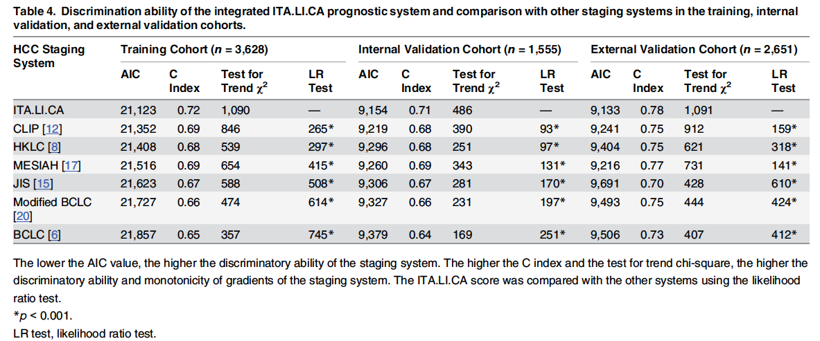
The ITA.LI.CA «prognostic score»
The lower the AIC, the higher the intra-stratum homogeneity and monotonicity of gradients.
The higher the C Index, the higher the discriminatory ability.
The higher the χ² test for trend, the higher the discriminatory ability and monotonicity of gradients.
Farinati F et al. for ITA.L.ICA, PLoS Med 2016; 13(4): e1002006

Slide 19
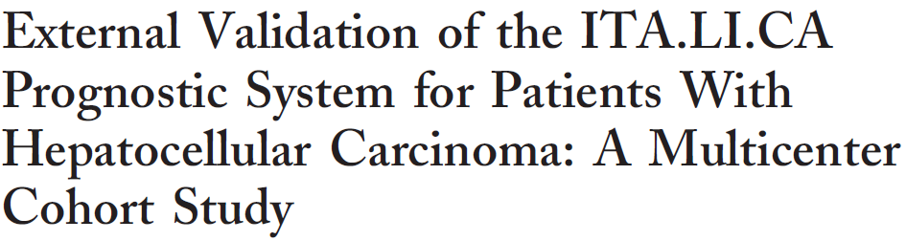
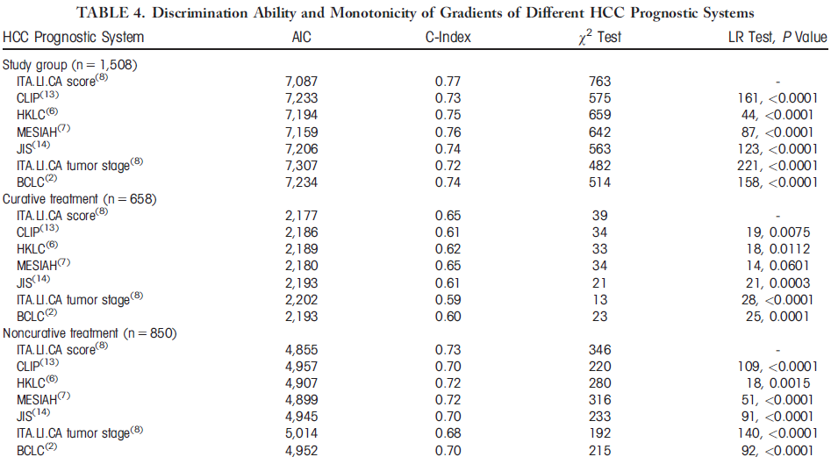

Borzio M et al. Hepatology 2018; 67: 2215-2225

Slide 20
Treatment

Slide 21
Treatment distribution
(ITA.LI.CA database 2018)
Main treatment in 2197 pts (2014-2018)
BSC6%
OLT
5%
Syst.10%
IAT 25%
Ablaz.
36%
Garuti F et al., for ITA.LI.CA. Liver Int 2021; 41: 585-597

Slide 22

OLT as HCC treatment in clinical practice
(ITA.LI.CA database 2018)
Potential amenability to OLT by Metroticket 2 criteria in patients ≤70 year old
11% underwent OLT
83%
Garuti F et al., for ITA.LI.CA. Liver Int 2021; 41: 585-597

Slide 23
OLT as HCC treatment in clinical practice
(ITA.LI.CA database 2018)
Factors curtailing the use of OLT in HCC patients ≤70 year old
Major comorbidities
Graft shortage
Under-referral to OLT centers
Low «transplant benefit»
Garuti F et al., for ITA.LI.CA. Liver Int 2021; 41: 585-597
Notes:
Likely, they are: the frequent presence of major comorbidieties, a certain graft shortage, an under-referral to transplant centres and, last but not least, an insufficient “transplant benefit”.

Slide 24
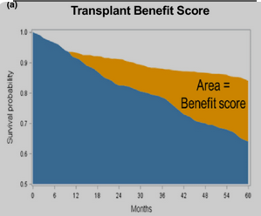
Survival gain offered by LT by comparison with the best alternative therapy
5-year adjusted OLT benefit
(Monte Carlo simulation)
Transplant
≅12%
Best alternative treatment

Slide 25
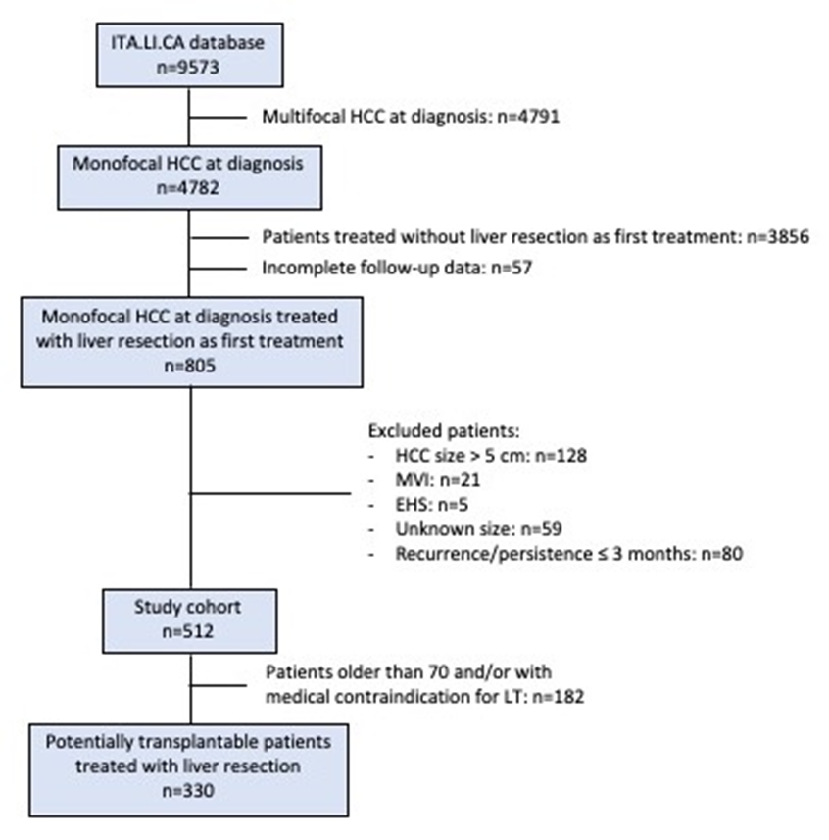
Outcomes of patients with single small (≤5 cm) HCC treated with liver resection as first-line therapy
(ITA.LI.CA database 2020)
- Median F-U after resection: 4.2 years
Overall recurrence rate: 55.9%
Extrahepatic recurrence: 8.4%
First recurrence beyond Milan criteria: 18.0%
Independent predictors of survival
 | Univariate |  | Multivariate
 | HR (95% CI) | p | HR (95% CI) | p
Sex
HCC size
≤ 3 cm > 3 cm | - 1.97 (1.31-2.95) | - 0.001 | - 1.85 (1.14-3.01) | - 0.01
AFP (ng/mL)
≤ 20 20-400 > 400 | - 1.85 (1.10-3.13) 3.27 (1.44-7.43) | - 0.02 0.005 | - 1.81 (1.07-3.06) 3.39 (1.49-7.69) | - 0.03 0.004
Pelizzaro F et al., for ITA.LI.CA 2023 (submitted)

Slide 26
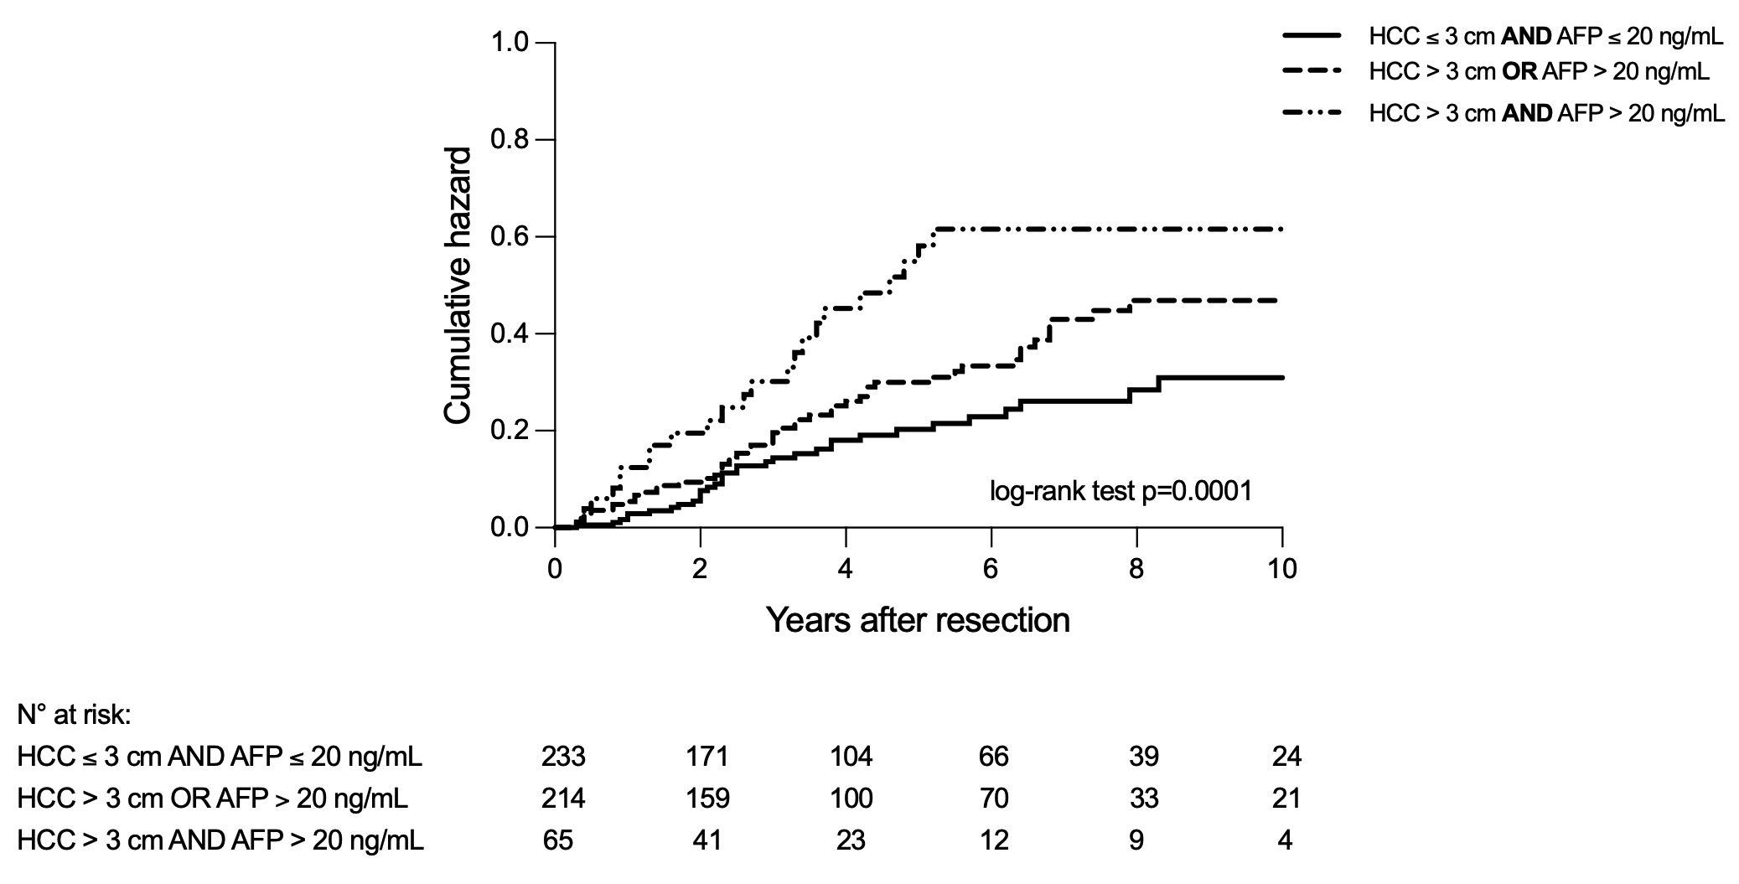

Outcomes of patients with single small (≤5 cm) HCC treated with liver resection as first-line therapy
(ITA.LI.CA database 2020)
Likelihood of presenting a recurrence beyond Milan criteria
AFP ≤20 ng/mL
Size ≤3 cm
Pelizzaro F et al., for ITA.LI.CA 2023 (submitted)

Slide 27
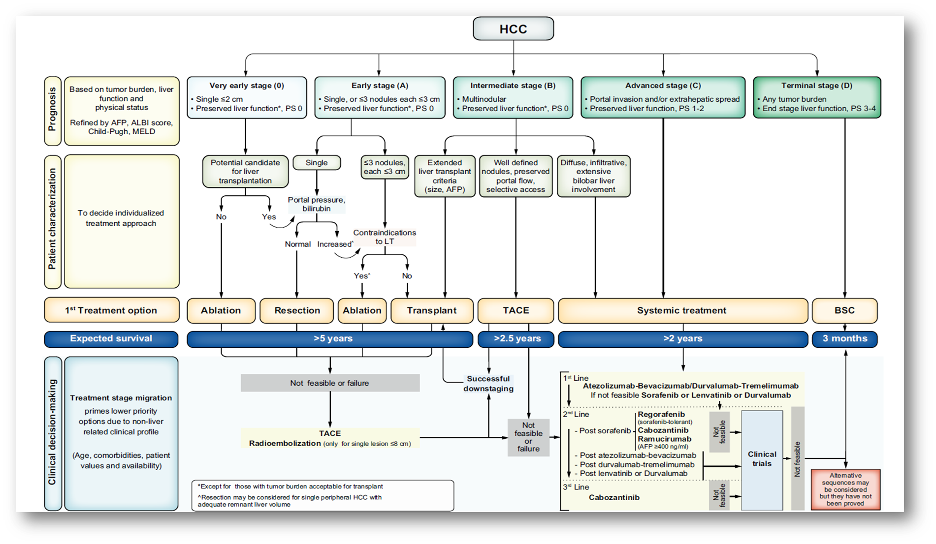
The 2022 updated BCLC therapeutic algorythm
Reig M et al. J Hepatol 2022;76: 681-93

Slide 28
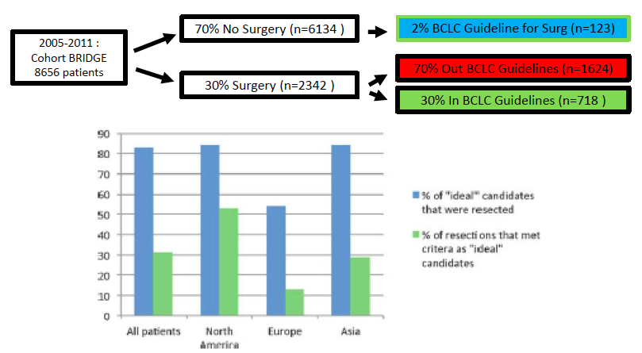
Evidence-based failure of strict treatment algorithms for HCC
Roayaie S, et al. Hepatology 2015; ^{62: 440}

Slide 29
Evidence-based failure of strict treatment algorithms for HCC:
the ITA.LI.CA registry 2016
638 resections
Ideal* candidates
147 (23%)
Non ideal candidates
147 (77%)
* single HCC, bilirubin <1.2 mg/dL, no CSPH
148 CSPH
139 CSPH + bilirubin (>1.2 mg/dL)
90 CSPH + multinodular
56 multinodular
27 bilirubin
16 bilirubin + multinodular
15 all 3 conditions
ITA.LI.CA database 2016, umpublished data

Slide 30
The 2022 updated BCLC therapeutic algorythm
Reig M et al. J Hepatol 2022;76: 681-93

Slide 31

Over time use of TACE as «main treatment» of BCLC B patients
(ITA.LI.CA database 2018)
1270 consecutive BCLC B patients managed from 1988 to 2018
The percentage of BCLC B patients undergoing TACE as main treatment sharply dropped after 1998
from ≈ 62% to ≈38%
Survival by treatment
TACE
Pelizzaro F et al., for ITA.LI.CA. Front Oncol 2022 Jan 31; 12: 822507
doi: 10.3389/fonc.2022.822507

Slide 32
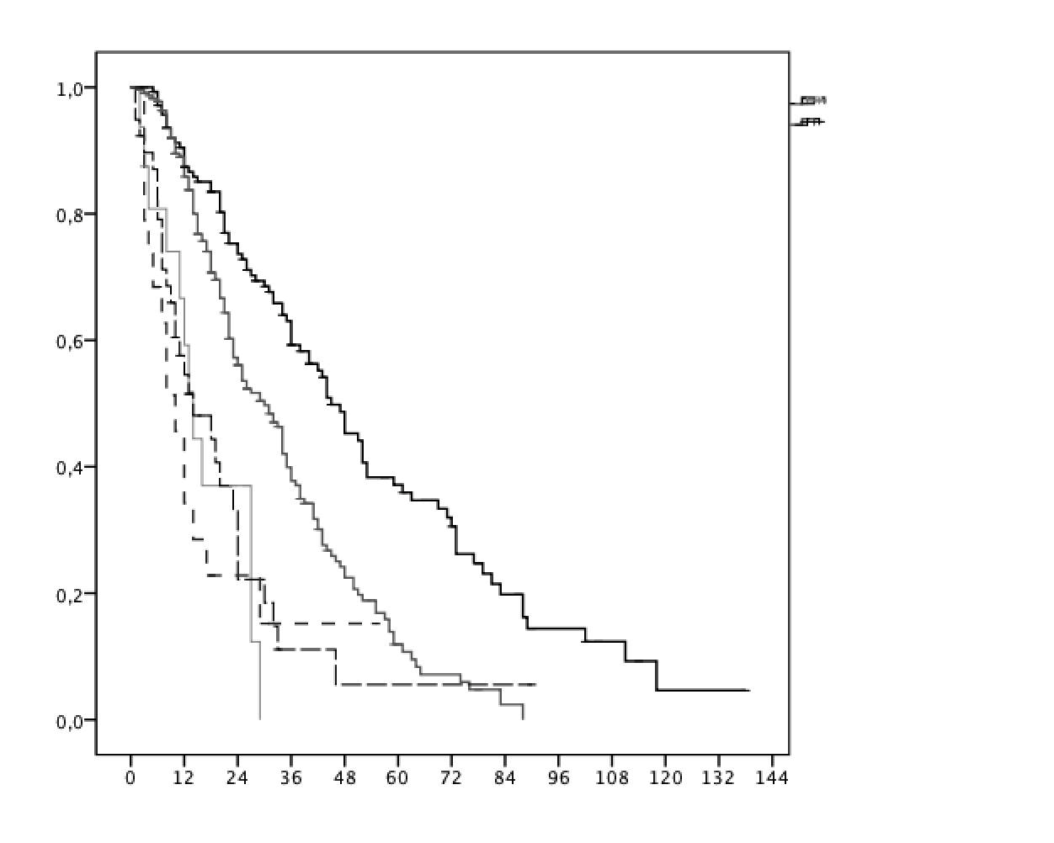
Curative therapies are superior to TACE in intermediate stage HCC
Survival by treatment
of 456 BCLC-B patients
Curative treatments:
n. 145
TACE
(standard of care): n. 233
Sorafenib:
n. 18
Upward treatment
Other treatments:
n. 39
Best Supportive Care: n.21
Overall survival
Treatment remained a prognostic factor after:
adjustment for other predictors (Cox)
propensity score matching.
Months
Pecorelli A et al., for ITA.L.ICA. Liver Int 2016, 37: 423-433

Slide 33
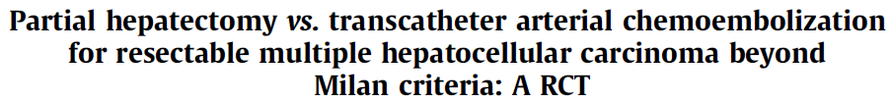
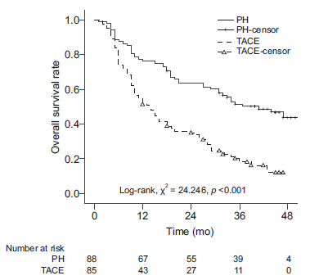
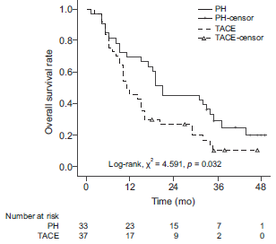

Characteristics RESECTION TACE
N. pts 88 85
HBSAg+ 81 77
Cirrhosis: 69 74
C-P class (A/B): 87/1 80/5
Max size (mean±SD): 7.3±2.5 7.4±2.3
N. nodules: 2-5
Bilobar: 31 40
N. TACE (mean) - 3.3
Pts. with >2 nodules
Yin L et al. J Hepatol 2014 doi: 10.1016/j.jhep.2014.03.012
Notes:
33

Slide 34
The 2022 updated BCLC therapeutic algorythm
Reig M et al. J Hepatol 2022;76: 681-93

Slide 35
Reasons for allocation to BCLC-C stage
Preserved liver function
ECOG PS 1-2
Vascular invasion
Extrahepatic spread
Giannini EG et al., for ITA.LI.CA. Hepatology 2018,65:1784-96

Slide 36
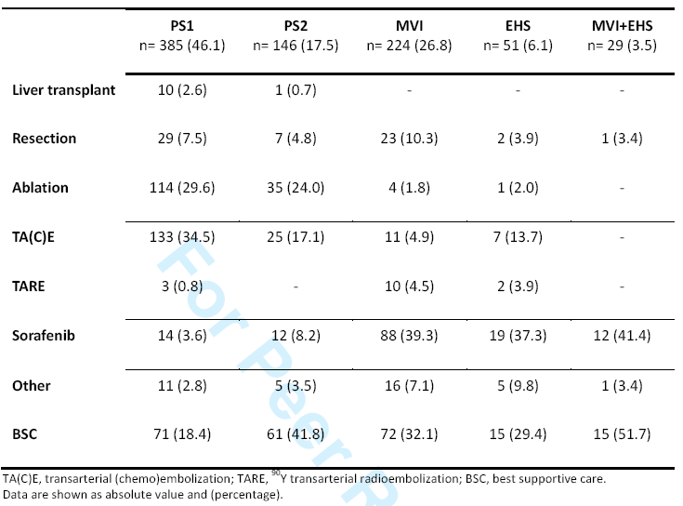
First-line therapy in BCLC-C stage
OS by allocation reason
40%
29%
Giannini E et al., for ITA.LI.CA. Hepatology 2018, 65: 1784-96

Slide 37
Whole group
IPTW matched
Famularo S et al., for HERCOLES and ITA.LI.CA group

Slide 38
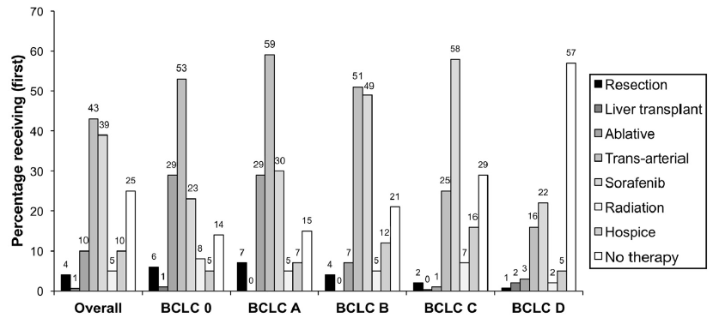
Adherence to BCLC in dications in clinical practice
3,988 HCC pts
followed from January 2008 to December 2014 in 128 Veterans Administration centers
Adherence rate
70%
95%
85%
35%
45%
91%
Serper et al., Gastroenterology 2017; 152(8): 1954-196

Slide 39
The adherence to BCLC staging system indications
Retrospective study (2011-2017): 1801 Taiwanese HCC pts
BCLC stage | Adherence rate
0 (n. 302) | 86%
A (n. 783) | 77%
B (n. 242) | 50%
C (n. 358) | 26%
D (n. 116) | 72%
0
A
B
C
D
Yen Y-H et al. Plos One, March 2021

Slide 40
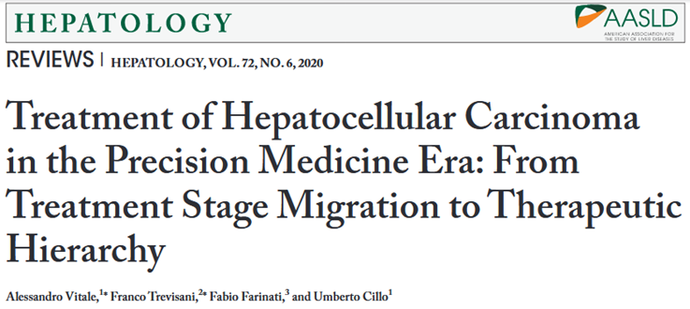



The therapeutic hierarchy for HCC
HCC
Transplant
Resection
Ablation
Intra-arterial therapy
Systemic therapy
BSC

Slide 41
ITA.LI.CA staging system and therapeutic hierachy
Intermediate HCC
Advanced HCC
ITA.LI.CA stage
0
A
B1
B2
B3
C
D
ITA.LI.CA
tumor stage
Expected median survival (months)
S
U
R
V
I
V
A
L
Non-curative
Curative
Therapeutic hierachy
Vitale A et al. Hepatology 2020; 72: 2206-2218
Notes:
So, as clinical practice results showed that the treatment may vary in the different stage of HCC, the outcome depic a clear hierarchy of treatment efficacy which is maintained within each stage, with LT at the top and BSC at the bottom of efficacy

Slide 42
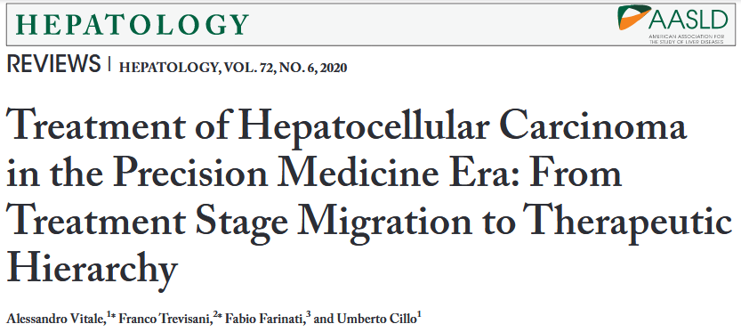
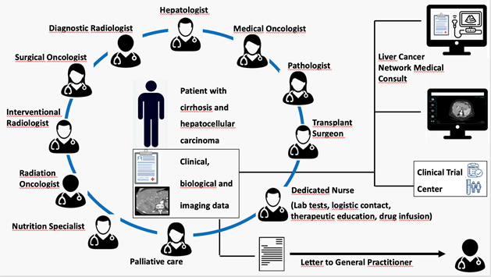
Therapeutic algorithm: two conceptual approaches
HCC staging
Specific
contraindications
Stage
hierarchy
Therapeutic
hierarchy
Stage-linked approach
BCLC 1999
EASL
AASLD
ITA.LI.CA 2018
Treatment stage migration
Treatment stage alternative
Therapeutic decision
Multidiscilinary tumor board

Slide 43
Stage-dictated treatment
Therapeutic hierarchy
Stage
Stage
Expert opinion article (submitted for publication)

Slide 44
Stars indicate the importance
Vitale A et al. Lancet Oncol 2023 (in pubblicazione)

