Slide 1

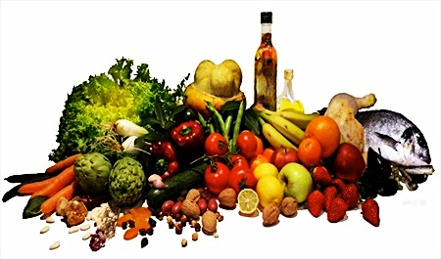
III Sessione - NAFLD
Moderatori: M. Romano - A. Belfiore
Il trattamento non farmacologico della NAFLD
Giulio Marchesini
“Alma Mater Studiorum” Università di Bologna

Slide 2
Giulio Marchesini
Conflitti d’interesse negli ultimi due anni:
Eli Lilly: onorario per lettura

Slide 3
Interventi comportamentali nella NAFLD
Terapia comportamentale
  Perdita di peso
  Scelte alimentari
  Dieta mediterranea
  Non solo dieta ed attività fisica
Interventi via web
  On line/Off line

Slide 4
Perdita di peso ed interventi comportamentali nella NAFLD
PICO 5 - Nei pazienti adulti con NAFLD, qual è l'efficacia della perdita di peso sul danno epatico valutato istologicamente e sugli outcome epatici rispetto a nessun intervento?
Raccomandazione
5.1) Si suggerisce che i soggetti con NAFLD, inclusi quelli con lean-NAFLD (non obesa), siano coinvolti in programmi di correzione dello stile di vita mirati a una dieta sana e all'attività fisica abituale per una perdita di peso del 10%, associata a un miglioramento dell'istologia, inclusa la fibrosi (Forza Raccomandazione Condizionata - Qualità evidenza Alta).
5.2) Nei pazienti con NAFLD si suggerisce che l'approccio dietetico sia mirato a favorire l'aderenza ai principi della dieta Mediterranea, compreso un ridotto apporto di zuccheri raffinati e industriali, che sono stati associati alla riduzione del contenuto di grassi epatici e alla riduzione del rischio cardiovascolare (Forza Raccomandazione Condizionata - Qualità evidenza Alta).

Slide 5
Perdita di peso ed interventi comportamentali nella NAFLD
PICO 5 - Nei pazienti adulti con NAFLD, qual è l'efficacia della perdita di peso …….?
Raccomandazione
5.3) In pazienti non cirrotici con NAFLD si suggerisce di evitare anche un consumo modesto di alcol (Forza Raccomandazione Condizionata - Qualità evidenza Bassa), mentre la totale astinenza è indicata in pazienti con NAFLD e cirrosi epatica (Forza Raccomandazione Condizionata - Qualità evidenza Alta).
5.4) Nei pazienti con NAFLD si suggerisce di svolgere sistematicamente attività fisica di qualsiasi tipo, così come di limitare la sedentarietà, al fine di ridurre il grasso epatico, indipendentemente dalle variazioni del peso corporeo (Forza Raccomandazione Condizionata - Qualità evidenza Alta)
5.5) Nei soggetti obesi affetti da NAFLD, per ridurre la severità della malattia, si raccomanda la perdita di peso attraverso programmi di stile di vita intensivi e/o farmacoterapia e/o chirurgia bariatrica (Forza Raccomandazione Forte - Qualità evidenza Alta)

Slide 6
NAFLD e perdita di peso: la piramide
Fibrosis
(45%)
Patients achieving:
1 Vilar-Gomez E, et al. Gastroenterology. 2015;149:367-78.
2 Promrat K, et al. Hepatology. 2010;51:121-9
3 Harrison SA, et al. Hepatology. 2009;49:80-6.
4 Wong VW, et al. J Hepatol. 2013;59:536-42
Weight Loss ≥10%¹
<10% in 1 year¹
NASH Resolution
(64–90%)*
Weight Loss ≥7%¹
18% in 1 year¹
Ballooning / inflammation
(41–100%)*
Weight Loss ≥5%¹⁻³
30% in 1 year¹
Steatosis
(35–100%)*
Weight Loss ≥3%¹⁻⁴
*Depending on degree of weight loss
Slide courtesy of S. Harrison

Slide 7
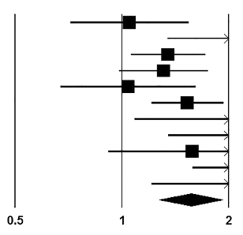
Dietary patterns and NAFLD
Meta-analysis of observational studies
The Western dietary pattern was characterized by high intake of processed food, red meat, high-fat diary and refined grains, the Prudent and the Mediterranean by fruit, vegetable, whole grain, fish and olives
Hassani Zadeh, J Gastroenterol Hepatol 2021

Slide 8
Dietary intervention (CHO restriction)
Systematic review of 50 trials for T2D management
6-month
12-month
Jayedi, Am J Clin Nutr 2022

Slide 9
Intermittent fasting
Mild to moderate weight loss (1–8% over 8 weeks), consistent with reduction in energy intake (10-30%)
Zero-calorie ADF
Modified ADF: 25% calorie
Benefits on cardiometabolic health by decreasing blood pressure, insulin resistance, and oxidative stress.
Varady, Ann Rev Nutr 2021

Slide 10
Dietary intervention (Time-restricted eating)
139 patients with obesity randomized to TRE (eating between 8:00a.m. and 4:00p.m.+ calorie restriction – CR) or CR alone for 12 months. Diet: 1500-1800 kcal/day for men, 1200-1500 for women.
Metabolic risk factors change in parallel with the results of the primary outcome
A regimen of time-restricted eating not more beneficial with regard to reduction in body weight, body fat, or metabolic risk factors than daily calorie restriction.
Liu, N Engl J Med 2022

Slide 11
Alternative Healthy Eating Index— 2010 (AHEI-2010)
Alternate Mediterranean Diet (AMED)
Healthful Plant-based Diet Index (hPDI)
Dietary Approaches to Stop Hypertension
Diabetes Risk Reduction Diet (DRRD)
World Cancer Research Fund/Am Inst for Cancer Research (WCRF/AICR)
Reversed empirical dietary index for hyperinsulinemia (rEDIH)
Reversed empirical dietary inflammatory pattern (rEDIP)
Wang, Nat Med 2023

Slide 12
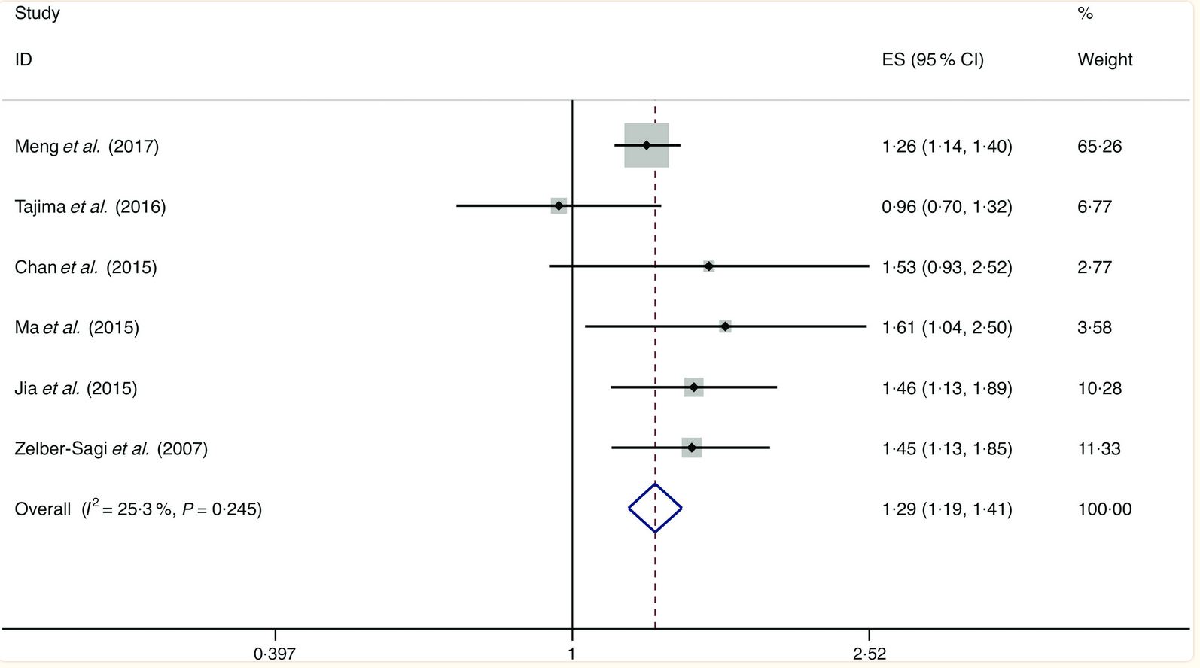
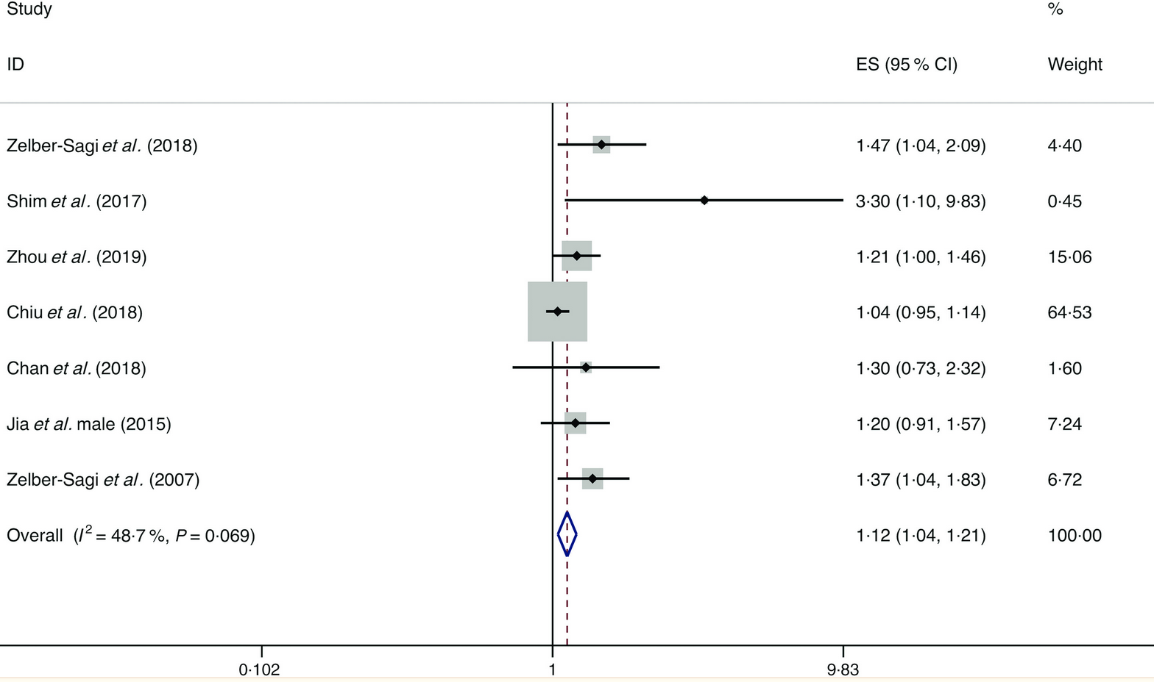
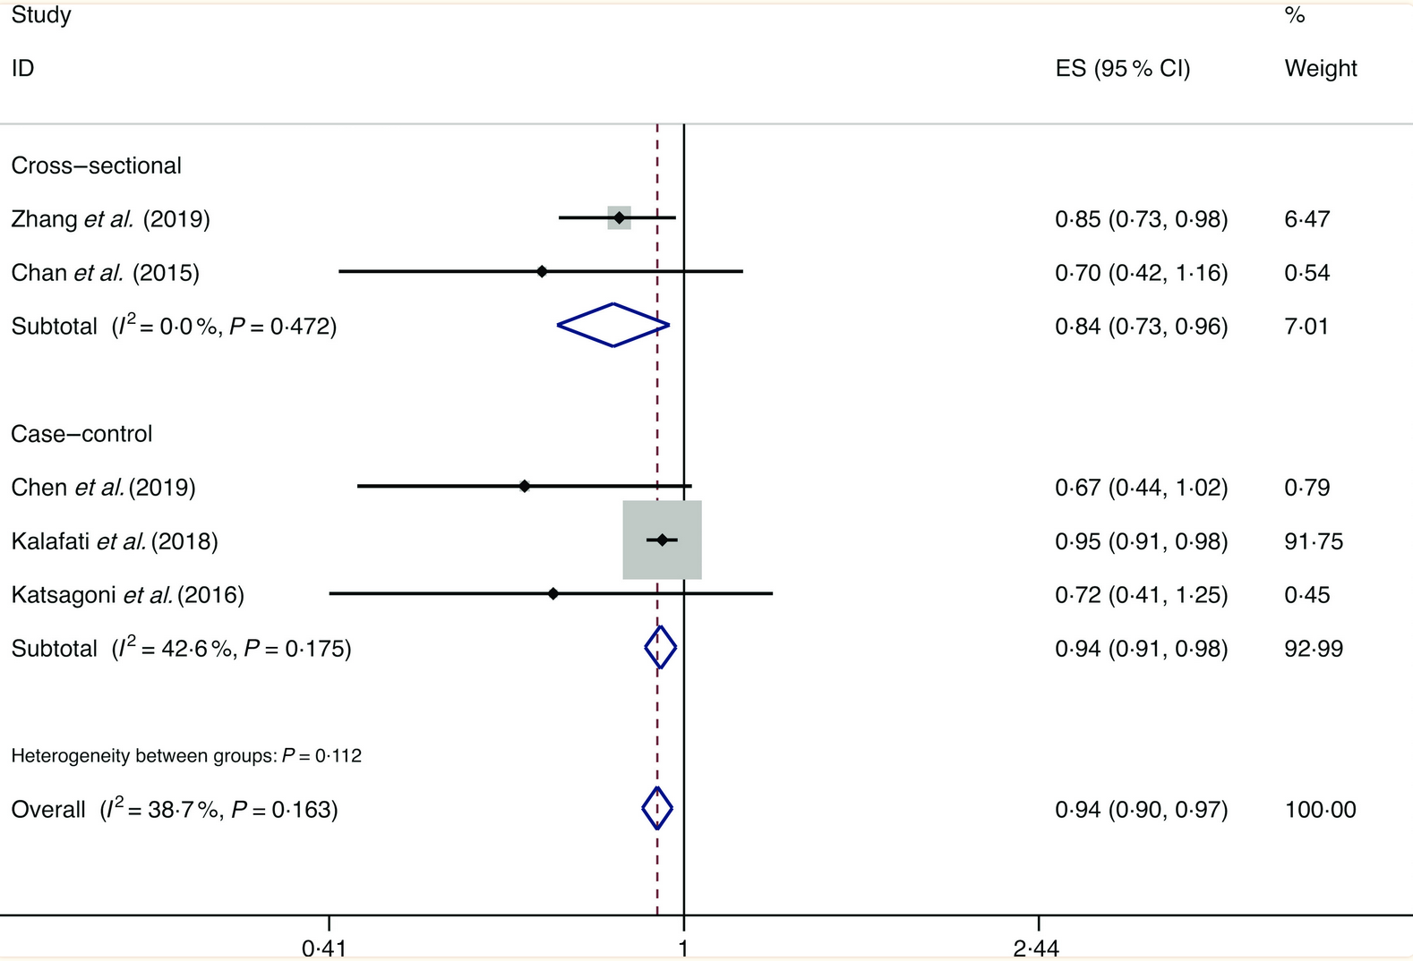
Food groups and the likelihood of NAFLD
Meta-analysis of cross-sectional and case-control studies
Soft drinks; OR, 1.29
No significant influences of grains, refined grains, fish, fruits, vegetables, eggs, dairy products and legumes
Red meat; OR, 1.12
Nuts; OR, 0.94
He, Br J Nutr 2020

Slide 13
UPF consumption and risk of NAFLD
16168 participants aged 18-90 years from the Tianjin Chronic Low-grade Systemic Inflammation and Health (TCLSIH) Cohort Study. Information on ultra-processed food consumption was collected at baseline using a validated food frequency questionnaire. NAFLD was defined as the presence of sonographic fatty liver in the absence of significant alcohol intake
Monteiro,
≤ 10
≥ 40
Zhang, Int J Epidemiol 2022

Slide 14
Meat consumption and risk of NAFLD/Fibrosis
Monteiro,
Adjusted for age, gender, BMI, energy, protein and cholesterol intake
Zhang, Int J Epidemiol 2022

Slide 15
VLCD intervention (DIRECT STUDY)
Pts with T2D entering a strict VLCD regimen
The intervention comprised withdrawal of drugs, total diet replacement (825–853 kcal/day formula diet for 3–5 months), stepped food reintroduction (2–8 weeks), and structured support for long-term weight loss maintenance.
Outcomes: i) weight loss >15kg, ii) T2D remission, off drugs
Highlights
- Substantial weight loss can reverse the processes underlying type 2 diabetes
- Liver fat content is normalized and pancreas fat content decreased in all
- Return to non-diabetic glucose control depends upon beta-cell ability to recover
Lean, Lancet 2018
Taylor, Cell Metabolism 2018

Slide 16
Food groups consumption and NAFLD
Data from observational studies:
Increased risk of liver steatosis and fibrosis associated with diet based on food at higher dietary insulinemic potential (Zhu et al, Liver Int 2022)
Protection by nuts, increased risk by red meat and soft drinks (He et al, Br J Nutr 2020)
Decreased risk by high fruit-vegetal dietary pattern (Gray et al, Nutrients 2022)
Increased risk by high red and processed meat consumption (Zelber-Sagi et al, J Hepatol 2018)
Reduced risk with plant-based proteins, increased risk with high-fat diary (Kim et al, Clin Nutr 2022)
Increased calorie intake by use of ultra-processed food (Hall et al, Cell Metabolism 2019); increased risk of metabolic syndrome (Zelber-Sagi et al, Liver int 2021)
Dose-dependent risk by soft drink consumption (Zhang et al, Am J Clin Nutr 2021)

Slide 17
Sugar-sweetened beverages and metabolic risk
Substitution of SSB with low- no-calorie sweetened beverages (LNCSB) or water
14 studies having BMI, anthropometry, incident CHD, overall and CV mortality as outcomes
Commissioned by EASD
Some indication that substitution of LNCSB for SSB may be associated with cardio-metabolic benefit, comparable with water
Lee, Diabetes Care 2022

Slide 18
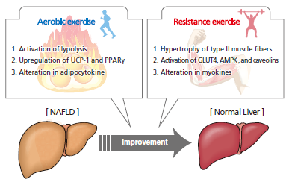
Physical Activity and NAFLD
Both aerobic and resistance exercise reduce hepatic with similar frequency, duration, and period of exercise (40–45 min/ session 3 times/week for 12 weeks);
Intensity and energy consumption were significantly lower for resistance than for aerobic exercise;
Resistance exercise may be more feasible than aerobic exercise for NAFLD patients with poor cardiorespiratory fitness or for those who cannot tolerate or participate in aerobic exercise.
Hashida et al, J Hep 2017

Slide 19
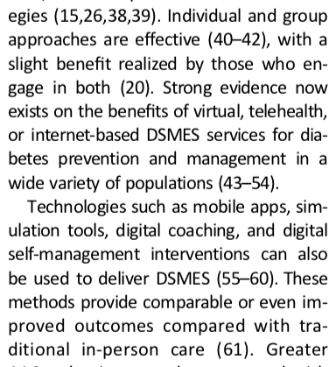
Telehealth/eHealth
……………………..
………..
ElSayed, Diabetes Care 2023;46(Suppl. 1):S68–S96

Slide 20
Automated web-based programs
ANODE study T2DM+Obesity
16-week follow-up
FLIP Program
2-year follow-up
Percentage of patients achieving weight loss by e-coaching compared with follow-up by GPs
Hansel, J Med Internet Res 2017
Mazzotti, J Hepatology 2017

Slide 21
Readiness & acceptance of eHealth
Singapore study. Participants from the general population with (n =436) and without (n =2459) diabetes. Globally, 47.3% of the overall sample and 75.7% of DM group answering that they were not ready for eHealth (P<0.001).
Disadvantages
Advantages
Age (≥35 years), ethnicity (Indian), lower education status (primary school), BMI (underweight), and marital status (being single) were associated with a lower likelihood of eHealth acceptance.
AshaRani, J Med Internet Res 2021

Slide 22
Web-based intervention and incident DM
Petroni, Nutrients 2023

Slide 23
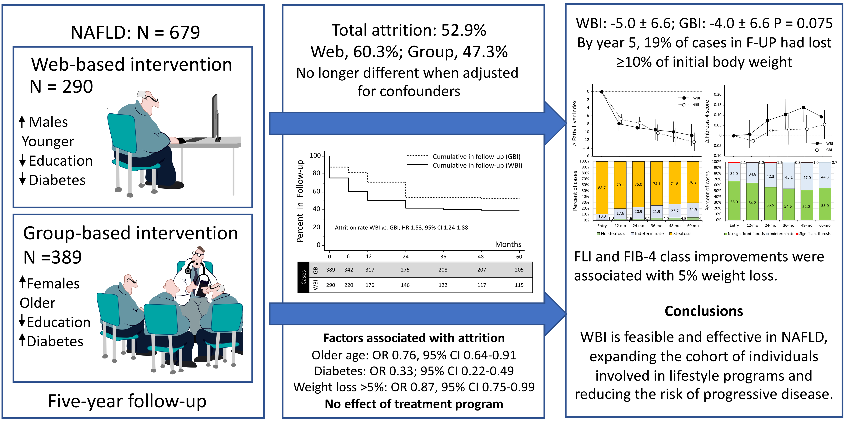
Web-based intervention and biomarkers
Petroni, submitted

Slide 24
Evoluzione della eHealth
ChatBot, del tipo JITAI - Just-in-time-adaptive-interventions - un processo che permette di fare domande con risposte chiuse, legate ad algoritmi pre-definiti
Artificial intelligence (in grado di leggere il linguaggio naturale) che permettono di fare domande aperte
Integrazione con sensori di movimento e GPS in grado di misurare l’attività fisica
Misurazione dell’apporto calorico mediante la definizione delle calorie presenti nei cibi fotografati dai pazienti

Slide 25
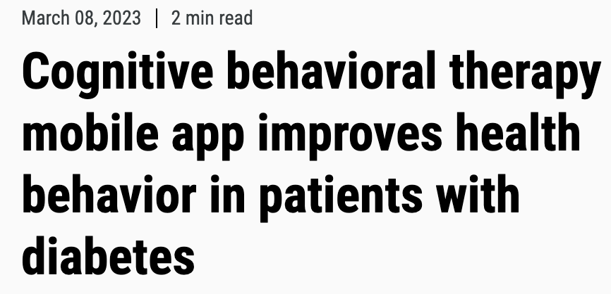

The pivotal trial of the BT-001 mobile app (Better Therapeutics) enrolled 669 patients with diabetes at 12 sites (mean age, 58 years; mean BMI, 35 kg/m²; 56% women; 55% white). Random assignment to the intervention app or a control app on top of standard diabetes care. The primary outcome was change in mean HbA1c at 90 days.
Compared with controls, patients assigned to appCBT reduced HbA1c at both 90 days (mean difference in change, 0.4%; P < .0001) and 180 days (0.3%; P < .01).
The appCBT had less antihyperglycemic drug intensification compared with the control arm (24.4% vs. 14.4%; P < .01), and was less likely to start or increase insulin (3.8% vs. 1.5%; P < .05) and more likely to stop or decrease insulin (–0.9% vs. –2.2%; P < .05).
“Compared to a control app, cognitive behavioral therapy delivered with a digital mobile app or digital therapeutic not only lowered HbA1c, but it did so requiring less intensification of antihyperglycemic therapy, less requirement of insulin intensification, and significantly and persistently reduced HbA1c”.

Slide 26
Hsia, Diabetes Care 2022

Slide 27
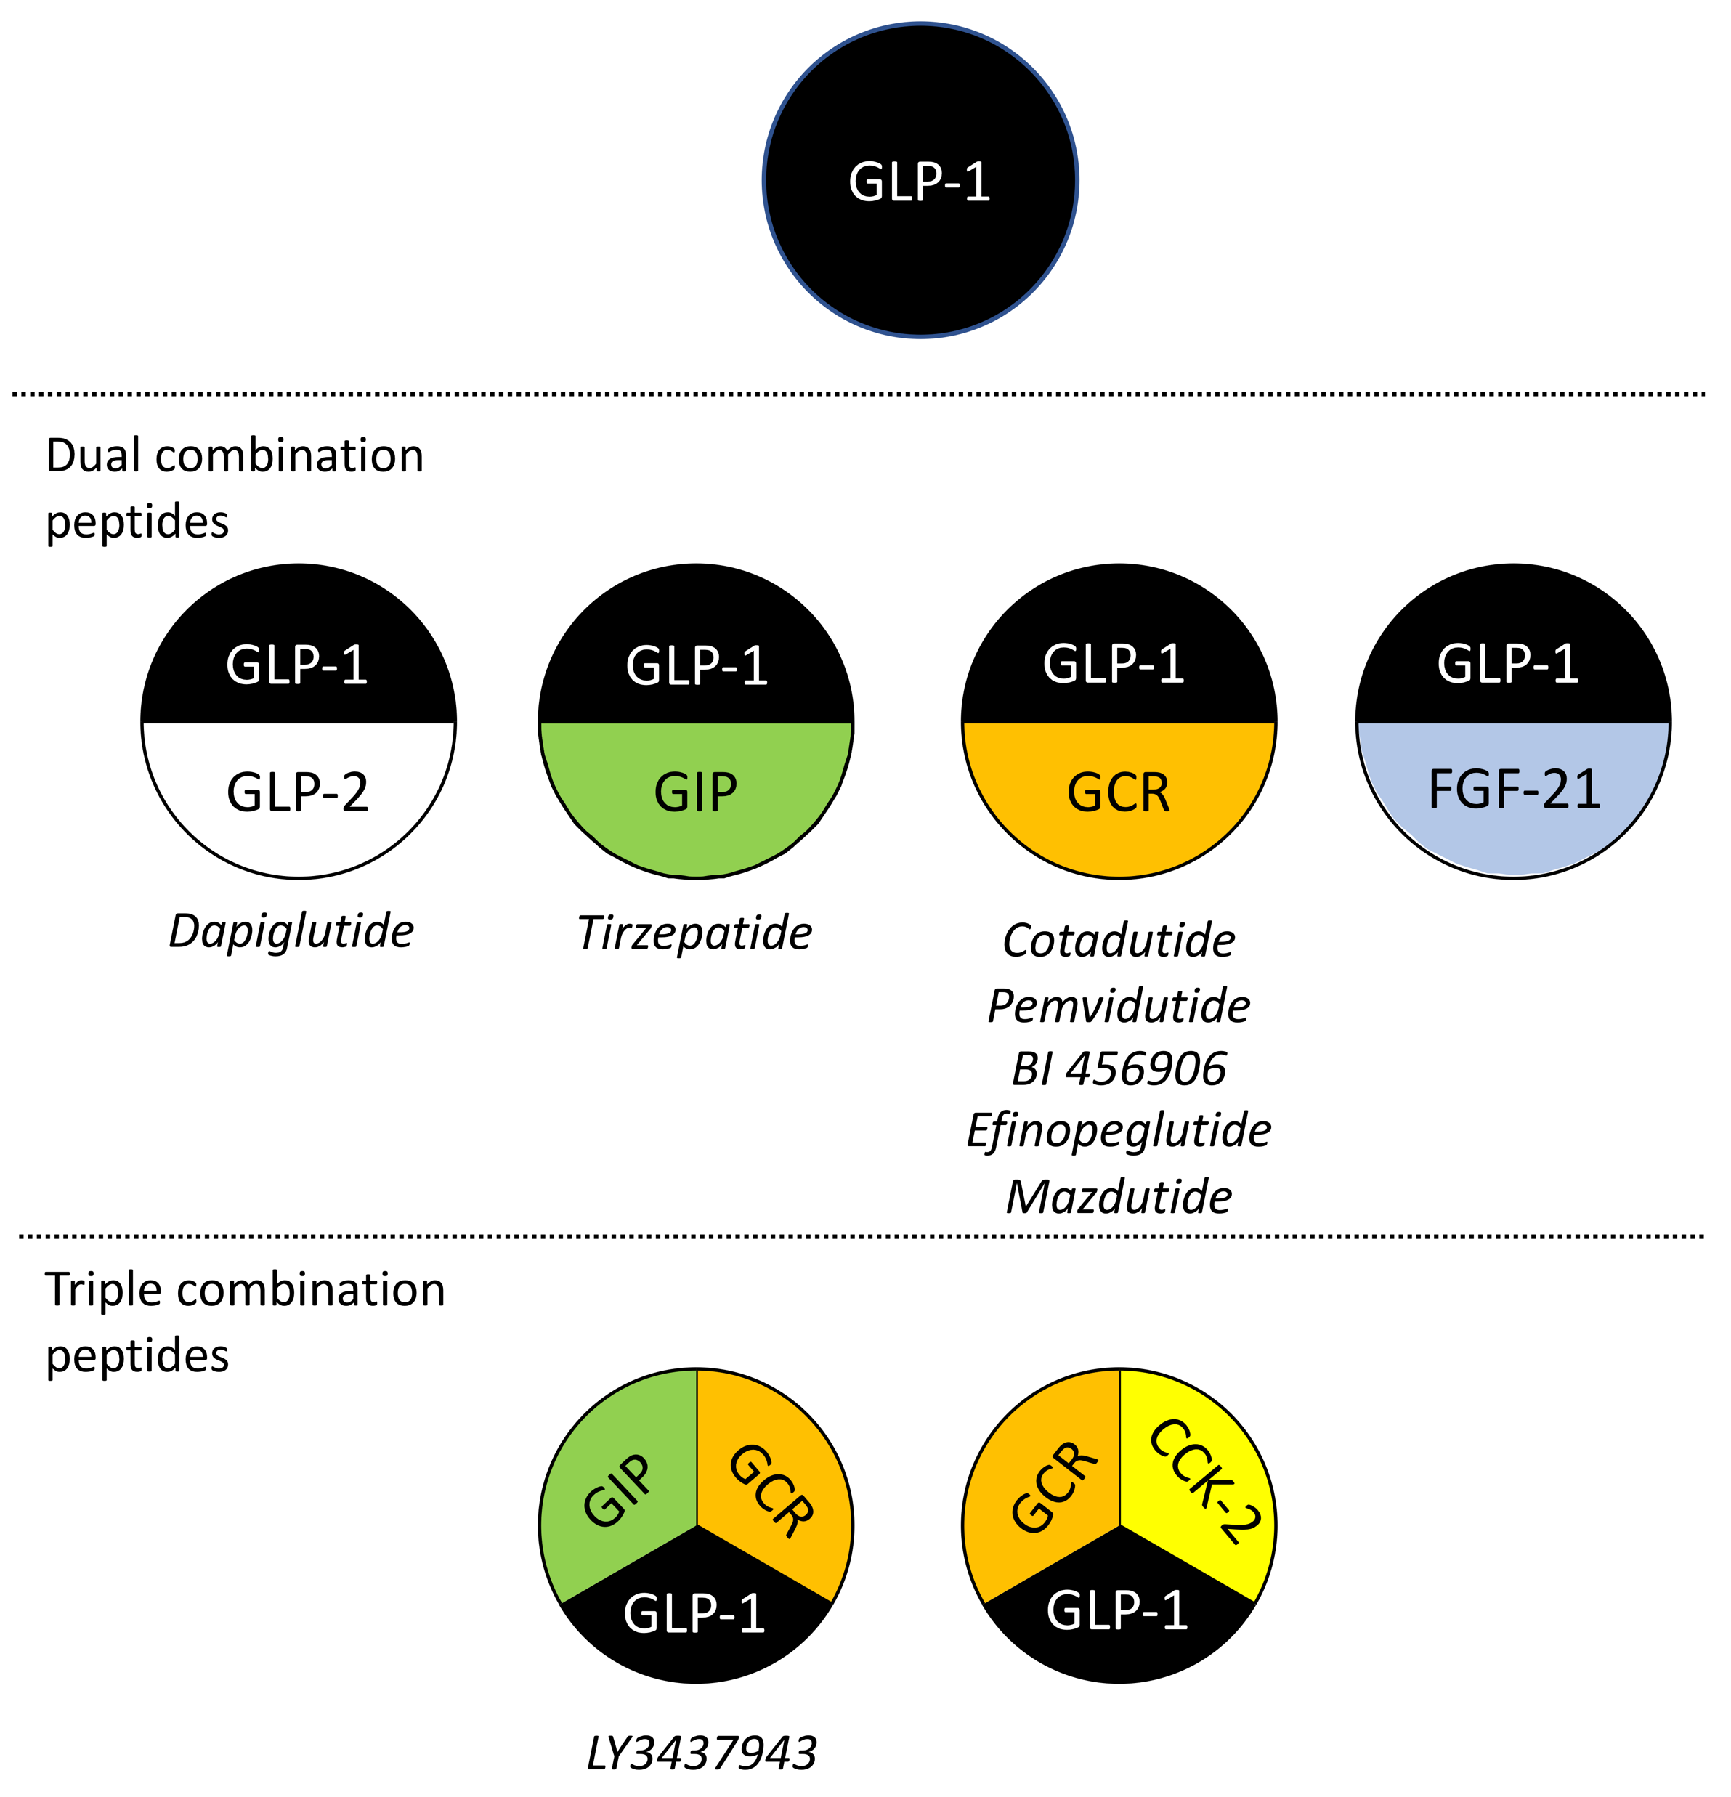
Brodosi, Exp Opin Pharmacother 2023

