Slide 1
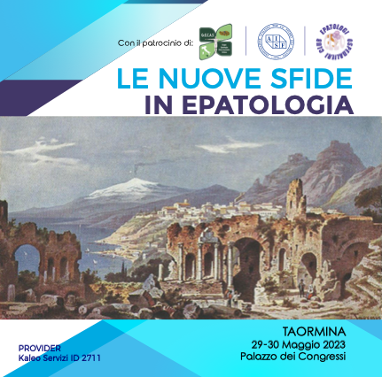



Il trattamento della colangite biliare primitiva:
i dati della rete CBP-Sicilia
Vincenza Calvaruso, MD, PhD
Gastroenterologia & Epatologia, PROMISE
Università degli Studi di Palermo
vincenza.calvaruso@unipa.it

Slide 2
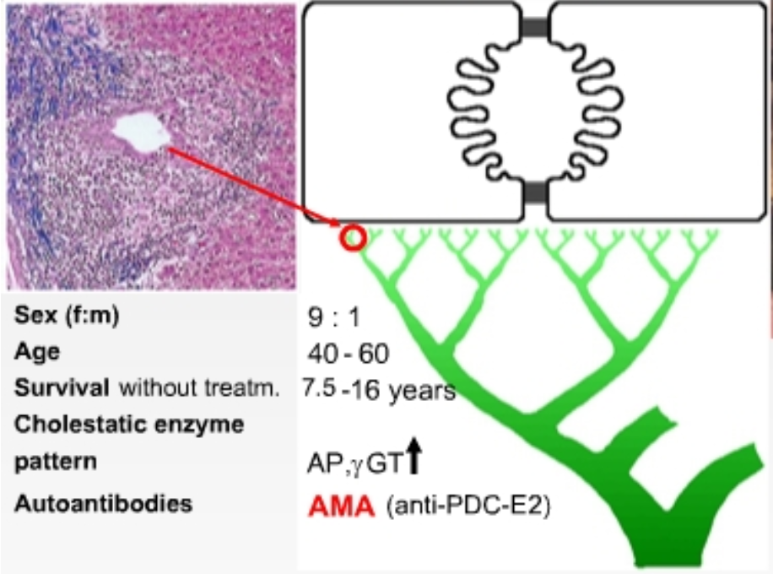
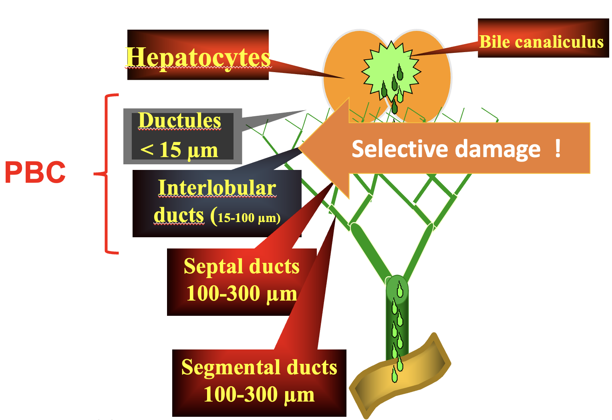
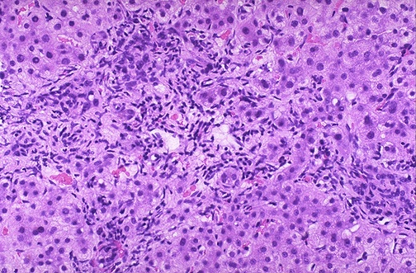
Primary Biliary Cholangitis
A chronic cholestatic disease due to a non-suppurative destructive cholangitis of intrahepatic bile ducts, immune mediated

Slide 3
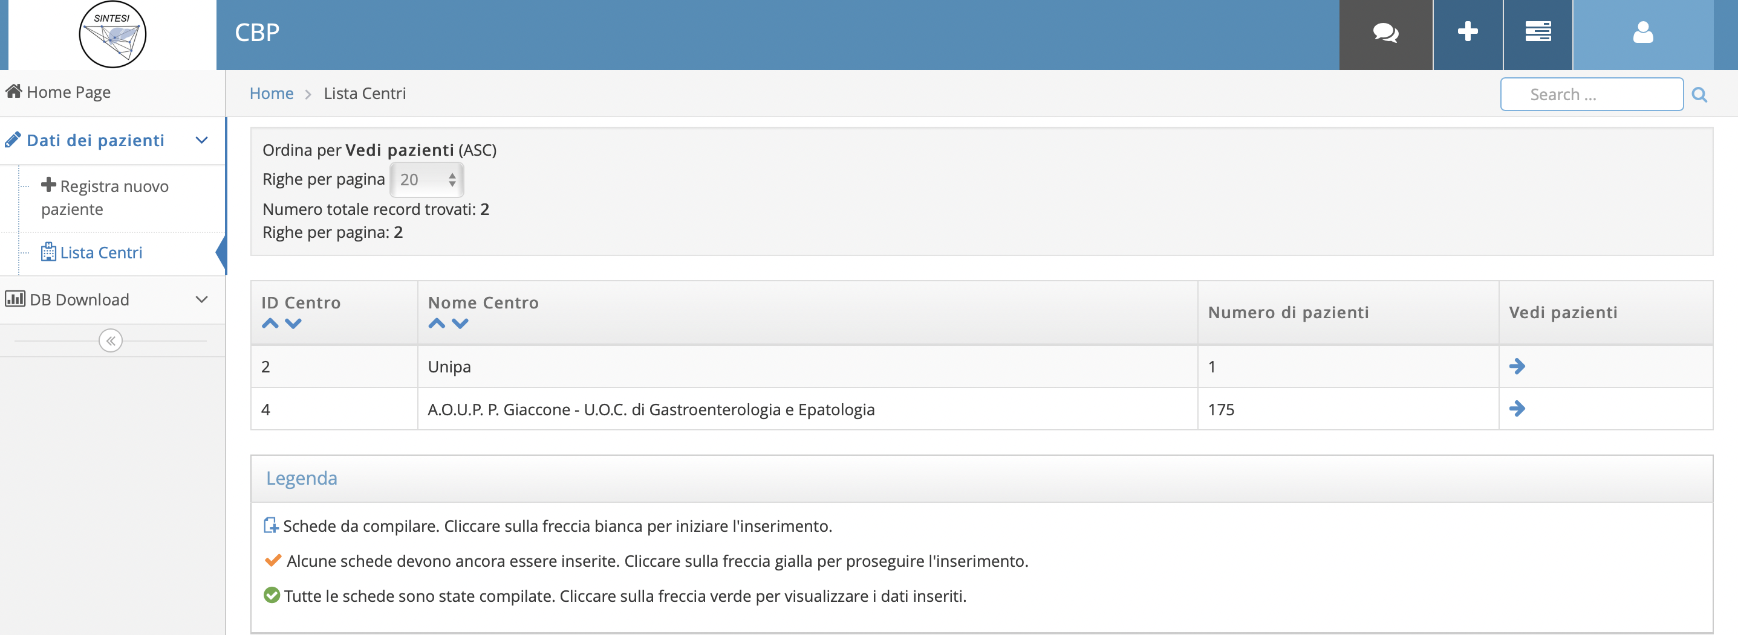
SINTESI HEPATOLOGY
CBP SICILIA – Web network
Survey centri: novembre 2019
Piattaforma CINECA attiva da gennaio 2021

Slide 4
1°Database lock (15.01.2023)
Completamento dati di definizione diagnostica di tutti i 477 pazienti (32 missing)
Inserimento di almeno un FU per paziente (77 missing)
2° Database lock (31.05.2023)
Inserimento di tutti i pazienti presi in carico (520-530?)

Slide 5
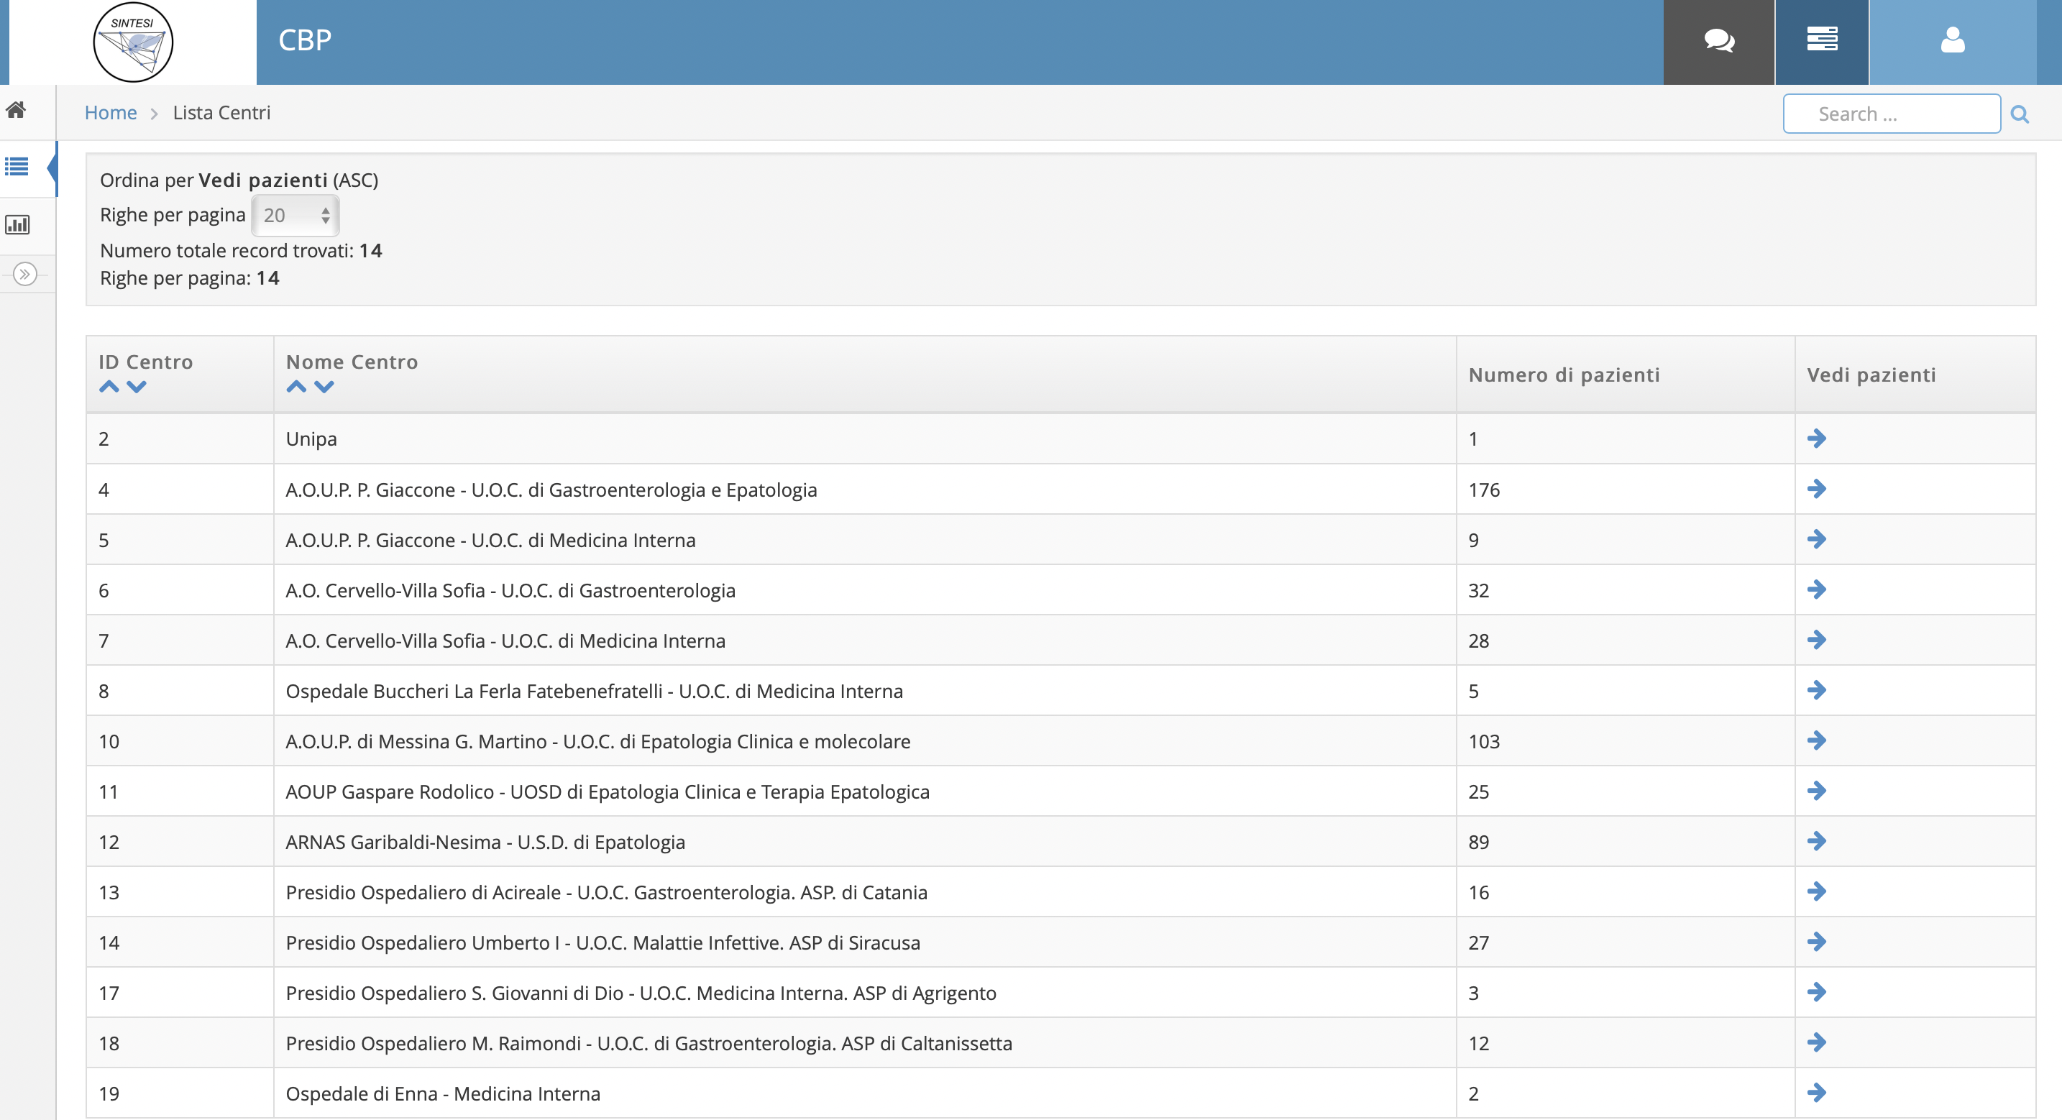
CBP- pazienti registrati in rete
477 531
(12/2022) (27/05/2023)

Slide 6
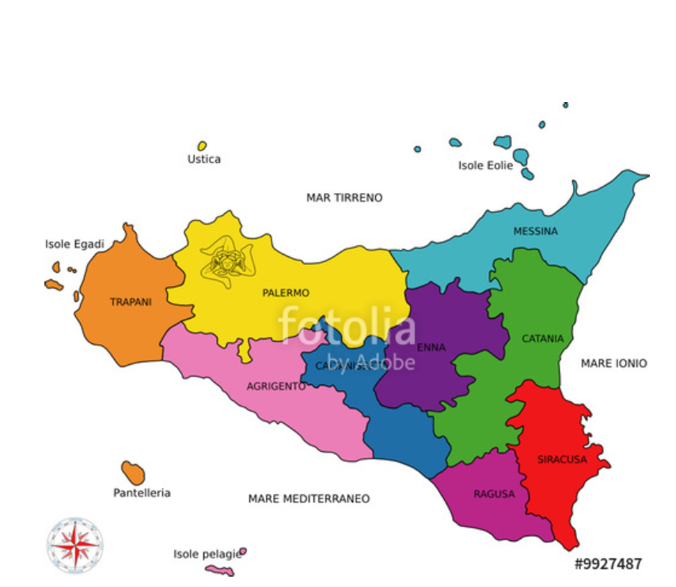
531 pts
35 fuori regione
80
171
112
18
14
30
28
29
13

Slide 7
Epidemiology of PBC
Remains a female predominant disease
  Mainly >40 years
  Does not present in childhood
Global: Estimated 1 in 1,000 women over the age of 40 years old living with PBC
Europe: Estimated incidence 1–2 per 100,000 population per year
  Incidence range: 0.3–5.8 per 100,000
  Prevalence range: 1.9–40.2 per 100,000
Italy
- Incidence range: 5.3 per 100,000
- Prevalence range: 27.9 per 100,000
531 pts = 10.2 per 100.000 ???
EASL CPG PBC. J Hepatol 2017;67:145–72
Marzioni M et. Al Digestive and Liver Disease 2019

Slide 8
Initial diagnosis of PBC
PBC should be suspected in patients with persistent cholestatic serum liver tests or symptoms
  Including pruritus and fatigue
Test | Finding | Suspicion | Diagnosis | Prognosis
ALP | ⬆ | ✓ | ✓ | ✓
AST/ALT | ⬆ | ✓ |  | ✓
GGT | ⬆ | ✓
IgM | ⬆ | ✓
AMA (>1/40) | + |  | ✓
Specific ANA | + |  | ✓
Anti-gp210 | + |  | ✓ | ✓
Anti-sp100 | + |  | ✓
Anti-centromere | + |  |  | ✓
Bilirubin | ⬆ |  |  | ✓
Platelets | ⬇ |  |  | ✓
INR | ⬆ |  |  | ✓
Albumin | ⬇ |  |  | ✓
*Statements 7–10
EASL CPG PBC. J Hepatol 2017;67:145–72
Notes:
AIH, autoimmune hepatitis; ALP, alkaline phosphatase; AMA, antimitochondrial antibody; ANA, antinuclear antibody; ELISA, enzyme-linked immunosorbent assay; NASH, non-alcoholic steatohepatitis

Slide 9
Initial diagnosis of PBC
PBC should be suspected in patients with persistent cholestatic serum liver tests or symptoms
  Including pruritus and fatigue
Grade of evidence
Grade of recommendation
Recommendations*
In adults with cholestasis and no likelihood of systemic disease, an elevated ALP plus AMA at a titre >1:40 is diagnostic | III | 1
In the correct context, a diagnosis of AMA-negative PBC can be made in patients with cholestasis and specific ANA immunofluorescence (nuclear dots or perinuclear rims) or ELISA results (sp100, gp210) | III | 1
Liver biopsy not required for diagnosis of PBC, unless PBC-specific antibodies absent, coexistent AIH or NASH suspected, or other (usually systemic) comorbidities are present | III | 1
AMA reactivity alone is not sufficient to diagnose PBC. Follow up patients with normal serum liver tests who are AMA positive with annual biochemical reassessment for the presence of liver disease | III | 1
*Statements 7–10
EASL CPG PBC. J Hepatol 2017;67:145–72
Notes:
AIH, autoimmune hepatitis; ALP, alkaline phosphatase; AMA, antimitochondrial antibody; ANA, antinuclear antibody; ELISA, enzyme-linked immunosorbent assay; NASH, non-alcoholic steatohepatitis

Slide 10
Caratteristiche demografiche alla diagnosi
della coorte CBP Sicilia
CARATTERISTICHE AL BASELINE | TOTALE (N=531)
Età media alla diagnosi (anni) | 56,6 ± 12.7
Sesso femminile, n (%) | 483 (90.9%)
Figli Media figli | 84% 2.3
Istruzione Licenza elementare Licenza Media Diploma Laurea | 6.4% 39.1% 29.8% 14.6%
Occupati lavorativamente Casalinga Disoccupato | 59.6% 35.8% 4.6%
Fumatori Ex fumatori Non fumatori Non noto/segnalato | 12.4% 10.0% 63.3% 14.3%
Consumo di alcool | 67 (14%)
Notes:
6 pazienti con varici esofagee e 2 paz con ascite al basale;
Circa il 70% aveva una malattia in stadio I-II

Slide 11
Caratteristiche cliniche alla diagnosi di 531 pazienti con CBP
CARATTERISTICHE AL BASELINE | TOTALE (N=531)
Età media alla diagnosi (anni) | 56,6 ± 12.7
Sesso femminile, n (%) | 483 (90.9%)
AMA + n, (%) | 478 (90.0%)
ANA + Sp100 Gp210 | 293 (55.1) 17/76 27/76
BMI | 25.3 ± 13
Prurito n (%) | 202 (40.3%)
Astenia n, (%) | 162 (32.3%)
Biopsia (%) | 266/501 (53%)
Overlap Syndrome | 56/501 (11%)
TE mean* TE median | 9.8 ± 8.7 7.0
Cirrosi clinica/istologica Scompensata Varici | 88 (17.5%) 11 35
Esami di laboratorio* | TOTALE (N=501)
Bilirubina (mg/dL) | 0.9 ± 1.2
GGT (x ULN) | 7.7 ± 11.4
ALP (x ULN) | 2.7 ± 2.1
ALT (x ULN) | 2.9 ± 4.6
AST (x ULN) | 2.4 ± 2.5
Albumina (g/dL) | 4.0 ± 0.5
Piastrine (x10⁹/L) | 232 ± 86
INR | 1.0 ±1.0
Colesterolo totale (mg/dL) | 218 ± 60
Colesterolo HDL (mg/dL) | 65 ± 24
Trigliceridi | 107 ± 42
IgM | 405 ± 315
IgG | 1491 ± 536
* 501 patients
Notes:
6 pazienti con varici esofagee e 2 paz con ascite al basale;
Circa il 70% aveva una malattia in stadio I-II

Slide 12
Caratteristiche cliniche alla diagnosi di 445 pazienti con CBP
Caratteristiche istologiche e valutazione non invasiva al baseline | TOTALE (445)
Biopsia | 252 (56.6%)
Stadio I | 35%
Stadio II | 36%
Stadio III | 22%
Stadio IV | 18 (7%)
Overlap Syndrome | 11%
Steatosi | 14.6%
Portal vein (mean) | 11.3 ± 10.7
Spleen size (mean) | 11.0 ± 2.1
TE mean* TE median | 10.1 ± 8.7 7.0
Cirrosi clinica/istologica | 81 (18%)
Pazienti con cirrosi alla diagnosi | TOTALE (81)
Cirrosi compensata | 71 (88%)
Child Pugh (mediana) | 6
MELD | 8
Varici esofagee alla diagnosi (%) Varici assenti Varici F1 Varici F2/F3 Non noto | 24 (29.6) 22 (27.2) 11(13.6) 25 (31)
Ascite | 6
EPS | 3
EDS | 1
* 240 TE disponibile alla diagnosi

Slide 13
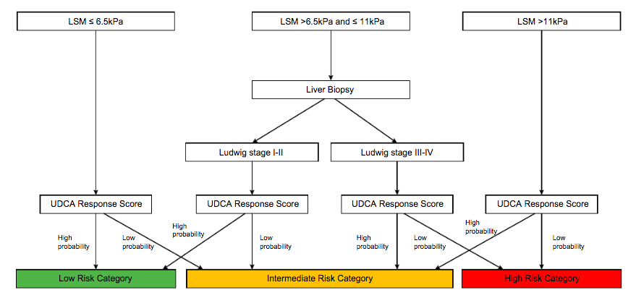
Proposed algorithm for risk stratification at diagnosis in PBC patients
CRISTOFERI, CALVARUSO, ET AL. Hepatology 2021

Slide 14
Valori di stiffness e diagnosi di fibrosi avanzata in 240 pazienti con CBP e Fibroscan alla diagnosi

Slide 15
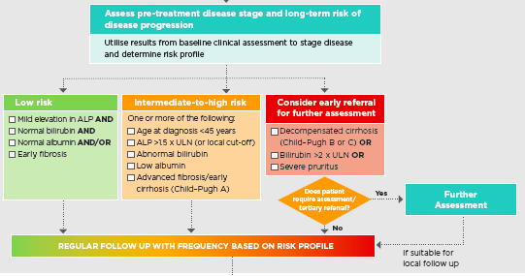
Predittori di progressione di malattia
63 pts
328 pts
37 pts

Slide 16
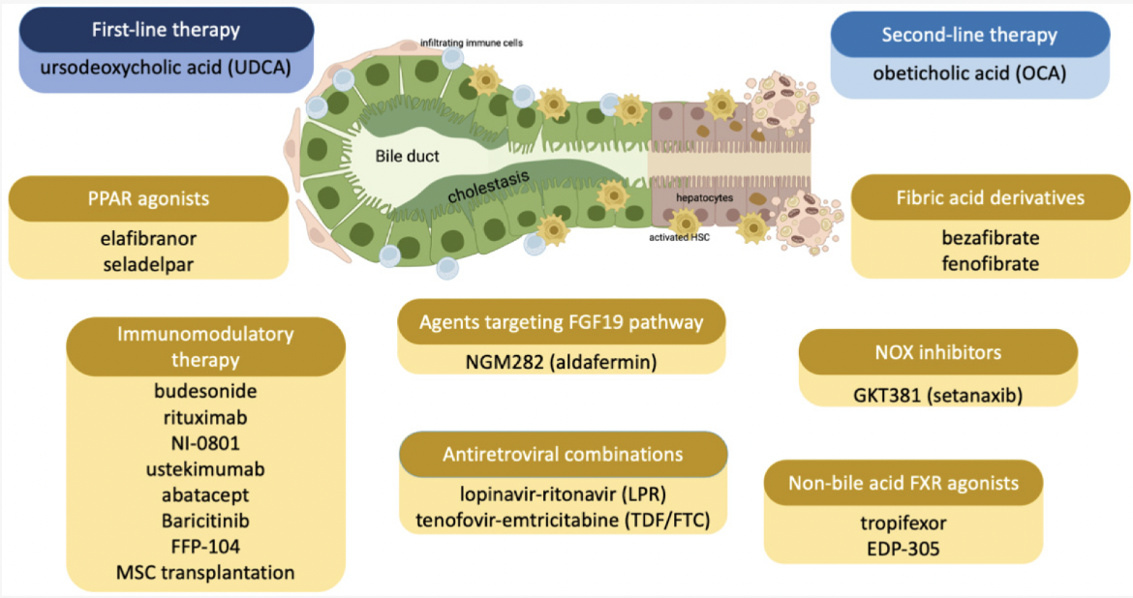
Drugs approved (in blue) or under evaluation (in yellow) for the treatment of PBC

Slide 17
Clinical Practice Guidelines
Journal of Hepatology 2017 vol. 67 I 145–172
Notes:
La failure al trattamento con UDCA viene valutata a 12 mesi (ALP
e bilirubina)
Una inadeguata risposta biochimica ad UDCA si ha nel 25-50%
dei pazienti trattati nella maggior parte delle coorti
Necessità di valori soglia stadio-specifici

Slide 18
Different mechanisms of action are involved in UDCA’s beneficial effect
a) choleretic and anti-cholestatic effects, due to intracellular molecular signalling pathways that stimulate cellular secretions by promoting vesicular exocytosis and trans-membrane carriers' insertion (2);
b) cytoprotection against toxic effects of BAs and cytokine-induced injury, by stabilization of cell membranes, enhancement of the defences against oxidative stress and inhibition of apoptosis (3); in addition to this, UDCA contributes to the biliary bicarbonate (HCO3−) umbrella enhancing biliary HCO3−secretion against the acidification of the apical surface of cholangiocytes and hepatocytes due to acid BAs (4), and up-regulates liver glutathione synthesis (5);
c) immunomodulation and anti-inflammatory effects, by inhibiting prostaglandin E2 (PGE2) thus blocking the
propagation of autoimmune liver injury; moreover, UDCA strongly decreases the hepatocellular expression of MHC class I and the biliary expression of MHC class II, thus interfering with the autoimmune basic mechanisms (5); it also decreases eosinophil levels in blood stream, and suppresses the immune reaction against PAMPs such LPS's Lipid A (5);
d) increase of the hydrophilicity of the circulating endogenous BA pool (5).
1. EASL clinical practice guidelines: the diagnosis and of patients with primary biliary cholangitis. J Hepatol 2017;67:145–72
2. Beuers U et al. New paradigms in the treatment of cholestasis: from UDCA to FXR, PXR and beyond. J Hepatol 2015;62:S25–37.
3. Beuers U. Drug insight: mechanisms and sites of action of ursodeoxycholic acid in cholestasis. Nat Clin Pract Gastroenterol Hepatol 2006;3:318–28.
4. Beuers U et al. The biliary HCO3− umbrella: a unifying hypothesis on pathogenetic and therapeutic aspects of fibrosing cholangiopathies. Hepatology 2010;52:1489–96.
5. Poupon R. Ursodeoxycholic acid and bile-acid mimetics as therapeutic agents for cholestatic liver diseases: an overview of their mechanisms of action.
Clin Res Hepatol Gastroenterol 2012;36(Suppl. 1):S3–12.
Notes:
bile acid (BA);
MHC: Il complesso di geni MHC di classe II assieme a quello di classe I e a molti altri è parte del complesso maggiore di istocompatibilità (MHC) è implicato nel riconoscimento degli antigeni da parte del sistema immunitario. Nello specifico l'MHC-II si occupa di mostrare alle difese dell'organismo gli antigeni provenienti dallo spazio extracellulare al contrario di quanto fa l'MHC-I che mostra invece lo spazio intracellulare.

Slide 19
Different mechanisms of action are involved in UDCA’s beneficial effect
choleretic and anti-cholestatic effects
cytoprotection against toxic effects of BAs and cytokine-induced injury
immunomodulation and anti-inflammatory effects
increase of the hydrophilicity of the circulating endogenous BA pool
The Effect of Ursodeoxycholic Acid Therapy on Liver Fibrosis
Progression in Primary Biliary Cirrhosis
CHRISTOPHE CORPECHOT, FABRICE CARRAT, ANNE-MARIE BONNAND, RENEE EUGENIE POUPON, AND RAOUL POUPON
Probability of remaining free of extensive
fibrosis or cirrhosis
UDCA therapy was associated with a 5-fold lower progression rate from early histologic stage toward extensive fibrosis or cirrhosis. Indeed, the rate of stage progression was 7% per year in UDCA-treated patients, as compared with 34% per year in placebo-treated patients
HEPATOLOGY Vol. 32, No. 6, 2000

Slide 20
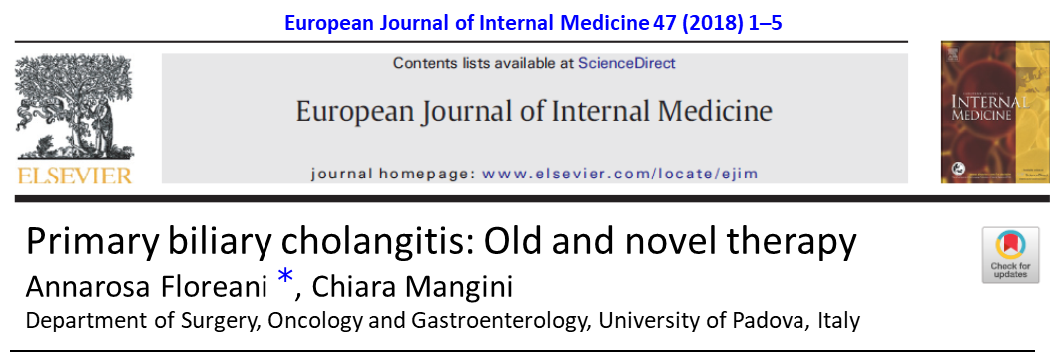
The introduction of UDCA as the first-line therapy for PBC drastically changed the natural history of the disease, lowering the mortality of PBC patients, especially when administered at early stages, as demonstrated in many studies; the survival rate of patients with stage 1 or 2 treated with UDCA long-term was similar to that of general population (1-3).
It was widely demonstrated that UDCA improves blood markers of cholestasis and consistently reduces IgM levels in blood and AMA titres; moreover, UDCA improves the histological features of PBC patients and decreases the risk of development of oesophageal varices (4-7).
1. Corpechot C et al. The effect of ursodeoxycholic acid therapy on the natural course of primary biliary cirrhosis. Gastroenterology 2005;128:297–303.
2. Pares A et al. Excellent long-term survival in patients with primary biliary cirrhosis and biochemical response to ursodeoxycholic acid. Gastroenterology 2006;130:715–20.
3. Borg PC et al. Prognosis ofursodeoxycholic acid-treated patients with primary biliary cirrhosis. Results of a 10-yr cohort study. Am J Gastroenterol 2006;101:2044–50.
4. Papatheodoridis GV et al. Am J Gastroenterol 2002;97:2063–70.
5. Parés A et al. UDCA-Cooperative Group from the Spanish Association for the Study of the Liver. J Hepatol 2000;32:561–6
6. Corpechot C et al. Hepatology 2000;32:1196–9.
7. Lee YM, Kaplan MM. Semin Liver Dis2005;25:321–6.

Slide 21
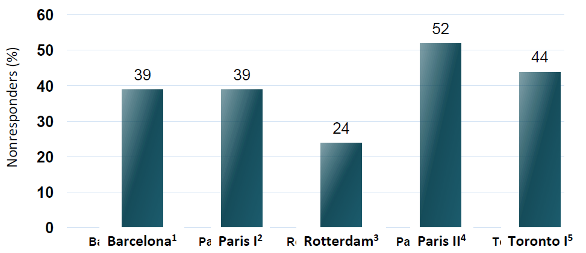
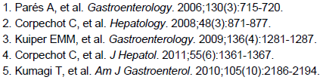
Despite PBC treatment with UDCA, a considerable number of patients
continue to have an inadequate response to treatment

Slide 22
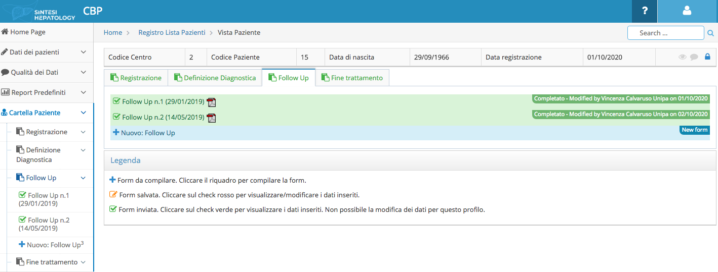
Simplification and maintenance of SoC in patients with PBC in Sicily (PDTA PBC)
Management of side effects and improvement of compliance
439

Slide 23
UDCA THERAPY
Responder a terapia di prima linea con UDCA (sec. Toronto): 70%
132/439 non responder (30%)
All patients (439)
Non responder to UDCA (30%)
(132 pts)

Slide 24
Clinical Practice Guidelines
Journal of Hepatology 2017
vol. 67 I 145–172
Notes:
La failure al trattamento con UDCA viene valutata a 12 mesi (ALP
e bilirubina)
Una inadeguata risposta biochimica ad UDCA si ha nel 25-50%
dei pazienti trattati nella maggior parte delle coorti
Necessità di valori soglia stadio-specifici

Slide 25

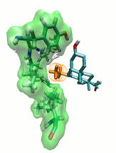
Obeticholic acid
Bile Acid
Metabolism
Lipid
Metabolism
Controls bile acid biosynthesis, disposal and transport
Downregulates hepatic fatty acid biosynthesis and VLDL formation
FXR
RXR
Inflammation & Fibrosis
INT-747
Carbohydrate
Metabolism
Anti-inflammatory & anti-fibrotic effects in the liver, intestine and kidney
Insulin signaling & sensitivity and hepatic gluconeogenesis
Notes:
FXR agonists are an attractive class of drugs for patients with chronic liver diseases. In addition to their critical role in regulating BA, carbohydrate, and lipid metabolism, they also possess potent anti-inflammatory and anti-fibrotic properties.

Slide 26

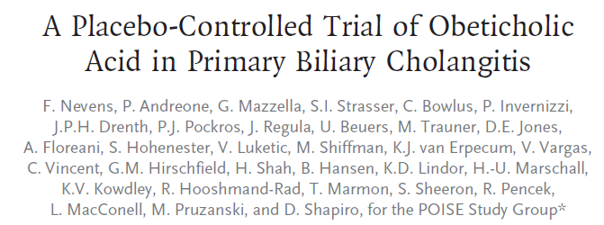

Significant Reductions in ALP
Within 2 Weeks
POISE
OCA Treatment Significantly Reduced GGT
Notes:
Table 14.2.9.1.1
QC15MAR2014

Slide 27
At End of Study Pruritus Experience Was Similar for All Subjects Using a Visual Analog Score
 | Placebo (n=73) | Titration OCA (n=70) | 10 mg OCA (n=73)
 | n (%) | n (%) | n (%)
Pruritus | 28 (38%) | 39 (56%) | 50 (68%)
Fatigue | 10 (14%) | 11 (16%) | 17 (23%)
Nasopharyngitis | 13 (18%) | 17 (24%) | 13 (18%)
Nausea | 9 (12%) | 4 (6%) | 8 (11%)
Diarrhoea | 8 (11%) | 2 (3%) | 8 (11%)
Arthralgia | 3 (4%) | 4 (6%) | 7 (10%)
Headache | 13 (18%) | 12 (17%) | 6 (8%)
Oropharyngeal pain | 1 (1%) | 5 (7%) | 6 (8%)
Cough | 5 (7%) | 4 (6%) | 6 (8%)
Constipation | 4 (5%) | 5 (7%) | 5 (7%)
Oedema peripheral | 2 (3%) | 2 (3%) | 5 (7%)
Influenza | 4 (5%) | 5 (7%) | 4 (5%)
Abdominal pain upper | 5 (7%) | 5 (7%) | 4 (5%)
Back pain | 8 (11%) | 4 (6%) | 4 (5%)
Upper respiratory tract infection | 8 (11%) | 4 (6%) | 4 (5%)
Urinary tract infection | 8 (11%) | 4 (6%) | 4 (5%)
Rash | 3 (4%) | 3 (4%) | 4 (5%)

Slide 28
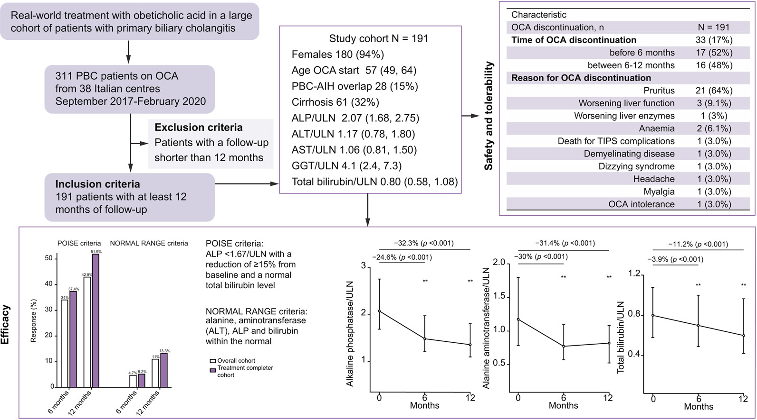
Real-world experience with obeticholic acid in patients with PBC
D’Amato D. et al. JHep Reports 2021

Slide 29
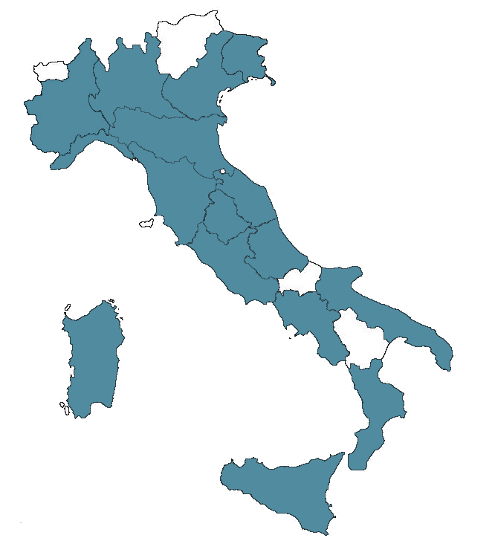
Extension of real-world OCA in Italy: RECAPITULATE STUDY
Characteristics | N 441
Socio-demographics and comorbidities
Sex, female | 390 (88%)
Age at OCA start, years | 57.8 (10.9)
Age at PBC diagnosis, years | 49.4 (10.8)
Duration of disease before OCA start, years | 7 (3-12)
Body Mass Index, Kg/m² | 24.6 (4.3)
Diabetes mellitus | 30 (7%)
Liver disease characterization
AMA positivity | 377 (85%)
ANA positivity | 228 (52%)
PBC-AIH overlap | 59 (13%)
GLOBE score | 0.2 (0.9)
VCTE LSM, kPa | 7.9 (6.1-11.9)
not available | 134 (30%)
Cirrhosis | 152 (34%)
Diagnosis of cirrhosis Clinical Histological Elastographic$ | 103 (67%) 37 (24%) 14 (9%)
Child-Pugh class A B C | 148 (97%) 4 (3%) 0 (0%)
MELD | 7.1 (6.4-8.5)
Ascites controlled with diuretics present | 4 (3%) 2 (1%)
Esophageal varices presence gastroscopy not performed | 42 (28%) 6 (4%)
Milano (4)
Monza (1)
Brescia (1)
Val Trompia (1)
Rho (1)
Pavia (1)
Sondrio (1)
Lecco (1)
Como (1)
Torino (2)
Biella (1)
Asti (1)
Novara (1)
Padova (1)
Ferrara (1)
Bologna (1)
Ravenna (1)
Genova (1)
Firenze (1)
Pisa (1)
Ancona (1)
Perugia (1)
Pescara (1)
Roma (7)
Civitavecchia (1)
Barletta (1)
Bari (2)
Foggia (2)
Napoli (1)
Cagliari (2)
Sassari (1)
Catanzaro (1)
Messina (1)
Palermo (1)
Siracusa (1)
Catania (2)
By courtesy of Umberto Vespasiani Gentilucci

Slide 30
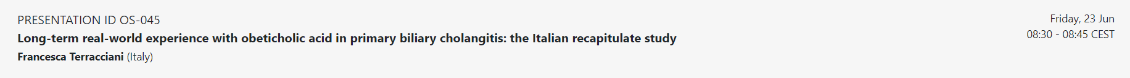
RECAPITULATE Study
Study population (1)
Characteristics | N 441
Socio-demographics and comorbidities
Sex, female | 390 (88%)
Age at OCA start, years | 57.8 (10.9)
Age at PBC diagnosis, years | 49.4 (10.8)
Duration of disease before OCA start, years | 7 (3-12)
Body Mass Index, Kg/m² | 24.6 (4.3)
Diabetes mellitus | 30 (7%)
Liver disease characterization
AMA positivity | 377 (85%)
ANA positivity | 228 (52%)
PBC-AIH overlap | 59 (13%)
GLOBE score | 0.2 (0.9)
VCTE LSM, kPa | 7.9 (6.1-11.9)
not available | 134 (30%)
Cirrhosis | 152 (34%)
Diagnosis of cirrhosis Clinical Histological Elastographic$ | 103 (67%) 37 (24%) 14 (9%)
Child-Pugh class A B C | 148 (97%) 4 (3%) 0 (0%)
MELD | 7.1 (6.4-8.5)
Ascites controlled with diuretics present | 4 (3%) 2 (1%)
Esophageal varices presence gastroscopy not performed | 42 (28%) 6 (4%)
Databases analysed: N 51
Total Population: N 487
excluded 10 subjects with unavailable ALP values at baseline
excluded 36 subjects without at least 12m of follow-up
Sample for the analyses: N 441
Oral presentation, EASL 2023, Wien

Slide 31
RECAPITULATE Study
Liver enzymes and bilirubin over time
By courtesy of Umberto Vespasiani Gentilucci

Slide 32
RECAPITULATE Study
Primary and Secondary endpoints (Overall population)
By courtesy of Umberto Vespasiani Gentilucci

Slide 33
RECAPITULATE Study
Primary and Secondary endpoints (Non-Cirrhotics Vs Cirrhotics)
p<0.01
By courtesy of Umberto Vespasiani Gentilucci

Slide 34
RECAPITULATE Study
Primary and Secondary endpoints («Pure» PBC Vs Overlap PBC/AIH)
P<0.001

Slide 35
RECAPITULATE Study
Primary and Secondary endpoints («Pure» PBC Vs Overlap PBC/AIH)
p=0.2
By courtesy of Umberto Vespasiani Gentilucci

Slide 36
Murillo Perez CF, Fisher H et al. Gastroenterology 2022

Slide 37
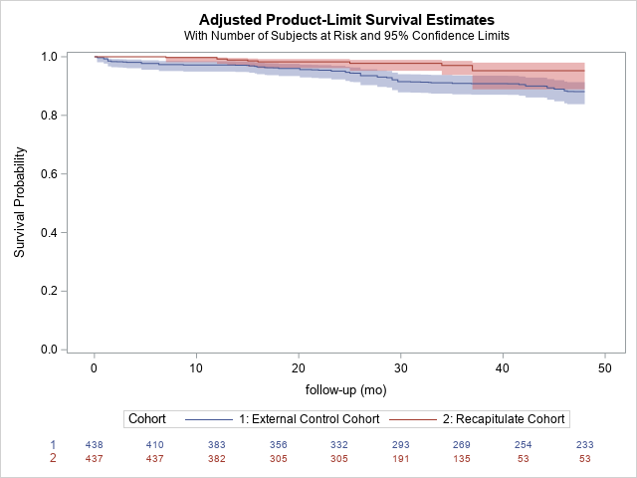
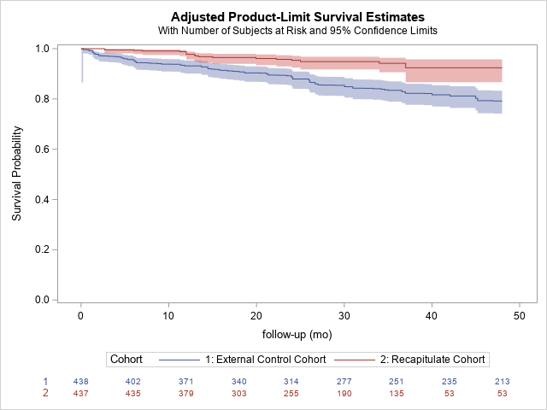
RECAPITULATE Vs GLOBAL PBC
Liver transplant free survival
Event free survival
HR 0.318 [95%CI: 0.153-0.660]
HR 0.327 [95%CI: 0.196-0.543]
P <.0001
P <.0001
By courtesy of Umberto Vespasiani Gentilucci

Slide 38
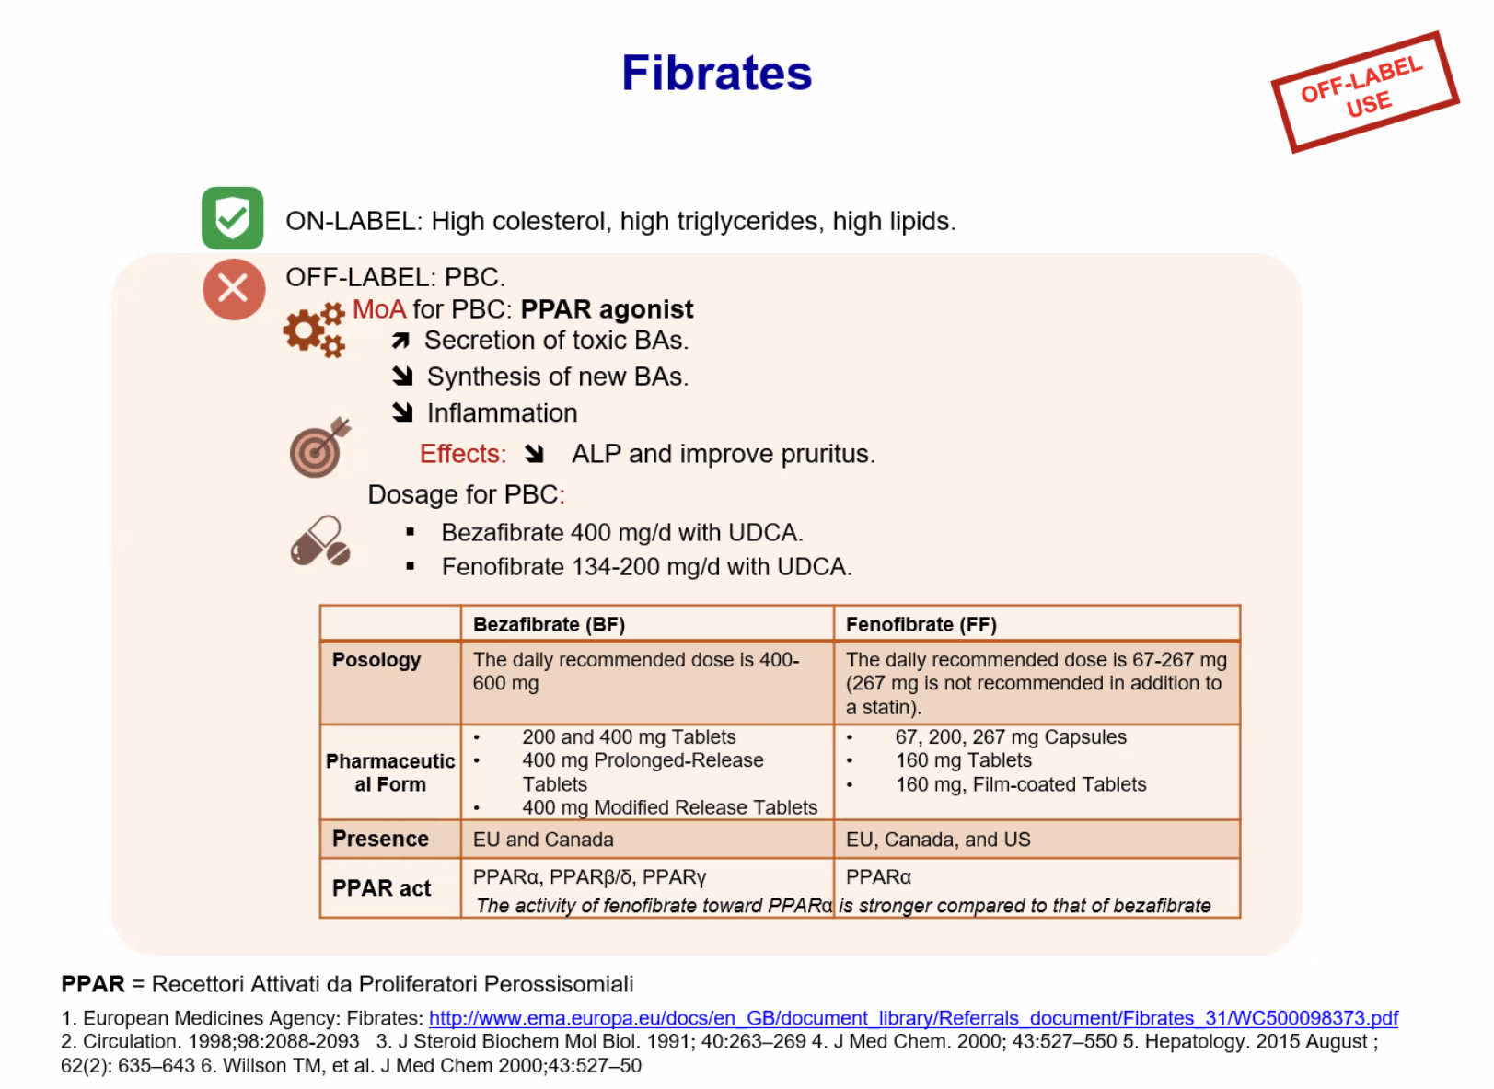
PPAR - Fibrates

Slide 39
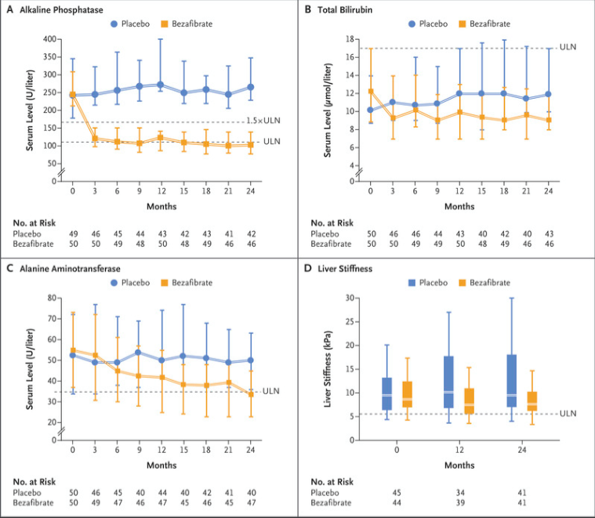
Bezurso trial
Corpechot et al NEJM 2018

Slide 40
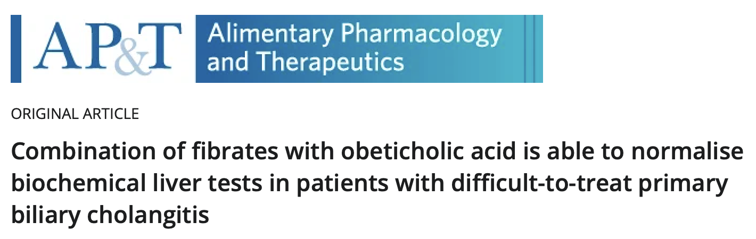
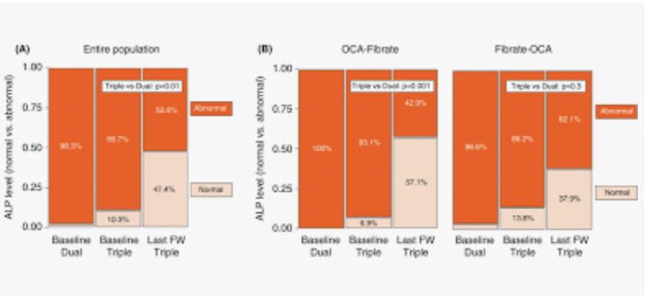
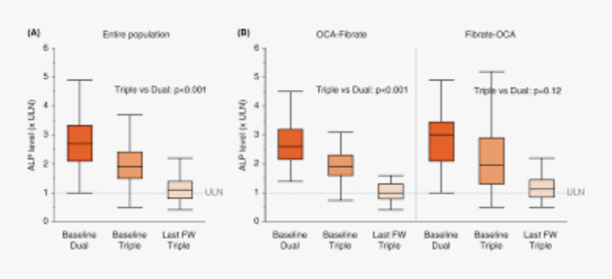
Soret P et al. APT 2021

Slide 41
Terapia di seconda linea: dati preliminari rete CBP Sicilia
+UDCA: assunto in media da 61 mesi
n. of patients

Slide 42
OBETICOLIC ACID THERAPY (65 patients with FU data)

Slide 43
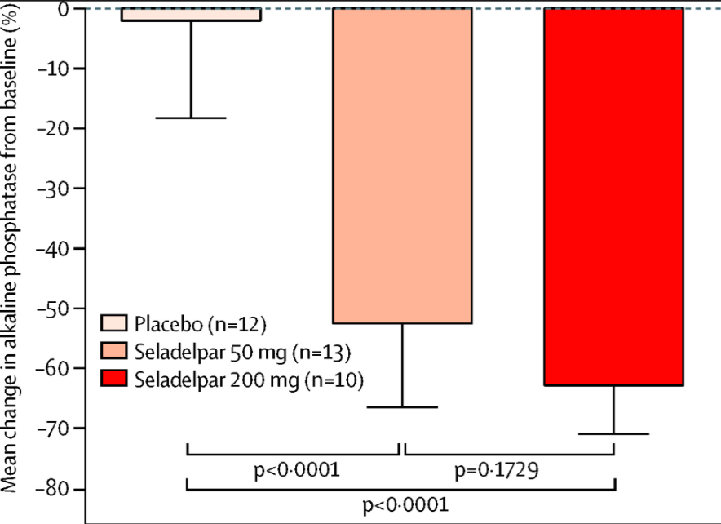
PPAR - Potential treatment drugs of PBC
Seladelpar, selective PPAR𝛅- agonist
Elafibranor, Dual PPAR 𝛂/𝛅 agonist
Jones DE et al The Lancet Gastroenterology and Hepatology, 2017
Saroglitazar, Dual PPAR (𝛂/𝛄)agonist
Schattenberg M et al J Hepatology, 2021
Vuppalanchi R. et al J Hepatology, 2021

Slide 44
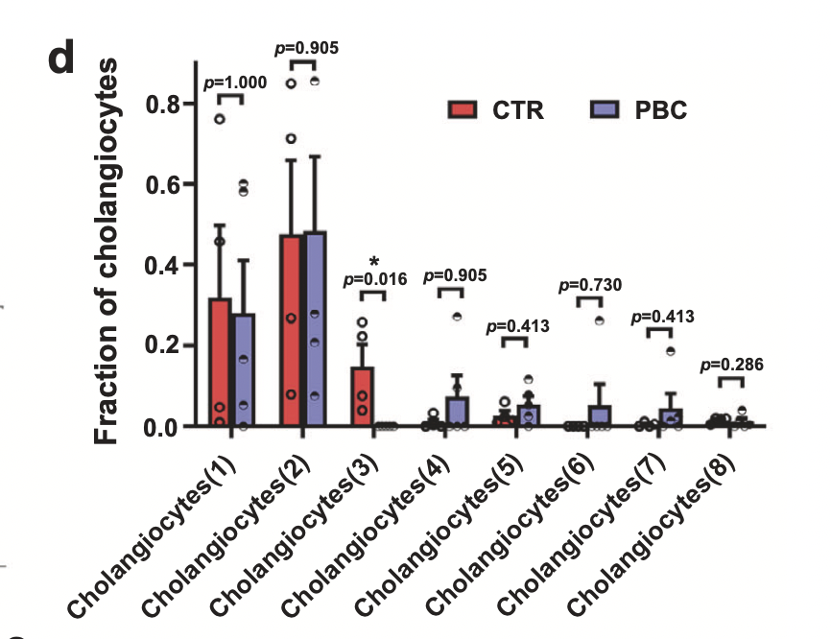
DUOX2= dual oxydase 2
Regulated production of ROS;
NOX/DUOX derived ROS play a biological role in hypertension, innate immunity
- Involved in thyroid hormone biosynthesis..generates H₂O₂ utilized by TPO for biosynthesis of thyroid hormones:
(congenital hypothyroidism resultant from an inactivating mutation in the DUOX2 gene)
ACE2 = Angiotensin-converting enzyme 2
Negative regulator of the renin-angiotensin system
Stabilizer of neutral amino acid transporters.
Protective role in cardiovascular diseases
Loss of ACE2: functional deterioration of the heart and progression of cardiac, renal, and vascular pathologies.
Recombinant soluble human ACE2 protein beneficial effects in various animal models of cardiovascular diseases.
ACE2 has been implicated in the pathology of Hartnup's disease (pellagra-like dermatosis)..amino acid transport,
Recently….ACE2 controls intestinal inflammation and diarrhea, thus regulating the gut microbiome.
Receptor for SARS-CoV-2
RESULTS: We have identified a unique type of DUOX2^{+/}ACE2⁺ small cholangiocytes in human and mouse livers, whose selective decrease was associated with the development and progression of PBC.
Preservation of DUOX2+ACE2+ small cholangiocytes: prognostic marker and target of treatment
Xi Li et al.; Nat Commun. 2023
Notes:
Primary CK19+ DUOX2+ ACE2+ cells accounted for 18.7% of CK19+ liver cells in human control livers
(FACS analyses using anti-CK19, anti-DUOX2 and antiACE2 Abs and their corresponding fluorescent isotype)

Slide 45
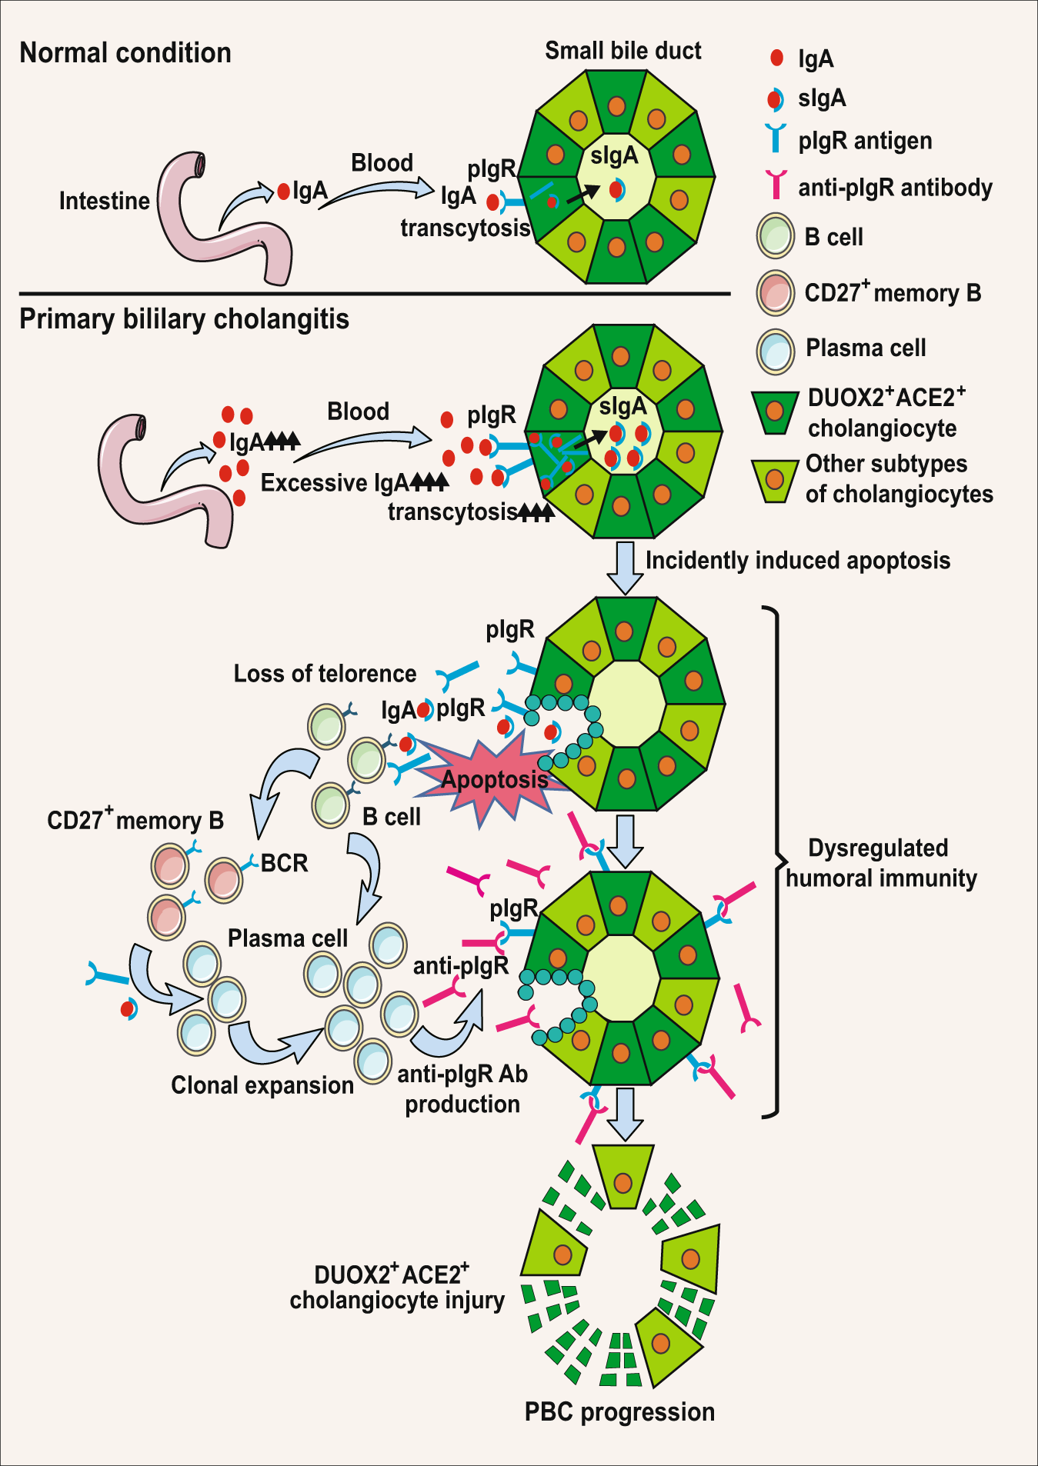
PBC Pathogenesis
A unique type of DUOX2+ACE2+ small cholangiocytes are iden- tified in human and mouse livers
PATHOGENETIC and CLINICO/Therapeutic IMPLICATIONS:
Small bile ducts are the selective target in PBC !!!! Impaired bile secretion and regeneration activities !
SPECIFIC histologic and serum MARKERS of PBC AMA +/-
- DUOX2⁺ACE2⁺ small cholangiocytes
- serum anti-pIgR autoantibody levels
3. Preservation of DUOX2⁺ACE2⁺ small cholangiocytes: prognostic marker and target of treatment
4. Targeting anti-pIgR Abs may be valuable strategies for future therapeutic interventions for PBC.
5. Viruses (SARS-Covid2) and PBC pathogenesis !!
6. GUT-LIVE AXIS, GUT MICROBIOTA and PBC ??
Xi Li et al.; Nat Commun. 2023
which can
cause persistent cholestasis in some survivors of severe COVID-19 patients^{20,21}.
It is possible that SARS-CoV-2 infection may damage DUOX2⁺ACE2⁺ small cholangiocytes,
a similar pathogenic process as for PBC, supporting the notion that SARS-CoV-2 infection
might promote the development of PBC²². However, more relevant studies would need to
investigate whether SARS-CoV-2 infection is related to PBC progression.
nterestingly, ACE2 is a receptor of severe acute respiratory distress syndrome coronavirus-2 (SARS-CoV-2)¹⁹,
which can cause persistent cholestasis in some survivors of severe COVID-19 patients^{20,21}.
It is possible that SARS-CoV-2 infection may damage DUOX2⁺ACE2⁺ small cholangiocytes, a similar pathogenic
process as for PBC, supporting the notion that SARS-CoV-2 infection might promote the development of PBC²².
However, more relevant studies would need to investigate whether SARS-CoV-2 infection is related to PBC progression.
Notes:
A proposed immunological mechanism underlying the pathogenesis of PBC.
Initially, excessive IgA undergo transcytosis through the pIgR into DUOX2+- ACE2+ small cholangiocytes and incidentally induce cholangiocyte apoptosis. Subsequently, the apoptotic DUOX2+ACE2+ small cholangiocytes cause the leakage of pIgR autoantigen, leading to the loss of immune tolerance by inducing pIgR- specific humoral and T cell immunity, and recruiting CD27+ memory B and plasma cell infiltration in the hepatic portal tracks. The induced pIgR-specific auto- antibodies specifically damage liver DUOX2+ACE2+ small cholangiocytes in the small bile ducts to impair bile secretion, leading to PBC development. PBC primary biliary cholangitis, IgA immunoglobulin A, sIgA secretory immunoglobulin A, BCR B-cell receptor.

Slide 46
Challenges in PBC
Identification and treatment in high-risk patients (beyond UDCA)
PRESENT: non-responder to UDCA as 1st line therapy
FUTURE: more proactive, don’t waste liver & bile duct time, aim at LFTs normalisation
Optimize treatment (in non-responders)
Now several therapeutic stategies will be available
Opportunities for combination (FXR + PPAR?)
How to bring all of this into clinical reality by efficient trial strategy

Slide 47
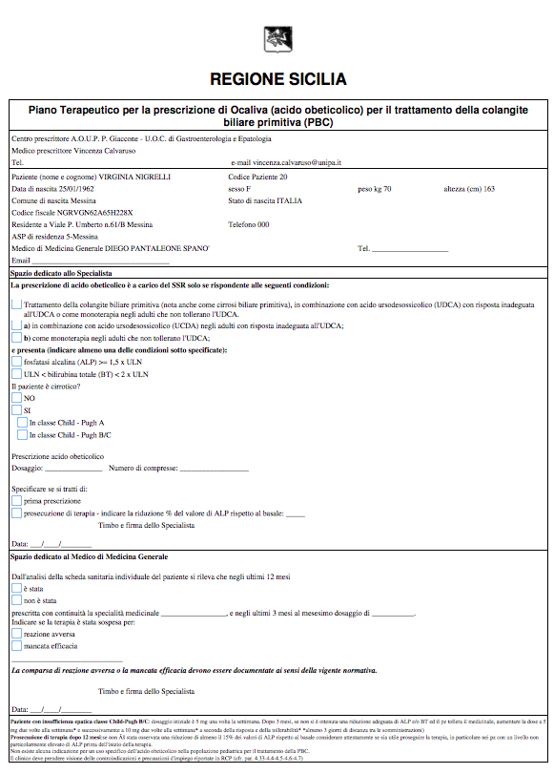
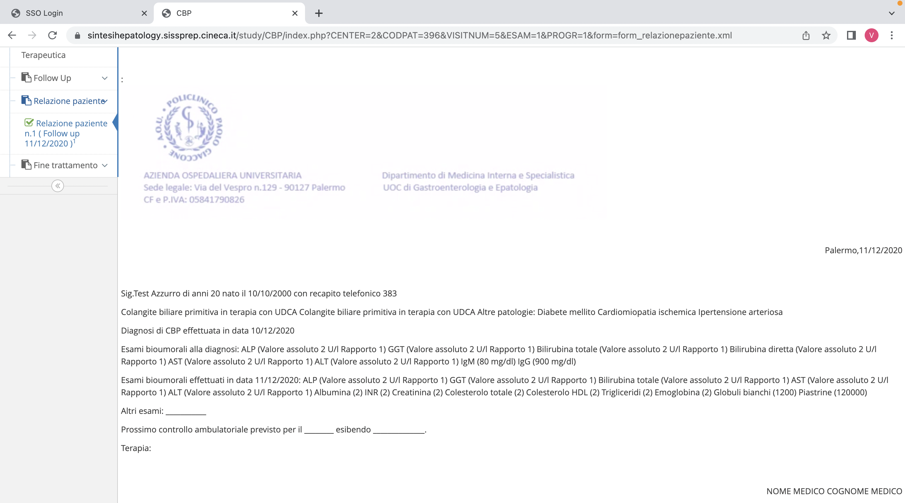
Piano terapeutico
Acido Obeticolico
Relazione ambulatoriale

Slide 48
1°Database lock (15.01.2023)
Completamento dati di definizione diagnostica di tutti i 477 pazienti (32 missing)
Inserimento di almeno un FU per paziente (77 missing)
OK
2° Database lock (31.05.2023)
Inserimento di tutti i pazienti presi in carico (520-530?)
OK
3° Database lock (31.07.2023)
Completamento dell’inserimento dei dati:
della definizione diagnostica (30 missing)
del follow-up (92 missing)

Slide 49
Main clinical and research objectives of PBC-Sicily Web-network
Epidemiology
UDCA response predictors (UDCA response score validation)
Effectiveness of second-line treatments and predictors of efficacy (safety)
Predictors of liver events
Evaluation of QoL and Symptom Management
Evaluation of comorbidity
Evaluation of cardiovascular risk
Non invasive evaluation of liver fibrosis and portal hypertension
Analisi e predittori di eventi epatici – paper GGT, submission entro 10.06.2023
Valutazione del rischio cardiovascolare e della steatosi (CAP).
Valutazione anti-HBc positività e progressione della malattia.
Validazione Stiffness Dual cut-off approach (Corpechot. et al. J Hep 2022)
Valutazione non invasiva dell’ipertensione portale – Progetto condiviso con Registro nazionale
In submission

Slide 50
PARTECIPANTS TO SINTESI-CBP
PALERMO A.O.U.P. Paolo Giaccone, Palermo: U.O.C. di Gastroenterologia e Epatologia ( V. Calvaruso, V. Di Marco); U.O.C. di Medicina Interna (A. Licata, L. Giannitrapani). A.O. Villa Sofia-Cervello, Palermo: U.O.C. di Medicina Interna (S. Madonia) U.O.C. di Gastroenterologia (F. Bronte, G. Malizia) Ospedale Buccheri La Ferla, Palermo U.O.C. di Medicina Interna (F. Cartabellotta, MG Minissale)
MESSINA A.U.O.P G Martino, Messina. U.O.C. di Epatologia Clinica e Biomolecolare (C. Saitta, G. Raimondo) CATANIA A.O.U.P. Vittorio Emanuele, Catania: U.O.C. di Medicina Interna e d’Urgenza (G. Bertino)
ARNAS Garibaldi-Nesima, Catania: U.S.D. di Epatologia (M. Russello, MR Cannavò). UOC di Gastroenterologia Ospedale di Acireale (F. Salomone)
CALTANISSETTA UO di Gastroenterologia Ospesale di Caltanissetta (M. Maida)
RAGUSA ASP di Ragusa, U.O.C. Medicina Interna Ospedale di Comiso (A. Digiacomo)
SIRACUSA ASP di Siracusa, U.O.C. Malattie Infettive Ospedale di Siracusa (M Distefano), UOC di Medicina (R. Risicato, M.Loreno)
TRAPANI ASP di Trapani. U.O.C. Medicina Interna Ospedale di Trapani (I. Scalisi)
AGRIGENTO ASP di Agrigento. U.O.C. Medicina Interna Ospedale di Agrigento (G. Alaimo)
ENNA ASP di Enna; U.O.C. Medicina Interna Ospedale di Enna (M.Sapienza)
(*) PARTECIPANTS TO RECIST-HCV
PALERMO A.O.U.P. Paolo Giaccone, Palermo: U.O.C. di Gastroenterologia e Epatologia ( A. Craxì, V. Di Marco, P. Almasio, C. Cammà, V. Calvaruso, S. Petta); U.O.C. di Malattie Infettive ( P. Colletti, G. Mazzola), U.O.C. di Medicina Interna ( G. Montalto, A. Licata, L. Giannitrapani). ARNAS Civico-Di Cristina-Benefratelli, Palermo: U.O.C. di Malattie Infettive (T. Prestileo, F. Di Lorenzo, R. Dalle Nogare, A. Sanfilippo, A. Ficalora) A.O. Villa Sofia-Cervello, Palermo: U.O.C. di Medicina Interna (S. Madonia) U.O.C. di Gastroenterologia (F. Tinè, G. Malizia) Ospedale Buccheri La Ferla, Palermo U.O.C. di Medicina Interna (F. Cartabellotta, R. Vassallo) ISMETT, Palermo: Ambulatorio Trapianti di Fegato (R. Volpes)
MESSINA A.U.O.P G Martino, Messina. U.O.C. di Epatologia Clinica e Biomolecolare (I. Cacciola; G. Caccamo, S. Maimone, C. Saitta, G. Squadrito, G. Raimondo) A.O. Papardo Piemonte, Messina. U.O.C. Malattie Infettive (N. Tripodi, S. D'Andrea)
CATANIA A.O.U.P. Vittorio Emanuele, Catania: U.O.C. di Medicina Interna e d’Urgenza (G. Bertino, A.L. Ardiri, Ma Proiti, E. Frazzetto, G. Rigano) U.O.C. di Malattie Infettive ( A. Montineri, L. N. Larocca, C. Iacobello) ARNAS Garibaldi-Nesima, Catania: U.S.C. di Malattie Infettive ( B. Cacopardo, F. Benanti), U.S.D. di Epatologia (M. Russello, R. Benigno) A.O. Cannizzaro, Catania U.O.C. Malattie Infettive (G. Mannino)
RAGUSA ASP di Ragusa, U.O.C. di Malattie Infettive Ospedale di Modica (A. Davì, MA Di Rosolini) U.O.C. Medicina Interna Ospedale di Comiso (A. Digiacomo, G. Fuduli)
SIRACUSA ASP di Siracusa, U.O.C. Malattie Infettive Ospedale di Siracusa (G. Scifo, M Di Stefano)
TRAPANI ASP di Trapani. U.O.C. Malattie Infettive Ospedale di Trapani (V. Portelli. F. Savalli, C. Geraci) U.O.C. Medicina Interna Ospedale di Catelvetrano (I. Scalici, G. Gioia)
AGRIGENTO ASP di Agrigento. U.O.C. Medicina Interna Ospedale di Agrigento (A. Magro, G. Alaimo)
CALTANISSETTA ASP di Caltanissetta, U.O.C. Malattie Infettive Ospedale di Caltanissetta( A. Salvo, A. Averna, F. Lomonaco, U. Quattrocchi).
ENNA ASP di Enna; U.O.C. Malattie Infettive Ospedale di Enna (L. Guarneri F. Maffeo,E. Falzone, F. Pulvirenti)

Slide 51

“Gamma Glutamyl Transferase as a marker of risk of progression to cirrhosis in patients with Primary Biliary Cholangitis”
V. Calvaruso, C. Saitta, M. Russello, A. Fichera, G. Bertino, FM. Bueti, F. Bronte, M. Di Stefano,
M. Giacchetto, F. Salomone, S. Madonia, L. Cadamuro, MS. Franzè, A. Licata, G. Alaimo,
C. Pitrone, M. Minissale, M. Sapienza, MR Cannavò, F. Cartabellotta.
G. Raimondo, C. Cammà, A. Craxì, V. Di Marco on behalf of Rete CBP Sicilia Study Group
vincenza.calvaruso@unipa.it

Slide 52

Flow chart of the study
430 patients with PBC registered in SINTESI-PBC
Year of diagnosis: <2017 279 (66%)
> 2017 151 (34%)
Excluded Patients
36 with Overlap Syndrome
21 with follow-up shorter than 12 months
9 without available follow-up data
364 patients with follow up
longer than 12 months
63 patients with cirrhosis
at diagnosis
301 patients without bridging fibrosis/cirrhosis
at diagnosis
21 patients (7%) developed cirrhosis
during follow-up
(median 52 months)

Slide 53
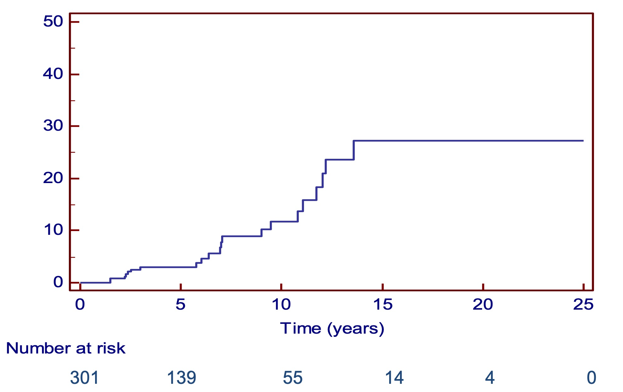
Response to UDCA e progression to cirrhosis of 301 patients with PBC
All patients started UDCA at mean dosage of 14.6/mg/kg/die
96 patients (31.9 %) were non responder to UDCA (55 started OCA, 41 fibrates; 11 both)
21 patients (7%) developed cirrhosis during a median FU of 52 months
- 9 patients out of 205 responders to UDCA (4.4%)
- 12 patients out of 96 non responder to UDCA (12.5%), p= 0.03.
Overall progression to cirrhosis
5-year probability: 3.0%
10-year probability: 11.7%
15-year probability: 27.2%

Slide 54
Risk factors for progression to cirrhosis by Cox multivariate model
Univariate Cox’s regression Multivariate Cox’s regression
 | HR HR (95% CI) p | HR HR (95% CI) p
ALP at baseline | 1.16 0.96 – 1.40 0.13 | -
GGT at baseline | 1.05. 1.01 – 1.09 0.023 | -
GGT > 3.2 ULN at 1 year | 4.32 2.52 - 19.25 0.002 | 3.74 1.32 - 10.55 0.013
ALP > 1.5 ULN at 1 year | 2.79 1.13-6.91 0.019 | 1.30. 0.45 – 3.71 0.13
Liver stiffness by TE* | 1.23 1.05 – 1.44 0.01 | -
* 229/301 TE available at diagnosis
Screened variables at univariate Cox regression : age, gender, BMI, histological stage, AMA positivity, diabetes, arterial hypertension, baseline ALP, GGT, AST, ALT, IgM, albumin, bilirubin, INR, PLT, stiffness by Fibroscan, GGT>3.2 ULN at 1 year, ALP>1.5 ULN at 1 year

Slide 55
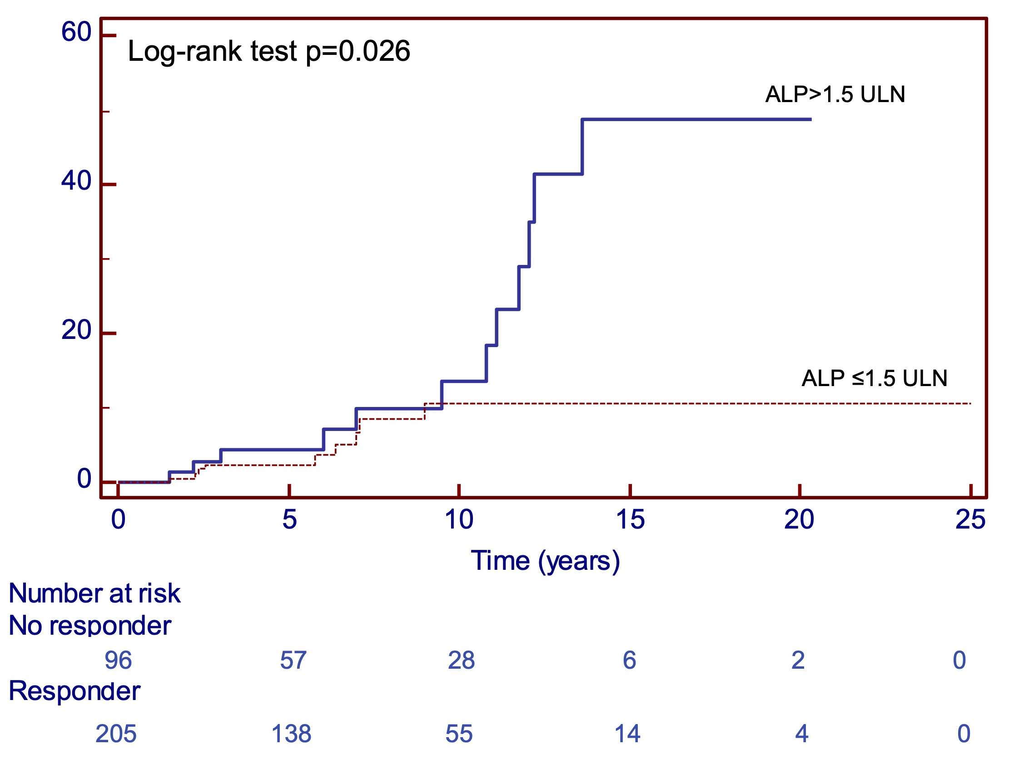
Progression to cirrhosis according UDCA response

Slide 56
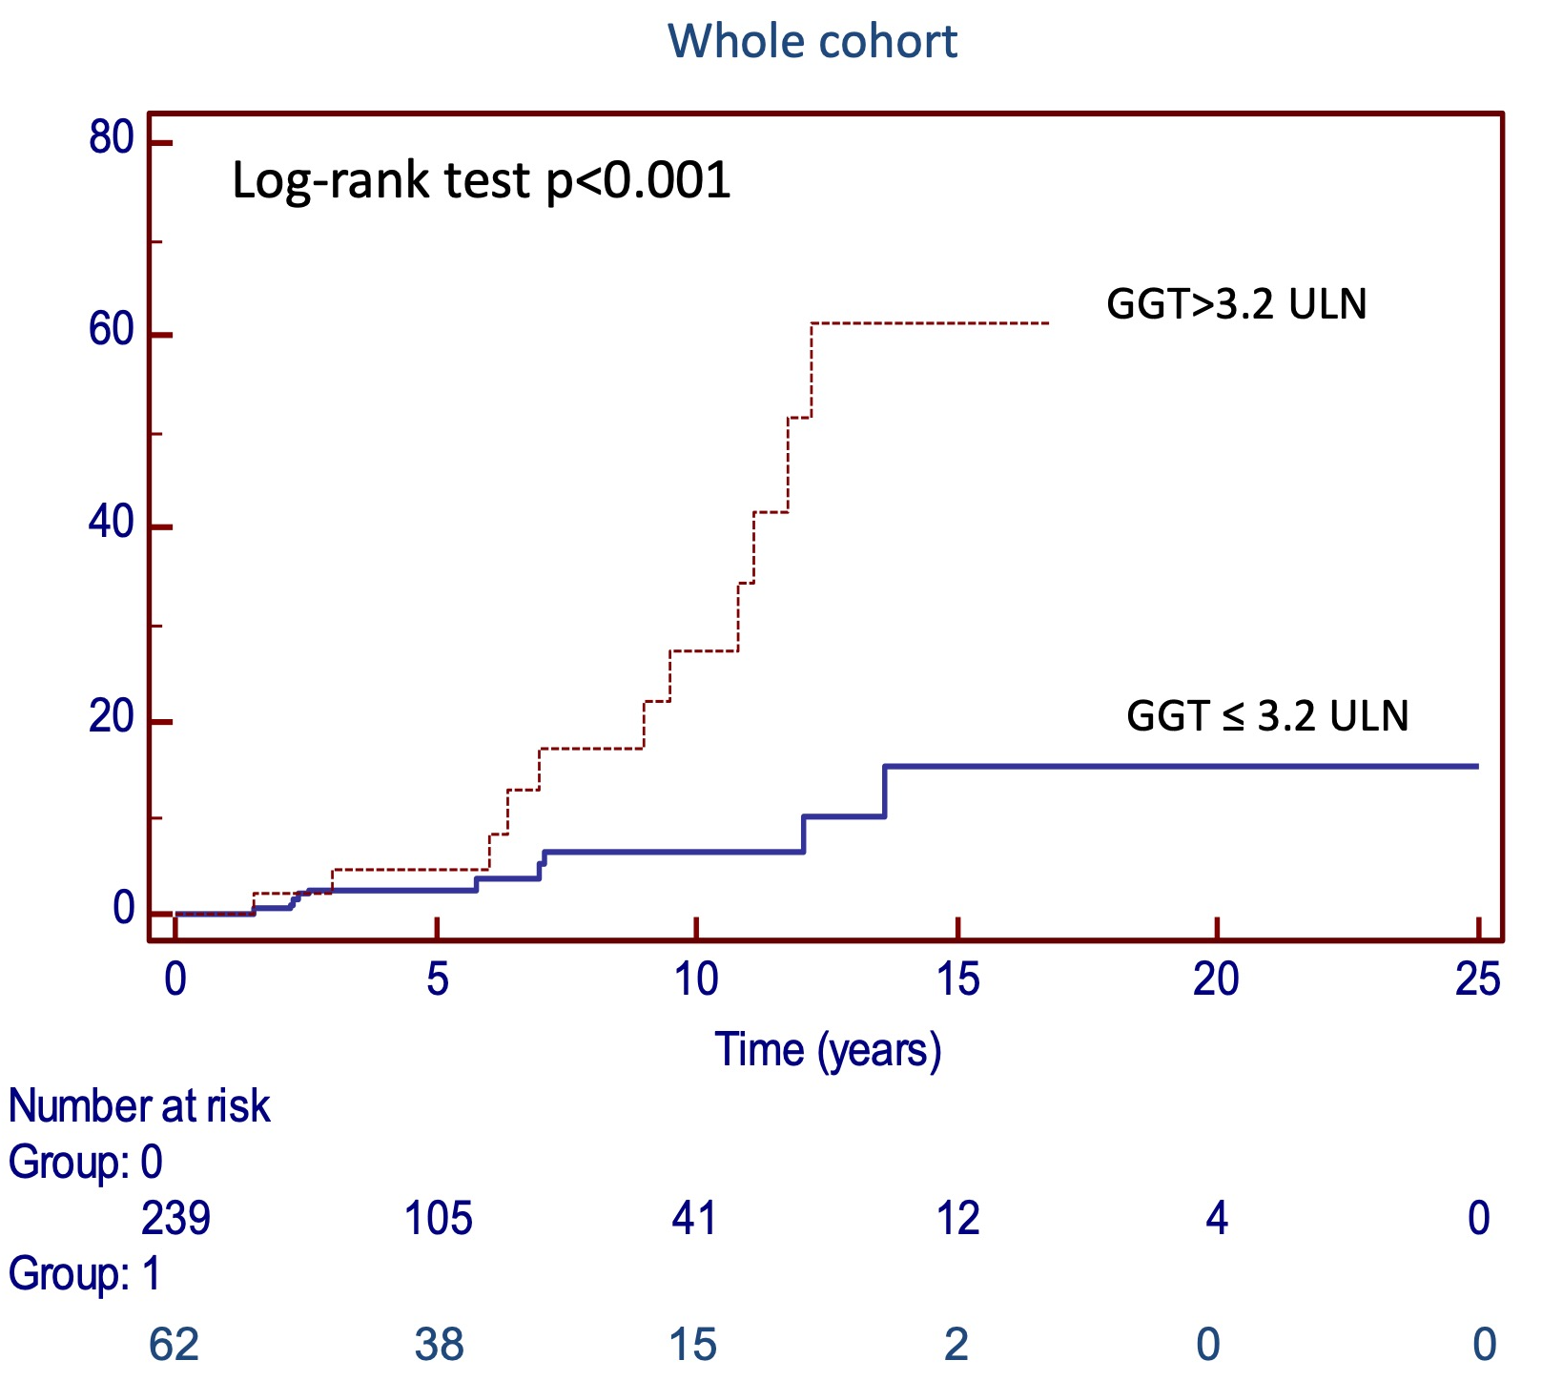
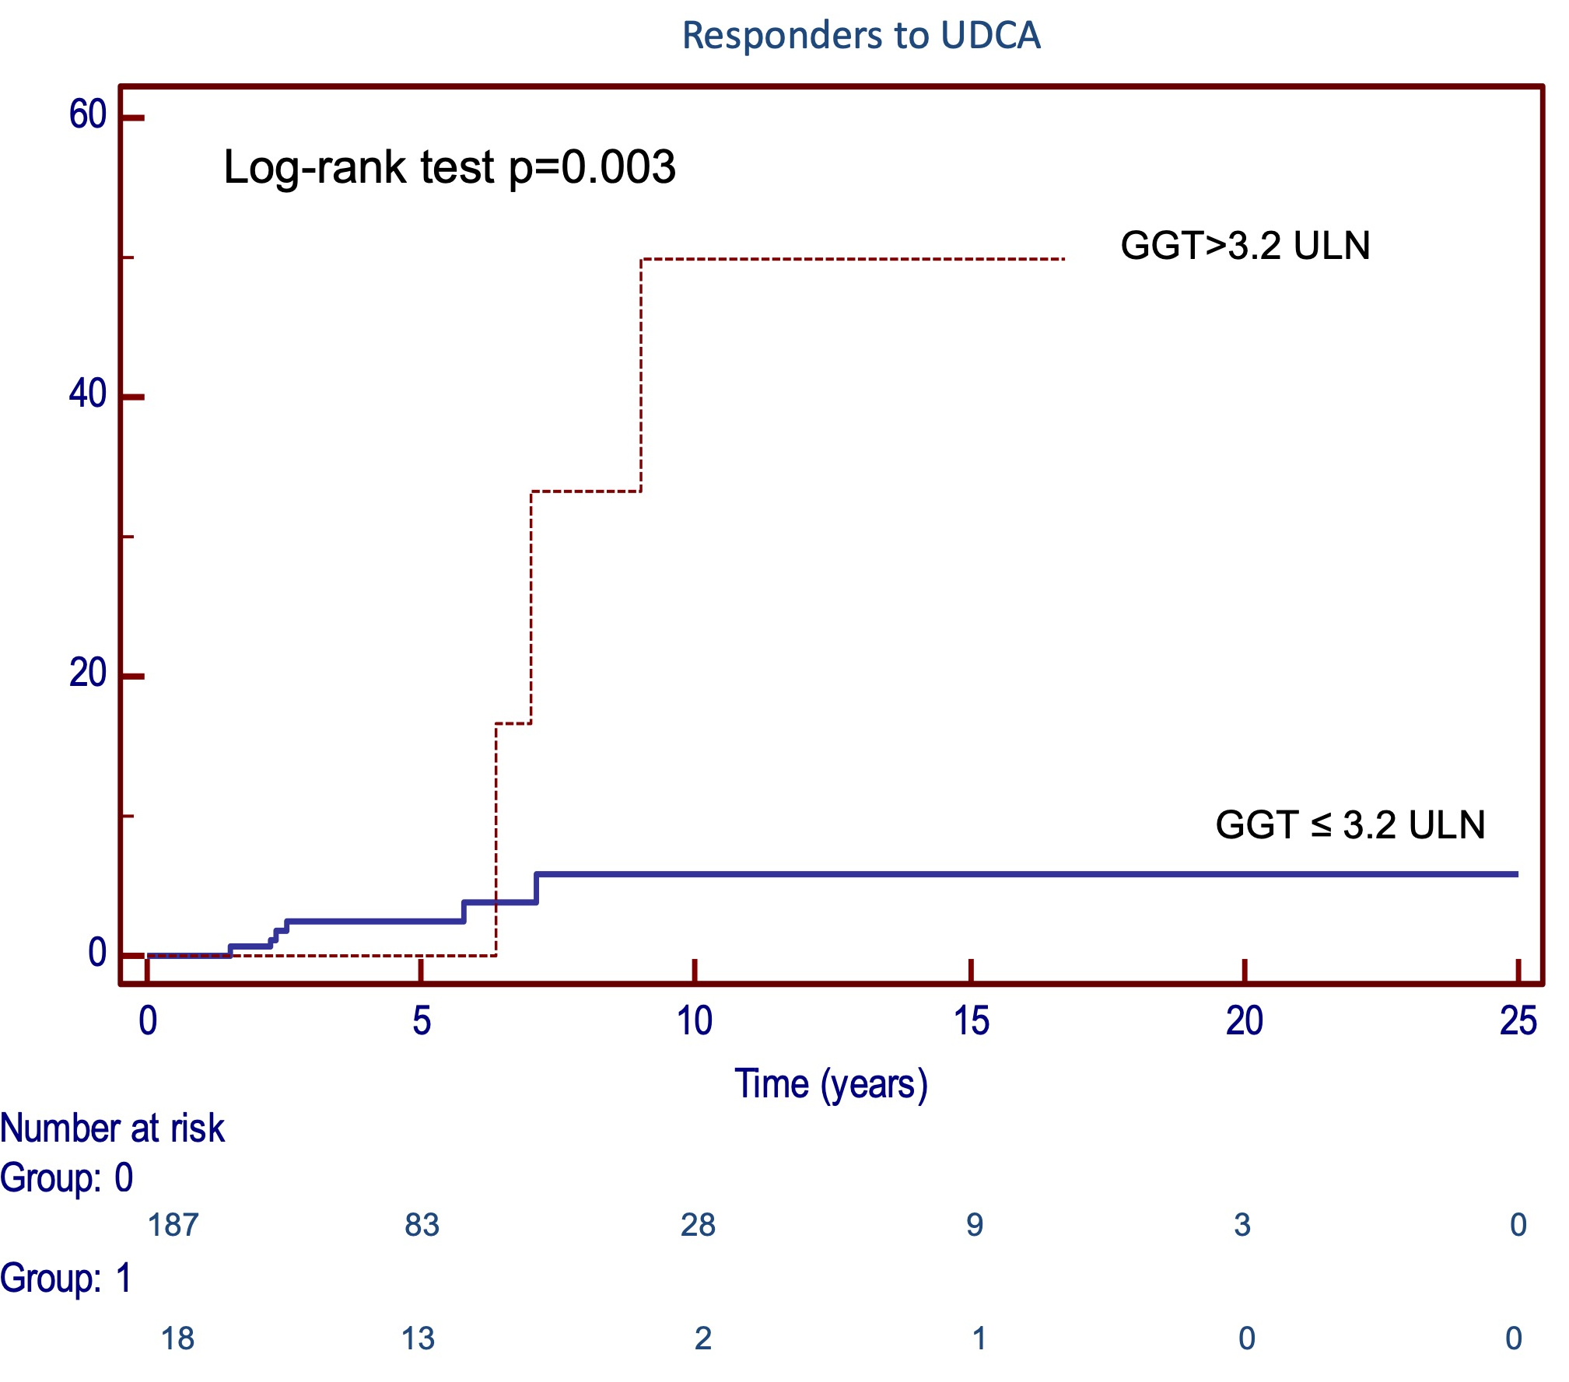
Progression to cirrhosis according to GGT value after 12 months of therapy with UDCA in all PBC cohort and in responder to UDCA (205 patients)

Slide 57
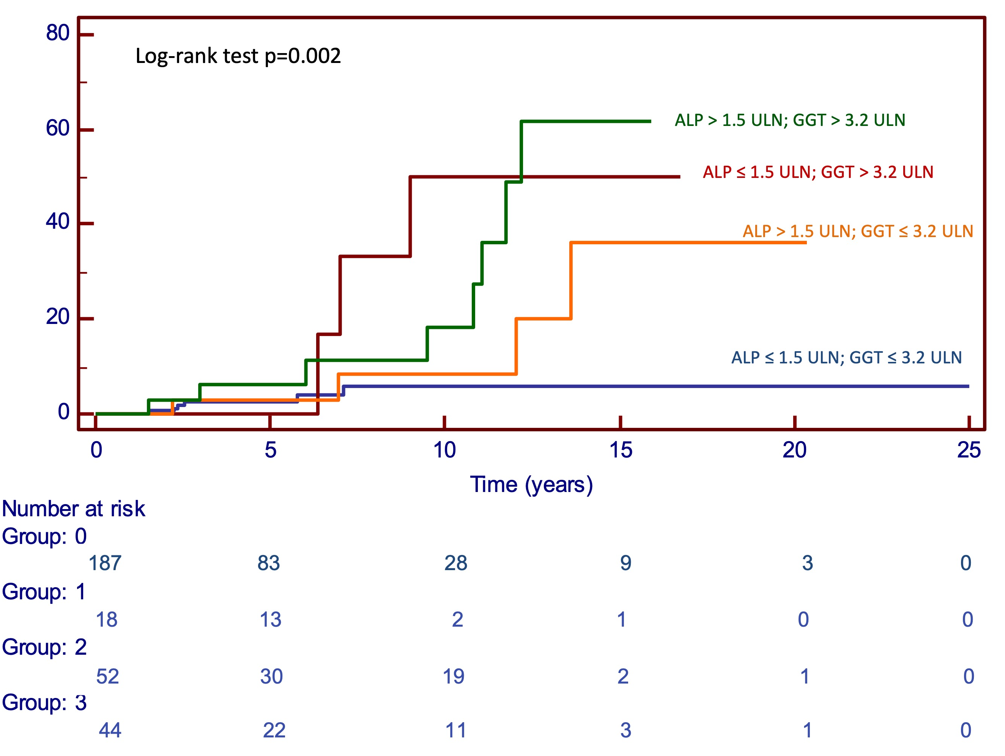
Progression to cirrhosis of patients with GGT levels ≤ 3.2 ULN versus >3.2 ULN at 12-month follow-up in patients with ALP levels ≤ 1.5 ULN and those with >1.5 ULN

Slide 58
Clinical Practice Guidelines
27% NR
≈138 pts?
Journal of Hepatology 2017 vol. 67 I 145–172
Notes:
La failure al trattamento con UDCA viene valutata a 12 mesi (ALP
e bilirubina)
Una inadeguata risposta biochimica ad UDCA si ha nel 25-50%
dei pazienti trattati nella maggior parte delle coorti
Necessità di valori soglia stadio-specifici

Slide 59
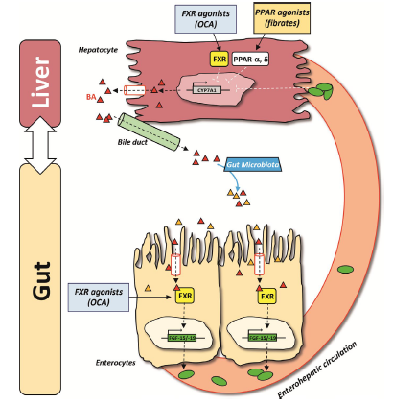
Primary Biliary Cholangitis with inadequate response UDCA
No data on fibrate
Primary biliary cholangitis management: controversies, perspectives and daily practice implications from an expert panel. Liver International 2020;00:1–12

Slide 60
OBETICOLIC ACID THERAPY
Preliminary data seem to confirm that OCA therapy is related with rapid improvement in liver biochemistry also in real word experience
Monitoring should be performes every 3 to 6 months
Pruritus is the most common adverse event
Journal of Hepatology 2017 vol. 67 I 145–172
Primary biliary cholangitis management: controversies, perspectives and daily practice implications from an expert panel. Liver International 2020;00:1–12

Slide 61
OCA Treatment Showed Sustained Improvement in ALP Over Time
Mean (SD) Change from BL (U/L) | Placebo ± UDCA | OCA 5-10 mg ± UDCA | OCA 10 mg ± UDCA
∆ 12 Months† | -7.7 (88.0) | -103.5 (87.0)*** | -117.7 (73.3)***
∆ OLE 18 Months‡ | -100.8 (87.4)*** | -118.8 (96.3)*** | -98.0 (92.9)***
***p<0.0001; †p-value for comparing active treatments to Placebo is obtained using an ANCOVA model with baseline value as a covariate and fixed effects for treatment and randomization strata factor, p-value based on LS mean difference values; ‡p-value for the within treatment comparisons are obtained using a paired t-test.
Notes:
DB:pht14.3.4.3.1-chem-titrgrp-05APR2016
LTSE: t14.2.8.1.2-eff-lab-db-saf-wadd-20May2016
t14.2.9.1.2-eff-lab-chg-db-saf-wadd-20May2016
QC KS 25Aug2016

Slide 62
Proposal for COVID era ………and beyond
RETE CBP
SIcilian Network for Therapy, Epidemiology and ScreenIng in Epatology (www.sintesihepatology.org)
Dedicated APP
Instant Messaging
Lab/Test repository
Video communication
Admission plan
Rapid record and management of side effects
Drugs Home Delivery
Simplification of therapy
Reduce costs
Improve compliance
Cut back on patient’s travel
Personalized, life-long approach of PBC

Slide 63

Rete NAFLD
Rete CBP
Condivisione di Strategie e di Risorse
Awareness e
Epidemiologia
Equo accesso
alla diagnosi e alla terapia
Misurazione degli outcomes

Slide 64
OBETICOLIC ACID THERAPY: preliminary Sicilian data
n. of patients

Slide 65
Treatment modalities for primary biliary cholangitis

