Slide 1

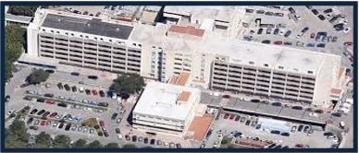
Impatto clinico ed economico
della encefalopatia epatica
tra ospedale e territorio
Dr S. Madonia
Divisione di Medicina osp. V. Cervello
Palermo
Notes:
Trends in total number of discharges for hepatic
encephalopathy-related hospitalizations in the United
States, 1993–2003. Data from the Healthcare Cost and
Utilization Project.13 ICD-9-CM code 572.2 . hepatic
encephalopathy; ICD-9-CM code 348.3 . encephalopathy,
unspecified; ICD-9-CM code 572.3 . portal hypertension;
ICD-9-CM code 571.2 . alcoholic cirrhosis; ICD-9-CM
code 571.5 . non-alcoholic cirrhosis. ICD-9-CM, International
Classification of Diseases, Ninth revision, Clinical
Modification.

Slide 2
HE: prevalence at first presentation
Prevalence of overt HE (OHE) at the time of diagnosis
At diagnosis of cirrhosis, general: 10-14%
At diagnosis of cirrhosis, decompensated: 16-21%
EASL-AASLD Guidelines on Hepatic Encephalopathy. J Hepatol 2014

Slide 3
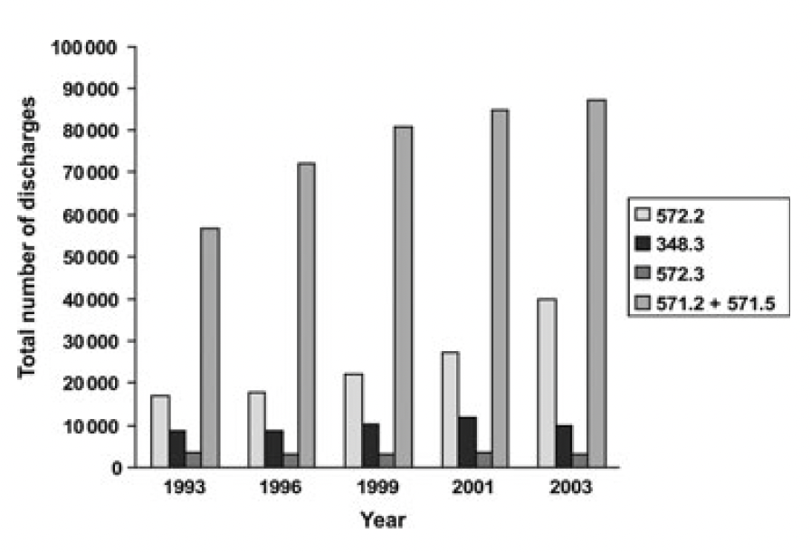
HE: number of discharges and economic burden
Trends in total number of discharges for hepatic
encephalopathy-related hospitalizations in the United States, 1993–2003.
F. F. POORDAD Aliment Pharmacol Ther 2006; 25 (Suppl. 1), 3–9
Notes:
The prevalence of OHE at the time of diagnosis of cirrhosis is
10%–14% in general [16–18], 16%–21% in those with decompensated
cirrhosis [7,19], and 10%–50% in patients with transjugular
intrahepatic portosystemic shunt (TIPS) [20,21]. The cumulated
numbers indicate that OHE will occur in 30%–40% of those with
cirrhosis at some time during their clinical course and in the
survivors in most cases repeatedly [22]. Minimal HE (MHE) or
covert HE (CHE) occurs in 20%–80% of patients with cirrhosis
[23–27,81
Trends in the total charges for hepatic
encephalopathy-related hospitalizations in the United
States, 1993–2003

Slide 4
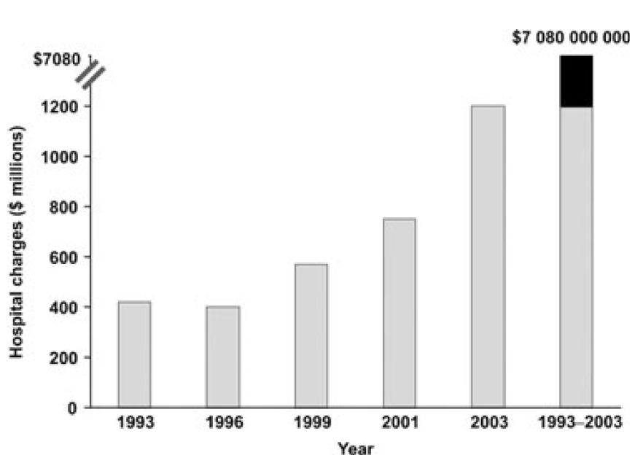
HE: number of discharges and economic burden
Trends in total number of discharges for hepatic
encephalopathy-related hospitalizations in the United States, 1993–2003.
Trends in the total charges for hepatic
encephalopathy-related hospitalizations in the United
States, 1993–2003.
F. F. POORDAD Aliment Pharmacol Ther 2006; 25 (Suppl. 1), 3–9
Notes:
The prevalence of OHE at the time of diagnosis of cirrhosis is
10%–14% in general [16–18], 16%–21% in those with decompensated
cirrhosis [7,19], and 10%–50% in patients with transjugular
intrahepatic portosystemic shunt (TIPS) [20,21]. The cumulated
numbers indicate that OHE will occur in 30%–40% of those with
cirrhosis at some time during their clinical course and in the
survivors in most cases repeatedly [22]. Minimal HE (MHE) or
covert HE (CHE) occurs in 20%–80% of patients with cirrhosis
[23–27,81
Trends in the total charges for hepatic
encephalopathy-related hospitalizations in the United
States, 1993–2003

Slide 5
HE: patient charge and social implications
The socioeconomic implications of persisting HE may be very profound.
They include:
impairment in quality of life
decline in work performance
increase in the risk of accidents
economic support required
EASL-AASLD Guidelines on Hepatic Encephalopathy. J Hepatol 2014

Slide 6
HE: Overt HE is usually easy to diagnose

Slide 7
HE: Overt HE is usually easy to diagnose
Sometime diagnosis can be challenging,
especially at first occurrence or because of atypical onset

Slide 8
HE: differential diagnosis
The role of brain scans
The risk of intracerebral hemorrhage is at least 5-fold increased in this patient group, and the symptoms may be indistinguishable
Computed tomography (CT) or magnetic resonance (MR) or other image modality scans do not contribute diagnostic or grading information.
A brain scan is usually part of the diagnostic workup of first-time HE and on clinical suspicion of other pathology
.
EASL-AASLD Guidelines on Hepatic Encephalopathy. J Hepatol 2014
Notes:
The prevalence of OHE at the time of diagnosis of cirrhosis is
10%–14% in general [16–18], 16%–21% in those with decompensated
cirrhosis [7,19], and 10%–50% in patients with transjugular
intrahepatic portosystemic shunt (TIPS) [20,21]. The cumulated
numbers indicate that OHE will occur in 30%–40% of those with
cirrhosis at some time during their clinical course and in the
survivors in most cases repeatedly [22]. Minimal HE (MHE) or
covert HE (CHE) occurs in 20%–80% of patients with cirrhosis
[23–27,81

Slide 9
HE: differential diagnosis
The role of ammonia
High blood-ammonia levels alone do not add any diagnostic, staging, or prognostic value
In case an ammonia level is checked in a patient with OHE and it is normal, the diagnosis of HE is in question.
Ammonia is reported either in venous, arterial blood, or plasma ammonia: should only be employed when laboratory standards allow for reliable analyses.
Ferenci P. Gastroenterology Report 2017;5:138-147
EASL-AASLD Guidelines on Hepatic Encephalopathy. J Hepatol 2014
Notes:
The prevalence of OHE at the time of diagnosis of cirrhosis is
10%–14% in general [16–18], 16%–21% in those with decompensated
cirrhosis [7,19], and 10%–50% in patients with transjugular
intrahepatic portosystemic shunt (TIPS) [20,21]. The cumulated
numbers indicate that OHE will occur in 30%–40% of those with
cirrhosis at some time during their clinical course and in the
survivors in most cases repeatedly [22]. Minimal HE (MHE) or
covert HE (CHE) occurs in 20%–80% of patients with cirrhosis
[23–27,81

Slide 10
HE: the best approach in the acute phase

Slide 11
HE: the best approach in the acute phase
Correction of precipitant factors is the main step of HE treatment
The two main forms of medical therapy for HE are nonabsorbale disaccharides and nonabsorbable antibiotics (i.e. rifaximin)
BCAAs and intravenous LOLA can be used as an alternative or additional agents to treat patients nonresponsive to conventional therapy
Adequate energy and protein provision should be warranted

Slide 12
HE: episodic vs recurrent
Notes:
The prevalence of OHE at the time of diagnosis of cirrhosis is
10%–14% in general [16–18], 16%–21% in those with decompensated
cirrhosis [7,19], and 10%–50% in patients with transjugular
intrahepatic portosystemic shunt (TIPS) [20,21]. The cumulated
numbers indicate that OHE will occur in 30%–40% of those with
cirrhosis at some time during their clinical course and in the
survivors in most cases repeatedly [22]. Minimal HE (MHE) or
covert HE (CHE) occurs in 20%–80% of patients with cirrhosis
[23–27,81

Slide 13
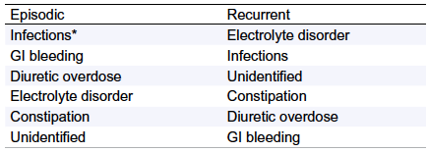
HE: episodic vs recurrent
⁄More recent unpublished case series confirm the dominant role of infections
Precipitant factors for OHE by decreasing frequency
*More recent unpublished case series confirm the dominant role of infections
Ferenci P. Gastroenterology Report 2017;5:138-147
EASL-AASLD Guidelines on Hepatic Encephalopathy. J Hepatol 2014
Notes:
The prevalence of OHE at the time of diagnosis of cirrhosis is
10%–14% in general [16–18], 16%–21% in those with decompensated
cirrhosis [7,19], and 10%–50% in patients with transjugular
intrahepatic portosystemic shunt (TIPS) [20,21]. The cumulated
numbers indicate that OHE will occur in 30%–40% of those with
cirrhosis at some time during their clinical course and in the
survivors in most cases repeatedly [22]. Minimal HE (MHE) or
covert HE (CHE) occurs in 20%–80% of patients with cirrhosis
[23–27,81

Slide 14
HE: episodic vs recurrent
⁄More recent unpublished case series confirm the dominant role of infections
Precipitant factors for OHE by decreasing frequency
*More recent unpublished case series confirm the dominant role of infections
Ferenci P. Gastroenterology Report 2017;5:138-147
EASL-AASLD Guidelines on Hepatic Encephalopathy. J Hepatol 2014
Notes:
The prevalence of OHE at the time of diagnosis of cirrhosis is
10%–14% in general [16–18], 16%–21% in those with decompensated
cirrhosis [7,19], and 10%–50% in patients with transjugular
intrahepatic portosystemic shunt (TIPS) [20,21]. The cumulated
numbers indicate that OHE will occur in 30%–40% of those with
cirrhosis at some time during their clinical course and in the
survivors in most cases repeatedly [22]. Minimal HE (MHE) or
covert HE (CHE) occurs in 20%–80% of patients with cirrhosis
[23–27,81

Slide 15
HE: episodic vs recurrent
⁄More recent unpublished case series confirm the dominant role of infections
Precipitant factors for OHE by decreasing frequency
*More recent unpublished case series confirm the dominant role of infections
Ferenci P. Gastroenterology Report 2017;5:138-147
EASL-AASLD Guidelines on Hepatic Encephalopathy. J Hepatol 2014
Notes:
The prevalence of OHE at the time of diagnosis of cirrhosis is
10%–14% in general [16–18], 16%–21% in those with decompensated
cirrhosis [7,19], and 10%–50% in patients with transjugular
intrahepatic portosystemic shunt (TIPS) [20,21]. The cumulated
numbers indicate that OHE will occur in 30%–40% of those with
cirrhosis at some time during their clinical course and in the
survivors in most cases repeatedly [22]. Minimal HE (MHE) or
covert HE (CHE) occurs in 20%–80% of patients with cirrhosis
[23–27,81

Slide 16
HE: episodic vs recurrent
⁄More recent unpublished case series confirm the dominant role of infections
Precipitant factors for OHE by decreasing frequency
*More recent unpublished case series confirm the dominant role of infections
Ferenci P. Gastroenterology Report 2017;5:138-147
EASL-AASLD Guidelines on Hepatic Encephalopathy. J Hepatol 2014
Notes:
The prevalence of OHE at the time of diagnosis of cirrhosis is
10%–14% in general [16–18], 16%–21% in those with decompensated
cirrhosis [7,19], and 10%–50% in patients with transjugular
intrahepatic portosystemic shunt (TIPS) [20,21]. The cumulated
numbers indicate that OHE will occur in 30%–40% of those with
cirrhosis at some time during their clinical course and in the
survivors in most cases repeatedly [22]. Minimal HE (MHE) or
covert HE (CHE) occurs in 20%–80% of patients with cirrhosis
[23–27,81

Slide 17
HE: after discharge
Notes:
The HRQoL was evaluated using the Short Form-36 (SF-36) questionnaire corrected for age, education and
occupation of a healthy Italian population sample (18). The SF-36 is a paper–pencil test, which investi-
gates the full range of the patient’s health by 36 multiple-choice questions. It measures eight domains, four
in the area of “physical health” (physical functioning,role limitation-physical, bodily pain, general health)
and four in the area of “mental health” (role limitation-emotional, vitality, mental health and social func-
tioning).

Slide 18
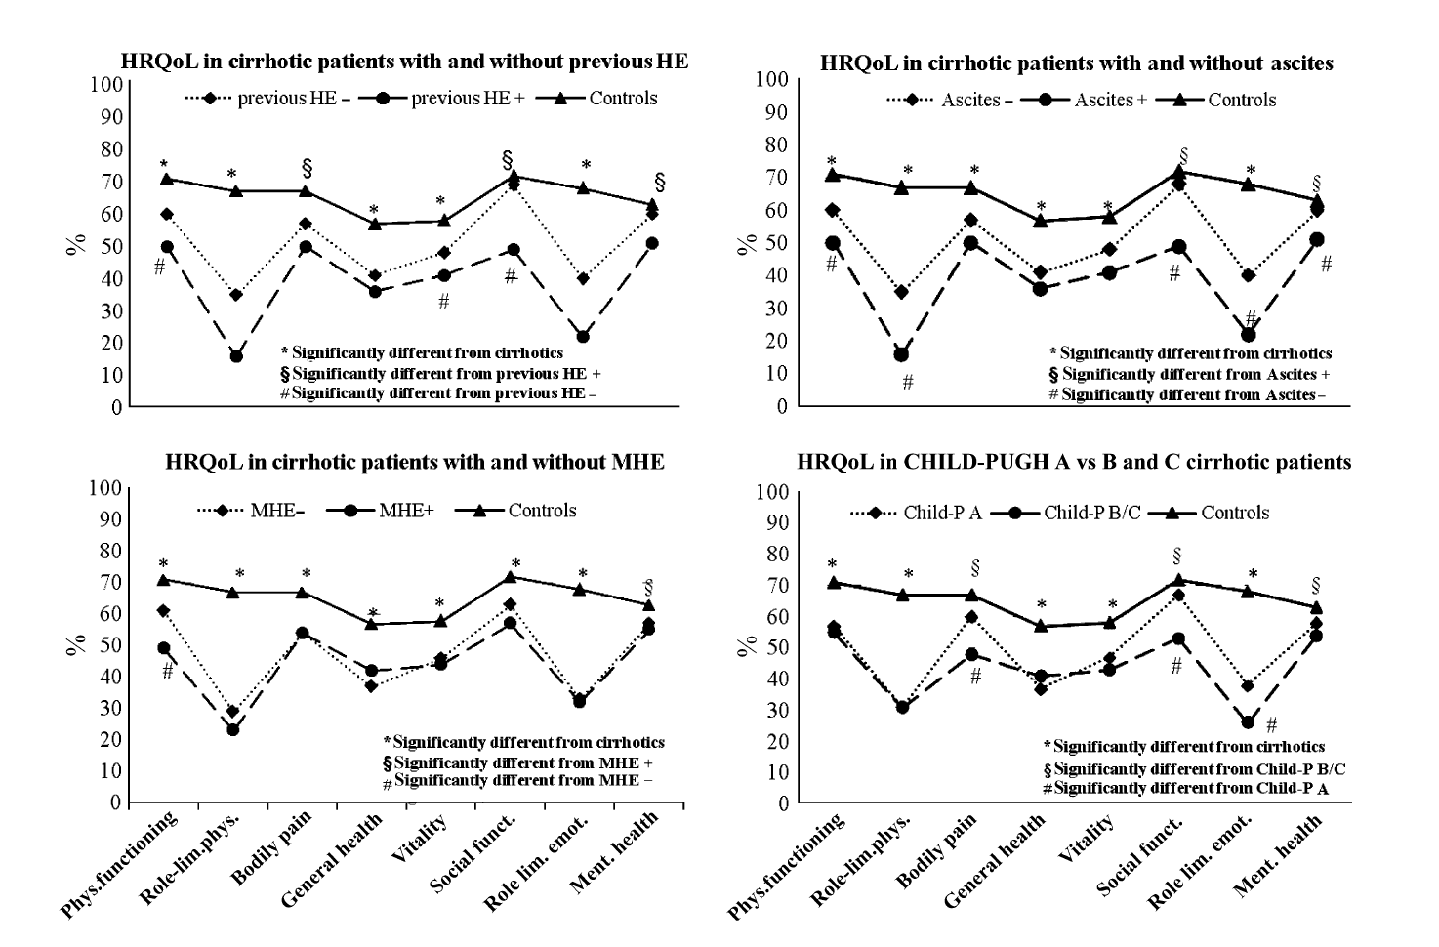
HE: quality of life after discharge
⁄
Compared with those without, the patients with previous bouts of overt HE had a significantly worsened vitality, social and physical functioning
Moscucci F et al. Liv Intern 2011; DOI:10.1111/j.1478-3231.2011.02598
Notes:
The HRQoL was evaluated using the Short Form-36 (SF-36) questionnaire corrected for age, education and
occupation of a healthy Italian population sample (18). The SF-36 is a paper–pencil test, which investi-
gates the full range of the patient’s health by 36 multiple-choice questions. It measures eight domains, four
in the area of “physical health” (physical functioning,role limitation-physical, bodily pain, general health)
and four in the area of “mental health” (role limitation-emotional, vitality, mental health and social func-
tioning).

Slide 19
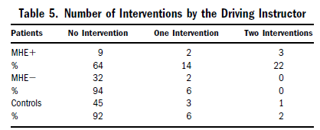
HE: fitness to drive
⁄
Wein C et al, HEPATOLOGY 2004;39:739 –745

Slide 20
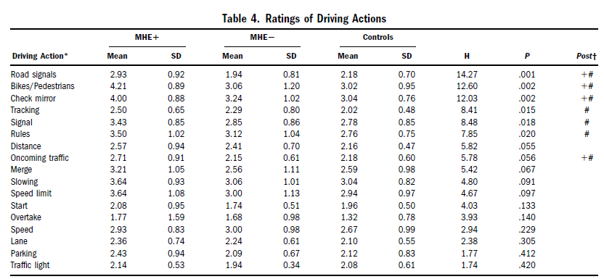
HE: fitness to drive
⁄
Wein C et al, HEPATOLOGY 2004;39:739 –745

Slide 21
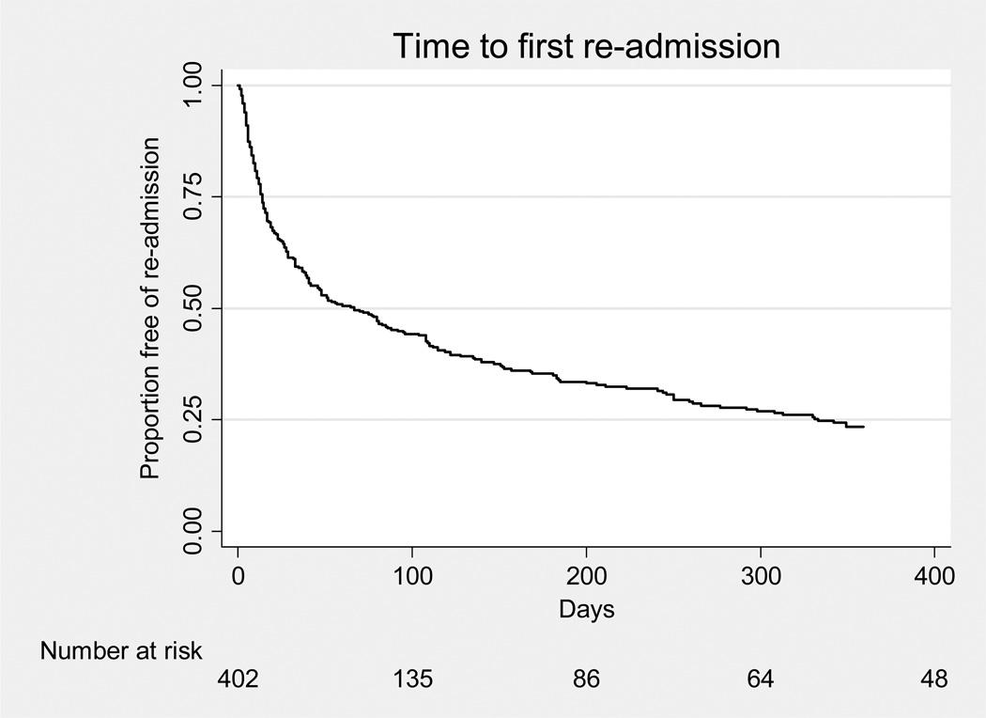
HE: outcome after discharge
⁄
Hospital readmission after discharge in patients
with decompensated cirrhosis in U.S. (n=402)
Of the 165 readmissions within 1 month,
36 (22 % ) were judged to be possibly
preventable.
The most common cause for possibly
preventable readmissions was hepatic
encephalopathy.
Reasons was failure to appropriately
titrate lactulose:
the patient was not having adequate
number of bowel movements
- was not aware of the need
to adjust the dose
did not notify the clinic for worsening
symptoms,
37 %
75%
Volk ML et al Am J Gastroenterol 2012; 107:247–252
Notes:
402 patients discharged after one of the following complications of cirrhosis: ascites, spontaneous bacterial peritonitis, renal failure, hepatic encephalopathy, or variceal hemorrhage.
Overall, 276 (69 % ) subjects had at least one nonelective readmission, with a median time to fi rst readmission of 67 days. By 1 week after discharge, 14 %of subjects had been readmitted, and 37 % were readmitted within 1 month. Of the 165 readmissions within 1 month, 36 (22 % ) were judged to be possibly preventable. The most common causes for possibly preventable readmissions were hepatic encephalopathy and fluid imbalance (hyper- and hypovolemia). Reasons why these admissions were judged to be possibly preventable were as follows. (i) Failure to appropriately titrate lactulose – numerous chart examples were seen where the patient was not having adequate number of bowel movements, was not aware of the need to adjust the dose, did not notify the clinic for worsening symptoms, and was subsequently admitted for encephalopathy. (

Slide 22
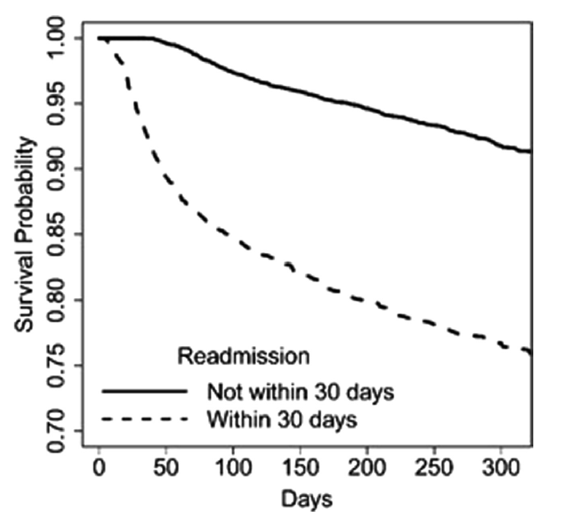
HE: outcome after discharge
Survival probability in patients with hepatic encephalopathy comparing those readmitted
versus not readmitted within 30 days.
Kaplan–Meier curves showing survival probability in patients with hepatic encephalopathy comparing those readmitted versus not readmitted within 30 days.Patients readmitted within 30 days of index hospitalization had significantly lower calendar-year survival than those not readmitted within 30 days (HR: 4.03; 95% CI:3.50–4.66).
A.J. Kruger et al. / Annals of Hepatology 18 (2019) 310–317

Slide 23
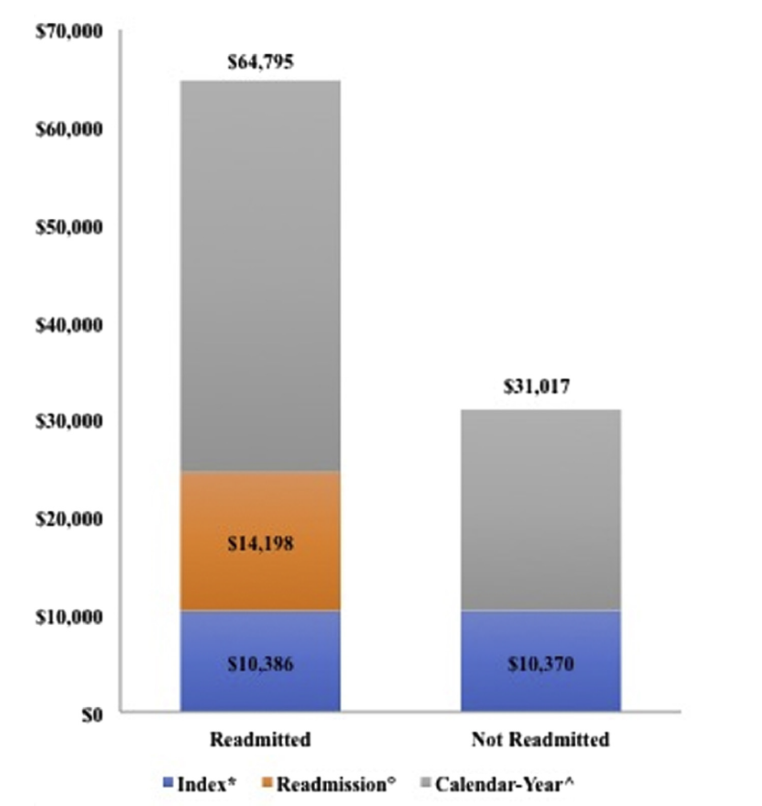
Cost of hospitalization for HE
Cost of hospitalization in cirrhosis patients admitted with hepatic encephalopathy: 2013 Nationwide Readmission Database
Cost of hospitalization in cirrhosis patients admitted with hepatic encephalopathy: 2013 Nationwide Readmission Database.
Comparing index admission and total-calendar year costs of hospitalizations in those readmitted versus not readmitted; comparing index admission versus first readmission costs in those readmitted within 30 days
A.J. Kruger et al. / Annals of Hepatology 18 (2019) 310–317

Slide 24
Outpatient management: an absolute priority

Slide 25
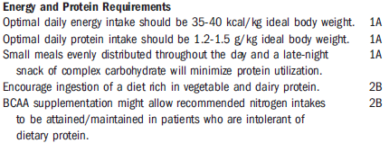
HE: nutritional management
⁄
Summary Statements and Recommendations Regarding Energy and Protein Provision
In Patients With Cirrhosis and HE
Amodio P et al. Hepatology 2013;58:325-336

Slide 26
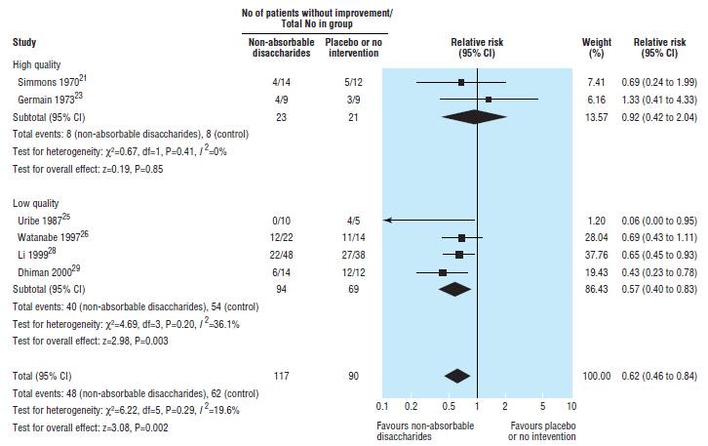
HE: non-absorbable disaccharides
⁄
Non-absorbable disaccharides for hepatic encephalopathy
Number of patients without improvement of hepatic encephalopathy in trials on non-absorbable disaccharides
versus placebo or no intervention, stratified according to quality of methods
Als_Nielsen B et al. BMJ, doi:10.1136/bmj.38048.506134.EE (published 30 March 2004)
Notes:
The prevalence of OHE at the time of diagnosis of cirrhosis is
10%–14% in general [16–18], 16%–21% in those with decompensated
cirrhosis [7,19], and 10%–50% in patients with transjugular
intrahepatic portosystemic shunt (TIPS) [20,21]. The cumulated
numbers indicate that OHE will occur in 30%–40% of those with
cirrhosis at some time during their clinical course and in the
survivors in most cases repeatedly [22]. Minimal HE (MHE) or
covert HE (CHE) occurs in 20%–80% of patients with cirrhosis
[23–27,81

Slide 27
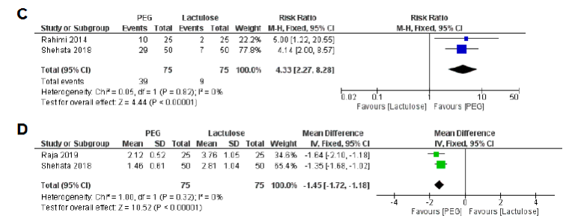
HE: Polyethylene glycol versus lactulose
⁄
Proportion of patients with a HESA Score of grade 0 at 24 hours post treatment (C)
and time to resolution of HE (D)
Hoilat GJ et al BMJ Open Gastro 2021;8:e000648. doi:10.1136/ bmjgast-2021-000648
Notes:
The prevalence of OHE at the time of diagnosis of cirrhosis is
10%–14% in general [16–18], 16%–21% in those with decompensated
cirrhosis [7,19], and 10%–50% in patients with transjugular
intrahepatic portosystemic shunt (TIPS) [20,21]. The cumulated
numbers indicate that OHE will occur in 30%–40% of those with
cirrhosis at some time during their clinical course and in the
survivors in most cases repeatedly [22]. Minimal HE (MHE) or
covert HE (CHE) occurs in 20%–80% of patients with cirrhosis
[23–27,81

Slide 28
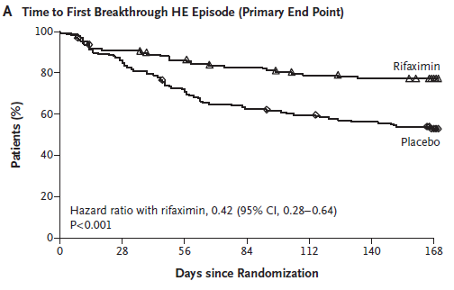
HE: rifaximin
⁄
Rifaximin 550 mg BID for 6 months (140 pts) vs placebo (159 pts)
Rifaximin significantly reduced the risk of an episode of hepatic encephalopathy,as compared with placebo, over a 6-month period (hazard ratio with rifaximin, 0.42; 95% confidence interval [CI], 0.28 to 0.64; P<0.001).
Bass NM et al. New Eng J Med 2010; 362:1071-81

Slide 29
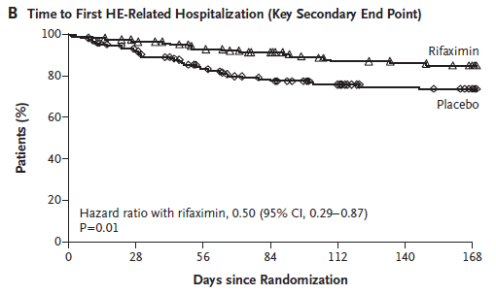
HE: rifaximin
⁄
Rifaximin 550 mg BID for 6 months (140 pts) vs placebo (159 pts)
A total of 13.6% of the patients in the rifaximin group had a hospitalization involving hepatic encephalopathy, as compared with 22.6% of patients in the placebo group, for a hazard ratio of
0.50 (95% CI, 0.29 to 0.87; P = 0.01).
Bass NM et al. New Eng J Med 2010; 362:1071-81

Slide 30
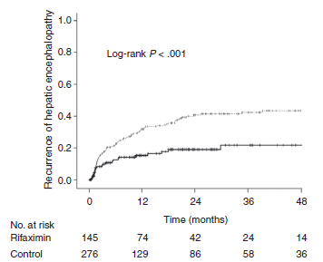
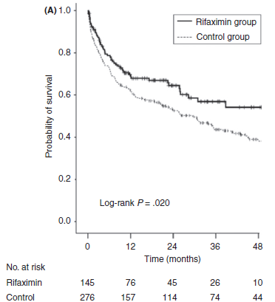
HE: lactulose plus rifaximin
⁄
145 patients receiving rifaximin plus lactulose (the rifaximin group)
and 276 patients receiving lactulose alone (the control group).
Kang SH et al. Aliment Pharmacol Ther. 2017;1–11.
Notes:
Background: Rifaximin might decrease the risk of portal hypertension-related complications by controlling small intestinal bacterial overgrowth. Aim: To evaluate whether rifaximin was associated with the risk of death and cirrhotic complications. Methods: We conducted a retrospective study that included 1042 patients experiencing hepatic encephalopathy (HE): 421 patients without hepatocellular carcinoma (HCC; the non-HCC cohort) and 621 patients with HCC (the HCC cohort). The primary endpoint was overall survival and secondary endpoints were recurrence of HE and the development of spontaneous bacterial peritonitis (SBP), hepatorenal syndrome (HRS) and variceal bleeding. Results: In the non-HCC cohort, 145 patients received rifaximin plus lactulose (the rifaximin group) and 276 patients received lactulose alone (the control group). The multivariate analysis revealed that rifaximin was significantly associated with lower risk of death (adjusted hazard ratio [aHR], 0.697; P = .024) and reduced the risk of recurrent HE (aHR, 0.452; P < .001), SBP (aHR, 0.210; P < .001) and variceal bleeding (aHR, 0.425; P = .011) but not HRS (aHR, 0.598; P = .08). In the HCC cohort, 173 patients received rifaximin plus lactulose and 448 patients received lactulose. Rifaximin was not associated with the risk of death (aHR, 1.177; P = .121). Rifaximin was associated with lower risk of SBP (aHR, 0.323; P < .001) but not with variceal bleeding (aHR, 0.660; P = .104) or recurrent HE (aHR, 0.689; P = .057). The risk of Clostridium difficile-associated diarrhoea was not different between the groups (aHR, 0.028; P = .338). Conclusions: In patients without HCC, rifaximin treatment was significantly associated with prolonged overall survival and reduced risks of spontaneous bacterial peritonitis, variceal bleeding and recurrent hepatic encephalopathy

Slide 31
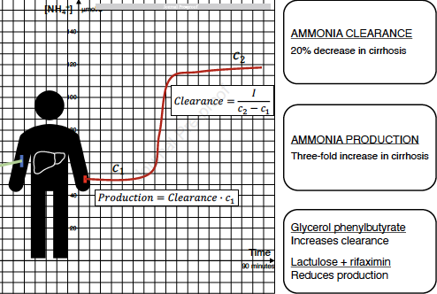
HE: lactulose plus rifaximin
Lactulose plus rifaximin reduce ammonia production
⁄
Lactulose + rifaximin reduced production by 20%
Eriksen PL et al. J Hepatol 2023doi.org/10.1016/j.jhep.2023.03.042.

Slide 32
HE: the outpatient management
EASL Clinical Practice Guidelines on the management of hepatic encephalopathy
When should prophylactic therapy for HE be discontinued in patients with cirrhosis?
Journal of Hepatology 2022 vol. 77 j 807–824

Slide 33
HE: the outpatient management
EASL Clinical Practice Guidelines on the management of hepatic encephalopathy
When should prophylactic therapy for HE be discontinued in patients with cirrhosis?
In patients with a history of overt HE with improvement of liver function and nutritional status and in whom precipitant factors have been controlled, discontinuation of anti-HE therapy should be considered on an individual basis (LoE 5, weak recommendation, 77% consensus).
Journal of Hepatology 2022 vol. 77 j 807–824

Slide 34
HE: the outpatient management

Slide 35
HE: the outpatient management
Nuovo modello di gestione
del paziente con
Encefalopatia Epatica
Suggerimenti su diagnosi e follow up
DOCUMENTO DI CONSENSO
REGIONE SICILIA
ADVISORY BOARD
Antonio Craxì (Specialista in malattie del fegato)
Giovanni Raimondo (Specialista in malattie del fegato)
Maurizio Russello (Specialista in malattie del fegato)
Silvia Radosti (Medico di Medicina Generale)
Concetta La Seta (Farmacista Ospedaliero)
GRUPPO DI LAVORO
Giuseppe Alaimo
Gaetano Bertino
Marco Ciancio
Maria Despina Cucinotta
Antonio Digiacomo
Salvatore Madonia
Ignazio Scalisi
Gaetano Scifo
Giovanni Squadrito

Slide 36
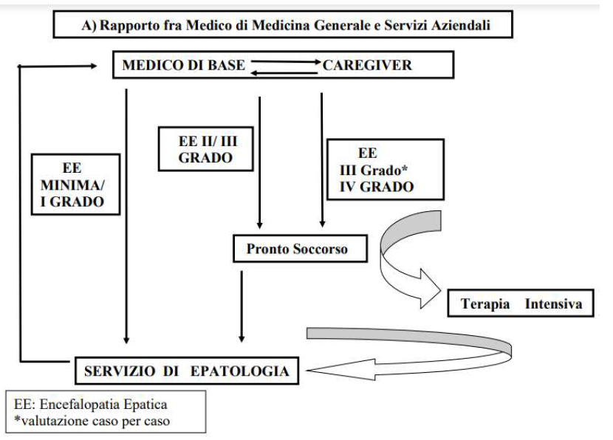
HE: the outpatient management

Slide 37
HE: the outpatient management

Slide 38
HE: the outpatient management
Electrolyte disorders
Constipation
Diuretic overdose

Slide 39
HE: the outpatient management

Slide 40
HE: the outpatient management
Qualora il Paziente sia gestito a livello ospedaliero, si richiede il ricovero quando:
l’EE risulta particolarmente severa (grado III-IV);
il paziente non presenta miglioramento pur avendo controllato/escluso il fattore precipitante;
il quadro clinico è particolarmente complesso (Paziente con altre comorbidità attive)

Slide 41
HE: the outpatient management
Qualora il Paziente sia gestito a livello ospedaliero, si richiede il ricovero quando:
l’EE risulta particolarmente severa (grado III-IV);
il paziente non presenta miglioramento pur avendo controllato/escluso il fattore precipitante;
il quadro clinico è particolarmente complesso (Paziente con altre comorbidità attive)
La tempestività nella diagnosi di EE è un aspetto fondamentale per una pronta risoluzione della sintomatologia e una ripresa più rapida del paziente.

Slide 42
HE: smartphone app
Minimal hepatic encephalopathy (MHE) detection is difficult because of the unavailability of short screening tools. Therefore, MHE patients can remain undiagnosed and untreated.
Notes:
Median and interquartile range of time required to complete
the app in the off and on states. (A) Distribution of values in the
entire group in which control values are compared to patients with cirrhosis
without previous OHE and those with previous OHE. (B) Comparison
between controls and patients with cirrhosis with MHE and no
MHE based on SPTs. No_OHE, no previous OHE; OHE, previous OHE;
No_MHE, no MHE and MHE, minimal hepatic encephalopathy. All comparisons
were highly statistically signific

Slide 43

HE: the EncephalApp smartphone app
Minimal hepatic encephalopathy (MHE) detection is difficult because of the unavailability of short screening tools. Therefore, MHE patients can remain undiagnosed and untreated.
Cunha-Silva M. et al. Ann Hepatol 27 (2022)
Notes:
Median and interquartile range of time required to complete
the app in the off and on states. (A) Distribution of values in the
entire group in which control values are compared to patients with cirrhosis
without previous OHE and those with previous OHE. (B) Comparison
between controls and patients with cirrhosis with MHE and no
MHE based on SPTs. No_OHE, no previous OHE; OHE, previous OHE;
No_MHE, no MHE and MHE, minimal hepatic encephalopathy. All comparisons
were highly statistically signific

Slide 44
HE: the EncephalApp smartphone app
Minimal hepatic encephalopathy (MHE) detection is difficult because of the unavailability of short screening tools. Therefore, MHE patients can remain undiagnosed and untreated.
Notes:
Median and interquartile range of time required to complete
the app in the off and on states. (A) Distribution of values in the
entire group in which control values are compared to patients with cirrhosis
without previous OHE and those with previous OHE. (B) Comparison
between controls and patients with cirrhosis with MHE and no
MHE based on SPTs. No_OHE, no previous OHE; OHE, previous OHE;
No_MHE, no MHE and MHE, minimal hepatic encephalopathy. All comparisons
were highly statistically signific

Slide 45
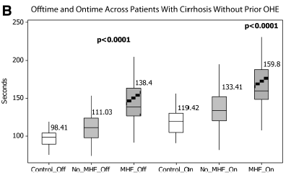
HE: the EncephalApp smartphone app
Minimal hepatic encephalopathy (MHE) detection is difficult because of the unavailability of short screening tools. Therefore, MHE patients can remain undiagnosed and untreated.
⁄
The EncephalApp smartphone app is a short, valid and reliable tool for screening of MHE
Median and interquartile range of time required to complete the app in the off and on states
All comparisons were highly statistically significant
Bajaj JS et al. HEPATOLOGY 2013;58:1122-1132
Notes:
Median and interquartile range of time required to complete
the app in the off and on states. (A) Distribution of values in the
entire group in which control values are compared to patients with cirrhosis
without previous OHE and those with previous OHE. (B) Comparison
between controls and patients with cirrhosis with MHE and no
MHE based on SPTs. No_OHE, no previous OHE; OHE, previous OHE;
No_MHE, no MHE and MHE, minimal hepatic encephalopathy. All comparisons
were highly statistically signific

Slide 46
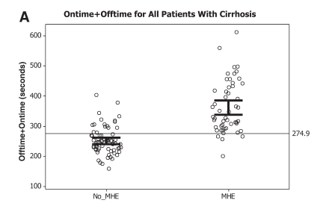
HE: the EncephalApp smartphone app
Minimal hepatic encephalopathy (MHE) detection is difficult because of the unavailability of short screening tools. Therefore, MHE patients can remain undiagnosed and untreated.
Bajaj JS et al. HEPATOLOGY 2013;58:1122-1132
Notes:
Median and interquartile range of time required to complete
the app in the off and on states. (A) Distribution of values in the
entire group in which control values are compared to patients with cirrhosis
without previous OHE and those with previous OHE. (B) Comparison
between controls and patients with cirrhosis with MHE and no
MHE based on SPTs. No_OHE, no previous OHE; OHE, previous OHE;
No_MHE, no MHE and MHE, minimal hepatic encephalopathy. All comparisons
were highly statistically signific

Slide 47
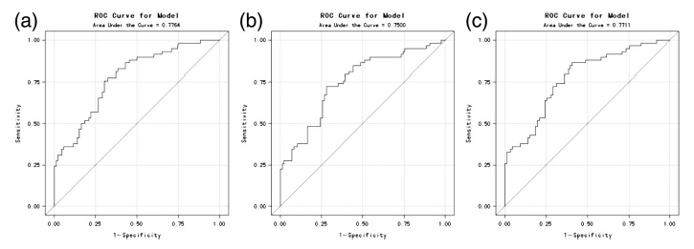
HE: the EncephalApp smartphone app
Receiver operating characteristic (ROC) curve results for EncephalApp Stroop Test in all patients, using psychometric hepatic encephalopathy score as the golden standard. (a) ROC curve for factor off time, (b) ROC curve for factor on time, and (c) ROC curve for factor off time + on time.
⁄
Zeng X et al. J Gastroenterol Hepatol 2019; doi:10.1111/jgh.14656
Notes:
Median and interquartile range of time required to complete
the app in the off and on states. (A) Distribution of values in the
entire group in which control values are compared to patients with cirrhosis
without previous OHE and those with previous OHE. (B) Comparison
between controls and patients with cirrhosis with MHE and no
MHE based on SPTs. No_OHE, no previous OHE; OHE, previous OHE;
No_MHE, no MHE and MHE, minimal hepatic encephalopathy. All comparisons
were highly statistically signific

Slide 48
HE: the outpatient management
TARGET
AZIONI MIGLIORATIVE
Attività di counseling che veda anche nell’infermiere una possibile figura di riferimento, soprattutto per le informazioni di ordine più pratico (es. come praticare il clistere)
Materiale informativo (sia in formato cartaceo che elettronico) contenente le informazioni necessarie per la prevenzione delle recidive dell’EE e la corretta gestione delle stesse
Paziente/
Caregiver
Specialista in Epatologia
Formazione/aggiornamento sull’EE (Formazione residenziale o a distanza)
Integrazione nella pratica clinica di Test psicometrici semplici ed efficaci (in cartaceo e/o elettronico)
Medico di Medicina Generale
Formazione/aggiornamento sulla cirrosi e le sue complicanze (Formazione a distanza)
Materiale informativo su come riconoscere e gestire l’EE (es. Flashcard)
Personale infermieristico
Formazione/aggiornamento (Riunioni di Reparto con cadenza semestrale/annuale)
Medicina d’urgenza
Formazione/aggiornamento
Materiale comunicazionale (es. Flashcard)

Slide 49
Conclusions (at last)
Notes:
Median and interquartile range of time required to complete
the app in the off and on states. (A) Distribution of values in the
entire group in which control values are compared to patients with cirrhosis
without previous OHE and those with previous OHE. (B) Comparison
between controls and patients with cirrhosis with MHE and no
MHE based on SPTs. No_OHE, no previous OHE; OHE, previous OHE;
No_MHE, no MHE and MHE, minimal hepatic encephalopathy. All comparisons
were highly statistically signific

Slide 50
Conclusions (at last)
Hepatic encephalopathy is generally a not challenging clinical condition:
- easy to diagnose in most cases
- treatment well established
The most relevant goal is to reduce the relapse rate and minimize readmissions:
- non absorbable disaccharides
- rifaximine
- avoid constipation, diuretic overdose, electrolyte disorders
Outpatient management is conceivable in early cases:
- early diagnosis is mandatory
- remove precipitating factors
- electronic support (mobile APP) can be useful in this setting
Notes:
Median and interquartile range of time required to complete
the app in the off and on states. (A) Distribution of values in the
entire group in which control values are compared to patients with cirrhosis
without previous OHE and those with previous OHE. (B) Comparison
between controls and patients with cirrhosis with MHE and no
MHE based on SPTs. No_OHE, no previous OHE; OHE, previous OHE;
No_MHE, no MHE and MHE, minimal hepatic encephalopathy. All comparisons
were highly statistically signific

Slide 51




Slide 54
HE: precipitant factors
⁄More recent unpublished case series confirm the dominant role of infections
Precipitant factors for OHE by decreasing frequency
*More recent unpublished case series confirm the dominant role of infections
Ferenci P. Gastroenterology Report 2017;5:138-147
EASL-AASLD Guidelines on Hepatic Encephalopathy. J Hepatol 2014
Notes:
The prevalence of OHE at the time of diagnosis of cirrhosis is
10%–14% in general [16–18], 16%–21% in those with decompensated
cirrhosis [7,19], and 10%–50% in patients with transjugular
intrahepatic portosystemic shunt (TIPS) [20,21]. The cumulated
numbers indicate that OHE will occur in 30%–40% of those with
cirrhosis at some time during their clinical course and in the
survivors in most cases repeatedly [22]. Minimal HE (MHE) or
covert HE (CHE) occurs in 20%–80% of patients with cirrhosis
[23–27,81

Slide 55
HE: the outpatient management

Slide 56
HE: precipitant factors
⁄More recent unpublished case series confirm the dominant role of infections
Precipitant factors for OHE by decreasing frequency
*More recent unpublished case series confirm the dominant role of infections
Ferenci P. Gastroenterology Report 2017;5:138-147
EASL-AASLD Guidelines on Hepatic Encephalopathy. J Hepatol 2014
Notes:
The prevalence of OHE at the time of diagnosis of cirrhosis is
10%–14% in general [16–18], 16%–21% in those with decompensated
cirrhosis [7,19], and 10%–50% in patients with transjugular
intrahepatic portosystemic shunt (TIPS) [20,21]. The cumulated
numbers indicate that OHE will occur in 30%–40% of those with
cirrhosis at some time during their clinical course and in the
survivors in most cases repeatedly [22]. Minimal HE (MHE) or
covert HE (CHE) occurs in 20%–80% of patients with cirrhosis
[23–27,81

Slide 57
HE: smartphone app
Notes:
Median and interquartile range of time required to complete
the app in the off and on states. (A) Distribution of values in the
entire group in which control values are compared to patients with cirrhosis
without previous OHE and those with previous OHE. (B) Comparison
between controls and patients with cirrhosis with MHE and no
MHE based on SPTs. No_OHE, no previous OHE; OHE, previous OHE;
No_MHE, no MHE and MHE, minimal hepatic encephalopathy. All comparisons
were highly statistically signific

